Slide 1

Describing me and others
verde
Follow ups 1-5
Notes:
Artwork by Steve Clarke. All additional pictures selected are available under a Creative Commons license, no attribution required.
The frequency rankings for words that occur in this PowerPoint which have been previously introduced in the resources are given in the SOW (excel document) and in the resources that first introduced and formally re-visited those words.
Phonics: Source: noche[164] Cluster: chocolate [3408] leche[1397] chino [1349]
Vocabulary: tiene [8] cantante [2105] cara [337] gafas [>5000] nariz [1570] ojo [169] pelo [873] profesor / profesora [501] azul [811] corto [1055] grande [66] gris [1751] largo [300] moreno [3304] negro [307] pequeño [202] rubio [2861] redondo [2470] verde [812] los / las [1]
Revisit 1: tienes [tener 19] tiene [tener 19] árbol [748] calle [269] escuela [424] estadio [2581] hotel [1163] iglesia [437] mentira [1673] museo [1114] parque [1354] piscina [4604] puente [1715] plaza [806] universidad [387] verdad [176] allí [197] aquí [130] blanco [372] bonito [891] perfecto [1115] grande [66] alto [231] verde [812] unos, unas [>5000]
Revisit 2: concierto [1456] cumpleaños [3372] fiesta [796] mes [288] enero [1173] febrero [1419] marzo [1231] abril [1064] mayo [909] junio [1035] julio [659] septiembre [1150] octubre [1242] noviembre [1434] diciembre [1165] cuándo [138] de [2] trece [2700] catorce [2411] quince[1215] dieciséis [3373] diecisiete [3400] dieciocho [2730] diecinueve [4232] veinte [819] veintiuno [819/425] veintidós | veintitrés | veinticuatro | veinticinco |veintiseis |veintisiete|veintiocho |veintinueve | treinta [830] treinta y uno [830/4/425]
For any other words that occur incidentally in this PowerPoint, frequency rankings will be provided in the notes field wherever possible.
adivinar [2201] investigar [1571] burbuja [4850] tableta [>5000]
Source: Davies, M. & Davies, K. (2018). A frequency dictionary of Spanish: Core vocabulary for learners (2nd ed.). Routledge: London

Slide 2




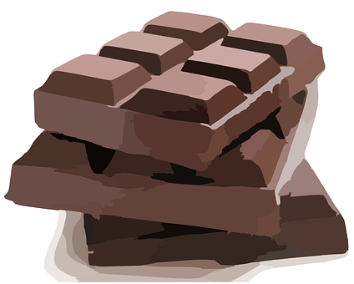
Follow up 1:
[ch]
noche
pronunciar
leche
chocolate
chino
Notes:
Timing: 1 minute
Aim: to introduce SSC [ch]
Procedure
Introduce and elicit the pronunciation of the individual SSC [ch] and then the source word ‘noche’ (with gesture, if using).
Click to bring the picture & get students to repeat (with gesture, if using).
Note: the [ch] sound in Spanish is the same as one of the pronunciations English has for this sound, as in the word ‘chocolate’. However, English also pronounces [ch] differently, mostly in borrowed words such as ‘chef’. In teaching this sound in Spanish, we also bear in mind that many pupils will learn French at some point, and will learn a different pronunciation for these two letters.
Gesture: one suggestion would be to use British sign language for night, which is shown here: https://www.signbsl.com/sign/night
It is best to watch the video clip but here is a description: arms bent at the elbow, palms open and facing the speaker, move quickly in front of the body, crossing over so that right finger tips end up facing left, and left facing right, to emulate the suddenness of nightfall.

Slide 3



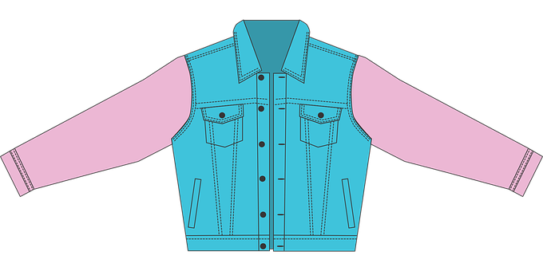


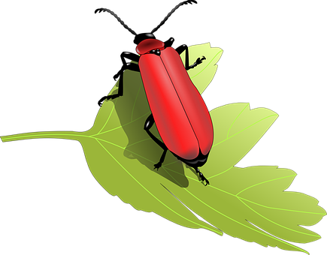
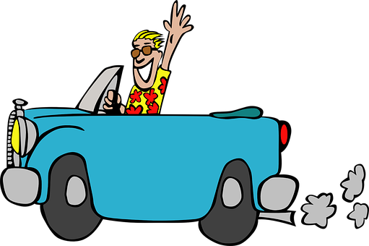

Follow up 1:
Escribe nueve palabras.
¡Bingo!
Tu compañero/a pronuncia y adivina*.
pronunciar
escuchar
dieciocho
mancha
chaqueta
60
China
chino
leche
Pancho
cuchara
bicho
flecha
chocolate
noche
coche
chimenea
S
Persona A
Persona B
0
adivinar – to guess
START
Notes:
Timing: 3 minutes
Aim: to practise SSC [ch]
Procedure:
1. Introduce the task. All pupils write 9 words of their choice from the list. The aim is to pronounce the words correctly and try to call bingo by figuring out all the words their partners wrote down.
2. Start the timer for Pupil A (s/he tries to read aloud all of the words, within the 60 seconds allowed).
3. They swap roles and repeat the task.
adivinar [2201]

Slide 4

Follow up 2:
¿Cómo son las personas? Escribe en inglés.
leer
 | El cantante Luis Miguel tiene los ojos verdes.
 | El cantante Pablo Alborán tiene el pelo corto.
 | El pintor Picasso tiene la nariz grande.
 | La cantante Shakira tiene el pelo rubio.
 | El cantante Camarón tiene el pelo largo.
 | El pintor Salvador Dalí tiene los ojos redondos.
E
The (male) singer Luis Miguel has green eyes.
1
The (male) singer Pablo Alborán has short hair.
2
The painter Picasso has a big nose.
3
The (Female) singer Shakira has blonde hair.
4
The (male) singer Camarón has long hair.
5
The painter Dalí has round eyes.
Notes:
Timing: 10 minutes
Aim: to practise written comprehension of this week’s vocabulary in sentences.
Procedure:
Do the example with pupils. They write (or say) the English sentence meaning (they could do this on mini whiteboards).
Complete sentences 1-5 and correct them. The English sentence meanings appear on consecutive mouse clicks.
Part 2 of the task
Photo by John Kelly/WireImage.com - Image courtesy WireImage.com. Downloaded from https://www.imdb.com/name/nm0586064/?ref_=nm_mv_close
By U.S. State Department - https://www.flickr.com/photos/statephotos/38832214941/in/photolist-22ayQ4r-215bWSS-22atfBg, Public Domain, https://commons.wikimedia.org/w/index.php?curid=76810256
https://www.last.fm/music/Pablo+Albor%C3%A1n/Terral/Pasos+de+cero
Picasso: https://www.galeries-bartoux.com/en/artists/pablo-picasso/
De Roger Higgins, World Telegram staff photographer - Esta imagen está disponible en la División de Impresiones y Fotografías de la Biblioteca del Congreso de los Estados Unidos bajo el código digital cph.3c14985. Dominio público, https://commons.wikimedia.org/w/index.php?curid=1304063

Slide 5
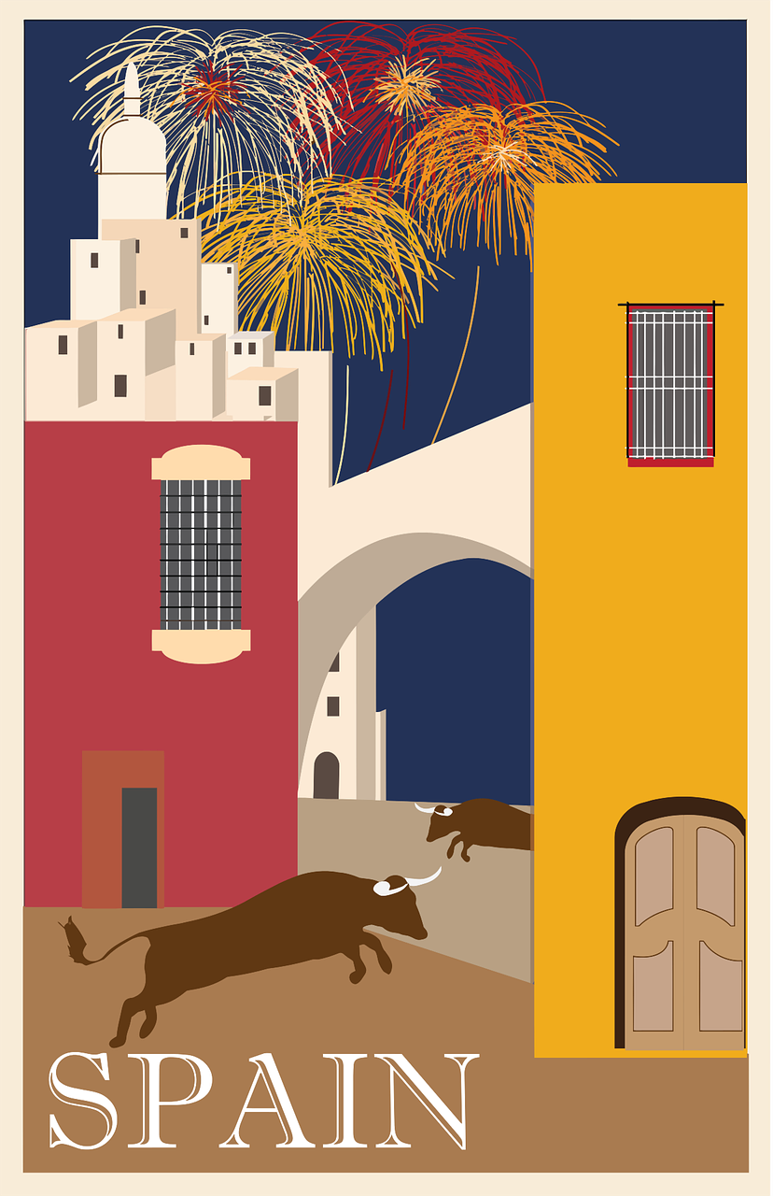




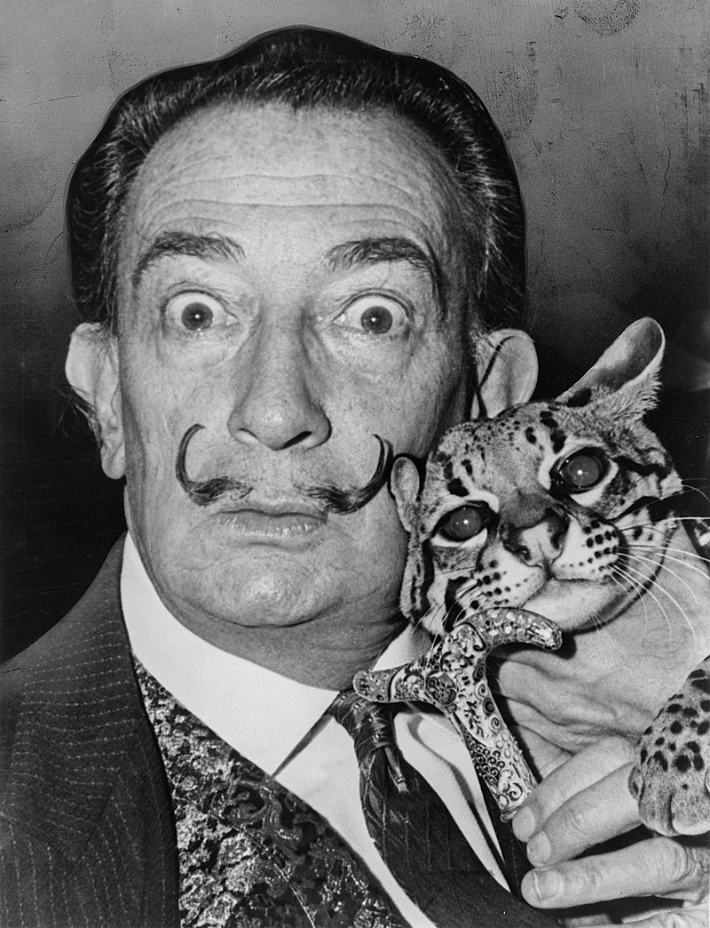

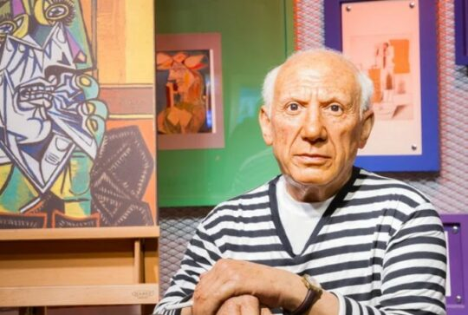

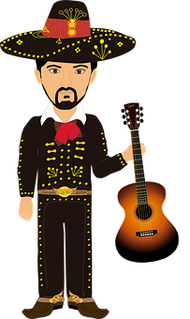
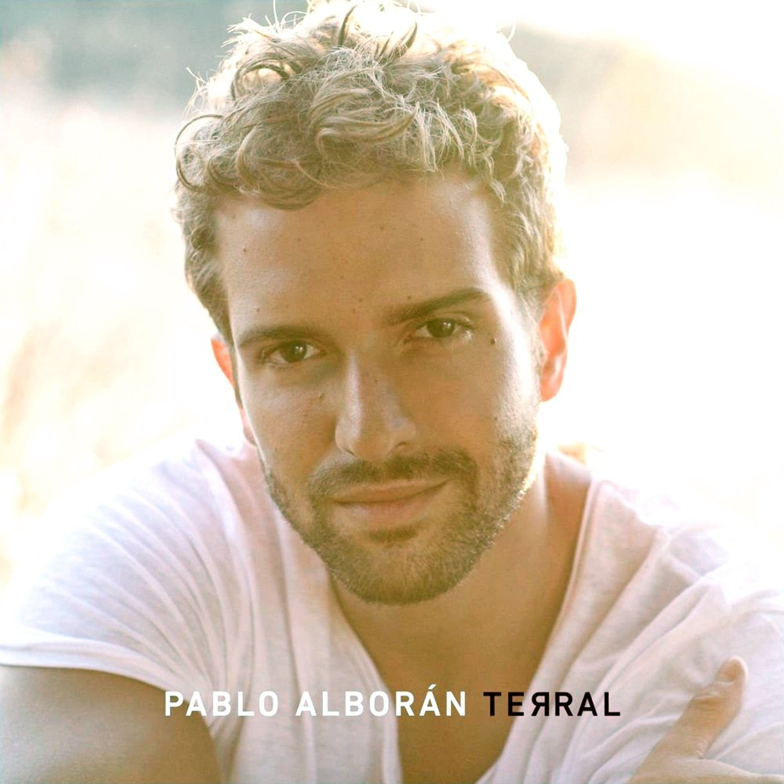
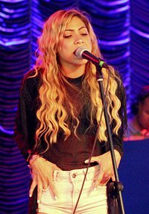
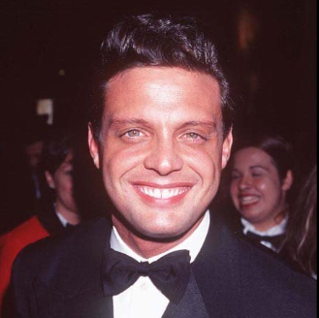
Follow up 2:
En un ordenador o tableta*, investiga*.
El flamenco es un estilo de música típico de _________.
El mariachi
es un estilo de música típico de ________.
Nombre:
Salvador Dalí
Nombre:
Camarón (de la Isla)
Nombre:
Pablo Picasso
pintor
cantante
Profesión: _____________
País: _____________
Famoso por: ____________
________________________
pintor
Profesión: _____________
País: _____________
Famoso por: ____________
________________________
Profesión: _____________
País: _____________
Famoso por: ____________
________________________
España
España
España
España
Flamenco
surrealismo
Cubismo
‘Como el agua’
Méjico
Nombre:
Pablo Alborán
Nombre:
Shakira
Nombre:
Luis Miguel
cantante
cantante
Profesión: _____________
País: _____________
Famoso por: ____________
________________________
Profesión: _____________
País: _____________
Famoso por: ____________
________________________
cantante
Profesión: _____________
País: __________________
Famoso por: ____________
________________________
España
Colombia
Puerto Rico, Méjico
Pop
Pop,
Pop latino,
‘Solamente tú’
reguetón.
‘La bicicleta’
‘Suave’; Mariachi
(la) tableta = tablet
investigar = to research
Notes:
Aim: to research information about 6 iconic Spanish-speaking artists
Procedure:
Before beginning the activity, the teacher may want to clarify the key info pupils need to find out: profession, country of origin, what they are famous for (this could be genre/style, the name of a song/painting, etc.).
1. Tell pupils that they need to write the missing info in Spanish. Profession Can be found in part 1 of this follow up.
2. Click to reveal written answers (From the top left). Pupils will have different answers for ‘famoso for’ which will present an opportunity to practise a range of SSCs. Support and praise as necessary.
3. Elicit answers for the ‘cultura’ box’.
If pupils don’t have access to computers or tablets, this task could be left out or suggested as optional research for home / golden time, etc.
tableta [>5000] investigar [1571]
Image source:
Luis Miguel: Photo by John Kelly/WireImage.com - Image courtesy WireImage.com. Downloaded from https://www.imdb.com/name/nm0586064/?ref_=nm_mv_close
Pablo Alborán: https://www.last.fm/music/Pablo+Albor%C3%A1n/Terral/Pasos+de+cero
Picasso: https://www.galeries-bartoux.com/en/artists/pablo-picasso/
Dalí: De Roger Higgins, World Telegram staff photographer - Esta imagen está disponible en la División de Impresiones y Fotografías de la Biblioteca del Congreso de los Estados Unidos bajo el código digital cph.3c14985. Dominio público, https://commons.wikimedia.org/w/index.php?curid=1304063
Camarón: https://soundcloud.com/camaron-de-la-isla

Slide 6


Follow up 3:
Usa las palabras en las burbujas y escribe las frases.
escribir
 | She has a pretty face.
 | My mum has black hair.
 | The (female) singer has big eyes.
 | My brother has weird feet.
 | My grandad has a round face.
 | The (male) singer has new glasses.
cara
pequeños
las
E
Tiene la cara bonita.
hermano
las
la
redonda
tiene
1
la
Mi madre tiene el pelo negro.
el
tiene
ojos
cara
2
nuevas
gafas
La cantante tiene los ojos grandes.
tiene
cantante
mi
3
pies
el
la
Mi hermano tiene los pies pequeños.
madre
tiene
abuelo
tiene
4
los
negro
cantante
Mi abuelo tiene la cara redonda.
bonita
pelo
5
mi
mi
grandes
El cantante tiene las gafas nuevas.
tiene
los
(la) burbujar = bubble
Notes:
Timing: 5 minutes
Aim: to practise written comprehension of this week’s vocabulary in sentences.
Procedure:
Do the example with pupils. They write (or say) the English sentence meaning (they could do this on mini whiteboards).
Complete sentences 1-5 and correct them. The English sentence meanings appear on consecutive mouse clicks.
Burbuja [4850]

Slide 7



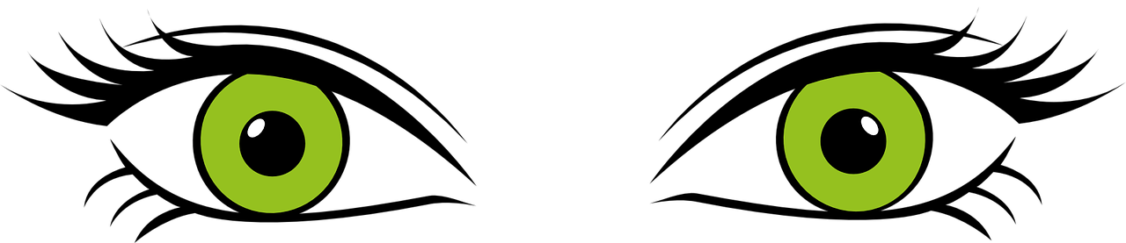



Follow up 4:
En parejas, pregunta y contesta.
Panchita
Chema
Costa
Casandra
hablar
Cuevas
Pincho
Maca
Puncha
Concha
Pancha
Costa
Carmel
Pancho
Chantel
Conrado
Cruz
round face? |black or green eyes? | long or short hair?| blonde, black or brown hair?
big or small nose?
Notes:
Timing: 5 minutes
Aim: to practise oral production of tiene + definite article + noun + adjective.
Before beginning the activity, the teacher may want to clarify the variables: round face? |black or green eyes? | long or short hair?| blonde, black or brown hair? big or small nose?
Click to bring up the aide memoire at the bottom of the slide.
Pupils work in pairs. The aim of the activity is to identify a character chosen by one of the partners.
Pupil B chooses one of the people but doesn’t tell his/her partner which one.
Pupil A asks questions in Spanish to determine which person B has chosen. E.g. ¿Tiene el pelo corto?
Pupil A makes notes and after several questions can ask ¿Eres [XXX]?
When A has correctly identified the person, they swap roles.
Notes:
The names practise the SSC [ch] and other previously taught SSC.
Several of these names are neutral and work equally for boys and girls. These include: Costa, Cruz, Carmel, Cuevas.

Slide 8


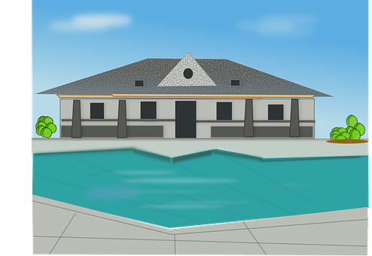
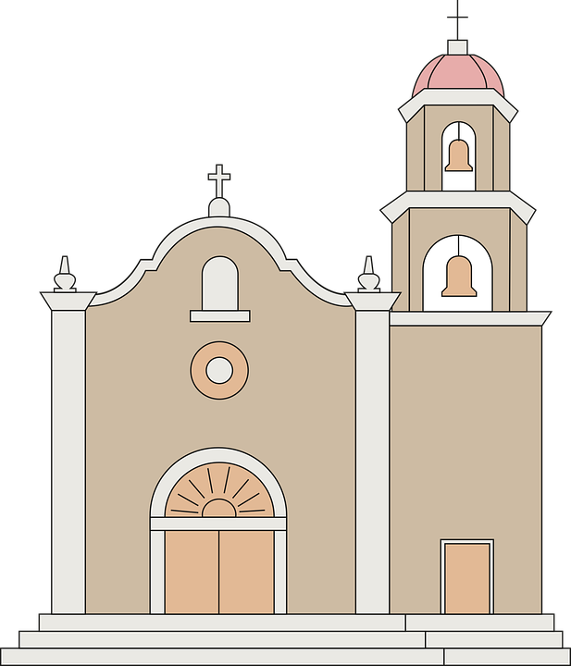
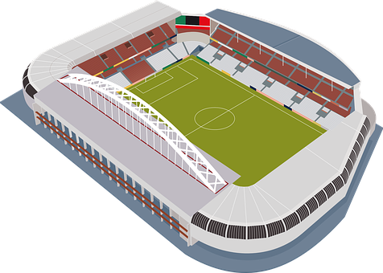



Follow up 5:

¿Qué falta? Escribe las palabras en español.
faltar = to be missing
6. En casa, Max no tiene una piscina .
_____
_____
_____
escribir
[big]
5. ¿Tienes un estadio grande? No, tengo una iglesia pequeña.
______
______
______
___
______
4. Mi ciudad tiene unas escuelas y un museo.
_________
___ ________________
___ _______________
3. veinte, veintidós, veinticuatro, veintiséis, veintiocho, treinta
______
______
______
2. doce, trece, catorce, quince, dieciséis
______
______
1. enero, febrero, marzo, abril, mayo, junio, julio, agosto, septiembre, octubre, noviembre, diciembre
______
______
______
______
______
______
Notes:
Timing: 10 minutes
Aim: to practise written production of vocabulary from the revisited weeks.
Procedure:
1. Tell pupils that they need to write the missing words, and to look both sides of the gap to decide which words are missing.
2. Do the first one with them. We are working from the bottom up. The items increase in difficulty to the top.
3. Click to reveal written answers.

