Slide 1

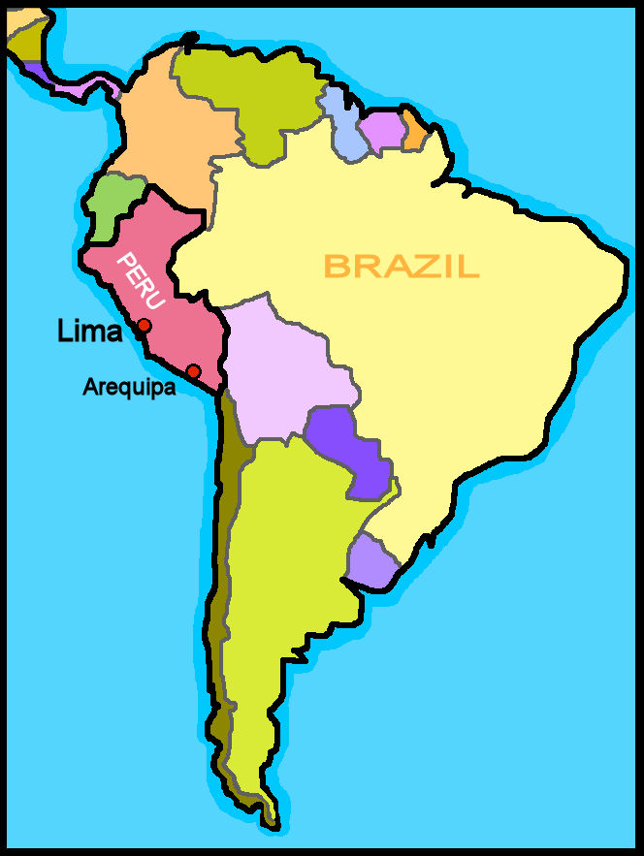
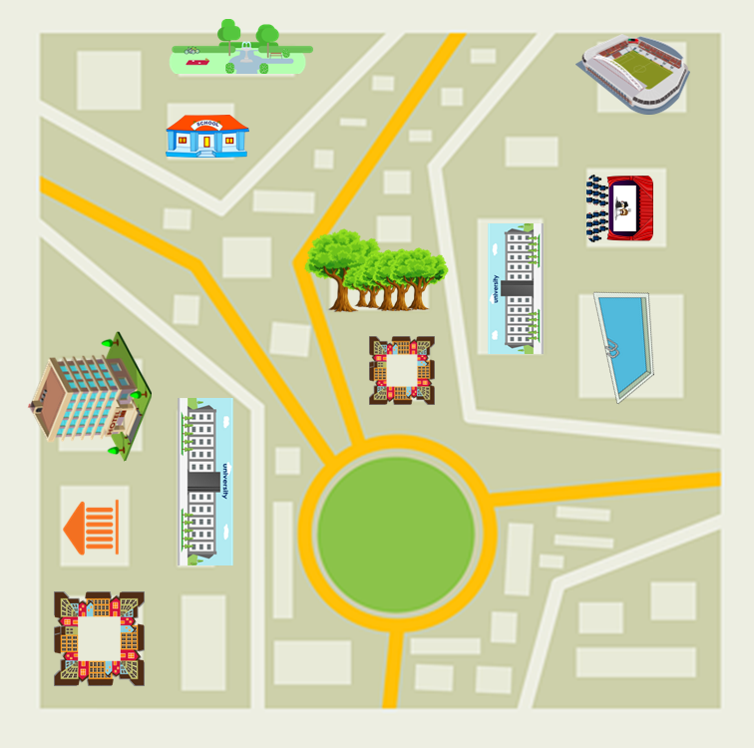
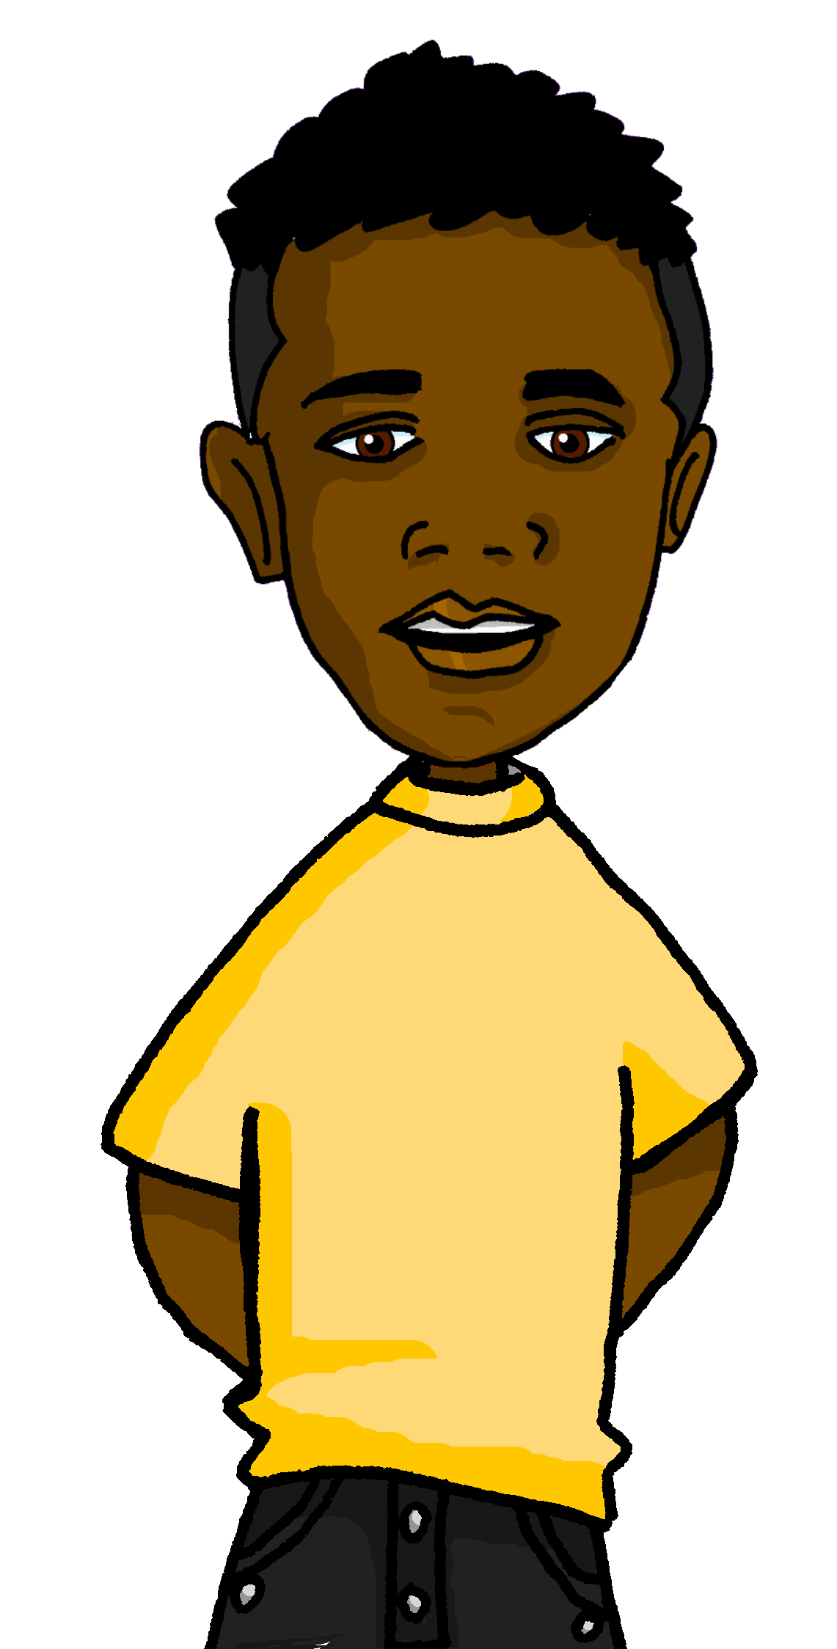
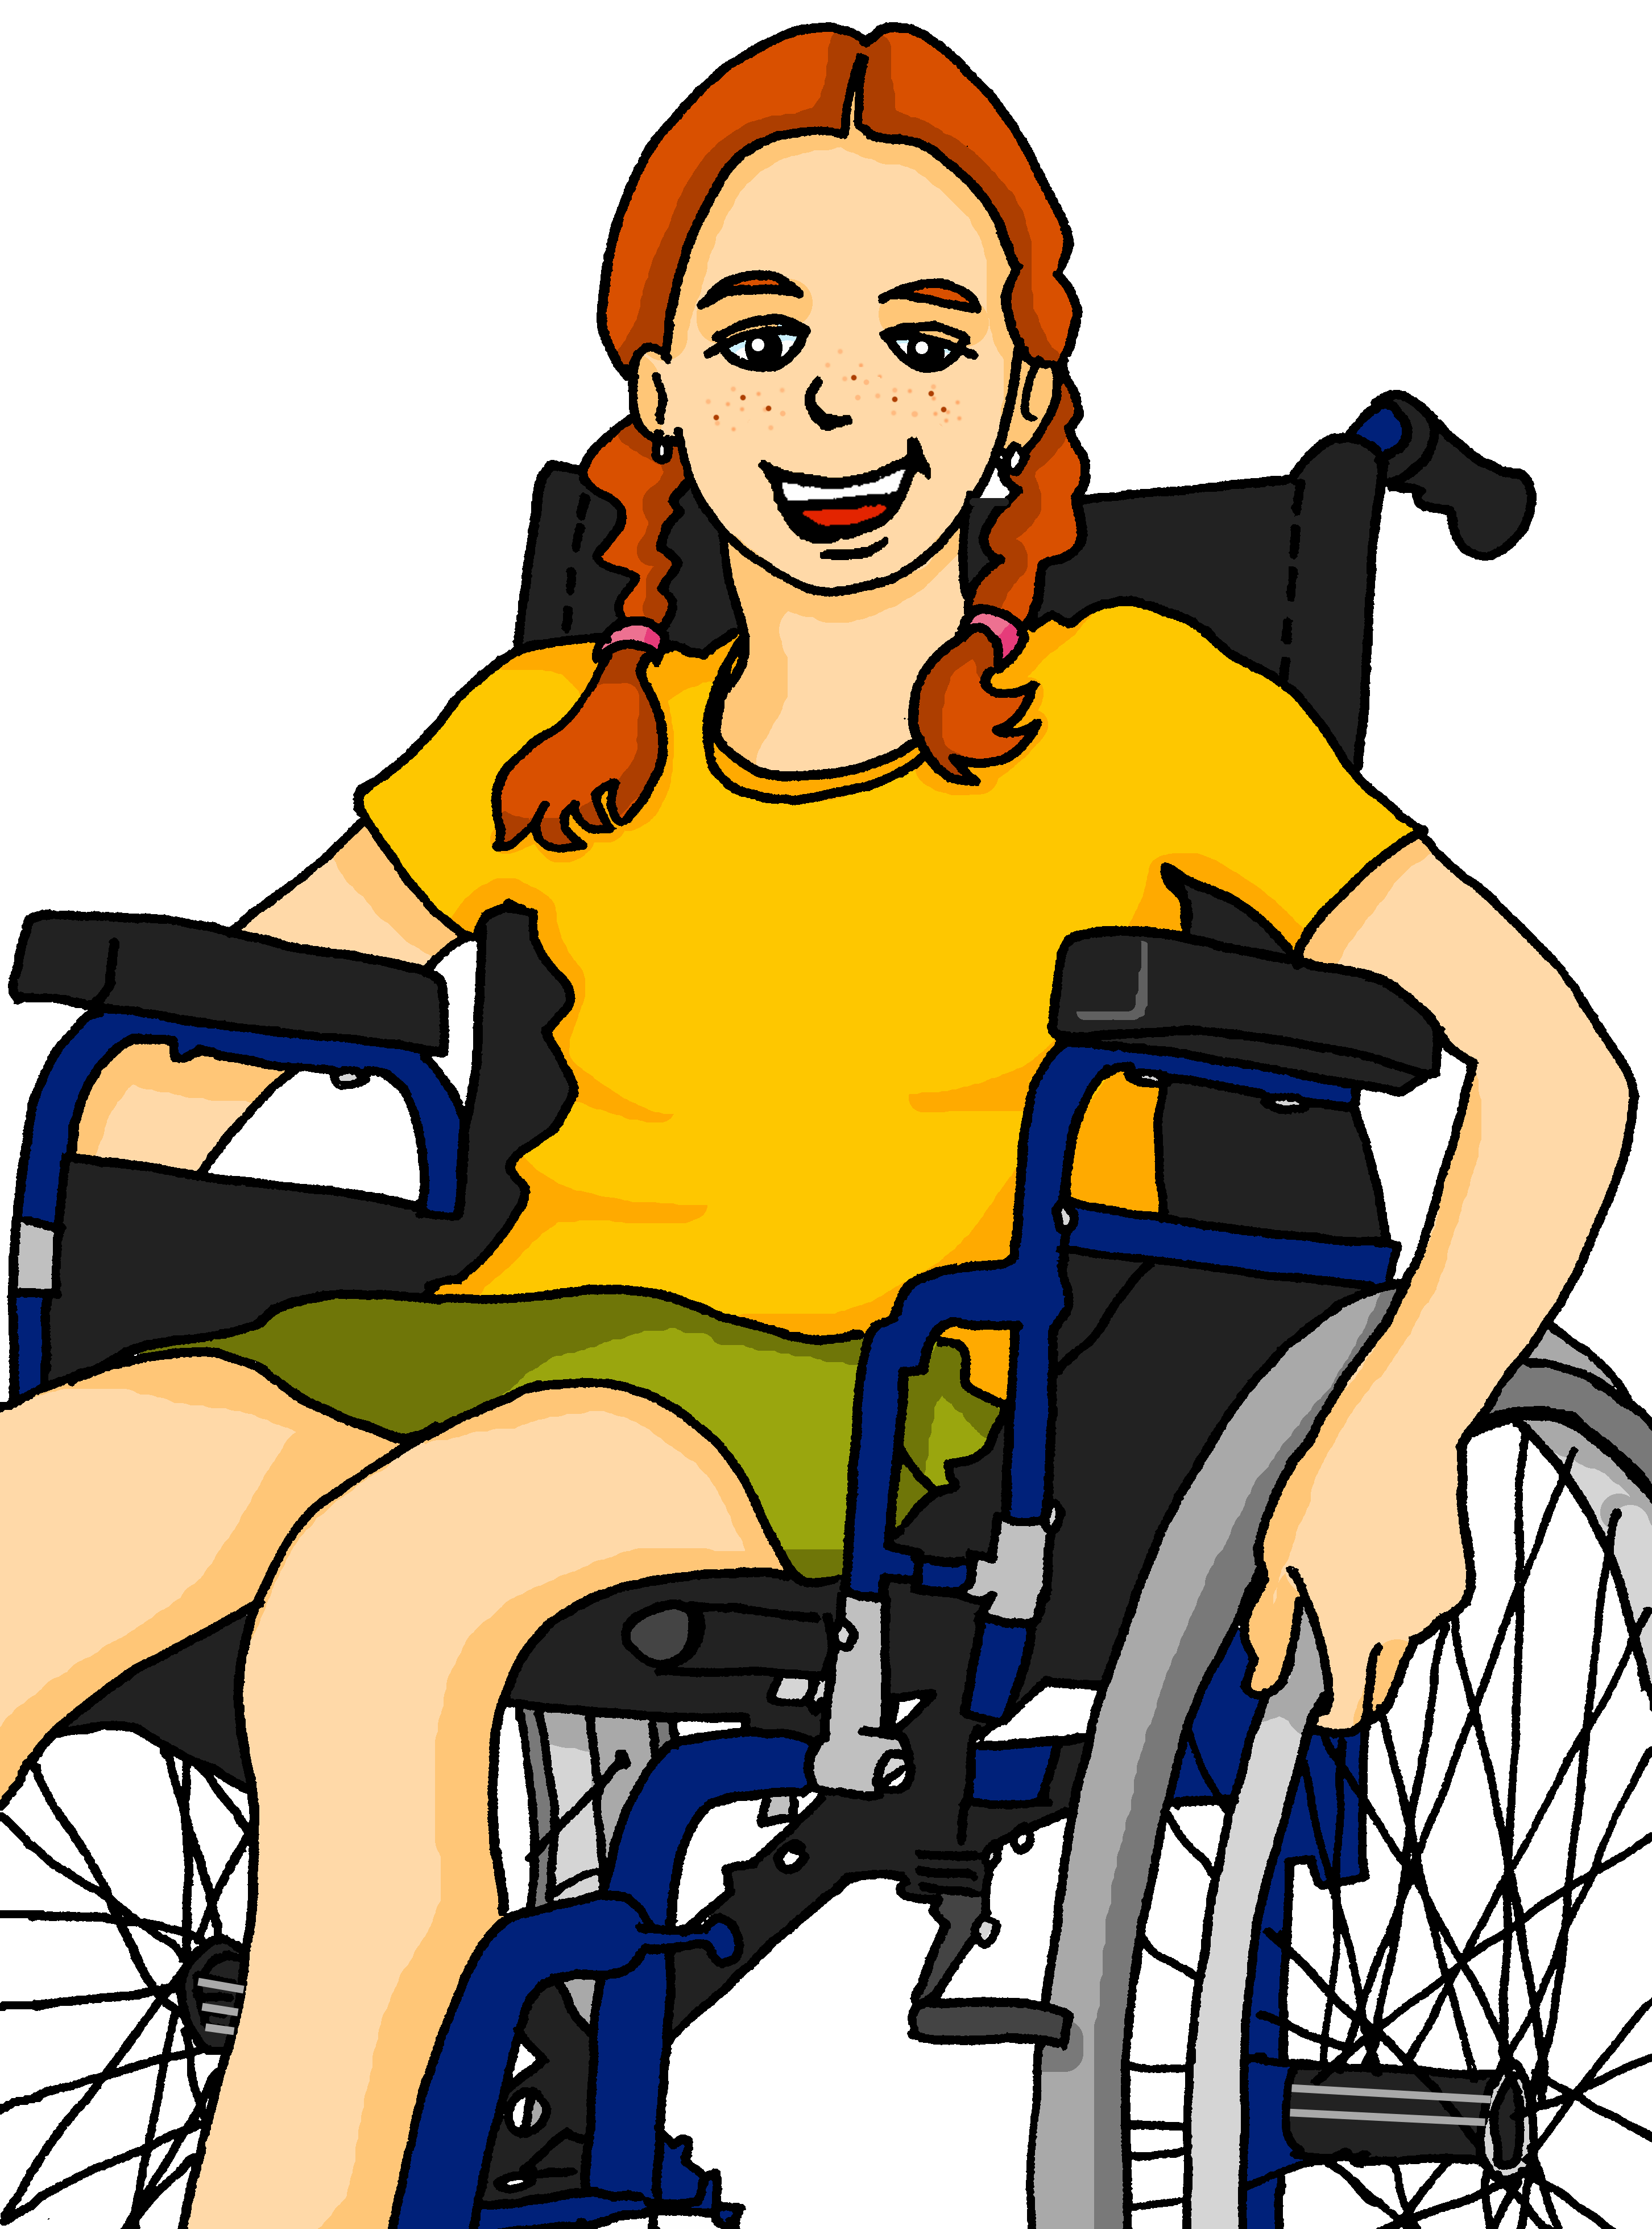
Describing me and others
lugares
verde
Follow ups 1-5
Notes:
Artwork by Steve Clarke. All additional pictures selected are available under a Creative Commons license, no attribution required.
The frequency rankings for words that occur in this PowerPoint which have been previously introduced in the resources are given in the SOW (excel document) and in the resources that first introduced and formally re-visited those words.
Phonics: zapato [1477]
Vocabulary: tienen [8] tenemos [8] edificio [857] aquí [130] de12 [2] delante [1742] detrás [2044] dónde [161] en1[6] entre [63]
Revisit 1: tener [19] tengo [tener 19] tiene [tener 19] compañero / compañera [551] escuela [424] hotel [1163] piscina [4604] puente [1715] feo [2373] muy [43] bastante [308]que [50] un [6] una [6] re-use adjectives: bonito [891] diferente [293] divertido [2465] fuerte [435] grande [66] importante [171] independiente [1177] inteligente [2167] lento [1569] normal [1000] pequeño [202] perfecto [1115] pesado [2166] serio [856]
Revisit 2: somos [ser, 7] estamos [estar, 21] amable [2707] curioso [1811] enfermo [1092] imposible [1418] nervioso [1521] sano [1961] y [4]
For any other words that occur incidentally in this PowerPoint, frequency rankings will be provided in the notes field wherever possible.
Glossed:
hablar [90] mencionar [1102]
Source: Davies, M. & Davies, K. (2018). A frequency dictionary of Spanish: Core vocabulary for learners (2nd ed.). Routledge: London

Slide 2

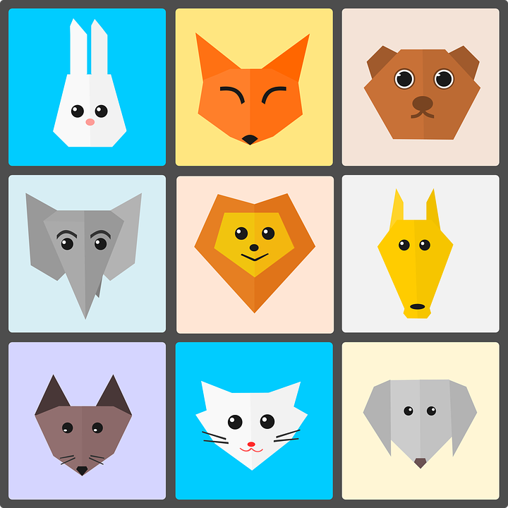



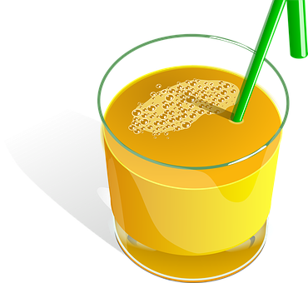

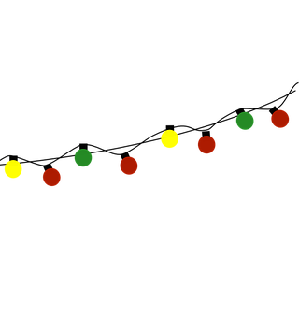





Follow up 1:
[z]
zapato
[A] Escucha y escribe [za] [zo] [zu] [ce] o [ci].
[B] Practica
pronunciar
Persona A
⚠ [z] is always followed by [a] [o] [u]. [z] sounds the same as [c] in front of [e] [i]
Persona B
cien
zoo
paz
100
_ _
[near]
[EJ]
c e r c a
zumo
corazó n
[2]
_ _
decisión
zona
[decision]
_ _
[3]
cima
[area]
[4]
_ _
luce s
zapato
[5]
calabaza
_ _
_ _
_ _
[6]
c e r e z a
dulce
celebrar
[sweets]
[to celebrate]
Notes:
Timing: 5 minutes
Aim: to consolidate phonological awareness of the similarities between [za] [zo] [zu] [ce] and [ci].
Procedure:
Part A
Students listen and write [za] [zo] [zu] [ce] [ci]
The teacher shows the answers for each word, one by one.
Transcript:
cerca
corazón
cima
luces
calabaza
cereza
Part B
Procedure:
Partner A sits with their back to the board whilst partner B reads aloud the first five words that on the first click. Partner A writes the words.
Partner then swap roles. Teacher clicks to bring up the remaining 5 words (and remove the first five for clarity).
Teacher clicks again to bring all words back. Pupils check their spellings.
Teachers should circulate to listen to students’ pronunciation and praise/correct as necessary.
Click on each of the words to hear it pronounced.
Frequency of unknown words and cognates:
corazón [475] cima [4632] luz (luces) [278] calabaza [>5000] decisión [590] cereza [>5000] zoo [>5000] paz [554] cien(to) [440] zona [359] cerca [1042] zumo [>5000] dulce [3450] celebrar [886]
Source: Davies, M. & Davies, K. (2018). A frequency dictionary of Spanish: Core vocabulary for learners (2nd ed.). Routledge: London

Slide 3

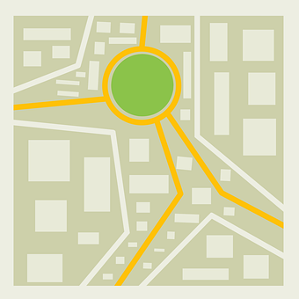
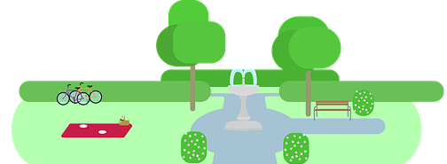

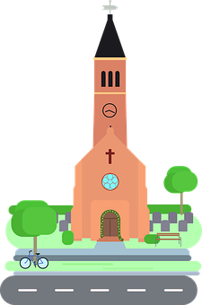


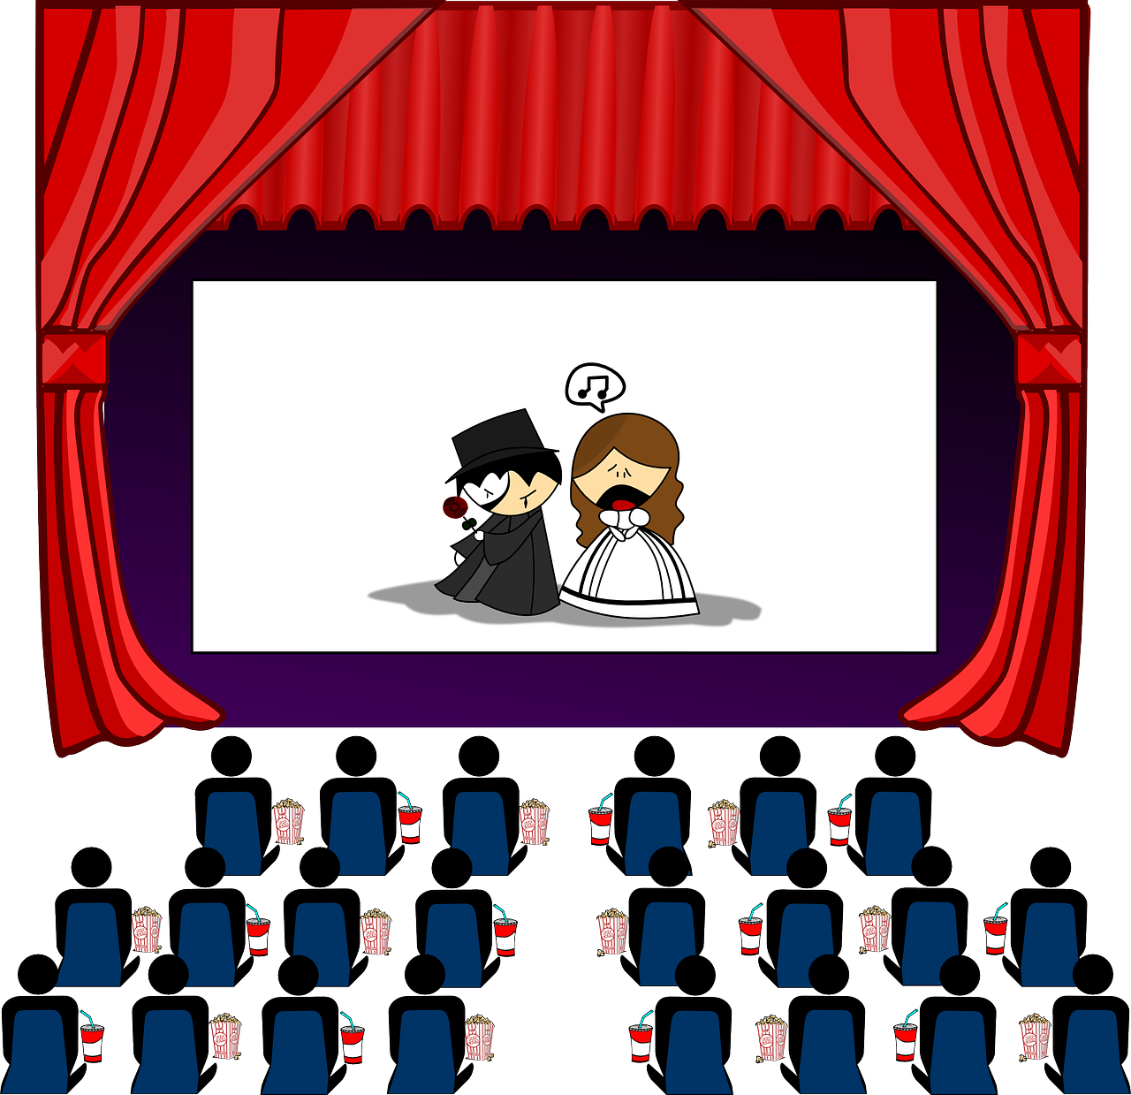
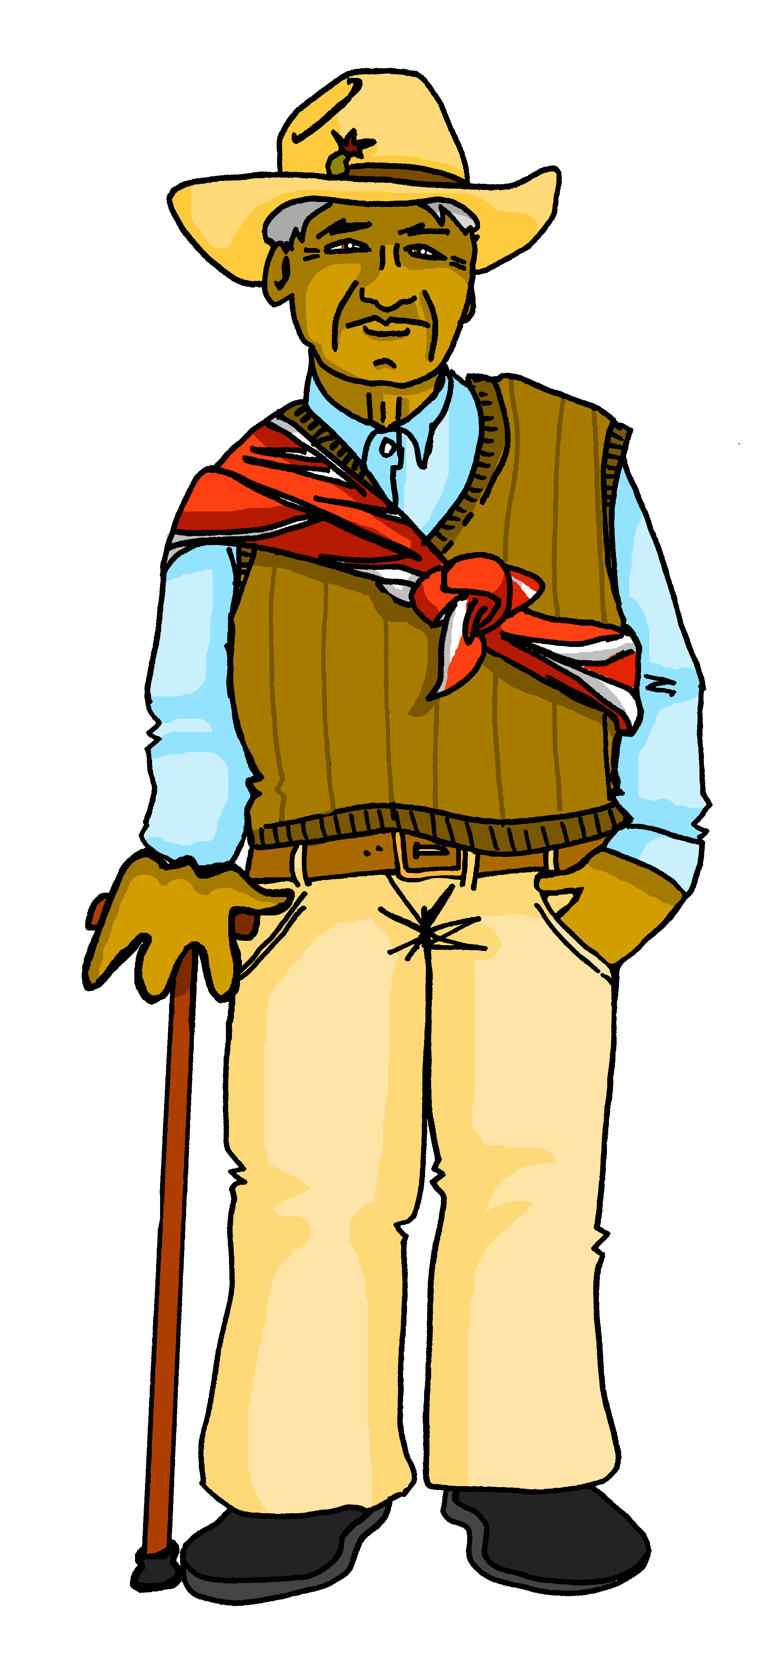
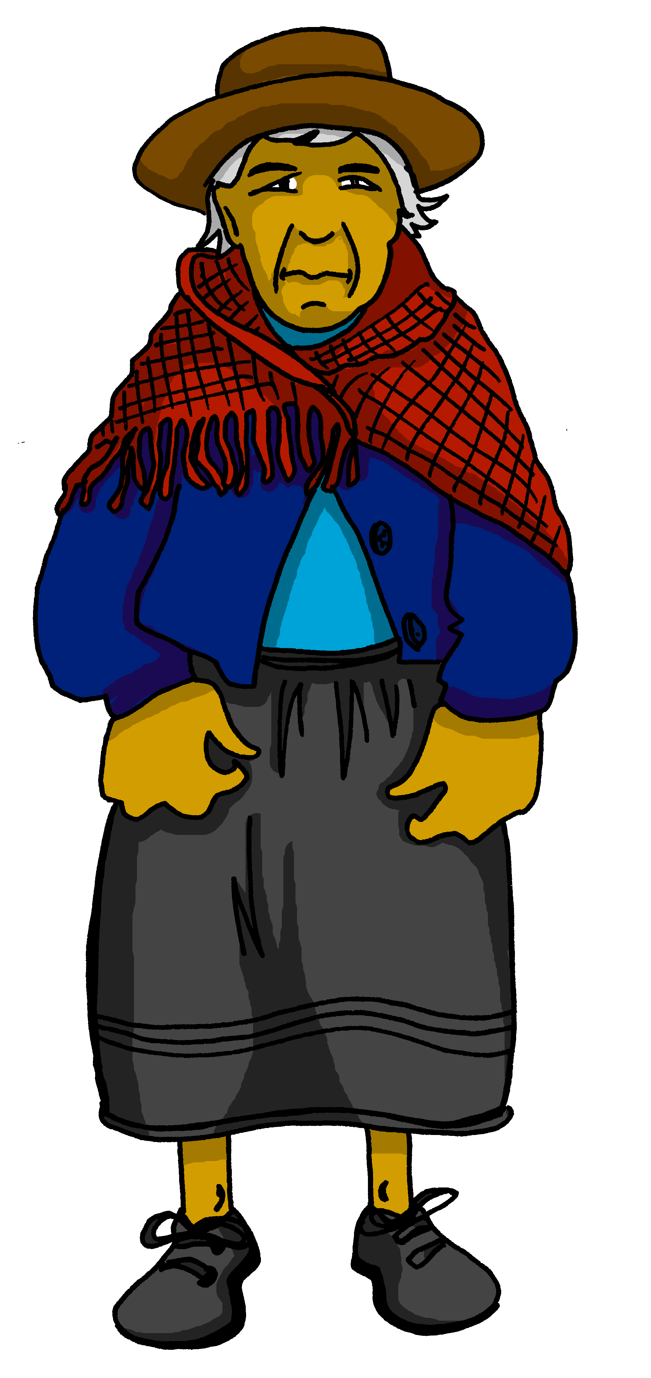
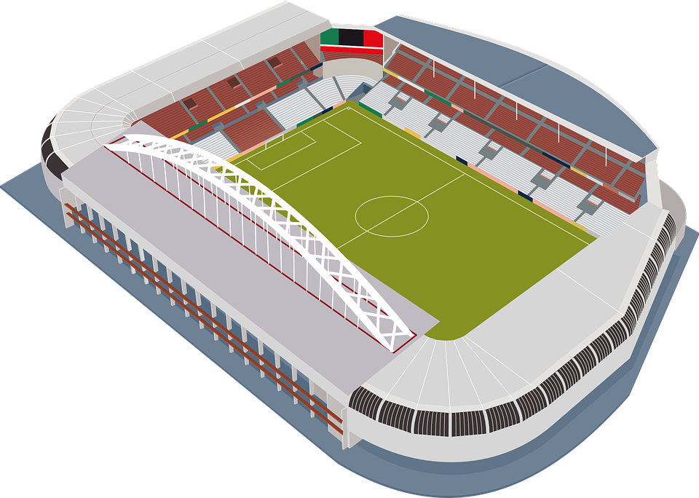

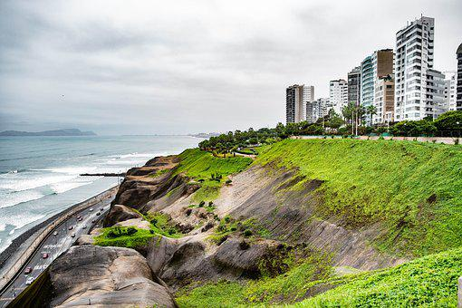


Follow up 2: la ciudad de la abuela
Los abuelos hablan* de Lima.
escuchar
¿Menciona un, una, unos o unas?
hablan = they speak
menciona = she mentions
En Lima tenemos…
Notes:
Timing: 4 minutes (two slides)
Use this first slide to set the scene.
Procedure:
1. Read the title and click to bring up the instructions in Spanish.
2. Move to the next slide for the task.
Frequency of unknown words and cognates:
hablar [90] mencionar [1102]
Source: Davies, M. & Davies, K. (2018). A frequency dictionary of Spanish: Core vocabulary for learners (2nd ed.). Routledge: London

Slide 4

escuchar
En Lima tenemos…
La ciudad de Lima.
Los abuelos hablan de Lima.
¿Menciona un, una, unos o unas?
 | un / una / unos / unas | puente | playa
 | un / una / unos / unas | cines | escuelas
 | un / una / unos / unas | iglesia | museo
 | un / una / unos / unas | universidad | hotel
 | un / una / unos / unas | iglesias | árboles
 | un / una / unos / unas | calles | parques
E
E
1
1
2
2
3
3
4
4
5
5
Notes:
Timing: 4 minutes
Aim: to practise aural recognition of un / una / unos / unas and their connection with an appropriate noun.
Procedure:
Read the title and click to bring up the instructions in Spanish.
Do the example (E). (Note: some learners will benefit from being able to circle the words on the sheet).
Click to bring up the answers.
Draw pupils’ attention to the nouns.
Pupils write (or circle) the correct noun, according to its final letter.
Pupils check their answers.
Click to confirm the answers.
(Click the buttons on the left to hear the answers.)
Transcript 1:
Ej. ¿Qué tenemos? Pues, tenemos una [playa]
Tenemos unos [cines]
Tenemos un [museo]
Tenemos una [universidad]
Tenemos unas [iglesias]
Tenemos unos [parques].

Slide 5



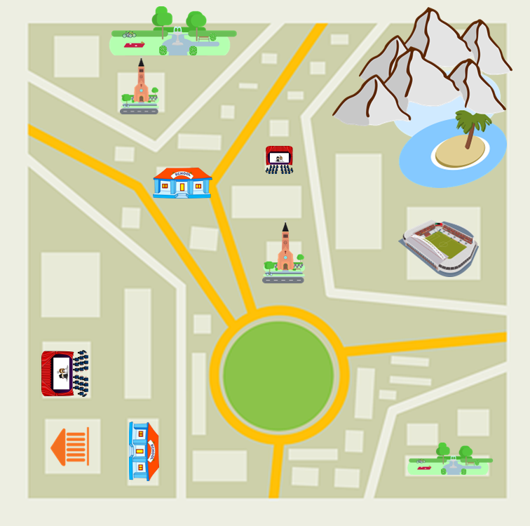
Follow up 3:
¿Qué menciona Elena? ¿Qué no menciona?
Escribe dos listas en inglés.
Lee y decide
leer
unos parques | un hotel
unos cines | unas universidades
unas calles | unas iglesias
una playa | unos puentes
unas montañas | un museo
Abuelita has forgotten to mention two places.
¿Qué más tienen los abuelos?
some parks
some cinemas
some streets
¡un estadio!
a beach
a hotel
¡unas escuelas!
some mountains
some universities
some churches
some bridges
a museum
Notes:
Timing: 5 minutes
Aim: to practise written comprehension of the new vocabulary.
Procedure:
1. Ensure that pupils understand the task. They need to identify and list in English the 6 places that abuelita mention, and the 5 items that she doesn’t mention.
2. Pupils write the words in English.
3. Click to reveal answers.
4. Note: the picture clues are available on a mouse click, but first pupils should try to recall as many of the meanings as they can. Most of the words have been taught and revisited before. Teachers should judge the most appropriate moment to provide the additional support. If not needed, it can be clicked to appear just prior to revealing the answers.

Slide 6


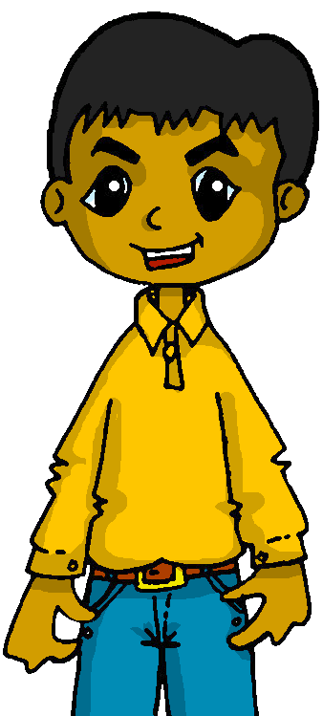
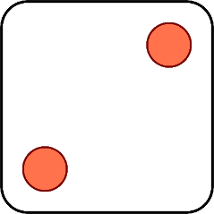
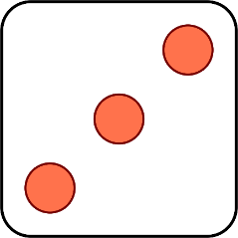




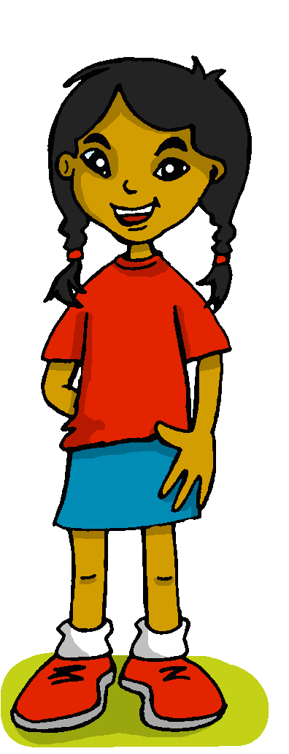
Follow up 4:
Sofía habla sobre Luis, Krina y Max
¿Qué menciona? Habla en español.
hablar
No tienen unas montañas importantes.
¿Tienen una universidad pequeña?
No tiene una playa perfecta.
No tenemos un museo grande.
Tiene unos parques divertidos.
Tenemos una iglesia bonita.
1 | She has…
2 | She does not have…
3 | We have…
4 | We do not have…
5 | They do not have…
6 | Do they have…?
1 | a big museum
2 | a perfect beach
3 | some fun parks
4 | some important mountains
5 | a pretty church
6 | a small university
a / an
some
Notes:
Timing: 5 minutes
Aim: to practise oral production of three parts of tener (question and affirmative / negative phrases).
Procedure:
1. Click to ‘roll’ the dice.
2. Pupils translate the verbs and nouns whose numbers correspond to the respective dice to make a short sentence. They say the answer chorally.
3. Click to reveal the correct sentence.
4. Repeat until all six combinations have been said.

Slide 7




Follow up 5:
Escribe en español: Can you get at least 15 points?
 | we are (perm.) | ill (m, pl.) | we are (state)
 | kind (f) | impossible | healthy (f)
 | partner (f) | annoying (m) | slow (f)
 | quite | strong (m/f) | very
 | in front (of) | (the) building | (the) cinema
 | we have | between | behind
vocabulario
somos
enfermos
estamos
x3
amable
imposible
sana
la compañera
pesado
lenta
x2
bastante
fuerte
muy
delante (de)
el edificio
el cine
x1
tenemos
entre
detrás (de)
Notes:
Timing: 6 minutes
Aim: to practise written production of vocabulary for this week and previous weeks.
Procedure:
1. Pupils need to write the Spanish for as many words as possible, aiming to get at least 15 points (but more if possible).
2. Click for Spanish answers.

Slide 8
Handout Follow up 5:
Follow up 5:
Escribe en español: Can you get at least 15 points?
 | we are (perm.) | ill (m, pl.) | we are (state)
 | kind (f) | impossible | healthy (f)
 | partner (f) | annoying (m) | slow (f)
 | quite | strong (m/f) | very
 | in front (of) | (the) building | (the) cinema
 | we have | between | behind
vocabulario
x3
x2
x1
Notes:
Timing: 6 minutes
Aim: to practise written production of vocabulary for this week and previous weeks.
Procedure:
1. Pupils need to write the Spanish for as many words as possible, aiming to get at least 15 points (but more if possible).
2. Click for Spanish answers.

