Slide 1
español, con Sofía

Slide 2
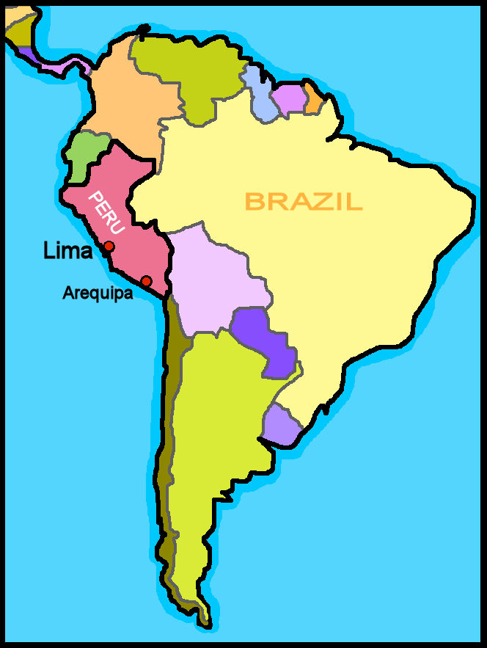
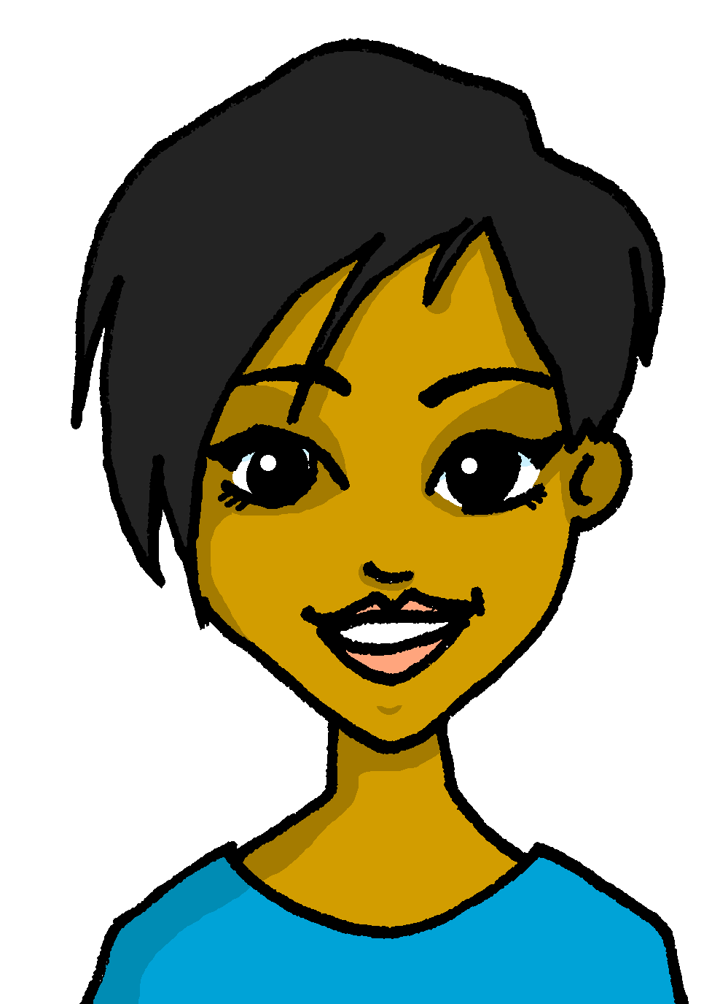
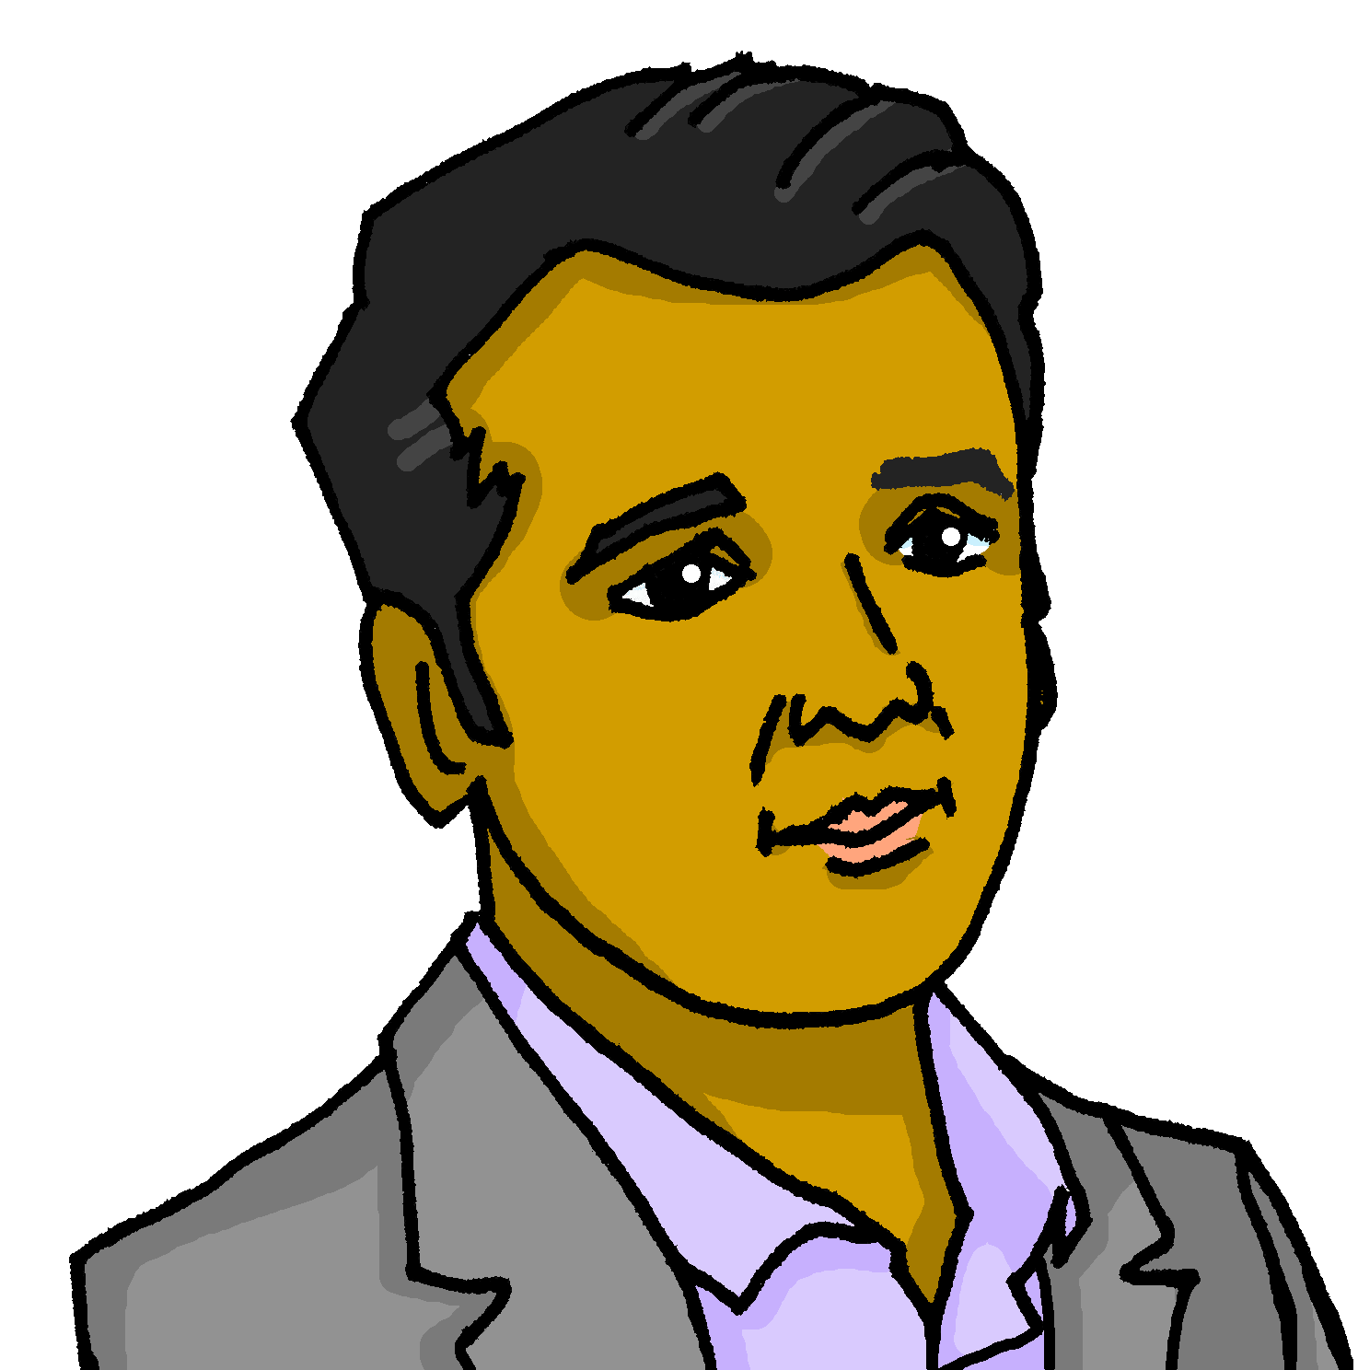
Saying what I and others have
tener: 3rd person singular & plural
negation
SSC: [ce] [ci]
verde
Notes:
Artwork by Steve Clarke. All additional pictures selected are available under a Creative Commons license, no attribution required.
The frequency rankings for words that occur in this PowerPoint which have been previously introduced in the resources are given in the SOW (excel document) and in the resources that first introduced and formally re-visited those words.
Phonics: [ce] [ci] decir [32] centro [317] cerca [1042] celebrar [886] dulce [1861] cero [1731] cocina [1214]
Vocabulary: tienen [8] calle [269] cine [952] escuela [424] hotel [1163] iglesia [437] museo [1114] parque [1354] piscina [4604] plaza [806] puente [1715] universidad [387] enorme [631] histórico [830] solo [181] de¹²
Revisit 1: hay [13] cuántos/cuántas [580] bolígrafo [>5000] camiseta [4130] cuaderno [3301] deporte [1489] mochila [>5000] capaz [645] difícil [374] esencial [1872] fácil [584] útil [3951] Recycle nouns and adjectives from previous years: amarillo [1381] divertido[2465] fuerte [435] lento [1569] pequeño [202]
Revisit 2: es [ser, 7] está [estar 21] negativo [1804] perdido [1899] positivo [1188] preparado [2092] tranquilo [1093] mi [37] demasiado [494] hoy [167] normalmente [1696] pero [30]
For any other words that occur incidentally in this PowerPoint, frequency rankings will be provided in the notes field wherever possible.
Glossed: corregir [2351] vivir [142] lugar [144] ] vez [59] su [12] otra [35]
Source: Davies, M. & Davies, K. (2018). A frequency dictionary of Spanish: Core vocabulary for learners (2nd ed.). Routledge: London

Slide 3
pronunciar
[ci]
decir
[to say, tell]
[ce]
centro
Notes:
Timing: 1 minute
Aim: to revisit SSC [ce] and [ci]
Procedure:
Present and elicit the pronunciation of the individual SSC [ci] and then the source word ‘decir’ (with gesture, if using).
Click to bring up the picture and get pupils to repeat (with gesture, if using).
Present and elicit the pronunciation of the individual SSC [ce] and then the source word ‘centro’ (with gesture, if using).
Click to bring up the picture and get pupils to repeat (with gesture, if using).
Suggested gestures: i) For ‘centre’, pupils can bring their two index fingers together to touch as per the image where arrows converge in a central point.
ii) British sign language for ‘say’ is to lift the right index finger to mouth and then direct it quickly away from the body (as though tracing the trajectory of a string of words coming out of the mouth towards a listener in front). For a video, see here: https://www.signbsl.com/sign/say

Slide 4
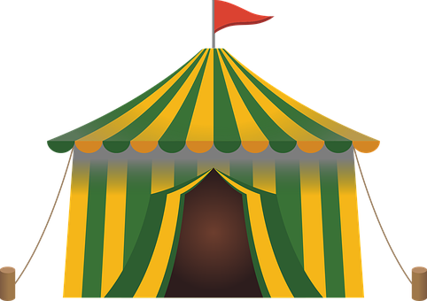
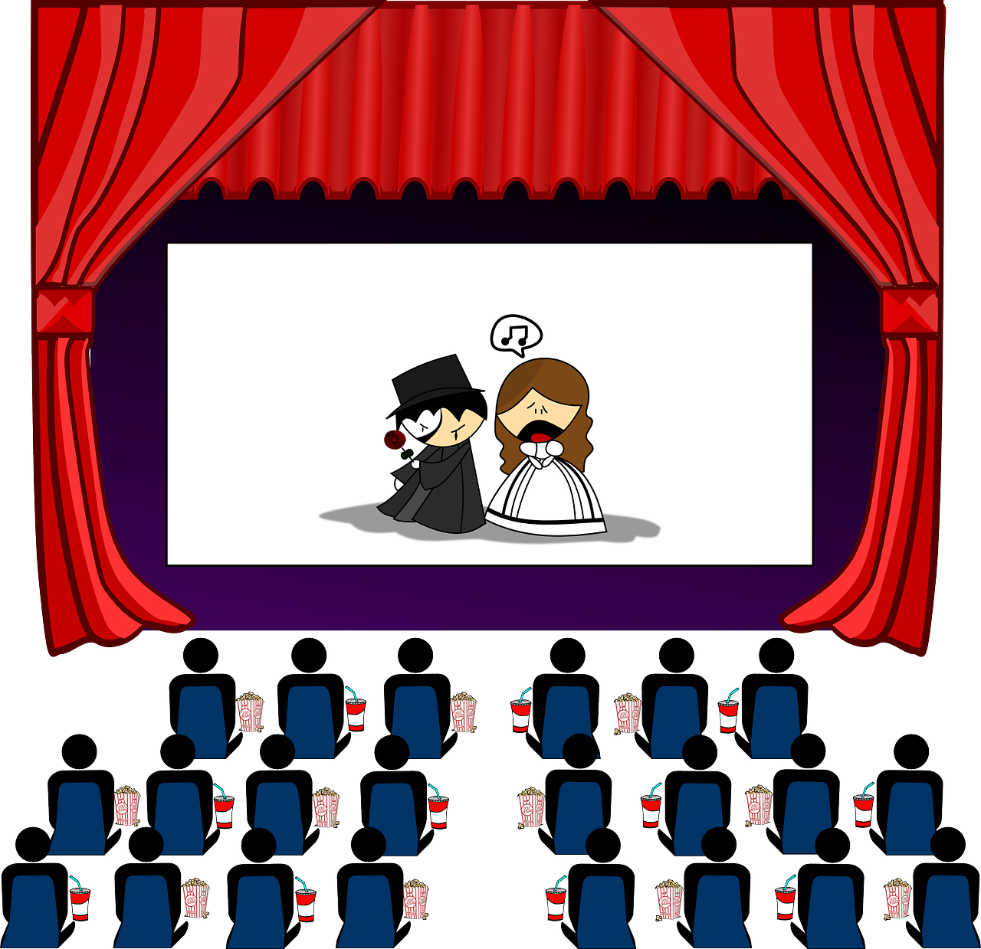
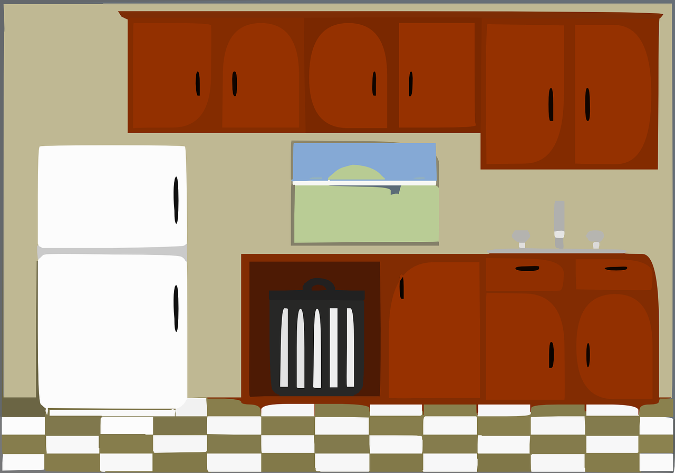
pronunciar
Pronuncia las palabras.
cerca
circo
[near]
30 segundos
cesta
edificio
dulces
cocina
cine
celebrar
oficina
0
INICIO
Notes:
Timing: 4 minutes
Aim: to practise SSC [ce] [ci] in a read aloud task. Procedure: 1. Partner A writes down 5 of the words on the slide. 2. Partner B, without seeing A’s list, says all the words on the slide as quickly as possible, trying to match all of Partner A’s list before the 30 seconds is up. If s/he succeeds s/he has won the round, if not all five words have been said, Partner B wins the round. 3. Swap roles.
Note: this activity can be repeated a couple of times.

Slide 5
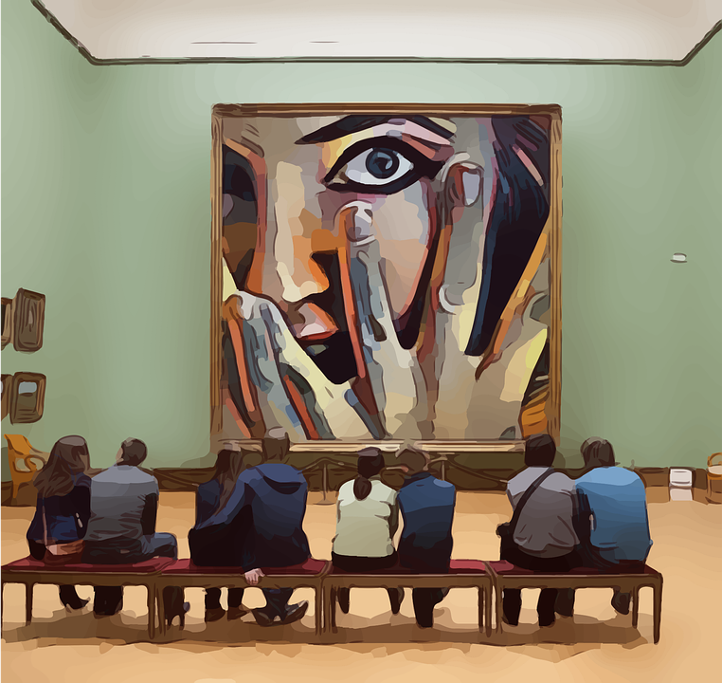
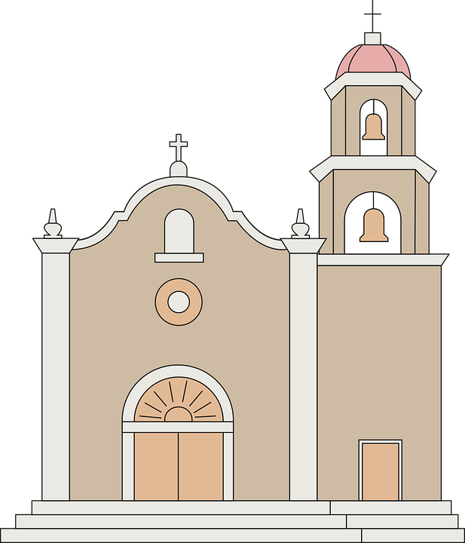
vocabulario
¿Cómo es en español?
el
museo
historical
la calle
la plaza
histórico
el m_ s _ _
h_ _ t_ r_ c_
la c_ ll_
la p_ _ z_
la ciudad
enormous
(the) square
enorme
(the) game
(the) square
(the) church
street
historical
pretty (f)
(the) cinema
museum
pretty (f)
only
enormous
(the) museum
historical
(the) street
(the) cinema
(the) city
(the) church
enormous
only
la c_ _d_ d
e _ _rm_
pretty (f)
only
la iglesia
el cine
bonita
solo
la ig _ _ s_ _
b_n _ t _
el c_n_
s_l_
Notes:
Timing: 5 minutes
Aim: to present and practise written comprehension and read aloud of previously taught vocabulary and new words for this week.
Procedure: 1. Click for an English item. Elicit pronunciation of the Spanish from pupils.
2. Continue with the remaining items.
3. Optional at this stage: elicit the Spanish from pupils, (English prompts reappear on each mouse click) this time with some written support.
4. Click on the picture (or English definition) to hear the audio for each word again, if needed.

Slide 6
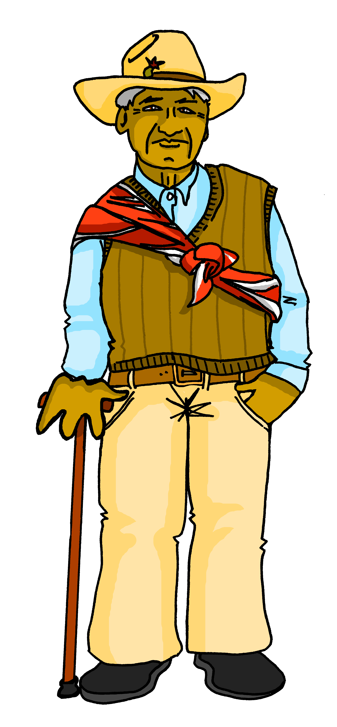
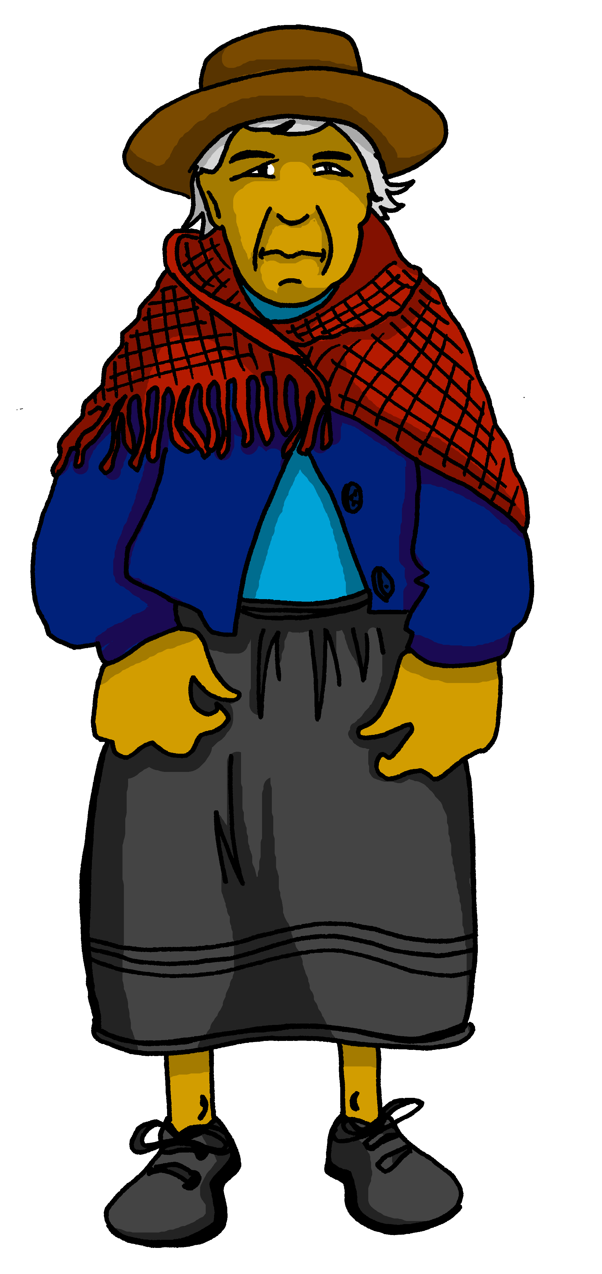
leer
Lee la Información sobre la familia de Sofía y Quique.
viven = they live
vive = s/he lives
sus = his/her (+ plural)
Los abuelos de Luis, Sofía y Quique viven* en ___________, en una casa grande.
Lima
Arequipa
Luis vive* en ___________ con sus* padres. Arequipa es una ciudad histórica con un volcán famoso, Misti.
El volcán Misti, Arequipa
Notes:
Timing: 2 minutes
Aim: to introduce the context of the lesson and locate two important Peruvian cities on a map.
Procedure:
Clarify the instruction.
Read the information and elicit the name of the correct city from pupils.
Frequency of unknown and cognate vocabulary:
vivir [142] su [12]
Source: Davies, M. & Davies, K. (2018). A frequency dictionary of Spanish: Core vocabulary for learners (2nd ed.). Routledge: London

Slide 7
Tener: s/he, it has | they have
[to have, having]
[3rd person singular & plural]
The Spanish verb tener is irregular.
To say ‘s/he, it has’ we say ______.
To say ‘they have’ we say ____________.
tiene
tienen
Los abuelos tienen una cocina grande.
Luis tiene una habitación enorme.
Luis has a huge room.
The grandparents have a big kitchen.
He has a huge room.
They have a big kitchen.
Notes:
Timing: 2 minutes
Aim: to revisit 3rd person singular and plural of ‘tener’.
Procedure:
Click to present the information.
Elicit English translations for the Spanish examples provided.

Slide 8
escuchar
Remember: We use unos or unas with plural nouns.
otra = another (f)
(la) vez = time
(el) lugar = place
Escucha a Sofía.
¿Es la ciudad de Luis (Arequipa) o la de los abuelos (Lima)?
Escucha otra vez y escribe las cosas.
Marca
Rodea el adjetivo correcto.
Luis (he) | abuelos (they)
lugares | ¿cómo es / son?
 | famoso / famosa / famosos / famosas
 | histórico / histórica / históricos / históricas
 | grande / grandes
 | divertido / divertida / divertidos / divertidas
 | bonito / bonita / bonitos / bontias
 | imposible / imposibles
E
E
unas montañas
1
1
una plaza
2
2
unos museos
3
3
un parque
4
4
una playa
5
5
unas calles
Notes:
Timing: 6 minutes
Aim: to practise aural comprehension of ‘tienen’ and ‘tiene’.
Procedure:
Pupils write 1-6 in their books and Luis / abuelos as headings.
Click to listen to the example. Pupils decide whether Sofía is talking about Luis (he), or the grandparents (they). They will hear ‘tiene’ (he has) or ‘tienen’ (they have).
Click to listen again. Pupils transcribe the noun and article in Spanish.
Complete the task with items 1-5, listening once for the person of the verb (he or they).
Click to correct.
Listen again. Pupils transcribe the noun and article.
They then select the correct form of the adjective (grammar task) based on their knowledge of number and gender agreement.
Click to bring up a new set of audio buttons. Listen to the full sentences (Transcript 2) to check, and reveal written answers.
Transcript 1:
Tiene unas montañas.
Tiene una plaza.
Tienen unos museos
Tiene un parque.
Tienen una playa.
Tienen unas calles.
Transcript 2:
Tiene unas montañas famosas.
Tiene una plaza histórica.
Tienen unos museos grandes
Tiene un parque divertido.
Tienen una playa bonita.
Tienen unas calles imposibles.
otra [35] vez [59] lugar [144]

Slide 9
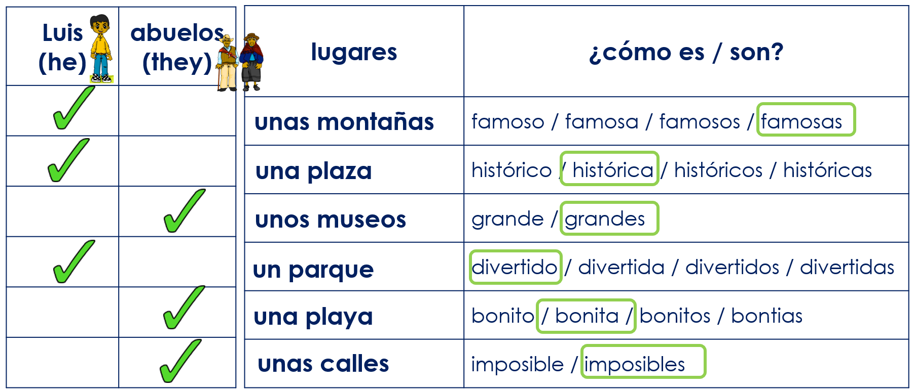
leer
¿Qué es incorrecto? Corrige el error.
mountains.
Ej. They have a famous mountain . 1. He has some historical squares.
2. They have some old museums.
3. They have some fun parks . 4. She has a new beach . 5. She has an impossible street.
some
a
square.
big
a
park.
a pretty
some
streets.
corrige = correct
Notes:
Timing: 4 minutes
Aim: to practise written comprehension of singular and plural nouns based on the connection to the singular or plural indefinite articles as well as revisited vocabulary.
Procedure:
Read the title – ‘¿Qué es incorrecto? Ensure that pupils understand the title & instruction.
Explain that this is the list Sofía has read aloud in the previous task. They need to work out the mistakes in the sentences.
Do [EJ] with them to model the task.
Pupils correct the mistake in each of these translations.
Frequency of unknown words and cognates:
corregir [2351]
Source: Davies, M. & Davies, K. (2018). A frequency dictionary of Spanish: Core vocabulary for learners (2nd ed.). Routledge: London

Slide 10
Using the negative ‘no’
In Spanish, to say what you or others don’t have, put ‘no’ before the verb. This makes a negative.
Luis no tiene un ordenador.
Luis does not have a computer.
He does not have a computer.
This works for any verb and any person (e.g., I, s/he, they).
Los abuelos no tienen un ordenador.
The grandparents do not have a computer.
They do not have do not have a computer.
Notes:
Timing: 2 minutes
Aim: to introduce negation with ‘no’
Procedure:
1. Click to bring up each new part of the explanation.
2. Interactive elicitation: Try to elicit the English meaning in each of the example sentences.

Slide 11
escuchar
Escucha la frase. ¿Es positiva o negativa? [1/4]
1
leer
????
Tienen una universidad importante.
s/he
they
[positiva]
[negativa]
Notes:
Timing: 4 minutes (4 slides)
Aim: to practise aural comprehension of negative ‘no’ in combination; to practise written comprehension of ‘tiene’ & ‘tienen’
Procedure:
Explain to pupils that they need to identify whether the statement is positive or negative
Click to play the sentence.
Elicit the response from pupils.
Click to show the sentence, with the callout pointing towards the speakers.
Click to bring up the possible persons of the verb
Elicit the correct meaning from pupils.
Click to confirm with a tick.
Repeat steps 2-7 with the next three slides.
Transcript:
Tienen una Universidad importante.

Slide 12
escuchar
Escucha la frase. ¿Es positiva o negativa? [2/4]
2
leer
No tienen un puente.
????
s/he
they
[positiva]
[negativa]
Notes:
Transcript:
No tienen un puente.

Slide 13
escuchar
Escucha la frase. ¿Es positiva o negativa? [3/4]
3
leer
????
No tiene una playa.
s/he
they
[positiva]
[negativa]
Notes:
Transcript:
No tiene una playa.

Slide 14
escuchar
Escucha la frase. ¿Es positiva o negativa? [4/4]
4
leer
????
Tiene unas escuelas nuevas.
s/he
they
[positiva]
[negativa]
Notes:
Transcript:
Tiene unas escuelas nuevas.

Slide 15
¡adiós!
verde

