Slide 1
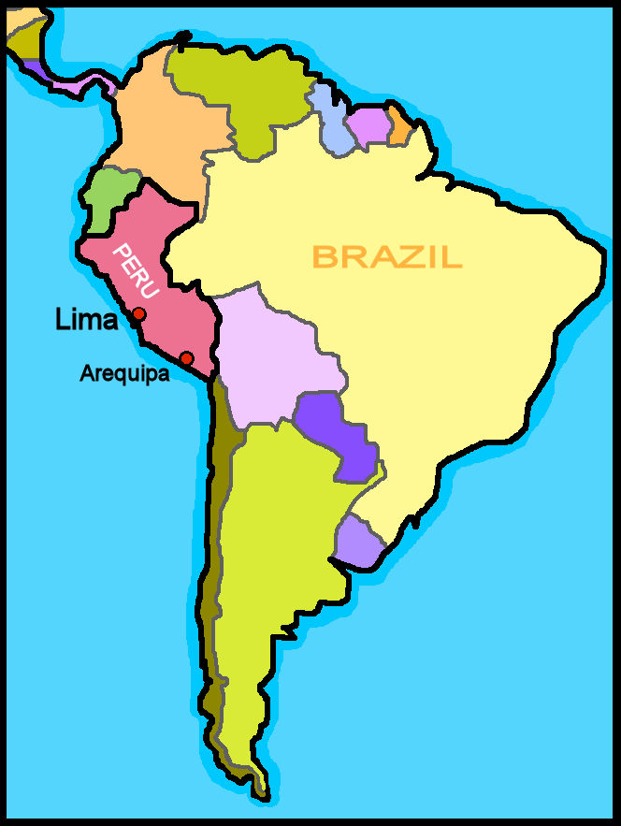
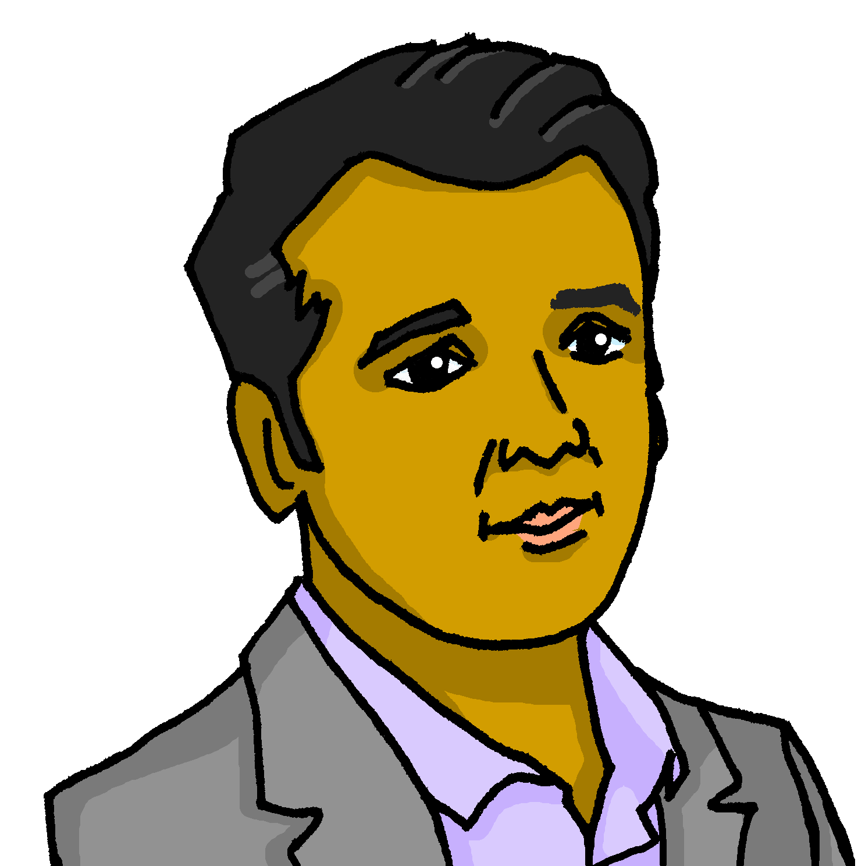
Describing me and others
verde
Follow ups 1-5
Notes:
Artwork by Steve Clarke. All additional pictures selected are available under a Creative Commons license, no attribution required.
The frequency rankings for words that occur in this PowerPoint which have been previously introduced in the resources are given in the SOW (excel document) and in the resources that first introduced and formally re-visited those words.
Phonics: decir [32] centro [317] cerca [1042] celebrar [886] dulce [1861] cero [1731] cocina [1214]
Vocabulary: tienen [8] histórico [830] enorme [631] solo [181] re-use nouns: calle [269] cine [952] escuela [424] hotel [1163] iglesia [437] piscina [4604] plaza [806] puente [1715] universidad [387] plus previous: museo [1114] parque [1354] re-use known nouns (see above) de12 and regular adjectives
Revisit 1: hay [13] cuántos/cuántas [580] bolígrafo [>5000] camiseta [4130] cuaderno [3301] deporte [1489] mochila [>5000] capaz [645] difícil [374] esencial [1872] fácil [584] útil [3951] Recycle nouns and adjectives from previous years: amarillo [1381] divertido[2465] fuerte [435] lento [1569] pequeño [202]
Revisit 2: hay [13] cuántos/cuántas [580] bolígrafo [>5000] camiseta [4130] cuaderno [3301] deporte [1489] mochila [>5000] capaz [645] difícil [374] esencial [1872] fácil [584] útil [3951] Recycle nouns and adjectives from previous years: amarillo [1381] divertido[2465] fuerte [435] lento [1569] pequeño [202]
For any other words that occur incidentally in this PowerPoint, frequency rankings will be provided in the notes field wherever possible.
Glossed:
mirar [125] edificio [857]
Source: Davies, M. & Davies, K. (2018). A frequency dictionary of Spanish: Core vocabulary for learners (2nd ed.). Routledge: London

Slide 2
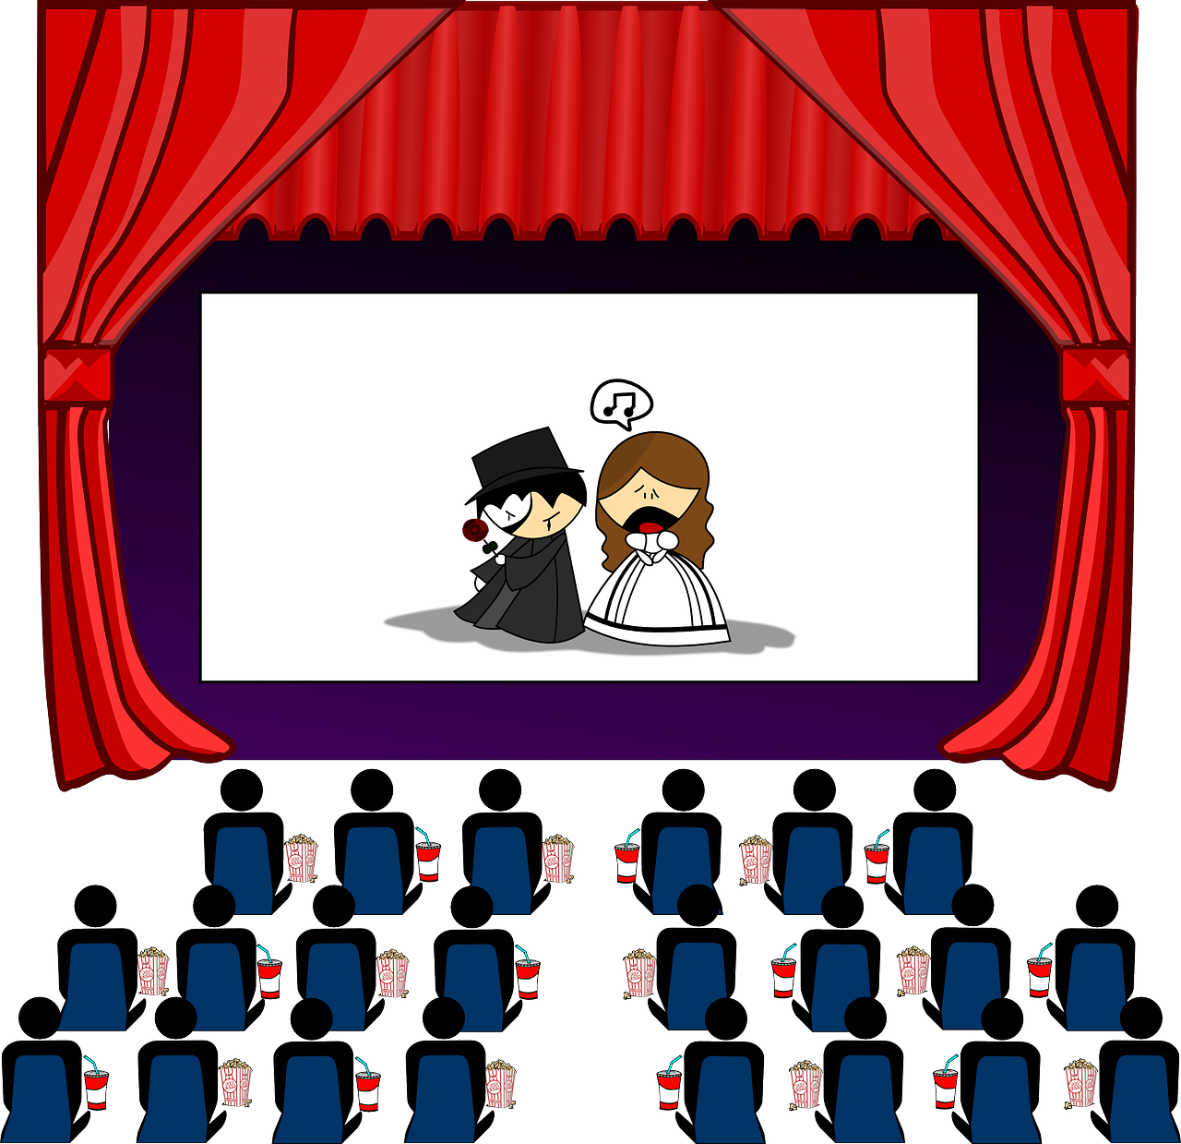
Follow up 1:
[ce]
[ci]
En la escuela… ¿Quién tiene qué?
escuchar
 | ¿Quién? ¿Quiénes? |  | tiene tienen |  | ?
 | Cintia Cintia y Celina |  | tienen |  | césped
 | Cecilio y Cisco Cisco |  | tienen |  | un cine
 | Cirilo y Celeste Cirilo |  | tiene |  | una pecera
 | Cecilia y César César |  | tienen |  | una oficina
 | Cedric y Celia Celia |  | tiene |  | un cerezo
hablar
1
………
………
2
………
………
3
………
………
4
………
………
5
………
………
Notes:
Timing: 5 minutes
Aim: to apply knowledge of the SSC [ce] and [ci] to the transcription of some known and unfamiliar words, and to their oral production.
Procedure:
Teacher explains the scenario. Pupils have been talking about very unusual things they have at home.
Click to listen. First pupils need to identify whether the sentence refers to one or more people. They write the name or names.
They then write the corresponding form of ‘has/have’.
Click to listen again and pupils transcribe the item.
Elicit answers orally from pupils.
Click to reveal written answers and pictures.
Pupil A practises pronouncing sentence 1. Partner B translates into English.
Transcript: Cintia y Celina tienen césped. Cecilio y Cisco tienen un cine. Cirilo tiene una pecera.
Cecilia y César tienen una oficina. Celia tiene un cerezo.
Frequency of unknown words and cognates: césped [>5000] cine [952] pecera [>5000] oficina [1072] cerezo [>5000] Source: Davies, M. & Davies, K. (2018). A frequency dictionary of Spanish: Core vocabulary for learners (2nd ed.). Routledge: London

Slide 3
Hay (there is, there are) | tiene (s/he, it has)
Remember! Hay means there is or there are and tiene means s/he it has.
To say what there is in the class say:
To say what the class has, say:
hay
tiene
En la clase __________ una ventana.
La clase ___________ una ventana.
In the class there is a window.
The class has a window.
⚠ The meaning of these sentences is essentially the same. What is different about how they start?
Notes:
Use before Follow up 2.
Timing: 2 minutes
Aim: to revisit the meaning of hay and tiene and to present a useful contrast to practise in the next activity.
Procedure:
Click to present the information in stages.
Elicit English translations for the Spanish examples provided.

Slide 4
Follow up 2:
Luis manda mensajes a Quique.
Describe la ciudad pero hay un problema con el teléfono.
¿La frase comienza ‘La ciudad…’ o ‘En la ciudad?
leer
1
2
comienza = starts (el) edificio = building
La ciudad tiene una piscina divertida.
En la ciudad hay una plaza histórica.


📧
3
4

En la ciudad hay unas montañas grandes.
La ciudad tiene edificios blancos.

5
6
7
La ciudad tiene unas iglesias históricas.
En la ciudad hay una universidad importante.



En la ciudad hay unos museos interesantes.
Notes:
Timing: 3 minutes
Aim: to use knowledge of tiene and hay to determine how each sentence must begin.
Procedure:
Read the scenario with pupils. They should understand that Luis is sending messages to Quique describing his town, Arequipa, but that there is a glitch with the phone. They need to work out how each sentence starts ‘En la ciudad’ or ‘La ciudad’.
Do the first one with pupils. They work it out by looking at the verb ‘tiene’, understanding that it means ‘has’ and conclude that the sentence must begin ‘la ciudad’ for ‘the city has…’.
Pupils write 2-8 and complete the tasks. Alternatively pupils could discuss in pairs and then feed back their answers orally.
Click to correct.
Note: Follow up 3 provides an opportunity to practise comprehension of the full sentences and revisit the vocabulary meanings.
edificio [857]

Slide 5
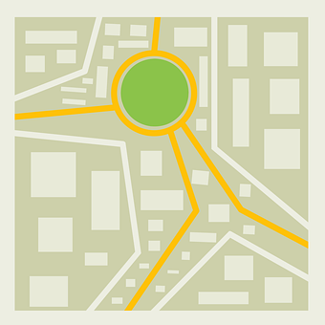
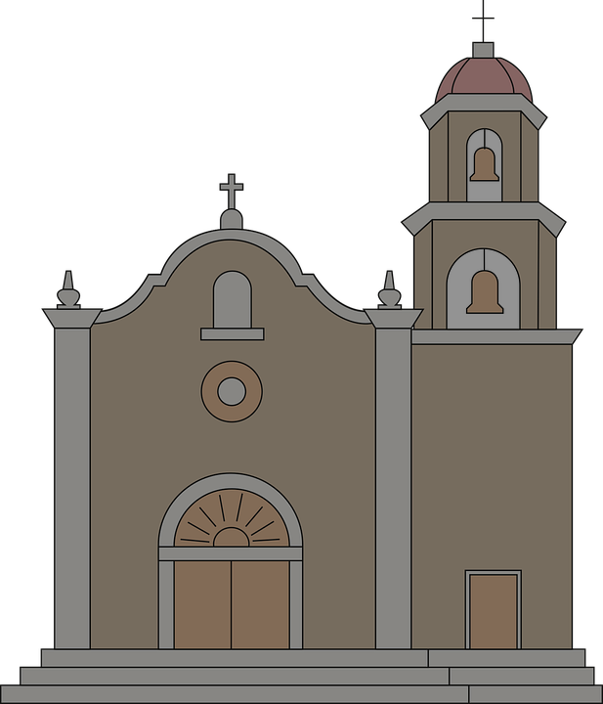
Follow up 3:
Escribe las frases en negativo.
Luis manda un mapa de Arequipa a Quique.
mira = look
Mira el mapa y la frase. ¿Es verdad o mentira?
leer
M
1
La ciudad tiene una piscina divertida.
La ciudad no tiene una piscina divertida.
V
2
En la ciudad hay una plaza histórica.
3
En la ciudad hay unas montañas grandes.
V
V
4
La ciudad tiene edificios blancos.
5
V
La ciudad tiene unas iglesias históricas.
M
6
En la ciudad hay una universidad importante.
En la ciudad no hay una universidad importante.
Arequipa is known as the White City because of its architecture, built with white volcanic stone, called sillar.
Notes:
Timing: 5 minutes
Aim: to use vocabulary knowledge to identify which sentences are true/false; to use knowledge of negation with ‘no’ to re-write the false sentences.
Procedure:
Read the scenario with pupils. They should understand that Quique has sent a photo of his classroom to go with his whatsapp messages describing it. But not every one is true.
Pupils look at the photo and read the sentence, deciding if they are true (V) or false (M).
Click to correct. (In the audio version, audio is attached to the numbered buttons, if teachers want to use this to correct.
For the false (M) sentences, pupils should re-work the sentences (either writing on mini whiteboards or speaking) in the negative.
Click to reveal the correct negative sentences.
mirar [125]

Slide 6
Follow up 4:
Quique chatea con Luis sobre Arequipa.
- Luis, ¿cómo [is] tu ciudad? ¿Qué [does it have]?
- Tiene muchas [things].
- ¿[How many] parques hay?
- [There is] solo [one park] pero es [quite] grande. [Also] tiene unos puentes [important].
- ¿Cómo [are they]?
Son [historical] y [pretty] .
- ¿Qué más hay?
- [In] Arequipa hay también [a university] pero es [a bit] [old].
- [Are you] en casa ahora?
- Sí, y estoy muy [pleased] hoy.
es
tiene
escribir
cosas.
Cuántos
Hay
un parque
bastante
leer
una universidad
También
importantes.
hay
cuántos
son
es
bastante
históricos
bonitos
cosas
también
en
importantes
un parque
En
una universidad
contento
un poco
vieja
un poco
son
¿Estás
históricos
tiene
bonitos
contento
estás
vieja
Notes:
Timing: 10 minutes
Aim: to practise written production of known vocabulary and structures from this and the revisited weeks.
Procedure:
Pupils can number 1 – 17 rather than copy out the whole dialogue.
First, they spend 5 minutes trying to write any of the missing Spanish words that they know. Note: reassure pupils that it is always important to try written recall from memory first, but that in stage 2 there will be some prompts.
After five* minutes, click to reveal the jumbled answers. Pupils spend another 3 minutes trying to complete the missing translations, using the prompts.
Click to reveal the answers. There is also an audio recording of the full dialogue to listen to. Note: Click on Quique to hear the full audio.
If time allows, elicit English meanings for each sentence from the whole class, orally.
*Teachers will judge for themselves when to bring up the reading prompts. It may be much sooner, depending on the vocabulary knowledge of the class.

Slide 7
Follow up 5a:
Escribe en español: Can you get at least 15 points?
 | s/he, it is (trait) | quiet,calm (m) | too (much)
 | slow (f) | pleased (m) | today
t | (the) t-shirt | able | useful
 | there is / are | (the) sport | (the) school bag
 | (the) square | (the) bridge | (the) school
 | only | (the) street | (the) church
 | they have | historical (m) | enormous
vocabulario
es
tranquilo
demasiado
x3
lenta
contento
hoy
la camiseta
capaz
útil
x2
hay
el deporte
la mochila
la plaza
el puente
la escuela
solo
la calle
la iglesia
x1
tienen
histórico
enorme
Notes:
Timing: 6 minutes
Aim: to practise written production of vocabulary for this week and previous weeks.
Procedure:
1. Pupils need to write the Spanish for as many words as possible, aiming to get at least 15 points (but more if possible).
2. Click for Spanish answers.

Slide 8
Handout Follow up 5a:
Follow up 5a:
Escribe en inglés: Can you get at least 15 points?
 | s/he, it is (trait) | quiet,calm (m) | too (much)
 | slow (f) | pleased (m) | today
 | (the) t-shirt | able | useful
 | there is / are | (the) sport | (the)school bag
 | (the) square | (the) bridge | (the) school
 | only | (the) street | (the) church
 | they have | historical (m) | enormous
vocabulario
x3
x2
x1
Notes:
Timing: 6 minutes
Aim: to practise written production of vocabulary for this week and previous weeks.
Procedure:
1. Pupils need to write the Spanish for as many words as possible, aiming to get at least 15 points (but more if possible).
2. Click for Spanish answers.

