Slide 1
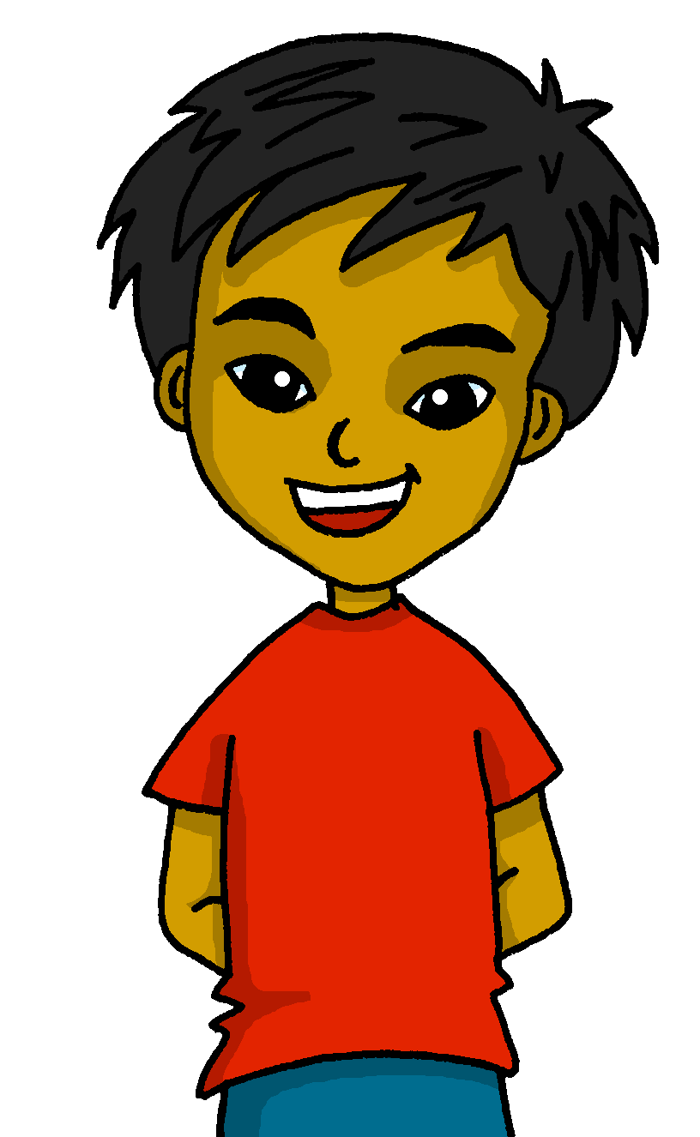
español, con Quique

Slide 2
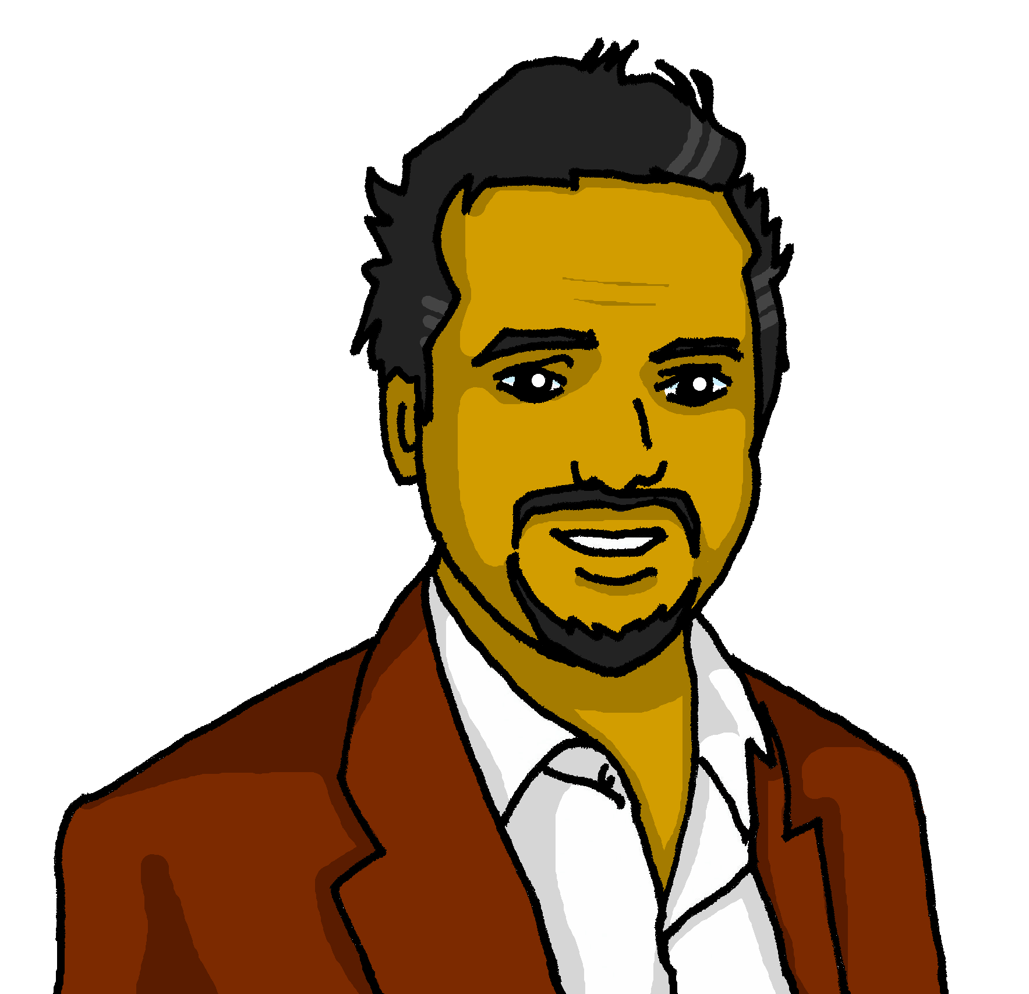
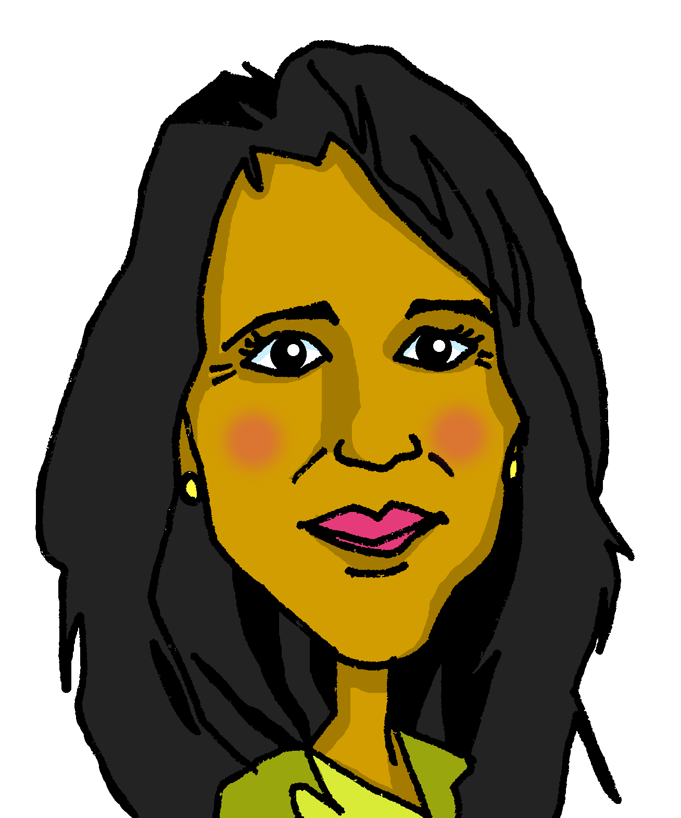
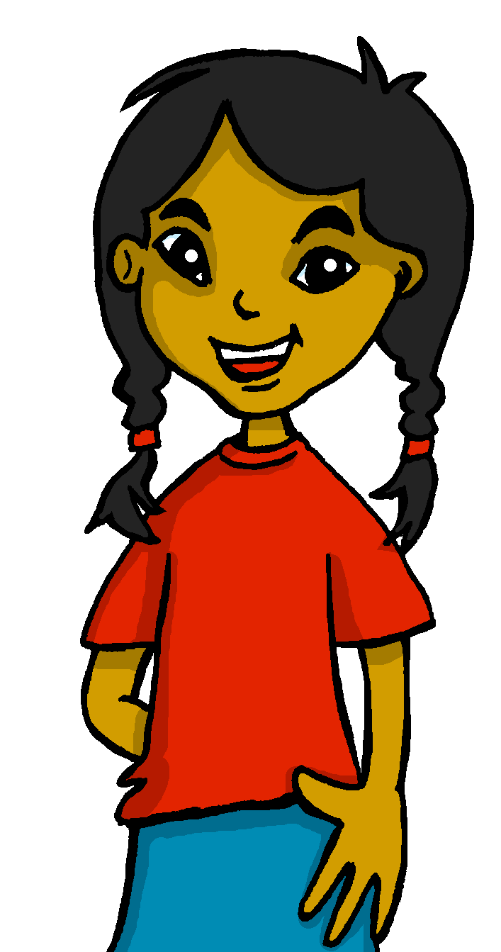
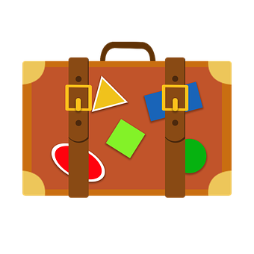
Saying what I and others want to do
2-verb structure: querer SSC repaso 2
azul
De viaje por España
NB: Audio to be added to this week’s lessons.
Notes:
Artwork by Steve Clarke. All additional pictures selected are available under a Creative Commons license, no attribution required.
The frequency rankings for words that occur in this PowerPoint which have been previously introduced in the resources are given in the SOW (excel document) and in the resources that first introduced and formally re-visited those words.
Phonics: SSC revisión 1
Vocabulary (new words in bold): querer, quiero, quieres, quiere [58] avión [1399] probar [959] aburrido [3917]
Revisit 1: aeropuerto [2492] bandera [2446] puerto [1077] río [496]
Revisit 2: ir [33] voy vas va estar [21] estoy estás está cine [952] costa [896] mercado [487] teatro [605]
Source: Davies, M. & Davies, K. (2018). A frequency dictionary of Spanish: Core vocabulary for learners (2nd ed.). Routledge: London
For any other words that occur incidentally in this PowerPoint, frequency rankings will be provided in the notes field wherever possible.
cueva [4480] isla [810] nombre [215] salsa [4201] volcán [2454] aburrido [3917]

Slide 3
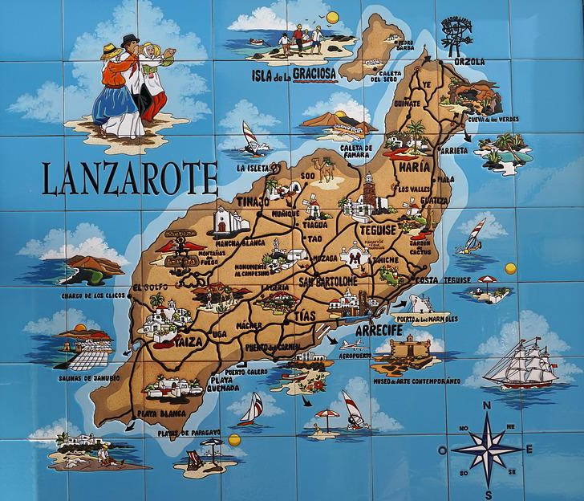
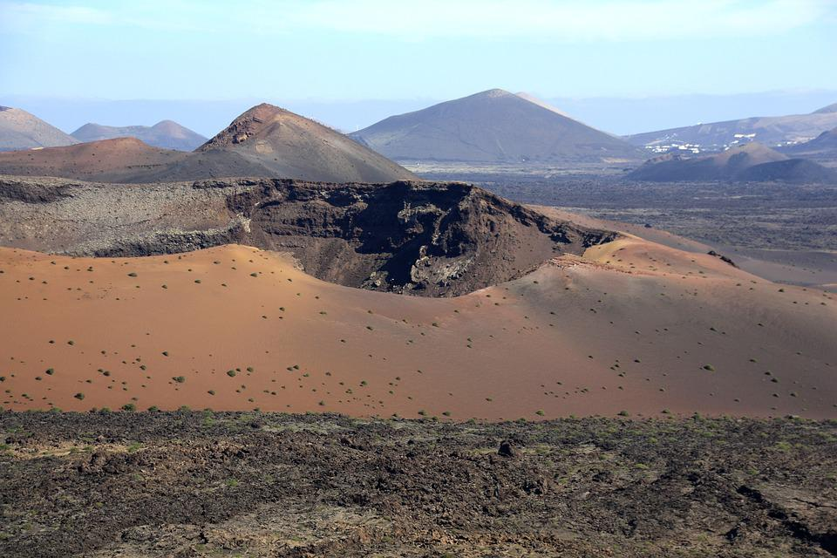
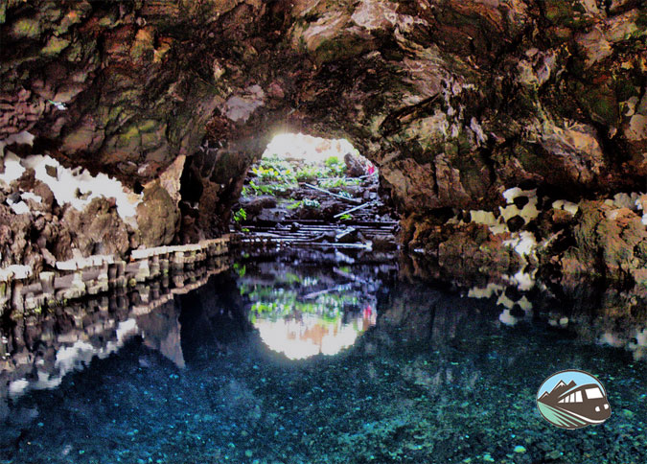
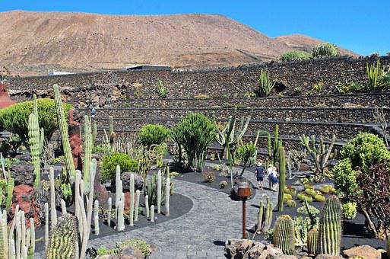
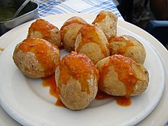
Lee la Información con tu compañero/a.
SSC Repaso
Lanzarote es una isla de las Islas Canarias, al oeste de África. Es famosa por la cueva de Jameos del Agua, su jardín de cactus y el volcán. Es típico comer ‘papas arrugadas’ con mojo picón, una salsa.
pronunciar
(la) isla – island
(la) cueva – cave
(el) volcán - volcano
(la) salsa - sauce
con mojo Picón
el volcán
Jameos del Agua
el jardín de cactus
Papas arrugadas
Notes:
Timing: 4 minutes
Aim: to learn about Lanzarote and whilst practising a range of SSCs.
Procedure:
Allow pupils to read the text aloud.
Read the text aloud, so pupils can follow. (Click on the text to hear the audio, if preferred).
Elicit pupils’ understanding.
Frequency of unknown words and cognates:
cueva [4480] isla [810] salsa [4201] volcán [2454]
De Fer.. - flickr, CC BY 2.0, https://commons.wikimedia.org/w/index.php?curid=1662044
https://www.rutasporespana.es/blog/2014/06/las-10-cuevas-mas-bonitas-de-espana/
Many thanks to José, Adrián and Alicia.

Slide 4
vocabulario
¿Qué palabra es?
(el) nombre – noun, name
verano
nadar
agua
comprar
fruta
vender
tirar
tomates
España
viaje
aeropuerto
cielo
comer
paella
churros
playa
mercado
festival
avión
probar
¿Cuántos nombres hay en total?
¿Cuántos verbos hay en total?
seis
catorce
Hay ________ verbos en total.
Hay _________ nombres en total.
to swim
summer
to sell
trip
to try
to throw
to eat
plane
sky
avión festival playa
mercado probar
to buy
Notes:
Timing: 5 minutes
Aim: to recap previously introduced vocabulary as well as introduce context-specific words.
Procedure:
Part 1
Read the instruction in Spanish. Check understanding of ‘palabra’.
Tell pupils they need to figure out which word is being described. They have the possible options at the bottom. Por ejemplo, verano, nadar, agua. Is it ‘festival’, ‘playa’ or ‘mercado’?
Pupils work in pairs to read the words for each “card” (box) and work out the word being described.
5. Elicit answers from pupils and click on each box to reveal the answer.
Part 2:
Click to bring up all the ‘cards’ (boxes) back again.
Click to bring up the first English word (to buy) and elicit the Spanish word from pupils (comprar). Click to bring up the tick next to ‘vender’. Repeat x9.
Part 3
Click to bring up the first question about parts of speech.
Elicit answer from pupils.
nombre [215]

Slide 5
Saying what you want to do
[querer: to want, wanting]
In Spanish, the verb ‘querer’ is followed by the infinitive verb.
‘Querer’ does not follow the general rules.
‘quer’ changes to ‘quier’
Quiero nadar en el mar.
As usual, the verb endings change to match the person of the verb.
I want to swim in the sea.
Quieres ir a la playa.
Quiere ir a la montaña.
You want to go to the beach.
S/he wants to go to the beach.
☺ Same endings as for all –er verbs
Notes:
Timing: 3 minutes
Aim: to introduce querer (2-verb structure) in 1st , 2nd and 3rd person singular.
Procedure:
Click through the animations to present the information.
Elicit English translations for the Spanish examples provided.

Slide 6
escuchar y escribir
[1/6]
Escucha y escribe.
Escucha y escribe.
Quiero
E. _________ aprender sobre la cultura.
I
you
s/he
3
a
b
c
to learn
to try (out)
to be
2
1
¿Qué es en inglés?
¡escribe!
I want to learn about the culture.
Notes:
Timing: 8 minutes (6 slides)
Aim: to practise listening out for the verbs ‘quiero’, ‘quieres’ and ‘quiere’ and process the person of the verb they refer to. To then practise processing the meaning of both the newly introduced and revisited vocabulary
Slide 1/6
Procedure:
Read the instructions in Spanish. The following instructions apply to the next 5 slides.
Tell students this is a delayed dictation activity. You will play a sentence twice and they will have to retain that sentence in their working memory (picturing it in their heads!) for 3 seconds.
(NB. They can choose to use the help on the board or without looking – encourage students to choose their own level of challenge).
Click to start timer once you’ve played / read the sentence x2. Once the time is up, the instruction ‘escribe’ will come up and they need to write the whole sentence (or just the verb if they are facing the board for more support)
4. Click to reveal the missing verb. Pupils who were facing away turn back to check their answers.
5. Click again to bring up the different prompts and elicit answers from pupils.
Full transcript:
E. Quiero aprender sobre la cultura.
1. Quiere ir a un festival.
2. Quiere hablar con la gente.
3. Quieres probar la comida.
4. Quiere bailar Flamenco.
5. Quiero comer muchas tapas.

Slide 7
escuchar y escribir
[2/6]
Escucha y escribe.
Quiere
1. _________ ir a un festival.
I
you
s/he
3
a
b
c
to be
to go
to visit
2
1
¿Qué es en inglés?
¡escribe!
S/he wants to go to a festival.
Notes:
Slide 2/6
Transcript:
1. Quiere ir a un festival.

Slide 8
escuchar y escribir
[3/6]
Escucha y escribe.
Quiere
2. _________ hablar con la gente.
I
you
s/he
3
a
b
c
to listen
to swim
to talk
2
1
¿Qué es en inglés?
¡escribe!
S/he wants to talk to people.
Notes:
[3/6]
Transcript:
2. Quiere hablar con la gente.

Slide 9
escuchar y escribir
[4/6]
Escucha y escribe.
Quieres
3. _________ probar la comida.
I
you
s/he
3
a
b
c
to eat
to try (out)
to buy
2
1
¿Qué es en inglés?
¡escribe!
You want to try the food.
Notes:
[4/6]
Full transcript:
3. Quieres probar la comida.

Slide 10
escuchar y escribir
[5/6]
El flamenco es un baile típico* de Andalucía, en el sur de España.
Escucha y escribe.
Quiere
4. _________ bailar Flamenco.
típico - typical
I
you
s/he
3
a
b
c
to dance
to sing
to listen
2
1
¿Qué es en inglés?
¡escribe!
S/he wants to dance flamenco.
Notes:
[5/6]
Transcript:
4. Quiere bailar Flamenco.

Slide 11
escuchar y escribir
[6/6]
Las tapas son platos pequeños.
Escucha y escribe.
Quiero
5. _________ comer muchas tapas.
I
you
s/he
3
a
to eat
c
to see
to try (out)
b
2
1
¿Qué es en inglés?
¡escribe!
I want to eat many tapas.
Notes:
[6/6]
Transcript:
5. Quiero comer muchas tapas.

Slide 12
leer
El viaje a Lanzarote. Quique habla con Sofía sobre el viaje con mamá.
Lee las frases. ¿Quién quiere qué?
 | Quieres comer churros.
 | Quiero ver el volcán.
 | Quiere ir a la playa.
 | Quiere descansar en la cama.
 | Quieres visitar una cueva importante: Jameos del Agua.
 | Quieres ver un jardín de cactus.
 | Quieres ir al pueblo de Punta Mujeres.
 | Quiero comprar Mojo Picón.
Escribe el número y el verbo en inglés.
E
(la) cueva – cave
(el) volcán - volcano
1
2
3
Sofía [I] | Quique [you] | Mamá Elena [she]
4
1
E
to eat
2
to see
to go
4
to visit
3
to rest
5
7
to buy
5
to see
6
6
to go
7
Notes:
Timing: 7 minutes
Aim: reading to differentiate between 1st, 2nd and 3rd person singulaof querer; written comprehension of key vocabulary introduced this week.
Procedure:
Read the context and click to bring up instructions.
Read the first sentence. Ask pupils to identify de if it’s Quique (I), Sofía (you) or mum (she) and write the correct verb in English.
Continue with items 1 – 7.

Slide 13
leer
Lee las frases. ¿Qué opinas?
¡Reacciona! 😃😟
Quiero…
hablar
… comer churros.
… ver el volcán.
… ir a la playa.
… descansar en la cama.
… visitar una cueva importante: Jameos del Agua.
… ver un jardín de cactus.
… ir al pueblo de Punta Mujeres.
… comprar Mojo Picón.
(la) cueva – cave
(el) volcán - volcano
Quiero ver el volcán.
B
¡Es bonito!
A
😃 bonito | fantástico | divertido |importante | diferente
😟 tranquilo | terrible | aburrido*
Notes:
Timing: 3 minutes
Aim: to practise reading comprehension of both newly introduced and revisited vocabulary & apply logic to the statements.
Procedure:
Click x2 to bring up speech bubbles and model the conversation.
Pupil take turns to read statements 1-6 and react to them according to their own opinion.
cueva [4480] volcán [2454] aburrido [3917]

Slide 14
¡adiós!
azul

