Slide 1
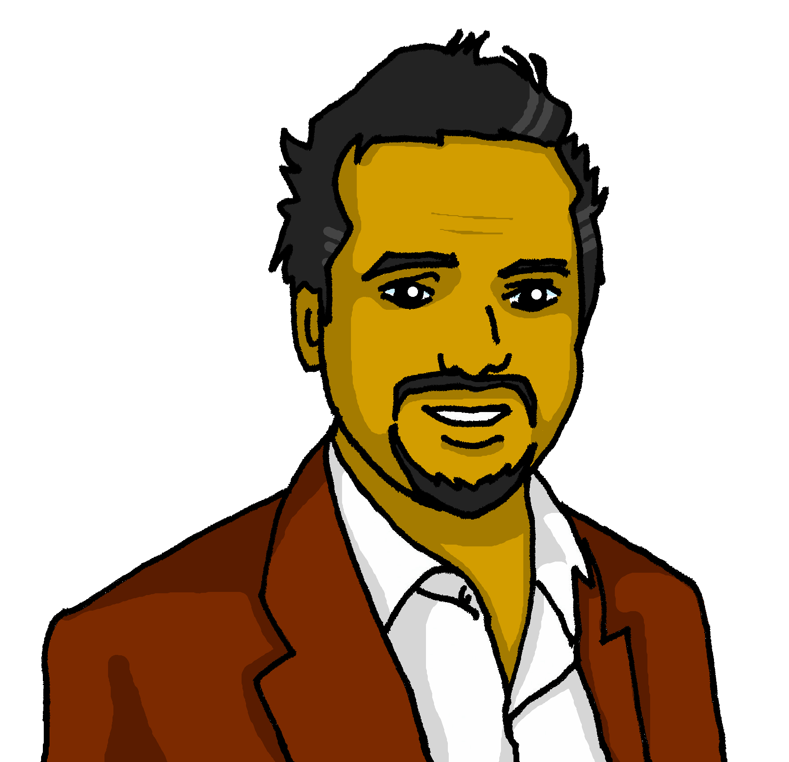
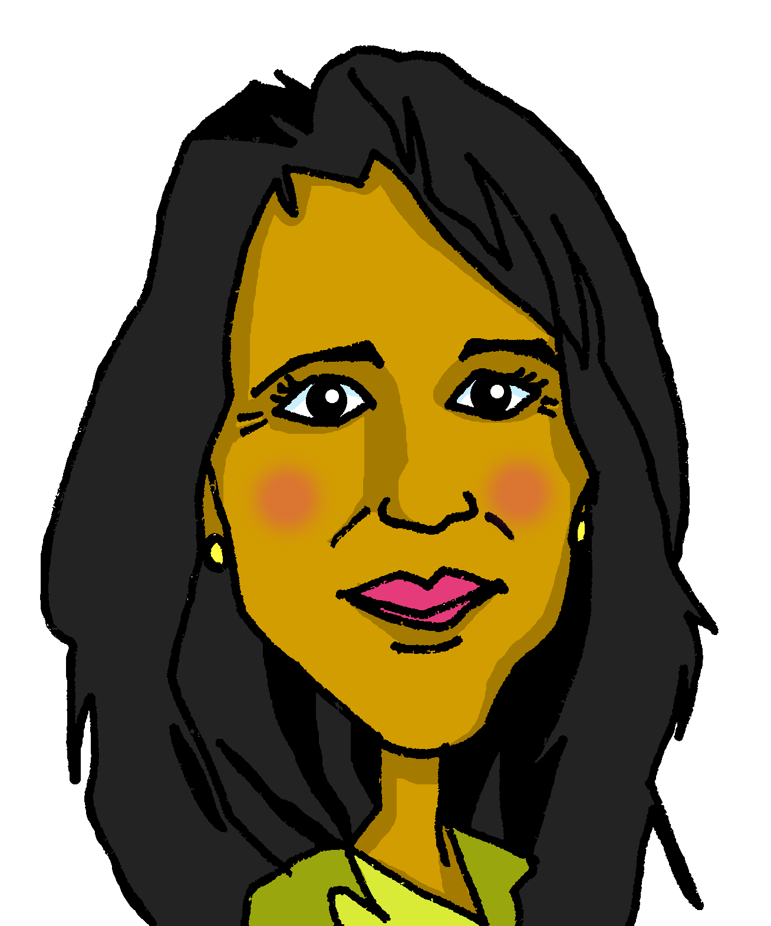
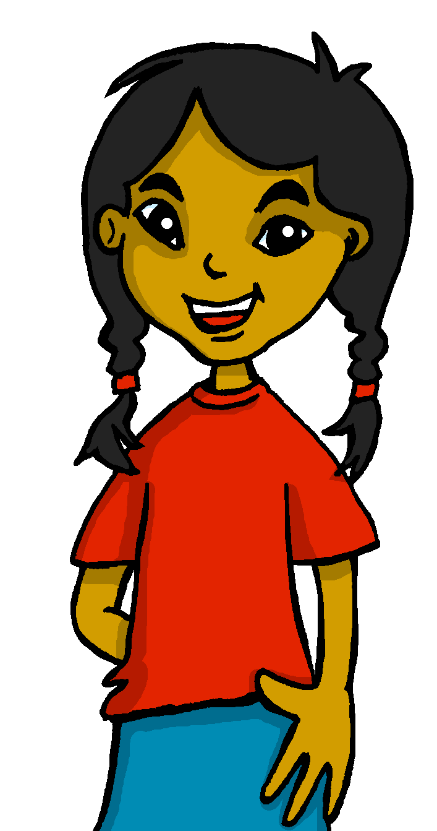
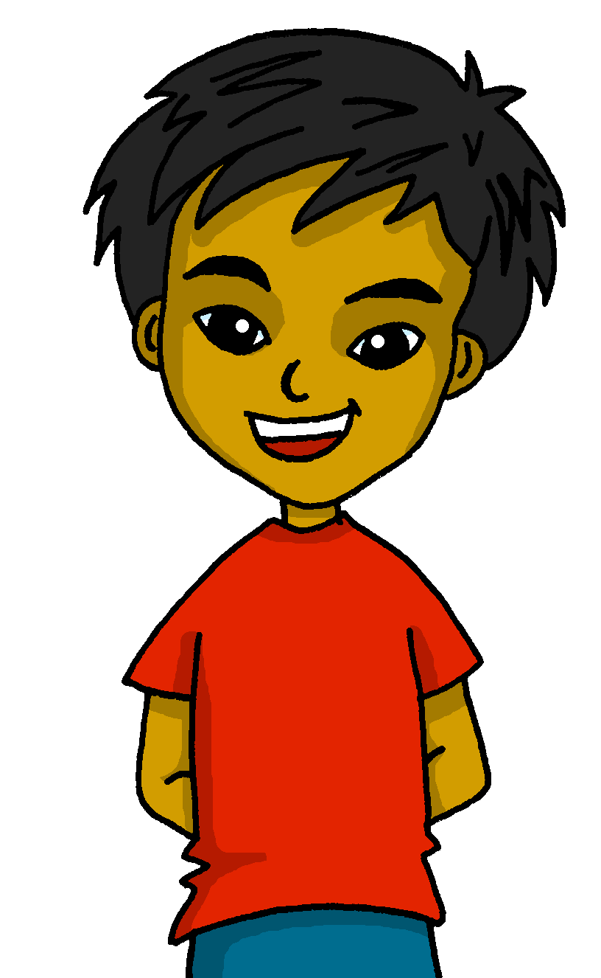
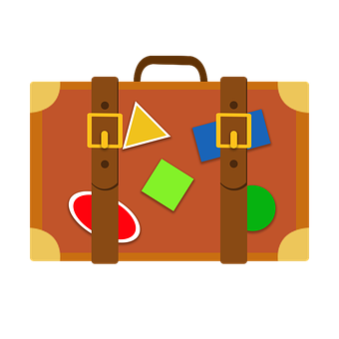
Saying what I and others want to do
azul
De viaje por España
Follow ups 1-5
Notes:
Artwork by Steve Clarke. All additional pictures selected are available under a Creative Commons license, no attribution required.
The frequency rankings for words that occur in this PowerPoint which have been previously introduced in the resources are given in the SOW (excel document) and in the resources that first introduced and formally re-visited those words.
Phonics: SSC revisited
Vocabulary (new words in bold): querer, quiero, quieres, quiere [58] avión [1399] probar [959] aburrido [3917]
Revisit 1: aeropuerto [2492] bandera [2446] puerto [1077] río [496]
Revisit 2: ir [33] voy vas va estar [21] estoy estás está cine [952] costa [896] mercado [487] teatro [605]
Source: Davies, M. & Davies, K. (2018). A frequency dictionary of Spanish: Core vocabulary for learners (2nd ed.). Routledge: London
For any other words that occur incidentally in this PowerPoint, frequency rankings will be provided in the notes field wherever possible.
cada [107]

Slide 2
Follow up 1:
SSC Repaso
Practica el trabalenguas.
pronunciar
Pablito clavó un clavito
¿Qué clavito clavó Pablito?
El clavo quedó clavado
¡Claro! Lo clavó Pablito
60
(Pablito nailed a tiny nail)
(What tiny nail did Pablito nail?)
(The nail stayed nailed)
0
(Of course! Pablito nailed the tiny nail)
INICIO
Notes:
Timing: 5 minutes
Aim: to revisit several SSCs and develop phonological confidence
Procedure: 1. Pupils read the texts aloud in pairs
2. Click on the play button to listen to each line
3. Move to next slide to play the video and encourage pupils to join,

Slide 3
Follow up 1:
SSC Repaso
Escucha y practica.
pronunciar
Notes:
Timing: 5 minutes
Aim: to revisit several SSCs and develop phonological confidence
Procedure: 1. Pupils read the texts aloud in pairs
2. Click on the play button to listen to each line
https://www.youtube.com/watch?v=7p4AxvnYDbA&ab_channel=123Andr%C3%A9s

Slide 4
Follow up 2
Escribe nueve palabras en inglés.
¡Bingo!
¿Tienes 3? Responde ‘línea’
palabras
¿Tienes 9? Responde ‘bingo’
quiero | quiere
quieres | aburrido
el avión | probar
el verano | la gente
descansar | el viaje
la ciudad | ir
línea
bingo
Notes:
Timing: 5 minutes
Aim: to practise written comprehension of this week’s new language.
Procedure: 1. Pupils choose any 9 of the words from the Spanish table and write them into their grid in English..
2. Teacher then calls out the Spanish for any of the 16 words in the table in whichever order.
3. Pupils call ‘línea’ when they have any three in a row (vertical, horizontal, or diagonal) and then ‘bingo’ again for the first full house.

Slide 5
Follow up 3:
Adjectives following the noun
We have learned that many adjectives follow the noun:
noun
adjective
Quiero ir a una playa bonita.
adjective
noun
I want to go to a beautiful beach.
They also agree (match) in gender (masculine or feminine)and number (singular or plural) with the noun they are describing.
Quiero comer comida rápida.
When we describe more than one person or animal, we add an ‘s’ after‘o’, ‘a’ and ‘e’.
Quiero ver montañas bonitas.
I want to see beautiful mountains.
I want to eat fastfood.
Quiero visitar un teatro bonito.
Quiero ir a mercados bonitos.
I want to visit a beautiful theatre.
I want to go to beautiful markets.
Notes:
Timing: 6-8 minutes (grammar reminder + translation practice, 6 slides).
Aim: to revisit post-nominal adjective agreement.
Procedure:
Read the grammar explanation on post-nominal adjective agreement.
Elicit English translations for the Spanish examples provided.

Slide 6
Follow up 3:
[1/5]
Traduce la frase al español.
leer
hablar
Quiero visitar un teatro importante.
30
I want to visit an important theatre.
visitar
importante
importantes
un teatro
quiero
quiere
0
⚠ You do not need all of the words!
INICIO
Notes:
Time: 6-8 minutes (5 slides)
Aim: to practise guided oral sentence building. Targeted features: postnominal regular gender agreement | revisit quiero | quiere | quieres Procedure:
1. Click for English sentence and Spanish prompt words. 2. Click inicio to start the timer.
3. Pupils select from the words given to create and say the sentence out loud before the time elapses. 4. Click for the Spanish sentence to appear.

Slide 7
Follow up 3:
[2/5]
Traduce la frase al español.
leer
hablar
Quieres ver una película aburrida.
30
You want to watch a boring film.
leer
aburridas
aburrida
aburrido
ver
quiero
quieres
una película
0
⚠ You do not need all of the words!
INICIO
Notes:
Time: 6-8 minutes (5 slides)
Aim: to practise oral sentence building. Targeted features: postnominal regular gender agreement | revisit quiero | quiere | quieres Procedure:
1. Click for English sentence and Spanish prompt words. 2. Click inicio to start the timer.
3. Pupils select from the words given to create and say the sentence out loud before the time elapses. 4. Click for the Spanish sentence to appear.

Slide 8
Follow up 3:
[3/5]
Traduce la frase al español.
leer
hablar
Quiero leer libros divertidos.
30
I want to read fun books.
pasar
quiero
libros
divertidas
leer
divertido
divertidos
quiere
0
⚠ You do not need all of the words!
INICIO
Notes:
Time: 6-8 minutes (5 slides)
Aim: to practise oral sentence building. Targeted features: postnominal regular gender agreement | revisit quiero | quiere | quieres Procedure:
1. Click for English sentence and Spanish prompt words. 2. Click inicio to start the timer.
3. Pupils select from the words given to create and say the sentence out loud before the time elapses. 4. Click for the Spanish sentence to appear.

Slide 9
Follow up 3:
[4/5]
Traduce la frase al español.
leer
hablar
Quiero probar tapas pequeñas.
30
I want to try small tapas.
practicar
quiero
tapas
pequeñas
probar
pequeña
querer
quiere
0
⚠ You do not need all of the words!
INICIO
Notes:
Time: 6-8 minutes (5 slides)
Aim: to practise oral sentence building. Targeted features: postnominal regular gender agreement | revisit quiero | quiere | quieres Procedure:
1. Click for English sentence and Spanish prompt words. 2. Click inicio to start the timer.
3. Pupils select from the words given to create and say the sentence out loud before the time elapses. 4. Click for the Spanish sentence to appear.

Slide 10
Follow up 3:
[5/5]
Traduce la frase al español.
leer
hablar
Quieres ir a ciudades tranquilas.
30
You want to go to quiet cities.
practicar
tranquila
ciudades
quiere
probar
quieres
tranquilas
tranquilos
0
⚠ You do not need all of the words!
INICIO
Notes:
Time: 6-8 minutes (5 slides)
Aim: to practise oral sentence building. Targeted features: postnominal regular gender agreement | revisit quiero | quiere | quieres Procedure:
1. Click for English sentence and Spanish prompt words. 2. Click inicio to start the timer.
3. Pupils select from the words given to create and say the sentence out loud before the time elapses. 4. Click for the Spanish sentence to appear.

Slide 11
Follow up 4:
Saying what you want to do
[querer: to want, wanting]
In Spanish, the verb ‘querer’ is followed by the infinitive verb.
‘Querer’ does not follow the general rules.
‘quer changes to ‘quier’
Quiero nadar en el mar.
As usual, the verb endings change to match the person of the verb.
I want to swim in the sea.
Quieres ir a la playa.
Quiere ir a la montaña.
You want to go to the beach.
S/he wants to go to the beach.
☺ Same endings as for all –er verbs
Notes:
Timing: 5 minutes (grammar reminder + translation practice, 6 slides).
Aim: to revisit post-nominal adjective agreement.
Procedure:
Read the grammar explanation on post-nominal adjective agreement.
Elicit English translations for the Spanish examples provided.

Slide 12
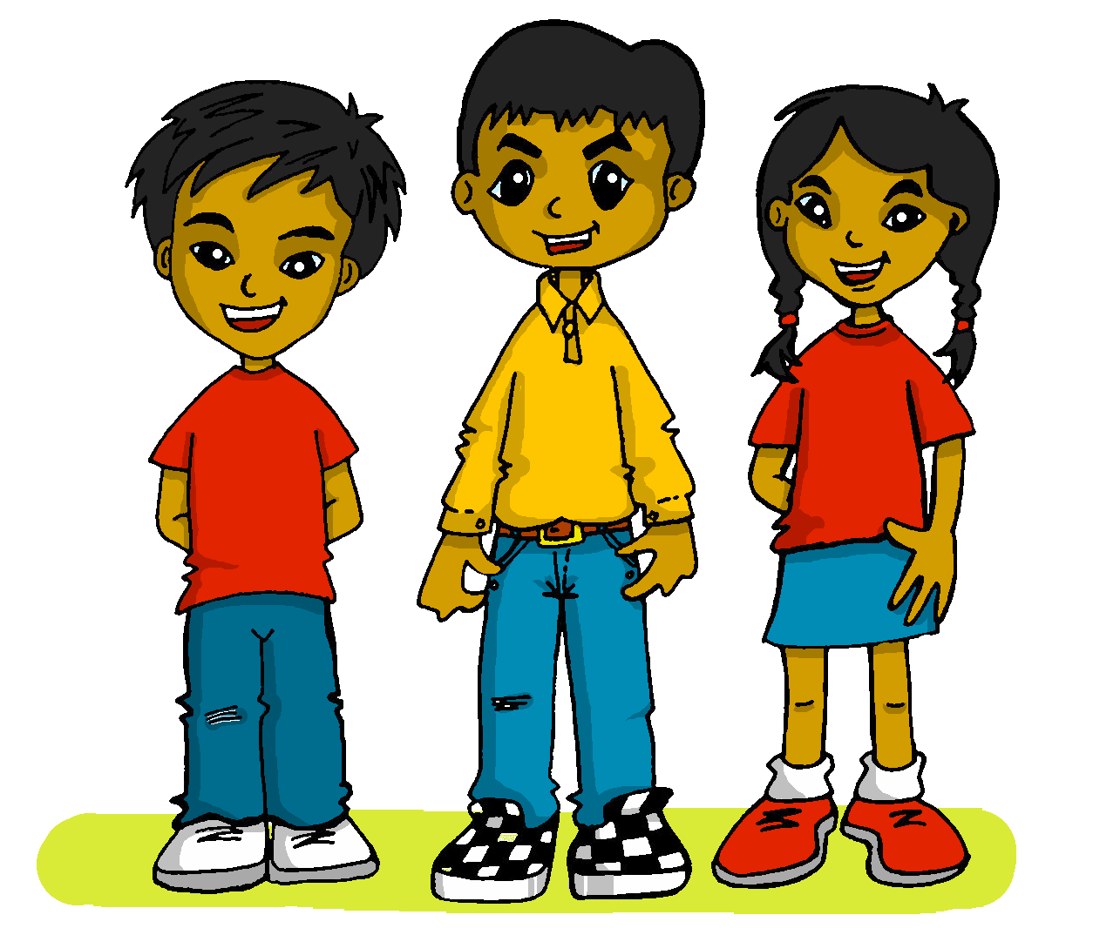
Follow up 4:
Quique planea el viaje de Luis.
¿Qué quiere hacer cada uno?
I want
You want
S/he wants
Escribe 6 frases.
escribir
[I]
[Luis = he]
to go to a big mountain
to relax in a comfortable bed
to talk to nice people
to visit a quiet village
to learn a fun dance, Flamenco
to see an elegant parade
[You]
to practise a different sport
to go to an important festival
to try a big paella
cada – each
Notes:
Timing: 10 minutes
Aim: to practise more independent written production of singular persons of querer and postnominal adjective agreement, drawing on a variety of previously taught vocabulary.
Procedure:
Pupils write sentences using the singular persons of querer. Ensure they write at least one for each person of a total of 6 sentences.
Note: Teachers can add a list of verbs and adjectives to the slide to help pupils, if needed. E.g.
- ir, descansar, hablar, visitor, aprender, ver, practicar, ir, probar.
- grande, tranquilo, cómodo, amable, diferente, importante, elegante, divertido
cada [107]

Slide 13
Follow up 4:
Quique planea el viaje de Luis.
Corrige tus respuestas.
escribir
[I]
go to a big mountain
relax in a comfortable bed
talk to nice people
Quiero ir a una montaña grande.
Quiero descansar en una cama cómoda..
Quiero hablar con gente amable.
cada – each
Notes:
Timing: 10 minutes
Aim: to practise more independent written production of singular persons of querer and postnominal adjective agreement, drawing on a variety of previously taught vocabulary.
Procedure:
Pupils write sentences using the singular persons of querer. Ensure they write at least one for each person of a total of 6 sentences.
Note: Teachers can add a list of verbs and adjectives to the slide to help pupils, if needed. E.g.
- ir, descansar, hablar, visitor, aprender, ver, practicar, ir, probar.
- grande, tranquilo, cómodo, amable, diferente, importante, elegante, divertido

Slide 14
Follow up 4:
Quique planea el viaje de Luis.
Corrige tus respuestas.
escribir
[You]
Quieres practicar un deporte diferente.
practise a different sport
go to an important festival
try a big paella
Quieres ir a un festival importante.
Quieres probar una paella grande.
cada – each
Notes:
Timing: 10 minutes
Aim: to practise more independent written production of singular persons of querer and postnominal adjective agreement, drawing on a variety of previously taught vocabulary.
Procedure:
Pupils write sentences using the singular persons of querer. Ensure they write at least one for each person of a total of 6 sentences.
Note: Teachers can add a list of verbs and adjectives to the slide to help pupils, if needed. E.g.
- ir, descansar, hablar, visitor, aprender, ver, practicar, ir, probar.
- grande, tranquilo, cómodo, amable, diferente, importante, elegante, divertido

Slide 15
Follow up 4:
Quique planea el viaje de Luis.
Corrige tus respuestas.
escribir
[Luis = he]
Quiere visitar un pueblo tranquilo.
visit a quiet village
learn a fun dance, Flamenco
see an elegant parade
Quiere aprender un baile divertido, el flamenco.
Quiere ver un desfile elgante.
cada – each
Notes:
Timing: 10 minutes
Aim: to practise more independent written production of singular persons of querer and postnominal adjective agreement, drawing on a variety of previously taught vocabulary.
Procedure:
Pupils write sentences using the singular persons of querer. Ensure they write at least one for each person of a total of 6 sentences.
Note: Teachers can add a list of verbs and adjectives to the slide to help pupils, if needed. E.g.
- ir, descansar, hablar, visitor, aprender, ver, practicar, ir, probar.
- grande, tranquilo, cómodo, amable, diferente, importante, elegante, divertido

Slide 16
follow up extra:

Escribe en inglés: can you get at least 15 points?
 | la costa | va | el teatro
 | la ciudad | el mercado | vas
 | voy | ir | el río
 | la bandera | el aeropuerto | el puerto
 | quiero | quiere | aburrido
 | quieres | el avión | probar
vocabulario
(the) coast
s/he goes
(the) theatre
x3
(the) city
(the) market
You go
I go
to go, going
(the) river
x2
(the) flag
(the) airport
(the) port
I want
s/he wants
boring
x1
You want
(the) plane
to try, trying
Notes:
Timing: 7 mniutes
Aim: to practise written comprehension of vocabulary from this week and this week’s revisited sets (next slide).
Procedure:
1. Give pupils a blank grid. They fill in the English meanings of any of the words they know, trying to reach 15 points in total.
Note: The most recently learnt and practised words are pink, words from the first revisit are green and those from the second revisit are blue, thus more points are awarded for them, to recognise that memories fade and more effort (heavy lifting!) is needed to retrieve them.

Slide 17
follow up 5:

Escribe en español: can you get at least 15 points?
 | S/he goes | (the) coast | (the) city
 | (the) market | You go | (the) theatre
 | (the) port | (the) flag | to go, going
 | (the) river | (the) river | I go
 | to try, trying | (the) plane | You want
 | s/he wants | I want | boring
vocabulario
va
la costa
la ciudad
x3
el mercado
vas
el teatro
el puerto
la bandera
ir
x2
el río
el aeropuerto
voy
probar
el avión
quieres
x1
quiere
quiero
aburrido
Notes:
Timing: 7 mniutes
Aim: to practise written comprehension of vocabulary from this week and this week’s revisited sets (next slide).
Procedure:
1. Give pupils a blank grid. They fill in the English meanings of any of the words they know, trying to reach 15 points in total.
Note: The most recently learnt and practised words are pink, words from the first revisit are green and those from the second revisit are blue, thus more points are awarded for them, to recognise that memories fade and more effort (heavy lifting!) is needed to retrieve them.

Slide 18
¡adiós!
azul

Slide 19
Handout: follow up 5 extra

Escribe en inglés: can you get at least 15 points?
 | la costa | va | el teatro
 | la ciudad | el mercado | vas
 | voy | ir | el río
 | la bandera | el aeropuerto | el puerto
 | quiero | quiere | aburrido
 | quieres | el avión | probar
vocabulario
x3
x2
x1
Notes:
Timing: 7 mniutes
Aim: to practise written comprehension of vocabulary from this week and this week’s revisited sets (next slide).
Procedure:
1. Give pupils a blank grid. They fill in the English meanings of any of the words they know, trying to reach 15 points in total.
Note: The most recently learnt and practised words are pink, words from the first revisit are green and those from the second revisit are blue, thus more points are awarded for them, to recognise that memories fade and more effort (heavy lifting!) is needed to retrieve them.

Slide 20
Handout: follow up 5

Escribe en español: can you get at least 15 points?
 | S/he goes | (the) coast | (the) city
 | (the) market | You go | (the) theatre
 | (the) port | (the) flag | to go, going
 | (the) river | (the) river | I go
 | to try, trying | (the) plane | You want
 | s/he wants | I want | boring
vocabulario
x3
x2
x1
Notes:
Timing: 7 mniutes
Aim: to practise written comprehension of vocabulary from this week and this week’s revisited sets (next slide).
Procedure:
1. Give pupils a blank grid. They fill in the English meanings of any of the words they know, trying to reach 15 points in total.
Note: The most recently learnt and practised words are pink, words from the first revisit are green and those from the second revisit are blue, thus more points are awarded for them, to recognise that memories fade and more effort (heavy lifting!) is needed to retrieve them.

