Slide 1
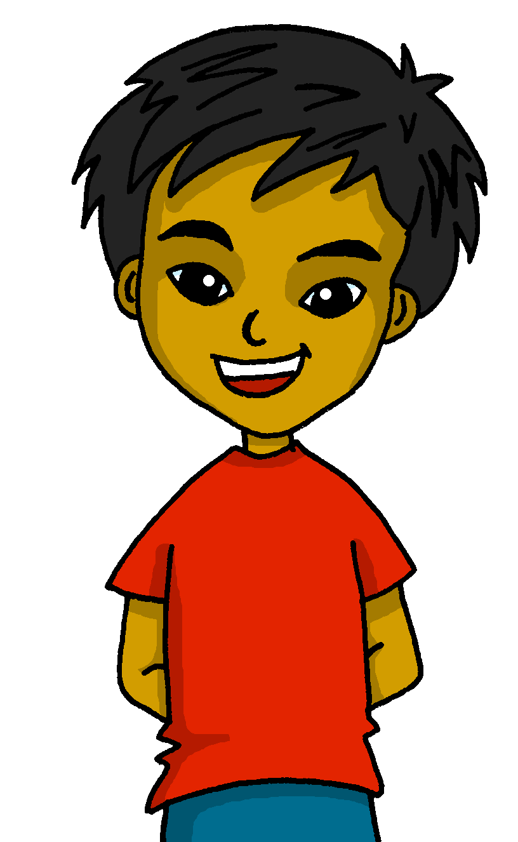
español, con Quique

Slide 2
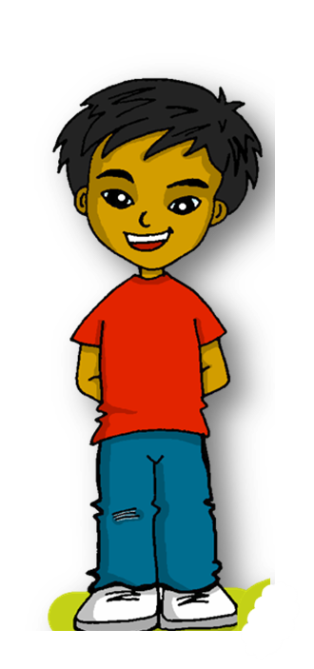
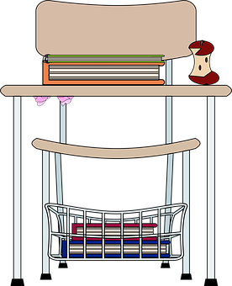
Saying what I and others have to do
2-verb structure: deber
SSC repaso 2
azul
Notes:
Artwork by Steve Clarke. All additional pictures selected are available under a Creative Commons license, no attribution required.
The frequency rankings for words that occur in this PowerPoint which have been previously introduced in the resources are given in the SOW (excel document) and in the resources that first introduced and formally re-visited those words.
Phonics: SSC revision 2
Vocabulary (new words in bold): deber [71 silencio [[518] tarde [457] colegio [628] deberes [2187]
Revisit 1: bandera [2446] desfile [4514] pan [1342] visitante [2428] mucho [41] todo [472] todo el mundo [n/a]
Revisit 2: ir [33] voy va cine [952] ciudad [178] España [>5000] este [24] norte [624] oeste [2416] sur [661] a [8] el [1] la [1]
Source: Davies, M. & Davies, K. (2018). A frequency dictionary of Spanish: Core vocabulary for learners (2nd ed.). Routledge: London
For any other words that occur incidentally in this PowerPoint, frequency rankings will be provided in the notes field wherever possible.
norma [1174] aburrido [3917]

Slide 3
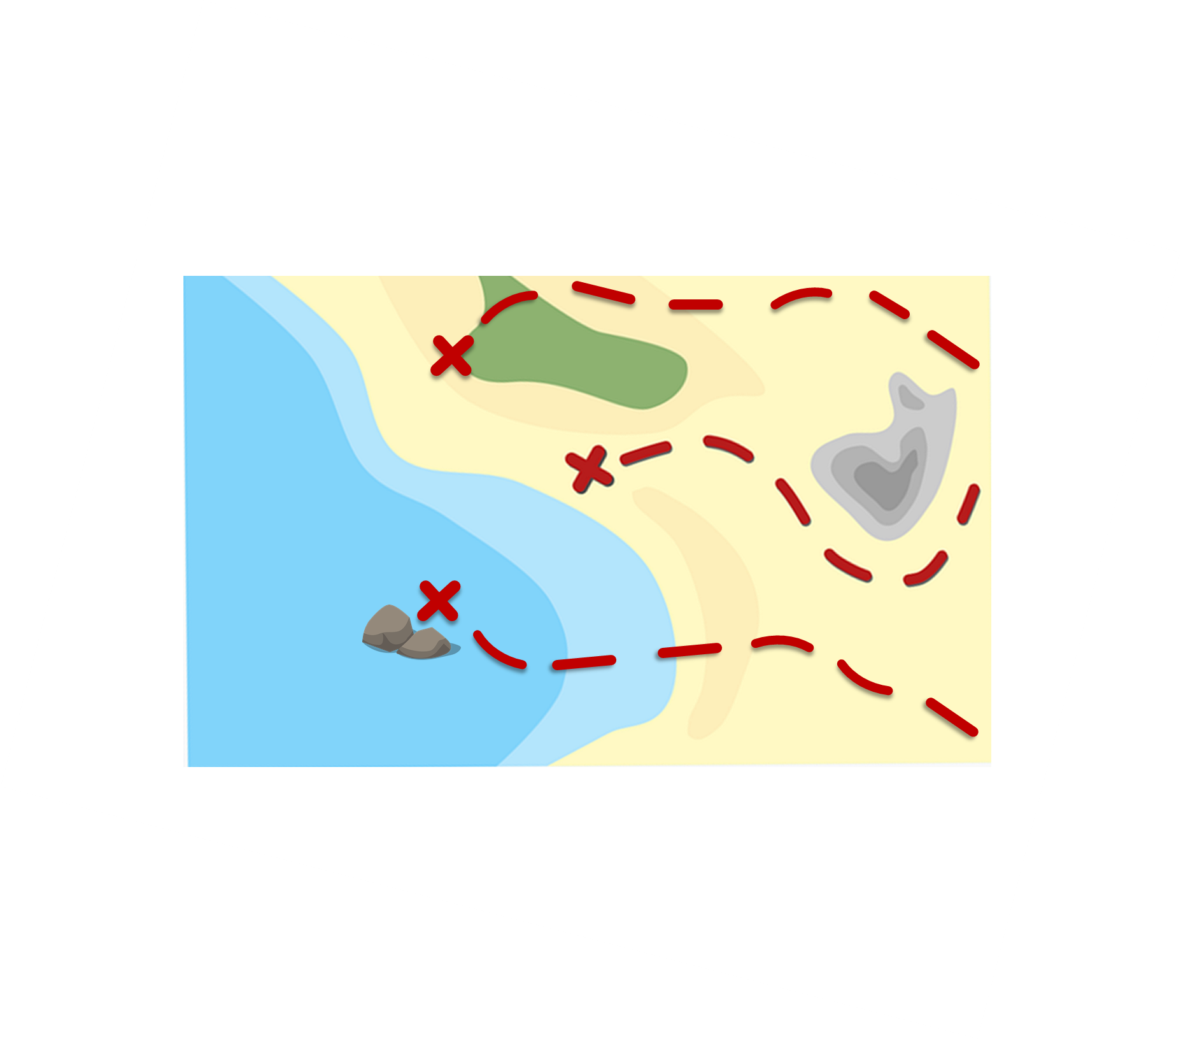
La ruta de las monedas
SSC Repaso
Pronuncia las palabras y colecciona monedas.
pronunciar
ácido
pared
carro
Turno 2: Persona B
cueva
Turno 1: Persona A
cazuela
gama
paño
creer
juguete
enemigo
gusto
palo
atroz
página
calle
aceite
euro
química
agua
INICIO
Notes:
Timing: 3 minutes
Aim: to revisit term 1-3 SSC. [rr] [a] [e] [i] [o] [u] [j] [ga] [gu] [gi] [gue] [v] [z] [rr] [r] [v] [ll] [l] [eu] [ee] [ei] [ua] [qui] [ñ] [ci] [ce]
Timing: 5 minutes
Procedure:
Pupils work in pairs to practise pronunciation. They can choose where to start and have one minute to collect as many coins as possible.
Divide the class in A & B and click to indicate it’s ‘persona A’’s turn.
Pupil A starts from either ‘paño’, ‘gusto’ or ‘agua’, and follows the path to pronounce the words and collect the corresponding coins.
Click to bring up Persona B’s turn.

Slide 4
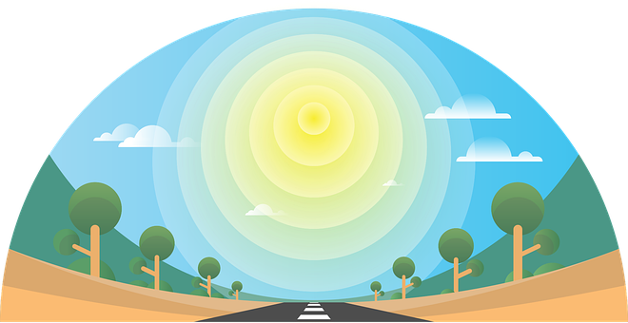
vocabulario
Escucha y repite 🗣
pm
_ _ c _ l_g_ _
la tarde
los deberes
el colegio
la tarde
el colegio
l_ _ d _ b_ r_ _
los deberes
[school]
[afternoon]
[homework]
la t_ _ d_
Notes:
Timing: 4 minutes
Aim: to introduce key vocabulary for this week.
Procedure: 1.Teacher introduces items one by one (word, picture, English) & pupils practise pronunciation aloud.
Alternatively, pupils work in pairs, reading the Spanish words out loud and looking at the English meanings (1 minute). 2. Then the teacher removes the English words or pictures, and pupils try to recall the English orally (chorally), looking at the Spanish (1 minute). 3. Teacher brings up hints – pupils work in pairs trying to recall the Spanish.
4. Elicit answers from pupils (from left to right).
NB. Further rounds of learning can be facilitated by one pupil turning away from the board, and his/her partner asking him/her the meanings (‘Cómo se dice X en español?’). This activity can work from L2 → L1 or L1 → L2.

Slide 5
vocabulario
¿Qué es en español?
tirar
la tarde
escuchar
el silencio
el bolígrafo,boli
hacer
correr
el colegio
(the) pen
(the) silence
(the) school
to run, running
(the) homework
to listen, listening
to help, helping
to do, doing
to throw, throwing
(the) afternoon
los deberes
ayudar
Notes:
Timing: 5 minutes
Aim: to revisit infinitive verbs and nouns from previous weeks (and the 3 new nouns introduced this week).
Procedure: 1. Click for an English prompt.
2. Elicit the Spanish word from pupils. 3. Continue until all 10 items have been seen and heard.

Slide 6
Saying what you have to do
[deber: to have to, must]
In Spanish, the verb ‘deber’ is followed by the infinitive verb.
The verb ending tells you who the sentence refers to.
To say what you or others must not do, put ‘no’ before the verb. This makes a negative.
Debo escuchar en clase.
No debo escuchar en clase.
I must listen in class.
I must not listen in class.
Debe hacer los deberes.
No debe hacer los deberes.
S/he must do the homework.
S/he must not do the homework.
Notes:
Timing: 3 minutes
Aim: to introduce deber (2-verb structure) in 1st and 3rd person singular; revisit negatives
Procedure:
Click through the animations to present the information.
Elicit English translations for the Spanish examples provided.

Slide 7
escuchar
Las normas
Quique habla de las normas.
¿Quién es?
Marca
(la) norma - rule
 | Yo | Él | negative?
E
1
2
3
4
5
Notes:
Timing: 7 minutes [2 slides]
Aim: to practise connection of the 1st and 3rd person singular of deber, and negative form.
Procedure:
Pupils listen to each phrase.
Attending to the verb ending, pupils decide if it’s ‘I’ or ‘s/he’ and whether it’s a negative statement.
Click to reveal answers.
Transcript
E. [yo] no debo correr en casa. 1. [él] debe escuchar a la profesora. 2. [él] debe comer en el patio.
3. [yo] no debo comer en clase. 4. [él] no debe tener un boli 5. [yo] Debo beber a menudo.
norma [1174]

Slide 8
escuchar
Las normas
Remember! We can use pronouns (e.g., I, he) in Spanish to emphasise a contrast.
Escribe el infinitivo.
Escucha ¿Qué actividad es?
 | verbo 2
 | No debo
 | Debe
 | Debe
 | No debo
 | No debe
 | Debo
Información extra
at home|in class
to grandma |to the teacher
in the kitchen | in the playground
at home|in class
a pen | a gluestick
sometime| often
E
I must not run
correr
1
escuchar
He must listen
2
comer
He must eat
3
comer
I must not eat
4
He must have
tener
5
beber
I must drink
Notes:
Timing: 7 minutes
Aim: aural recognition of the infinitive verb; aural comprehension of vocabulary.
Procedure:
Introduce the task and do the example with them. At this stage pupils focus on understanding more information about each sentences.
Pupils transcribe the infinitive verb and can select any extra info they pick up.
Click to bring up answers.
Teachers can elicit full English translation.
Transcript
E. [yo] no debo correr en casa. 1. [él] debe escuchar a la profesora. 2. [él] debe comer en el patio.
3. [yo] no debo comer en clase. 4. [él] no debe tener un boli 5. [yo] Debo beber a menudo.

Slide 9
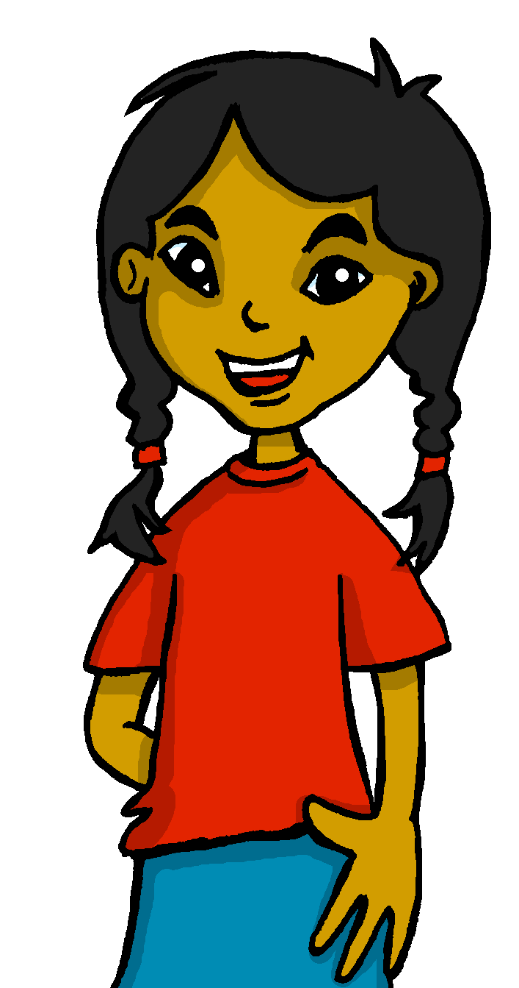
leer
[1/5]
Lee los mensajes de Quique a Luis.
¿Quién es?
E
Debe leer un texto.
ella
✉
yo
¿Qué imagen es?
a
b
c
Notes:
Timing: 5 minutes
Aim: reading to differentiate between 1st and 3rd person singular of deber; written comprehension of key vocabulary introduced this week.
Procedure:
Read the context. Tell students Quique is sending messages to Rubén.
Read the first message. Ask pupils to identify de if it’s Quique (yo = I), or Sofía (ella = she).
Click to bring part 2 – checking understanding of infinitive verb and elicit oral response.
Continue with items 1 – 5.

Slide 10
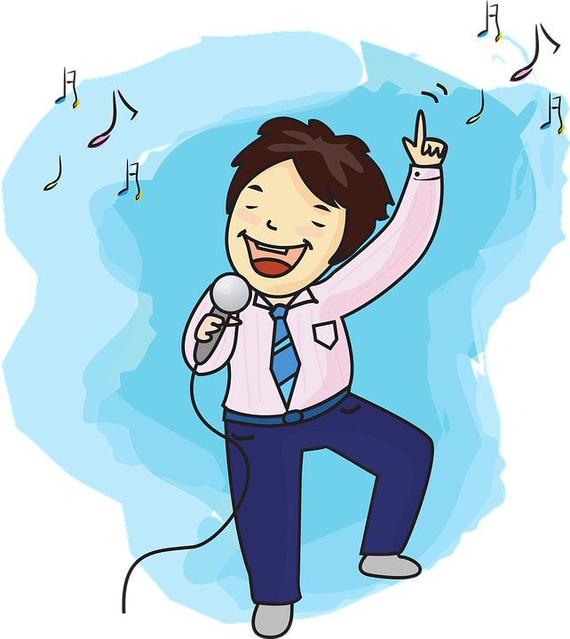
leer
[2/5]
Lee los mensajes de Quique a Luis.
¿Quién es?
1
Debo estar en silencio en clase.
ella
✉
yo
¿Qué imagen es?
a
b
c
to learn, learning
to be
Notes:
Timing: 7 minutes
Aim: reading to differentiate between 1st and 3rd person singular of deber; written comprehension of key vocabulary introduced this week.
Procedure:
Read the context. Tell students Quique is sending messages to Rubén.
Read the first message. Ask pupils to identify de if it’s Quique (yo = I), or Sofía (ella = she).
Click to bring part 2 – checking understanding of infinitive verb and elicit oral response.
Continue with items 1 – 5.

Slide 11
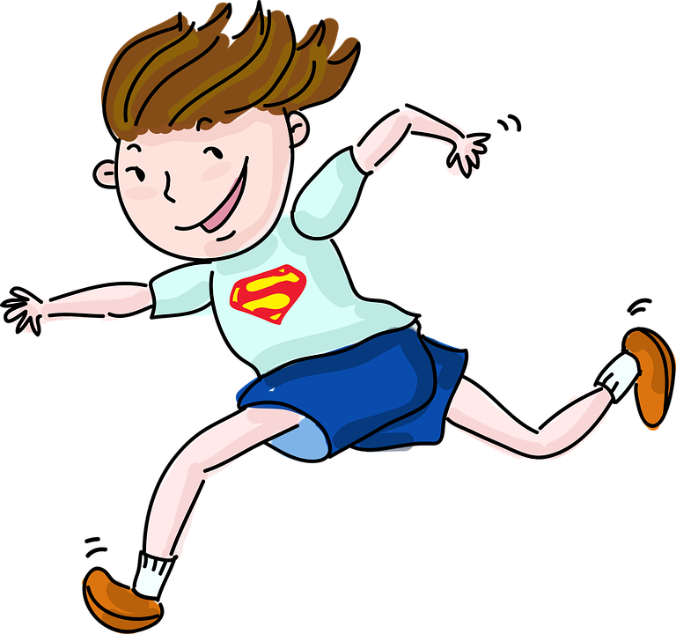
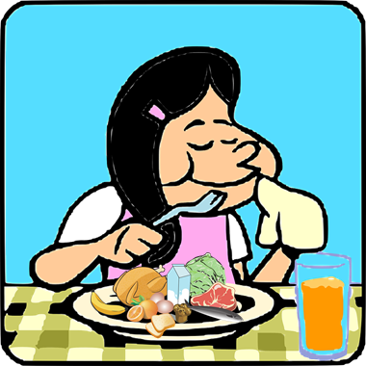
leer
[3/5]
Lee los mensajes de Quique a Luis.
¿Quién es?
2
Debe correr en el recreo.
ella
✉
yo
¿Qué imagen es?
a
b
c
Notes:
Timing: 7 minutes
Aim: reading to differentiate between 1st and 3rd person singular of deber; written comprehension of key vocabulary introduced this week.
Procedure:
Read the context. Tell students Quique is sending messages to Rubén.
Read the first message. Ask pupils to identify de if it’s Quique (yo = I), or Sofía (ella = she).
Click to bring part 2 – checking understanding of infinitive verb and elicit oral response.
Continue with items 1 – 5.

Slide 12
leer
[4/5]
Lee los mensajes de Quique a Luis.
¿Quién es?
3
✉
Debe aprender vocabulario.
ella
yo
¿Qué imagen es?
a
b
c
to learn
Notes:
Timing: 7 minutes
Aim: reading to differentiate between 1st and 3rd person singular of deber; written comprehension of key vocabulary introduced this week.
Procedure:
Read the context. Tell students Quique is sending messages to Rubén.
Read the first message. Ask pupils to identify de if it’s Quique (yo = I), or Sofía (ella = she).
Click to bring part 2 – checking understanding of infinitive verb and elicit oral response.
Continue with items 1 – 5.

Slide 13
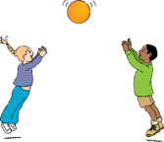
leer
[5/5]
Lee los mensajes de Quique a Luis.
¿Quién es?
4
E Debo hacer los deberes por la tarde.
ella
✉
yo
¿Qué imagen es?
to do, make
to prepare
a
b
c
to play
Notes:
Timing: 7 minutes
Aim: reading to differentiate between 1st and 3rd person singular of deber; written comprehension of key vocabulary introduced this week.
Procedure:
Read the context. Tell students Quique is sending messages to Rubén.
Read the first message. Ask pupils to identify de if it’s Quique (yo = I), or Sofía (ella = she).
Click to bring part 2 – checking understanding of infinitive verb and elicit oral response.
Continue with items 1 – 5.

Slide 14
leer
Lee las frases. ¿Qué opinas?
¡Reacciona! 😃😟
hablar
A
Debe leer un texto .
E Debe leer un texto.
1 Debo estar en silencio en clase.
¡Es normal!
B
2 Debe correr en el recreo.
3 Debe aprender vocabulario.
😃 importante | fantástico | divertido
😟 estricto | terrible | aburrido*
4 Debo hacer los deberes por la tarde.
aburrido - boring
Notes:
Timing: 3 minutes
Aim: to practise reading comprehension of both newly introduced and revisited vocabulary & apply logic to the statements.
Procedure:
Click x2 to bring up speech bubbles and model the conversation.
Pupil take turns to read statements 1-6 and react to them according to their own opinion.
aburrido [3917]

Slide 15
¡adiós!
azul

