Slide 1
español, con Quique

Slide 2
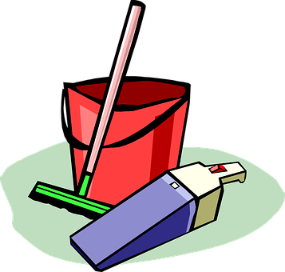
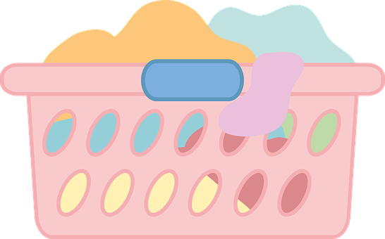
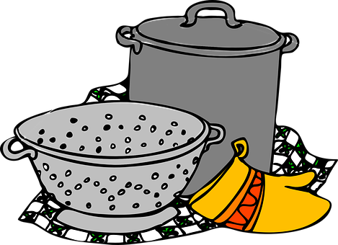
Saying what I and others like and dislike doing
azul
-AR & -ER verbs: we & they
2-verb structures: amar, odiar
SSC repaso
Notes:
Artwork by Steve Clarke. All additional pictures selected are available under a Creative Commons license, no attribution required.
The frequency rankings for words that occur in this PowerPoint which have been previously introduced in the resources are given in the SOW (excel document) and in the resources that first introduced and formally re-visited those words.
Phonics: SSC revision 1
Vocabulary (new words in bold): lavar [1676] ordenar [1184] preparar [570] coche [1190] juguete [3163] ropa [782] suelo [552]
Revisit 1: tirar1 [685] gente [137] hora1 [160] durante [139]
Revisit 2: hay [13] dos [64] tres [134] cuatro [241] cinco [284] seis [438] siete [603] ocho [641] nueve [991] diez [449] once [1701] doce [1138] trece [2700] catorce [2411] quince[1215] dieciséis [3373] diecisiete [3400] dieciocho [2730] diecinueve [4232] veinte [819] veintiuno [819/425] veintidós, veintitrés, veinticuatro, veinticinco, veintiséis, veintisiete, veintiocho, veintinueve, treinta [830] treinta y uno [830/4/425]
Source: Davies, M. & Davies, K. (2018). A frequency dictionary of Spanish: Core vocabulary for learners (2nd ed.). Routledge: London
For any other words that occur incidentally in this PowerPoint, frequency rankings will be provided in the notes field wherever possible.

Slide 3
¡Bingo!
[SSC revisit 1]
Escribe nueva palabras.
Tu compañero/a pronuncia y adivina.
pronunciar
genial
zapato
correr
novio
galleta
60
llegar
guiso
leche
paquete
viento
bolsa
ella
niña
equipo
intelligente
cocina
aire
Persona A
S
Persona B
0
adivinar – to guess
START
Notes:
Timing: 3 minutes
Aim: to revisit term 1-3 SSC.
Procedure: 1. Introduce the task. All pupils write 9 words of their choice from the list. The aim is to pronounce the words correctly and try to call bingo by figuring out all the words their partners wrote down.
2. Start the timer for Pupil A (s/he tries to read aloud all of the words, within the 60 seconds allowed).
3. They swap roles and repeat the task.

Slide 4
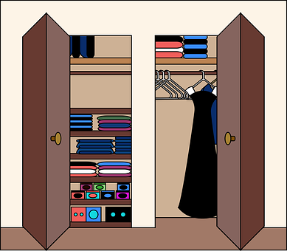
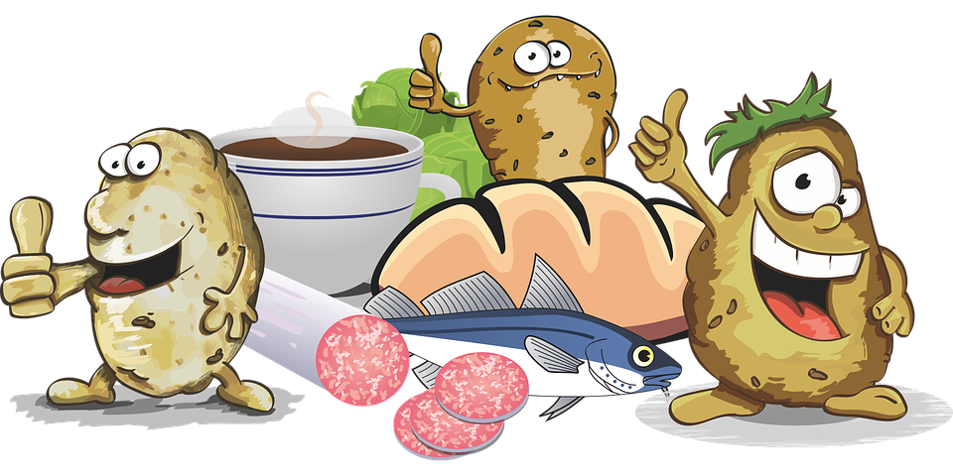
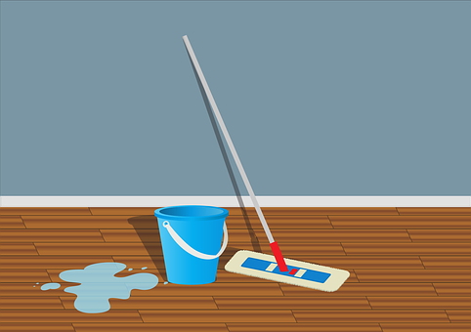
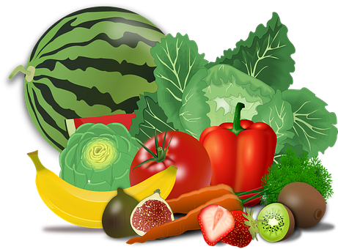
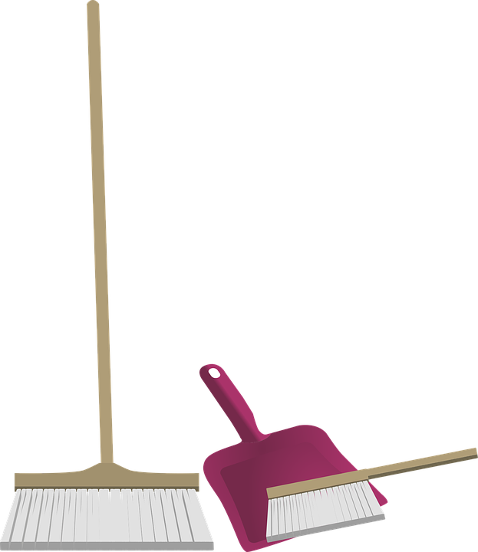
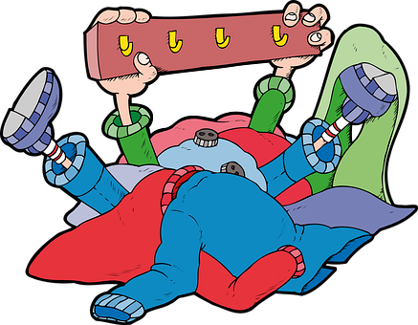
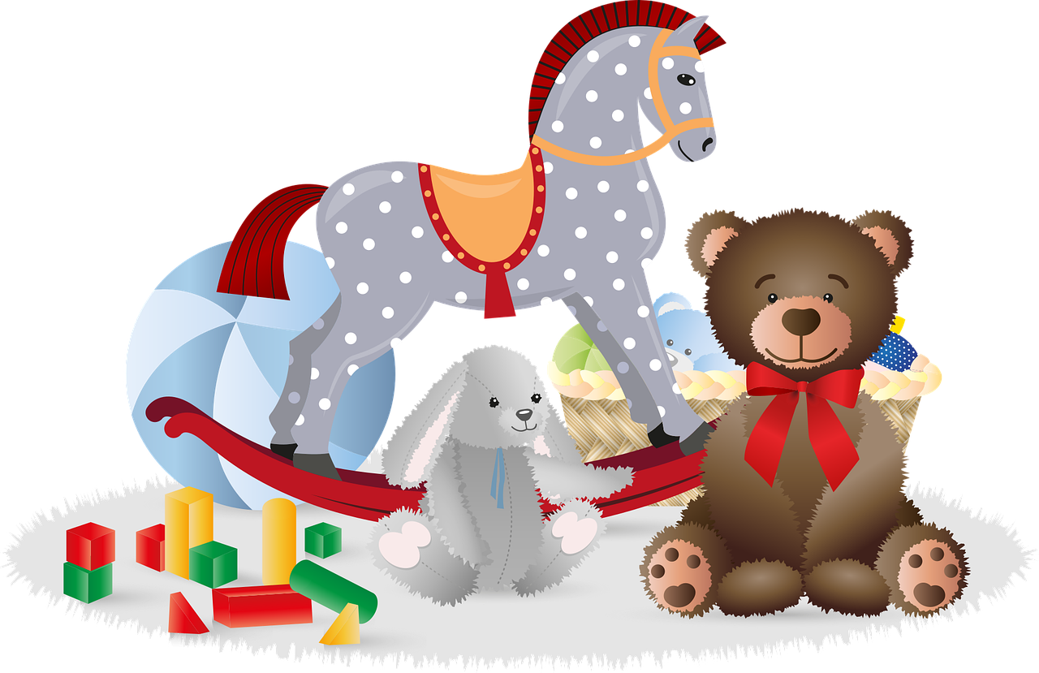
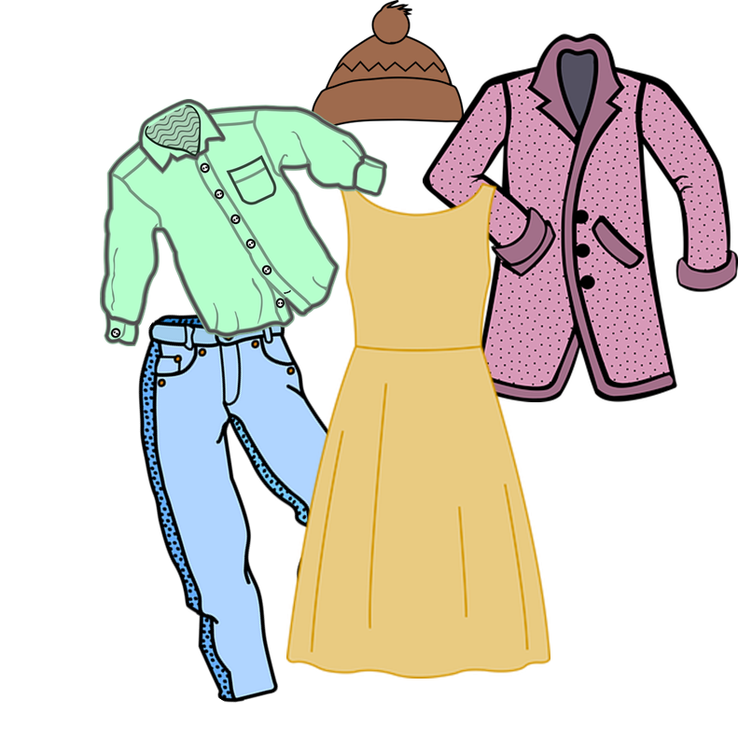
vocabulario
Vocabulario
¿Cómo es en español?
lavar
ordenar
la comida
limpiar
to do, make
el juguete
(the) toy
hacer
to clean, cleaning
to wash, washing
(the) floor, ground
to prepare, preparing
to clean, cleaning
to help, helping
to tidy up, tidying up
to prepare, preparing
(the) clothes
(the) food
(the) floor, ground
to do, make
(the) food
to tidy up, tidying up
to wash, washing
(the) clothes
to do, make; doing, making
to help, helping
(the) toy
to prepare
la ropa
ayudar
el suelo
preparar
Notes:
Timing: 5 minutes
Aim: to present and practise written comprehension and read aloud of previously taught vocabulary and three new words for this week.
Procedure: 1. Click for an English item. Elicit pronunciation of the Spanish from pupils.
2. Click to cover the Spanish word with a picture.
3. Continue with the remaining items.
4. Optional at this stage: elicit the Spanish from pupils, (English prompts reappear on each mouse click) this time without written Spanish support.

Slide 5
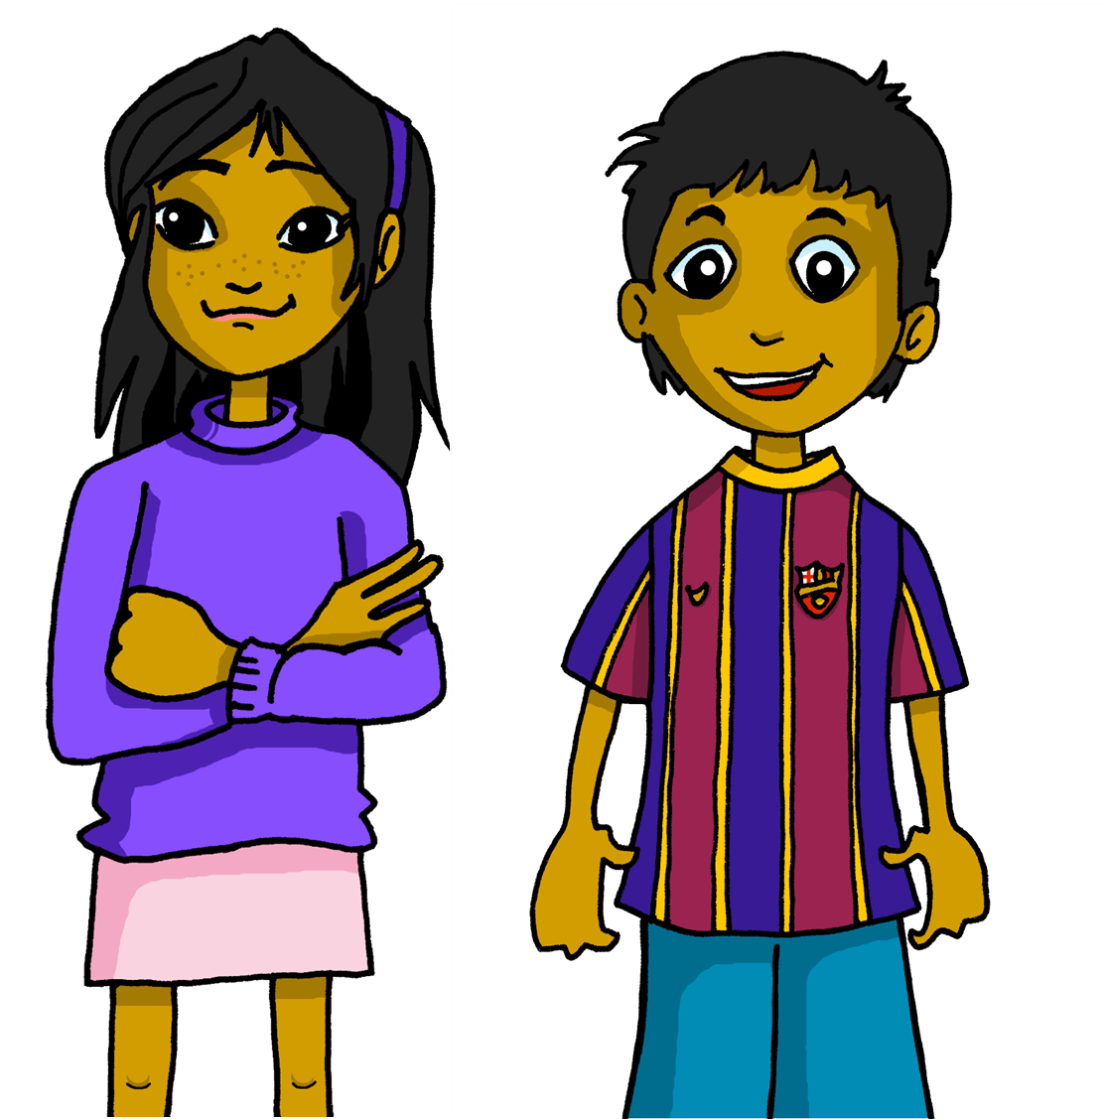
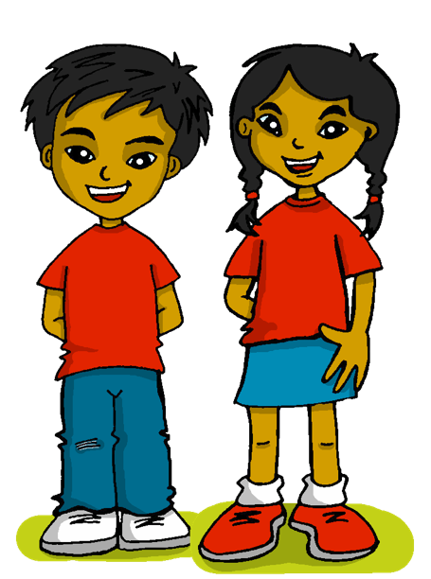
Knowing who does what
[‘we’ vs. ‘they’]
Remember: to mean ‘we’ with an -ar verb, remove –ar and add –amos.
To mean ‘they’ with a verb, we remove –ar and add –an.
Ayudamos en el jardín.
Ayudan en casa.
We help in the garden.
They play at home.
To mean ‘S/he, it’ with an –er verb, remove –er and add -emos.
To mean ‘they’ with a verb, we remove –er and add –en.
Hacemos la cama.
Hacen la cama.
We make the bed.
We make the bed.
Notes:
Timing: 4 minutes
Aim: to revisit 1st and 3rd persons plural for–ar and –er verbs (hacer, jugar).
Procedure:
Click through the animations to present the new information.
Elicit English translations for the Spanish examples provided.

Slide 6
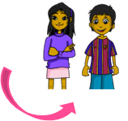
escuchar
Las tareas del hogar
Escucha. ¿Quién hace la tarea?
Marca
Escribe el verbo.
la tarea del hogar – household chore
 | we | they | VERBO
E
preparan
1
hacemos
2
ordenamos
3
hacen
4
ordenan
5
lavamos
Notes:
Timing: 7 minutes
Aim: to practise connection of the 1st and 3rd person plural and aural recognition of vocabulary.
Procedure:
Pupils listen to each phrase.
Attending to the verb ending, pupils decide if it’s ‘we’ or ‘they’. Encourage them to write the verb.
Click to reveal answers.
On the 2nd time of listening (NEXT SLIDE), pupils write the English meaning of the sentences. Teachers can click on the blue box to provide support if required.
Transcript:
E. [ellos] preparan la mochila. 1. [nosotros] hacemos la cama. 2. [nosotros] ordenamos la habitación. 3. [ellos] hacen un bocadillo. 4. [ellos] ordenan la ropa. A veces, [nosotros] lavamos los juguetes.

Slide 7
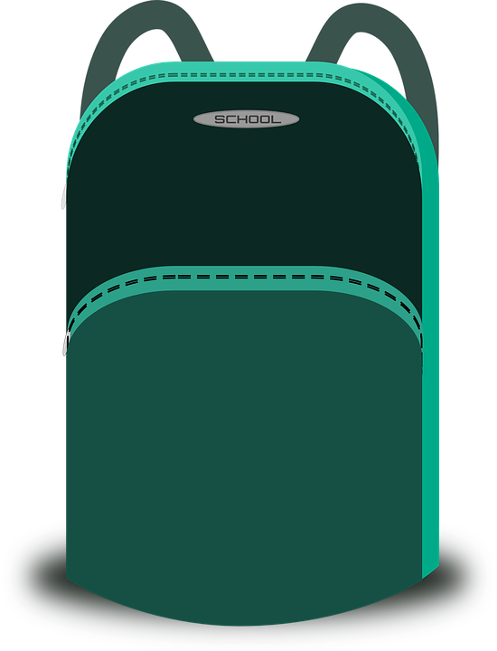
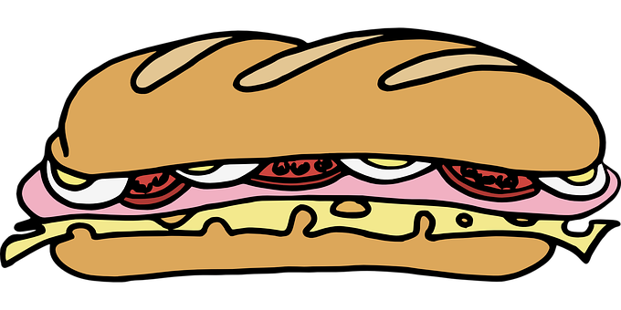
escuchar
Las tareas del hogar
Escucha y escribe en inglés.
 | VERBO | frase en inglés
 | preparan
 | hacemos
 | ordenamos
 | hacen
 | ordenan
 | lavamos
E
They prepare the school bag.
1
We make the bed.
2
We tidy up the room.
3
They make a sandwich.
4
They tidy up the clothes.
5
Sometimes, we wash the toys.
Notes:
On the 2nd time of listening, pupils write the English meaning of the sentences. Teachers can click on the blue box to provide support if required.
Transcript
E. [ellos] preparan la mochila. 1. [nosotros] hacemos la cama 2. [nosotros] ordenamos la habitación. 3. [ellos] hacen un bocadillo 4. [ellos] ordenan la ropa A veces, [nosotros] lavamos los juguetes

Slide 8
Saying you like doing something
[amar|odiar]
Change the ending of amar|odiar to say who loves or hates.
To say ‘love/hate to do’ or ‘love/hate doing’ in Spanish, the verbs ‘amar’ and ‘odiar’ are followed by the infinitive verb:
In English, we usually use the gerund (-ing form).
Amo hablar español.
Amamos preparar comida.
I love to speak Spanish.
We love to prepare food.
speaking
preparing
Amas jugar con tu hermano.
Aman cocinar con la abuela.
You love to play with your brother.
playing
They love to cook with grandma.
cooking
Ama ordenar los juguetes.
S/he loves to tidy up the toys.
tidying up
Notes:
Timing: 4 minutes
Aim: to introduce 2-verb structures with 2 opinion verbs (amar, odiar).
Procedure:
Click through the animations to present the information.
Elicit English translations for the Spanish examples provided.

Slide 9
leer
Lee los mensajes de Quique.
[1/6]
¿Es una opinión? o ¿es solo una actividad?
Es una opinión.
E
Amamos poner la mesa por la noche.
🅰
You know that ‘poner’ literally means to put, but in English we say ‘to set the table’.
We can also translate it as ‘we love setting the table in the evening’.
✉
_______
to tidy up
to set
to wash
the bedroom
the table
the bed
morning
evening
We love
in the
Notes:
Timing: 7 minutes (6 slides)
Aim: to differentiate between the meaning and form of single and 2-verb structures; to practise written comprehension of key vocabulary introduced this week.
Procedure:
Read the context. Tell students Quique is receiving messages from different friends.
Read the first message. Ask pupils to identify amar if it’s an opinion or a task (¿Es una opinión o una actividad?). Click to model TL response from pupils.
Click to bring part 2 (support for pupils to translate the message) and elicit oral response.
Continue with items 1 – 5.

Slide 10
leer
Ordenamos los libros de la habitación. Amamos hacer los bocadillos para la excursión. ¡Es genial! Hacemos la cama todos los días. Por la mañana ordenamos los juguete y amamos jugar en el jardín.
[2/6]
1
Hacemos la cama todos los días.
Es una actividad.
🅰
✉
_______
make
prepare
cook
the chair
the food
the bed
every night
every morning
every day
We
Notes:
Slide 2/6

Slide 11
leer
[3/6]
2
Es una opinión y una actividad
Odiamos limpiar el suelo pero lavamos el coche siempre.
🅰
✉
_______
to clean
to wash
to do
___ ___
always
never
wash
prepare
play
the toys
the car
the bags
We hate
the playground
the wardrobe
the floor
but we
OR cleaning
Notes:
Slide 3/6

Slide 12
leer
[4/6]
3
Es una actividad
Ordenamos los libros de la habitación.
🅰
✉
_______
help
tidy up
prepare
the clothes
the books
the chairs
the kitchen
the house
the room
We
___
of
Notes:
Slide 4/6

Slide 13
leer
[5/6]
4
Es una opinión.
Amamos hacer los bocadillos para el viaje. ¡Es divertido!
🅰
✉
___
___
_______
to prepare
to cook
to make
the sandwiches
the school bags
the food
for
the trip.
the class.
the race.
It’s
boring!
fun!
different!
We love
OR making
Notes:
Slide 5/6

Slide 14
leer
[6/6]
5
Es una opinión y una actividad.
Por la tarde preparamos los juguetes y amamos jugar en el jardín.
🅰
✉
OR playing
__
__
__
play
clean
prepare
___
___
__
In
the afternoon
The morning
we
the toys
the clothes
the school bags
and
we
love
to do
to play
in
the house
the garden
the class
Notes:
Slide 6/6

Slide 15
¡adiós!
azul

