Slide 1
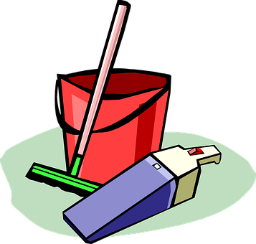
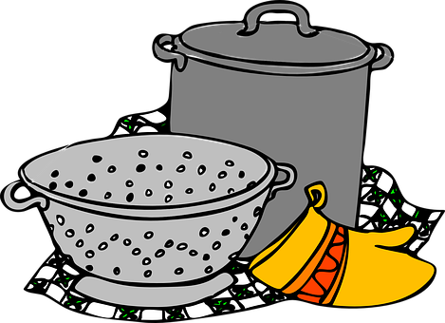
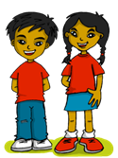
Saying what I and others like and dislike doing
azul
Follow ups 1-5
Notes:
Artwork by Steve Clarke. All additional pictures selected are available under a Creative Commons license, no attribution required.
The frequency rankings for words that occur in this PowerPoint which have been previously introduced in NCELP resources are given in the NCELP SOW and in the resources that first introduced and formally re-visited those words.
Phonics: SSC revisión 1
Vocabulary (new words in bold): lavar [1676] ordenar [1184] preparar [570] coche [1190] juguete [3163] ropa [782] suelo [552]
Revisit 1: tirar1 [685] gente [137] hora1 [160] durante [139]
Revisit 2: hay [13] dos [64] tres [134] cuatro [241] cinco [284] seis [438] siete [603] ocho [641] nueve [991] diez [449] once [1701] doce [1138] trece [2700] catorce [2411] quince[1215] dieciséis [3373] diecisiete [3400] dieciocho [2730] diecinueve [4232] veinte [819] veintiuno [819/425] veintidós, veintitrés, veinticuatro, veinticinco, veintiséis, veintisiete, veintiocho, veintinueve, treinta [830] treinta y uno [830/4/425]
Glossed words: decir [31] plato [1808] tarea [995] su [12]
For any other words that occur incidentally in this PowerPoint, frequency rankings will be provided in the notes field wherever possible.
Source: Davies, M. and Davies, K. (2018). A frequency dictionary of Spanish: Core vocabulary for learners (2nd ed.). Routledge: London

Slide 2
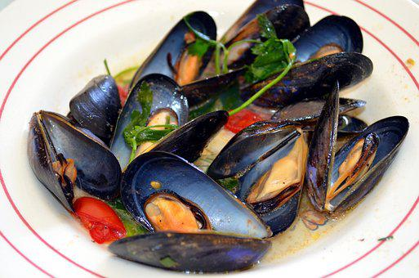
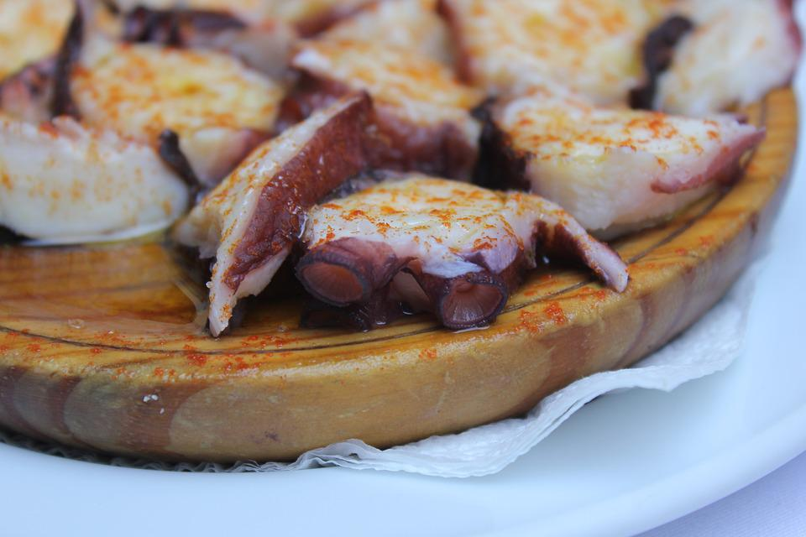
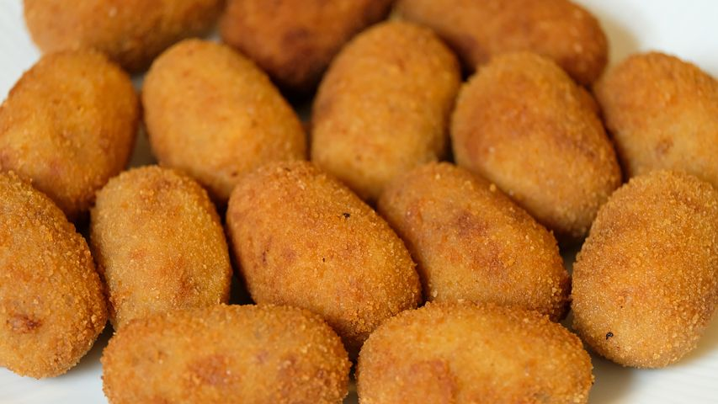
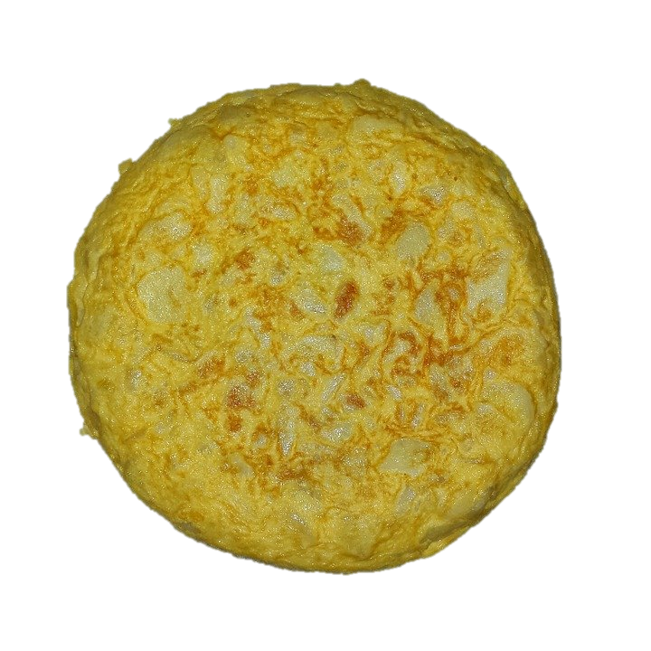
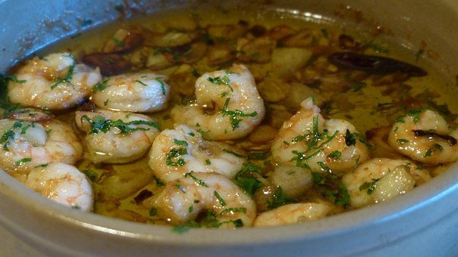
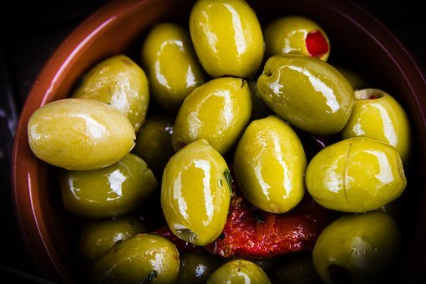
Follow up 1
¿Qué son estos platos?
Escucha y escribe las letras.
Son tapas.
A Escribe
pronunciar
d
a
b
c
la tor_ _lla
E
ti
c
1
las cro_ _ _tas
que
c
c
e
2
las _ _ m _ _ s
d
ga
ba
a
los me _ _ llo _ _ _
3
ji
nes
b
po
el _ _ l _ _
4
pu
e
las a _ _ itu _ _ _
5
ce
nas
Las tapas son platos pequeños.
¿Amas las gambas?
¡Sí! Amo las gambas.
¡No! Odio el pulpo.
¿Amas el pulpo?
A Con tu compañero/a, pregunta.
(el) plato – dish, plate
A
B
Notes:
Timing: 5 minutes
Aim: to revisit several SSCs.
Procedure: 1. Click to play each word. Pupils write down the missing letters.
2. Click to correct.
3. Click to reveal the pictures of the ‘tapas’ and prompt with the question ‘Qué son estos platos?’
4. Click again to reveal the answer: ‘Son tapas’ and the short definition.
5. Pupils then ask each other whether they love or hate these dishes.
Frequency of unknown words:
plato [1808] tapa [3645]
For any other words that occur incidentally in this PowerPoint, frequency rankings will be provided in the notes field wherever possible.
Source: Davies, M. and Davies, K. (2018). A frequency dictionary of Spanish: Core vocabulary for learners (2nd ed.). Routledge: London

Slide 3
Follow up 2
Lee las frases. ¿Son ‘ellos’ o ‘nosotros’?
leer
 | we / they
Odian hacer la comida
Amamos hacer una tarta.
Amamos preparar una fiesta.
Odian hacer la cama.
Odiamos ordenar la ropa.
Aman ayudar a sus* padres.
Odian cocinar pollo.
Odiamos lavar a Manchita y Pancho.
E
they
😠
1
we
❤
2
we
❤
3
they
😠
4
we
😠
5
they
❤
6
they
😠
7
we
😠
sus = their (pl)
Notes:
Timing: 10 minutes
Aim: to practise reading comprehension of ‘we’ and ‘they’ form of odiar + amar and key vocabulary presented this week.
Procedure:
Introduce the task and do the example with pupils.
At this stage pupils focus on recognising the person of the verb and whether it is amar or odiar.
Move to next slide to complete part two (vocab comprehension).
Frequency of unknown words and cognates: su [12]
Source: Davies, M. & Davies, K. (2018). A frequency dictionary of Spanish: Core vocabulary for learners (2nd ed.). Routledge: London

Slide 4
Follow up 2:
Escribe las frases en inglés.
escribir
leer
They hate hacer la comida.
We love hacer una tarta.
We love preparar una fiesta.
They hate hacer la cama.
We hate ordenar la ropa.
They love ayudar a sus* padres.
They hate cocinar pollo.
We hate lavar a Manchita y Pancho.
E
to make/ making (the) food.
1
to make/ making a cake.
2
to prepare/ preparing a party.
3
making the bed.
4
tidying up the clothes.
5
helping their parents.
6
cooking chicken.
7
washing Machita and Pancho.
sus = their (pl)
Notes:
Timing: 10 minutes
Aim: to practise reading comprehension of ‘we’ and ‘they’ form of odiar + amar and key vocabulary presented this week.
Procedure:
Introduce the task and do the example with them.
At this stage pupils focus on recognising the person of the verb and whether it is amar or odiar.
Move to next slide to complete part two (vocab comprehension). .
Frequency of unknown words and cognates: su [12]
Source: Davies, M. & Davies, K. (2018). A frequency dictionary of Spanish: Core vocabulary for learners (2nd ed.). Routledge: London

Slide 5
Follow up 3
Escribe los verbos en español.
Remember: to mean ‘we’ with an -ar verb, remove –ar and add –amos. To mean ‘they’ with a verb, we remove –ar and add –an.
escribir
a
m
a
n
o
d
i
a
m
o
s
p
r
e
p
a
r
a
m
o
s
they love
we hate
we prepare
l
a
v
a
n
o
r
d
e
a
n
a
n
h
r
c
e
a
m
o
s
they wash
they tidy up
we do, make
j
r
g
a
u
m
o
s
a
m
a
m
o
s
p
o
n
e
n
we play
we love
they put
Notes:
Timing: 5 minutes
Aim: to practise written production of some of this week’s new and revisited vocabulary. Some letters are provided to prompt recall of the word in Spanish.
Procedure:
Give students 4 minutes in pairs to write the Spanish word for the English translation.
Click to reveal the answers sequentially from left to right.
In the audio version, click on the English verbs to hear Spanish audio, if required.

Slide 6
Follow up 4:
[1/5]
la tarea – task
dice – s/he says
¿Qué dice la frase?
Quique habla de las tareas*.
hablar
E
they
[to prepare, preparing]
[a cake]
Aman preparar una tarta.
Notes:
Timing: 5 minutes (5 slides)
NOTE: there is an alternative version of this activity with a higher degree of challenge on slide 11.
Aim: to practise spoken production of 2-verb structures (amar / odiar) in the 1st and 3rd plural.
Procedure:
Do number 1 with pupils to model the task.
Click to reveal the answer.
Give pupils 30 seconds to say / practise the next sentence with a partner.
Elicit the sentence from the whole class chorally, then click to confirm.
Repeat steps 3-4 for the remaining sentences.
Frequency of unknown words and cognates:
tarea [995] su [12] decir [31]
Source: Davies, M. and Davies, K. (2018). A frequency dictionary of Spanish: Core vocabulary for learners (2nd ed.). Routledge: London

Slide 7
Follow up 4:
[2/5]
hablar
1
we
[tidying up]
[the room]
Amamos ordenar la habitación.
Notes:
[2/5]

Slide 8
Follow up 4:
[3/5]
hablar
2
we
😠
[helping]
[in the morning]
Odiamos ayudar por la mañana.
Notes:
[3/5]

Slide 9
Follow up 4:
[4/5]
hablar
3
they
😠
[to wash]
[the clothes]
Odian lavar la ropa.
Notes:
[4/5]

Slide 10
Follow up 4:
[5/5]
hablar
4
they
[to wash]
[the floor]
Aman lavar el suelo.
Notes:
[5/5]

Slide 11
Follow up 4:
¡Tu turno! Crea tus frases.
la tarea – task
dice – s/he says
the clothes
the floor
the food
the kitchen
the room
the bed
the toy
the book
the school bag
hablar
they
to wash
to clean
to prepare
to tidy up
to cook
to help
to put
to play
to do, make
we
😠
Notes:
ALTERNATIVE TO THE PREVIOUS SPEAKING TASK FOR HIGHER PROFICIENCY LEARNERS (or it could be a follow on activity, time-allowing)
Aim: to practise more independent speaking production of 2-verb structures (amar / odiar) in the 1st and 3rd plural; oral production of vocabulary of house chores.
Timing: 5 minutes
Procedure:
Do number 1 with pupils to model the task.
Click to reveal the answer.
Give pupils 30 seconds to say / practise the next sentence with a partner.
Elicit the sentence from the whole class chorally, then click to confirm.
Repeat steps 3-4 for the remaining sentences.
Frequency of unknown words and cognates:
tarea [995] su [12] decir [31]
Source: Davies, M. and Davies, K. (2018). A frequency dictionary of Spanish: Core vocabulary for learners (2nd ed.). Routledge: London

Slide 12
follow up 5:

Escribe en inglés: can you get at least 15 points?
 | treinta y uno | treinta | quince
 | diecisiete | veintiséis | catorce
 | hay | la hora | la gente
 | durante | tirar | cinco
 | lavar | la ropa | preparar
 | el suelo | ordenar | el juguete
vocabulario
31
30
15
x3
17
26
14
there is/are
hour
people
x2
during
to throw, throwing
5
to wash, washing
(the) clothes
to prepare, preparing
x1
(the) floor
to tidy up, tidying up
(the) toy
Notes:
Timing: 7 mniutes
Aim: to practise written comprehension of vocabulary from this week and this week’s revisited sets (next slide).
Procedure:
1. Give pupils a blank grid. They fill in the English meanings of any of the words they know, trying to reach 15 points in total.
Note: The most recently learnt and practised words are pink, words from the first revisit are green and those from the second revisit are blue, thus more points are awarded for them, to recognise that memories fade and more effort (heavy lifting!) is needed to retrieve them.

Slide 13
follow up 5:

Escribe en español: can you get at least 15 points?
 | 30 | 14 | 31
 | 26 | 15 | 17
 | people | There is / are | 5
 | to throw, throwing | hour | during
 | to tidy up, tidying up | (the) floor | (the) clothes
 | to wash, washing | (the) toy | to prepare, preparing
vocabulario
treinta
catorce
treinta y uno
x3
veintiséis
quince
diecisiete
la gente
hay
cinco
x2
tirar
la hora
durante
ordenar
el suelo
la ropa
x1
el juguete
lavar
preparar
Notes:
Timing: 7 mniutes
Aim: to practise written comprehension of vocabulary from this week and this week’s revisited sets (next slide).
Procedure:
1. Give pupils a blank grid. They fill in the English meanings of any of the words they know, trying to reach 15 points in total.
Note: The most recently learnt and practised words are pink, words from the first revisit are green and those from the second revisit are blue, thus more points are awarded for them, to recognise that memories fade and more effort (heavy lifting!) is needed to retrieve them.

Slide 14
¡adiós!
azul

Slide 15
follow up 5:

Escribe en inglés: can you get at least 15 points?
 | treinta y uno | treinta | quince
 | diecisiete | veintiséis | catorce
 | hay | la hora | la gente
 | durante | tirar | cinco
 | lavar | la ropa | preparar
 | el suelo | ordenar | el juguete
vocabulario
x3
x2
x1
Notes:
Timing: 7 mniutes
Aim: to practise written comprehension of vocabulary from this week and this week’s revisited sets (next slide).
Procedure:
1. Give pupils a blank grid. They fill in the English meanings of any of the words they know, trying to reach 15 points in total.
Note: The most recently learnt and practised words are pink, words from the first revisit are green and those from the second revisit are blue, thus more points are awarded for them, to recognise that memories fade and more effort (heavy lifting!) is needed to retrieve them.

Slide 16
Handout: follow up 5 extra

Escribe en español: can you get at least 15 points?
 | 30 | 14 | 31
 | 26 | 15 | 17
 | people | There is / are | 5
 | to throw, throwing | hour | during
 | to tidy up, tidying up | (the) floor | (the) clothes
 | to wash, washing | (the) toy | to prepare, preparing
vocabulario
x3
x2
x1
Notes:
Timing: 7 mniutes
Aim: to practise written comprehension of vocabulary from this week and this week’s revisited sets (next slide).
Procedure:
1. Give pupils a blank grid. They fill in the English meanings of any of the words they know, trying to reach 15 points in total.
Note: The most recently learnt and practised words are pink, words from the first revisit are green and those from the second revisit are blue, thus more points are awarded for them, to recognise that memories fade and more effort (heavy lifting!) is needed to retrieve them.

