Slide 1


español, con Quique

Slide 2

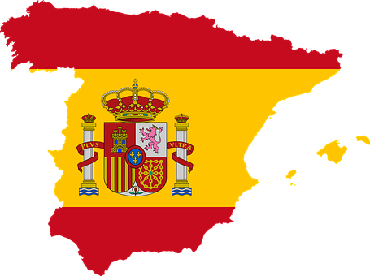

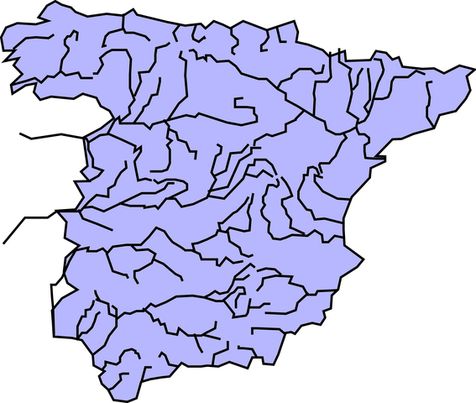
Saying what others and I do
Geografía física
azul
muchos / as
hay
[ge, gi | ga, go, gu | gue, gui]
Notes:
Artwork by Steve Clarke. All additional pictures selected are available under a Creative Commons license, no attribution required.
The frequency rankings for words that occur in this PowerPoint which have been previously introduced in the resources are given in the SOW (excel document) and in the resources that first introduced and formally re-visited those words.
Phonics: ge | gi | ga | go | gu | gue | gui
Source: gesto [928] página [598] ganar [295] lago [2151] gusano [4217] juguete [3163] guitarra [2705]
Cluster: gemelo/a [>5000] genial [2890] colegio [628] imaginar [500] domingo [693] galleta [>5000] canguro [>5000] gota [2391] hoguera [>5000] seguir [99] guiso [>5000] guerra [283]
Vocabulary (new words in bold): aeropuerto [2492] puerto [1077] río [496]
Revisit 1: hace [26] invierno [1813] otoño [3504] primavera [2735] verano [1139] frío [1020] calor [945] sol [383] cuando [57] + revise week 1 & 2 vocabulary + hacer [hago]
Revisit 2: armario [5000] cosa [69] habitación [1069] piso [889] radio [933] televisión [825] bicicleta [3684] cama [609] cuaderno [3301] gato [1728] idea [247] oso [4449] perro [888]
Source: Davies, M. & Davies, K. (2018). A frequency dictionary of Spanish: Core vocabulary for learners (2nd ed.). Routledge: London
For any other words that occur incidentally in this PowerPoint, frequency rankings will be provided in the notes field wherever possible.

Slide 3


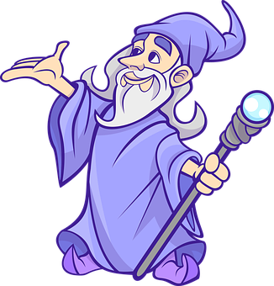
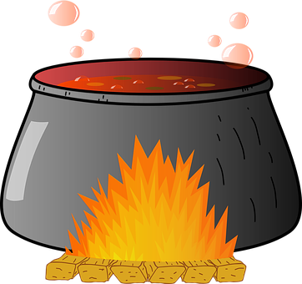


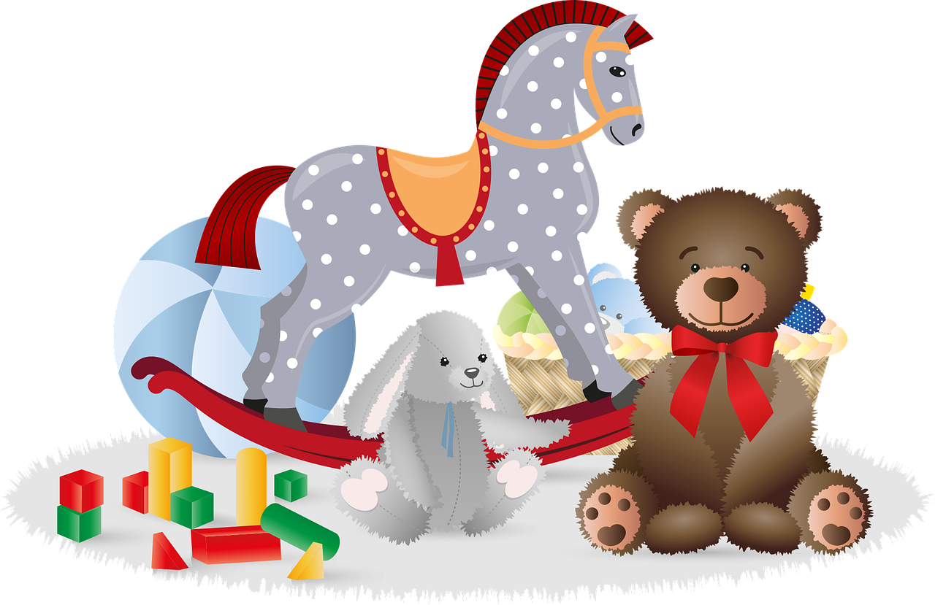
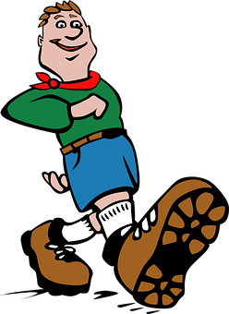
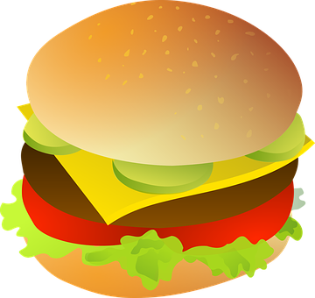
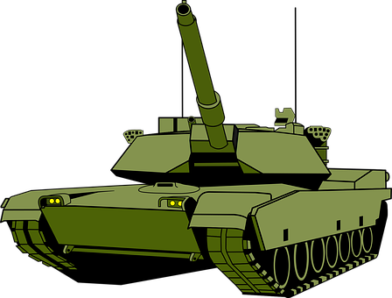


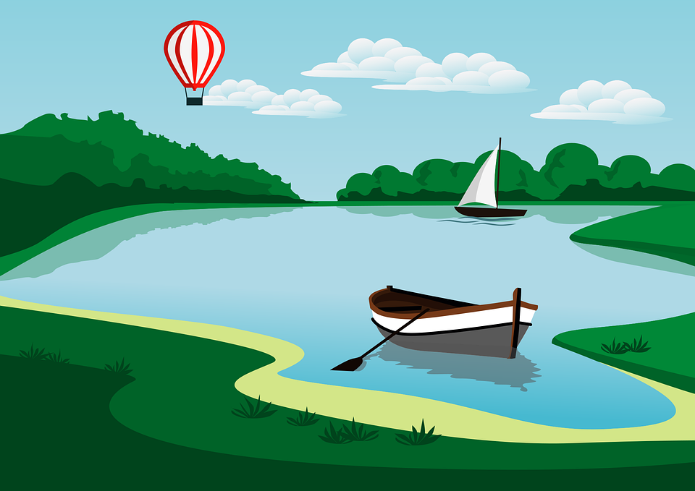
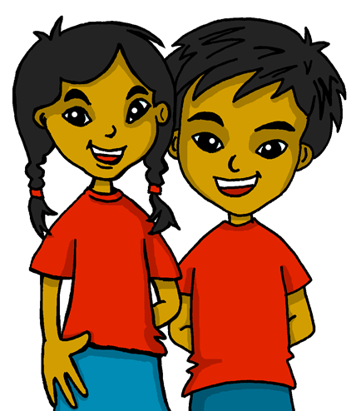
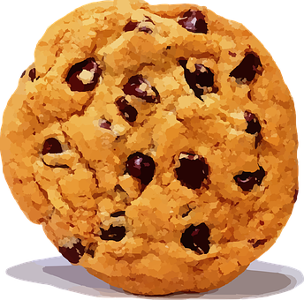

Repaso
[ge, gi | ga, go, gu | gue, gui]
pronunciar
gesto
[gesture]
magia
[magic]
mago
[magician]
guisantes
[peas]
gesto |  | magia | mago | guisantes |  | guiso
juguete |  | seguir |  | hamburguesa |  | guerra
lago | gemelos | galleta |  | Bélgica | igual | corregir
60
guiso
[stew]
juguete
[toy]
hamburguesa
[burger]
S
seguir
[to continue]
guerra
[war]
lago
[lake]
gemelos
[twins]
igual
[equal]
Bélgica
[Belgium]
galleta
[biscuit]
corregir
[to correct]
0
START
Notes:
Timing: 5 minutes
Aim: to practise applying knowledge of ge | gi | ga | go | gu | gue | gui to known and unknown words.
Procedure:
1. Start the timer. Pupil A tries to read aloud all of the words pronouncing n / ñ correctly, within the 60 seconds allowed.
2. Pupil B listens. If Pupil A mispronounces the SSC by mistake, Pupil B can direct him/her to start again from the beginning.
3. They swap roles and repeat the task.
Frequency of unknown words and cognates:
corregir [2351] guerra [283] guisante [>5000] hamburguesa [>5000] igual [263] mago [4573]
Source: Davies, M. & Davies, K. (2018). A frequency dictionary of Spanish: Core vocabulary for learners (2nd ed.). Routledge: London

Slide 4



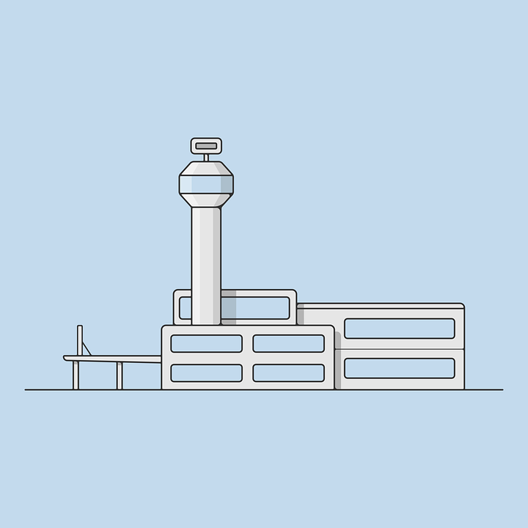
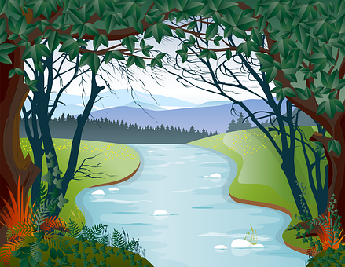
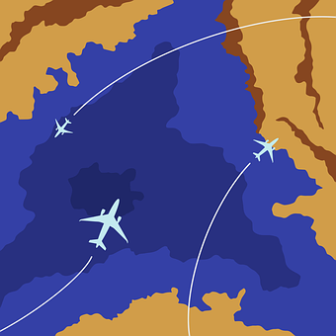

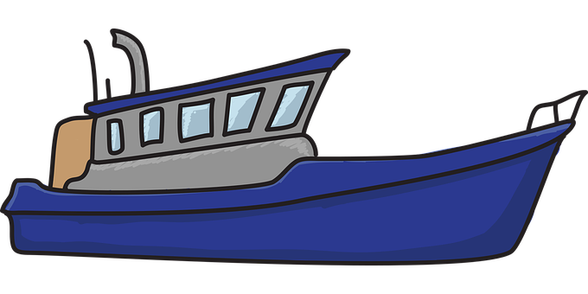
vocabulario
Vocabulario [1/2]
Escucha y pronuncia bien.
el puerto
el aeropuerto
el río
Notes:
Timing: 7 minutes (two slides)
Aim: to present and practise written comprehension and read aloud of previously taught vocabulary and the three new words for this week.
Procedure:
Click to bring up the Spanish word and say the word together with the pupils.

Slide 5

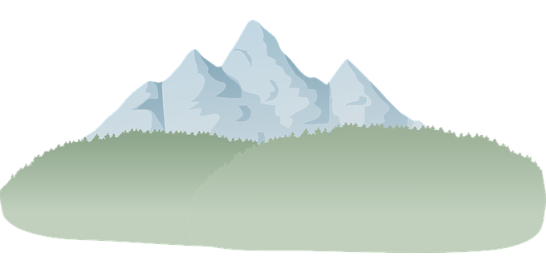



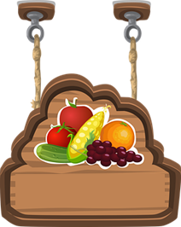
vocabulario
Vocabulario [2/2]
¿Cómo es en español?
la playa
la casa
la montaña
la bandera
el lago
beach
el puerto
flag
market
port
mountain
market
airport
river
house
port, harbour
river
lake
village
flag
lake
mountain
village
airport
beach
house
el pueblo
el río
el mercado
el aeropuerto
Notes:
Timing: 7 minutes (slide 2)
Aim: to present and practise written comprehension and read aloud of previously taught vocabulary and three new words for this week.
Procedure:
1. Click for an English item. Elicit pronunciation of the Spanish from pupils.
2. Click to cover the Spanish word with a picture.
3. Continue with the remaining items.
4. Optional at this stage: elicit the Spanish from pupils, (English prompts reappear on each mouse click) this time without written Spanish support.

Slide 6


muchos, muchas
[many, a lot of, lots of]
Muchos, muchas means many, a lot of, lots of.
We use muchos, muchas before plural nouns. The spelling changes to match gender and number:
masculine
feminine
muchos puertos
muchas playas
many ports
many beaches
Notes:
Timing: 3 minutes
Aim: to introduce muchos,as and how to use it with masculine and feminine plural nouns.
Procedure:
Click through the animations to present the new information.
Elicit English translations for the Spanish examples provided.

Slide 7




escuchar
En clase de geografía.
Escucha. ¿Qué hay en España?
¿Qué menciona? Escucha y escribe las palabras.
Después, marca
 | muchos | muchas
 |  |  | puertos | playas
 |  |  | casas | ríos
 |  |  | ríos | montañas
 |  |  | jardines | playas
 |  |  | aeropuertos | montañas
 |  |  | montañas | ríos
E
E
1
1
2
2
3
3
4
4
5
5
Notes:
Timing: 7 minutes
Aim: to practise aural transcription of plural nouns and their connection to the correct determiner – muchos or muchas.
Procedure:
Pupils write 1-5 in their books.
Click to listen to the example. Pupils listen out for the place that is mentioned and transcribe the noun. (The article is beeped out).
Click to correct.
Pupils now decide whether it should say ‘muchos’ or ‘muchas’.
Click to bring up a new set of audio buttons. Listen to the full sentences (Transcript 2) to check, and reveal written answers.
Elicit what the sentences say that Spain has lots of, in English.
Transcript 1:
Ej. En España hay [muchos] puertos.
1. En España hay [muchas] casas.
2. En España hay [muchos] ríos.
3. En España hay [muchas] playas.
4. En España hay [muchos] aeropuertos.
5. En España hay [muchas] montañas.
Transcript 2:
Ej. En España hay muchos puertos.
1. En España hay muchas casas.
2. En España hay muchos ríos.
3. En España hay muchas playas.
4. En España hay muchos aeropuertos.
5. En España hay muchas montañas.

Slide 8

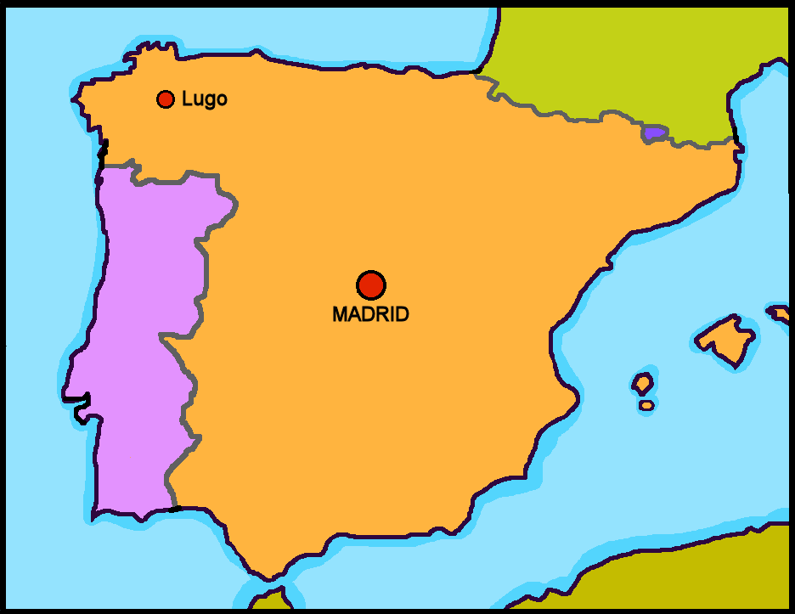

hablar
[1/5]
¿Qué hay en España?
Con tu compañero/a, habla.
En España hay…
a river
two rivers
many rivers
un río
dos ríos
muchos ríos
Notes:
Time: 5 minutes
(Slide 1/5)
Aim: to practise oral sentence building. Targeted features: agreement of many, plural marking
Procedure:
1. Use this slide to model the activity. Elicit Spanish from volunteers and click through the animations to bring up answers.
2. For slide 2-5, pupils work in pairs to produce the full sentence for each picture. Click on inicio to allow pupils to work in pairs for 30 seconds.
3. Click for the Spanish sentence to appear.

Slide 9

hablar
[2/5]
¿Qué hay en España?
Con tu compañero/a, habla
En España hay…
30
S
a port
two ports
many ports
un puerto
dos puertos
muchos puertos
0
INICIO
Notes:
Time: 5 minutes
(Slide 2/5)
Aim: to practise oral sentence building. Targeted features: 1st & 3rd person singular; prepositions
Procedure:
1. Click for English sentence and Spanish prompt words.
2. Click inicio to start the timer.
3. Pupils select from the words given to create and say the sentence out loud before the time elapses.
4. Click for the Spanish sentence to appear.

Slide 10
hablar
[3/5]
¿Qué hay en España?
Con tu compañero/a, habla
En España hay…
30
S
S
a beach
two beaches
many beaches
una playa
dos playas
muchas playas
0
INICIO
Notes:
Time: 5 minutes
(Slide 3/5)
Aim: to practise oral sentence building. Targeted features: 1st & 3rd person singular; prepositions
Procedure:
1. Click for English sentence and Spanish prompt words.
2. Click inicio to start the timer.
3. Pupils select from the words given to create and say the sentence out loud before the time elapses.
4. Click for the Spanish sentence to appear.

Slide 11
hablar
[4/5]
¿Qué hay en España?
Con tu compañero/a, habla
En España hay…
30
S
an airport
two airports
many airports
un aeropuerto
dos aeropuertos
muchos aeropuertos
0
INICIO
Notes:
Time: 5 minutes
(Slide 4/5)
Aim: to practise oral sentence building. Targeted features: 1st & 3rd person singular; prepositions
Procedure:
1. Click for English sentence and Spanish prompt words.
2. Click inicio to start the timer.
3. Pupils select from the words given to create and say the sentence out loud before the time elapses.
4. Click for the Spanish sentence to appear.

Slide 12
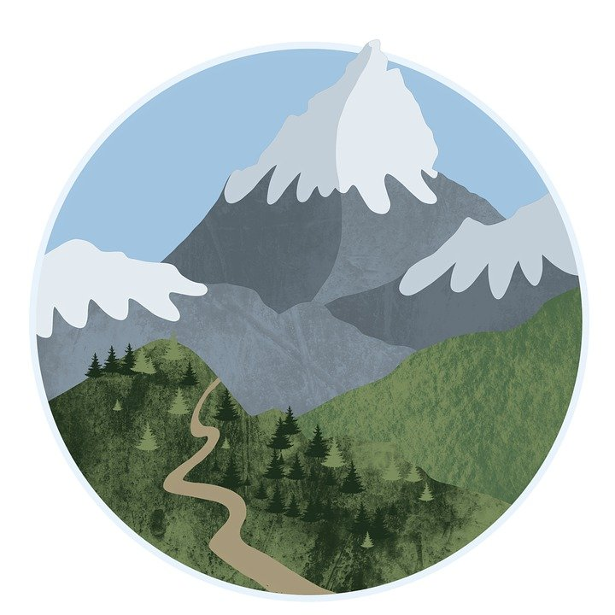
hablar
[5/5]
¿Qué hay en España?
Con tu compañero/a, habla
En España hay…
30
S
a mountain
two mountains
many mountains
una montaña
dos montañas
muchas montañas
0
INICIO
Notes:
Time: 5 minutes
(Slide 5/5)
Aim: to practise oral sentence building. Targeted features: 1st & 3rd person singular; prepositions
Procedure:
1. Click for English sentence and Spanish prompt words.
2. Click inicio to start the timer.
3. Pupils select from the words given to create and say the sentence out loud before the time elapses.
4. Click for the Spanish sentence to appear.

Slide 13
¡adiós!
azul

