Slide 1
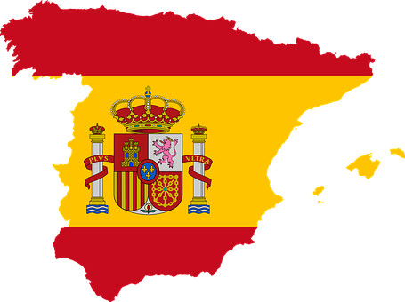
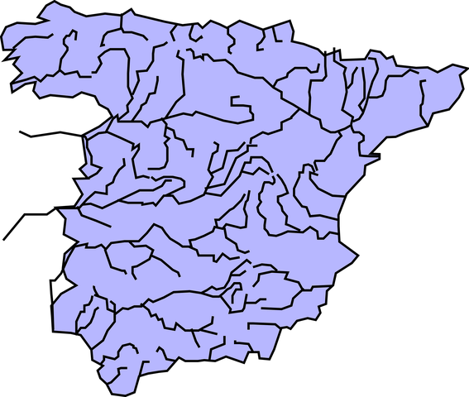
Saying what I and others do
Geografía física
azul
Follow ups 1-5
Notes:
Artwork by Steve Clarke. All additional pictures selected are available under a Creative Commons license, no attribution required.
The frequency rankings for words that occur in this PowerPoint which have been previously introduced in NCELP resources are given in the NCELP SOW and in the resources that first introduced and formally re-visited those words.
Phonics: ge | gi | ga | go | gu | gue | gui
Source: gesto [928] página [598] ganar [295] lago [2151] gusano [4217] juguete [3163] guitarra [2705]
Cluster: gemelo/a [>5000] genial [2890] colegio [628] imaginar [500] domingo [693] galleta [>5000] canguro [>5000] gota [2391] hoguera [>5000] seguir [99] guiso [>5000] guerra [283]
Vocabulary (new words in bold): haeropuerto [2492] puerto [1077] río [496]
Revisit 1: hace [26] invierno [1813] otoño [3504] primavera [2735] verano [1139] frío [1020] calor [945] sol [383] cuando [57] + revise week 1 & 2 vocabulary + hacer [hago]
Revisit 2: armario [5000] cosa [69] habitación [1069] piso [889] radio [933] televisión [825] bicicleta [3684] cama [609] cuaderno [3301] gato [1728] idea [247] oso [4449] perro [888]
Glossed words: llamar [122] pasar [68] habitante [1121] menos [117]
For any other words that occur incidentally in this PowerPoint, frequency rankings will be provided in the notes field wherever possible.
Source: Davies, M. and Davies, K. (2018). A frequency dictionary of Spanish: Core vocabulary for learners (2nd ed.). Routledge: London

Slide 2
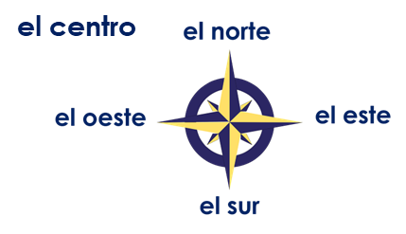
Follow up 1:
Observa el mapa y completa los textos.
Escucha y comprueba tus respuestas.
Órbigo
Pisuerga
pronunciar
Los ríos ____________ y ________________ están en el norte de España. Pasan por la región de Castilla y León.
El río ____________ está en el este de España. Pasa por las regiones de Murcia, Comunidad Valencia y Andalucía.
El río ________________ está en el oeste de España. Pasa por la región de Extremadura.
Los ríos ____________________ y __________ están en el sur de España. Pasan por la región de Andalucía.
Órbigo
Pisuerga
Segura
Guadiana
Guadiana
Segura
Guadalquivir
Genil
Guadalquivir
Genil
En España hay diecinueve comunidades.
pasar – to pass
Notes:
Timing: 5 minutes
Aim: to practise applying knowledge of ge | gi | ga | go | gu | gue | gui to unknown words.
Procedure: 1. Pupils read the texts in pairs, filling the gaps with the names of the rivers in the map.
2. They then read the shorts texts aloud, focusing in particularly on the SSC ge | gi | ga | go | gu | gue | gui.
2. Click on the play button for pupils to listen to the texts and check their answers.
Click on the culture button to play the sentence. Explain that ‘comunidades’ is the word for areas, regions – the way that Spain is divided up to organise the country – similar to the idea of counties in England.
Frequency of unknown words and cognates: pasar [68]
Source: Davies, M. and Davies, K. (2018). A frequency dictionary of Spanish: Core vocabulary for learners (2nd ed.). Routledge: London

Slide 3
Follow up 2:
Lee el texto. Completa con la palabra correcta.
leer
En España la gente habla normalmente español. Hay mucha gente - 47 millones de habitantes*. España es grande - 500 000 km².(Inglaterra es menos* grande - 245 000 km².). En España hay muchos puertos y muchas montañas. La bandera de España es roja y amarilla. El país es famoso por el sol, el flamenco y por las playas.
_______
1
_______
2
_______
3
_______
_______
_______
5
6
4
_______
_______
7
8
bandera
playas
grande
la gente
habitantes – inhabitants
menos – less, fewer
muchas
muchos
sol
mucha
Notes:
Timing: 6 minutes
Aim: to practise use of the correct forms of mucho to match the noun that follows; to practise written comprehension of previously taught vocabulary and most of this week’s new words.
Procedure:
Pupils first look at the words that follow the gaps. For each one (1-7) they decide which word is needed from the options below and write it down.
Teacher elicits the responses and clicks to reveal the answers.
Pupils then read the text aloud with teacher support, as needed.
Click on the play button to hear an audio version of the text, if desired.
Teachers elicit an oral translation of the text from the class to consolidate meaning of the text.
Frequency of unknown words and cognates: habitante [1121] menos [117]
Source: Davies, M. & Davies, K. (2018). A frequency dictionary of Spanish: Core vocabulary for learners (2nd ed.). Routledge: London

Slide 4
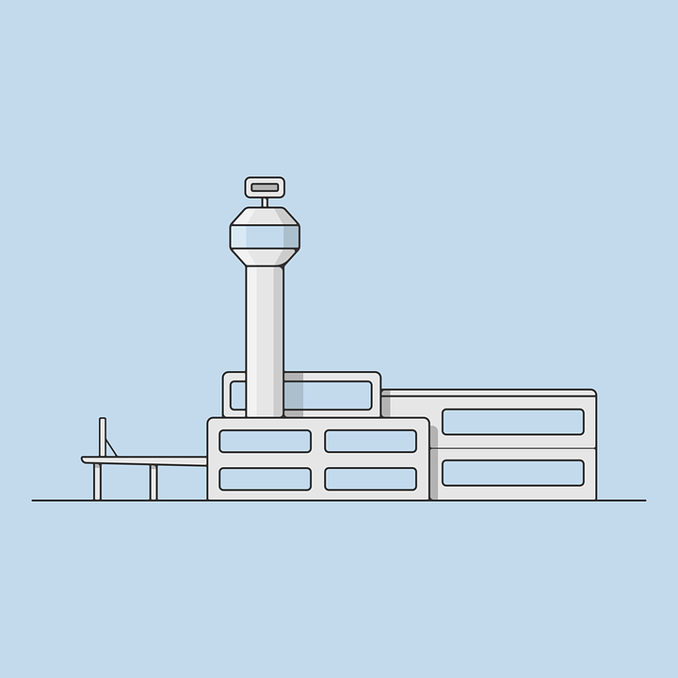
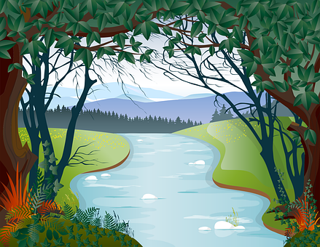
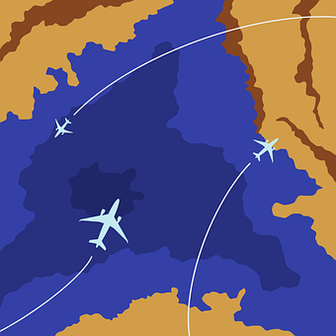
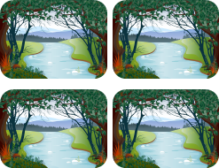
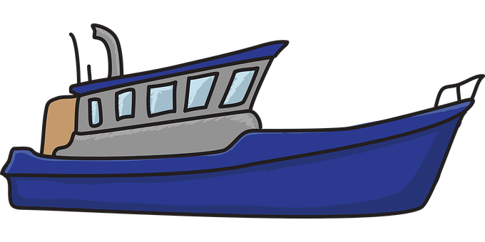
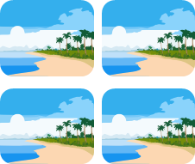
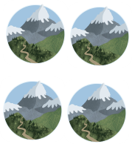
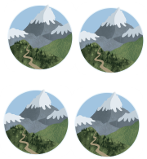
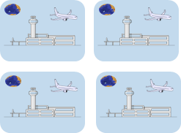
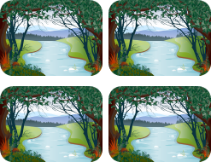
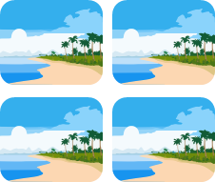
Follow up 3 [1/4]
Escucha y usa tus tarjetas. ¿Cuál es la tarjeta extra?
escuchar
uno / una
o
muchos / muchas
1
1 | 2 | 3
4 | 5 | 6
7 | 8 | 9
La tarjeta extra es…
Notes:
Timing: 5 minutes (four slides)
Aim: to practise aural comprehension of taught vocabulary
Procedure:
Give out the cards and ‘bingo’ cards to pupils before explaining the instructions.
Pupils are going to listen and put their cards in the order they hear the sentences, working from left to right and ending up with a 9-picture 3x3 formation. (NB. Pupils can work in pairs or individually).
Pupils might find it helpful for put their cards more or less as they appear on the right hand side of the slide, in singular and plural groups, just to help them find them more easily, as they listen.
Click the audio icon to listen. The audio is continuous, but at a reasonably slow pace with a pause after each word to allow process. Subsequent rounds of listening reduce the pauses to after each set of three words and increase the pace a little.
Click to allow pupils to check their answers and move on to the next round.
Transcript:
Hay una montaña.
Hay un aeropuerto.
Hay muchos ríos.
Hay muchas playas.
Hay un río.
Hay unas montañas.
Hay unos aeropuertos.
Hay un Puerto.
Hay una playa.

Slide 5
Follow up 3 [2/4]
2
escuchar
1 | 2 | 3
4 | 5 | 6
7 | 8 | 9
La tarjeta extra es…
Notes:
Transcript:
Hay una playa.
Hay muchas playas.
Hay muchas montañas.
Hay muchos ríos.
Hay un aeropuerto.
Hay un río.
Hay una montaña.
Hay unos puertos..
Hay un puerto.

Slide 6
Follow up 3 [3/4] Más rápido
3
escuchar
1 | 2 | 3
4 | 5 | 6
7 | 8 | 9
La tarjeta extra es…
Notes:
Transcript:
Hay un puerto.
Hay muchas montañas.
Hay una playa.
Hay una montaña.
Hay muchos ríos.
Hay muchos aeropuertos.
Hay un río.
Hay un aeropuerto.

Slide 7
Follow up 3 [4/4] Súper rápido
escuchar
4
1 | 2 | 3
4 | 5 | 6
7 | 8 | 9
La tarjeta extra es…
Notes:
Transcript:
Hay un puerto.
Hay muchas montañas.
Hay una playa.
Hay una montaña.
Hay muchos ríos.
Hay muchos aeropuertos.
Hay un río.
Hay un aeropuerto.

Slide 8
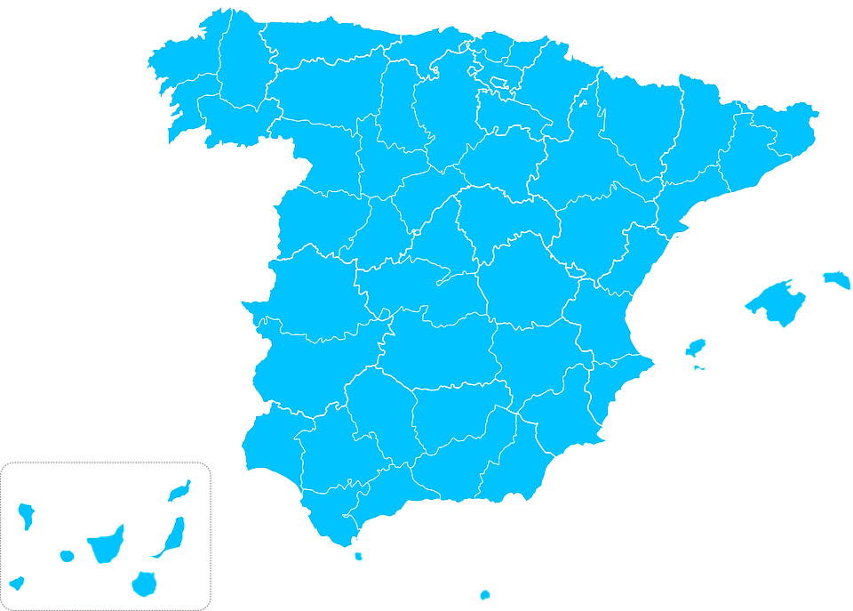
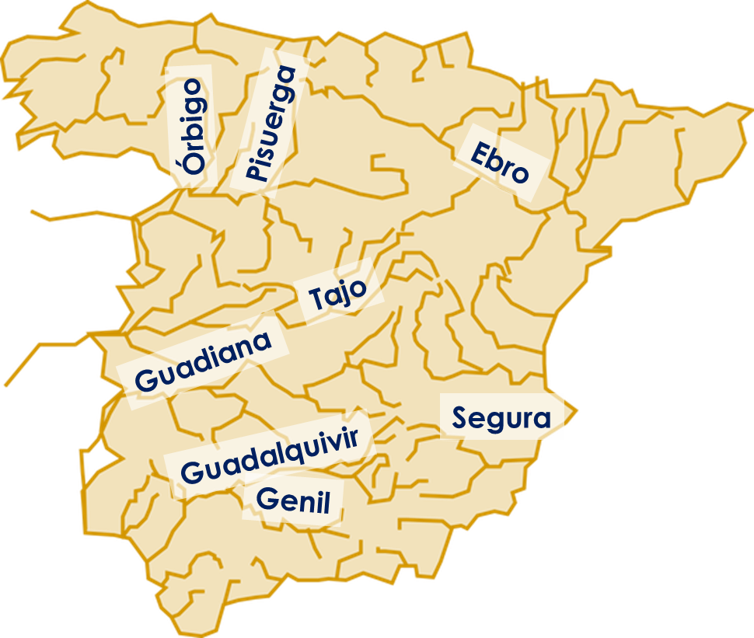
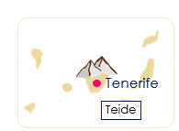
Follow up 4:
¿Qué hay en España?
de La Concha
En España hay muchos | muchas ________.
En _________ hay un |una __________ famoso | famosa , _______.
San Sebastián
hablar
Huesca
Pico Aneto
Barcelona
El Prat
Madrid
Adolfo Suárez - Barajas
Valencia
Puerto de Valencia
Mulhacén
Murcia
Granada
Málaga
Puerto de Murcia
Costa del Sol
Notes:
Timing: 5 minutes
Aim: to use this week’s vocabulary with the correct form of muchos / muchas in guided oral.
Procedure: 1. Pupils work in pairs to describe the map.
llamar [122]

Slide 9
Follow up 5:
Escribe 5 frases y describe España.
⚠ Remember: when using mucho before a noun, the spelling changes to match gender and number.
escribir
Examples
In Spain there is an airport.
In Spain there are many beaches.
In Spain there is a lake.
In Spain there are many ports.
In Spain there are many mountains.
Find the name and location in Spain of a famous example of each of these:
Beach 3 Port 5 Lake
River 4 Mountain 6 Airport
Write the name of it and where it is in Spain.
Notes:
Timing: 10 minutes
Aim: written production of key vocabulary and the correct form of the article (a/an/many).
Procedure:
Teacher to read the instruction and ensure this is clear.
Click to bring up speech bubble and remind pupils about using the correct form of muchos/as.
Click to bring up examples in English to support pupils who might need help. Encourage more linguistically able pupils to come up with their own sentences.
Click to bring up part two of the task. Pupils can conduct their own independent research. This would provide an extra opportunity to apply their SSC knowledge when pronouncing the names of the different places they research.

Slide 10
follow up extra:

Escribe en inglés: can you get at least 15 points?
 | el armario | la cama | la habitación
 | el piso | pero | la cosa
 | el otoño | hace | el sol
 | el calor | la primavera | el frío
 | muchas | la bandera | muchos
 | el río | el aeropuerto | el puerto
vocabulario
(the) wardrobe
(the) bed
(the) room
x3
(the) flat
but
(the) thing
(the) autumn
it is (weather)
(the) sun
x2
(the) heat
(the) spring
(the) cold
many (f)
(the) flag
many (m)
x1
(the) river
(the) airport
(the) port
Notes:
Timing: 7 minutes
Aim: to practise written comprehension of vocabulary from this week and this week’s revisited sets (next slide).
Procedure:
1. Give pupils a blank grid. They fill in the English meanings of any of the words they know, trying to reach 15 points in total.
Note: The most recently learnt and practised words are pink, words from the first revisit are green and those from the second revisit are blue, thus more points are awarded for them, to recognise that memories fade and more effort (heavy lifting!) is needed to retrieve them.

Slide 11
follow up extra:

Escribe en español: can you get at least 15 points?
 | (the) thing | but | (the) bed
 | (the) room | (the) wardrobe | (the) flat
 | (the) cold | (the) heat | (the) spring
 | it is (weather) | (the) sun | (the) autumn
 | (the) airport | (the) river | (the) port
 | many (f) | many (m) | (the) flag
vocabulario
la cosa
pero
la cama
x3
la habitación
el armario
el piso
el frío
el calor
la primavera
x2
hace
el sol
el otoño
el aeropuerto
el río
el puerto
x1
muchas
muchos
la bandera
Notes:
Timing: 7 minutes
Aim: to practise written comprehension of vocabulary from this week and this week’s revisited sets (next slide).
Procedure:
1. Give pupils a blank grid. They fill in the English meanings of any of the words they know, trying to reach 15 points in total.
Note: The most recently learnt and practised words are pink, words from the first revisit are green and those from the second revisit are blue, thus more points are awarded for them, to recognise that memories fade and more effort (heavy lifting!) is needed to retrieve them.

Slide 12
¡adiós!
Geografía física
azul

Slide 13
Handout: follow up 3
|
|
|
|
|
|
|
|
|
|
|
|
|
|
|
|
|
|
|
|
|
|
|
|
|
|
|
|
|
|
|
|
|
|
|
|

Slide 14
Handout: follow up 3
1 | 2 | 3
4 | 5 | 6
7 | 8 | 9
1 | 2 | 3
4 | 5 | 6
7 | 8 | 9

Slide 15
Handout: follow up 5 extra

Escribe en inglés: can you get at least 15 points?
 | el armario | la cama | la habitación
 | el piso | pero | la cosa
 | el otoño | hace | el sol
 | el calor | la primavera | el frío
 | muchas | la bandera | muchos
 | el río | el aeropuerto | el puerto
vocabulario
x3
x2
x1
Notes:
Timing: 7 mniutes
Aim: to practise written comprehension of vocabulary from this week and this week’s revisited sets (next slide).
Procedure:
1. Give pupils a blank grid. They fill in the English meanings of any of the words they know, trying to reach 15 points in total.
Note: The most recently learnt and practised words are pink, words from the first revisit are green and those from the second revisit are blue, thus more points are awarded for them, to recognise that memories fade and more effort (heavy lifting!) is needed to retrieve them.

Slide 16
follow up extra:

Escribe en español: can you get at least 15 points?
 | (the) thing | but | (the) bed
 | (the) room | (the) wardrobe | (the) flat
 | (the) cold | (the) heat | (the) spring
 | it is(weather) | (the) sun | (the) autumn
 | (the) airport | (the) river | (the) port
 | many (f) | many (m) | (the) flag
vocabulario
x3
x2
x1
Notes:
Timing: 7 minutes
Aim: to practise written comprehension of vocabulary from this week and this week’s revisited sets (next slide).
Procedure:
1. Give pupils a blank grid. They fill in the English meanings of any of the words they know, trying to reach 15 points in total.
Note: The most recently learnt and practised words are pink, words from the first revisit are green and those from the second revisit are blue, thus more points are awarded for them, to recognise that memories fade and more effort (heavy lifting!) is needed to retrieve them.

