Slide 1
español, con Quique

Slide 2
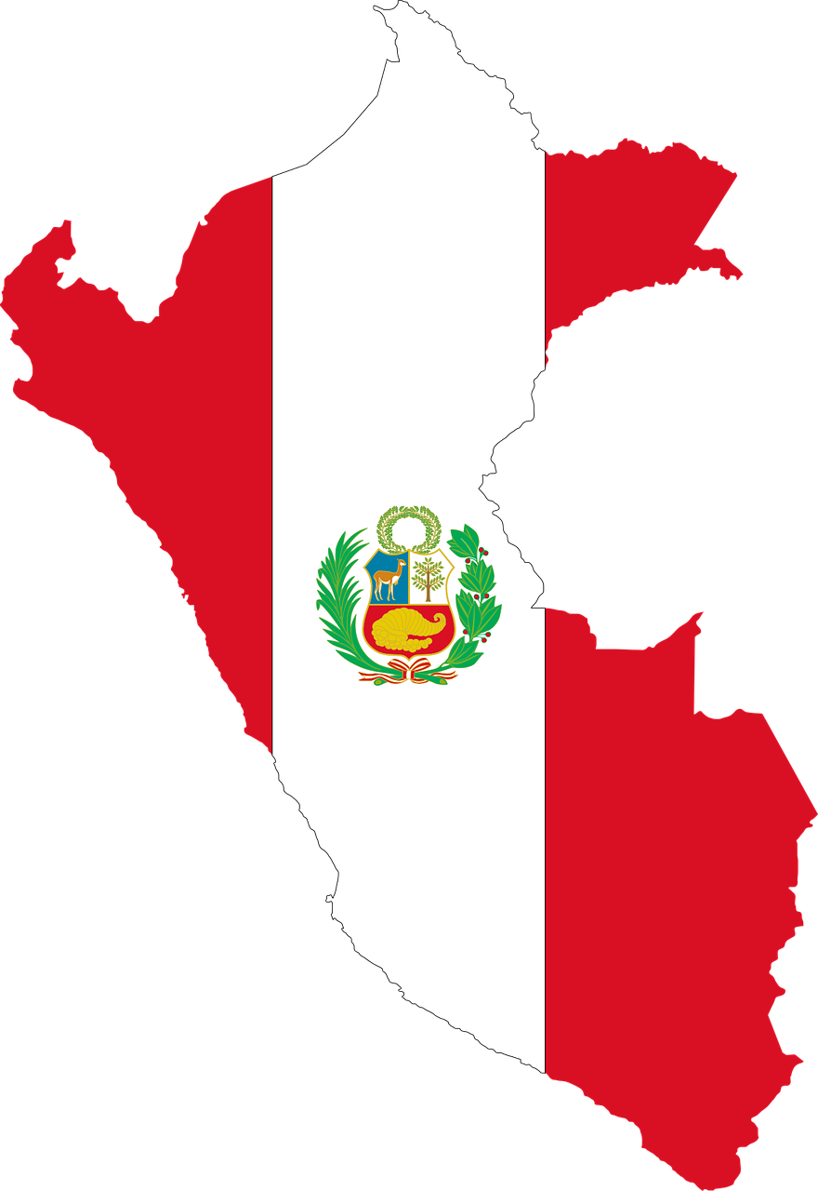
Saying what others and I do
azul
todo, mucho
-AR / -ER verbs: they, s/he
revisit several SSC
Notes:
Artwork by Steve Clarke. All additional pictures selected are available under a Creative Commons license, no attribution required.
The frequency rankings for words that occur in this PowerPoint which have been previously introduced in the resources are given in the SOW (excel document) and in the resources that first introduced and formally re-visited those words.
Phonics: Revisit several SSC - [z] [ca] [co] [cu] [ce] [ci] [ch] [que] [qui]
Vocabulary (new words in bold): bandera [2446] desfile [4514] pan [1342] visitante [2428] mucho [41] todo [472] todo el mundo [n/a]
Revisit 1: hacer [26] haces dibujo [1726] foto [882] imagen [384] derecha [1573] izquierda [1352] tarjeta [1958] a [8]
Revisit 2: ayudar [328] limpiar [1713] tocar [327] abuela [783] caballo [907] casa [106] cocina [1214] guitarra [2705] vaca [2775] de [2] dentro [548] fuera [299]
Source: Davies, M. & Davies, K. (2018). A frequency dictionary of Spanish: Core vocabulary for learners (2nd ed.). Routledge: London
For any other words that occur incidentally in this PowerPoint, frequency rankings will be provided in the notes field wherever possible.

Slide 3
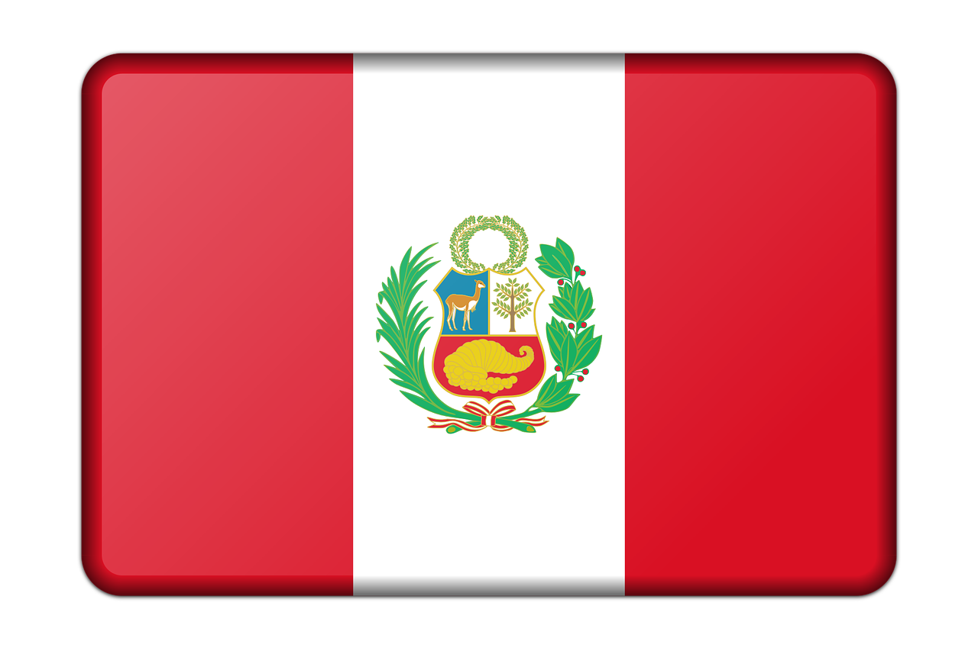
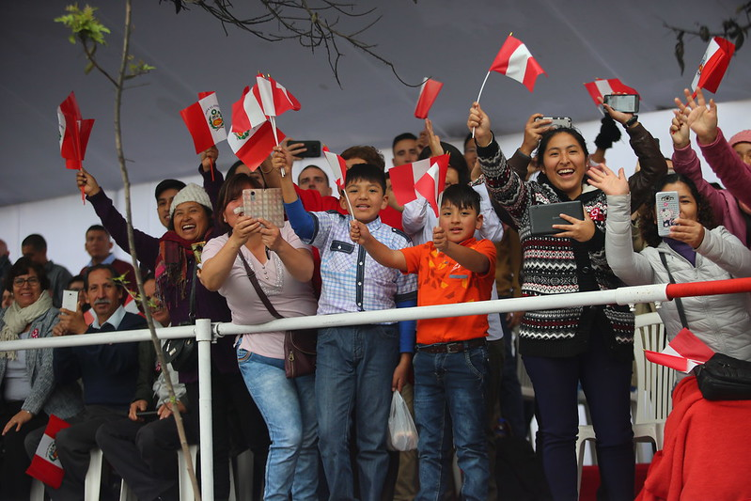
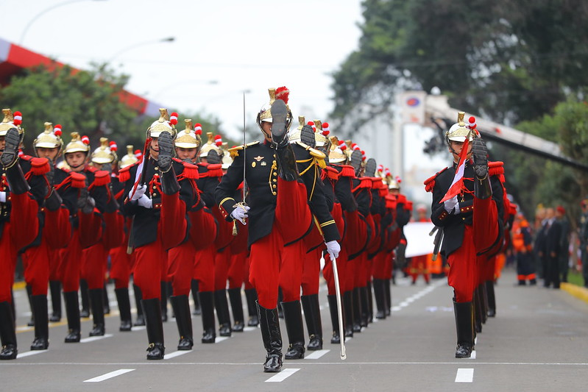
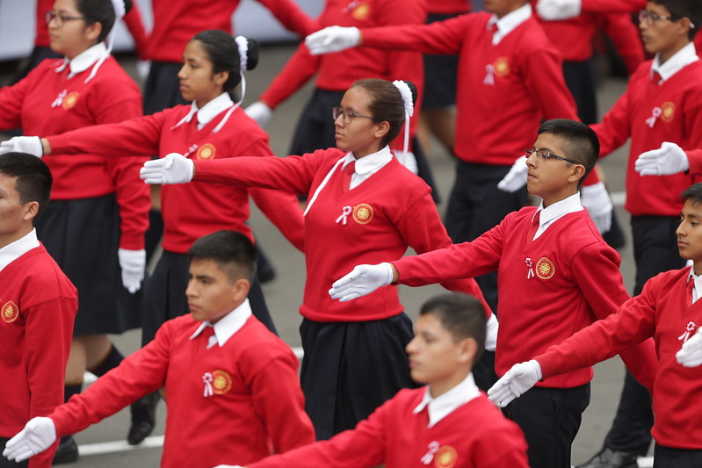
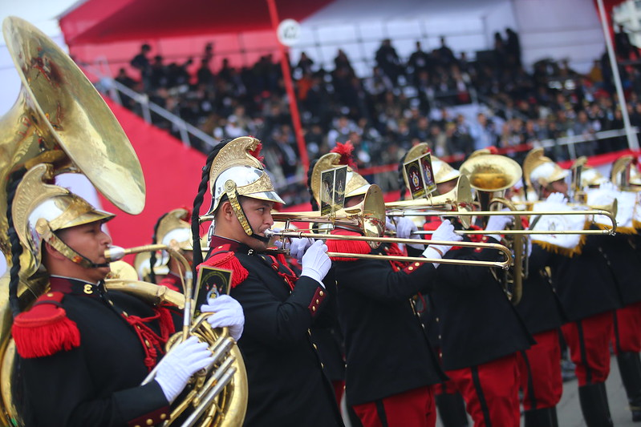
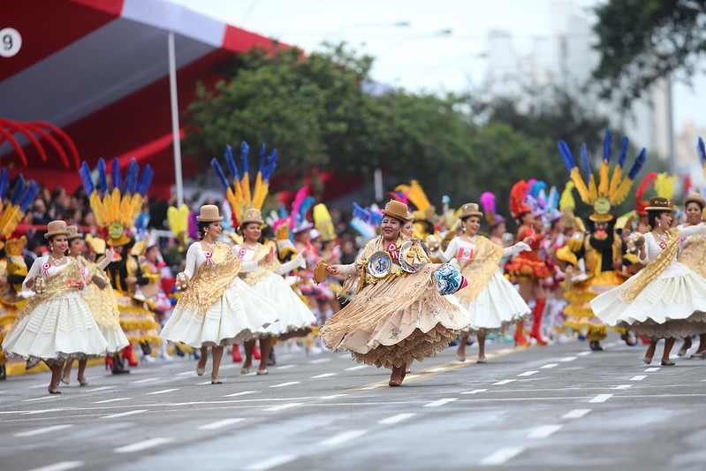
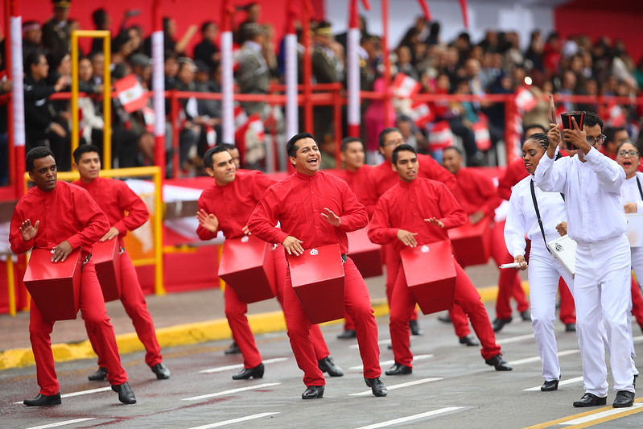
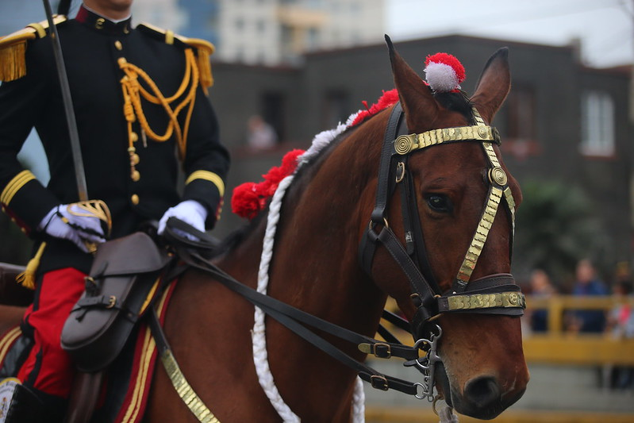
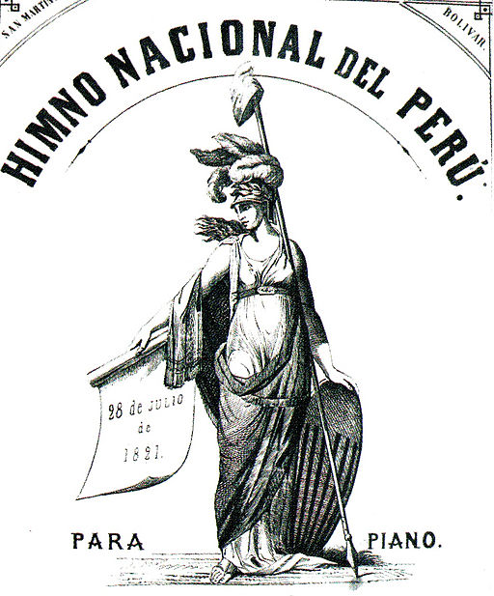
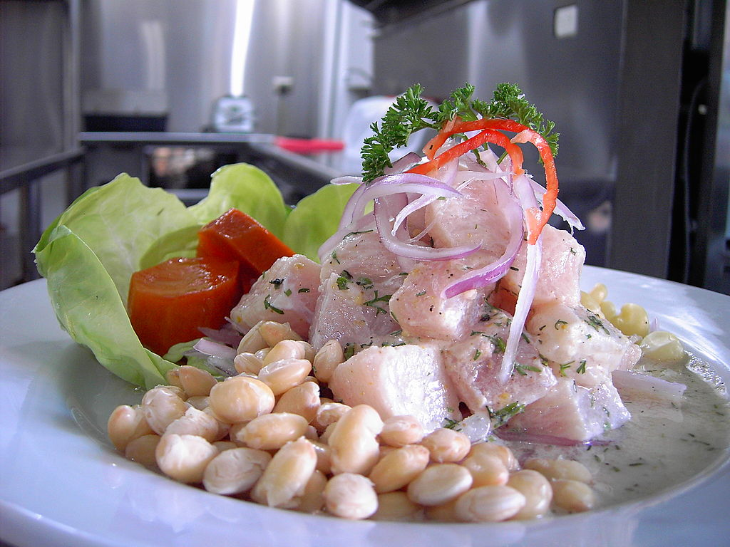
Fiestas Patrias en Perú
A cajón is a traditional drum. You usually sit on it to play it but here they are wearing them.
Peru became an independent country in 182. From 1533 to 1821 Peru was ruled by Spain.
The Peruvian escarapela is a red and white rosette worn on special celebration days like Fiestas Patrias.
On 29 July in Lima there is the Gran Parada (great parade). It includes parades (desfiles) of military and school pupils.
By law everyone must izar (hoist) the bandera (flag) of Peru in their houses.
Ceviche is a famous Peruvian dish. It is made with raw fish and is absolutely delicious!
Pronuncia las palabras.
pronunciar
1 | 2 | 3 | 4
5 | 6 | 7 | 8
9 | 10 | 11 | 12
60
izar la bandera nacional en las casas
celebrar la independencia
hacer muchas fotos
llevar una escarapela
S
mirar el desfile Cívico Militar
participar en el desfile escolar
escuchar música tradicional
bailar en la calle
0
cantar el himno nacional
tocar el cajón
ver los caballos
comer ceviche
INICIO
Notes:
Timing: 6 minutes
Aim: to practise read aloud of a mixture of familiar and unfamiliar words; to give an introduction to this week’s theme of festivals and celebrations in Peru
Procedure:
Tell pupils that this week they are going to learn about two important celebrations in Peru and that these are pictures of the first one – the Fiestas Patrias en Perú (their national day celebrations which are 28 and 29 July every year).
Pupils work in pairs to practise pronouncing activities that are part of these national celebrations.
Teacher elicits pronunciation from pupils and clicks on each picture (as necessary) to hear the phrase pronounced.
Teacher to clarify the meaning of unknown words and cultural references by clicking to bring up callouts.
Transcript:
izar la bandera nacional en las casas
celebrar la independencia
hacer muchas fotos
llevar una escarapela
mirar el desfile Cívico Militar
participar en el desfile escolar
escuchar música tradicional
bailar en la calle
tocar cajón
10. ver los caballos
11. cantar el himno nacional
12. comer ceviche
Picture attributions: 1. Llevar una escarapela – Tibetan Pop Rocks, CC BY-SA 4.0, via Wikimedia Commons 2. Comer el ceviche - Picanteria karol, CC BY-SA 4.0, via Wikimedia Commons
3. Celebrar la Independencia - LLs, CC BY-SA 4.0, via Wikimedia Commons
4. Hacer muchas fotos – Presidencia Perú - https://www.flickr.com/photos/presidenciaperu/albums/72157699186055384 Link to licence: https://creativecommons.org/licenses/by-nc-sa/2.0/ 5. Participar en el desfile escolar – Presidencia Perú 6. Mirar el desfile Cívico Militar – Presidencia Perú 7. Bailar en la calle – Presidencia Perú 8. Escuchar música tradicional – Presidencia Perú 9. Tocar cajón – Presidencia Perú
10. Cantar el himno nacional - Fernando murillo gallegos, Public domain, via Wikimedia Commons
11. Ver los caballos – Presidencia Perú

Slide 4
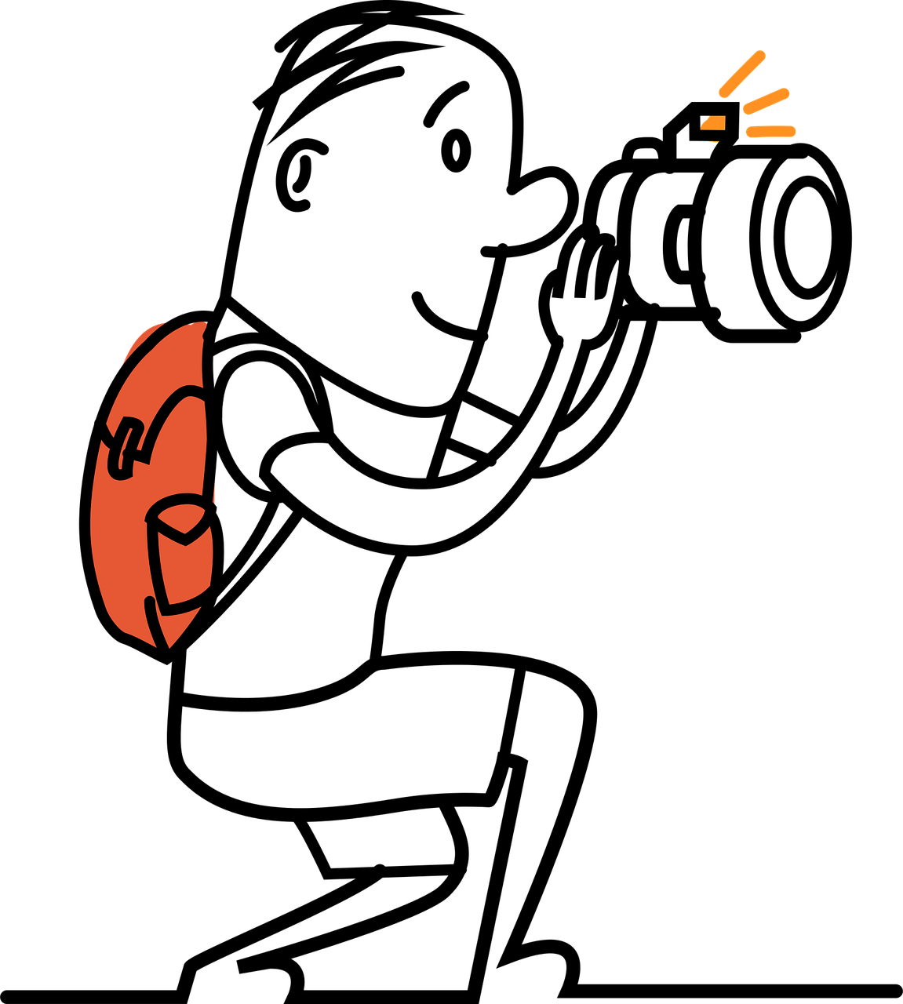
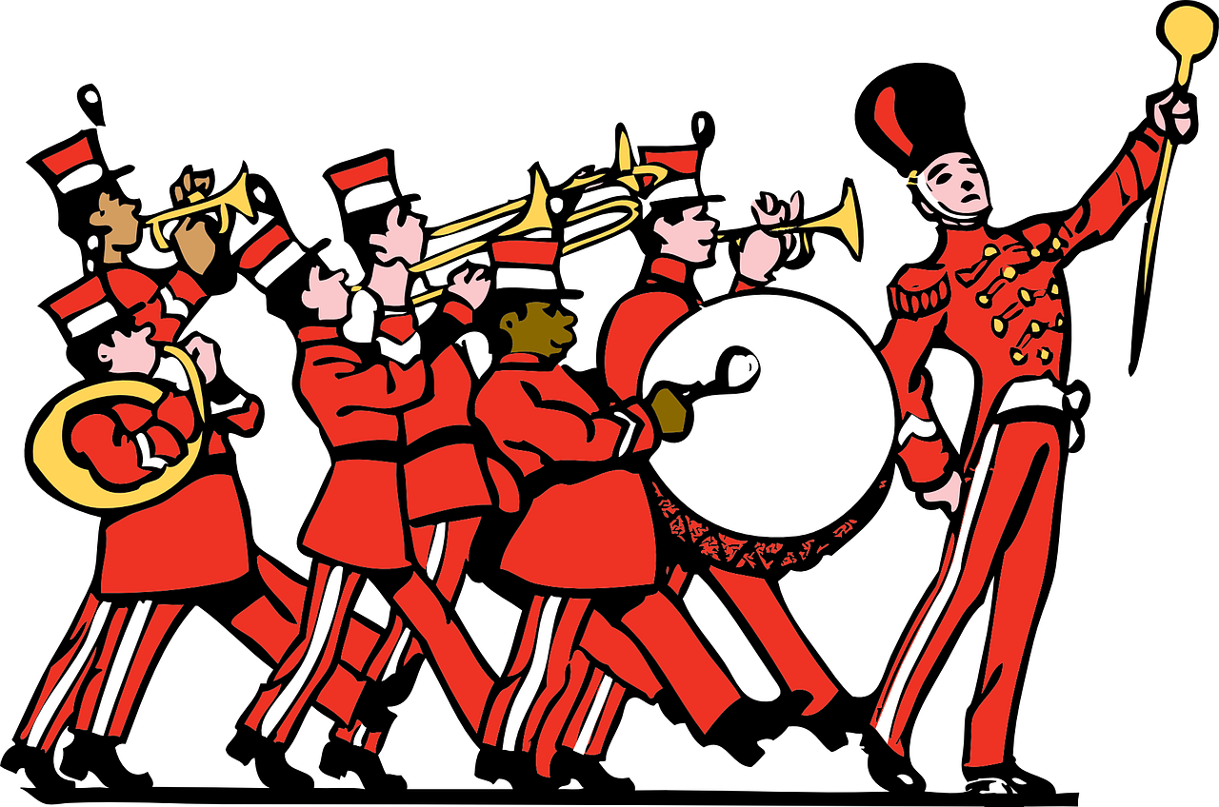
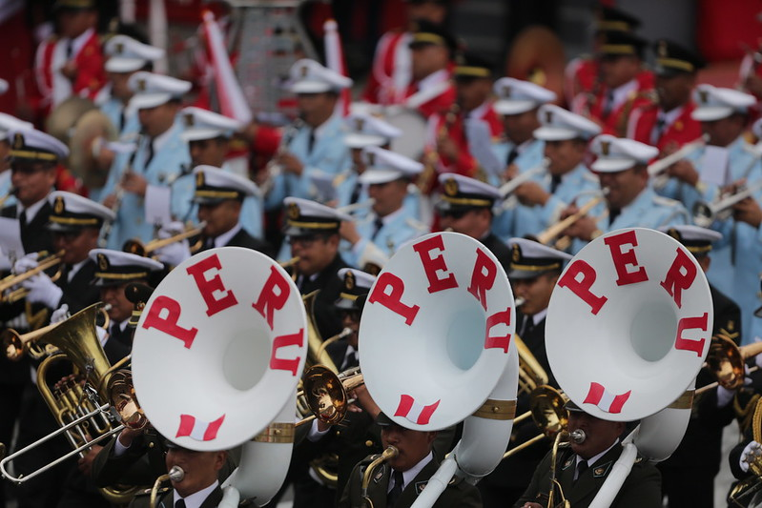
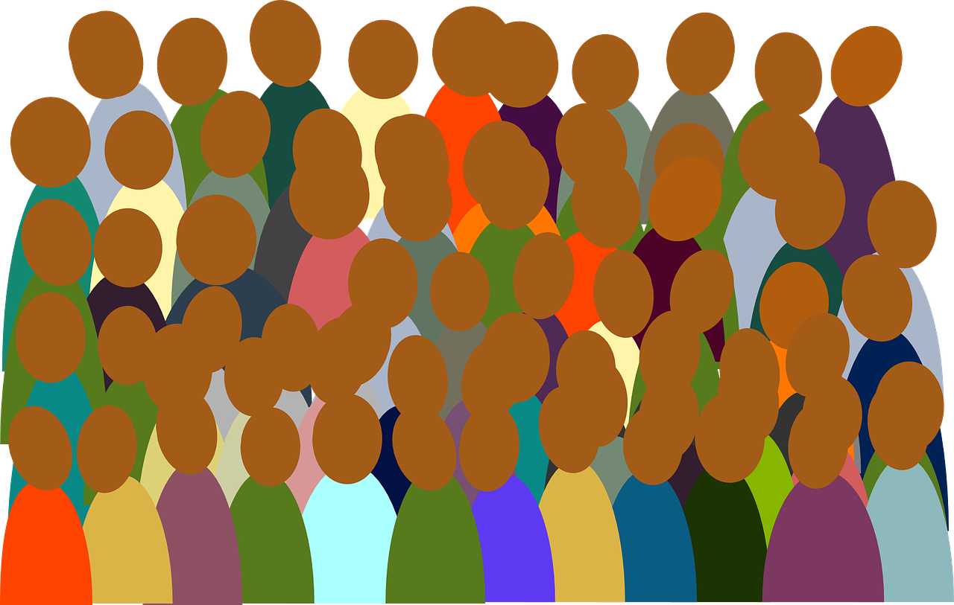
vocabulario
Vocabulario
¿Cómo es en español?
la imagen
el/la visitante
el desfile
la bandera
la izquierda
image
right
la derecha
bread
everybody
everybody
everything, all (of)
everything, all (of)
visitor
much, a lot (of)
image
bread
flag
parade
much, a lot (of)
parade
left
flag
right
left
visitor
mucho
todo
todo el mundo
el pan
everything, all (of)
much, a lot (of)
Notes:
Timing: 5 minutes
Aim: to present and practise written comprehension and read aloud of previously taught vocabulary and two new words for this week.
Procedure: 1. Click for an English item. Elicit pronunciation of the Spanish from pupils.
2. Click to cover the Spanish word with a picture.
3. Continue with the remaining items.
4. Optional at this stage: elicit the Spanish from pupils, (English prompts reappear on each mouse click) this time without written Spanish support.

Slide 5
todo
⚠ We also just use todos with a plural verb to mean all/everyone: Todos hablan español. All speak/Everyone speaks Spanish.
[everything | all (of)]
Todo means everything.
Veo todo.
I see everything.
We also use todo before a noun to mean all (of). The spelling changes to match gender and number:
singular
plural
todo el día
all day
todos los visitantes
all (of) the visitors
toda la gente
all (of) the people
todas las personas
all (of) the people
⚠ la gente is singular in Spanish: Toda la gente habla español. All the people speak / Everyone speaks Spanish.
⚠ Todas las personas hablan español. All the people speak Spanish.
Notes:
Timing: 3 minutes
Aim: to introduce todo and how to use it with masculine and feminine singular and plural nouns.
Procedure:
Click through the animations to present the new information.
Elicit English translations for the Spanish examples provided.

Slide 6
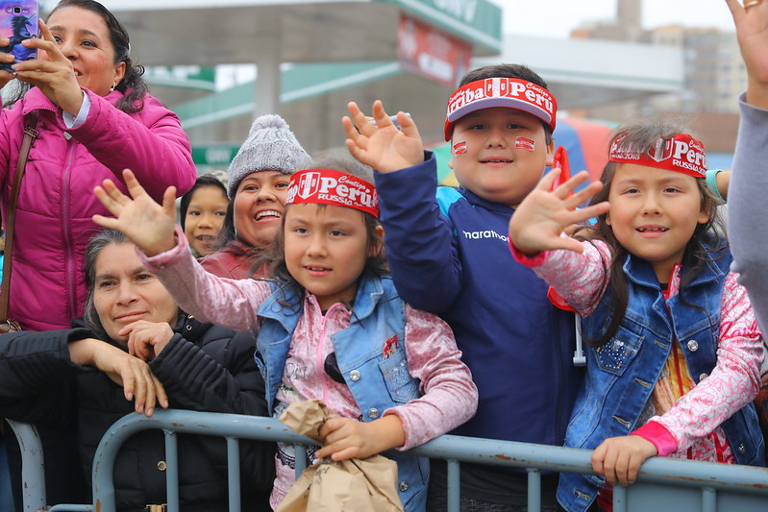
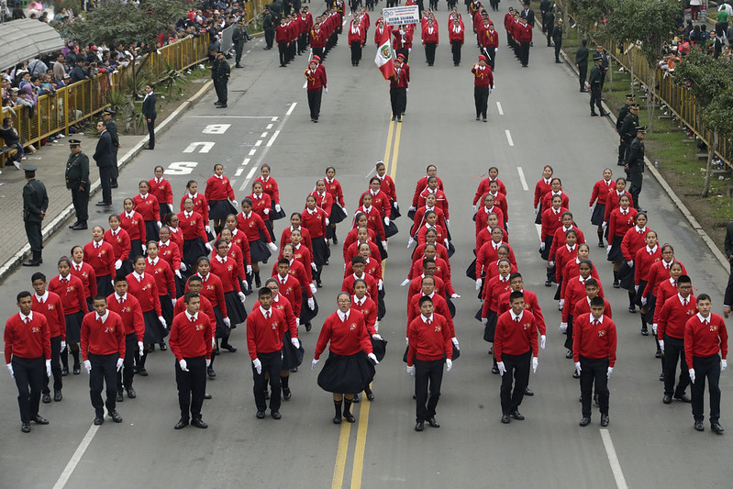
escuchar
Escucha. Luis describe las Fiestas Patrias. ¿Es ‘toda la gente’ o ‘todos’?
¿Qué hacen las personas? Escribe en inglés.
 | Toda la gente (everyone) | todos (all - they)
1
2
3
4
5
6
7
8
1
1
… celebrates the independence of Peru.
2
2
… put the national flag up in the houses.
3
3
… listen to a message from the President.
4
4
… wear a rosette.
5
5
… watches the parades in the street.
6
6
… goes to parties with friends and relatives.
… prepare special food.
7
7
la escarapela – rosette el mensaje – message la calle - street
8
8
… listens to music, sings and dances.
Notes:
Timing: 8 minutes
Aim: to practise aural recognition of verbs in the 3rd persons singular and plural; to understand new information about Peru’s national days.
Procedure:
Pupils listen to each phrase.
First, they decide if the missing words must be ‘toda la gente’ (singular verb) or ‘todos’ (plural verb).
Click to check the answers.
Click to listen again. On the 2nd time of listening, pupils write the rest of the phrase (i.e., the part following toda la gente/todos) in English.
Click to reveal answers.
Transcript:
1 El 28 de julio [toda la gente] celebra la independencia del Perú. 2 [Todos] ponen la bandera nacional en las casas.
3 [Todos] escuchan un mensaje del Presidente.
4 [Todos] llevan una escarapela.
5 [Toda la gente] mira los desfiles en la calle.
6 [Toda la gente] va a fiestas con amigos y familiares. 6 [Todos] preparan comida especial.
7 Por la noche [toda la gente] escucha música, canta y baila.
Picture attribution: Presidencia Perú - https://www.flickr.com/photos/presidenciaperu/albums/72157699186055384 Link to licence: https://creativecommons.org/licenses/by-nc-sa/2.0/

Slide 7
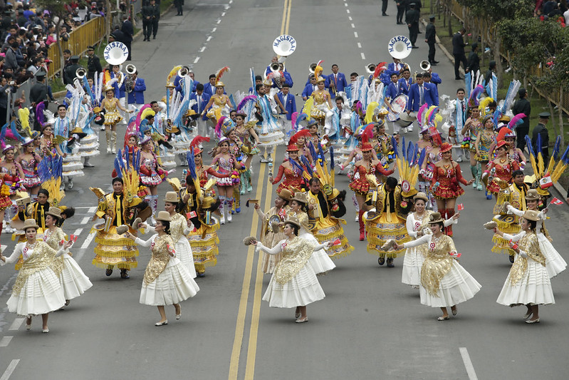
mucho
[much | a lot of]
Mucho means much, a lot (of).
Veo mucho.
I see a lot.
Mucha gente visita Lima (la capital de Perú) el 29 de julio para la Gran Parada.
We also use mucho before a noun. The spelling changes to match gender and number:
singular
plural
mucho sol
a lot of sun
muchos visitantes
a lot of visitors
mucha gente
a lot of people
muchas personas
a lot of people
Notes:
Timing: 2 minutes
Aim: to introduce mucho and how to use it with masculine and feminine singular and plural nouns.
Procedure:
Click through the animations to present the new information.
Elicit English translations for the Spanish examples provided.

Slide 8
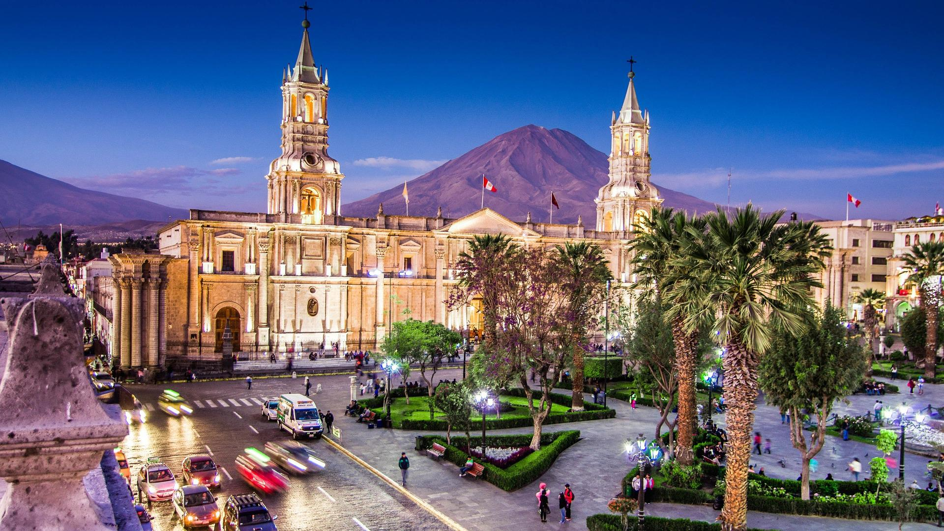
leer
por todas partes - everywhere
¡Es 28 de julio! Luis está en Arequipa y manda un mensaje a Sofía y Quique!
Lee el texto. Escribe mucho, mucha, muchos o muchas.
people
parade
grandma
visitor
la gente
el desfile
la abuela
el/la visitante
¡Hola Sofía y Quique! ¡Felices Fiestas Patrias! Hoy hace mucho sol y hay mucha gente dentro de la plaza. Todo el mundo está muy contento porque ¡no hay colegio! Veo muchas banderas por todas partes. Muchos visitantes son de fuera – de muchos países del mundo - pero también hay muchas personas de Arequipa. La abuela y yo miramos muchos desfiles fantásticos...
Arequipa
1
2
_______
_______
3
4
_______
_______
5
_______
6
_______
7
_______
inside
everybody
country
outside
dentro
todo el mundo
el país
fuera
Notes:
Timing: 6 minutes
Aim: to practise use of the correct forms of mucho to match the noun that follows; to practise written comprehension of previously taught vocabulary and most of this week’s new words.
Procedure:
Pupils first look at the words that follow the gaps. For each one (1-7) they decide which form of mucho is needed and write it down.
Teacher elicits the responses and clicks to reveal the answers.
Pupils then read the text aloud with teacher support, as needed.
Click on the image of Luis to hear an audio version of the text, if desired.
Pupils focus on the eight English words and identify the Spanish words from the text.
Pupils can volunteer answers in any order – teacher clicks on the English word and the Spanish translation appears.
4. Teachers elicit an oral translation of the text from the class to consolidate meaning of the text.
Note: Teachers can tell pupils that Arequipa is Peru’s 2nd city (after the capital Lima). It’s home to around 1 million people and sits in a valley surrounded by three (dormant) volcanoes.
Frequency of unknown words and cognates: patrio [>5000]
Source: Davies, M. & Davies, K. (2018). A frequency dictionary of Spanish: Core vocabulary for learners (2nd ed.). Routledge: London

Slide 9
¡adiós!
azul

