Slide 1


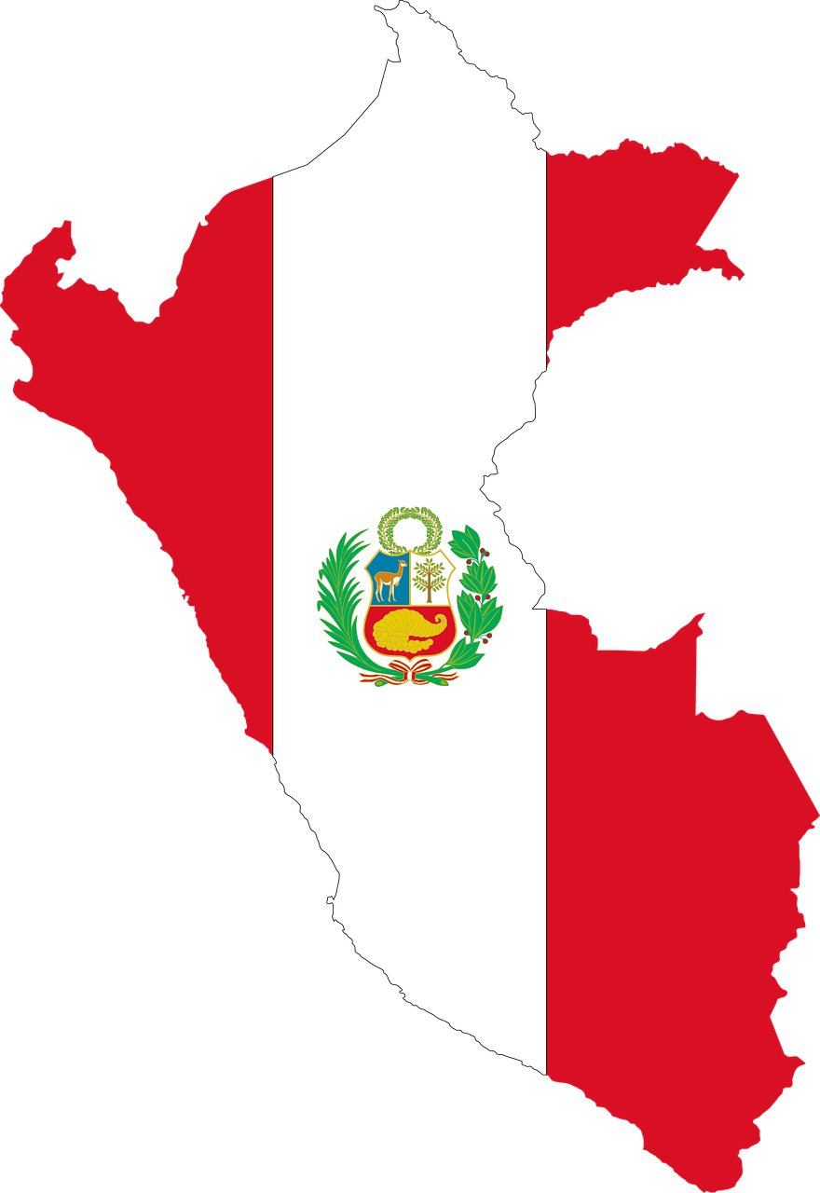


Saying what I and others do
azul
Follow ups 1-5
Notes:
Artwork by Steve Clarke. All additional pictures selected are available under a Creative Commons license, no attribution required.
The frequency rankings for words that occur in this PowerPoint which have been previously introduced in NCELP resources are given in the NCELP SOW and in the resources that first introduced and formally re-visited those words.
Phonics: Revisit several SSC - [z] [ca] [co] [cu] [ce] [ci] [ch] [que] [qui]
Vocabulary (new words in bold): bandera [2446] desfile [4514] pan [1342] visitante [2428] mucho [41] todo [472] todo el mundo [n/a]
Revisit 1: hacer [26] haces dibujo [1726] foto [882] imagen [384] derecha [1573] izquierda [1352] tarjeta [1958] a [8]
Revisit 2: ayudar [328] limpiar [1713] tocar [327] abuela [783] caballo [907] casa [106] cocina [1214] guitarra [2705] vaca [2775] de [2] dentro [548] fuera [299]
For any other words that occur incidentally in this PowerPoint, frequency rankings will be provided in the notes field wherever possible.
Source: Davies, M. and Davies, K. (2018). A frequency dictionary of Spanish: Core vocabulary for learners (2nd ed.). Routledge: London

Slide 2


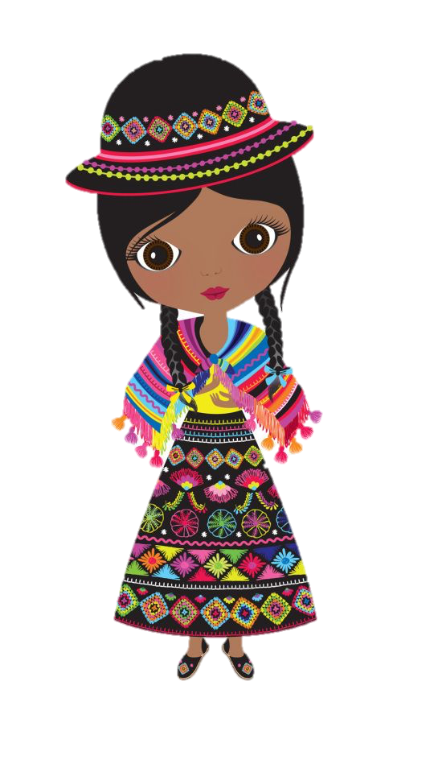
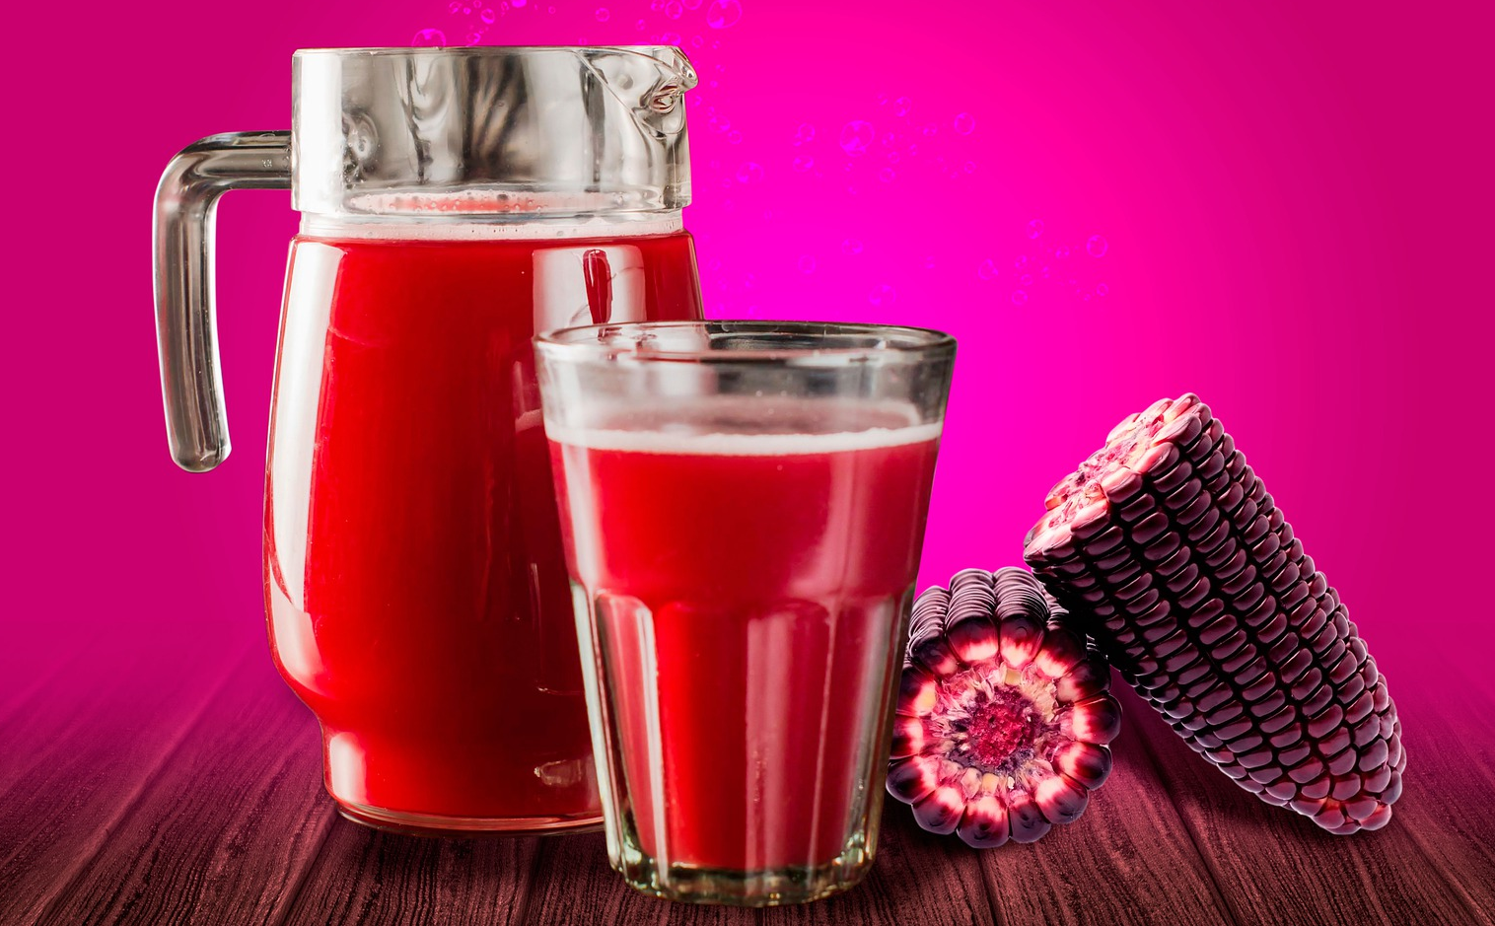
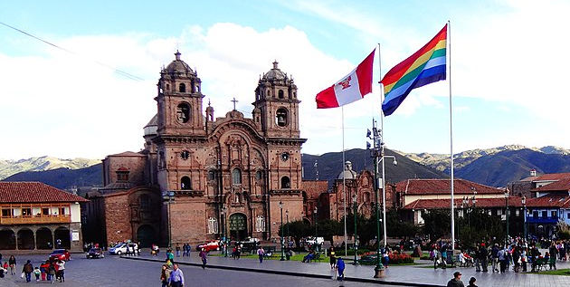
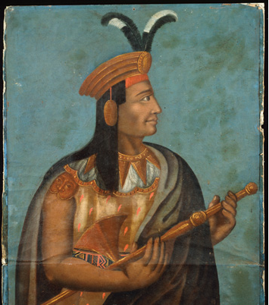
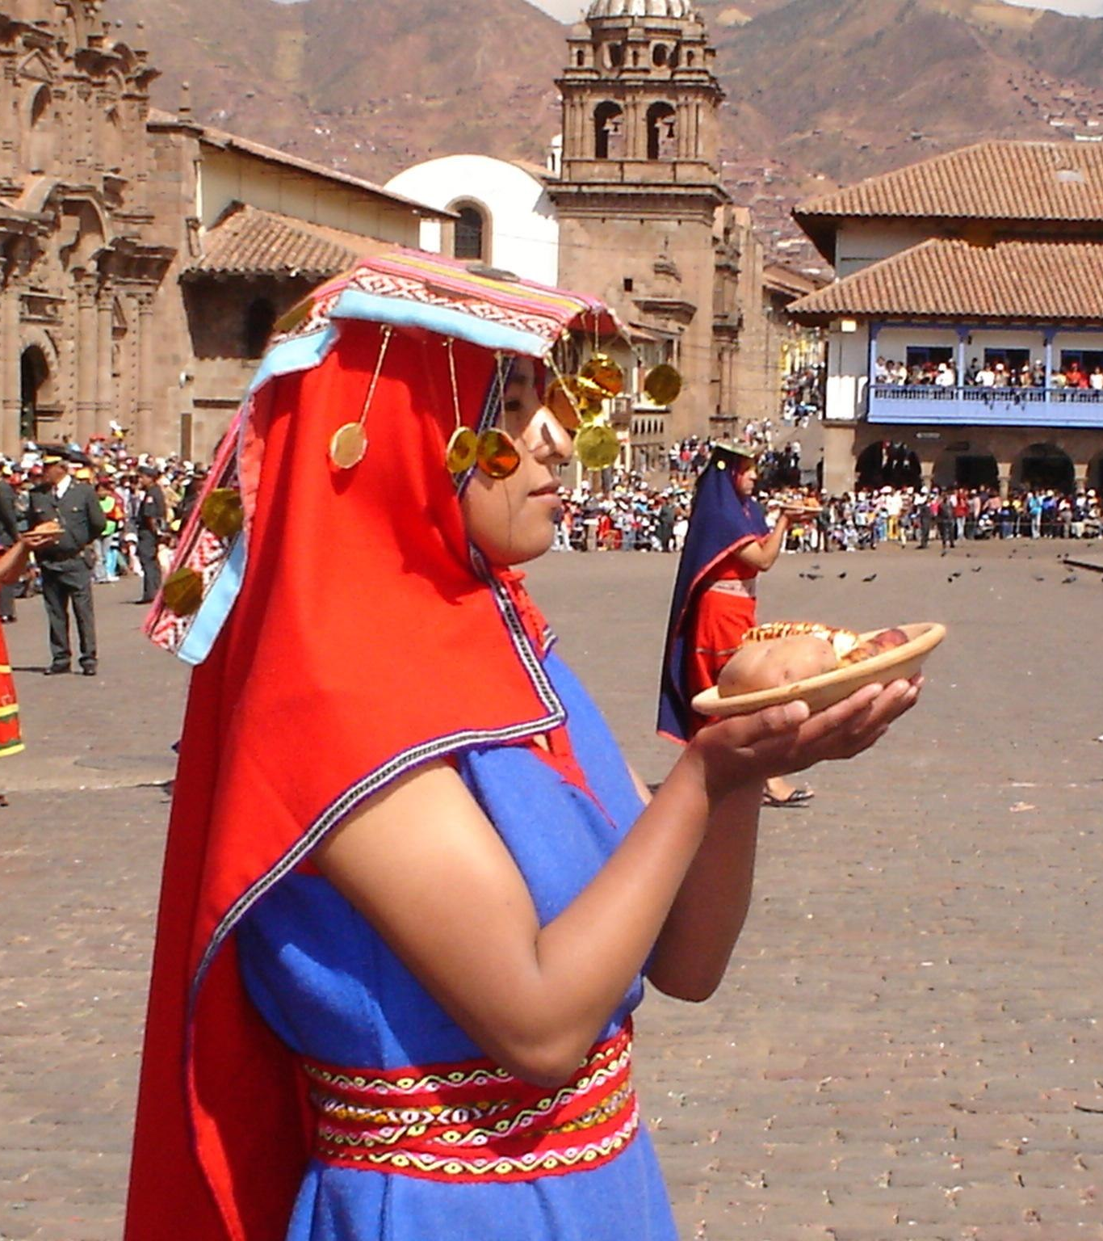
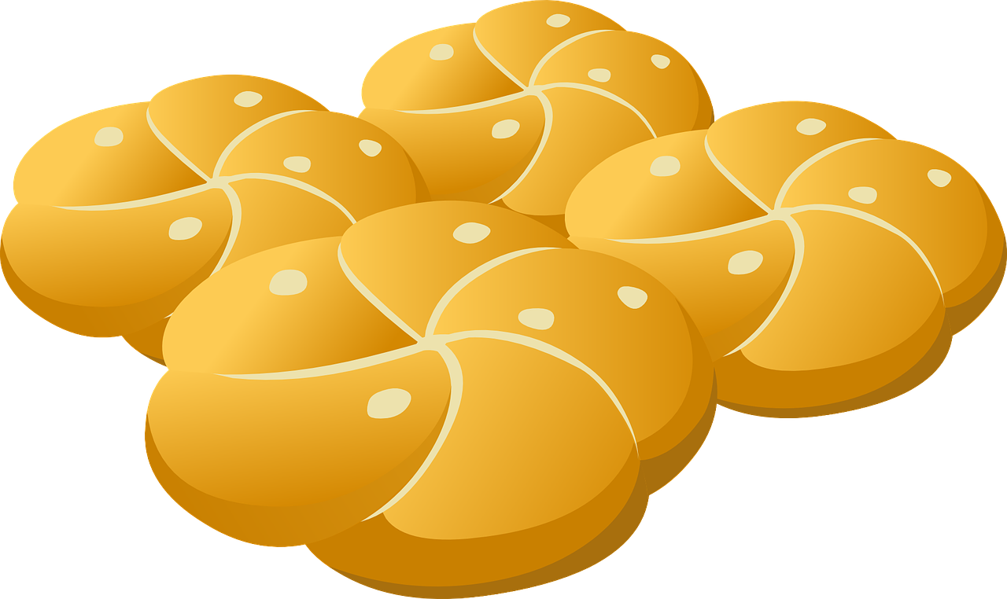
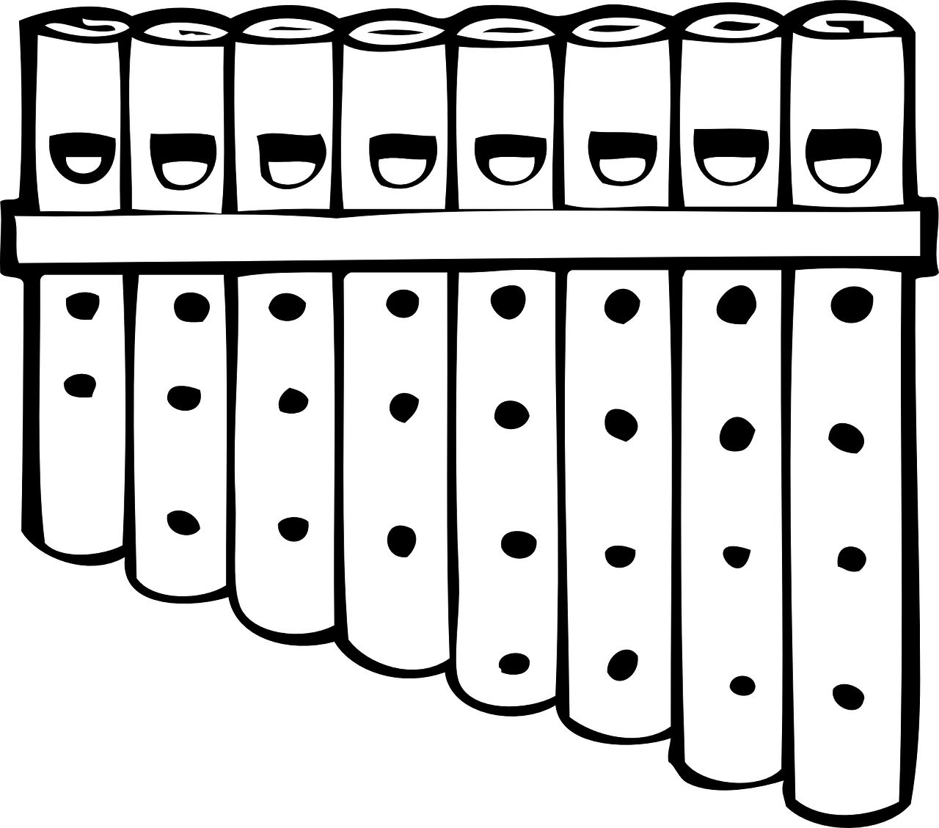
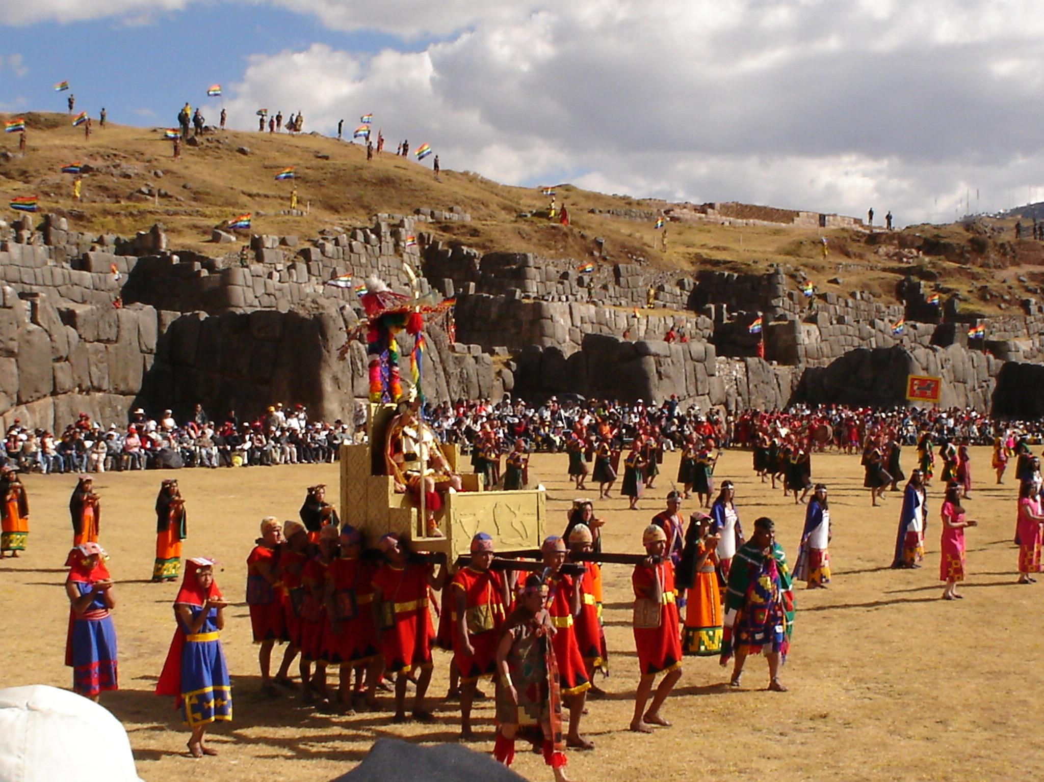
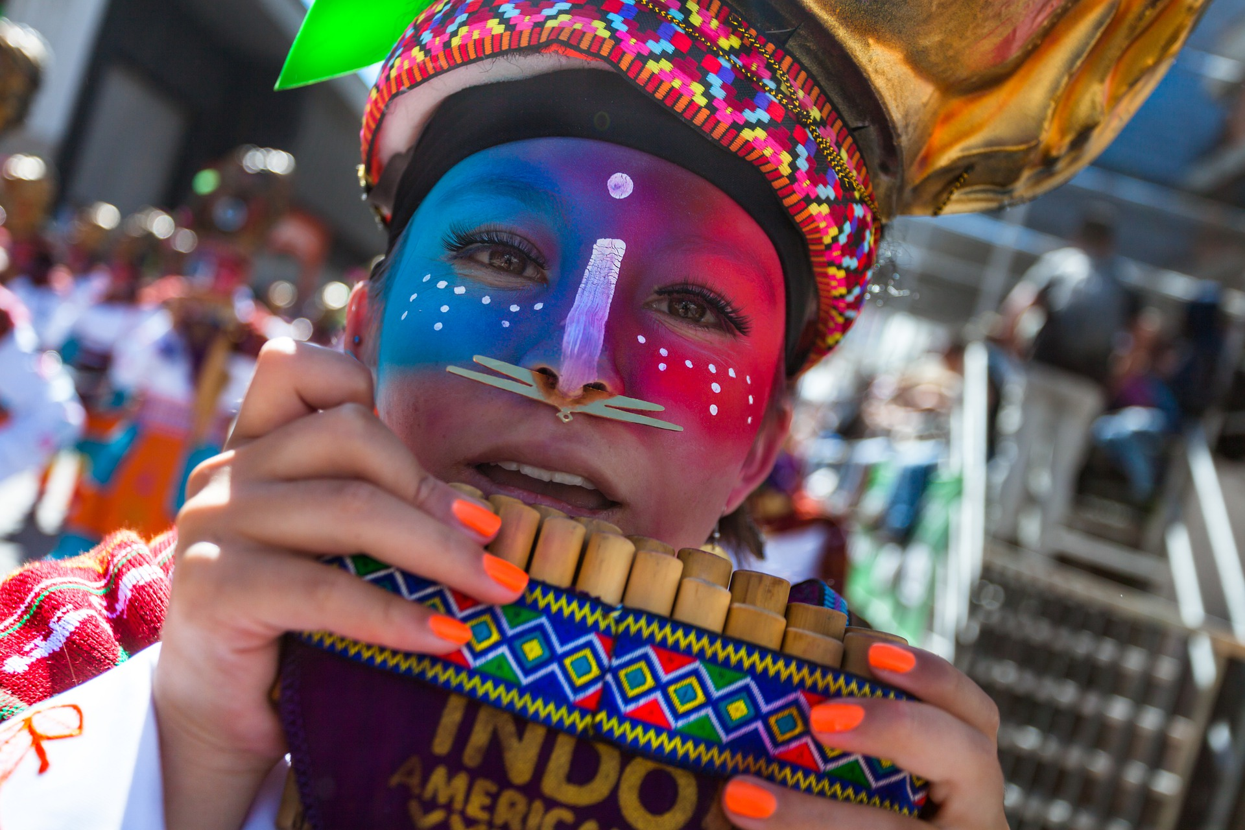
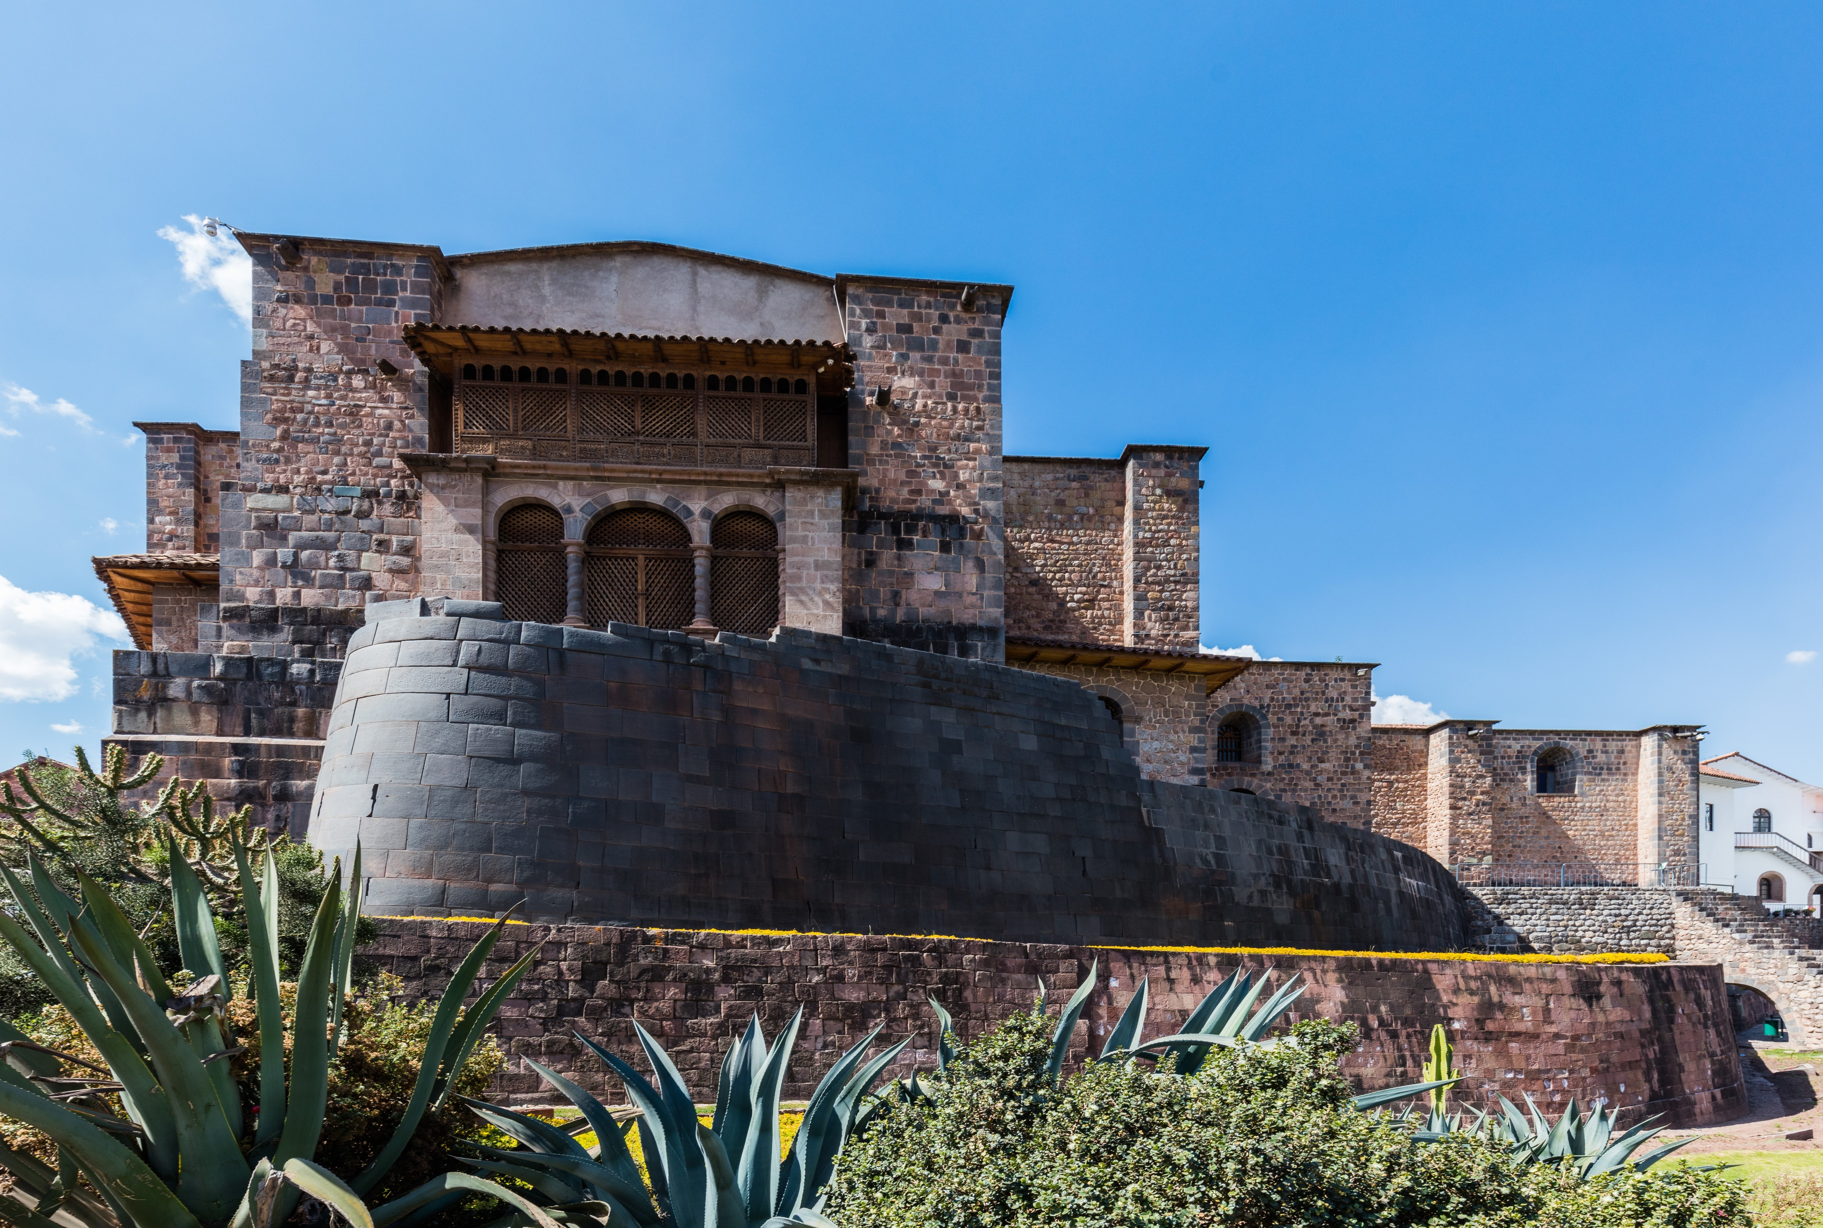
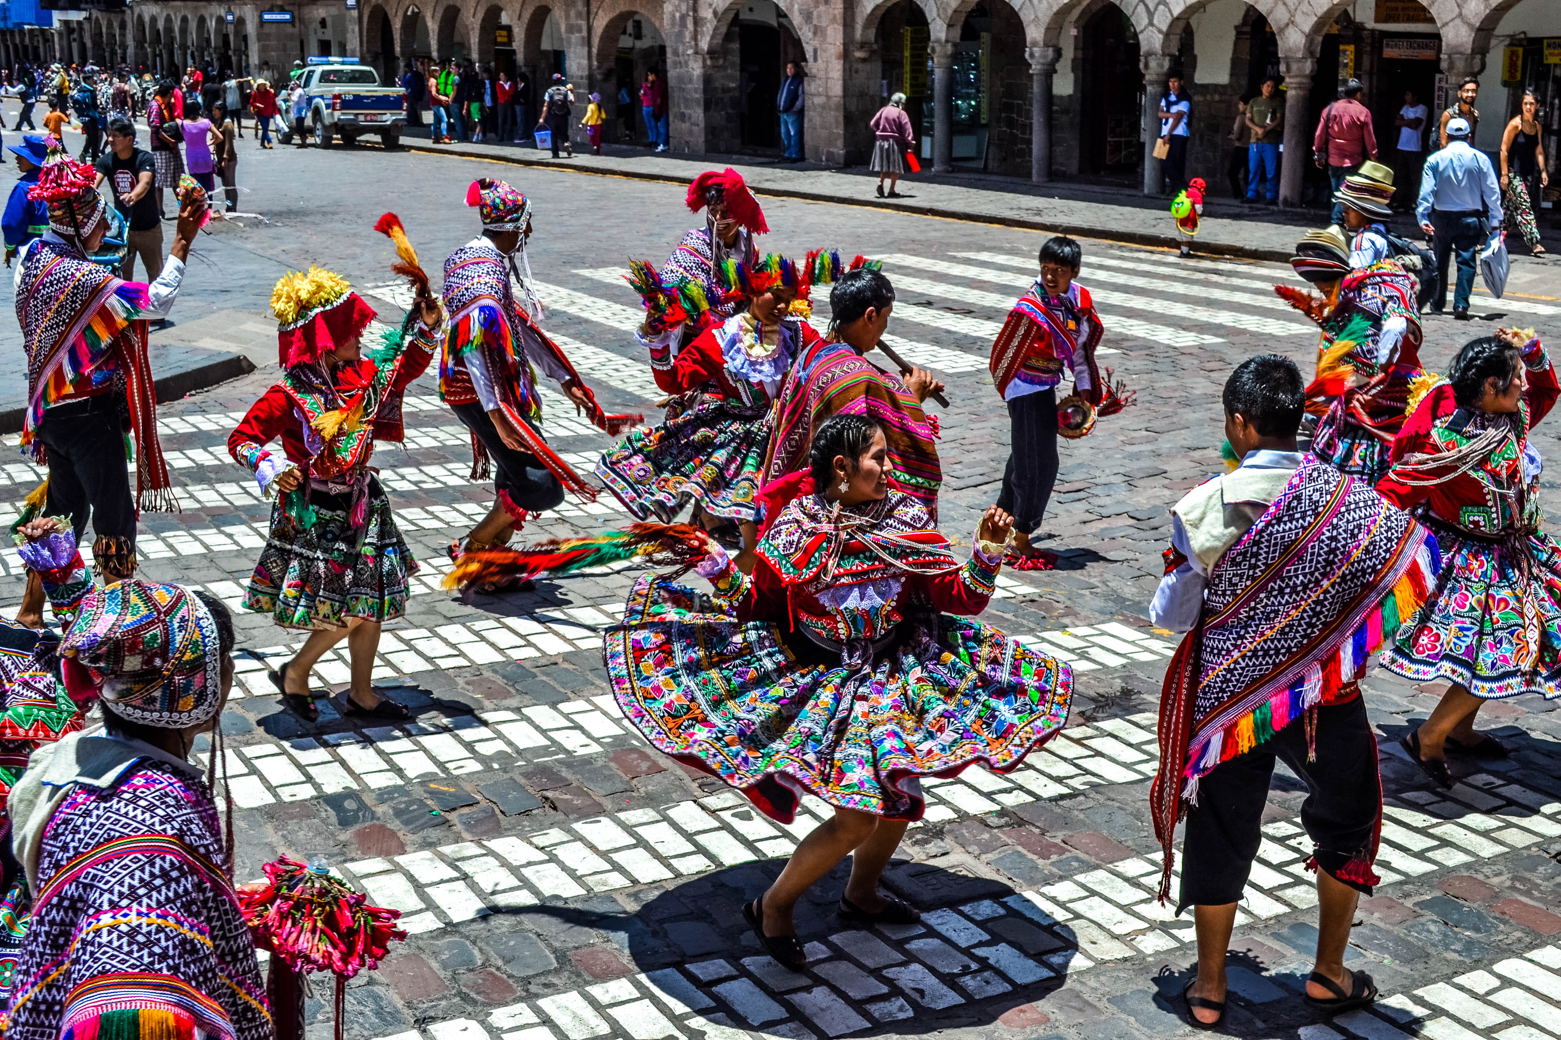
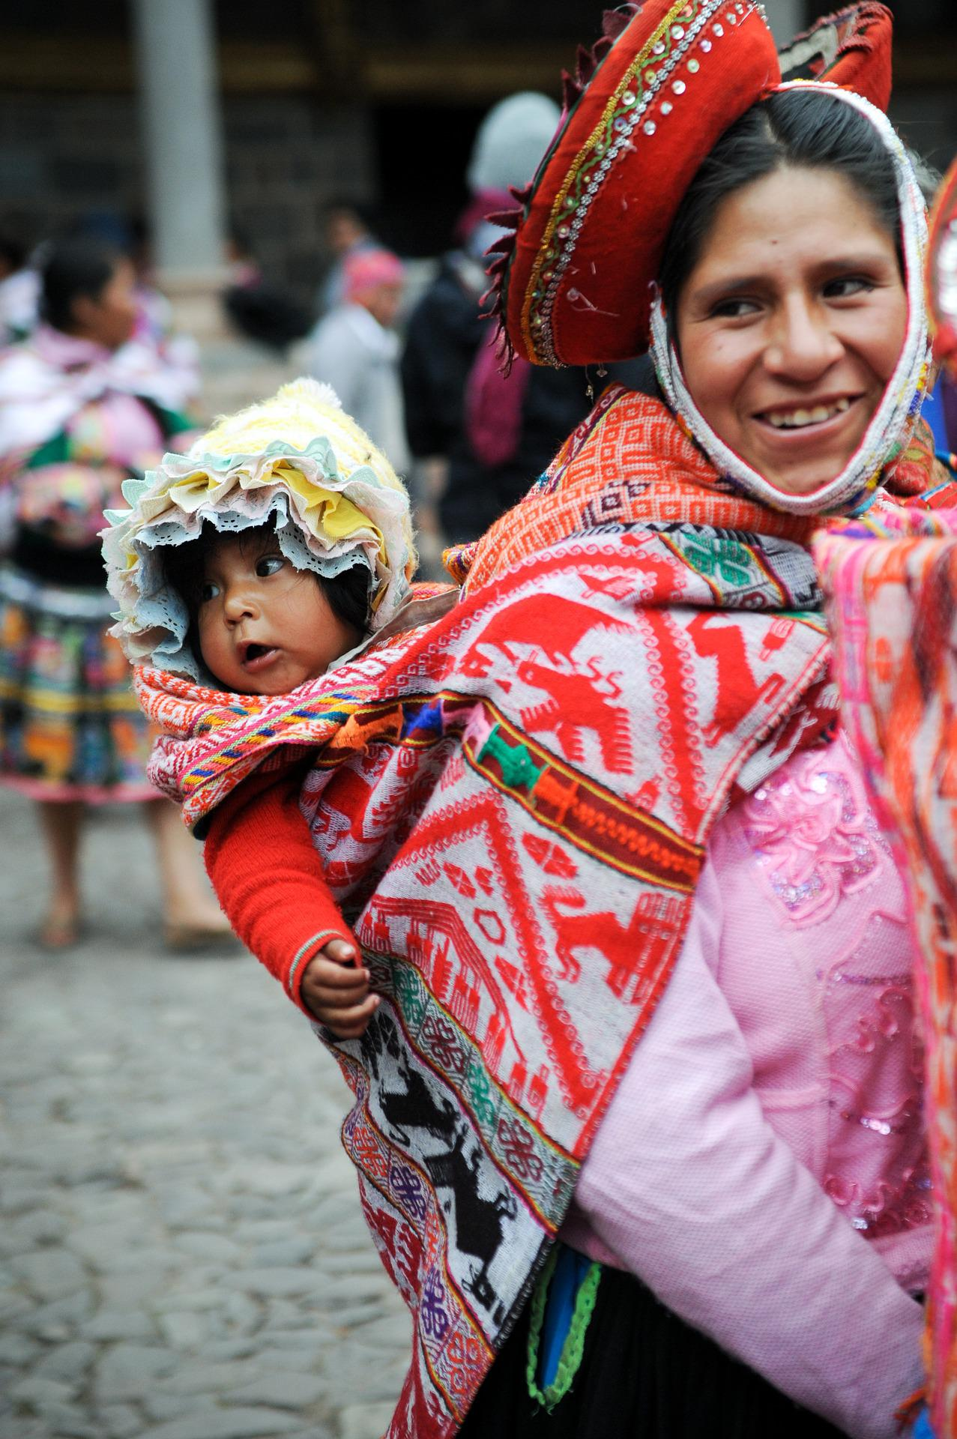
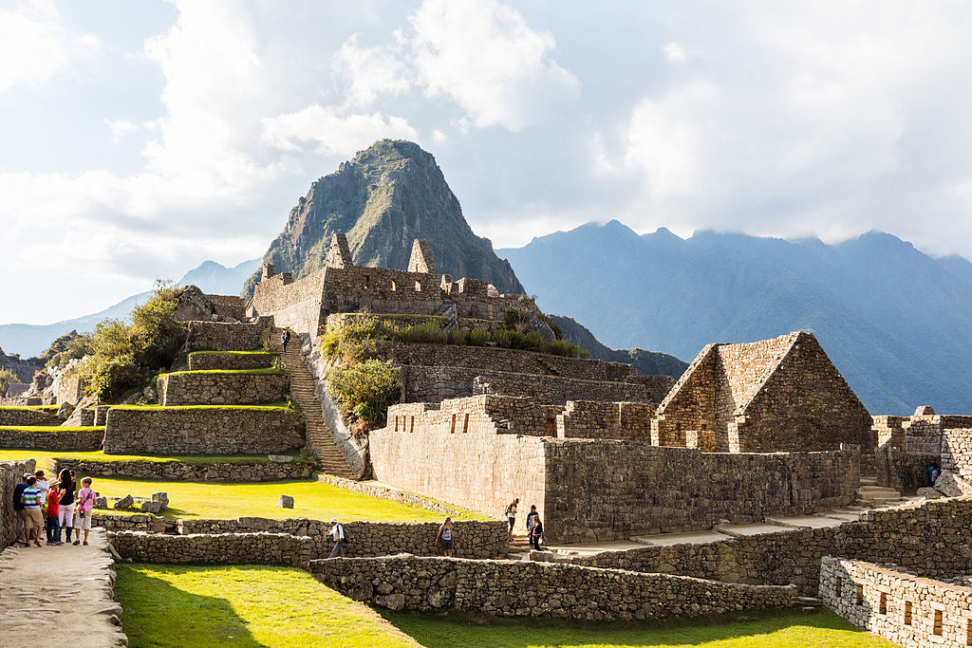
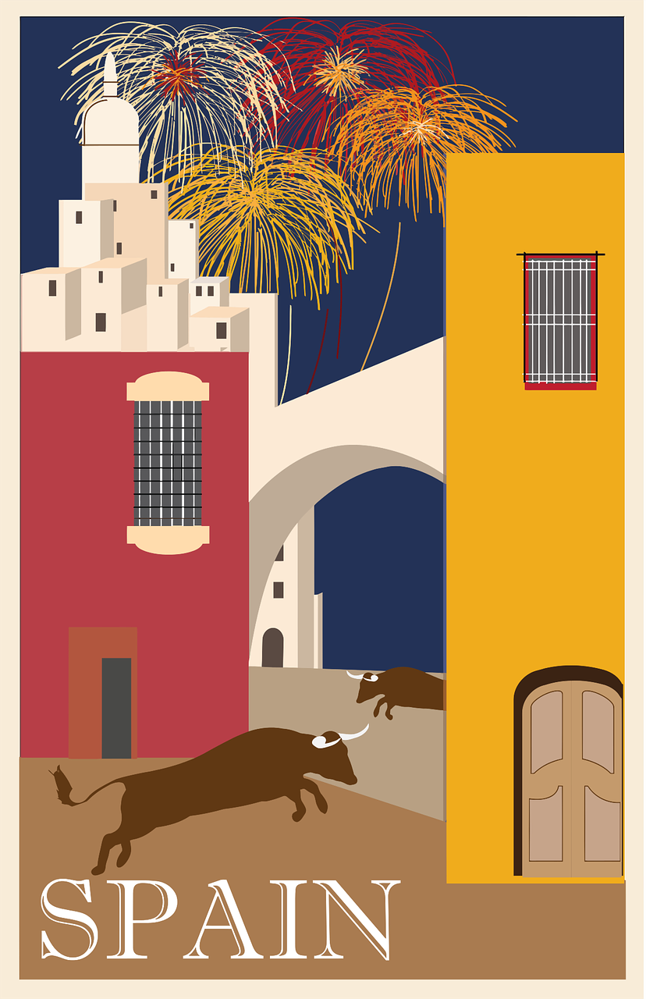

pronunciar
Follow up 1
The Inca Empire was powerful from 1438 – 1532. The Inca built advanced road systems and invented freeze-drying.
A zampoña is a type of panpipe from Peru. Most pupils learn to play it in primary school.
Quechua was the language of the Inca, and is still spoken by 10 million people in Peru, Ecuador, Bolivia and Chile.
Inti Raymi es un festival tradicional de los Inca. Inti significa ‘sol’ en quechua. La ceremonia es de 7 horas.
The Inca were great architects. Machu Picchu, built in the 1400s, is one of the most popular tourist destinations in the world.
Zancu is the name of an ancient Peruvian ceremonial bread (pan)
Chicha morada is a typical Peruvian drink made of purple corn.
Coricancha is a temple in Cusco, where the Inti Raymi festival starts.
Cusco is a city in the Peruvian Andes, which used to be the capital of the Inca Empire.
Pronuncia las palabras.
1
minuto
1 | 2 | 3 | 4
5 | 6 | 7 | 8
9 | 10 | 11 | 12
Allianchu!
Cusco
Inca
quechua
chicha morada
zancu
(pan ceremonial)
zampoña
ceremonia
tocar
INICIO
Coricancha
participantes
tradicional
arquitectura
Notes:
Timing: 5-8 minutes
Aim: to consolidate knowledge of SSC (ca-co-cu-ce-ci-z-que-qui) in a read aloud task using mainly unknown words and cognates; to provide an introduction to the 2nd festival of this week, the Peruvian sun festival Inti Raymi.
Procedure:
1. Teacher gives the instruction.
2. Pupils practise pronouncing the words in pairs.
3. Teacher to elicit words chorally. (Click on the picture to hear native audio, if required).
4. Teachers can decide if to bring up the information explaining more about all of the words. (Alternatively, the teacher can read these beforehand in advance and decide which details to give.)
5. Pupils work in pairs to pronounce words again, for 1 minute.
Transcript:
1 Cusco
2 Inca
3 quechua
4 chicha morada
5 zancu
6 zampoña
7 ceremonia
8 tocar
9 Coricancha
10 participantes
11 tradicional
12 arquitectura
Picture attribution:
Cusco plaza - VasenkaPhotography, CC BY 2.0, via Wikimedia Commons
Cusco - McKay Savage from London, UK, CC BY 2.0, via Wikimedia Commons
Coricancha - Diego Delso, CC BY-SA 4.0, via Wikimedia Commons
2

Slide 3

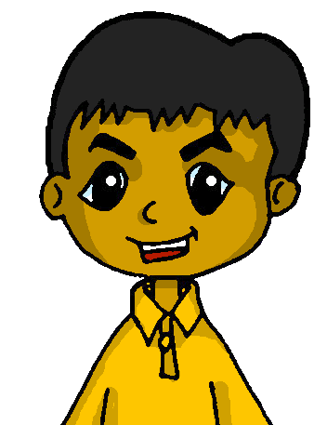

Follow up 2: Escucha. Luis describe Inti Raymi.
Escucha y escribe ‘todos’ o ‘todo el mundo’ y la frase en inglés. ✍.
escuchar
 | todos | todo el mundo
1
1
… celebrate Inti Raymi in Cusco.
2
2
… visit the Coricancha (temple).
3
3
… sings and dances.
4
4
… goes outside.
5
5
… take part in the ceremony.
6
6
… speak in quechua.
7
7
… drinks chicha morada.
8
8
… eats zancu.
Notes:
Timing: 5 minutes
Aim: to practise aural comprehension of 3rd person singular and plural verbs in the present tense; to practise comprehension of full sentences.
Procedure:
Explain the task, using the instructions. Remind pupils that todos needs a plural verb (‘all do X’) whereas everybody needs a singular verb (everybody does X).
Click to listen to the sentence.
Pupils write either todos (plural verb) or todo el mundo (singular verb) and an English translation of the rest of the sentence.
Repeat for the following 7 sentences.
Click to correct.
Transcription:
El 24 de junio [todos] celebran el festival de Inti Raymi en Cusco.
[Todos] visitan el Coricancha.
[Todo el mundo] canta y baila.
[Todo el mundo] va fuera.
[Todos] participan en la ceremonia.
En la ceremonia [todos] hablan en quechua.
[Todo el mundo] bebe chicha morada.
[Todo el mundo] come zancu, un pan ceremonial.

Slide 4







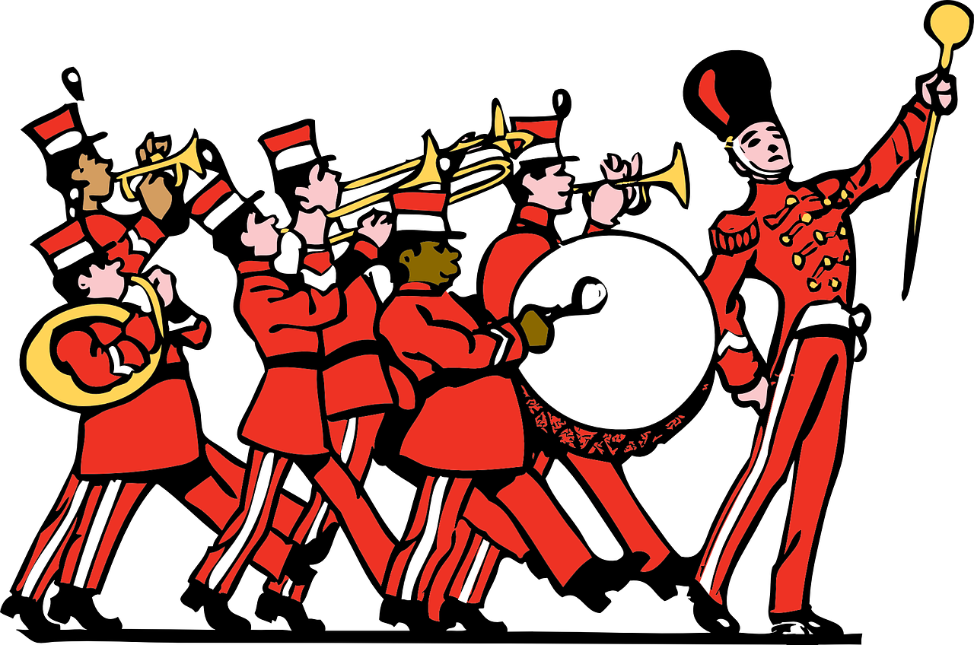


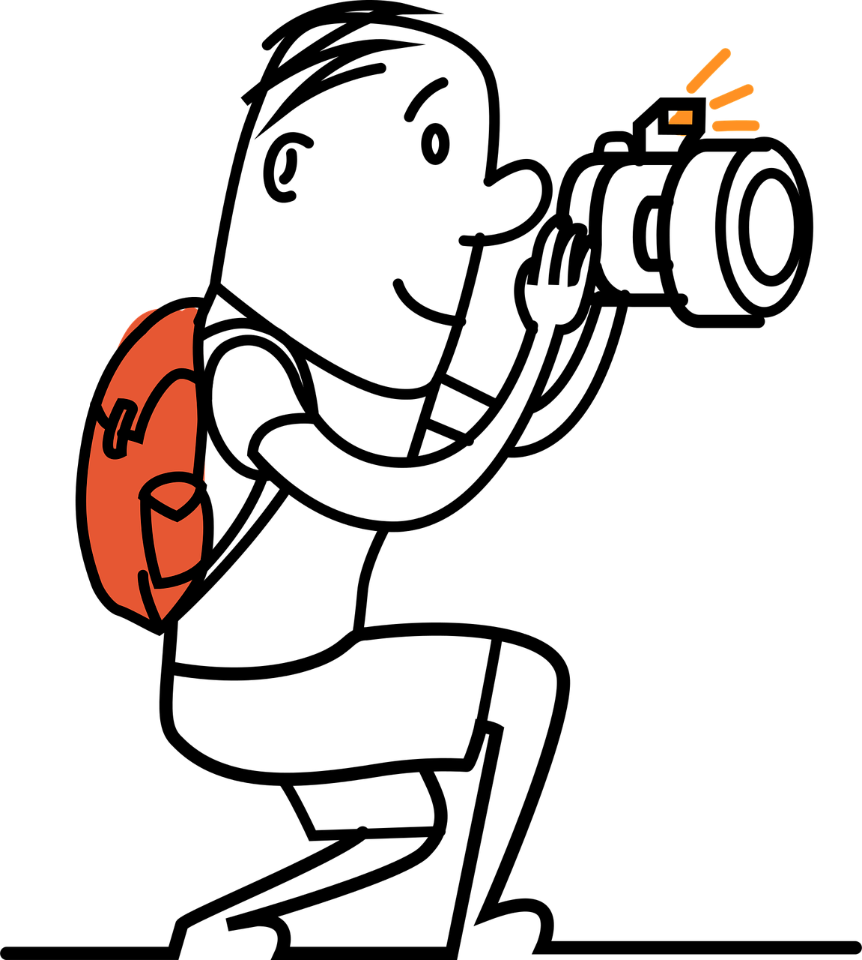


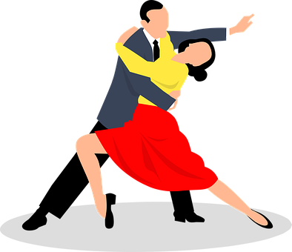
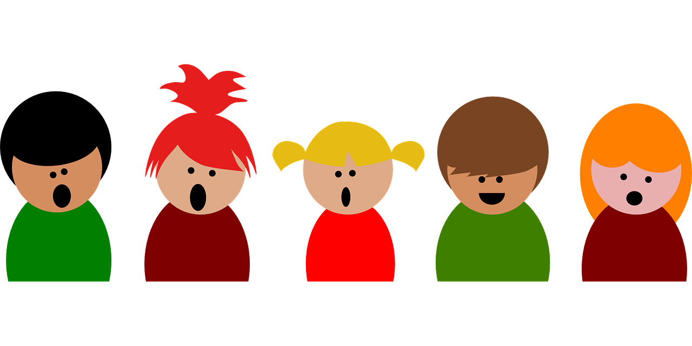

Follow up 3: Max busca información sobre festivales en Perú.
Escribe las frases en español.
escribir
 | In there is a very popular festival/celebration in Cusco.
 | visit Cusco for . Inti es en quechua.
 | and takes (makes) .
 | eat zancu, a special .
 | and .
E
En verano hay un festival muy popular en Cusco.
Muchas personas visitan Cusco para Inti Raymi. Inti es sol en quechua.
1
much,
a lot (of)
2
Todo el mundo mira el desfile y hace muchas fotos.
much,
a lot (of)
3
Todos los visitantes comen zancu, un pan especial.
every-thing,
all (of)
4
Muchos bailan y cantan.
much,
a lot (of)
Notes:
Timing: 5 minutes
Aim: to practise written production of mucho (mucha, muchos, muchas) and todo (toda, todos, todas) and other vocabulary from this and previous weeks.
Procedure:
Teacher models the task with sentence 1, using a ‘think aloud’ to interpret the picture, and eliciting suggestions from pupils as to a suitable sentence (perhaps initially in English and then Spanish, or just in Spanish).
Pupils write the sentences.
Click to correct.
Note: Teachers can differentiate the task, providing more support to lower proficiency learners by:
i. providing the initial letters of each word as prompts.
iii. enabling pupils to look at the vocabulary first (e.g. do Follow up 5 before this one).

Slide 5

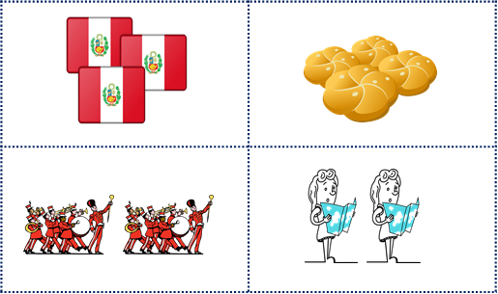
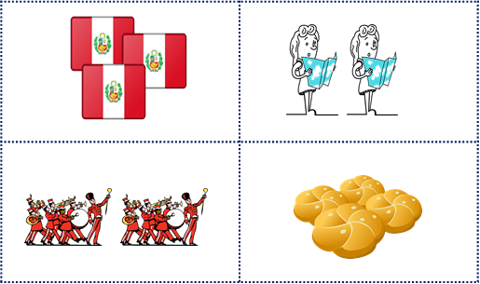

Follow up 4:
Habla con tu compañero/a. ¿Qué número es?
hablar
Persona A elige* una imagen.
Persona B identifica la imagen correcta.
Persona A
Persona B
arriba
1
2
a la izquierda
a la derecha
abajo
Arriba a la derecha hay muchos panes.
¡Es el número 2!
Abajo a la izquierda hay muchos desfiles.
No.
Sí.
B
A
Notes:
Timing: 5 minutes
Aim: to practise productive use of muchos, muchas and this week’s vocabulary; to practise use of previously taught vocabulary for positions/locations.
Procedure:
1. Use this slide to model the task.
2. Pupil A chooses a picture. (Note: there are only two pictures here which makes the task very easy – this is just to model it. In the task itself, there are 9 pictures, so more questions are usually needed).
3. Pupil B identifies the correct picture by giving statements about where the many items are.
4. Note: pupils may need reminding at this state about muchos + mpl nouns and muchas + fpl nouns. In this task there are:
muchas banderas, muchos panes, muchos desfiles, muchas visitantes (because the visitors are female), muchos caballos. Teachers can elicit these first from students, as needed.
4. Go to the next slide to play the game. Pupils can take it in turns and it can be played multiple times, taking around 30-45 seconds each time.

Slide 6
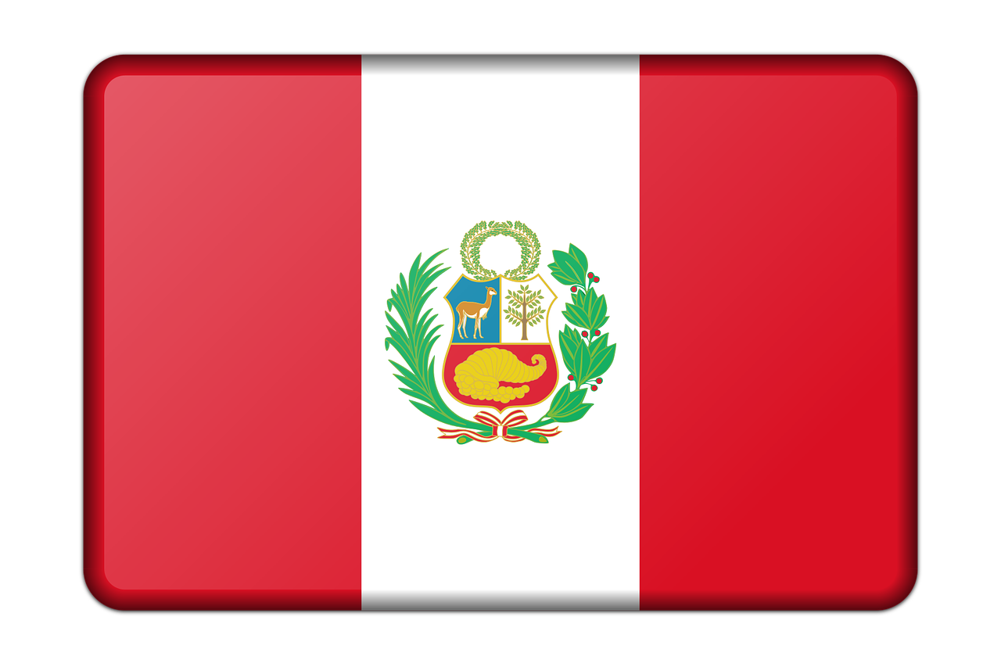
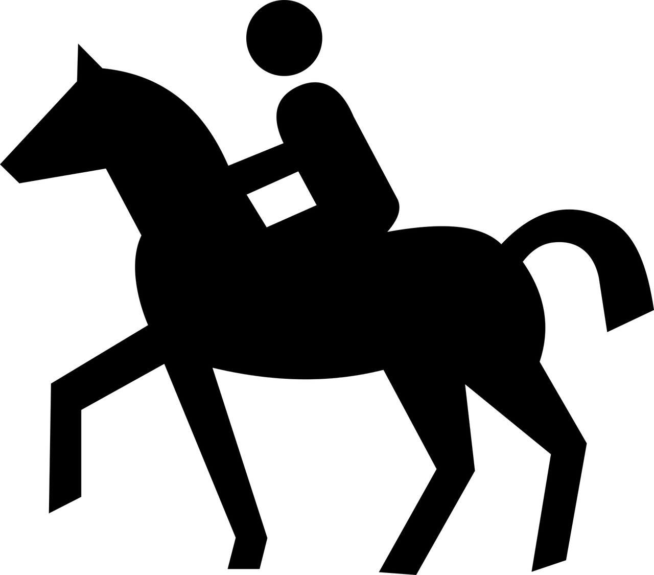
Habla con tu compaero/a. ¿Qué número es?
1 | 2 | 3
4 | 5 | 6
7 | 8 | 9
hablar
Notes:
Display during the speaking activity – no need to print anything out.

Slide 7




Follow up 5a:

Escribe en inglés: Can you get at least 15 points?
 | fuera | limpiar | ayudar
 | dentro | tocar | la vaca
 | la imagen | la tarjecta | la derecha
 | la izquierda | todo el mundo | el dibujo
 | el pan | el desfile | la bandera
 | mucho | el/la visitante | todo
vocabulario
outside
to clean, cleaning
to help, helping
x3
inside
to touch, play (instrument)
(the) cow
(the) image
(the) card
(the) right
x2
(the) left
everybody
(the) drawing
(the) bread
(the) parade
(the) flag
x1
much, a lot of
(the) visitor
everything, all (of)
Notes:
Timing: 7 mniutes
Aim: to practise written comprehension of vocabulary from this week and this week’s revisited sets (next slide).
Procedure:
1. Give pupils a blank grid. They fill in the English meanings of any of the words they know, trying to reach 15 points in total.
Note:
The most recently learnt and practised words are pink, words from the first revisit are green and those from the second revisit are blue, thus more points are awarded for them, to recognise that memories fade and more effort (heavy lifting!) is needed to retrieve them.

Slide 8
follow up 5b:

Escribe en español: can you get at least 15 points?
 | (the) cow | inside | outside
 | to help, helping | to clean, cleaning | to touch, play (instrument)
 | (the) left | (the) drawing | (the) card
 | everybody | (the) image | (the) right
 | (the) visitor | much, a lot of | everything, all (of)
 | (the) flag | (the) parade | (the) bread
vocabulario
la vaca
dentro
fuera
x3
ayudar
limpiar
tocar
la izquierda
el dibujo
la tarjeta
x2
todo el mundo
la imagen
la derecha
el/la visitante
mucho
todo
x1
la bandera
el desfile
el pan
Notes:
Timing: 7 mniutes
Aim: to practise written comprehension of vocabulary from this week and this week’s revisited sets (next slide).
Procedure:
1. Give pupils a blank grid. They fill in the Spanish meanings of any of the words they know, trying to reach 15 points in total.
Note:
The most recently learnt and practised words are pink, words from the first revisit are green and those from the second revisit are blue, thus more points are awarded for them, to recognise that memories fade and more effort (heavy lifting!) is needed to retrieve them.

Slide 9
¡adiós!
azul

Slide 10
follow up 5b:

Escribe en inglés: Can you get at least 15 points?
 | fuera | limpiar | ayudar
 | dentro | tocar | la vaca
 | la imagen | la tarjecta | la derecha
 | la izquierda | todo el mundo | el dibujo
 | el pan | el desfile | la bandera
 | mucho | el/la visitante | todo
vocabulario
x3
x2
x1
Notes:
HANDOUT 5A

Slide 11
follow up 5b:

Escribe en español: can you get at least 15 points?
 | (the) cow | inside | outside
 | to help, helping | to clean, cleaning | to touch, play (instrument)
 | (the) left | (the) drawing | (the) card
 | everybody | (the) image | (the) right
 | (the) visitor | much, a lot of | everything, all (of)
 | (the) flag | (the) parade | (the) bread
vocabulario
x3
x2
x1
Notes:
Handout Follow up 5B

