Slide 1
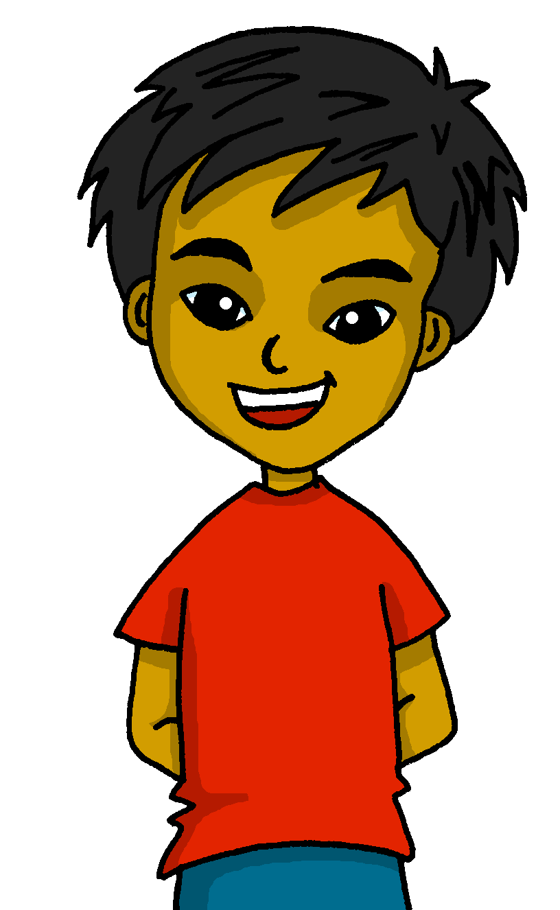
español, con Quique

Slide 2
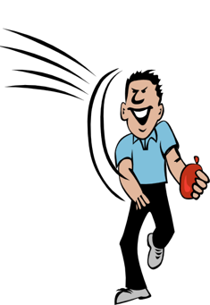
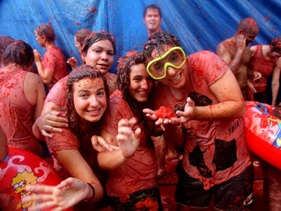
Saying what others and I do
azul
-AR / -ER verbs: they, s/he
revisit accents 1- 3
Notes:
Artwork by Steve Clarke. All additional pictures selected are available under a Creative Commons license, no attribution required.
The frequency rankings for words that occur in this PowerPoint which have been previously introduced in the resources are given in the SOW (excel document) and in the resources that first introduced and formally re-visited those words.
Phonics: Revisit accents rules 1-3
Vocabulary (new words in bold): tirar¹ [685] gente [137] hora¹ [160] durante [139]
Revisit 1: hacer [26] hago, hace actividad [344] baile [2040] carrera [481] dibujo [1726] jardinería [>5000] natación [>5000] viaje [904] lista [1189]
Revisit 2: aprender [428] comprender [434] hacer [26] leer [209] poner [91] responder [464] vencer [1426] actividad [344] cultura [469] juego [409] miedo [491] país [109] pregunta [507] prueba [651] revista [920] texto [753] vocabulario [>5000] con [14] sobre [62]
Source: Davies, M. & Davies, K. (2018). A frequency dictionary of Spanish: Core vocabulary for learners (2nd ed.). Routledge: London
For any other words that occur incidentally in this PowerPoint, frequency rankings will be provided in the notes field wherever possible.

Slide 3
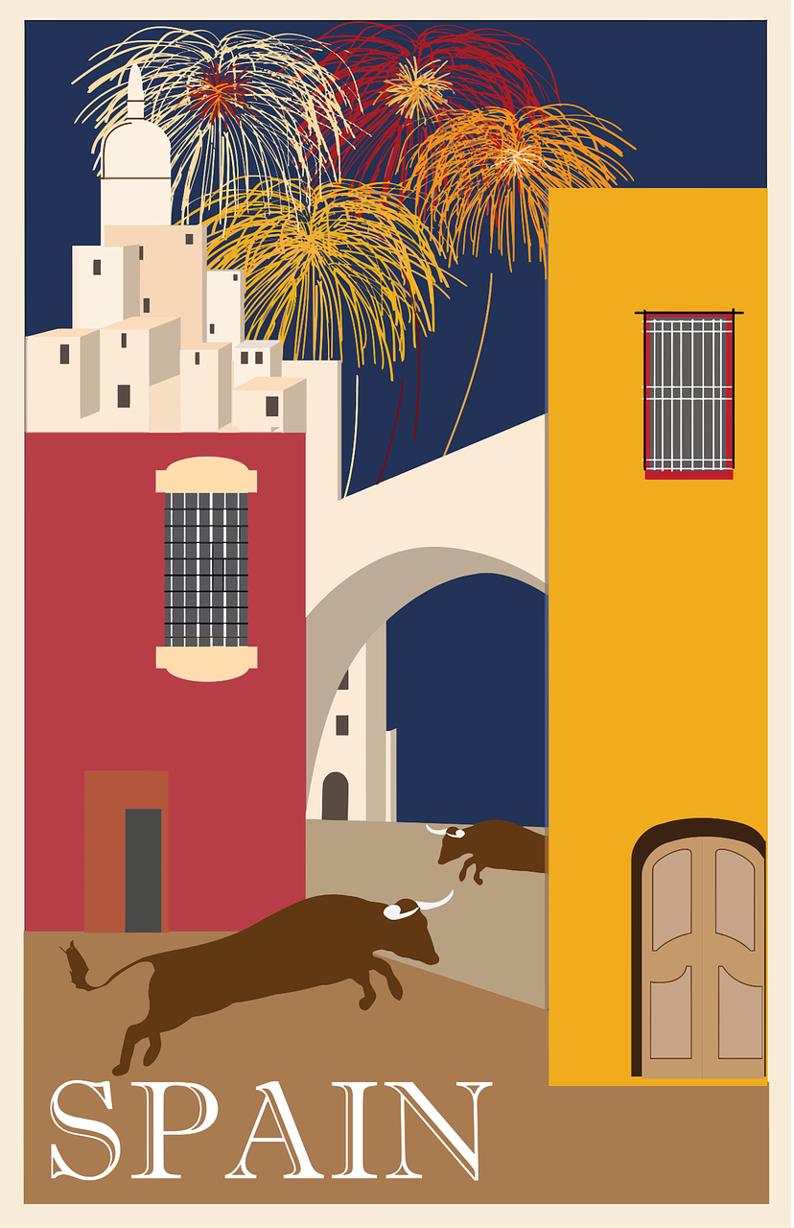
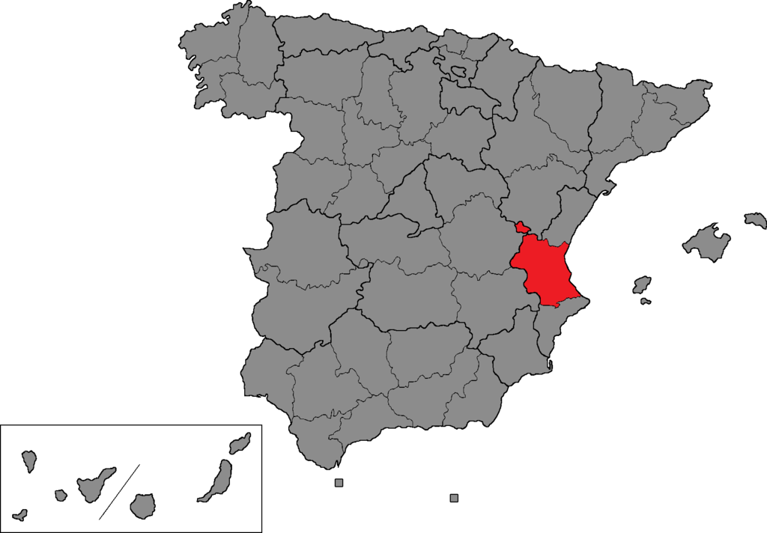
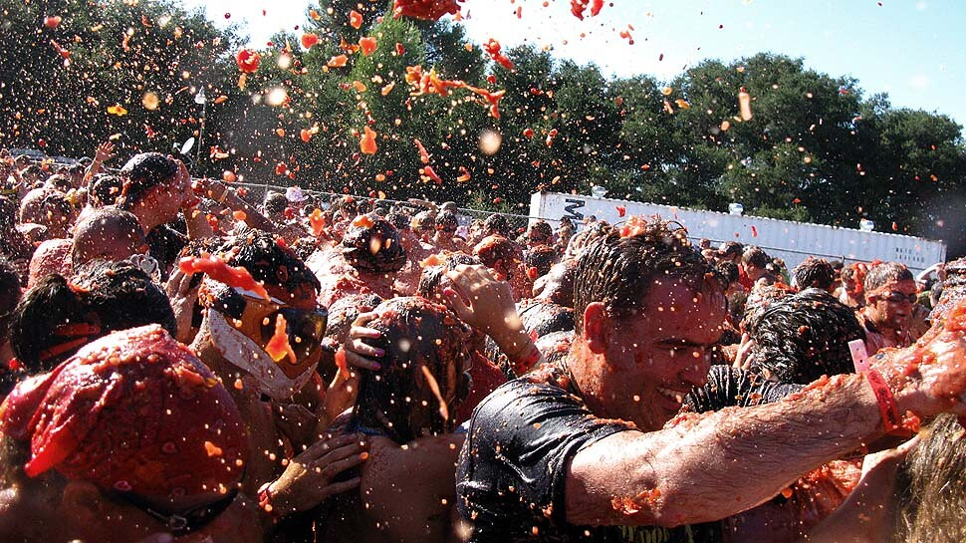
leer
l*a calle = street
people
during
to throw
each, every
la gente
durante
tirar
cada
¡La Tomatina es un festival muy diferente!
La gente celebra el festival en verano en Buñol, un pueblo en la región de Valencia.
Durante una hora la gente tira muchos kilos (¡150.000 kilos!) de tomates en las calles* y en la plaza.
Es una fiesta muy popular. Hay 20.000 – 30.000 visitantes cada año.
a village
celebration
summer
an hour
un pueblo
la fiesta
el verano
una hora
Notes:
Timing: 5 minutes
Aim: to set the scene for this week’s lesson – La Tomatina festival; to practise written comprehension of previously taught vocabulary and this week’s four new words,
Procedure:
Pupils read the text aloud with teacher support, as needed.
Click on each section of the text to hear an audio version of the text, if desired.
3. Pupils focus on the English words and identify the Spanish words from the bold words in the text. Pupils can volunteer answers in any click – teacher clicks on the English word and the Spanish translation appears.
4. Teachers elicit an oral translation of the text from the class to establish the context of this week’s lesson.
Picture attributions:
Map - Impru20, CC BY-SA 4.0, via Wikimedia Commons Tomatina – Gary Friedman, Los Angeles Times CC BY-SA 2.0, flickr
Frequency of unknown words and cognates: calle [269] festival [3194] región [545] kilo [2934] popular [790] visitante [2428]
Source: Davies, M. & Davies, K. (2018). A frequency dictionary of Spanish: Core vocabulary for learners (2nd ed.). Routledge: London

Slide 4
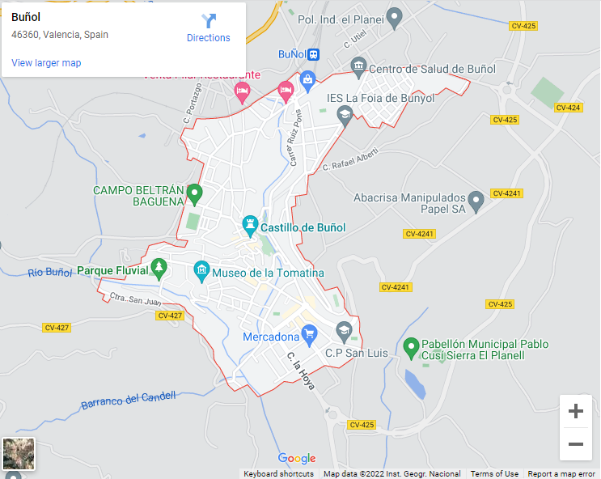
Buñol
Pronuncia las calles* de Buñol.
la calle = street
1. Calle Colón
pronunciar
Rule 1: All words with stress on the 3rd last syllable have an accent.
2. Calle Reyes Católicos
60
3. Avenida de la Música
Rule 2: Words ending in any consonant except –n or –s with stress on the penultimate syllable need an accent.
4. Calle Velázquez
S
5. Calle Moratín
6. Avenida de Benito Pérez Galdós
7. Calle de la Sartén
Rule 3: Words ending in a vowel or –n or –s need an accent if the stress is on the last syllable.
8. Avenida País Valenciano
0
9. Calle Maestro Albéniz
INICIO
Notes:
Timing: 3 minutes
Aim: to practise read aloud of unfamiliar words with and without accents.
Procedure:
Clarify the word calle and its pronunciation. Click on the gloss to hear the word pronounced (remind pupils that ‘ll’ = ‘y’ sound).
Pupils work in pairs to practise pronouncing some street names in Buñol (the location of the Tomatina festival which is the theme of this lesson).
Teacher elicits pronunciation from pupils and click on each street name (as necessary) to hear it pronounced.
Click to bring up each rule and ask pupils if they can suggest any words which match the rule. Continue with the other two rules. Colour-coding is used for those that find this helpful but it is not essential to understanding the information.
Note: the most important knowledge is for pupils to know that when they read aloud they stress the accented syllable. Teachers may want to remove the reference to the rules and the 2nd part of this task at this stage, which is absolutely fine.

Slide 5
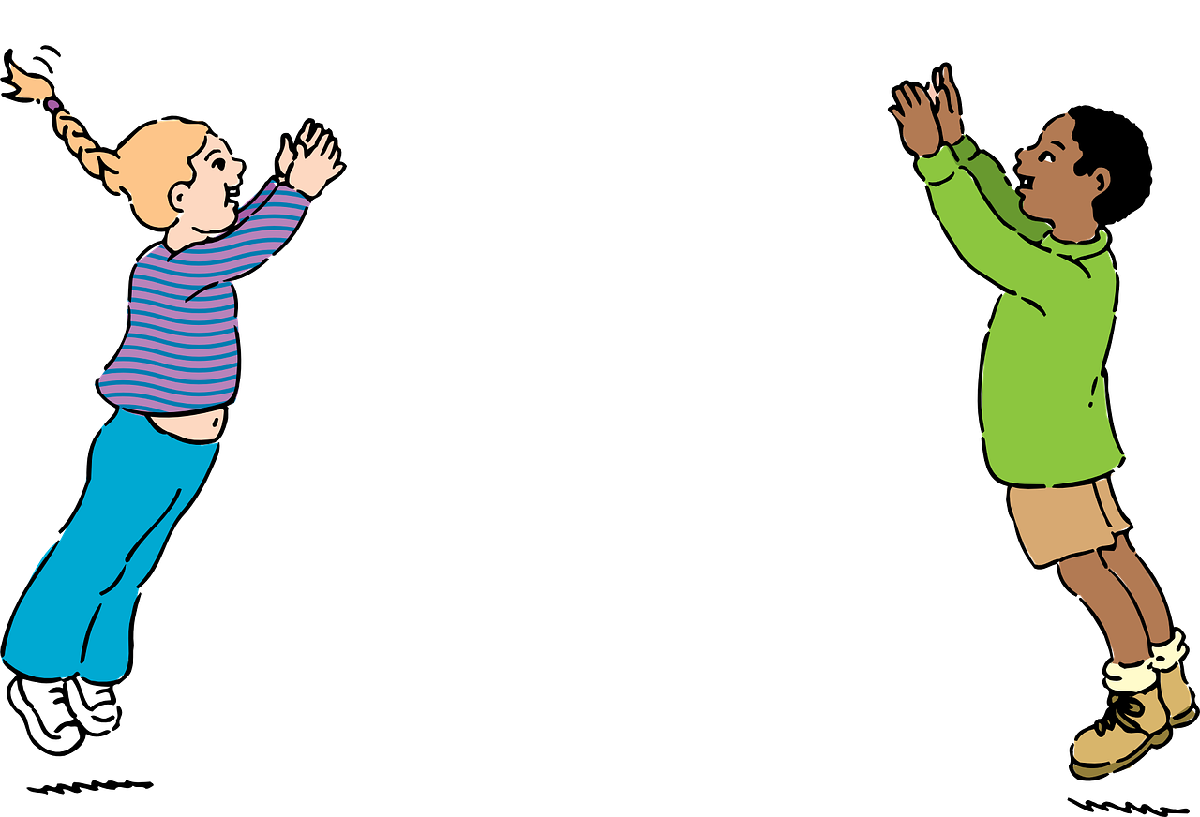
Knowing who does what
[–ar verbs: ‘S/he,it’ vs. ‘they’]
Remember: to mean ‘S/he, it’ with an -ar verb, remove –ar and add -a.
To mean ‘they’ with a verb, we remove –ar and add –an.
Tira tomates.
Tiran tomates.
S/he throws tomatoes.
They throw tomatoes.
To mean ‘S/he, it’ with an –er verb, remove –er and add -e.
To mean ‘they’ with a verb, we remove –er and add –en.
Corre por las calles.
Corren por las calles.
S/he runs through the streets.
They run through the streets.
Notes:
Timing: 2 minutes
Aim: to revisit 3rd persons singular and plural for–ar and –er verbs.
Procedure:
Click through the animations to present the new information.
Elicit English translations for the Spanish examples provided.

Slide 6
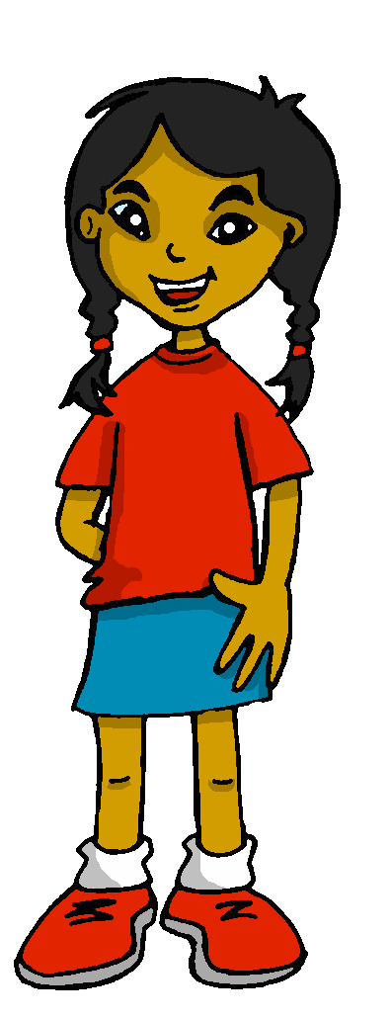
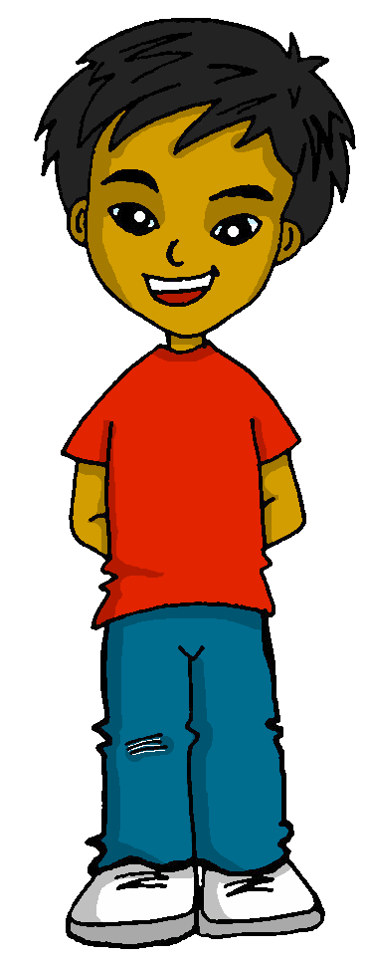
leer
La Tomatina Infantil
*tiene lugar = takes place
La Tomatina Infantil es una versión de la fiesta para los niños de 4 a 14 años. Tiene lugar el último sábado de agosto en la Plaza de Buñol.
¿Qué hacen Sofía y Quique? ¿Qué hace Sofía? |  | Sofía y Quique (they) | Sofía (she)
1 | ¡…están en Buñol para La Tomatina kids!
2 | …lee las instrucciones.
3 | …prepara la mochila.
4 | …beben agua.
5 | …ponen gafas de natación.
6 | …caminan a la plaza.
7 | …lleva una botella de agua.
8 | ¡…miran los tomates!
Notes:
Timing: 12 minutes (two slides)
Aim: to practise written comprehension of present tense –ar/-er verbs in 3rd persons singular and plural; to understand sentences containing a range of previously taught language in the new context.
Procedure:
Teachers set the scene by reading the introductory text about La Tomatina kids (a child version of the adult Tomatina with the same rules, also in Buñol, which takes place every year on the last Saturday of August.
Click on the text to hear an audio version of the text, if desired.
Ensure that pupils know that Sofía and Quique are in Buñol and the sentences describe what they both do and what Sofía does.
First pupils write 1-8 and they/she for each of the sentences, paying close attention to the verb endings.
Teachers elicit responses (time allowing, ask pupils to read each sentence aloud for additional practice), and click to reveal answers.
Move to the next slide for a comprehension task.
Source: https://www.tomatina.es/la-tomatina-infantil/

Slide 7
leer
La Tomatina Infantil
*tiene lugar = takes place
La Tomatina Infantil es una versión de la fiesta para los niños de 4 a 14 años. Tiene lugar el último sábado de agosto en la Plaza de Buñol.
¿Qué significan las frases en inglés?
1 | ¡…están en Buñol para La Tomatina kids!
2 | …lee las instrucciones.
3 | …prepara la mochila.
4 | …beben agua.
5 | …ponen gafas de natación.
6 | …caminan a la plaza.
7 | …lleva una botella de agua.
8 | ¡…miran los tomates!
1
They are in Buñol for Tomatina kids.
2
She reads the instructions.
3
She prepares the bag.
4
They drink water.
5
*goggles
They put on swimming goggles.
6
They walk to the square.
7
She carries a bottle of water.
8
They look at the tomatoes!
Notes:
Aim: to practise written comprehension of a range of singular and plural –-AR/-ER verbs and vocabulary initially learnt in different lessons and contexts.
Procedure:
Pupils volunteer English meanings of each sentence.
Teacher clicks to reveal written answers.
If desired, click the buttons to play full sentence audio.

Slide 8
escuchar
Escucha. Ahora Sofía y Quique están en la Plaza de Buñol…
¿Qué hacen Sofía y Quique? ¿Qué hace Quique?
 | Sofía y Quique (they) | Quique (he)
1
2
3
4
5
6
7
8
1
Who…
runs through the streets?
takes lots of photos?
is really pleased?
swims in a sea of tomatoes?
cleans the streets?
is nervous at the start?
relaxes in the afternoon?
eats a sandwich?
2
S & Q
3
Q
4
S & Q
5
S & Q
6
S & Q
7
Q
8
Q
9
Q
Notes:
Timing: 8 minutes
Aim: to practise aural recognition of vocabulary and understanding of 3rd person singular and plural present tense –AR-/-ER verbs.
Procedure:
Pupils listen to each phrase.
First, they decide if both Sofía y Quique are doing the action or just Quique.
Click to check the answers.
Click to bring up the table of questions. On the 2nd time of listening, work out who does each activity. (Note: the events are not in order 1-9 or pupils would have the answers from part 1).
Click to reveal answers.
Transcript:
1 Está muy nervioso.
2 Vence el miedo.
3 Tiran tomatoes durante una hora.
4 Corren por las calles.
5 Nadan en un mar de tomates.
6 Saca muchas fotos.
7 ¡Es muy divertido! Están súper contentos. 8. Limpian las calles.
9. Descansa por la tarde y come un bocadillo.

Slide 9
¡adiós!
azul

