Slide 1
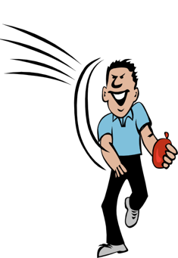
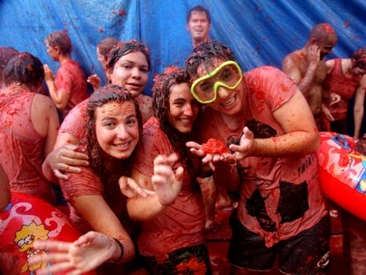
Saying what I and others do
azul
Follow ups 1-5
Notes:
Artwork by Steve Clarke. All additional pictures selected are available under a Creative Commons license, no attribution required.
The frequency rankings for words that occur in this PowerPoint which have been previously introduced in NCELP resources are given in the NCELP SOW and in the resources that first introduced and formally re-visited those words.
Phonics: Revisit accents rules 1-3
Vocabulary (new words in bold): tirar¹ [685] gente [137] hora¹ [160] durante [139]
Revisit 1: hacer [26] hago, hace actividad [344] baile [2040] carrera [481] dibujo [1726] jardinería [>5000] natación [>5000] viaje [904] lista [1189]
Revisit 2: aprender [428] comprender [434] hacer [26] leer [209] poner [91] responder [464] vencer [1426] actividad [344] cultura [469] juego [409] miedo [491] país [109] pregunta [507] prueba [651] revista [920] texto [753] vocabulario [>5000] con [14] sobre [62]
For any other words that occur incidentally in this PowerPoint, frequency rankings will be provided in the notes field wherever possible.
Source: Davies, M. and Davies, K. (2018). A frequency dictionary of Spanish: Core vocabulary for learners (2nd ed.). Routledge: London

Slide 2
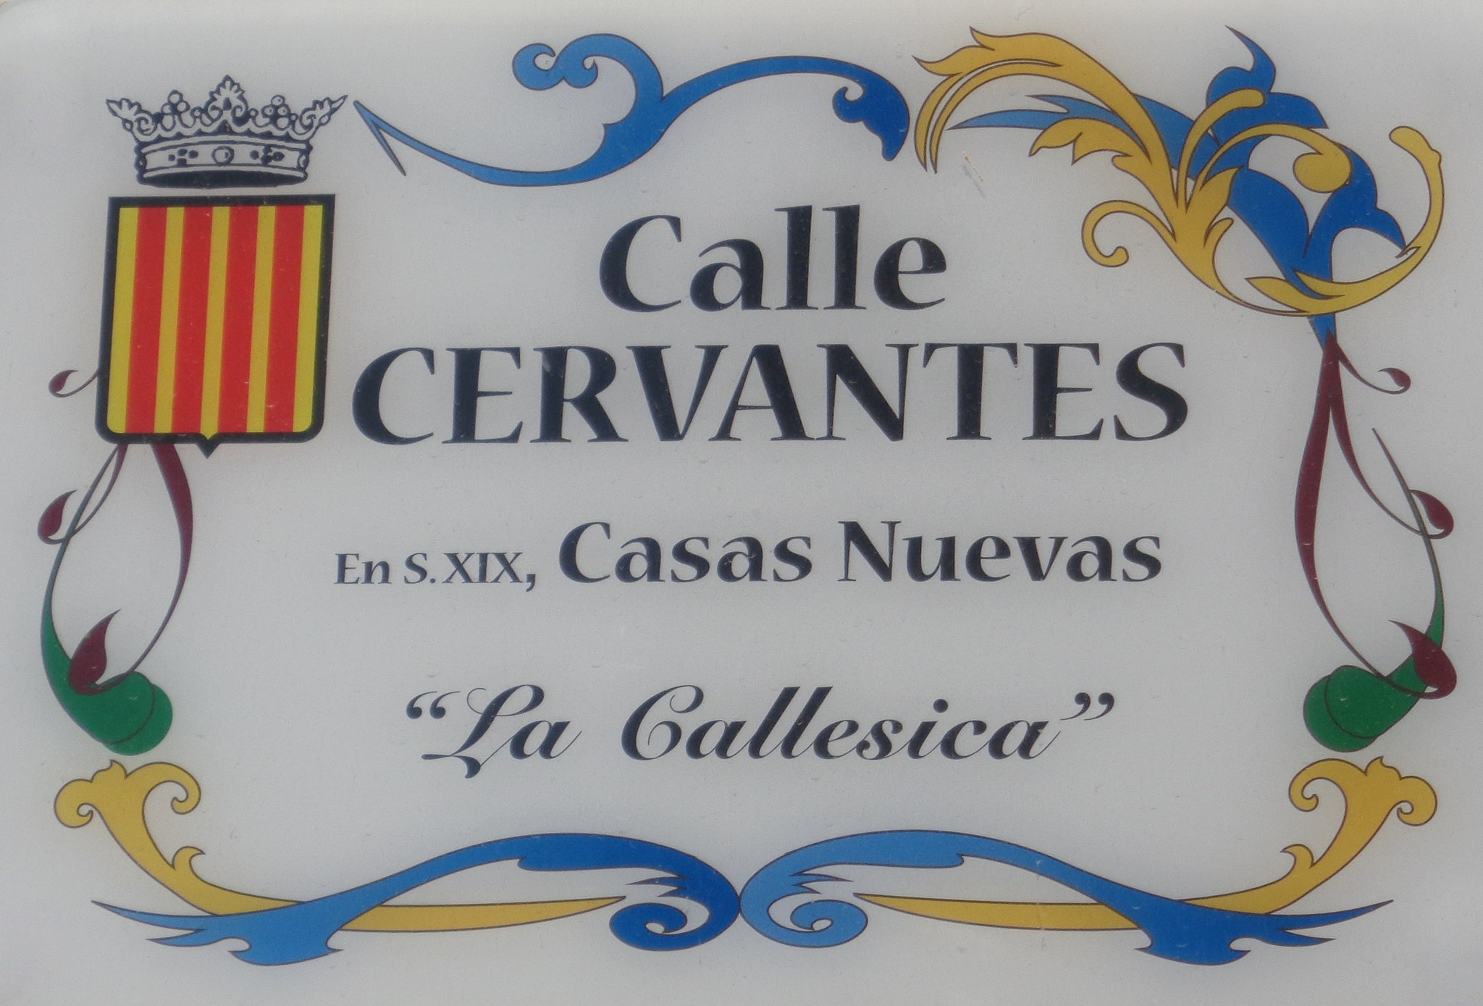
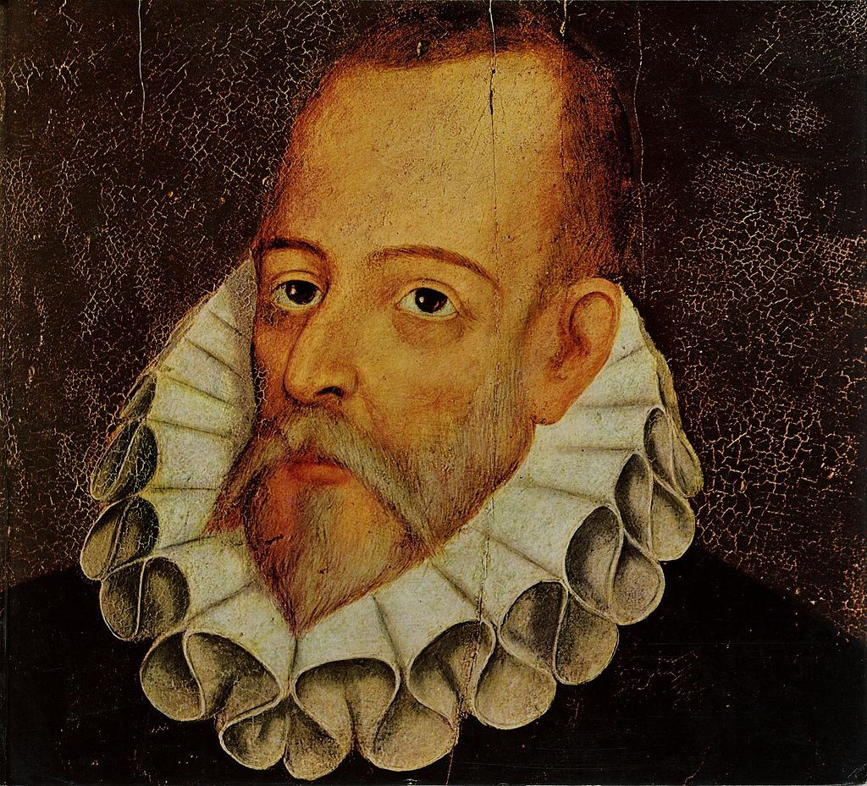
pronunciar
Follow up 1
¿Dónde tiene acento?
la avenida – avenue la calle – street
Escucha y escribe las palabras. ✍
1 minuto
 | calles de Buñol
 | Avenida de _ _ _ _ _ _ Baguena
 | Avenida de la Brigada _ _ _ _ _ _ _
 | Calle Poeta _ _ _ _ _ _ _ _ _ _
 | Calle Cat Ernesto _ _ _ _ _ _ _
 | Avenida de Vicente Blasco _ _ _ _ _ _
 | Calle Dolores _ _ _ _ _ _ _ _
‘
E
Beltran
‘
1
‘
Gimenez
‘
2
Moran
Badia
‘
3
Jimenez
‘
4
‘
Ibañez
5
Ibarruri
INICIO
Muchas calles en España llevan nombre de personas famosas. Por ejemplo, Calle Cervantes. Miguel de Cervantes es el autor de la novela Don Quixote, considerada como la primera novela moderna.
Notes:
Timing: 5 minutes
Aim: to develop understanding of the three accent rules.
Procedure:
Teacher gives the instruction
Pupils listen out and transcribe the words (ensure they understand these are all unknown words for them).
3. Click to bring up answers.
4. Now teacher clicks to ask pupils where the accents are. Each of the words has an accent.
5. Pupil apply the rule and write an accent if necessary.
4. Teacher brings up the information about Spanish street names and Cervantes.
5. Pupils work in pairs to pronounce the street names for 1 minute.
Transcript:
E Avenida de Beltrán Baguena
1 Avenida de la Brigada Giménez
2 Calle Poeta Morán Badía
3 Calle Cat Ernesto Jiménez
4 Avenida de Vicente Blasco Ibáñez
5 Calle Dolores Ibárruri
Picture attribution: Juan Martínez de Jáuregui y Aguilar, CC BY-SA 4.0, via Wikimedia Commons Enrique Íñiguez Rodríguez, CC BY-SA 3.0, via Wikimedia Commons
2

Slide 3
Follow up 2: Escucha. ¿Una persona o 2+ personas?
Escucha y escribe A o B y la frase en español. ✍.
escuchar
E
Ejemplo
A
B
Llevan uniforme.
Notes:
Timing: 5 minutes [Ejemplo] (9 slides in total but it is fine to do fewer)
Aim: to practise aural comprehension of 3rd person singular and plural verbs in the present tense; to practise transcription of previously taught vocabulary.
Procedure:
Explain the task, using the instructions.
Click to listen to the sentence.
Pupils write the sentence in Spanish and the correct letter A or B.
Click to reveal both.
Repeat for the following 6 sentences.
Differentiation: For more challenge in terms of comprehension ask pupils to translate the setence into English after transcribing it, and before they see the picture cues. Note that for this option, teachers will need to adjust the slides so that the singular options are always A. Transcription: Llevan uniforme.

Slide 4
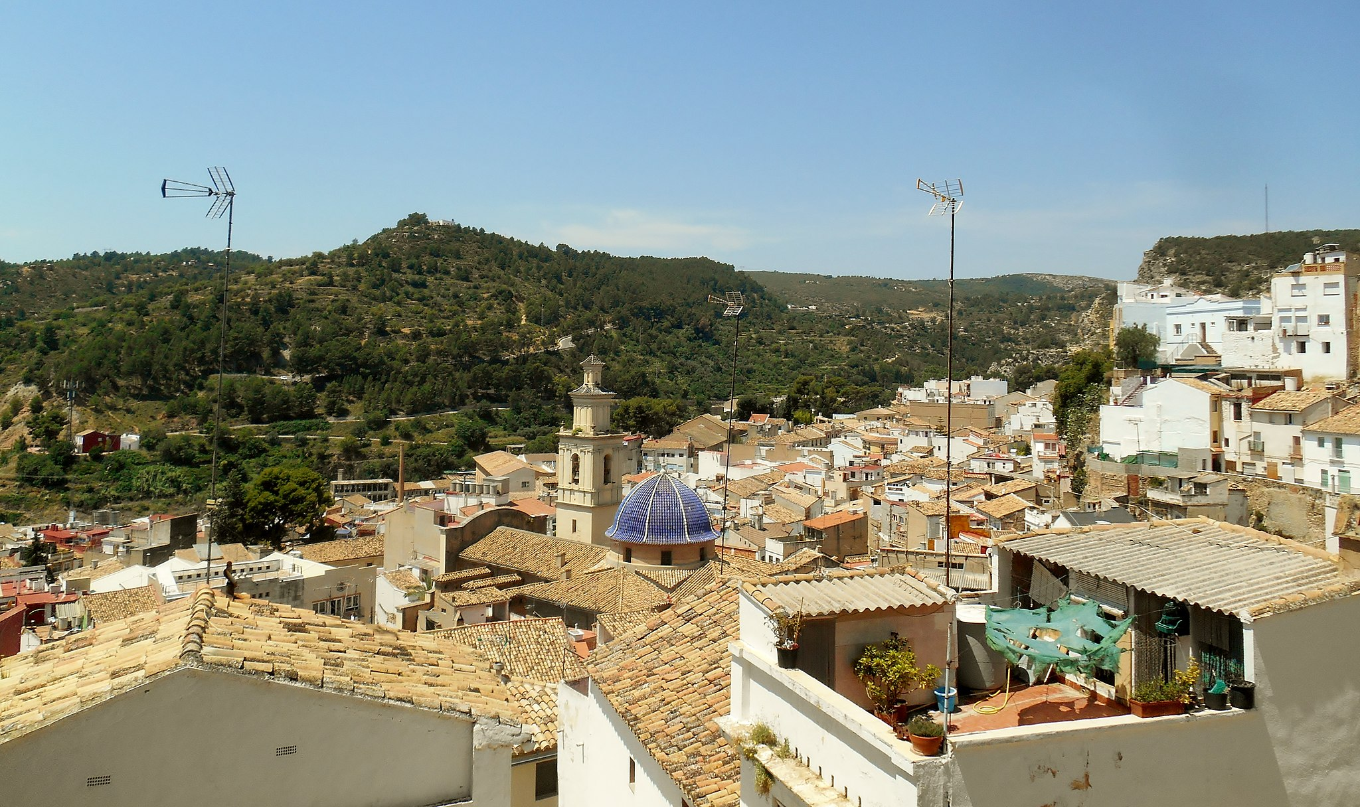
Follow up 2: [1/8]
Escucha y escribe A o B y la frase en español. ✍.
escuchar
1
A
B
Visitan el pueblo de Buñol.
Notes:
[1/8] Transcription: Visitan el pueblo de Buñol.

Slide 5
Follow up 2: [2/8]
Escucha y escribe A o B y la frase en español. ✍.
escuchar
2
A
B
Celebra el festival.
Notes:
[2/8] Transcription: Celebra el festival.

Slide 6
Follow up 2: [3/8]
Escucha y escribe A o B y la frase en español. ✍.
escuchar
3
A
B
Lee una revista.
Notes:
[3/8] Transcription: Lee una revista.

Slide 7
Follow up 2: [4/8]
Escucha y escribe A o B y la frase en español. ✍.
escuchar
4
A
B
Comprenden las preguntas.
Notes:
[4/8] Transcription: Comprenden las preguntas.

Slide 8
Follow up 2: [5/8]
Escucha y escribe A o B y la frase en español. ✍.
escuchar
5
A
B
Tiene miedo.
Notes:
[5/8] Transcription: Tiene miedo

Slide 9
Follow up 2: [6/8]
Escucha y escribe A o B y la frase en español. ✍.
escuchar
6
A
B
Tiran tomates.
Notes:
[6/8] Transcription: Tiran tomates.

Slide 10
Follow up 2: [7/8]
Escucha y escribe A o B y la frase en español. ✍.
escuchar
7
A
B
Hace una carrera.
Notes:
[7/8] Transcription: Hace una carrera.

Slide 11
Follow up 2: [8/8]
Escucha y escribe A o B y la frase en español. ✍.
escuchar
8
A
B
Aprenden sobre la cultura española.
Notes:
[8/8] Transcription: Aprenden sobre la cultural española.

Slide 12
Follow up 3:
Describe la visita a Buñol de Sofía y Quique.

Escribe seis frases.
escribir
gafas de natación
Notes:
Aim: to practise more independent written production of third person singular and plural sentences, drawing on a variety of previously taught vocabulary.
Procedure:
Pupils write sentences using the third person singular and plural of –AR and –ER verbs to describe (with 6 sentences) any of the activities that Sofía and Quique do at La Tomatina Infantil.
The Venn diagramm shows what Quique and Sofía do together, and what each does on his/her own.
Remind learners that the weather expressions use ‘hace’
Note: Teachers can add a list of verbs to the slide to help pupils, if needed. E.g. hacer, comer, descansar, mirar, caminar, llevar, tirar, correr, nadar, preparar, leer, llevar/beber.

Slide 13
Follow up 4:
Habla con tu compañero/a.
hablar
Persona A habla.
Persona B identifica la imagen correcta.
Persona A
They prepare the bag.
Persona B
1) _____________________
[A] [B]
Preparan la mochila.
They prepare the bag.
B
A
Notes:
Timing: 5-10 minutes
Aim: to practise receptive and productive knowledge of third person singular and plural of –er verbs in present tense.
Procedure: 1. Use this slide to model the task.
2. Pupil A produces the sentence in Spanish.
3. Pupil B identifies the correct picture – A or B and then writes the English down.
4. Complete items 1-5.
5. Then pupils swap roles and repeat the task. 6. See next slides for answers, and handouts at the end of the presentation.

Slide 14
Round 1
Persona A
1) S/he carries a bottle of water.
……………………………….
2) They read the list.
……………………………….
3) They walk to the square.
……………………………….
4) S/he throws tomatoes.
……………………………….
5) They are very pleased!
………………………………..
Persona B
hablar
[A] [B]
S/he carries a bottle of water.
Lleva una botella de agua.
They read the list.
Leen la lista.
They walk to the square.
Caminan a la plaza.
They throw tomatoes.
Tira tomates.
They are very pleased.
Están muy contentos.
Notes:
ANSWERS ROUND 1

Slide 15
Round 2
Persona B
1) They swim in the tomatoes.
……………………………….
2) They overcome the fear.
……………………………….
3) S/he runs through the square.
……………………………….
4) S/he cleans the square.
……………………………….
5) S/he rests in the afternoon.
………………………………..
Persona A
hablar
[A] [B]
They swim in the tomatoes.
Nadan en los tomates.
They overcome the fear.
Vencen el miedo.
S/he runs through the square.
Corre por la plaza.
S/he cleans the square.
Limpia la plaza.
S/he rests in the afternoon.
Descansa por la tarde.
Notes:
ANSWERS ROUND 2

Slide 16
Persona A
hablar
Persona A
1) S/he carries a bottle of water.
……………………………….
2) They read the list.
……………………………….
3) They walk to the square.
……………………………….
4) S/he throws tomatoes.
……………………………….
5) They are very pleased!
………………………………..
Persona A
[A] [B]
Notes:
HANDOUT Persona A

Slide 17
Persona B
Round 1
Round 2
hablar
Persona B
Person B
1) They swim in the tomatoes.
……………………………….
2) They overcome the fear.
……………………………….
3) S/he runs through the square.
……………………………….
4) S/he cleans the square.
……………………………….
5) S/he rests in the afternoon.
………………………………..
[A] [B]
Notes:
Handout Persona B

Slide 18
follow up 5b:

Escribe en inglés: Can you get at least 15 points?
 | el miedo | poner | la prueba
 | el viaje | vencer | sobre
 | la natación | la carrera | el dibujo
 | hacer | la jardinería | el baile
 | hace | hago | durante
 | la hora | tirar | la gente
vocabulario
(the) fear
to put, putting
(the) test
x3
(the) journey
to overcome
about
(the) swimming
(the) race
(the) drawing
x2
to do, make
gardening
(the) dance
I do, make
during
x1
s/he it does, makes
(the) hour
to throw
(the) people
Notes:
Timing: 7 mniutes
Aim: to practise written comprehension of vocabulary from this week and this week’s revisited sets (next slide).
Procedure:
1. Give pupils a blank grid. They fill in the English meanings of any of the words they know, trying to reach 15 points in total.
Note: The most recently learnt and practised words are pink, words from the first revisit are green and those from the second revisit are blue, thus more points are awarded for them, to recognise that memories fade and more effort (heavy lifting!) is needed to retrieve them.

Slide 19
follow up 5b:

Escribe en español: can you get at least 15 points?
 | (the) fear | (the) test | about
 | (the) journey | to put, putting | to overcome
 | (the) drawing | (the) gardening | (the) swimming
 | I do, make | (the) dance | (the) race
 | during | to do, make | s/he, it does, makes
 | to throw | (the) people | (the) hour
vocabulario
el miedo
la prueba
sobre
x3
el viaje
poner
vencer
el dibujo
la jardinería
la natación
x2
hago
el baile
la carrera
durante
hacer
hace
x1
tirar
la gente
la hora
Notes:
Timing: 7 mniutes
Aim: to practise written comprehension of vocabulary from this week and this week’s revisited sets (next slide).
Procedure:
1. Give pupils a blank grid. They fill in the Spanish meanings of any of the words they know, trying to reach 15 points in total.
Note: The most recently learnt and practised words are pink, words from the first revisit are green and those from the second revisit are blue, thus more points are awarded for them, to recognise that memories fade and more effort (heavy lifting!) is needed to retrieve them.

Slide 20
¡adiós!
azul

Slide 21
follow up 5b:

Escribe en inglés: Can you get at least 15 points?
 | el miedo | poner | la prueba
 | el viaje | vencer | sobre
 | la natación | la carrera | el dibujo
 | hacer | la jardinería | el baile
 | hace | hago | durante
 | la hora | tirar | la gente
vocabulario
x3
x2
x1
Notes:
HANDOUT 5A

Slide 22
follow up 5b:

Escribe en español: can you get at least 15 points?
 | (the) fear | (the) test | about
 | (the) journey | to put, putting | to overcome
 | (the) drawing | (the) gardening | (the) swimming
 | I do, make | (the) dance | (the) race
 | during | to do, make | s/he, it does, makes
 | to throw | (the) people | (the) hour
vocabulario
x3
x2
x1
Notes:
Handout Follow up 5B

