Slide 1
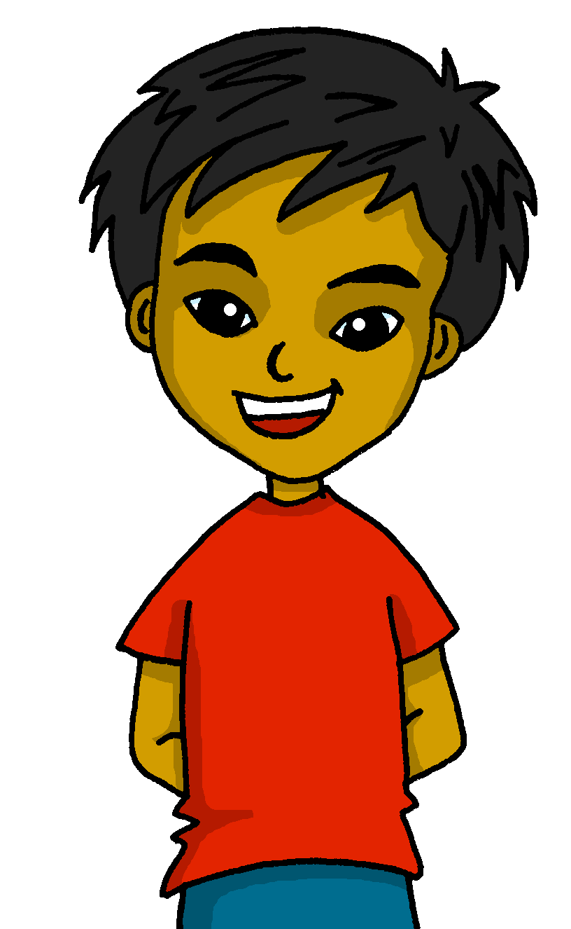
español, con Quique

Slide 2
Saying what others and I do
azul
hacer (hace) for weather
accents 3
NB: Audio to be added to this week’s lessons.
Notes:
Artwork by Steve Clarke. All additional pictures selected are available under a Creative Commons license, no attribution required.
The frequency rankings for words that occur in this PowerPoint which have been previously introduced in the resources are given in the SOW (excel document) and in the resources that first introduced and formally re-visited those words.
Phonics: López [N/A] Héctor [N/A] Félix [N/A]
Vocabulary (new words in bold): hace [26] invierno [1813] otoño [3504] primavera [2735] verano [1139] frío [1020] calor [945] sol [383]
Revisit 1: hay [13] dos [64] tres [134] cuatro [241] cinco [284] seis [438] siete [603] ocho [641] nueve [991] diez [449] once [1701] doce [1138] trece [2700] catorce [2411] quince[1215] dieciséis [3373] diecisiete [3400] dieciocho [2730] diecinueve [4232] veinte [819] veintiuno [819/425] veintidós, veintitrés, veinticuatro, veinticinco, veintiséis, veintisiete, veintiocho, veintinueve, treinta [830] treinta y uno [830/4/425]
Revisit 2: bailar [1323] cocinar [3074] mandar [588] mirar [125] luz [278] pollo [3577] suéter [>5000] tarjeta [1958] común [742]
Source: Davies, M. & Davies, K. (2018). A frequency dictionary of Spanish: Core vocabulary for learners (2nd ed.). Routledge: London
For any other words that occur incidentally in this PowerPoint, frequency rankings will be provided in the notes field wherever possible.

Slide 3
Accents 3
Words with penultimate (second-last) syllable stress that end in any consonants other than ‘n’ or ‘s’ need an accent.
pronunciar
López
Héctor
Félix
Notes:
Timing: 3 minutes
Aim: to explain the 3rd rule of written accents.
Procedure:
Read the explanation.
Introduce the example words to exemplify the rule.

Slide 4
vocabulario
Vocabulario
Escucha y pronuncia bien.
la primavera
el verano
el otoño
el invierno
summer
autumn
winter
spring
el calor
el sol
el frío
heat
cold
Notes:
Timing: 7 minutes (two slides)
Aim: to present and practise written comprehension and read aloud of previously taught vocabulary and the six new words for this week.
Procedure: 1. Click to bring up the Spanish word and say the word together with the pupils.
2. Click to bring up the English meaning.
3. Click to animate the Spanish word again and elicit repetition of the word.
4. Repeat with all 8 items and then proceed to the next slide.

Slide 5
vocabulario
Vocabulario
¿Cómo es en inglés?
el invierno
el sol
la primavera
el frío
el calor
el otoño
el invierno
Notes:
[2/2]
Aim: to practise written comprehension and read aloud of previously taught vocabulary and the six new words for this week.
Procedure: 1. Click to bring up an English picture/word prompt.
2. Pupils find the corresponding Spanish word and read it aloud, chorally.
3. Repeat with all 8 items.
4. Click on the Spanish word to hear it pronounced, if desired.

Slide 6
hacer (for weather)
You know to use ‘hace’ to mean ‘he does/is doing’:
Hace baile.
He does/is doing dance.
Also use ‘hace’ to mean ‘it is’ with weather:
⚠ This is a new meaning of ‘hace’.
Hace calor.
It is hot.
Hace frío.
It is cold.
Hace sol.
It is sunny.
⚠ Do not use the article ‘el’ in weather expressions.
Notes:
Timing: 2 minutes
Aim: to recap hace meaning ‘he does, is doing’ and introduce it to mean ‘it is’ for weather.
Procedure:
Click through the animations to present the information.
Elicit English translations for the Spanish examples provided.

Slide 7
escuchar
Escucha. Is it what Quique is doing or about the weather?
⚠ hace = he does, makes|is doing, is making
AND = it is …(weather)
 |  |  | en anglais
Or we could say ‘goes|is going on a journey.’
E
He makes|is making a trip.
1
It is sunny.
2
It is cold.
3
He does | is doing a race.
4
He makes|is making a card.
5
It is hot.
6
He goes | is going swimming.
Notes:
Timing: 6 minutes
Aim: to practise aural recognition of vocabulary and its connection with two meanings of ‘hace’.
Procedure:
Pupils listen to each phrase.
Attending to the vocabulary following ‘hace’ pupils decide between Quique’s activity and a weather expression.
On the 2nd time of listening, pupils write the English meaning of the sentences.
Click to reveal answers.
Transcript:
E Hace un viaje 1 Hace sol.
2 Hace frío.
3 Hace una carrera
4 Hace una tarjeta.
5 Hace calor.
6 Hace natación.

Slide 8
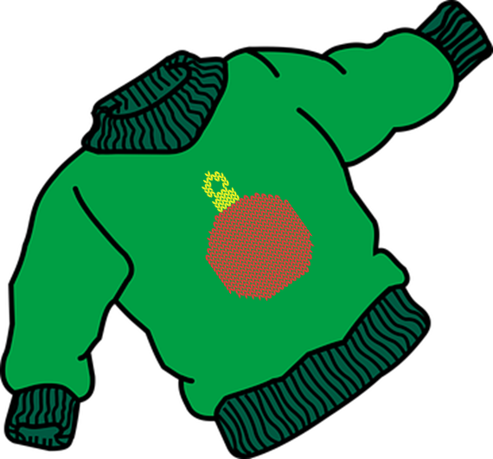
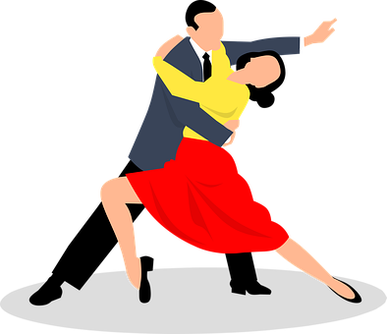
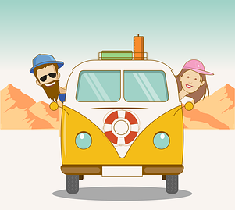
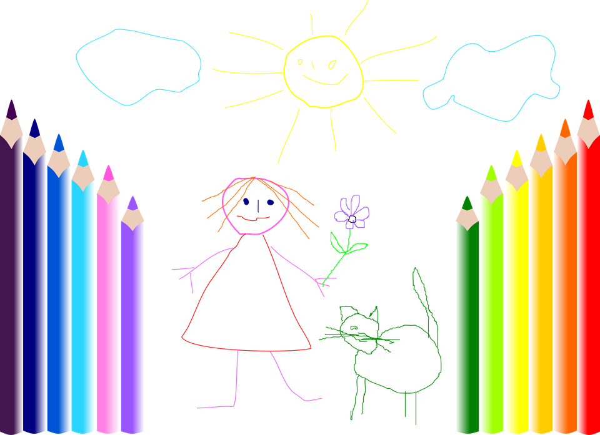
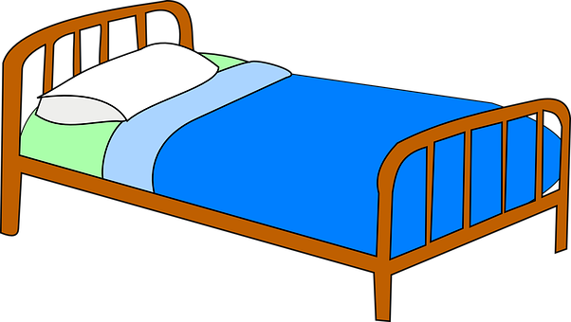
leer
Lee las frases e identifica la imagen correcta.
1 | Hace sol.
2 | Hace la cama.
3 | Haces un dibujo.
4 | Hace frío.
5 | Hago baile.
6 | Hace un viaje.
7 | Hace un suéter.
8 | Haces un regalo.
E
A
A | B | C
D |  | E
F | G | H
1
H
2
G
3
F
4
D
5
E
6
C
7
B
Notes:
Timing: 6 minutes
Aim: to practise written recognition of the singular forms of ‘hacer’ and connect these with meaning.
Procedure:
1. Read the rubric and ensure that pupils understand the task.
2. Pupils read the sentences and note down the letter of the picture. (1=A etc.)
3. Answers revealed on clicks.
4. Optional – click the numbered buttons to hear the full sentences.
5. Ask additional questions to assess comprehension of the singular forms of hacer – e.g., who is doing the shopping?

Slide 9
leer
Escribe las frases en inglés.
1 | Hace sol.
2 | Hace la cama.
3 | Haces un dibujo.
4 | Hace frío.
5 | Hago baile.
6 | Hace un viaje.
7 | Hace un suéter.
8 | Haces un regalo.
E
It is sunny.
1
S/he does |is doing the bed.
2
You make | are doing a drawing.
3
It is cold.
Or we could say ‘goes|is going on a journey.’
4
I do | am doing dance.
5
S/he does | is doing a trip.
6
S/he makes | is making a jumper.
7
You make | are making a gift.
Notes:
Timing: 5 minutes
Aim: to check more complete understanding of the new vocabulary and of the person of the verb used in each sentence, engaging the pupils again with the grammar feature from the past 2-3 weeks (singular persons of the verb hacer).
Procedure:
1. Pupils translate each sentence into English. This could be orally, on mini whiteboards or in exercise books.
2. Answers are revealed on a mouse click.
Note that is time is short, teachers can elicit answers orally or omit this activity.

Slide 10
¡adiós!
azul

