Slide 1
Saying what I and others do
azul
Follow ups 1-5
Notes:
Artwork by Steve Clarke. All additional pictures selected are available under a Creative Commons license, no attribution required.
The frequency rankings for words that occur in this PowerPoint which have been previously introduced in NCELP resources are given in the NCELP SOW and in the resources that first introduced and formally re-visited those words.
Phonics: López [N/A] Héctor [N/A] Félix [N/A]
Vocabulary (new words in bold): hace [26] invierno [1813] otoño [3504] primavera [2735] verano [1139] frío [1020] calor [945] sol [383]
Revisit 1: hay [13] dos [64] tres [134] cuatro [241] cinco [284] seis [438] siete [603] ocho [641] nueve [991] diez [449] once [1701] doce [1138] trece [2700] catorce [2411] quince[1215] dieciséis [3373] diecisiete [3400] dieciocho [2730] diecinueve [4232] veinte [819] veintiuno [819/425] veintidós, veintitrés, veinticuatro, veinticinco, veintiséis, veintisiete, veintiocho, veintinueve, treinta [830] treinta y uno [830/4/425]
Revisit 2: bailar [1323] cocinar [3074] mandar [588] mirar [125] luz [278] pollo [3577] suéter [>5000] tarjeta [1958] común [742]
For any other words that occur incidentally in this PowerPoint, frequency rankings will be provided in the notes field wherever possible.
Source: Davies, M. and Davies, K. (2018). A frequency dictionary of Spanish: Core vocabulary for learners (2nd ed.). Routledge: London

Slide 2
pronunciar
Follow up 1
el apellido – surname el nombre – first name
¿Tiene acento?
[A] Escucha y escribe la palabra ✍
Son apellidos* y nombres* españoles.
 | palabra
 | _ _ _ _
 | _ _ _ _
 | _ _ _ _ _
 | _ _ _ _ _
 | _ _ _ _ _
 | _ _ _ _
 | _ _ _ _
 | _ _ _ _ _
acento
Remember that words with penultimate (second-last) syllable stress that end in any consonants other than ‘n’ or ‘s’ need an accent.
‘
a
E
Gomez
1 minuto
a
[B] Practica combinaciones con tu compañero/a.
1
Soto
a
2
Silva
a
‘
Rojas
Ejemplo: Ángel Gómez Soto
3
n
Angel
4
‘
n
5
Eric
n
6
Nora
The tradition in is for a child
to take on the surname of their father and mother, usually in that order.
‘
a
7
Perez
INICIO
Notes:
Timing: 5 minutes
Aim: to develop understanding of rule for accents 3.
Procedure:
Teacher gives the instruction
Pupils listen out and transcribe the words (ensure they understand these are all unknown words for them).
3. Click to bring up answers.
4. Now teacher clicks to ask pupils whether these words need an accent or not, and bring up the speech bubble with a reminder of the rule.
5. Pupil apply the rule and write an accent if necessary.
6. Part B
4. Teacher clarifies these are all names or surnames & brings up reminder about Spanish surnames.
5. Pupils work in pairs to create combinations of names + surnames.
Transcript:
E Gómez
1 Soto
2 Silva
3 Rojas
4 Ángel
5 Éric
6 Nora
7 Pérez
ciudad [178] país [109]
2

Slide 3
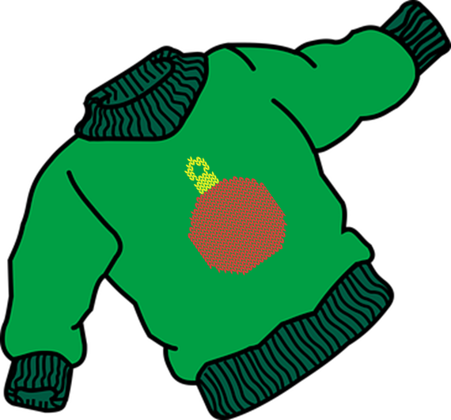
Follow up 2: ¿Cuántos hay? ¿Cuántas hay? [1/6]
Escucha la frase y escribe el número correcto y el objeto en inglés. ✍.
escuchar
E
Notes:
Timing: 5 minutes [Ejemplo]
Aim: to practise aural comprehension of numbers and previously taught vocabulary that we are revisiting this week.
Procedure:
Click to listen to the sentence.
Pupils write the number (in digits) and the item in English. (e.g. 13 bottles)
Click to highlight the number answer and reveal the noun.
Repeat for the follow 5 sentences.
Differentiation: For more challenge in terms of comprehension remove the number options (or in a mixed proficiency class, some pupils can turn away from the board). For additional transcription practice, ask pupils to transcribe the sentence and then translate it. Transcription: Hay veintitrés suéteres.

Slide 4
Follow up 2: ¿Cuántos hay? ¿Cuántas hay? [2/6]
Escucha la frase y escribe el número correcto y el objeto en inglés. ✍.
escuchar
1
Notes:
2/6 Transcription: Hay once pollos.

Slide 5
Follow up 2: ¿Cuántos hay? ¿Cuántas hay? [3/6]
Escucha la frase y escribe el número correcto y el objeto en inglés. ✍.
escuchar
2
Notes:
3/6 Transcription: Hay doce tarjetas.

Slide 6
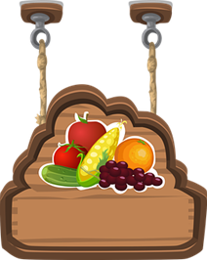
Follow up 2: ¿Cuántos hay? ¿Cuántas hay? [4/6]
Escucha la frase y escribe el número correcto y el objeto en inglés. ✍.
escuchar
3
Notes:
4/6 Transcription: Hay cinco mercados.

Slide 7
Follow up 2: ¿Cuántos hay? ¿Cuántas hay? [5/6]
Escucha la frase y escribe el número correcto y el objeto en inglés. ✍.
escuchar
Treinta y uno becomes treinta y un before a masculine noun. E.g., Hay treinta y un dibujos.
4
Notes:
5/6 Transcription: Hay treinta y un dibujos.

Slide 8
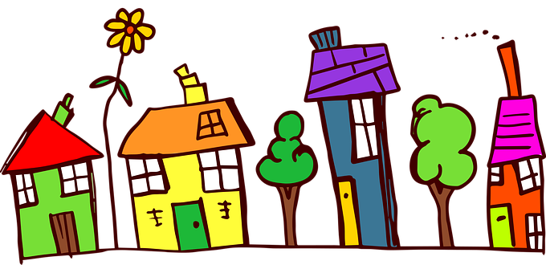
Follow up 2: ¿Cuántos hay? ¿Cuántas hay? [6/6]
Escucha la frase y escribe el número correcto y el objeto en inglés. ✍.
escuchar
5
Notes:
6/6 Transcription: Hay veinticuatro casas.

Slide 9
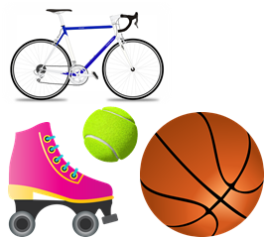
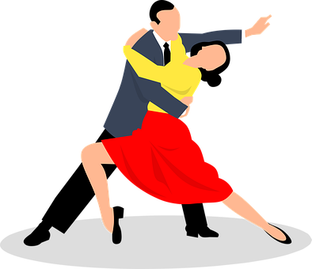
Follow up 3a:
Escucha. ¿Qué imagen es? Escribe la letra que corresponde.
escuchar
1
2
3
4
5
6
7
8
9
E
H
C
I
A
F
B
D
G
A | B | C
D | E | F
G | H | I
Notes:
Timing: 5 minutes
Aim: to practise recognition of the newly learnt expressions with ‘hacer’ in the oral modality.
Procedure:
Click on the numbers to play the audio.
Pupils write 1 = A etc… (To challenge higher proficiency learners, ask them to record who is doing the action or just weather.
Click to provide answers.
Transcript
1 Haces deporte
2 Haces un regalo.
3 Hace natación
4 Hago una carrera.
5 Hace calor.
6 Haces un viaje.
7 Hago la cama.
8 Hace frío.
9 Hace baile.

Slide 10
Follow up 3b:
Quique manda un e-mail a Krina.
Lee. Rodea la imagen y escribe la información extra en inglés.
Leer y escribir
actividad | tiempo | extra info?
does gardening
plays the guitar
does the cooking / cooks
does a drawing / draws
does activities
cleans
dances
¡Hola Krina! ¿Qué hago normalmente?
Pues cuando hace frío hago actividades en casa. Por ejemplo, limpio la cocina o toco la guitarra solo. También cocino con papá o hago un dibujo en mi habitación. Cuando hace calor bailo en el jardín o hago jardinería con Sofía. ¿Qué haces tú?
with Sofía
alone
with dad
in his room
at home
the kitchen
in the garden
Notes:
Timing: 10 minutes [version 1]
Aim: written comprehension of key vocabulary and hacer for weather.
Procedure:
Teacher to read the context and ensure this is clear.
Pupils to read the message aloud in pairs. Looking at the activities listed, they need to decide when Quique does them (when it’s cold hot) and note down an extra details. [Next slide is more challenging version of this task]
Elicit answers from pupils and click to bring up answers. Ask pupils how they knew and elicit Spanish from them (does gardening → the text says ‘hago jardinería’).

Slide 11
Follow up 3:
Quique manda un e-mail a Krina.
Lee. Rodea la imagen y escribe la información extra en inglés.
Leer y escribir
actividad | tiempo | extra info?
¡Hola Krina! ¿Qué hago normalmente?
Pues cuando hace frío hago actividades en casa. Por ejemplo, limpio la cocina o toco la guitarra solo. También cocino con papá o hago un dibujo en mi habitación. Cuando hace calor bailo en el jardín o hago jardinería con Sofía. ¿Qué haces tú?
does activities
at home
cleans
the kitchen
plays the guitar
alone
cooks
with dad
does a drawing / draws
in his room
dances
in the garden
does gardening
With Sofía
Notes:
Timing: 10 minutes [version 2]
Aim: written comprehension of key vocabulary and hacer for weather.
Procedure:
Teacher to read the context and ensure this is clear.
Pupils to read the message aloud in pairs
3. Pupils to find the 7 activities mentioned by Quique, when he does them and any extra information.

Slide 12
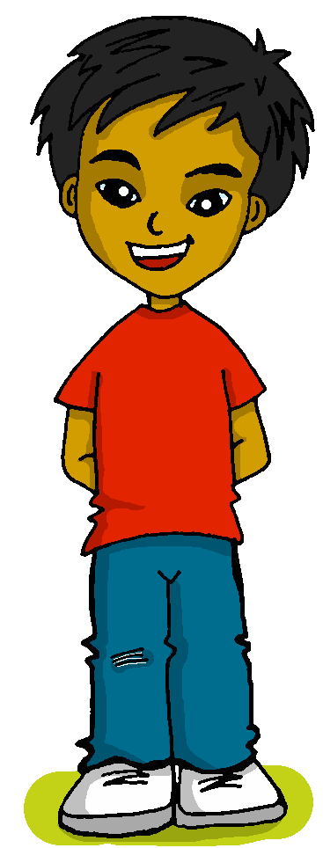
Follow up 4:
Negation
This works with any person of the verb.
[negative ‘no’]
Remember that to make a sentence negative, we simply put ‘no’ before the verb.
I
You (singular)
S/he
No hago deporte.
No haces baile.
No hace baile.
I don’t do sport.
You don’t do dance.
S/he doesn’t do dance.
No hace frío.
It’s not cold.
Notes:
Timing: 8 minutes (2 slides)
Aim: to revisit negation with ‘no’ and singular persons of ‘hacer’.
Procedure:
Click to present the reminder information.
Elicit English translation for the Spanish examples provided.

Slide 13
Follow up 4 :
[1/6]
Con tu compañero/a, lee las frases.
hablar
haces
en
25 segundos
hago
frío
In summer it is not cold.
En verano no hace frío.
hace
calor
verano
no
invierno
INICIO
Notes:
Timing: 5 minutes (6 slides)
Aim: to practise supported oral sentence creation of this week’s target structure and vocabulary.
Procedure:
Click for the English prompt.
Give pupils 10 sentences to work out the sentence and practise it aloud.
Click again to ‘disappear’ the distractor words.
Say ‘un, dos, tres’ to cue choral production of the sentence.
Click to bring up the Spanish sentence.
Repeat steps 1-3 for the remaining six slides.

Slide 14
Follow up 4 :
[2/6]
Con tu compañero/a, lee las frases.
hablar
haces
no
frío
25 segundos
hago
In autumn it is not hot.
En otoño no hace calor.
calor
otoño
hace
en
siempre
primavera
INICIO
Notes:
Timing: 5 minutes (6 slides)
Aim: to practise supported oral sentence creation of this week’s target structure and vocabulary.
Procedure:
Click for the English prompt.
Give pupils 10 sentences to work out the sentence and practise it aloud.
Click again to ‘disappear’ the distractor words.
Say ‘un, dos, tres’ to cue choral production of the sentence.
Click to bring up the Spanish sentence.
Repeat steps 1-3 for the remaining six slides.

Slide 15
Follow up 4 :
[3/6]
Con tu compañero/a, lee las frases.
hablar
haces
no
25 segundos
hace
pollo
You don’t make a cake.
No haces una tarta.
hago
calor
un
tarta
en
una
INICIO
Notes:
Timing: 5 minutes (6 slides)
Aim: to practise supported oral sentence creation of this week’s target structure and vocabulary.
Procedure:
Click for the English prompt.
Give pupils 10 sentences to work out the sentence and practise it aloud.
Click again to ‘disappear’ the distractor words.
Say ‘un, dos, tres’ to cue choral production of the sentence.
Click to bring up the Spanish sentence.
Repeat steps 1-3 for the remaining six slides.

Slide 16
Follow up 4 :
[4/6]
Con tu compañero/a, lee las frases.
hablar
haces
no
25 segundos
hace
dibujos
I don’t do a race.
No hago una carrera.
hago
carrera
un
tarjeta
en
una
INICIO
Notes:
Timing: 5 minutes (6 slides)
Aim: to practise supported oral sentence creation of this week’s target structure and vocabulary.
Procedure:
Click for the English prompt.
Give pupils 10 sentences to work out the sentence and practise it aloud.
Click again to ‘disappear’ the distractor words.
Say ‘un, dos, tres’ to cue choral production of the sentence.
Click to bring up the Spanish sentence.
Repeat steps 1-3 for the remaining six slides.

Slide 17
Follow up 4 :
[5/6]
Con tu compañero/a, lee las frases.
hablar
haces
no
25 segundos
hace
frío
You don’t do dance when it’s cold.
No haces baile cuando hace frío
calor
otoño
cuando
hago
en
baile
una carrera
INICIO
Notes:
Timing: 5 minutes (6 slides)
Aim: to practise supported oral sentence creation of this week’s target structure and vocabulary.
Procedure:
Click for the English prompt.
Give pupils 10 sentences to work out the sentence and practise it aloud.
Click again to ‘disappear’ the distractor words.
Say ‘un, dos, tres’ to cue choral production of the sentence.
Click to bring up the Spanish sentence.
Repeat steps 1-3 for the remaining six slides.

Slide 18
Follow up 4 :
[6/6]
Con tu compañero/a, lee las frases.
hablar
haces
no
25 segundos
hace
frío
I go* swimming when it’s not cold.
Hago natación cuando no hace frío.
calor
otoño
cuando
natación
en
deporte
hago
INICIO
Notes:
Timing: 5 minutes (6 slides)
Aim: to practise supported oral sentence creation of this week’s target structure and vocabulary.
Procedure:
Click for the English prompt.
Give pupils 10 sentences to work out the sentence and practise it aloud.
Click again to ‘disappear’ the distractor words.
Say ‘un, dos, tres’ to cue choral production of the sentence.
Click to bring up the Spanish sentence.
Repeat steps 1-3 for the remaining six slides.

Slide 19
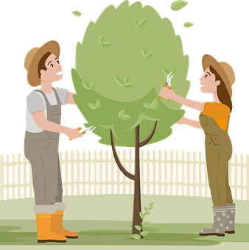
Follow up 5:
Escribe las frases en español.
escribir
 | En , [I do] con mi clase.
 | Cuando , [I don’t do] en mi habitación.
 | En , [s/he does] por la mañana.
 | Cuando , [s/he doesn’t do] actividades fuera.
 | In Spring, when it’s cold, I don’t do sport.
E
En invierno, hago un viaje con mi clase.
1
Cuando hace calor, no hago baile en mi habitación.
2
En verano, hace jardinería por la mañana.
3
Cuando hace frío, no hace actividades fuera.
4
En primavera, cuando hace frío, no hago deporte.
Notes:
Timing: 5 minutes
Aim: to practise written production of ‘hacer’ (1st and 3rd person) and the four weather items from this week’s vocabulary.
Procedure:
1. Teacher models the task with sentence 1, using a ‘think aloud’ to interpret the picture, and eliciting suggestions from pupils as to a suitable sentence (perhaps initially in English and then Spanish, or just in Spanish).
Note: Teachers can differentiate the task, providing more support to lower proficiency learners by: i. providing the initial letters of each word as prompts. iii. enabling pupils to look at the four vocabulary words (frío, calor, otoño, verano, invierno) first and practise those on mini whiteboards etc..

Slide 20
Follow up 5:

You are on holiday. Write any six sentences about your activities.
Escribe seis frases.
escribir
Notes:
ALTERNATIVE TO THE PREVIOUS WRITING TASK FOR HIGHER PROFICIENCY LEARNERS Aim: to practise more independent written production of first person singular of ‘hacer’ along with this week’s target vocabulary.
Procedure:
Pupils write sentences using the first person singular form of ‘hacer’ in response to the pictures, in order to narrate an imaginary day on holiday.
For an additional challenge, pupils could then be asked to do this using the second person singular form – i.e. writing about what ‘you’ do – or the third person singular form – i.e. writing about what s/he does.
Make it clear to pupils that they are writing in the present tense, i.e. saying what happens normally or is happening whilst they are on holiday.
Remind learners that the weather expressions use ‘hace’

Slide 21
follow up extra:

Escribe en español: can you get at least 15 points?
 | 30 | to look, looking | to cook, cooking
 | there is/are | to send, sending | 15
 | s/he does, makes | I do, make | You do
 | card | right | left
 | Winter | Summer | Autumn
 | Spring | cold | hot
vocabulario
treinta
mirar
cocinar
x3
hay
mandar
quince
hace
hago
haces
x2
la tarjeta
la derecha
la izquierda
el invierno
el verano
el otoño
x1
la primavera
frío
calor
Notes:
Timing: 7 mniutes
Aim: to practise written comprehension of vocabulary from this week and this week’s revisited sets (next slide).
Procedure:
1. Give pupils a blank grid. They fill in the English meanings of any of the words they know, trying to reach 15 points in total.
Note: The most recently learnt and practised words are pink, words from the first revisit are green and those from the second revisit are blue, thus more points are awarded for them, to recognise that memories fade and more effort (heavy lifting!) is needed to retrieve them.

Slide 22
¡adiós!
azul

