Slide 1
español, con Quique

Slide 2
Saying what others and I do
El cumpleaños
azul
hacer [to do, make]:
hago, haces, hace
accents 2
Notes:
Artwork by Steve Clarke. All additional pictures selected are available under a Creative Commons license, no attribution required.
The frequency rankings for words that occur in this PowerPoint which have been previously introduced in the resources are given in the SOW (excel document) and in the resources that first introduced and formally re-visited those words.
Phonics: Albarracín [N/A] Bogotá [N/A] Castellón [N/A]
Vocabulary (new words in bold) :hacer [26] haces dibujo [1726] foto [882] imagen [384] derecha [1573] fondo [413] izquierda [1352] tarta [>5000] tarjeta [1958] a [8]
Revisit 1: ir [33] voy vas va estar [21] estoy estás está cine [952] costa [896] mercado [487] teatro [605]
Revisit 2: aprender [428] beber [1085] comer [347] correr [343] hacer [26] leer [209] vender [528] ver [38] dinero [364] más [23]
Glossed: fiesta [796]
Source: Davies, M. & Davies, K. (2018). A frequency dictionary of Spanish: Core vocabulary for learners (2nd ed.). Routledge: London
For any other words that occur incidentally in this PowerPoint, frequency rankings will be provided in the notes field wherever possible.

Slide 3
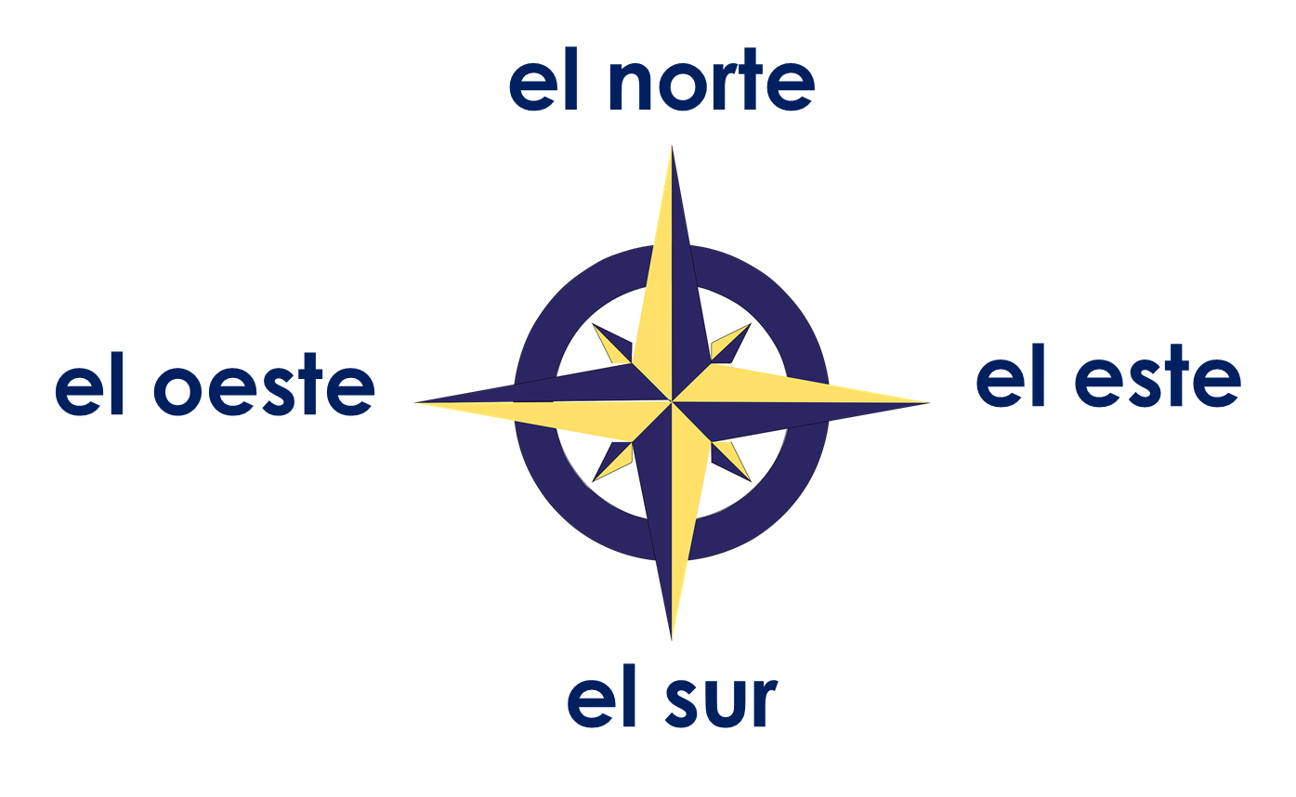
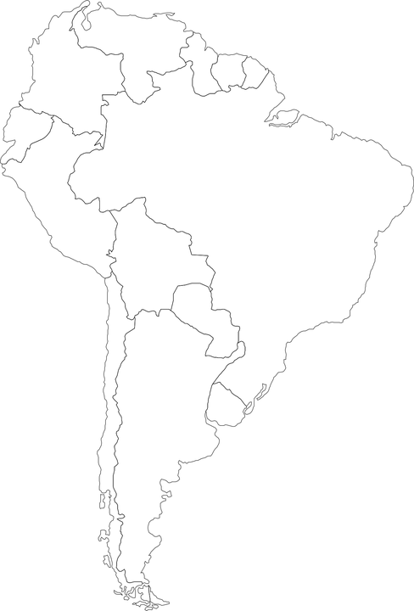
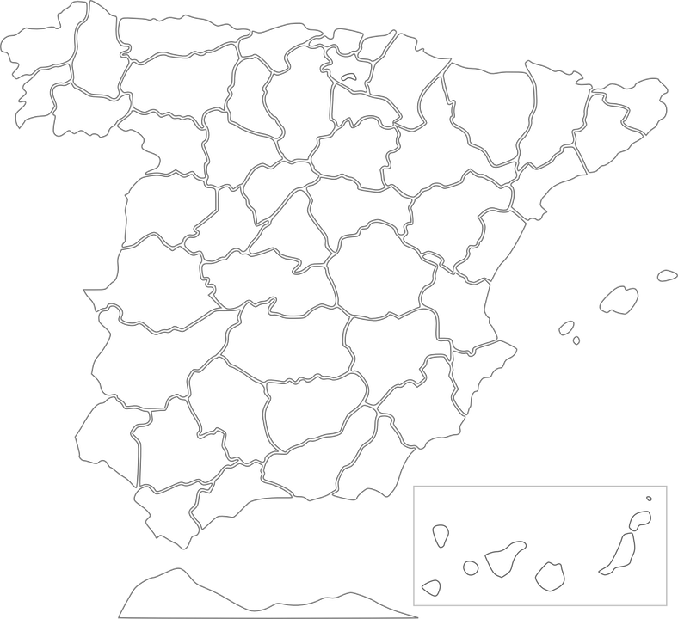
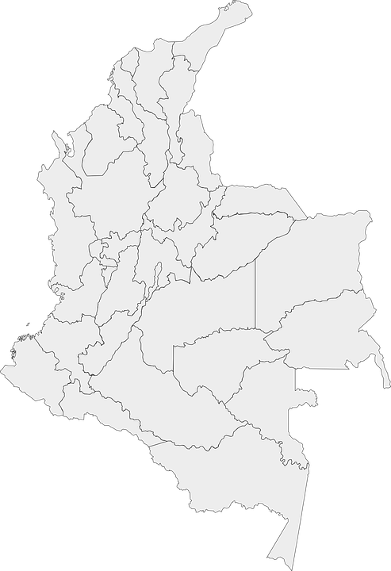
Accents 2
el centro
In Spanish, all words with last syllable stress that end in –n, -s or a vowel have an accent.
pronunciar
Cadaqués
Albarracín
Bogotá
¿Dónde está Bogotá?
¿Dónde está Albarracín?
¿Dónde está Cadaqués?
centro
norte
España
este
España
Cadaqués está en el ______ de _________.
Bogotá está en el _______ de __________.
Albarracín está en el ______ de _________.
Colombia
Notes:
Timing: 3 minutes
Aim: to explain the rule of written accents 1
Procedure:
Read the explanation.
Introduce the example words to exemplify the rule.
Click further to bring questions on location of the cities used as example and elicit answer from pupils (encourage them to answer in full sentences).

Slide 4
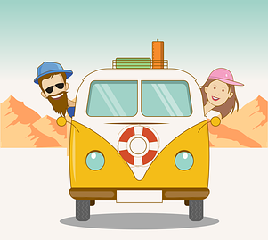
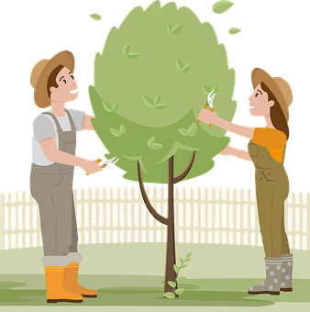
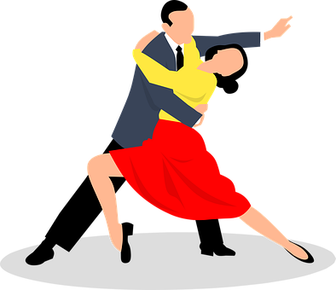
vocabulario
Vocabulario
¿Cómo es en español?
una lista
una tarta
la cama
un viaje
to do a drawing
to make the bed
un dibujo
to do gardening
to make a list
jardinería
to go swimming
to make a cake
to do dance
to do a race
to do gardening
to go* swimming
to make a list
to do dance
to do a drawing
to make a card
to make a card
to make a cake
to do a trip
to do a race
to do a trip
to make the bed
natación
una tarjeta
una carrera
baile
Notes:
Timing: 5 minutes
Aim: to present and practise written comprehension and read aloud of previously taught vocabulary and two new words for this week.
Procedure: 1. Click for an English item. Elicit pronunciation of the Spanish from pupils, the full phrase, i.e., hacer la cama.
2. Click to cover the Spanish word with a picture.
3. Continue with the remaining items.
4. Elicit the Spanish from pupils, (English prompts reappear on each mouse click) this time without written Spanish support.

Slide 5
Using the verb ‘hacer’
[to do: I do & s/he, it does]
Remember that the verb ‘hacer’ is an irregular verb and does not follow the general rules.
I
s/he, it
you
Hago un dibujo.
Hace una carrera.
Haces una tarta.
I do a drawing.
S/he does a race.
You make a cake.
Quique hace una carrera.
Quique does a race.
⚠ We use the verb hacer to mean to do and to make.
Notes:
Timing: 3 minutes
Aim: to introduce 2nd person singular of ;hacer’; to revisit 1st and 3rd person singular of ‘hacer’
Procedure:
Read the grammar explanation on irregular verb hacer.
Elicit English translation for the Spanish examples provided.

Slide 6
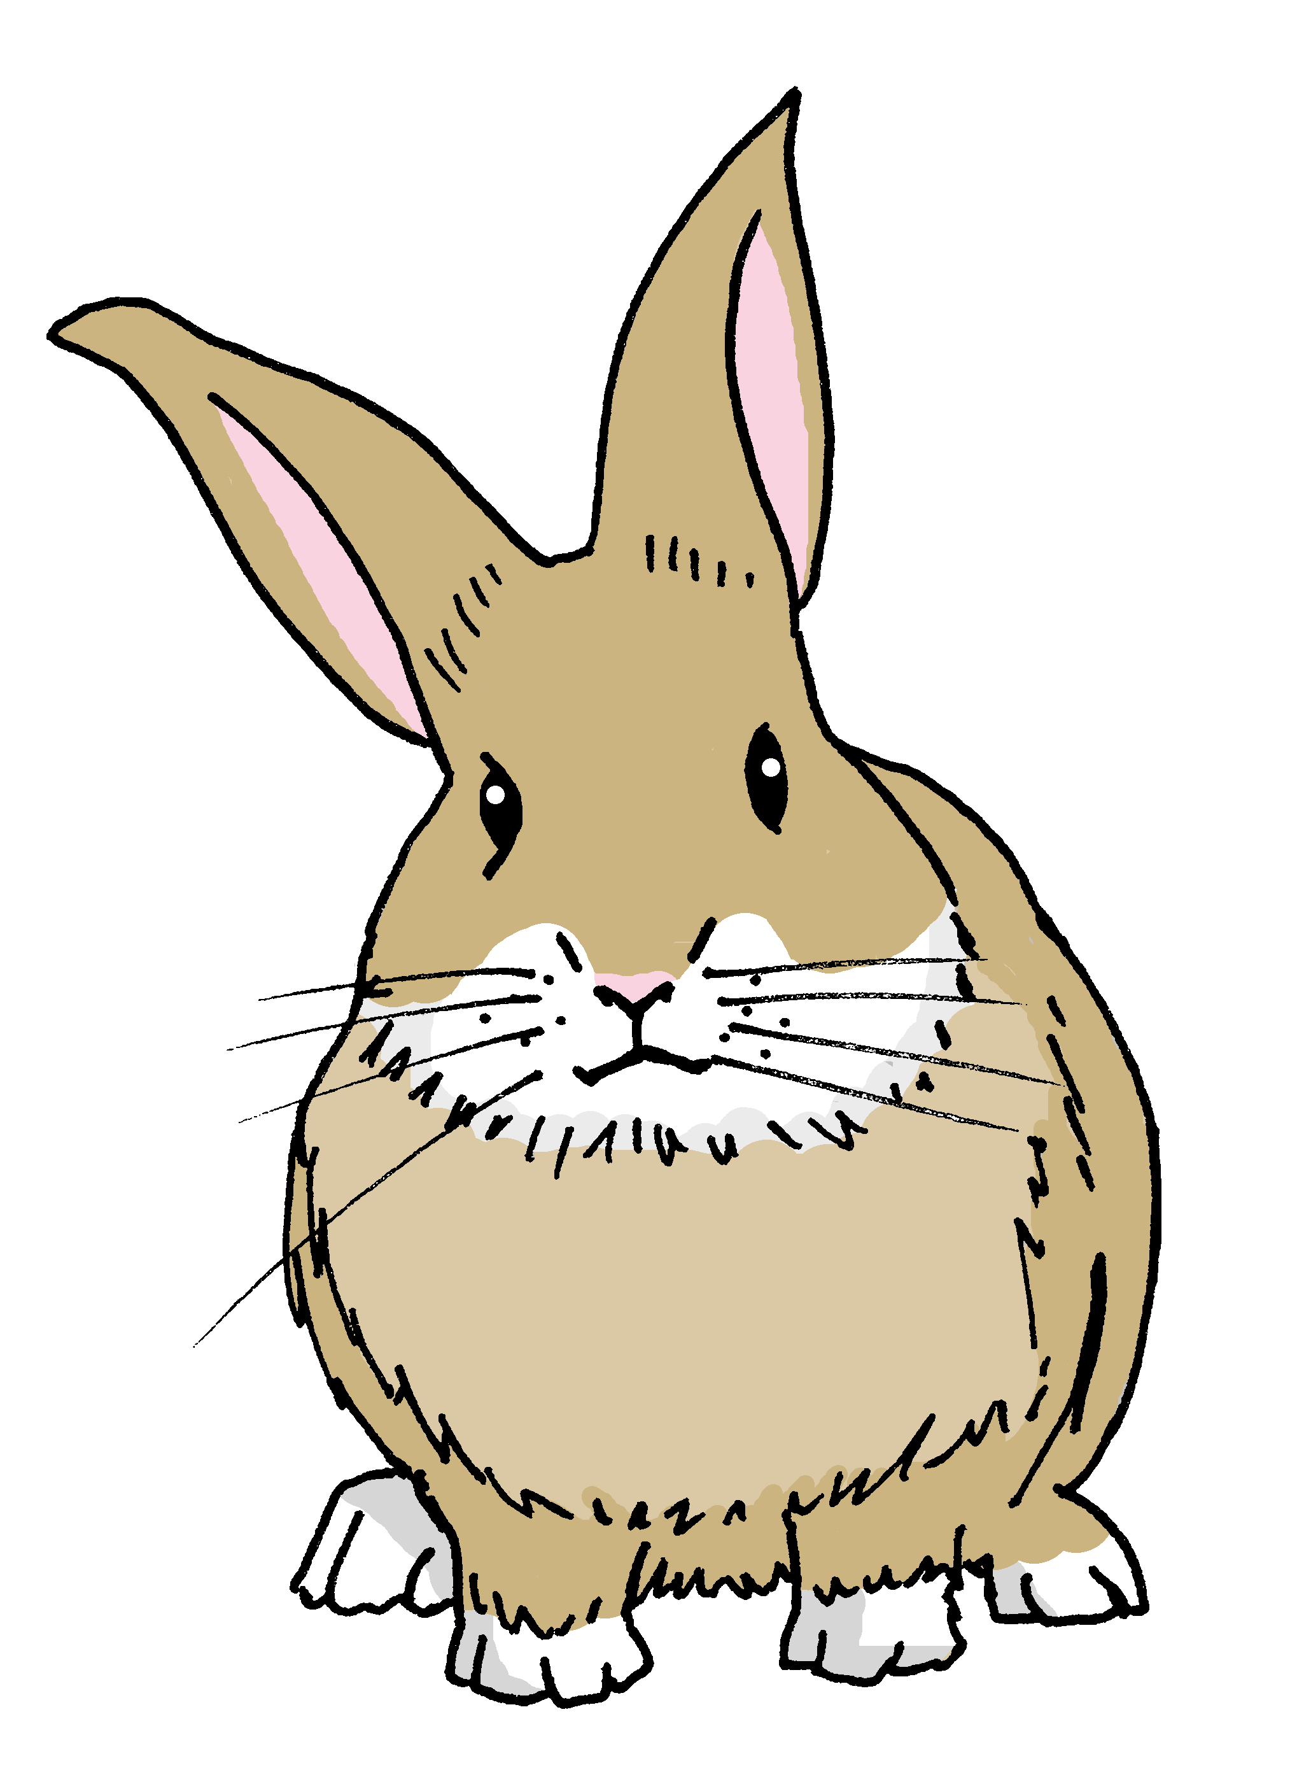
leer
El sábado, es el cumpleaños de Ángela! Quique organiza una fiesta.
Quique escribe una lista con las actividades, pero ¡Pancho tiene hambre!
¿Quién hace qué? ¿Es Sofía (you) o papá Pedro (he)?
⚠ We can also use hacer to mean ‘to take’ (photos).
2
Haces la tarta.
1
Haces la tarjeta.
tú (you)
él (he)
4
3
Hace el pollo.
Hace las fotos en la fiesta*.
1
2
3
4
5
6
7
5
Hace un viaje a casa de Ángela.
6
Haces los bocadillos.
7
Haces el regalo.
(la) fiesta – party
Notes:
Timing: 6 minutes
Aim: to practise written recognition of the second and third person singular forms of ‘hacer’ and connect these with meaning.
Procedure:
1. Read the rubric and ensure that pupils understand the context.
2. Pupils read the parts of sentences they can see and tick who they think it applies to. They should use their knowledge of verb forms to decide.
3. Answers revealed on clicks.
4. Optional – click the numbered buttons to hear the full sentences.
5. Ask additional questions to assess comprehension – e.g., who is doing the shopping? Who is making the present?

Slide 7
escuchar
Quique needs to check with Sofía that she understands the to-do list.
Escucha. ¿Es una pregunta? Escribe los detalles en inglés.
(you)
E
1
2
3
4
5
make the cake with dad
Statement
(I)
make the bed
statement
(you)
make the present
question
(you)
make the card
E
1
2
3
4
statement
5
(I)
do a dance
question
(you)
⚠
Three activities are not mentioned!
do a drawing
question
Notes:
Timing: 6 minutes
Aim: to practise aural differentiation of statements and intonation questions, and to recognise vocabulary aurally.
Procedure:
Pupils listen to each phrase.
Pupils note: 1. the person (I or you), what each person does, as well as if it is a question or a statement. They may need to listen more than once to get all the information.
Click to reveal the answers (person, statement or question, activity).
Transcript:
E Tu haces la tarta con papa. 1 Hago la cama
2 ¿Haces el regalo?
3 Haces la tarjeta
4 ¿Hago un baile?
5 ¿Haces un dibujo?

Slide 8
¡adiós!
azul

