Slide 1
Saying what I and others do
El cumpleaños
azul
Follow ups 1-5
Notes:
Artwork by Steve Clarke. All additional pictures selected are available under a Creative Commons license, no attribution required.
The frequency rankings for words that occur in this PowerPoint which have been previously introduced in NCELP resources are given in the NCELP SOW and in the resources that first introduced and formally re-visited those words.
Phonics:
Vocabulary (new words in bold): hacer [26] haces dibujo [1726] foto [882] imagen [384] derecha [1573] izquierda [1352] tarjeta [1958] a [8]
Revisit 1: ir [33] voy vas va estar [21] estoy estás está cine [952] costa [896] mercado [487] teatro [605]
Revisit 2: aprender [428] beber [1085] comer [347] correr [343] hacer [26] leer [209] vender [528] ver [38] dinero [364] más [23]
For any other words that occur incidentally in this PowerPoint, frequency rankings will be provided in the notes field wherever possible.
Source: Davies, M. and Davies, K. (2018). A frequency dictionary of Spanish: Core vocabulary for learners (2nd ed.). Routledge: London
ciudad [178] País [109]

Slide 2
pronunciar
Follow up 1
¿Tiene acento?
¿Cuántas sílabas tiene?
[A] Escucha y escribe la palabra ✍
 | palabra
 | _ _ _ _
 | _ _ _ _ _ _ _
 | _ _ _ _ _ _ _
 | _ _ _ _ _
 | _ _ _ _ _ _
 | _ _ _ _
 | _ _ _ _ _ _ _
 | _ _ _ _ _ _ _
Remember that in Spanish, all words with last syllable stress that end in –n, -s or a vowel have an accent.
‘
E
Peru
1
Badajoz
2
dibujar
‘
‘
3
avion
Los dos países en Sudamérica son ______ y _________ .
Perú
Ecuador
4
ingles
‘
Badajoz
Leon
Las dos ciudades de España son ___________ y ___________.
5
León
6
Ecuador
‘
7
corazon
la ciudad = city | el país = country
Notes:
Timing: 5 minutes (two slides)
Aim: to develop pupil’s awareness of word stress with unknown words (Spanish surnames)/
Procedure:
1. Teacher gives the instruction and clarifies ‘estrés’.
2. Pupils listen out for identifying the number of syllables in each word (ensure they understand these are all unknown words for them).
3. Click to bring up answers.
4. Listen one more time to focus on where the stress falls in the word – most linguistically may want to try to write the whole word.
5. Elicit the answers in the two gapped sentences. Click to reveal the answers. Click on each sentence to hear it pronounced.
Transcript:
E Perú
1 Badajoz
2 dibujar
3 avión
4 inglés
5 León
6 Ecuador
7 corazón
ciudad [178] País [109]
2

Slide 3
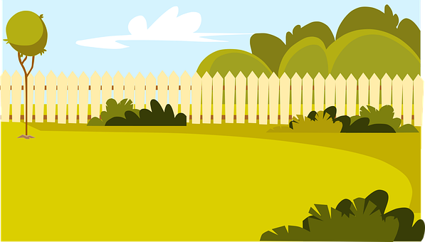
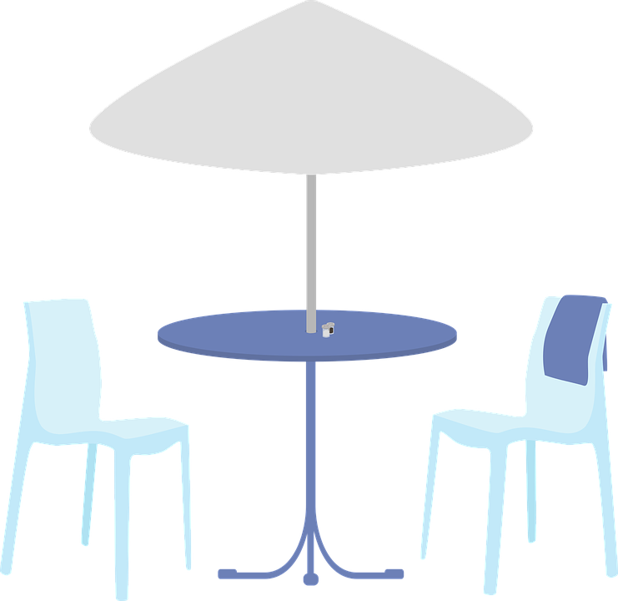
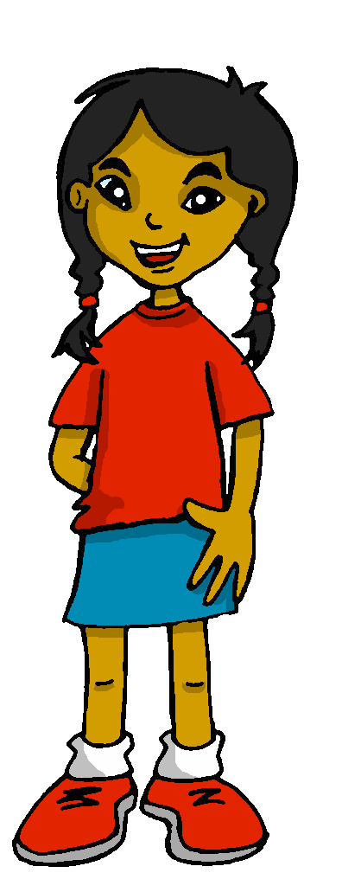
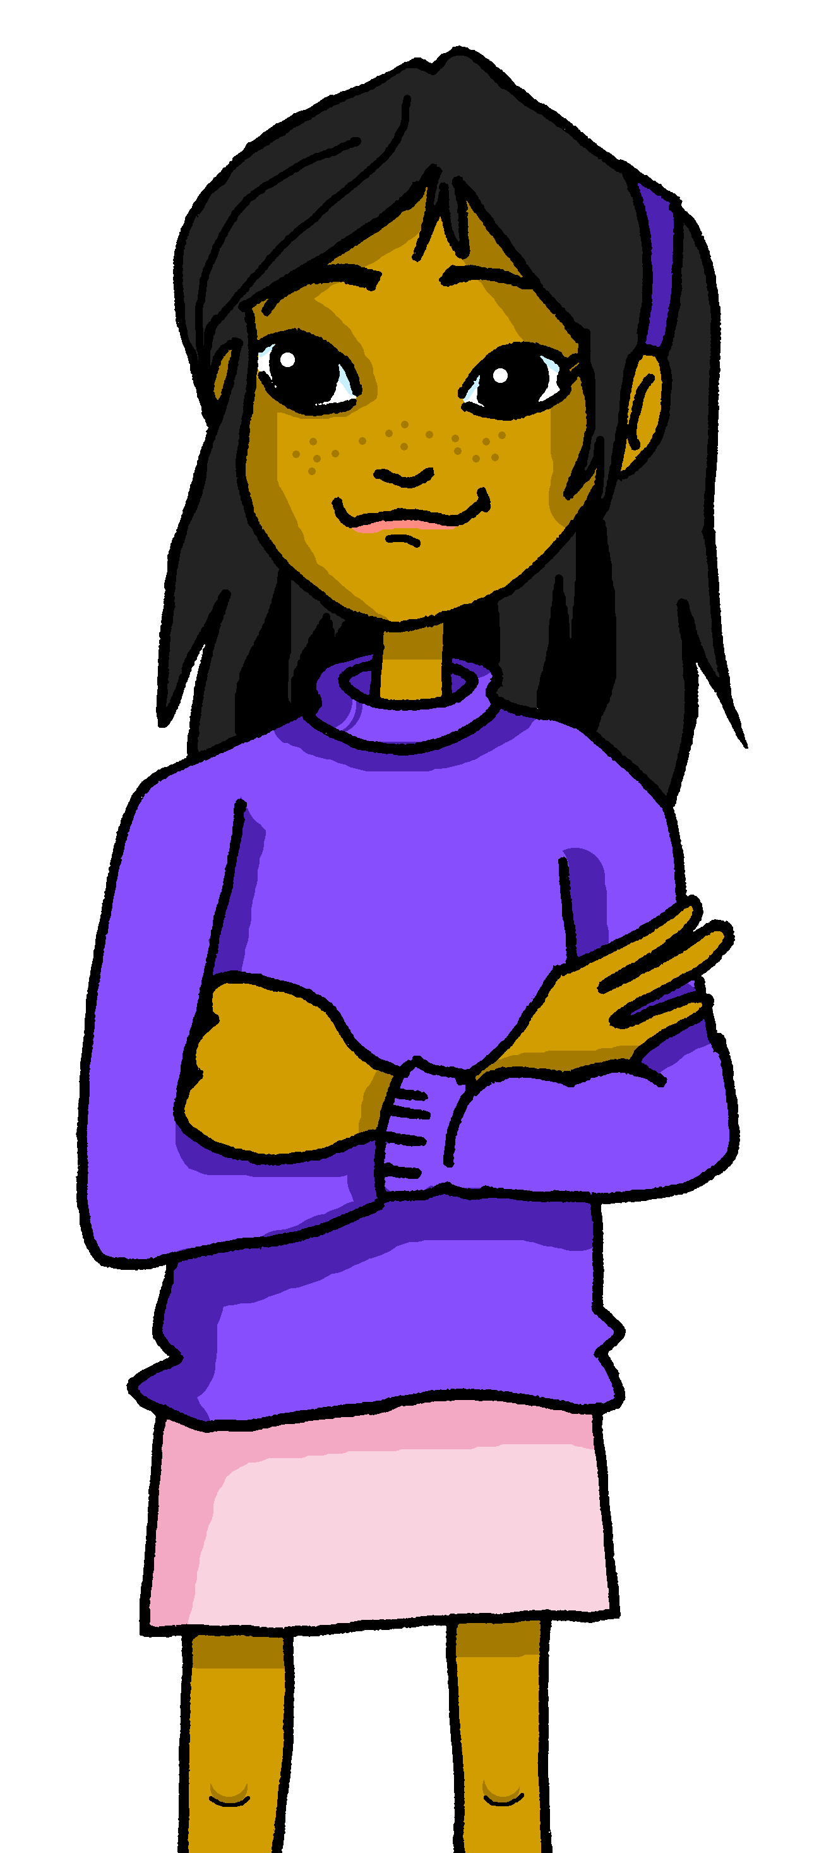
follow up 2a:
Una foto de la fiesta de cumpleaños de Ángela.
En la imagen, Ángela está a la derecha, Sofía está en el medio y Quique a la izquierda.
vocabulario
s/he is
right
está
la derecha
left
to
la izquierda
a
middle
image
el medio
la imagen
Notes:
Timing: 10 minutes (two slides)
Aim: to introduce 3 items of vocabulary (this slide) and to practise written comprehension of vocabulary from this week and this week’s revisited sets (next slide).
Procedure: Part 1 [3 minutes[
Give pupils 2-3 minutes to read the sentences with a partner and find the Spanish meanings for the six English words.
Pupils could be asked to read the text aloud in pairs, taking it in turns to read alternate sentences.
Click the audio buttons to hear each sentence, if desired.
Click on each English word to reveal the Spanish translation.

Slide 4
follow up 2b:

Escribe en inglés: can you get at least 15 points?
 | vender | correr | más
 | ver | comer | el dinero
 | el teatro | la costa | ir
 | voy | está | estar
 | haces | la imagen | la derecha
 | el baile | la izquierda | el viaje
vocabulario
to sell, selling
to run, running
more
x3
to see, seeing
to eat, eating
(the) money
(the) theatre
(the) coast
to go, going
x2
I go
s/he, it is (location)
to be, being (location)
you do
(the) image
(the) right
x1
(the) dance
(the) left
(the) journey
Notes:
Timing: 7 miutes
Aim: to practise written comprehension of vocabulary from this week and this week’s revisited sets (next slide).
Procedure:
Part 2 [7 minutes] 1. Give pupils a blank grid. They fill in the English meanings of any of the words they know, trying to reach 15 points in total.
Note: The most recently learnt and practised words are pink, words from the first revisit are green and those from the second revisit are blue, thus more points are awarded for them, to recognise that memories fade and more effort (heavy lifting!) is needed to retrieve them.

Slide 5
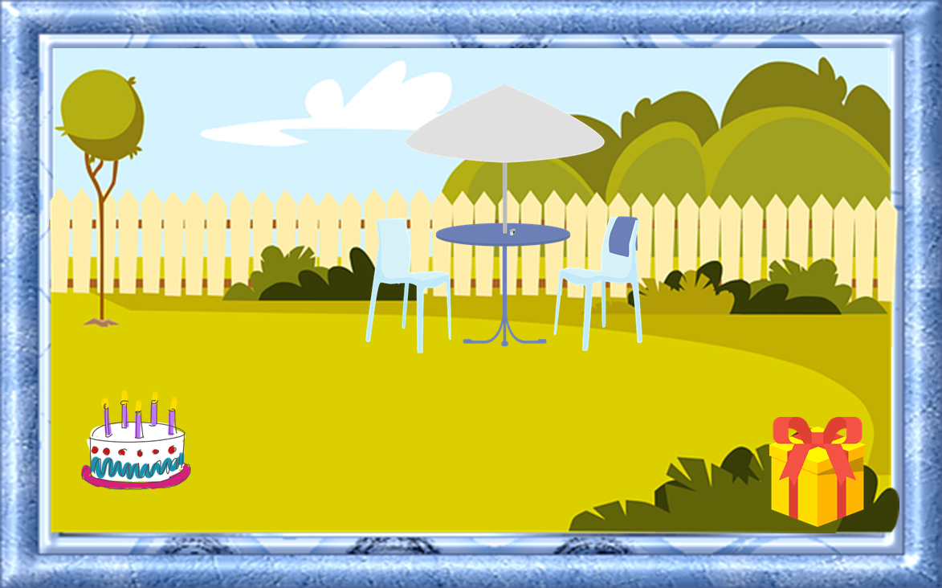
a la + position
[to the]
In Spanish use ‘a la derecha’ to mean ‘on the right’ and
‘a la izquierda’ to mean ‘on the left’.
This is a new meaning of ‘a’.
La tarta está a la izquierda.
The cake is on the left.
El regalo está a la derecha.
The present is on the right.
Notes:
Use this slide before Follow up 3
Timing: 5 minutes (2 slides)
Aim: to introduce the use of ‘a’ to mean ‘on’ when describing location on the left and right.
Procedure:
Click through the animations to present the information.
Elicit the Spanish translations for the English examples.

Slide 6
Follow up 3:

Lee las frases y corrige.
 | Sofía is doing an activity on the left .
 | Sofía hace una actividad a la derecha.
 | She is doing a race on the left.
 | Hago una carrera a la izquierda.
 | Dad is doing dance to the right.
 | Papá hace baile a la derecha. .
 | I’m making the bed on the right.
 | Hago la cama a la izquierda.
 | I’m doing a drawing with Sofía in the middle.
 | Haces un dibujo con Sofía en el medio.
right
escribir
leer
E
I’m doing
When describing ongoing actions we often use the continuous present in English, e.g. ‘is doing’. In Spanish, you can use the simple present : hace = does AND is doing.
1
on
2
left
3
You’re
4
Notes:
Timing: 5 minutes
Aim: written comprehension of hacer + positions
Procedure:
Tell pupils that there are mistakes in the ENGLISH sentences.
Pupils read the Spanish and write the corrections for the English sentence. They can just write the corrections rather than the full sentences.
Click to correct.
If desired, click on the numbers to hear the Spanish sentences.

Slide 7
Follow up 4 :
Quique describe las fotos a Ángela.
Observa las imágenes y habla [1/5].
hablar
25 segundos
She is making the bed on the left.
Hace
la cama
a la izquierda.
INICIO
Notes:
Timing: 5 minutes [5 slides]
Aim: to practise written or spoken production of vocabulary and grammar learned this week and last week.
Procedure:
Pupils write or say the Spanish.
Click to bring up answers (position, verb, complements)

Slide 8
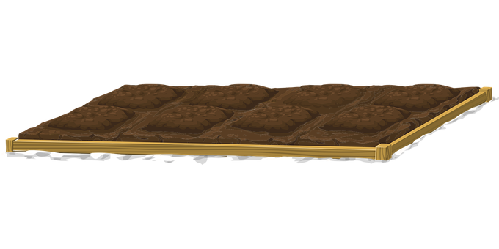
Follow up 4 :
Quique describe las fotos a Ángela.
Observa las imágenes y habla [2/5].
hablar
25 segundos
On the right you are (doing) gardening.
A la derecha
haces
jardinería.
INICIO
Notes:
[2/5]

Slide 9
Follow up 4 :
Quique describe las fotos a Ángela.
Observa las imágenes y habla [3/5].
hablar
25 segundos
A la derecha
y
On the right I’m making a list and on the left Sofía is making a card.
hago una lista
a la izquierda
Sofía hace una tarjeta.
INICIO
Notes:
[3/5]

Slide 10
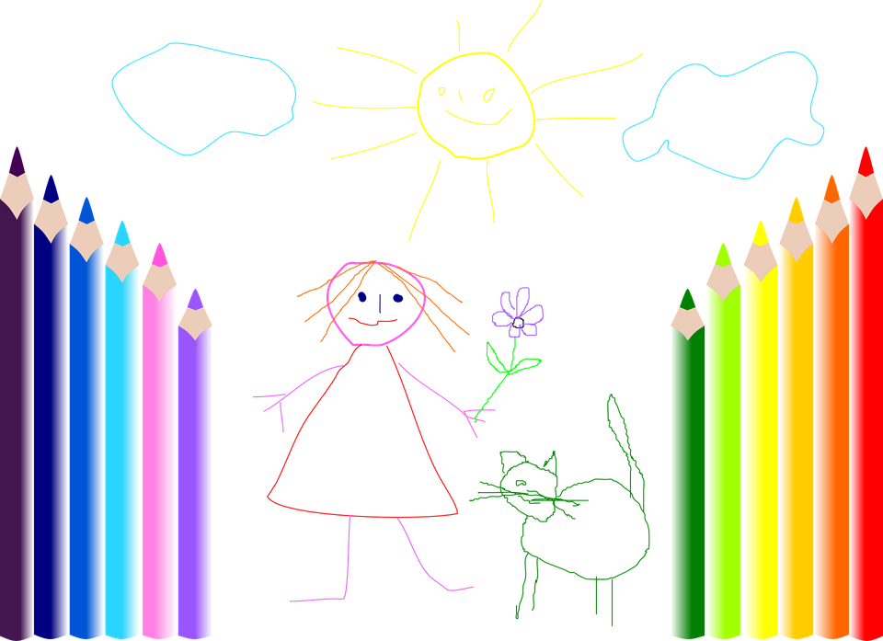
Follow up 4 :
Quique describe las fotos a Ángela.
Observa las imágenes y habla [4/5].
hablar
[a race]
25 segundos
On the left I’m doing a race and
on the right you’re doing a drawing.
A la izquierda
hago una carrera y
a la derecha
haces un dibujo.
INICIO
Notes:
[4/5]

Slide 11
Follow up 4 :
Quique describe las fotos a Ángela.
Observa las imágenes y habla [5/5].
hablar
25 segundos
Haces baile a la izquierda y
You’re dancing on the left and on the right Sofía is making a cake.
a la derecha
Sofía hace una tarta.
INICIO
Notes:
[5/5]

Slide 12
follow up 5:

Escribe en español: can you get at least 15 points?
 | (the) money | more | to eat, eating
 | to run, running | to sell, selling | to see, seeing
 | to go, going | s/he, it is (location) | to be, being (location)
 | the coast | the theatre | I go
 | the left | the journey | the dance
 | you do, make | the image | the right
vocabulario
el dinero
más
comer
x3
correr
vender
ver
ir
está
estar
x2
la costa
el teatro
voy
la izquierda
el viaje
el baile
x1
haces
la imagen
la derecha
Notes:
Timing: 5 minutes
Aim: to practise written production of vocabulary from this week and this week’s revisited sets.
Procedure: 1. Give pupils a blank grid. They fill in the Spanish meanings of any of the words they know, trying to reach 15 points in total.
Note: The most recently learnt and practised words are pink, words from the first revisit are green and those from the second revisit are blue, thus more points are awarded for them, to recognise that memories fade and more effort (heavy lifting!) is needed to retrieve them.

Slide 13
Handout 2a

Handout 2b:
escribe en inglés: can you get at least 15 points?
 | vender | correr | más
 | ver | comer | el dinero
 | el teatro | la costa | ir
 | voy | está | estar
 | haces | la imagen | la derecha
 | el baile | la izquierda | el viaje
vocabulario
x3
x2
x1
Notes:
HANDOUT 2B

Slide 14
follow up 2b:

Handout 5
Escribe en español: can you get at least 15 points?
 | (the) money | more | to eat, eating
 | to run, running | to sell, selling | to see, seeing
 | to go, going | s/he, it is (location) | to be, being (location)
 | the coast | the theatre | I go
 | the left | the journey | the dance
 | you do, make | the image | the right
vocabulario
x3
x2
x1
Notes:
HANDOUT 5

