Slide 1
español, con Quique

Slide 2
Saying what others and I do
azul
hacer [to do]:
hago & hace
accents 1
Notes:
Artwork by Steve Clarke. All additional pictures selected are available under a Creative Commons license, no attribution required.
The frequency rankings for words that occur in this PowerPoint which have been previously introduced in the resources are given in the SOW (excel document) and in the resources that first introduced and formally re-visited those words.
Phonics: Mérida [N/A] Córdoba [N/A] Málaga [N/A] Vocabulary (new words in bold): hacer [26] hago, hace actividad [344] baile [2040] carrera [481] dibujo [1726] jardinería [>5000] natación [>5000] viaje [904] lista [1189]
Revisit 1: ir [33] voy vas va estar [21] estoy estás está cine [952] costa [896] mercado [487] teatro [605]
Revisit 2: aprender [428] beber [1085] comer [347] correr [343] hacer [26] leer [209] vender [528] ver [38] dinero [364] más [23]
Source: Davies, M. & Davies, K. (2018). A frequency dictionary of Spanish: Core vocabulary for learners (2nd ed.). Routledge: London
For any other words that occur incidentally in this PowerPoint, frequency rankings will be provided in the notes field wherever possible.

Slide 3
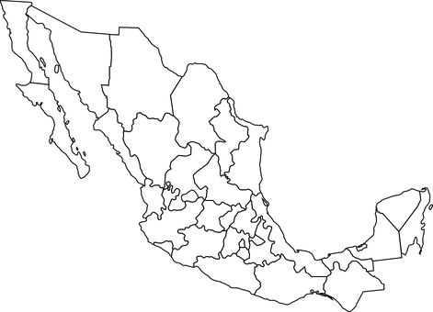
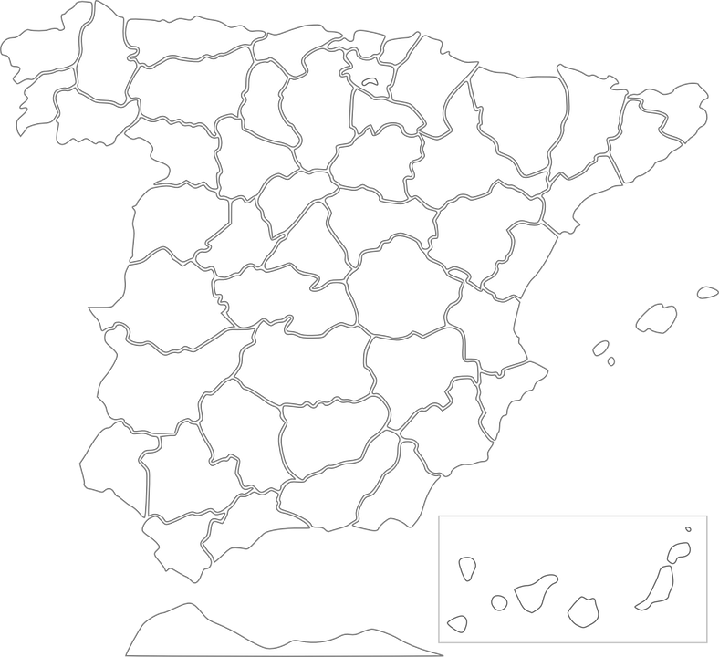
Accents 1
In Spanish, all words with antepenultimate (third-last) syllable stress have an accent.
pronunciar
¿Dónde está Córdoba?
Está en España
Mérida
Está en Méjico
Córdoba
Málaga
¿Dónde está Mérida?
Notes:
Timing: 3 minutes
Aim: to explain the 1st rule of written accents.
Procedure:
Read the explanation.
Introduce the example words to exemplify the rule.
Click further to bring questions on location of the cities used as example and elicit answer from pupils (encourage them to answer in full sentences).

Slide 4
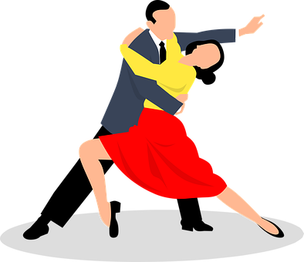
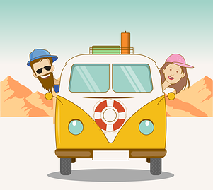
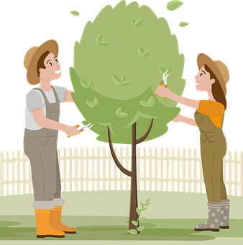
vocabulario
Escucha y repite 🗣
el baile
la carrera
el viaje
el b_il_
la carrera
el baile
la c_rr_ r_
el v_aj_
el viaje
[dance]
[race]
[trip]
la jardinería
la natación
la j_ rd _ n_rí_
la n_ t_c_ón
el dibujo
la jardinería
la natación
el dibujo
el d_ b _ j_
[drawing]
[gardening]
[swimming]
Notes:
Timing: 5 minutes
Aim: to introduce the six new nouns for this week.
Procedure: 1.Teacher introduces items one by one (word, picture & English) and pupils practise pronunciation aloud.
Alternatively, pupils work in pairs, reading the Spanish words out loud and looking at the English meanings (1 minute). 2. Then the teacher removes the English words or pictures, and pupils try to recall the English orally (chorally), looking at the Spanish (1 minute). 3. Teacher brings up hints – pupils work in pairs trying to recall the Spanish.
4. Elicit answers from pupils (from top left to bottom right).
NB. Further rounds of learning can be facilitated by one pupil turning away from the board, and his/her partner asking him/her the meanings (‘Cómo se dice X en español?’). This activity can work from L2 → L1 or L1 → L2.

Slide 5
Using the verb ‘hacer’
[to do: I do & s/he, it does]
Some verbs do not follow the general rules.
The verb ‘hacer’ is an example of this.
We use the verb ‘hacer’ to mean to do and to make.
I
s/he, it
Hago jardinería.
Hace baile.
S/he does dance.
I do gardening.
Quique hace baile.
Quique does dance.
Notes:
Timing: 3 minutes
Aim: to introduce 1st and 3rd person singular of ‘hacer’
Procedure:
Read the grammar explanation on irregular verb hacer.
Elicit English translation for the Spanish examples provided.

Slide 6
vocabulario
Vocabulario
¿Cómo es en español?
⚠ Here, we translate ‘hacer’ as ‘to go’.
hacer una carrera
hacer jardinería
hacer natación
hacer un dibujo
hacer una tarta
hacer un viaje
hacer una lista
hacer baile
Notes:
Timing: 5 minutes
Aim: to consolidate understanding and pronunciation of hacer + complementary nouns.
Procedure:
Click for Spanish prompt.
Elicit English from pupils, paying attention to when it is it ‘to do’ and when ‘to make’.
Click to confirm.
Then click again to reveal each picture again and use the English to elicit the Spanish for each phrase from pupils.

Slide 7
leer
Quique describe su cumpleaños y el de Sofía.
¿Quién hace qué? ¿Es Quique o Sofía?
To emphasise the contrast, we sometimes use pronouns (e.g., yo (I)) in Spanish.
 | (yo) | (ella)
Yo hago una lista.
Ella hace las camas.
Ella hace jardinería por la mañana.
Yo hago una tarjeta.
 | (yo) | (ella)
Ella hace natación.
Yo hago la tarta solo.
Ella hace un dibujo.
Yo hago baile fuera.
E
4
1
5
2
6
7
3
Notes:
Timing: 5 minutes
Aim: to practise written recognition of the first and third person singular forms of ‘hacer’ and connect these with meaning.
Procedure:
1. Pupils read the parts of sentences they can see and tick who they think it applies to. They should use their knowledge of verb forms to decide.
2. Answers revealed on clicks.
3. Optional – click the numbered buttons to hear the full sentences.
4. Ask additional questions to assess comprehension – e.g., who makes a list? When does she do gardening?
5. Ask pupils if any of the statements surprises them and or whether they do the same things for their birthdays. 6. Finally, bring up the callout to explain one use of Spanish pronouns – to emphasise a contrast e.g., between two people (I do X, you do Y).

Slide 8
escuchar
Escucha.
a menudo – often
¿Quién hace qué? Escribe en inglés.
 | Actividad | Extra info
Quique
Ángela
Sofía
[3]
[2]
goes swimming
1
often
does dance
makes a cake
on Sunday
[2]
[3]
does the bed
always
2
on Saturday
does a race
on the beach
[2]
[3]
does sport
with her brother
3
in the morning
do a drawing
in the room
Notes:
Timing: 5 minutes
Aim: to practise aural comprehension of this week’s vocabulary and use of 1st person of HACER.
Procedure:
Pupils listen to each phrase.
Pupils note what each person does as well as any extra information they hear.
Click first to reveal what they do and then to reveal the extra information.
Transcript:
Hago natación y hago baile a menudo. El domingo, hago una tarta.
Siempre hago la cama. El sábado hago una carrera en la playa.
Hago deporte con mi hermano. Por la mañana hago un dibujo en mi habitación.

Slide 9
¡adiós!
azul

