Slide 1
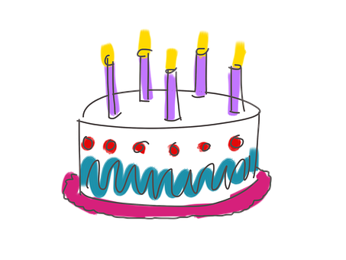
Saying what I and others do
El cumpleaños
azul
Follow ups 1-5
Notes:
Artwork by Steve Clarke. All additional pictures selected are available under a Creative Commons license, no attribution required.
The frequency rankings for words that occur in this PowerPoint which have been previously introduced in NCELP resources are given in the NCELP SOW and in the resources that first introduced and formally re-visited those words.
Phonics: Mérida [N/A] Córdoba [N/A] Málaga [N/A] Vocabulary (new words in bold): hacer [26] hago, hace actividad [344] baile [2040] carrera [481] dibujo [1726] jardinería [>5000] natación [>5000] viaje [904] lista [1189]
Revisit 1:
Revisit 2:
For any other words that occur incidentally in this PowerPoint, frequency rankings will be provided in the notes field wherever possible.
Source: Davies, M. and Davies, K. (2018). A frequency dictionary of Spanish: Core vocabulary for learners (2nd ed.). Routledge: London
planear [3186] colegio [628]

Slide 2
pronunciar
Follow up 1
¿Cuántas sílabas tiene?
¿Dónde está el estrés?
Marca
 | número
1st | 2nd | 3rd
Escribe la palabra.
E
3
Morgado
1
4
Espósito
2
3
Álvarez
3
2
Liñán
4
3
Úbeda
5
2
Sánchez
6
3
Salvador
Notes:
Timing: 5 minutes (two slides)
Aim: to develop pupil’s awareness of word stress with unknown words (Spanish surnames)
Procedure:
1. Teacher gives the instruction and clarifies ‘estrés’.
2. Pupils listen out for the number of syllables in each word (ensure they understand these are all unknown words for them).
3. Click to bring up answers.
4. Listen one more time to focus on where the stress falls in the word – ome pupils may want to try to write the whole word.
5. Move onto the next slide.
E Morgado
1 Espósito
2 Álvarez
3 Liñán
4 Úbeda
5 Sánchez
6 Salvador
2

Slide 3
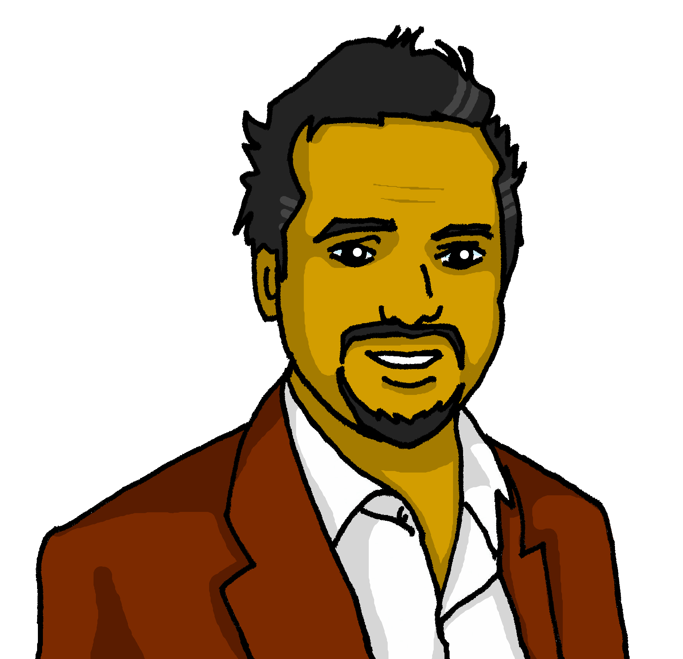
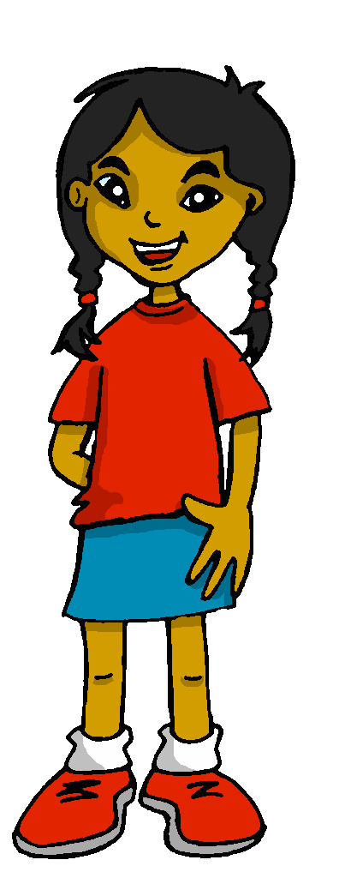
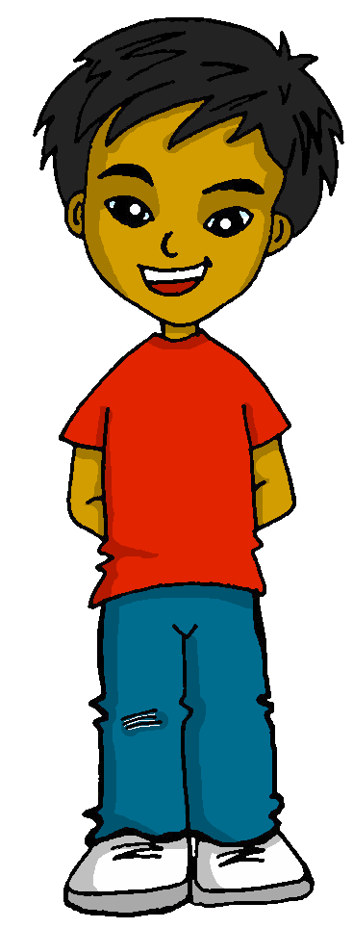
Los apellidos
En España y Latinoamérica, las personas tienen dos apellidos.
Ejemplo: Quique Mamani Flores
The tradition in is for a child to take on the surname of their father and mother, usually in that order.
¿Cuál es el apellido de Elena, la mamá de Quique?
Notes:
Timing: 2 minutes
Aim: to introduce the tradition in Spain and Latin America for people to have two surnames, taking the surname of their father and their mother.
Procedure:
Click to present the information.
Ask pupils what they think of this idea.

Slide 4
follow up 2a:

Escribe en inglés: can you get at least 15 points?
 | aprender | el recreo | leer
 | la semana | siempre | beber
 | el cine | estoy | el mercado
 | vas | el oeste | va
 | la natación | el dibujo | hago
 | hacer | hace | la carrera
vocabulario
to learn, learning
(the) break time
to read, reading
x3
(the) week
always
to drink, drinking
(the) cinema
i am (location)
(the) market
x2
you (s) go
(the) west
s/he, it goes
swimming
(the) drawing
i do, make
x1
to do, make
s/he does, makes
(the) race
Notes:
Timing: 10 minutes (two slides)
Aim: to practise written comprehension (this slide) and production (next slide) of vocabulary from this week and this week’s revisited sets.
Procedure: 1. Give pupils a blank grid. They fill in the English meanings of any of the words they know, trying to reach 15 points in total.
Note: The most recently learnt and practised words are pink, words from the first revisit are green and those from the second revisit are blue, thus more points are awarded for them, to recognise that memories fade and more effort (heavy lifting!) is needed to retrieve them.

Slide 5
follow up 2b:

Escribe en español: can you get at least 15 points?
 | (the) week | to drink, drinking | always
 | to read, reading | (the) break time | To learn, learning
 | I am (location_ | (the) west | You go
 | S/he, it goes | (the) cinema | (the) market
 | (the) drawing | s/he, it makes, does | (the) swimming
 | to do, make; doing, making | I make, do | (the) race
vocabulario
la semana
beber
siempre
x3
leer
el recreo
aprender
estoy
el oeste
vas
x2
va
el cine
el mercado
el dibujo
hace
la natación
x1
hacer
hago
la carrera
Notes:
Timing: 5 minutes
Aim: to practise written production of vocabulary from this week and this week’s revisited sets.
Procedure: 1. Give pupils a blank grid. They fill in the Spanish meanings of any of the words they know, trying to reach 15 points in total.
Note: The most recently learnt and practised words are pink, words from the first revisit are green and those from the second revisit are blue, thus more points are awarded for them, to recognise that memories fade and more effort (heavy lifting!) is needed to retrieve them.

Slide 6
Making sentences negative
[negative ‘no’]
⚠
Remember that in English…
However, in Spanish…
I do a trip.
I don’t do a trip.
Hago un viaje.
No hago un viaje.
…we add don’t before the verb to make the sentence negative.
…add no before the verb and to make the sentence negative.
Notes:
Timing: 1 minute
Aim: Recap negation with single-verb structures and draw attention to differences between Spanish and English negation structure. (Pupils were introduced to this last term – T2 Week 7).
Procedure:
Click through the animations to present the information.
Elicit English translations for the French examples provided.

Slide 7
Follow up 3:
?
What do Quique and Sofía do on their birthday?
Lee la lista de Quique. ¿Quién es?
leer
Write ? if the activity isn’t mentioned.
1) …………………………………
2) …………………………………
3) …………………………………
4) …………………………………
5) …………………………………
6) …………………………………
7)………………………………….
8)………………………………….
Hago natación con Ángela.
Hace un bocadillo en la cocina.
[I]
[She]
?
dance
a sandwich
a (vocab) test
swimming
a drawing
a trip
1
No hago baile en el colegio
2
?
No hace una prueba de vocabulario.
?
3
Hace un viaje con el abuelo.
4
No hace natación por la mañana.
5
?
No hago un viaje con la abuela.
6
Hago un dibujo en mi habitación.
colegio – school
Notes:
Timing: 5 minutes
Aim: to practise written comprehension of negative and 1st and 3rd person singular of ‘hacer’, together with vocabulary from this and previous weeks.
Note: the answers are not in the order of the text.
Procedure: 1. Pupils can write 1-6 and Quique (I) | Sofía (She) as two column headers.
2. Pupils read the sentences and tick if either or both characters do the activity, cross if they don’t and put ? if there is no mention of the activity for one or both of them.
3. For feedback of answers click to complete the table and to highlight the answer in the text itself.
4. Click the audio button to hear the full sentences, if desired.
Colegio [628]

Slide 8
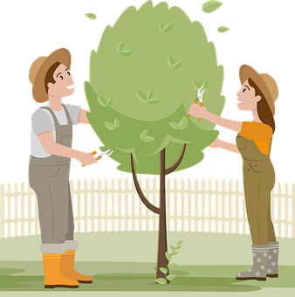
Follow up 4
Eres Ángela y planeas tu cumpleaños.
escribir
Escribe 5 mensajes.
4
2
5
1
3
1
Hago un dibujo.
2
Hace jardinería.
3
Hago una carrera
4
Hago natación
5
Hace una tarta.
planear – to plan
Notes:
Timing: 5 minutes
Aim: to practise written production of vocabulary and the first and third person singular forms of hacer.
Procedure:
Check understanding of the rubric, given in Spanish. Pupils know these words from previous learning.
Use stressed intonation and strategic pointing (i.e. at Ángela or Rubén) to ensure that the instruction for the task is fully understood.
Do the first one together as an example, ensuring pupils focus on the verb ending.
Then give students time to do questions 2-5, before checking them together.
planear [3186]
8

Slide 9
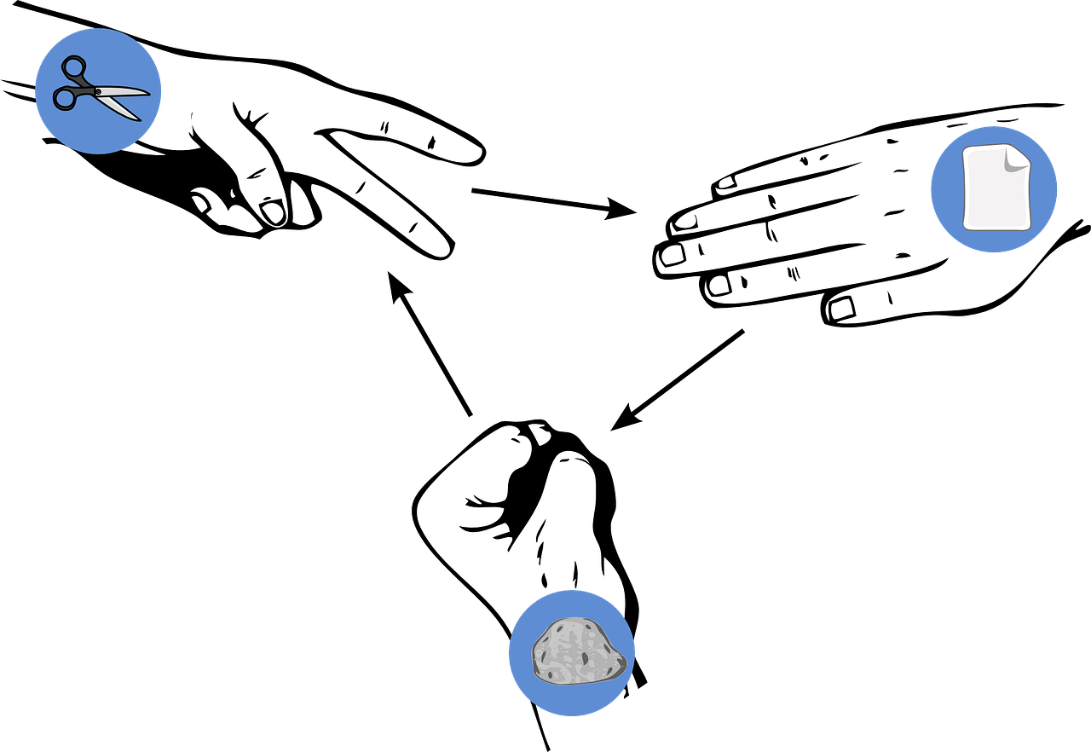
Follow up 5
Piedra-papel-tijeras*
Choose four activities and write four sentences in Spanish saying what you do OR don’t do: ‘I do…’ / ‘I don’t…’
escribir
hablar
Read your sentences. If your partner has exactly the same sentence as you, play rock-paper-scissors. The loser must write/say a different sentence. Play until you have successfully said all your sentences.
Ejemplo:
No hago la cama.
No hago la cama.
Hago una lista.
Persona A
Persona A
*Rock-paper-scissors
Notes:
Timing: 5-10 minutes (two rounds of speaking activity)
Aim: to practise oral production and comprehension of negative sentences with 1st person of HACER, and vocabulary from this week.
Note: This slide shows how the speaking task is intended to work. The stages are animated to support the teacher in modelling the task.
Procedure:
After modelling this example, display the next slide with 6 item choices (which gives 12 possible sentences, as each one can also be negative).
Partner As read first and Bs answer.
Then swap roles for Round 2.

Slide 10
Follow up 5
Piedra-papel-tijeras*
Remember you can make your sentences negative, too.
hablar
escribir
[a list]
[the bed]
[a sandwich]
[a card]
[a cake]
[chicken]
el baile
la carrera
el viaje
el dibujo
la jardinería
la natación
*rock-paper-scissors
Notes:
DISPLAY THIS SLIDE FOR PUPILS DURING THE TASK.
Note: if desired, click on the pictures to hear the Spanish phrases (as affirmative statements).

Slide 11
Handout 2a

Follow up 2a:
escribe en inglés: can you get at least 15 points?
 | aprender | el recreo | leer
 | la semana | siempre | beber
 | el cine | estoy | el mercado
 | vas | el oeste | va
 | la natación | el dibujo | hago
 | hacer | hace | la carrera
vocabulario
x3
x2
x1
Notes:
Timing: 10 minutes (two slides)
Aim: to practise written comprehension (this slide) and production (next slide) of vocabulary from this week and this week’s revisited sets.
Procedure: 1. Give pupils a blank grid. They fill in the English meanings of any of the words they know, trying to reach 15 points in total.
Note: The most recently learnt and practised words are pink, words from the first revisit are green and those from the second revisit are blue, thus more points are awarded for them, to recognise that memories fade and more effort (heavy lifting!) is needed to retrieve them.

Slide 12
follow up 2b:

Handout 2b
Escribe en español: can you get at least 15 points?
 | (the) week | to drink, drinking | always
 | to read, reading | (the) break time | To learn, learning
 | I am (location) | (the) west | You go
 | S/he, it goes | (the) cinema | (the) market
 | (the) drawing | s/he, it makes, does | (the) swimming
 | to do, make; doing, making | I make, do | (the) race
vocabulario
x3
x2
x1
Notes:
Timing: 5 minutes
Aim: to practise written production of vocabulary from this week and this week’s revisited sets.
Procedure: 1. Give pupils a blank grid. They fill in the Spanish meanings of any of the words they know, trying to reach 15 points in total.
Note: The most recently learnt and practised words are pink, words from the first revisit are green and those from the second revisit are blue, thus more points are awarded for them, to recognise that memories fade and more effort (heavy lifting!) is needed to retrieve them.

