Slide 1


español, con Quique

Slide 2


En la ciudad
azul
Un poema
SSC repaso
Notes:
Artwork by Steve Clarke. All additional pictures selected are available under a Creative Commons license, no attribution required.
The frequency rankings for words that occur in this PowerPoint which have been previously introduced in the resources are given in the SOW (excel document) and in the resources that first introduced and formally re-visited those words.
Phonics: SSC revision
Vocabulary:
Revisit 1: -
Revisit 2: tirar1 [685] gente [137] hora1 [160] durante [139]
Source: Davies, M. & Davies, K. (2018). A frequency dictionary of Spanish: Core vocabulary for learners (2nd ed.). Routledge: London
For any other words that occur incidentally in this PowerPoint, frequency rankings will be provided in the notes field wherever possible.
conectar [1973] repetir [512] salir [114] propio [183] que [3]

Slide 3



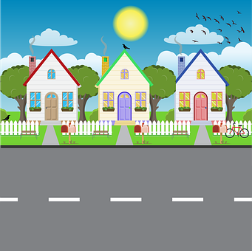

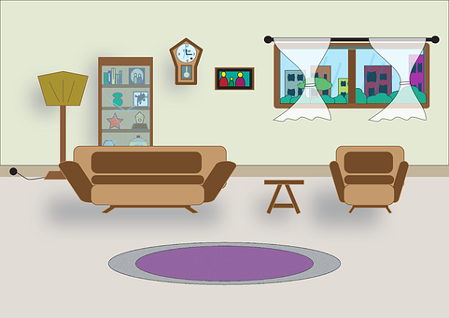
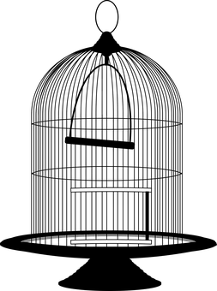

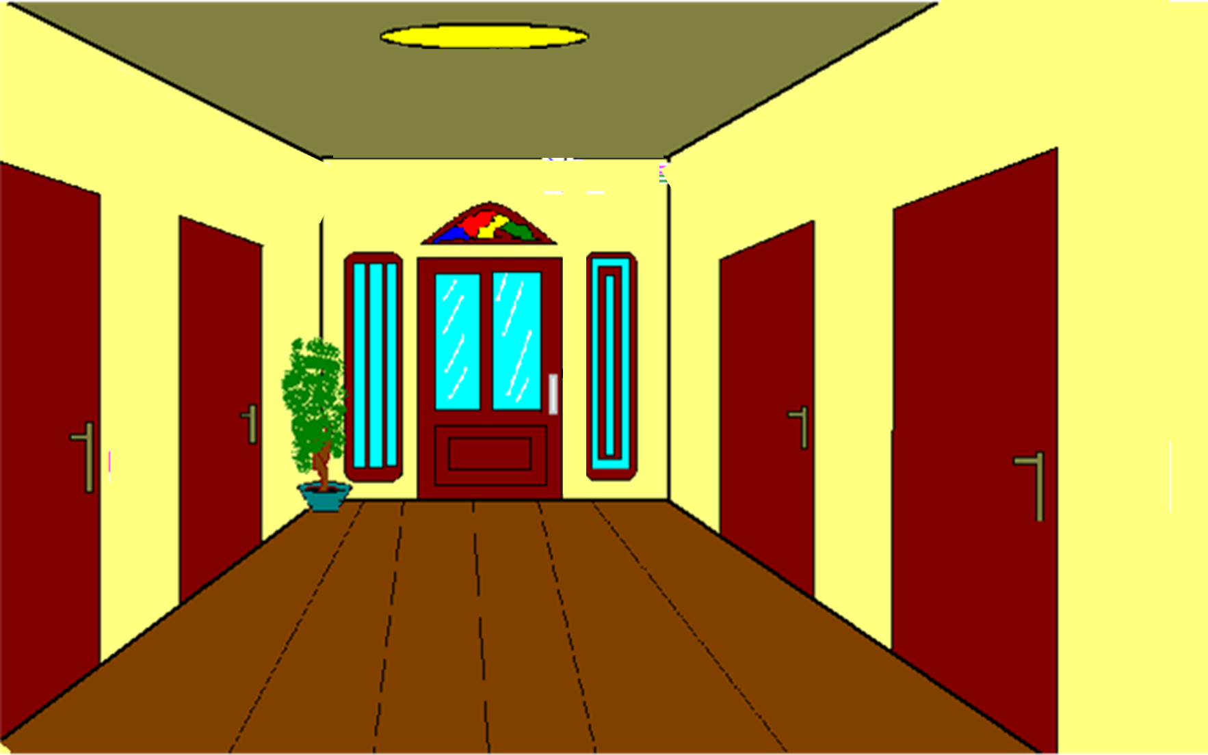
Practica con tu compañero/a.
repite = repeat
Escucha y repite.
pronunciar
1 minuto
la ciudad
la puerta
la calle
la plaza
la entrada
la sala
la jaula
el loro
INICIO
Notes:
Timing: 5 minutes
Aim: To revisit a range SSC with key vocab from the poem.
Procedure:
Clarify that instructions to pupils.
Click to present each item individually, and get pupils to repeat after.
Clarify the meaning of items 5-8 as these are unknown words.
la entrada (entrance); la sala (room); la jaula (cage); el loro (parrot).
Click to bring up a further instruction and ask pupils to practise reading the words aloud in pairs.
repetir [512]

Slide 4

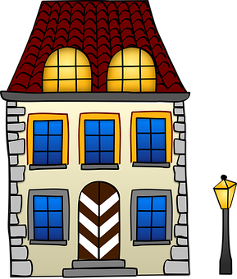
leer
Lee el poema.
[1/4]
En la ciudad
hay una puerta
la puerta conecta con una calle
La calle con una plaza
en la plaza hay una casa
hablar
conecta = it connects
Notes:
Timing: 6-8 minutes
Aim: to practise reading the poem aloud, understand it and begin to develop fluency with spoken production of the words.
Procedure:
Read the instruction to pupils.
Click to bring up each line and the pictures individually and read aloud chorally.
conectar [1973]

Slide 5
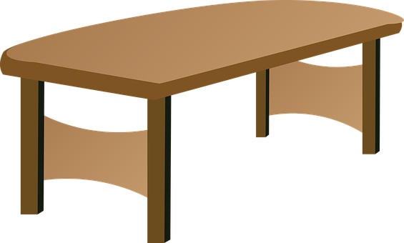
leer
Lee el poema.
[2/4]
en la casa hay una entrada
la entrada conecta con una sala
en la sala hay una mesa
en la mesa una jaula
en la jaula un loro
hablar
conecta = it connects
Notes:
Timing: 6-8 minutes
Aim: to practise reading the poem aloud and
Procedure:
Read the instruction to pupils
Click to bring up each verse and the pictures individually and read aloud chorally.
conectar [1973]

Slide 6
leer
Lee el poema.
[3/4]
hablar
🎶
El loro canta:
Quiero salir de la jaula
que está en la mesa
que hay en la sala
que conecta con la entrada
que está en la casa
salir = to go out/ leave
que = which
conecta = it connects
Notes:
Timing: 6-8 minutes
Aim: to practise reading the poem aloud and
Procedure:
Read the instruction to pupils
Click to bring up each verse and the pictures individually and read aloud chorally.
conectar [1973] salir [114] que [3]

Slide 7
leer
Lee el poema.
[4/4]
hablar
que hay en la plaza
que conecta con la calle
y la puerta
que hay en la ciudad.
conecta = it connects
Notes:
Timing: 6-8 minutes
Aim: to practise reading the poem aloud and
Procedure:
Read the instruction to pupils
Click to bring up each verse and the pictures individually and read aloud chorally.
conectar [1973]

Slide 8


escuchar
Escucha y lee.
[1/4]
¿Qué tarjetas son?
leer
En ___ ________
Hay ___ _________
___ _______ conecta con ___ _______
___ ____ con ____ _____
en ___ _____ hay ____ _____
1
la ciudad
2
una puerta
3
la puerta
una calle
4
la calle
una plaza
5
la plaza
una casa
conecta = it connects
Notes:
Timing: 6-8 minutes
Aim: to listen and read the story.
Procedure:
Read the instruction and click to bring up the question. Ensure pupils understand they need to show you the correct picture to go with the correct noun and definite / indefinite article.
Click to listen to each sentence/part sentence.
To check understanding, pupils show you the correct card.
To support understanding and check answers, click to bring up the rest of each sentence and the picture.
conectar [1973]

Slide 9
escuchar
Escucha y lee.
[2/4]
¿Qué tarjetas son?
leer
en ___ _____ hay ____ ________
___ ________ conecta con ____ _____
en __ ____ hay ____ ______
en __ _____ ____ _____
en __ _____ ___ _____
6
la casa
una entrada
7
la entrada
una sala
8
la sala
una mesa
9
la mesa
una jaula
10
la jaula
un loro
conecta = it connects
Notes:
Timing: 6-8 minutes
Aim: to listen and read the story.
Procedure:
Read the instruction and click to bring up the question. Ensure pupils understand they need to show you the correct picture to go with the correct noun and definite / indefinite article.
Click to bring up each sentence.
To check understanding, pupils show you the correct card
Click to bring up answer.
conectar [1973]

Slide 10
escuchar
Escucha y lee.
[3/4]
¿Qué tarjetas son?
leer
__ _____ canta:
Quiero salir de ___ _____
que está en __ ______
que hay en ___ _____
que conecta con ___ ________ que está en __ _____
11
el loro
12
la jaula
13
la mesa
14
la sala
15
la entrada
16
la casa
salir = to go out/ leave
que = which
conecta = it connects
Notes:
Timing: 6-8 minutes
Aim: to listen and read the story.
Procedure:
Read the instruction and click to bring up the question. Ensure pupils understand they need to show you the correct picture to go with the correct noun and definite / indefinite article.
Click to bring up each sentence.
To check understanding, pupils show you the correct card
Click to bring up answer.
conectar [1973] salir [114] que [3]

Slide 11
escuchar
Escucha y lee.
[4/4]
¿Qué tarjetas son?
leer
que hay en __ _______
que conecta con ___ ______
y __ ______
que hay en ___ ________.
17
la plaza
18
la calle
19
la puerta
20
la ciudad
conecta = it connects
Notes:
Timing: 6-8 minutes
Aim: to listen and read the story.
Procedure:
Read the instruction and click to bring up the question. Ensure pupils understand they need to show you the correct picture to go with the correct noun and definite / indefinite article.
Click to bring up each sentence.
To check understanding, pupils show you the correct card
Click to bring up answer.
conectar [1973]

Slide 12
¡adiós!
azul

Slide 13
un | una | la
el | casa | entrada
sala | mesa | jaula
loro | ciudad | puerta
calle | plaza

