Slide 1
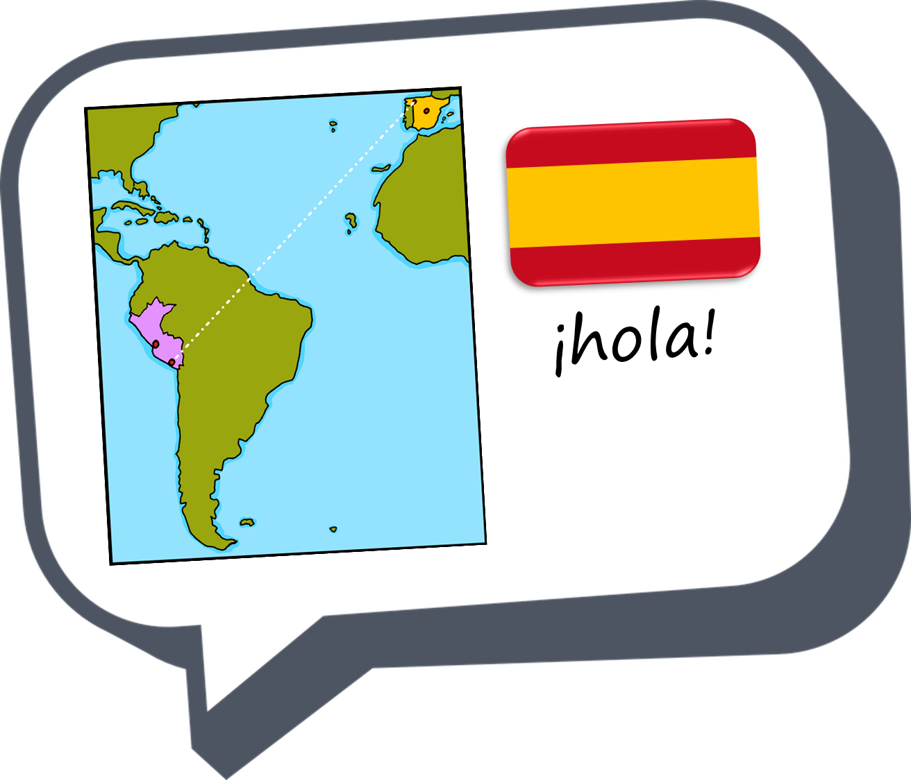
En la ciudad
azul
Follow ups 1-5
Notes:
Artwork by Steve Clarke. All additional pictures selected are available under a Creative Commons license, no attribution required.
The frequency rankings for words that occur in this PowerPoint which have been previously introduced in the resources are given in the SOW (excel document) and in the resources that first introduced and formally re-visited those words.
Phonics: SSC revision
Vocabulary:
Revisit 1: -
Revisit 2: tirar1 [685] gente [137] hora1 [160] durante [139]
Source: Davies, M. & Davies, K. (2018). A frequency dictionary of Spanish: Core vocabulary for learners (2nd ed.). Routledge: London
For any other words that occur incidentally in this PowerPoint, frequency rankings will be provided in the notes field wherever possible.

Slide 2
Follow ups:
propio = own
salir = to go out/ leave
que = which
conecta = it connects
Escribe tu propio poema.
escribir
En la ciudad hay una puerta
la puerta conecta con una calle
la calle con una plaza
en la plaza hay una casa
en la casa hay una entrada
la entrada conecta con una sala
en la sala hay una mesa
en la mesa una jaula
en la jaula un loro
el loro canta:
Quiero salir de la jaula
que está en la mesa
que hay en la sala
que conecta con la entrada
que está en la casa
que hay en la plaza
que conecta con la calle
y la puerta
que hay en la ciudad.
Notes:
Timing: 10-15 minutes
Aim: to write their own version of the poem.
Procedure:
1. Pupils to write their own poem with the same structure / style.
There are easy and more challenging ways to do these variations on a theme. E.g. Just change 2 or 3 nouns OR Change all the nouns
OR
Change the verbs as well (canta / quiero + salir)
OR
Change the positions as well (debajo, detrás, a la derecha, a la izquierda)
OR
Fully adapt the poem
conectar [1973] salir [114] que [3] propio [183]

Slide 3
¡adiós!
azul

