Slide 1
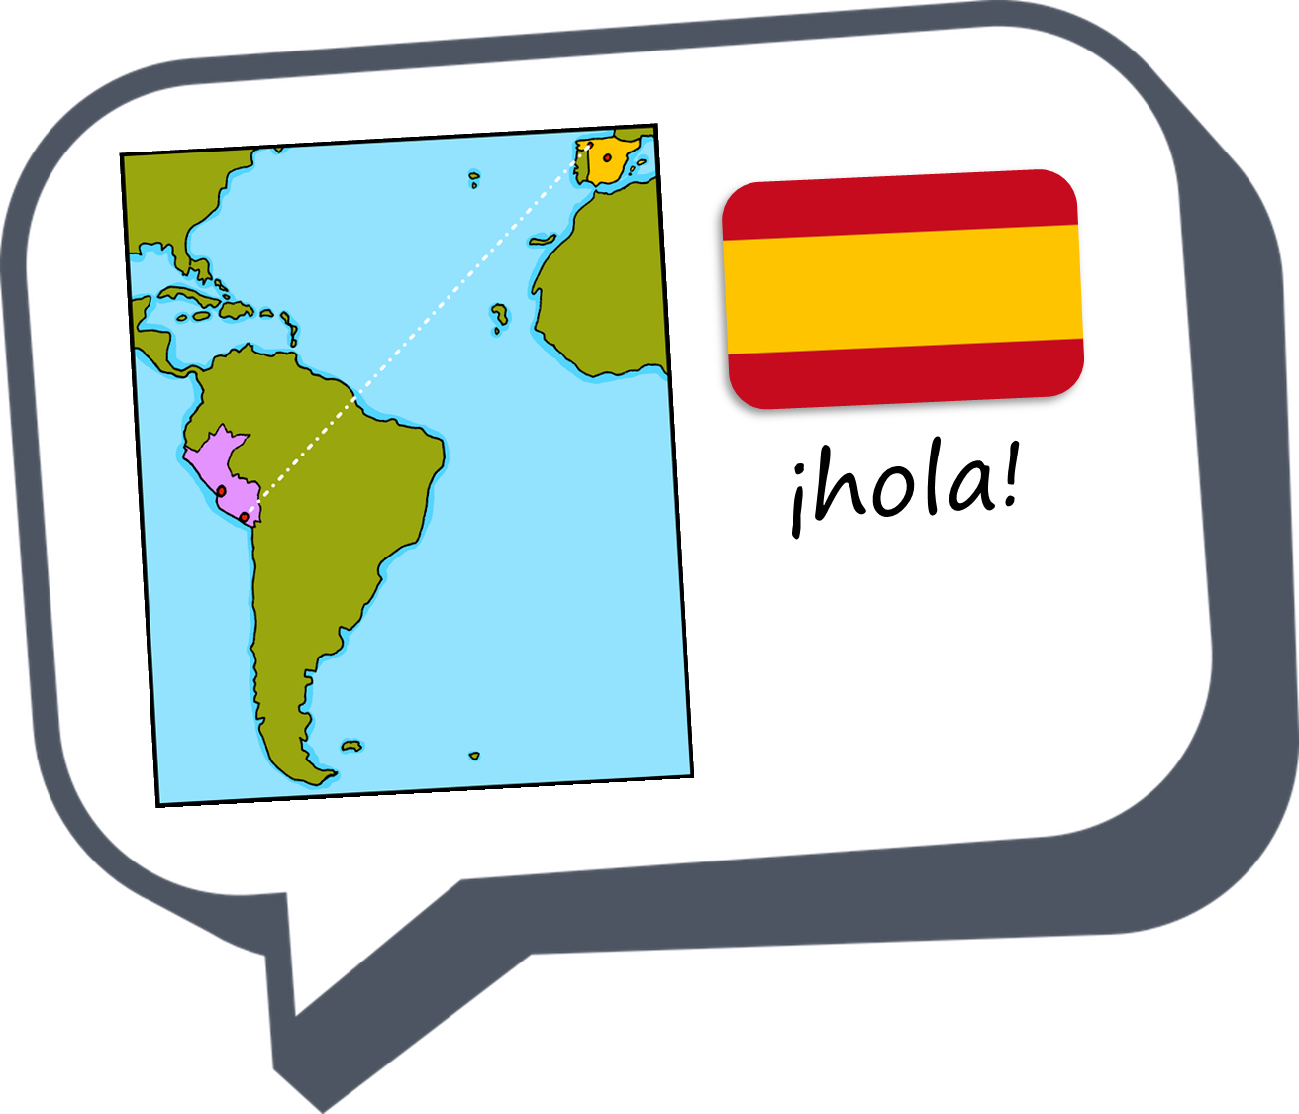
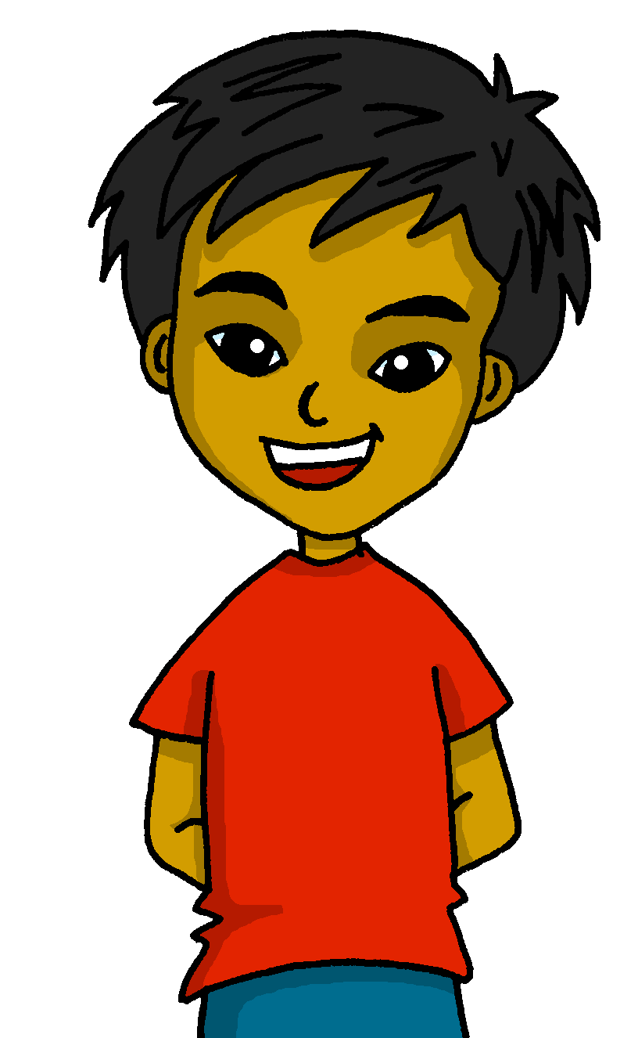
español, con Quique

Slide 2

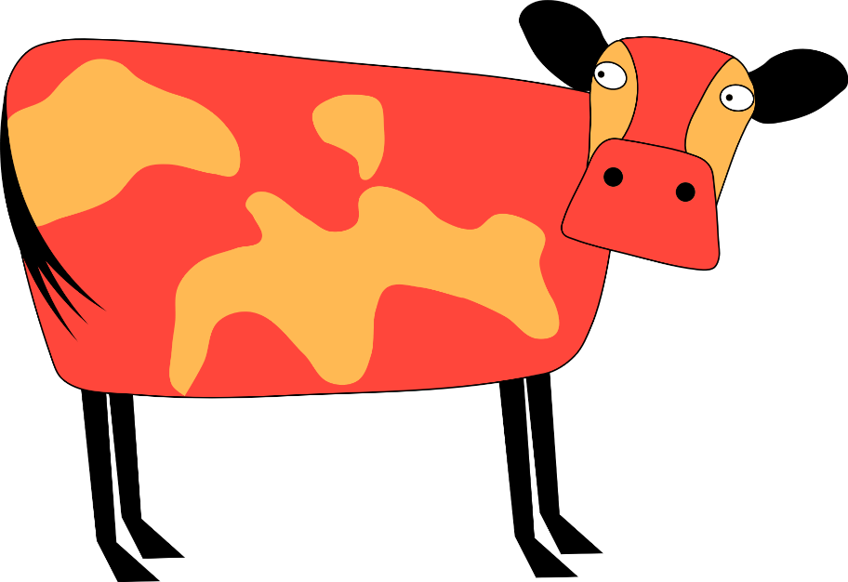

Quiero ver una vaca
Un poema
SSC repaso
azul
Notes:
Artwork by Steve Clarke. All additional pictures selected are available under a Creative Commons license, no attribution required.
The frequency rankings for words that occur in this PowerPoint which have been previously introduced in the resources are given in the SOW (excel document) and in the resources that first introduced and formally re-visited those words.
Phonics: SSC revision
Vocabulary:
Revisit 1: probar [959] querer, quiero, quieres, quiere [58] avión [1399] aburrido [3917]
Revisit 2: hace2 [26] invierno [1813] otoño [3504] primavera [2735] verano [1139] frío [1020] calor [945] sol [383] cuando [57] + revise week 1 & 2 vocabulary + hacer [hago]
Source: Davies, M. & Davies, K. (2018). A frequency dictionary of Spanish: Core vocabulary for learners (2nd ed.). Routledge: London
For any other words that occur incidentally in this PowerPoint, frequency rankings will be provided in the notes field wherever possible.
repetir [512] popular [790] típico [1934] cerca [1042]

Slide 3







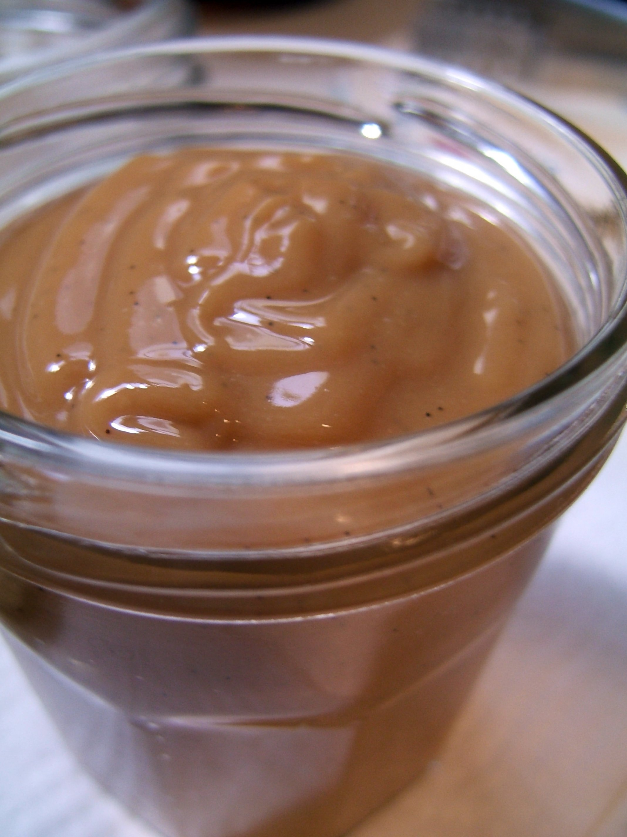
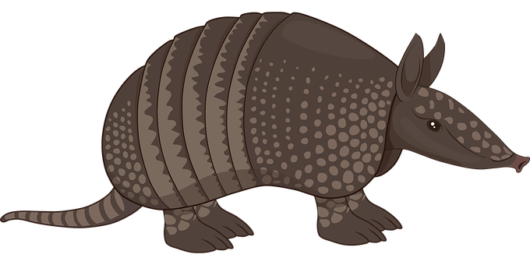


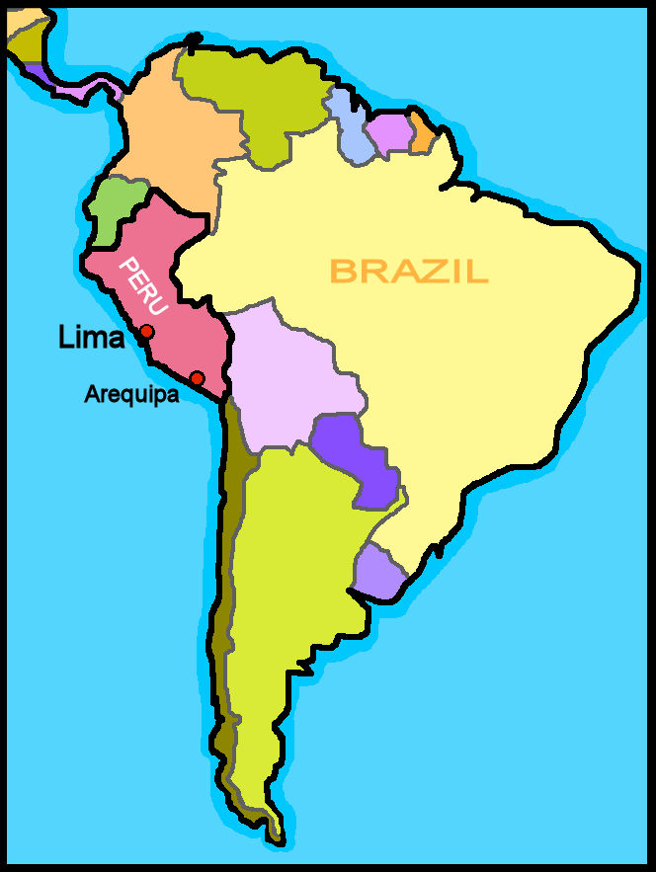
leer
Lee la Información sobre Uruguay.
Es verdad.
Es mentira.
hablar
cerca– near (to)
Uruguay
Uruguay
Está en Europa.
Sudamérica
Está cerca de Argentina.
Hablan español.
Lima es la capital.
Montevideo es la capital.
El ‘Dulce de Leche es típico.
El armadillo es un animal nativo del país.
Uruguay
Argentina
El fútbol
El rugby es muy popular.
Notes:
Timing: 5 minutes
Aim: to introduce the home country of the poet for this week’s lesson, Uruguay.
Procedure:
Read the instruction and clarify.
Pupils read the statements and decide in pairs whether the statement are true or false.
Go through the statements with the whole class and elicit their responses.
cerca [1042] popular [790] típico [1934]

Slide 4
leer
Lee la Información interesante.
hablar
En Uruguay hay muchas vacas.
Hay cuatro vacas por cada persona.
Uruguay
Argentina
Notes:
Timing: 2 minutes
Aim: to reintroduce ‘vaca’ and spark pupils’ interest on the fact that Uruguay is a cattle-raising country with an average of the 4 cows per inhabitant.
Procedure:
Read the instruction to pupils
Click to bring up the information and elicit English from pupils.

Slide 5
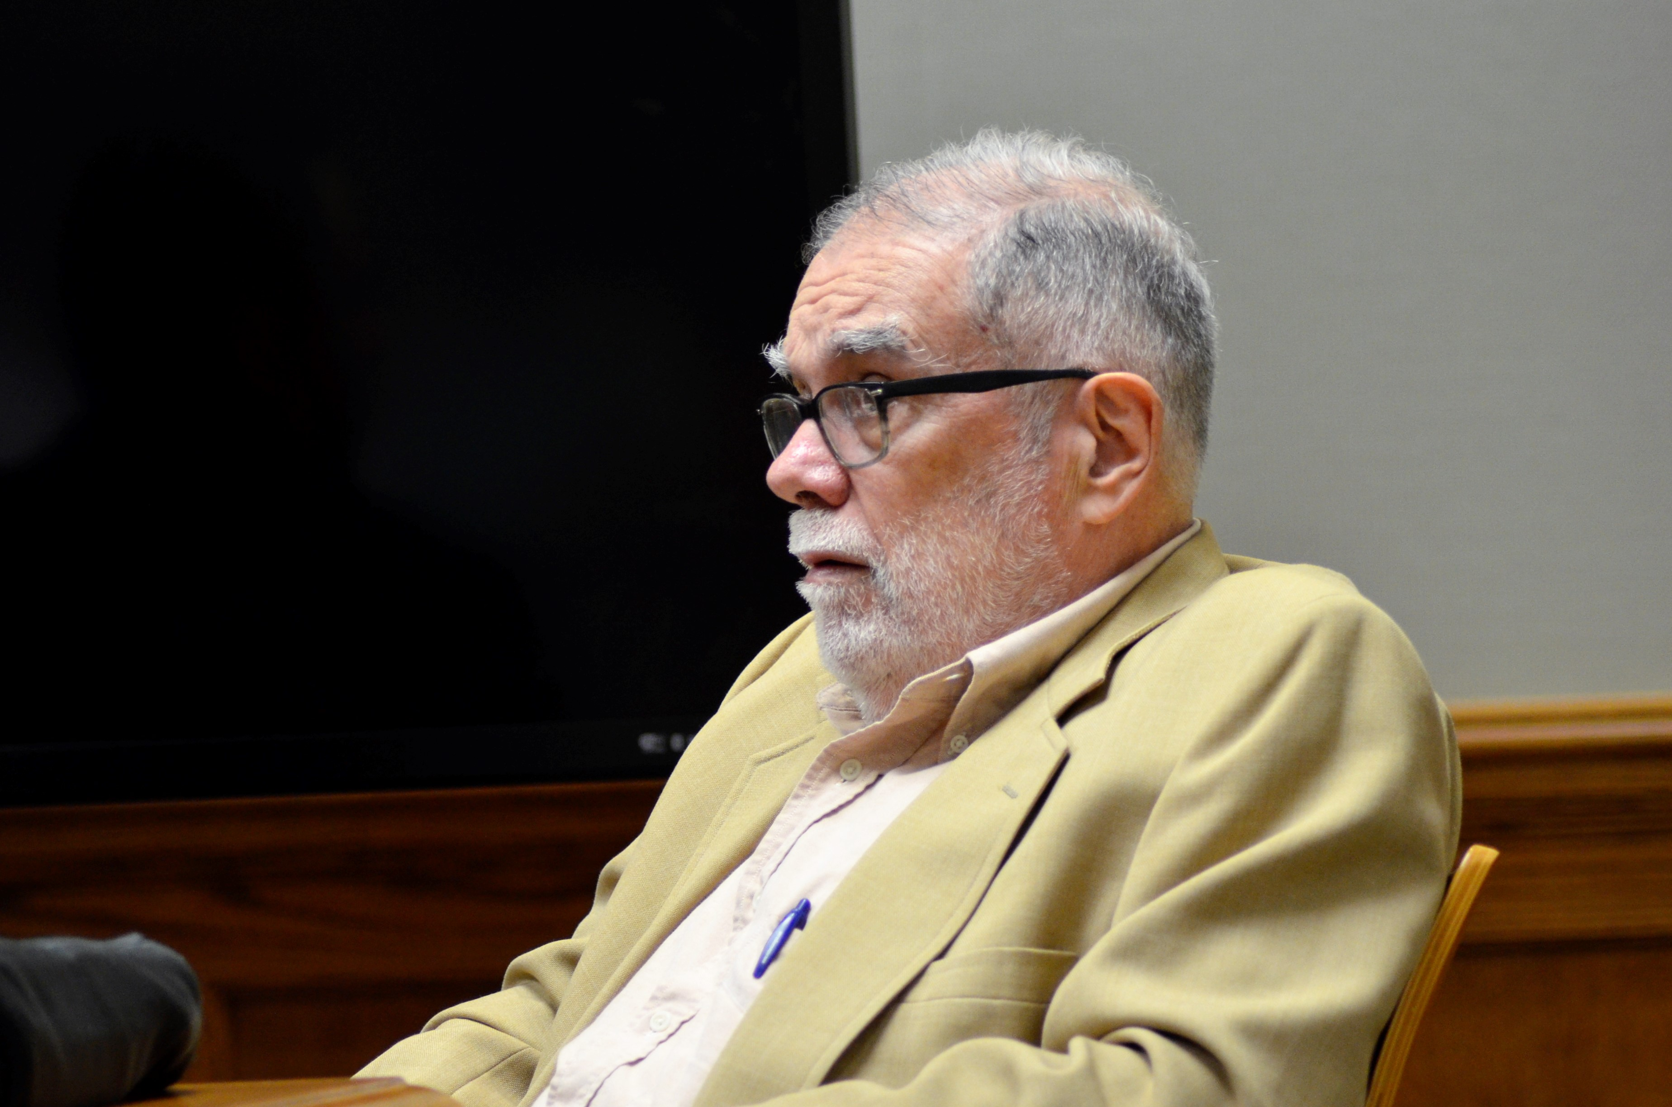
leer
Vamos a leer y aprender un poema.
El nombre del poema es ‘Quiero ver una vaca’.
El autor es Enrique Fierro (1942- presente).
Es un poeta de Uruguay.
Uruguay
Argentina
Notes:
Timing: 2 minutes
Aim: To introduce the poem of the lesson and the poet
Procedure:
Read the instruction and clarify meaning.
Click through the animations and elicit English translation from pupils.
De Pdx123 - Trabajo propio, CC BY-SA 4.0, https://commons.wikimedia.org/w/index.php?curid=56489003

Slide 6







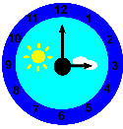
leer
Escucha y repite el poema.
[1/4]
repite = repeat
hablar
Quiero ver una vaca
Quiero ver una vaca colorada
Quiero ver una vaca colorada
A las tres de la tarde
Notes:
Timing: 6-8 minutes (4 slides)
Aim: to practise reading the poem aloud, understand it and begin to memorise it.
Procedure:
Read the instruction to pupils
Click to bring up each line and the pictures individually and read aloud chorally with optional gestures.
Optional gestures:
Quiero = hand on heart for ‘want’ on the first syllable ‘quie’ and then with the same hand point thumb toward self on the 2nd syllable ‘ro’ to indicate ‘I’.
ver = first and second fingers of right hand point to own eyes (makes a V) and then motion away from yourself
una vaca = ‘milking’ gesture right hand, then left hand (x 2) for each syllable u-na va-ca (so 4 x mimed ‘tugs’ altogether).
colorada = rainbow gesture – palm facing away, starting left to right, ‘draw’ a rainbow shape with your hand
a las 3 de la tarde = hold 3 fingers up, then tap your left wrist for watch
Note: colorada means ‘red’ or ‘coloured’ but generally ‘red’. The rainbow gesture is just to invoke the idea of colour! Colorida means colourful or multi-coloured.
repetir [512]

Slide 7

leer
Escucha y repite el poema.
[2/4]
repite = repeat
hablar
Quiero ver una vaca colorada
A las tres de la tarde
De un día de febrero
Notes:
Procedure:
Read the instruction to pupils
Click to bring up each verse and the pictures individually and read aloud chorally with optional gestures.
Optional gestures:
Quiero = hand on heart for ‘want’ on the first syllable ‘quie’ and then with the same hand point thumb toward self on the 2nd syllable ‘ro’ to indicate ‘I’.
ver = first and second fingers of right hand point to own eyes (makes a V) and then motion away from yourself
una vaca = ‘milking’ gesture right hand, then left hand (x 2) for each syllable u-na va-ca
colorada = rainbow gesture – palm facing away, starting left to right, ‘draw’ a rainbow shape with your hand
de un día de febrero = left palm up raise towards sky on ‘dí’ and right palm up raise towards sky for ‘a’ to show the day/night that = 1 x day, then hands overlap and touch your heart twice on febrero.
repetir [512]

Slide 8

leer
Escucha y repite el poema.
[3/4]
repite = repeat
hablar
Quiero ver una vaca colorada
A las tres de la tarde
De un día de febrero
En un campo verde
Notes:
Procedure:
Read the instruction to pupils.
Click to bring up each verse and the pictures individually and read aloud chorally with optional gestures.
Optional gestures:
Quiero = hand on heart for ‘want’ on the first syllable ‘quie’ and then with the same hand point thumb toward self on the 2nd syllable ‘ro’ to indicate ‘I’.
ver = first and second fingers of right hand point to own eyes (makes a V) and then motion away from yourself
una vaca = ‘milking’ gesture right hand, then left hand (x 2) for each syllable u-na va-ca
colorada = rainbow gesture – palm facing away, starting left to right, ‘draw’ a rainbow shape with your hand
de un día de febrero = left palm up raise towards sky on ‘dí’ and right palm up raise towards sky for ‘a’ to show the day/night that = 1 x day, then hands overlap and touch your heart twice on febrero.
en un campo verde – right hand make motion from left to right like ‘undulating hills’
repetir [512]

Slide 9

leer
Escucha y repite el poema.
[4/4]
repite = repeat
hablar
Quiero ver una vaca colorada
A las tres de la tarde
De un día de febrero
En un campo verde
O amarillo
Notes:
Procedure:
Read the instruction to pupils
Click to bring up each verse and the pictures individually and read aloud chorally with optional gestures.
Optional gestures:
Quiero = hand on heart for ‘want’ on the first syllable ‘quie’ and then with the same hand point thumb toward self on the 2nd syllable ‘ro’ to indicate ‘I’.
ver = first and second fingers of right hand point to own eyes (makes a V) and then motion away from yourself
una vaca = ‘milking’ gesture right hand, then left hand (x 2) for each syllable u-na va-ca
colorada = rainbow gesture – palm facing away, starting left to right, ‘draw’ a rainbow shape with your hand
de un día de febrero = left palm up raise towards sky on ‘dí’ and right palm up raise towards sky for ‘a’ to show the day/night that = 1 x day, then hands overlap and touch your heart twice on febrero.
en un campo verde – right hand make motion from left to right like ‘undulating hills’
o amarillo – make sunburst gesture to represent ‘yellow’
repetir [512]

Slide 10
leer
Lee los versos. ¿Qué imagen es?
 | En un campo verde
 | Quiero ver una vaca colorada
 | O amarillo
 | A las tres de la tarde
 | De un día de febrero
e
1
a
b
2
c
3
d
c
d
4
a
e
5
b
Notes:
Timing: 3 minutes
Aim: Reading comprehension of the 5 verses.
Procedure:
Introduce the task and clarify meaning.
Elicit answers from pupils (letters).

Slide 11
leer
Escucha y repite el poema.
[1/4]
repite = repeat
hablar
Q______o ver una v_____
Q______o ver una v_____ c________
Q______o ver una v_____ c________
A las t_____ de la tarde
Quiero ver una vaca
Quiero ver una vaca colorada
Quiero ver una vaca colorada
A las tres de la tarde
Notes:
Timing: 5 minutes (4 slides)
Aim: oral production of the poem, using the cued letters, visual prompts and teacher gestures.
NB. You could repeat this stage several times
Procedure:
Read the instruction to pupils and clarify.
Pupils say each stanza aloud using only the clues.
Some groups might benefit from reading aloud chorally first before attempting say the stanza independently.
repetir [512]

Slide 12
hablar
Escucha y repite el poema.
[2/4]
repite = repeat
Q______ v_____ una v_____ c___________
A l__ t______ de la t______
De un d_____ de febrero
Quiero ver una vaca colorada
A las tres de la tarde
De un día de febrero
Notes:
Timing: 5 minutes (4 slides)
Aim: oral production of the poem, using the cued letters, visual prompts and teacher gestures.
NB. You could repeat this stage several times
Procedure:
Read the instruction to pupils and clarify.
Pupils say each stanza aloud using only the clues.
Some groups might benefit from reading aloud chorally first before attempting say the stanza independently.
repetir [512]

Slide 13
hablar
Escucha y repite el poema.
[3/4]
repite = repeat
Q______ v_____ una v_____ c___________
A l__ t______ de la t______
De un d_____ de febrero
En un campo v________
Quiero ver una vaca colorada
A las tres de la tarde
De un día de febrero
En un campo verde
Notes:
Timing: 5 minutes (4 slides)
Aim: oral production of the poem, using the cued letters, visual prompts and teacher gestures.
NB. You could repeat this stage several times
Procedure:
Read the instruction to pupils and clarify.
Pupils say each stanza aloud using only the clues.
Some groups might benefit from reading aloud chorally first before attempting say the stanza independently.
repetir [512]

Slide 14
hablar
Escucha y repite el poema.
[4/4]
repite = repeat
Q______o v____ u___ v____ c____________
A l_____ t_____ d___ l____ t___________
D__ u___ d____ d____ f_____________
E___ u____ c__________ v_________
O a_______________
Quiero ver una vaca colorada
A las tres de la tarde
De una tarde de febrero
En un campo verde
O amarillo
Notes:
Timing: 5 minutes (4 slides)
Aim: oral production of the poem, using the cued letters, visual prompts and teacher gestures.
NB. You could repeat this stage several times
Procedure:
Read the instruction to pupils and clarify.
Pupils say each stanza aloud using only the clues.
Some groups might benefit from reading aloud chorally first before attempting say the stanza independently.
repetir [512]

Slide 15
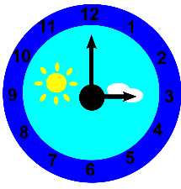


hablar
Escucha y repite el poema.
repite = repeat
Notes:
Timing: 5 minutes
Aim: oral production of the poem from picture prompts only.
Procedure:
Read the instruction to pupils and clarify.
Students to ‘read’ the poem aloud from memory just from the visual prompts
NB. You could repeat this stage several times
repetir [512]

Slide 16
¡adiós!
azul

