Slide 1
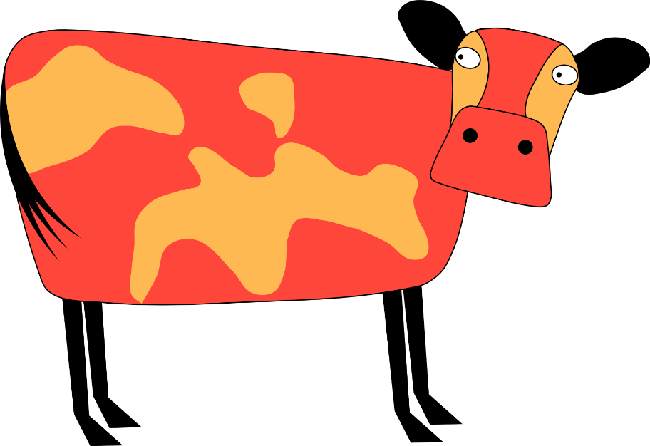
Quiero ver una vaca
azul
Follow ups 1-5
Notes:
Artwork by Steve Clarke. All additional pictures selected are available under a Creative Commons license, no attribution required.
The frequency rankings for words that occur in this PowerPoint which have been previously introduced in the resources are given in the SOW (excel document) and in the resources that first introduced and formally re-visited those words.
Phonics: SSC revisited
Vocabulary (new words in bold):
Revisit 1:
Revisit 2:
Source: Davies, M. & Davies, K. (2018). A frequency dictionary of Spanish: Core vocabulary for learners (2nd ed.). Routledge: London
For any other words that occur incidentally in this PowerPoint, frequency rankings will be provided in the notes field wherever possible.
analizar [1126] estructura [740] propio [183]

Slide 2
Follow up 1:
analizar– analyse
(la) estructura = structure
Analiza la estructura del poema.
escribir
Quiero ver una vaca | 1
Quiero ver una vaca colorada | 1+
Quiero ver una vaca colorada | 1+
A las tres de la tarde | 2
Quiero ver una vaca colorada
A las tres de la tarde
De un día de febrero
En un campo verde
1+
2
3
4
Quiero ver una vaca colorada
A las tres de la tarde
De un día de febrero
En un campo verde
O amarillo
1+
Quiero ver una vaca colorada
A las tres de la tarde
De un día de febrero
2
1+
3
2
4
3
5
Notes:
Timing: 5 minutes
Aim: to analyse the structure of the poem.
Procedure:
Explain to pupils that they are going to analyse the structure of the poem.
Each time there is a brand new line they give it a new number and each time a line repeats they give it the same number.
Give pupils 3-4 minutes to analyse the structure of the poem.
Elicit responses and click to check.
analizar [1126] estructura [740]

Slide 3
Follow up 2:
propio – own
Escribe tu propio poema.
escribir
Quiero ver una vaca | 1
Quiero ver una vaca colorada | 1+
Quiero ver una vaca colorada | 1+
A las tres de la tarde | 2
Quiero ver una vaca colorada
A las tres de la tarde
De un día de febrero
En un campo verde
1+
2
3
4
Quiero ver una vaca colorada
A las tres de la tarde
De un día de febrero
En un campo verde
O amarillo
1+
Quiero ver una vaca colorada
A las tres de la tarde
De un día de febrero
2
1+
3
2
4
3
5
Notes:
Timing: 5 minutes to get started (plus the rest of the follow up time this week). Pupils could produce a display version of their poems with illustrations.
Aim: to write their own version of the poem.
Procedure:
1. Pupils to write their own poem with the same structure / style.
There are easy and more challenging ways to do these variations on a theme. E.g. Just change the cow, time, month, colour of field OR Change the Quiero as well to Puedo / Debo / Tengo que / Voy a / Me gusta / Odio / etc… OR Change the VER as well OR Change everything except the essential structure
propio [183]

Slide 4
¡adiós!
azul

