Slide 1
español, con Quique

Slide 2
What do I know now?
azul
Phonics quiz
Notes:
Artwork by Steve Clarke. Pronoun pictures from LDP (www.ldpedagogy.org). All additional pictures selected from Pixabay and are
available under a Creative Commons license, no attribution required.
This lesson contains phonics read aloud and transcription assessments to check progress in SSC (sound-symbol correspondences) introduced and practised this year and in years 3 and 4.
Total marks available: 28 (14 read aloud, 14 transcription).

Slide 3
pronunciar
[cu]
[ce]
pronunciar
[shield]
[to twist, distort]
escudo
torcer
Notes:
Phonics quiz
Timing: flexible during Week 11 Procedure:
Print out one set of these 14 phonics cards.
Working with one pupil at a time, elicit the pronunciation of each word.
Say: You have not learnt these words, but you have learnt how to read aloud these sounds, so just have a go at reading each word aloud.
Focus only on the accurate pronunciation of the target SSC and tolerate any other inaccuracies.
Use the pupil scoring sheet at the end of this presentation to assess SSC knowledge and give feedback.
Note: Whilst working with individual children, others can be doing the Easter activities at the end of this presentation.
3

Slide 4
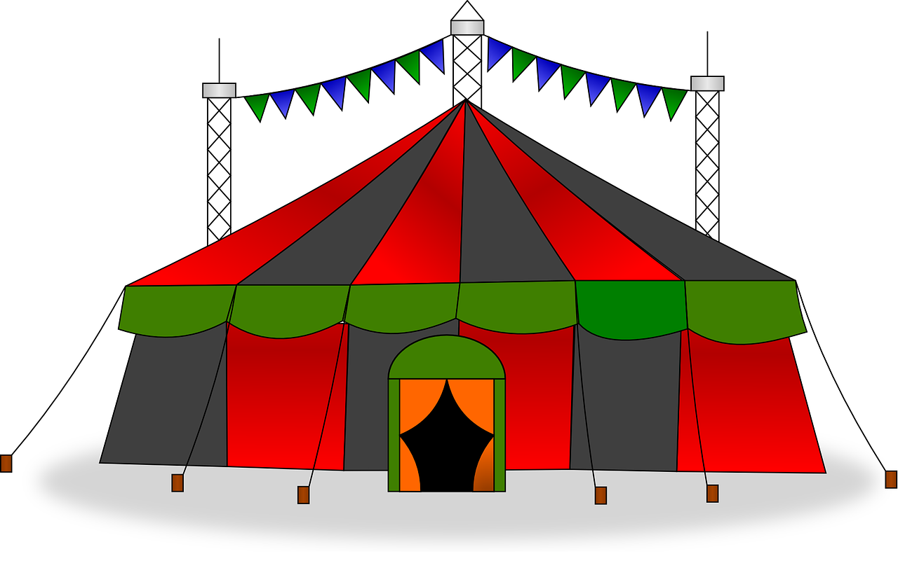
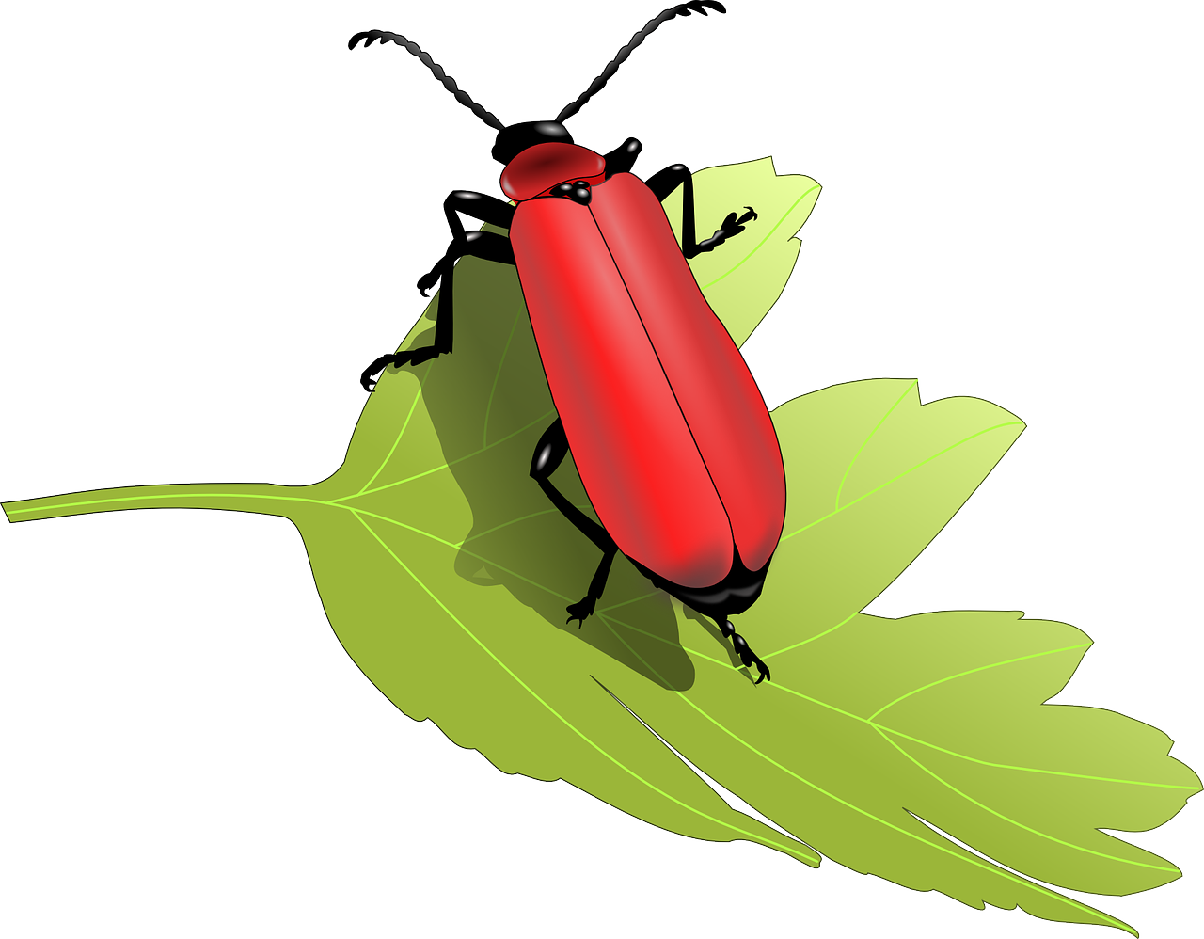
pronunciar
[ci]
[ch]
pronunciar
[circus]
[bug]
circo
bicho
Notes:
4

Slide 5
pronunciar
[z]
[j]
pronunciar
[to lift, raise]
[to celebrate]
alzar
festejar
Notes:
5

Slide 6
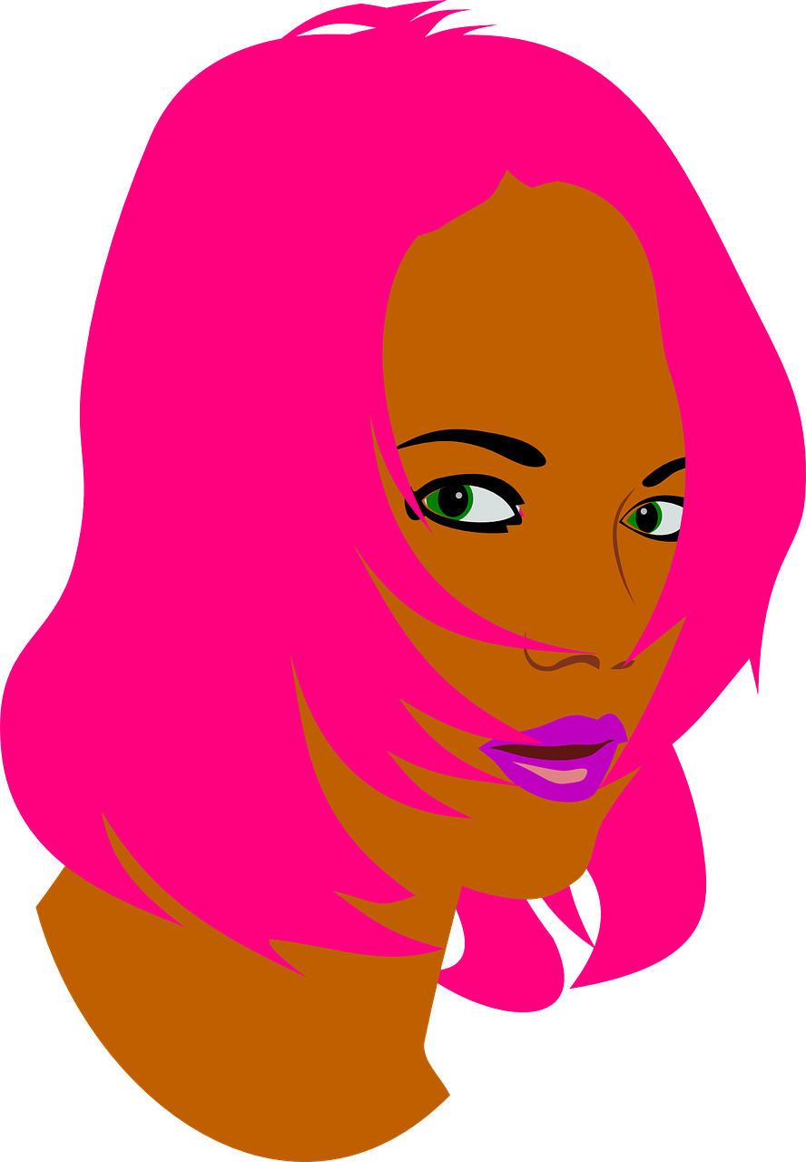
pronunciar
[ñ]
[r-/rr]
pronunciar
[to dye]
[rest]
teñir
reposo
Notes:
6

Slide 7
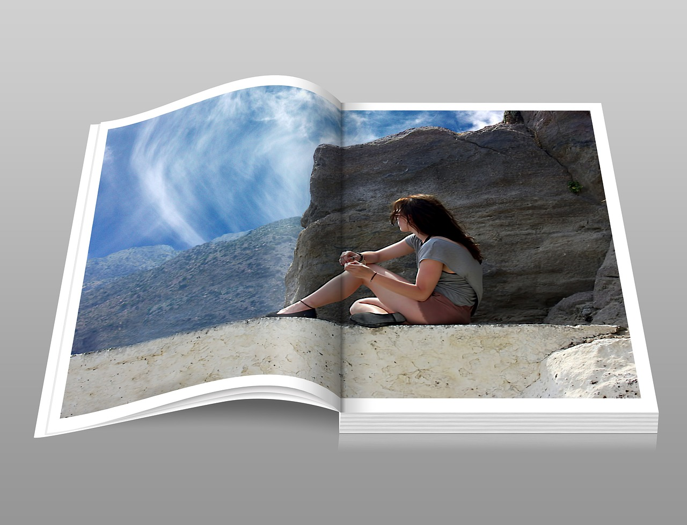
pronunciar
[qui]
[Stress 1]
pronunciar
[chemical]
[catalogue]
químico
catálogo
Notes:
7

Slide 8
pronunciar
[Stress 2]
[Stress 3]
pronunciar
[cover]
[desk, counter]
portada
mostrador
Notes:
8

Slide 9
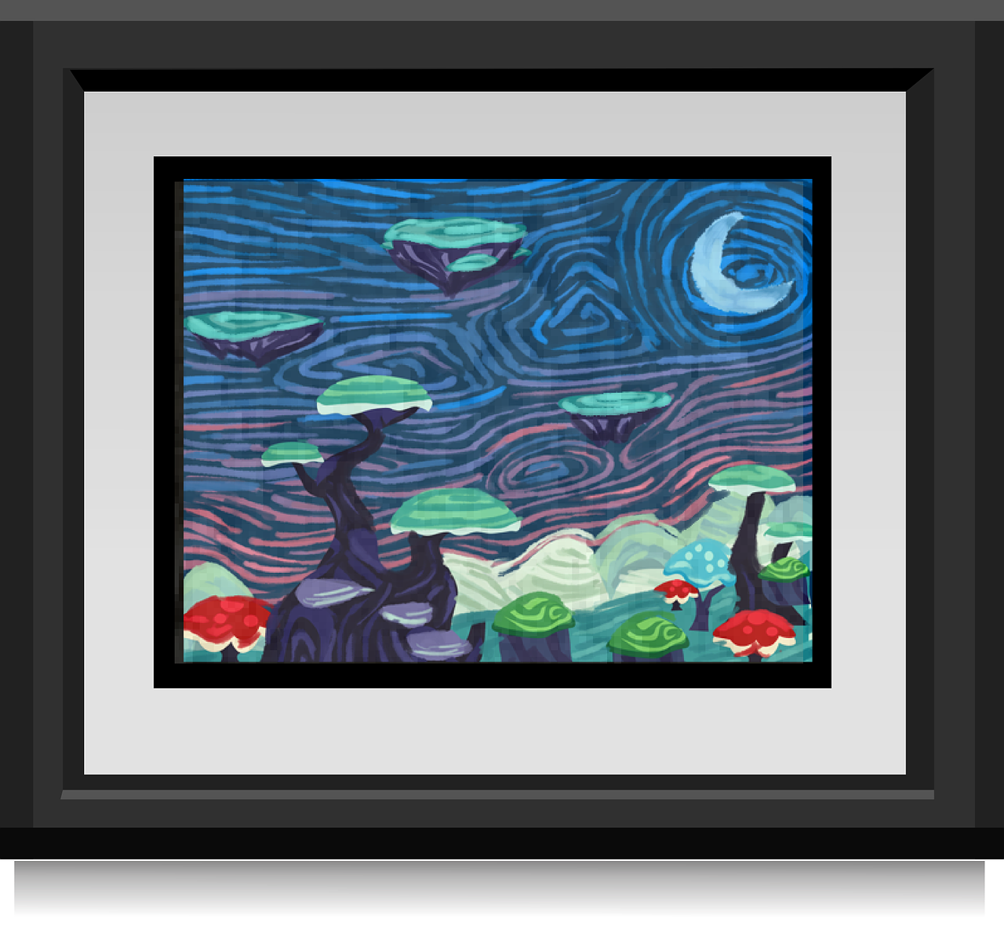
pronunciar
[weak vowel -i]
[strong vowels - ao]
pronunciar
[canvas, painting]
[chaos]
lienzo
caos
Notes:
9

Slide 10
pronunciar
Pupil name:
Pupil name:
SSC and word | px
escudo
torcer
circo
bicho
alzar
festejar
teñir
reposo
químico
catálogo
portada
mostrador
lienzo
caos
SSC and word | px
escudo
torcer
circo
bicho
alzar
festejar
teñir
reposo
químico
catálogo
portada
mostrador
lienzo
caos
Notes:
Pupil feedback and assessment sheet [14 points]
10

Slide 11
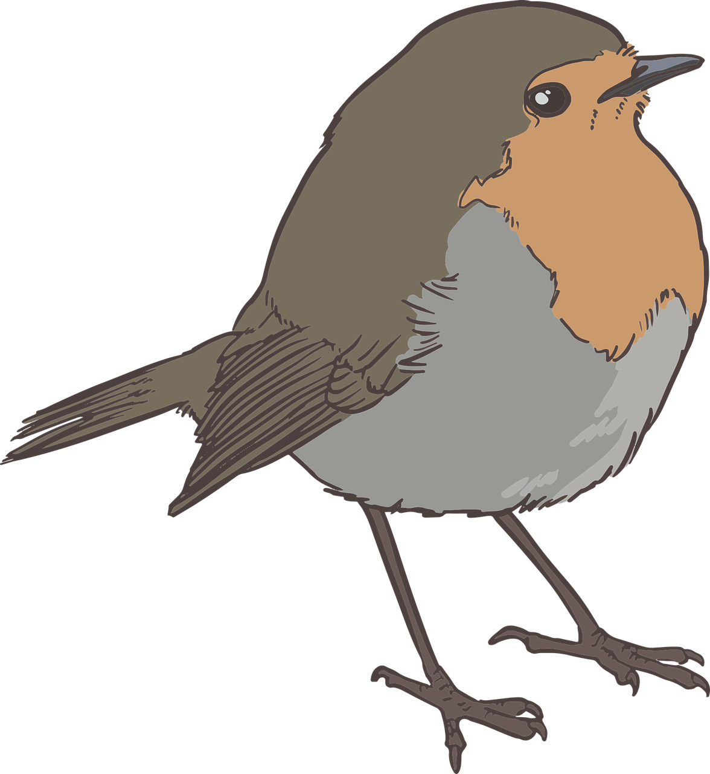
escuchar
escuchar
escribir
escribir
1. _uliana vive en _ _ _mbaya. [2]
1. _uliana vive en _ _ _mbaya. [2]
2. _ _ ltiva u_as pre_ _osas. [3]
2. _ _ ltiva u_as pre_ _osas. [3]
3. La ardi_ _a es _ _ula pero _umbona. [3]
3. La ardi_ _a es _ _ula pero _umbona. [3]
4. S_ _le comer nue_ _s y r_ _dores. [3]
4. S_ _le comer nue_ _s y r_ _dores. [3]
5. El canto del go_ _ión es aleg_e y melod_ _so. [3]
5. El canto del go_ _ión es aleg_e y melod_ _so. [3]
Notes:
Dictation [14 points]
11

Slide 12
¡Felices fiestas!
azul

Slide 13
escuchar
escribir
1. Juliana vive en Quimbaya. [2]
1. Juliana lives in Quimbaya.
2. Cultiva uñas preciosas. [3]
2. She is growing beautiful nails.
3. La ardilla es chula pero zumbona. [3]
3. The squirrel is cute but a tease.
4. Suele comer nueces y roedores. [3]
4. It usually eats nuts and rodents.
5. El canto del gorrión es alegre y melodioso. [3]
5. The song of the sparrow is cheerful and melodious.
Notes:
Dictation answers and English sentence translations for information [14 points]
13

