Slide 1
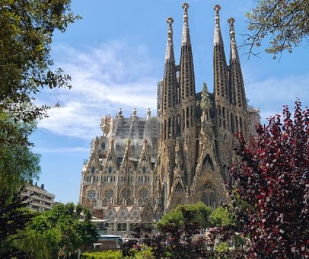
Saying what I and others do
azul
Follow ups 1-5
Notes:
Artwork by Steve Clarke. All additional pictures selected are available under a Creative Commons license, no attribution required.
The frequency rankings for words that occur in this PowerPoint which have been previously introduced in NCELP resources are given in the NCELP SOW and in the resources that first introduced and formally re-visited those words.
Phonics: [r] [rr] parar [706] correr [343] caro [2179] carro [1857] pera [>5000] perra [888]
Vocabulary (new words in bold): ir [33] voy vas va estar [21] estoy estás está cine [952] costa [896] mercado [487] teatro [605]
Revisit 1: armario [5000] cosa [69] habitación [1069] piso [889] radio [933] televisión [825] bicicleta [3684] cama [609] cuaderno [3301] gato [1728] idea [247] oso [4449] perro [888]
Revisit 2: bailar [1323] cocinar [3074] mandar [588] mirar [125] luz [278] pollo [3577] suéter [>5000] tarjeta [1958] común [742]
For any other words that occur incidentally in this PowerPoint, frequency rankings will be provided in the notes field wherever possible.
Source: Davies, M. and Davies, K. (2018). A frequency dictionary of Spanish: Core vocabulary for learners (2nd ed.). Routledge: London

Slide 2
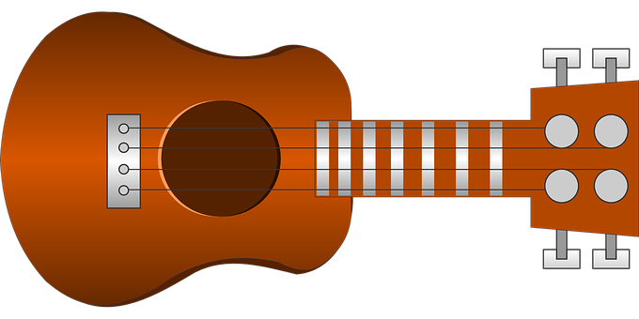
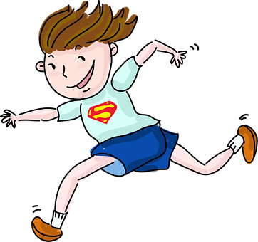
Follow up 1
[r] [rr]
A Escucha. ¿Qué sonido es?
pronunciar
Marca
 | r | rr
B ¡Practica el poema!
E
serio
1
febrero
Erre con erre guitarra
(r with r guitar)
corre
2
[s/he]
Erre con o serio
3
guitarra
(r with o serious.)
Erre y erre tiene perro.
terrible
4
😡
(r and r has dog)
5
diferente
y el burro marrón.
(and the brown donkey)
Notes:
Timing: 5 minutes
Aim: to develop phonological awareness of [r] [rr]
Procedure:
Click to bring up the instruction.
Click to bring up table and do example together (E).
Students tick and/or write the correct sound [r] or [rr].
Click to reveal answers and elicit pupils’ pronunciation of each word.
Click to bring up Part B and read instructions.
Click to bring up and listen to each sentence of the poem.
Allow pupils to practise in pairs.
Practise one more time as a whole class.
Transcript Part A: [EJ] serio
[1] febrero
[2] corre
[3] guitarra
[4] terrible
[5] diferente
Transcript Part B: Erre con erre guitarra
Erre con o serio
Erre y erre tiene perro
Y el burro marrón

Slide 3
Follow up 2:

Escribe en inglés: Can you get at least 15 points?
 | el suéter | la tarjeta | común
 | la luz | mirar | el pollo
 | cocinar | bailar | mandar
 | la radio | la habitación | la televisión
 | el armario | la cosa | el piso
 | el teatro | el mercado | la costa
 | ir | vas | el cine
(the) jumper
(the) card
common
vocabulario
(the) light
to watch, watching
(the) chicken
x3
to cook, cooking
to send, sending
to dance, dancing
(the) radio
(the) (bed)room
(the) television
x2
(the) wardrobe
(the) thing
(the) flat
(the) theatre
(the) market
(the) coast
x1
to go, going
you go, are going
(the) cinema
Notes:
Timing: 5 minutes
Aim: to practise written comprehension (this slide) and production (next slide) of vocabulary from this week and this week’s revisited sets.
Procedure: 1. Give pupils a blank grid. They fill in the English meanings of any of the words they know, trying to reach 15 points in total.
Note: The most recently learnt and practised words are pink, words from the first revisit are green and those from the second revisit are blue, thus more points are awarded for them, to recognise that memories fade and more effort (heavy lifting!) is needed to retrieve them.

Slide 4
Using the verb ‘ir’
[ir:- you go, s/he goes]
We have learned that the verb ‘ir’ (to go) is irregular:
vas
va
To say ‘you go’, use ‘____’.
To say ‘s/he goes’, use ‘____’.
You
S/he
Vas al cine por la mañana.
Va a la playa con papá.
You go to the cinema in the morning.
She goes to the beach with dad.
⚠ Remember to use correct words(s) for ‘to the’.
Notes:
Timing: 3 minutes
Aim: to introduce 1st and 2nd person singular of ‘ir’
Procedure:
Read the grammar explanation on irregular verb ir.
Elicit English translation for the Spanish examples provided.

Slide 5
Using the verb ‘estar’
[Estar:- you are, s/he is (location)]
We have learned that the verb ‘estar’ (to be, location) is often followed by the preposition ‘en’.
You
S/he
Estás en el cine.
Está en la habitación.
You are at the cinema.
She is in the room.
⚠ You decide the best translation for en - on, at, in - depending on the context.
Notes:
Timing: 3 minutes
Aim: to introduce 1st and 2nd person singular of ‘ir’
Procedure:
Read the grammar explanation on irregular verb ir.
Elicit English translation for the Spanish examples provided.

Slide 6
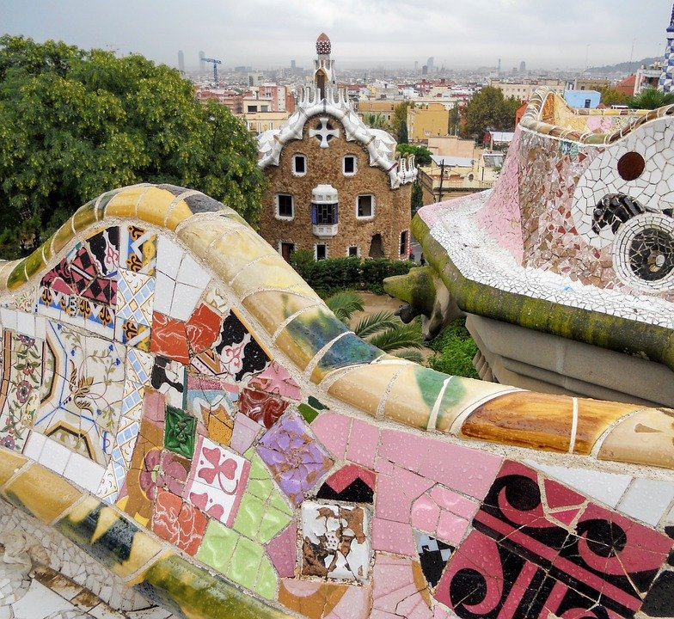
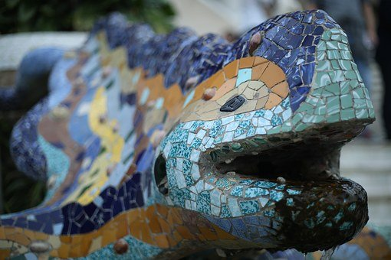
Follow up 3:
Lee las frases.
After ‘estoy’, ‘estás’ and ‘está’, we often use the preposition ____________.
A
en
leer
a la
After ‘voy’, ‘vas’ and ‘va’, we use _______ before feminine nouns, and _________ before masculine nouns.
al
B Lee. ¿Qué verbo es’?
C Escribe las frases en inglés ✍ .
 | Va al cine con mi papá. [I]
 | Estás en la cama de la habitación. [you]
 | Está en el mercado de Barcelona. [s/he]
 | Vas a la montaña al sur de la ciudad. [you]
 | Va al teatro al norte de la ciudad. [s/he]
 | Estás en la casa de un arquitecto famoso. [you]
E
I go to the cinema with my dad.
El arquitecto es
‘Antoni Gaudí’. Usa muchos colores y mosaicos.
1
You are in the room’s bed.
2
S/he is in the market of Barcelona.
3
You go to the mountain in the south of the city.
4
S/he goes to the theatre in the north of the city.
5
You are in the house of a famous architect.
Notes:
Timing: 10 minutes
Aim: to practise written comprehension of the verbs ir and estar in 2nd and 3rd person singular
Procedure:
Click to present the recap of verbs and the prepositions they are most often followed by.
Click to bring up Part B.
Pupils write 1-5 and the missing verbs.
Click to reveal answers.
Click to bring up Part C.
Pupils translate the sentences.
Click to bring up answers.

Slide 7
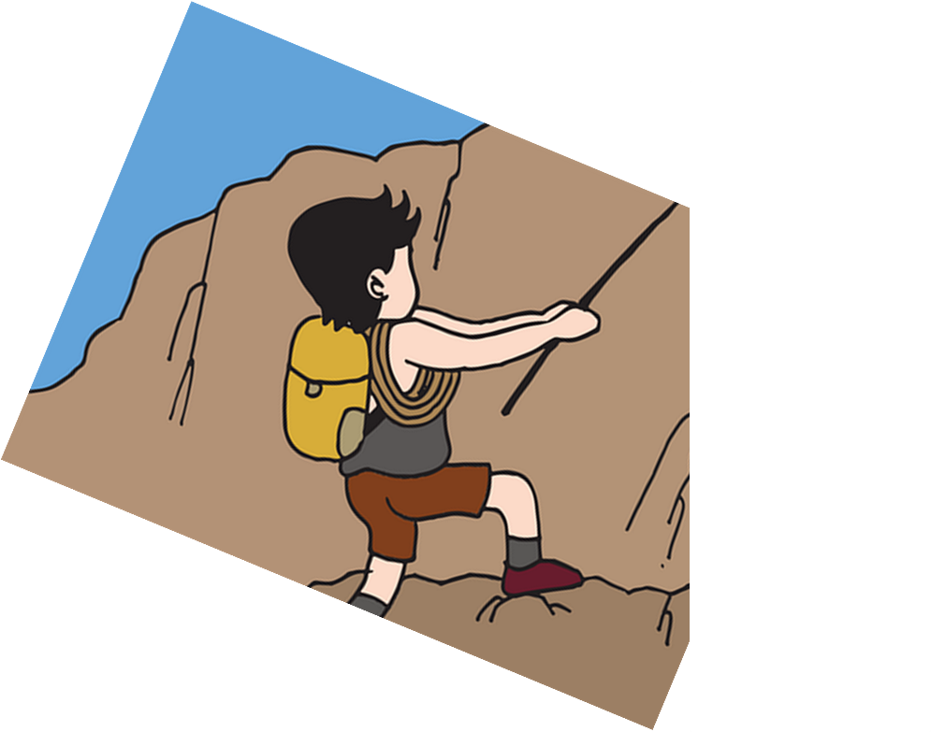
Follow up 4:
Habla en español [1/6]
Traduce 🗣
I go to the museum with my mum.
leer
hablar
mi papá
mi mamá
mi hermana
5
con
de
por
4
teatro
montaña
museo
playa
3
a la
al
en el
2
voy
vas
va
estoy
1
Notes:
Timing: 5 minutes [6 slides]
Aim: to use correct forms of estar / ir, and the correct preposition.
Procedure:
Tell students they need to use the words, starting from the bottom, to climb up the mountain (so that they translate the sentence!).
Ask students to work in pairs to practise first.
Click to trigger the timer (15 seconds per sentence).
Ask a volunteer from a pair to say the Spanish sentence out loud – next slide reveals the answer.
Repeat with the next 5 sentences (there are 6 in total).

Slide 8
Follow up 4:
Habla en español [2/6]
Traduce 🗣
You are at the cinema with grandma.
leer
hablar
la amiga
la abuela
el abuelo
5
de
con
por
4
cine
centro
mercado
mar
3
al
en el
a la
2
vas
estoy
estás
está
1
Notes:
[2/6]

Slide 9
Follow up 4:
Habla en español [3/6]
Traduce 🗣
She goes to the room in the morning.
leer
hablar
la tarde
la mañana
la mesa
5
por
de
con
4
ciudad
habitación
mercado
playa
3
a la
al
en la
2
vas
va
estás
estoy
1
Notes:
[3/6]

Slide 10
Follow up 4:
Habla en español [6/6]
Traduce 🗣
Sofía goes to Gaudí’s house.
leer
hablar
Gaudí
con
por
de
5
mercado
cine
clase
casa
4
a la
en el
al
3
va
estoy
voy
está
2
Sofía
1
Notes:
[4/6]

Slide 11
Follow up 4:
Habla en español [4/6]
Traduce 🗣
I am in the city of Barcelona with my brother.
leer
hablar
mi hermano
mi mamá
mi profesor
con
de
por
5
Barcelona
4
con
por
de
centro
casa
pueblo
ciudad
3
al
a la
en la
2
vas
estás
voy
estoy
1
Notes:
[5/6]

Slide 12
Follow up 4:
Habla en español [5/6]
Traduce 🗣
You go to the market in the morning.
leer
hablar
5
el mar
la montaña
la mañana
4
con
por
de
centro
cine
mercado
casa
3
al
en el
a la
2
estoy
vas
va
estás
1
Notes:
[6/6]

Slide 13
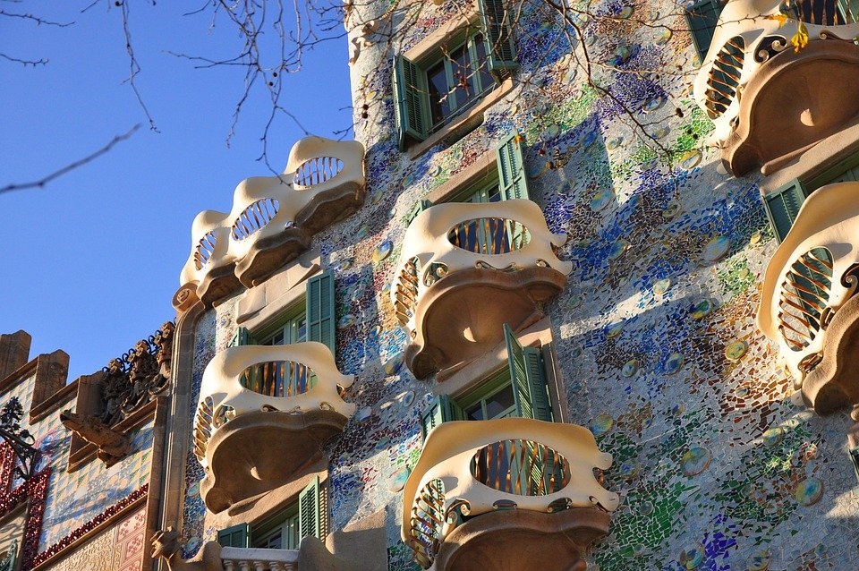
Follow up 4
Sofía y Quique hacen cosas diferentes en Barcelona.
leer
Only one of them goes to ‘Casa Batlló’, a building designed by Gaudí.
¿Quién va a la casa de Gaudí?
¡Sofía!
Casa Batlló
Notes:
Timing: 1 minute
Aim: to conclude Follow up 4 with a look at another building designed by Gaudí.
Procedure:
1. Ask the question ¿Quién va a la casa de Gaudí?
2. Click to provide the answer: Sofía.
3. Ask pupils how they would describe the buildings / places that Gaudí has designed in Barcelona.

Slide 14
Follow up 5:

Escribe las frases.
 | She goes ____ ______ cinema ____ Barcelona.
 | ____ al ________ en Barcelona.
 | _____ _____ on ________ beach ___ ____ morning.
 | Está ____ ____ playa por la ___________.
 | I am ____ the market ______ _____ brother.
 | ________ en ___ _________ con mi _____________.
 | Do you go ____ the __________ theatre?
 | _______ _______ ___________ famoso?
 | You are in ____ ___________ with _____ book.
 | _______ _____ la habitación ______ un ___________.
to the
in
E
escribir
Va
cine
She is
the
in the
1
en la
mañana
in
with my
2
Estoy
el mercado
hermano
to
famous
3
Vas
al
teatro
the room
a
4
Estás en
con
libro
Notes:
Timing: 5 minutes
Aim: written production and comprehension of estar, ir and the correct preposition.
Procedure:
Pupils to use the parts of the sentence in Spanish / English to write down the whole sentence in Spanish and English.
Click to correct.
If desired, click on the numbers to hear the sentences.

Slide 15
Follow up

Escribe en español: Can you get at least 15 points?
 | (the) jumper | (the) card | common
 | (the) light | to watch, watching | (the) chicken
 | to cook, cooking | to dance, dancing | To send, sending
 | (the) radio | (the) (bed)room | (the) television
 | (the) wardrobe | (the) thing | (the) flat
 | (the) cinema | (the) theatre | to go, going
 | you go | (the) market | (the) coast
el suéter
la tarjeta
común
vocabulario
la luz
mirar
el pollo
x3
cocinar
bailar
mandar
la radio
la habitación
la televisión
x2
el armario
la cosa
el piso
el cine
el teatro
ir
x1
vas
el mercado
la costa
Notes:
Timing: 5 minutes
Aim: to practise written comprehension (this slide) and production (next slide) of vocabulary from this week and this week’s revisited sets.
Procedure: 1. Give pupils a blank grid. They fill in the Spanish meanings of any of the words they know, trying to reach 15 points in total.
Note: The most recently learnt and practised words are pink, words from the first revisit are green and those from the second revisit are blue, thus more points are awarded for them, to recognise that memories fade and more effort (heavy lifting!) is needed to retrieve them.

Slide 16
Follow up 2:

Escribe en inglés: Can you get at least 15 points?
 | el suéter | la tarjeta | común
 | la luz | mirar | el pollo
 | cocinar | bailar | mandar
 | la radio | la habitación | la televisión
 | el armario | la cosa | el piso
 | el teatro | el mercado | la costa
 | ir | vas | el cine
vocabulario
x3
x2
x1
Notes:
HANDOUT FOLLOW UP 2

Slide 17
Follow up

Escribe en español: Can you get at least 15 points?
 | (the) jumper | (the) card | common
 | (the) light | to watch, watching | (the) chicken
 | to cook, cooking | to dance, dancing | To send, sending
 | (the) radio | (the) (bed)room | (the) television
 | (the) wardrobe | (the) thing | (the) flat
 | (the) cinema | (the) theatre | to go, going
 | you go | (the) market | (the) coast
vocabulario
x3
x2
x1
Notes:
HANDOUT FOLLOW UP EXTRA

