Slide 1


español, con Quique

Slide 2





Saying where you are going and what there is there
azul
ir [to go]: voy & va
Contractions (al vs. a la)
SSC: [b] [v]
Notes:
Artwork by Steve Clarke. All additional pictures selected are available under a Creative Commons license, no attribution required.
The frequency rankings for words that occur in this PowerPoint which have been previously introduced in the resources are given in the SOW (excel document) and in the resources that first introduced and formally re-visited those words.
Phonics: revisit SSC [b] and [v]
Vocabulary (new words in bold): ir, voy, va [33] campo [342] ciudad [178] España [>5000] este [24] norte [624] oeste [2416] sur [661] a [8] el [1] la [1]
Revisit 1: ayudar [328] limpiar [1713] tocar [327] abuela [783] caballo [907] casa [106] cocina [1214] guitarra [2705] vaca [2775] de [2] dentro [548] fuera [299]
Revisit 2: tiene [8] cara [337] médico [692] nariz [1570] ojo [169] oreja [2095] pelo [873] profesor / profesora [501] azul [811] corto [1055] grande [66] gris [1751] largo [300] moreno [3304] negro [307] pequeño [202] redondo [2470] rubio [2861] verde [812] los / las [1]
Glossed: el viaje [519] costa [896]
Source: Davies, M. & Davies, K. (2018). A frequency dictionary of Spanish: Core vocabulary for learners (2nd ed.). Routledge: London
For any other words that occur incidentally in this PowerPoint, frequency rankings will be provided in the notes field wherever possible.

Slide 3

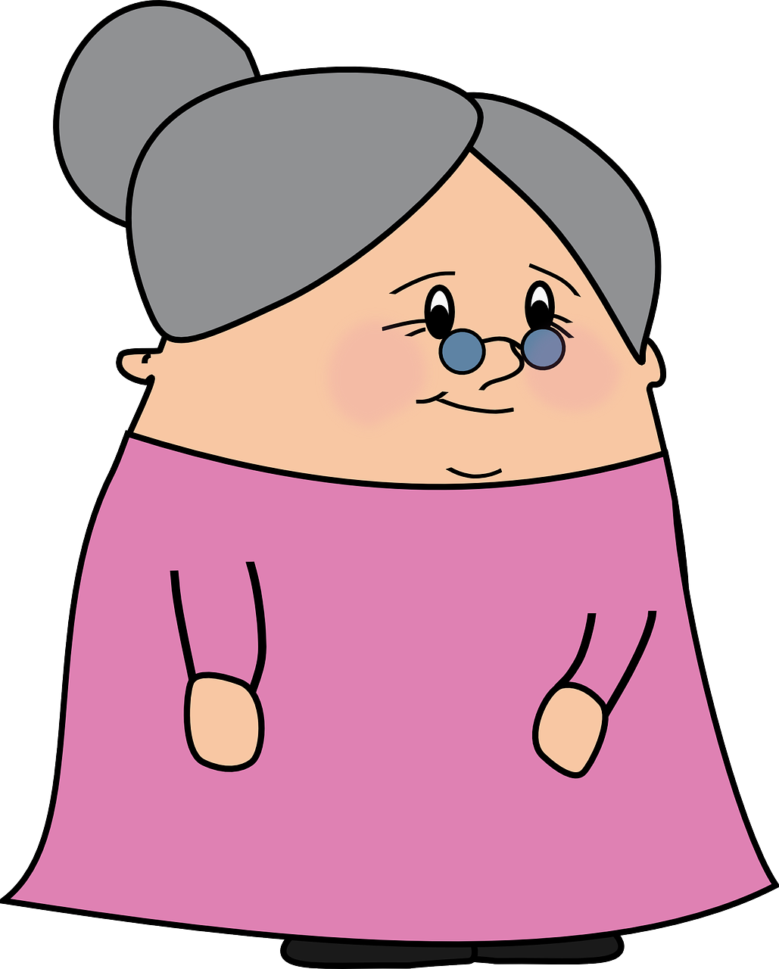
[b]
abuela
pronunciar
Notes:
Timing: 1 minute
Aim: To revisit SSC [b]
Procedure:
To recap and elicit the pronunciation of the individual SSC [b]
Click to bring the picture & get students to repeat (with gesture, if using).
Gesture suggestion: Spanish sign language for ‘abuela’ can be viewed here as a possible gesture:
https://www.youtube.com/watch?v=cxOcDkvKaJY

Slide 4



[v]
ver
Notice [v] has the same sound as [b] ☺.
pronunciar
Notes:
Timing: 1 minute
Aim: To revisit SSC [v]
Procedure:
To recap and elicit the pronunciation of the individual SSC [v]
Click to bring the picture & get students to repeat (with gesture, if using).
Gesture suggestion: point index and middle fingers of right hand towards the eyes and then away from the face to point forwards, gesturing ‘seeing you, looking at you’.

Slide 5

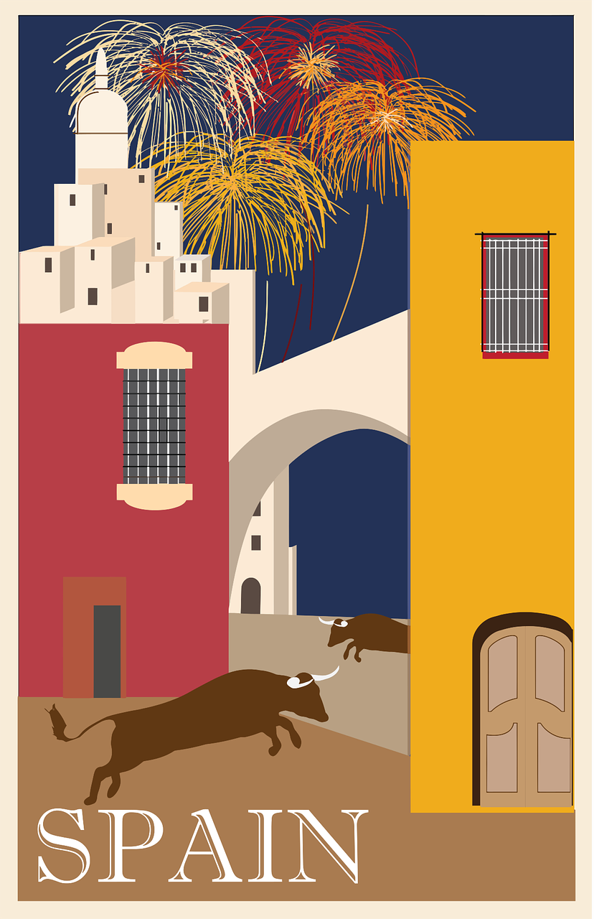

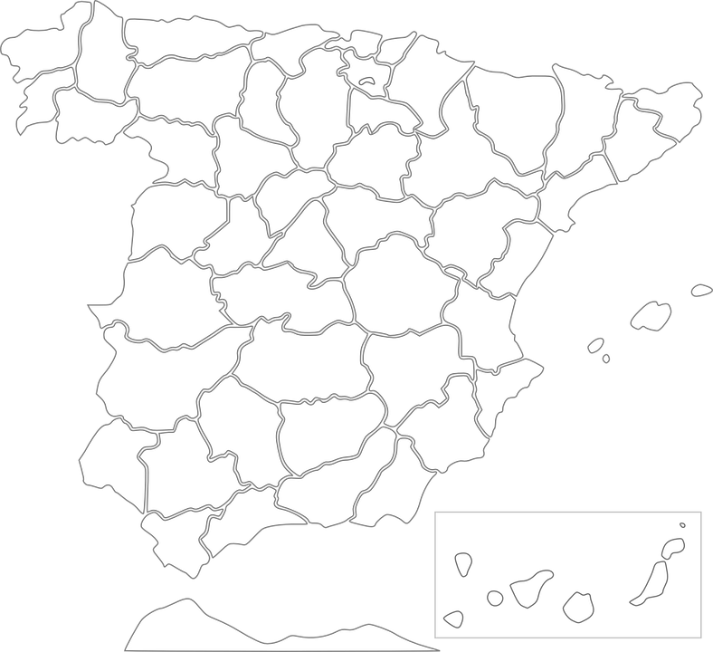
pronunciar
¡A practicar!
Burgos
Bilbao
Segovia
Barcelona
45
segundos
Ávila
Badajoz
Valencia
Albacete
Sevilla
INICIO
Notes:
Timing: 3 minutes
Aim: to practise reading aloud [b] [v] with unknown word (cities in Spain)
Procedure:
Pupils practise (chorally) saying all the city names, starting from Burgos and going round clockwise.
Start the timer.
3. The 2nd time around, in pairs, one pupil secretly selects a city and his/her partner has to try to say it is within the time. Then they swap roles and play again.

Slide 6
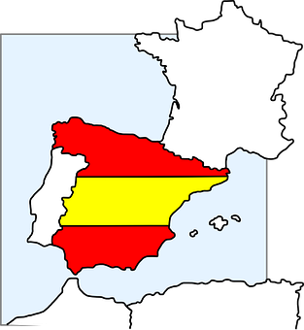
Leer y hablar
el norte
hablar
Notes:
Timing: 4 minutes (four pairs of slides, one per point of the compass) [1/4]
Aim: to present new items of vocabulary (points of the compass)
Procedure:
Teacher gets pupils to repeat and clarifies meaning before moving to next slide.
Teacher reads the question in SP.
Pupils locate the two cities in the north. Teachers could ask ¿Sevilla está en el norte? ¡No..! Sevilla no está el norte… ¿y Albacete? Before bringing up the support on the slide.
Teacher elicits full sentences from students.

Slide 7

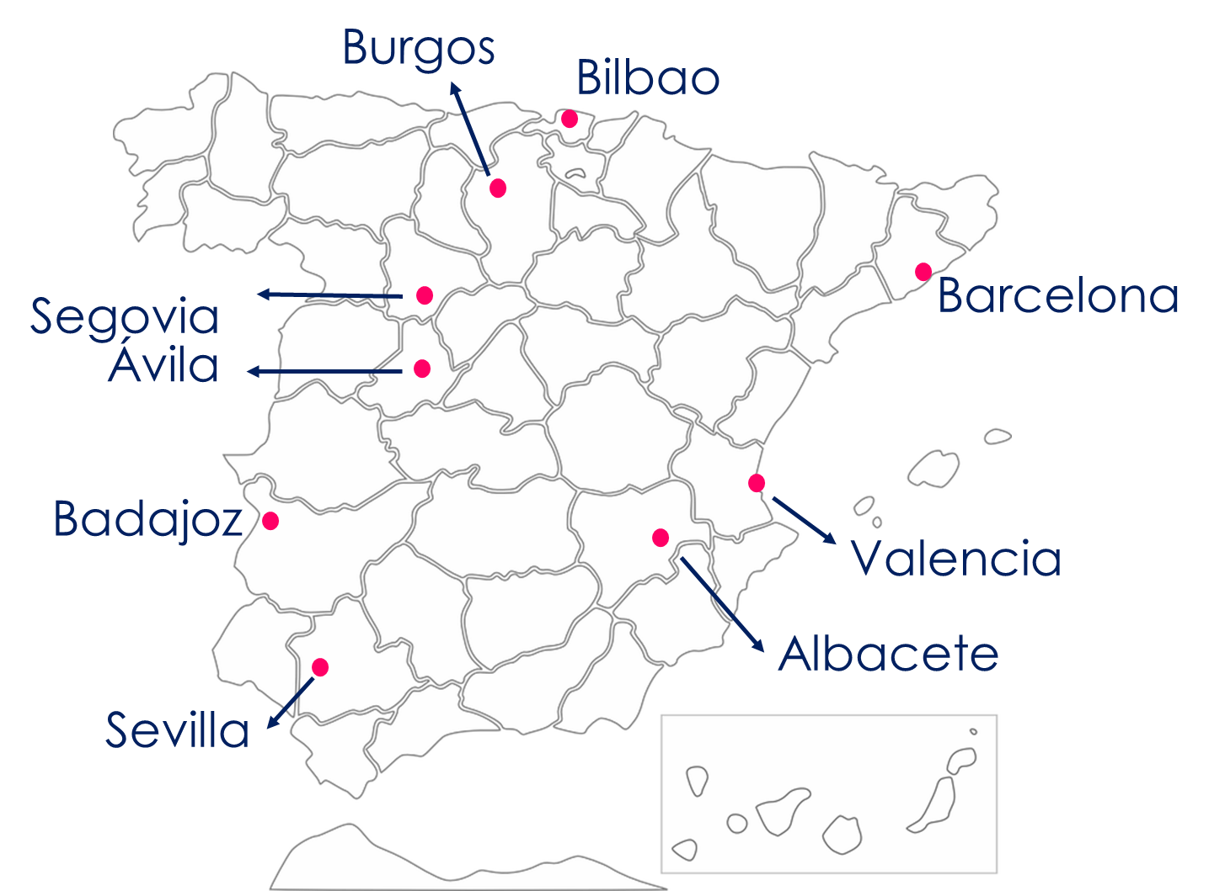

Leer y hablar
¿Qué ciudad* está en el norte?
Remember! La ciudad means city.☺
Burgos
_______ está en el norte.
leer
hablar
1
Bilbao
_______ está en el norte.
2
Notes:
[1/4]
Note: click the audio buttons to hear the full sentences, as required.

Slide 8
Leer y hablar
hablar
el sur
Notes:
[2/4]

Slide 9

Leer y hablar
¿Qué ciudad está en el sur?
Sevilla
_______ está en el sur.
leer
hablar
1
Notes:
[2/4]

Slide 10
Leer y hablar
hablar
el este
Notes:
[3/4]

Slide 11

Leer y hablar
¿Qué ciudad está en el este?
Barcelona
1
__________ está en el este.
leer
hablar
Valencia
2
__________ está en el este.
Albacete
3
__________ está en el este.
Notes:
[3/4]

Slide 12
Leer y hablar
hablar
el oeste
Notes:
[3/4]

Slide 13
Leer y hablar
¿Qué ciudad está en el oeste?
Badajoz
1
__________ está en el oeste.
leer
hablar
Ávila
2
__________ está en el oeste.
Segovia
3
__________ está en el oeste.
Notes:
[3/4]

Slide 14


Using the verb ‘ir’
[ir: I go vs. s/he goes]
Some verbs do not follow regular patterns.
The verb ‘ir’ (to go) is an irregular verb.
To say ‘I go’, we use ‘voy’.
To say ‘s/he goes’, we use ‘va’.
s/he, it
I
Voy con mamá.
Va con una amiga.
S/he goes with a (female) friend.
I go with mum.
Quique va con una amiga.
Quique goes with a (female) friend.
Notes:
Timing: 3 minutes
Aim: to introduce 1st and 3rd person singular of ‘ir’
Procedure:
Read the grammar explanation on irregular verb ir.
Elicit English translation for the Spanish examples provided.

Slide 15




escuchar
La excursión con el cole.
Sofía va de excursión con la clase, y Luis también.
¿Quién es?
Marca
Voy de excursion y Luis también va.
 | Sofía | Luis
Información extra
E
en marzo
1
a la ciudad
2
con uniforme
3
con el profesor
4
con la familia
5
en abril
Notes:
Timing: 5 minutes (2 slides)
Aim: to practise aural identification of 1st and 2nd person singular based on the verb ending.
Part 1
Procedure:
1. Ensure pupils are clear about the task. Point out Sofía’s speech bubble with ‘voy’ (I go) and Luis va (he goes).
2. Click to play the example. Ask pupils to tick Sofía (I) or ‘Luis’ (he)
3. Click to reveal the answer.
4. Play 1-5 and pupils to complete.
5. Click to reveal answers.
6. Click to listen to each sentence again. This time pupils write down any extra information, in Spanish.
7. Click to reveal the additional information.
Transcript:
[E] Voy en marzo.
[1] Va a la ciudad.
[2] Voy con uniforme.
[3] Voy con el profesor.
[4] Va con la familia
[5] Va en abril

Slide 16
Using ‘al’ & ‘a la’
[to the]
The Spanish word ‘a’ means ‘to’:
This is because it’s much easier to say ‘al’ than ‘a el’. Try it 😊!
Voy a Burgos.
I go to Burgos.
To mean ‘to the’ before a singular feminine noun, use ‘a la’.
To mean ‘to the’ before a singular masculine noun, use a + el → al.
Voy a la playa.
Voy al cine.
I go to the beach.
I go to the cinema.
Notes:
Timing: 3 minutes
Aim: to introduce contraction ‘al’.
Procedure:
Read the grammar explanation on ‘to the’.
Elicit English translations for the Spanish examples provided.

Slide 17


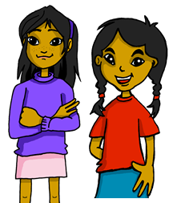
leer
El viaje de Luis y Sofía: Sofía escribe
el viaje = trip / journey
la costa = coast
¡Ay ay ay! ¡Un desastre con el chocolate!
Es “al” o “a la”?
¿Qué frase es? Escribe el número ✍
¿Quién es? ✍
E
Voy al norte.
 | I go | he goes to the coast.
 | I go | he goes to the beach.
 | I go | he goes to the city.
 | I go | he goes to the countryside.
 | I go | he goes to the South.
 | I go | he goes to the North.
[4]
1
Va a la playa.
[1]
2
Voy a la ciudad.
[2]
3
Va al sur.
[5]
4
Va a la costa*.
[3]
5
Voy al campo.
[E]
Notes:
Timing: 10 minutes
Aim: To identify the use of ‘al’ and ‘a la’.
This activity is structured in three parts. In Part 1 students decide if they need al or a la by looking at looking at the noun. Part 2 revisits vocabulary. Part 3 revisits 1st and 3rd person singular of ir.
Procedure:
Part 1
1. Teachers to set the context of the task
2. Do [E] with pupils. Draw their attention to the noun (norte). Is it masculine or feminine). It’s el norte, therefore it’s a masculine noun.
3. Click to bring up answers.
Pupils do 1-5.
Elicit answers from pupils and click to bring up answers.
If desired, click on the audio buttons to hear the full sentences.
Part 2
Click to bring up instructions and English translations.
Pupils to match up the English translations with Spanish sentences (E to 5).
Elicit answers from pupils and click to bring up correct numbers
Part 3
Click to bring up instructions & reveal sentences in full. (Check pupils understand the question - who is it? Luis? Or Sofia?).
Draw their attention to the verb (Voy/ va).
Pupils can write the verb & English translation for each number (NB. Some pupils might benefit from a having a paper copy of the task).
Elicit verb & English translation from pupils & and click to bring up answers.

Slide 18
¡adiós!
azul

