Slide 1
Saying where you are going and what there is there
azul
Follow ups 1-5
Notes:
Artwork by Steve Clarke. All additional pictures selected are available under a Creative Commons license, no attribution required.
The frequency rankings for words that occur in this PowerPoint which have been previously introduced in NCELP resources are given in the NCELP SOW and in the resources that first introduced and formally re-visited those words.
Phonics: revisit SSC [b] and [v]
Vocabulary (new words in bold): ir, voy, va [33] campo [342] ciudad [178] España [>5000] este [24] norte [624] oeste [2416] sur [661] a [8] el [1] la [1]
Revisit 1: ayudar [328] limpiar [1713] tocar [327] abuela [783] caballo [907] casa [106] cocina [1214] guitarra [2705] vaca [2775] de [2] dentro [548] fuera [299]
Revisit 2: tiene [8] cara [337] médico [692] nariz [1570] ojo [169] oreja [2095] pelo [873] profesor / profesora [501] azul [811] corto [1055] grande [66] gris [1751] largo [300] moreno [3304] negro [307] pequeño [202] redondo [2470] rubio [2861] verde [812] los / las [1]
Glossed words: costa [896] lengua [586] ordenador [2624] sueño [460] su [12] minoritaria [>5000]
For any other words that occur incidentally in this PowerPoint, frequency rankings will be provided in the notes field wherever possible.
Source: Davies, M. and Davies, K. (2018). A frequency dictionary of Spanish: Core vocabulary for learners (2nd ed.). Routledge: London

Slide 2
Follow up 1:
[A] Escribe ✍.
pronunciar
palabras
[C] ¿Qué significan las palabras?
 | negativo |  | viernes
 | bonito |  | trabajar
 | también |  | bocadillo
 | viejo |  | veintiuno
 | debajo |  | creativo
E
5
5
Friday to work, working
21 under
sandwich old pretty negative creative also, too
6
1
6
8
4
2
7
7
3
3
8
4
9
1
E
9
2
[B] Practica con
tu compañero / a.
Remember, [b] and [v] sound the same in Spanish 😊
Notes:
Timing: 7 minutes
Aim: to practise SSC [b] and [v] and revisit vocabulary.
NB. These are all words previously introduced in Azul terms 1 & 2 so far.
Procedure:
Pupils to write the missing letter (or the entire word).
Click to bring up answers.
Click to bring up part B. Pupils to practise the words. Remind pupils b and v have the same sound in Spanish.
Click to bring part C instructions. Pupils to match Spanish words with English translations. Encourage pupils to practise in pairs saying the Spanish word and the English translation rather than just saying the number.
Elicit number (or Spanish word) when going through answers.

Slide 3
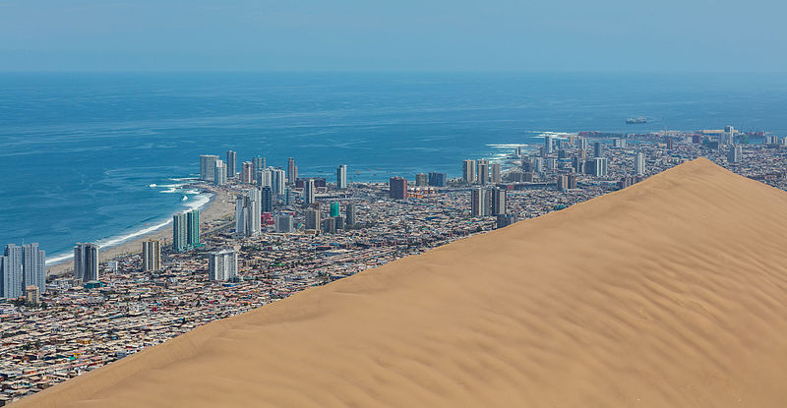
Follow up 2:
su = his/her
1
Luis va de excursión a Chile con su* familia.
Va a Iquique, un pueblo al norte de Chile.
Luis manda unos mensajes de voz a Sofía.
leer
2
(el) sueño = dream
(la) lengua = language
minoritaria = minority
3
North
he goes
to the
to
a town
voice
he sends
norte
va
al
a
un pueblo
voz
manda
En aymara, Iki Iki significa ‘'lugar de sueños*’ 😴.
El aymara, el español y el quechua son lenguas* oficiales en Bolivia y Perú. También es una lengua minoritaria* en el norte de Chile.
Iquique
Notes:
Timing: 10 minutes [Part 1 + Part 2]
Aim: written comprehension of some previously taught vocabulary within a longer text; to introduce the context for the remaining activities.
Procedure:
Part 1 [6 minutes]
Give pupils 2-3 minutes to read the sentences with a partner and find the Spanish meanings for the seven English words.
Pupils could be asked to read the text aloud in pairs, taking it in turns to read alternate sentences.
Click the audio buttons to hear each sentence, if desired.
Click on each English word to reveal the Spanish translation.
Part 2 (next slide)
Frequency of unknown words and cognates: sueño [460] su [12] lengua [586] minoritaria [>5000]
Source: Davies, M. & Davies, K. (2018). A frequency dictionary of Spanish: Core vocabulary for learners (2nd ed.). Routledge: London
Diego Delso, CC BY-SA 4.0 <https://creativecommons.org/licenses/by-sa/4.0>, via Wikimedia Commons

Slide 4
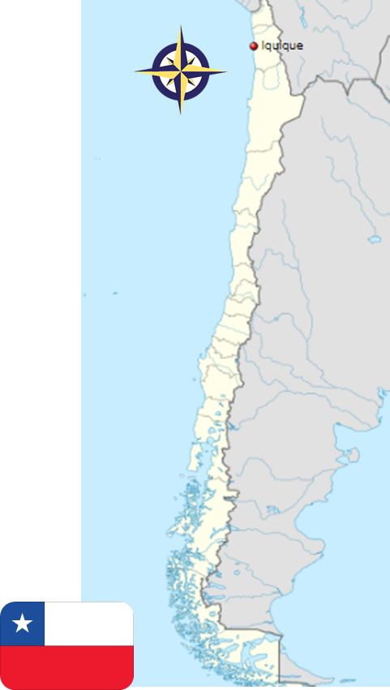
Follow up 3
de ella = hers
Sofía habla de la excursión de Luis y de ella*.
Leer y hablar
Lee el mensaje [1/6]. Completa la frase con las palabras correctas.
20
Va al ____
a la
norte
de Chile.
S
I
s/he
0
INICIO
Notes:
Timing: 4 minutes (Part 2) [1/6]
Aim: written comprehension of 1st and 3rd person singular and contractions; oral production of vocabulary.
Procedure:
Pupils work in pairs to read the sentence aloud, choosing the correct translation for ‘to the’ and the correct word for the gap (draw their attention to the picture to elicit this).
Click on ‘inicio’ to start the timer (25 seconds in total)
Elicit answer from pupils & click to bring up answers.
Click further to bring up further questions. Is Sofía talking about herself or about Luis?
Frequency of unknown words and cognates: ella [72]
Source: Davies, M. & Davies, K. (2018). A frequency dictionary of Spanish: Core vocabulary for learners (2nd ed.). Routledge: London
Diego Delso, CC BY-SA 4.0 <https://creativecommons.org/licenses/by-sa/4.0>, via Wikimedia Commons

Slide 5
Follow up 3
Lee el mensaje [2/6]. Completa la frase con las palabras correctas.
Leer y hablar
20
Voy al ______ .
a la
montaña
S
I
s/he
0
INICIO
Notes:
[2/6]

Slide 6
Follow up 3
Lee el mensaje [3/6]. Completa la frase con las palabras correctas.
Leer y hablar
20
Va al ____ .
a la
playa
S
I
s/he
0
INICIO
Notes:
[3/6]

Slide 7
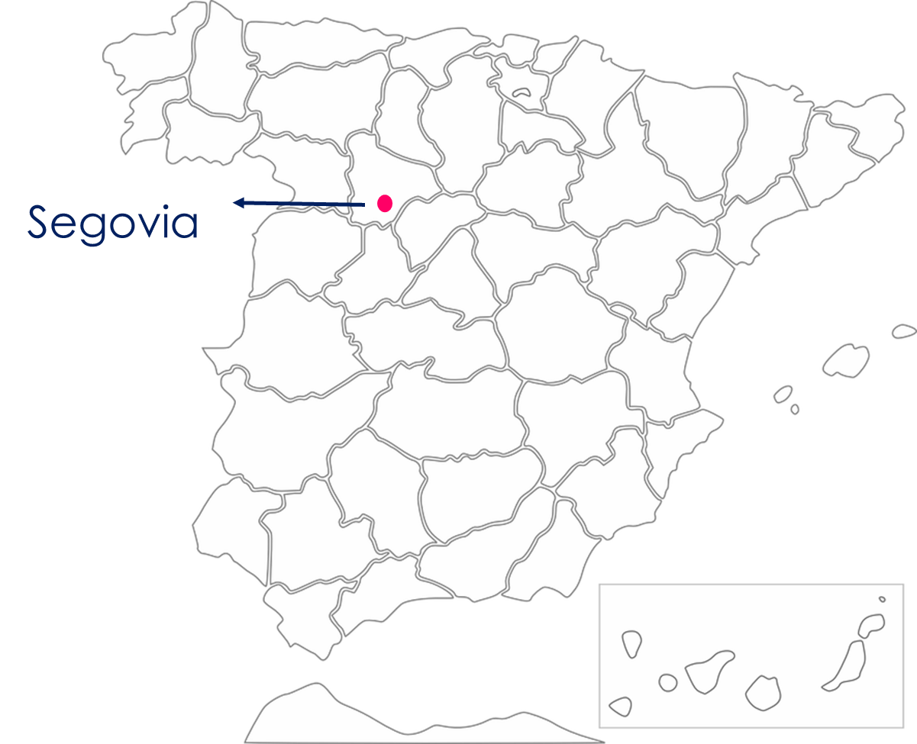
Follow up 3
Lee el mensaje [4/6]. Completa la frase con las palabras correctas.
Leer y hablar
20
Voy al ____ .
a la
oeste
S
I
s/he
0
INICIO
Notes:
[4/6]

Slide 8
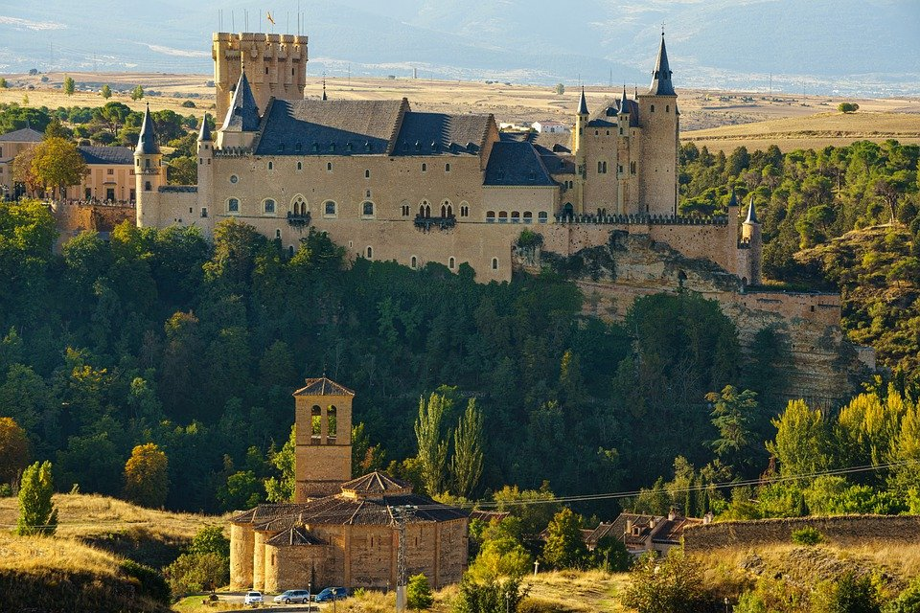
Follow up 3
Lee el mensaje [5/6]. Completa la frase con las palabras correctas.
Leer y hablar
20
Voy al ____ de Segovia.
a la
ciudad
[city]
S
I
s/he
0
INICIO
Notes:
[5/6]

Slide 9
Follow up 3
Lee el mensaje [6/6]. Completa la frase con las palabras correctas.
Leer y hablar
20
Va al ____ de Iquique.
a la
pueblo
[town]
S
Iquique
I
s/he
0
INICIO
Notes:
[6/6]
Pietroluciano, CC BY-SA 4.0 <https://creativecommons.org/licenses/by-sa/4.0>, via Wikimedia Commons

Slide 10
Follow up 4:
El ordenador* tiene un problema. 😨.
Lee el mensaje con tu compañero/a.
Leer y hablar
¡[Hello] Luis! Estoy en [home] [with] mi papá [in the kitchen]. El [Friday] [I go] de excursión con [my] clase. Mi profesor [has] el pelo [short] y [black] . [I go] [to the] ciudad de Segovia, en [the West] de España. Quique [goes] con la señora Mora. [He goes] [to the] countryside].
Hola
casa
con
en la cocina
viernes
voy
mi
tiene
corto
negro
Voy
a la
el oeste
va
Va
al
campo
el ordenador = computer
Notes:
Timing: 5 minutes
Aim: oral practice of the key grammatical features of week 6 (ir, to the)
Procedure:
Teacher to read the context and ensure this is clear.
Pupils to read the message aloud in pairs. Some words are jumbled, some others are in English.
Elicit answers from pupils and click to bring up answers.
Click to bring up part 2 of the task to check understanding. Pupils can say the English words for the items mentioned in the e-mail aloud (animations appear on click from left to right, in the order they are mentioned in the text).
el ordenador [2624]

Slide 11
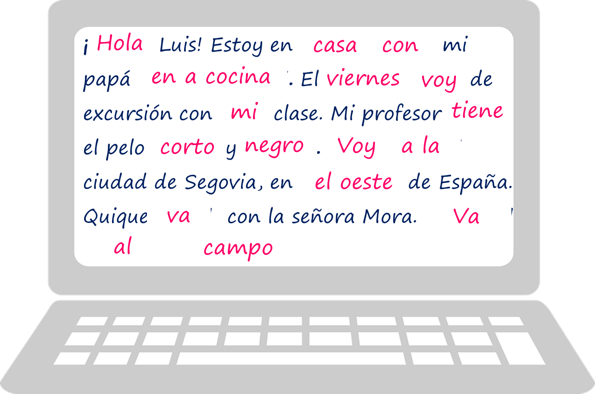
Follow up 4
Escribe el mensaje en inglés.
escribir
Hello, Luis!
I’m at home with my dad,
in the kitchen.
On Friday I’m going on
My teacher has
a trip with my class.
I’m going to the city
short, black hair.
of Segovia, in the West of Spain.
Quique is going with Mrs Mora.
He is going to the countryside.
Notes:
Timing: 6 minutes
Aim: written comprehension of the key grammatical features of week 6 (ir, to the) & previously introduced vocabulary.
Procedure:
Pupils to read the message again and translate it into English.
Click to bring up answers (each sentence at a time)

Slide 12
Follow up: 5

Escribe en inglés: Can you get at least 15 points?
 | moreno | negro | redondo
 | el pelo | corto | largo
 | la cara | el médico | la oreja
 | la vaca | dentro | fuera
 | ayudar | limpiar | tocar
 | el norte | el oeste | el sur
 | la ciudad | la costa | el este
 | ir | voy | va
dark (brown)
black
round
vocabulario
x3
(the) hair
short
long
(the) face
(the) doctor
(the) ear
x2
(the) cow
inside
outside
to help, helping
to clean, cleaning
to touch, play (instrument)
(the) north
(the) west
(the) south
x1
(the) city
(the) coast
(the) east
to go, going
I go, am going
s/he goes, is going
Notes:
Timing: 5 minutes
Aim: to practise written production of vocabulary from this week and this week’s revisited sets.
Procedure: 1. Give pupils a blank grid. They fill in the English meanings of any of the words they know, trying to reach 15 points in total.
Note: The most recently learnt and practised words are pink, words from the first revisit are green and those from the second revisit are blue, thus more points are awarded for them, to recognise that memories fade and more effort (heavy lifting!) is needed to retrieve them.

Slide 13
Follow up: 5

Escribe en español: Can you get at least 15 points?
 | dark (brown) | black | round
 | (the) hair | short | long
 | (the) face | (the) doctor | (the) ear
 | (the) cow | inside | outside
 | to help, helping | to touch, play (instrument) | to clean, cleaning
 | to go, going | s/he goes, is going | (the) city
 | (the) south | (the) coast | (the) east
 | (the) north | I go, am going | (the) west
moreno
negro
redondo
vocabulario
x3
el pelo
corto
largo
la cara
el médico
la oreja
x2
la vaca
dentro
fuera
ayudar
tocar
limpiar
ir
va
la ciudad
x1
el sur
la costa
el este
el norte
voy
el oeste
Notes:
Timing: 5 minutes
Aim: to practise written production of vocabulary from this week and this week’s revisited sets.
Procedure: 1. Give pupils a blank grid. They fill in the Spanish meanings of any of the words they know, trying to reach 15 points in total.
Note: The most recently learnt and practised words are pink, words from the first revisit are green and those from the second revisit are blue, thus more points are awarded for them, to recognise that memories fade and more effort (heavy lifting!) is needed to retrieve them.

Slide 14
Follow up: 5

Escribe en inglés: Can you get at least 15 points?
 | moreno | negro | redondo
 | el pelo | corto | largo
 | la cara | el médico | la oreja
 | la vaca | dentro | fuera
 | ayudar | limpiar | tocar
 | el norte | el oeste | el sur
 | la ciudad | la costa | el este
 | ir | voy | va
vocabulario
x3
x2
x1
Notes:
HANDOUT 1

Slide 15
Follow up: 5

Escribe en español: Can you get at least 15 points?
 | dark (brown) | black | round
 | (the) hair | short | long
 | (the) face | (the) doctor | (the) ear
 | (the) cow | inside | outside
 | to help, helping | to touch, play (instrument) | to clean, cleaning
 | to go, going | s/he goes, is going | (the) city
 | (the) south | (the) coast | (the) east
 | (the) north | I go, am going | (the) west
vocabulario
x3
x2
x1
Notes:
HANDOUT 2

