Slide 1


español, con Quique

Slide 2

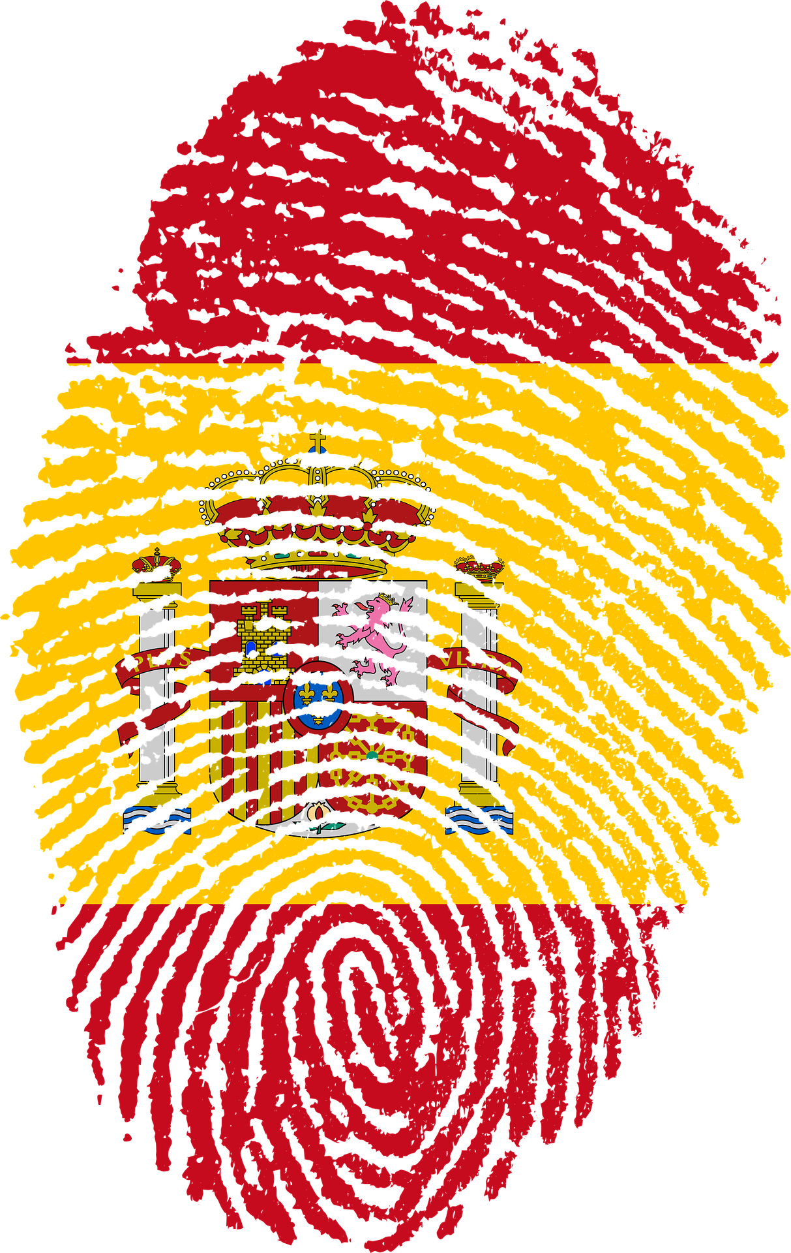



Saying where you are going and what there is there
azul
numbers 1-31
hay, no hay
unos, unas
SSC: [n] [ñ]
Notes:
Artwork by Steve Clarke. All additional pictures selected are available under a Creative Commons license, no attribution required.
The frequency rankings for words that occur in this PowerPoint which have been previously introduced in the resources are given in the SOW (excel document) and in the resources that first introduced and formally re-visited those words.
Phonics: Revisit [n] and [ñ]
Vocabulary (new words in bold*): hay [13] dos [64] tres [134] cuatro [241] cinco [284] seis [438] siete [603] ocho [641] nueve [991] diez [449] once [1701] doce [1138] trece [2700] catorce [2411] quince [1215] dieciséis [3373] diecisiete [3400] dieciocho [2730] diecinueve [4232] veinte [819] veintiuno [819/425] veintidós, veintitrés, veinticuatro, veinticinco, veintiséis, veintisiete, veintiocho, veintinueve, treinta [830] treinta y uno [830/4/425]
Revisit 1: patio [1197] recreo [>5000]
revisit: aprender [428] beber [1085] comer [37] correr [343] hacer [26] leer [209] chocolate [3408] semana [301] a menudo [958] a veces [vez 59] siempre [96]
Revisit 2: tienen [8] tenemos [8] botella [1878] espacio [451] foto [882] gato [1728] goma [4437] lámpara [2978] lápiz [3740] mesa [187] oficina [1072] perro [888] regla [1380] ventana [725] excelente [1546] aquí [130] de12 [2] debajo [1366] detrás [2044] en2 [6]
*none of these is words is new in this lesson; bold text indicates the new words for Azul.
Source: Davies, M. & Davies, K. (2018). A frequency dictionary of Spanish: Core vocabulary for learners (2nd ed.). Routledge: London
For any other words that occur incidentally in this PowerPoint, frequency rankings will be provided in the notes field wherever possible.

Slide 3




pronunciar
[n]
mano
español
[ñ]
¡hola!
Notes:
Timing: 1 minute
Aim: To revisit SSC [n] [ñ]
Procedure:
To recap and elicit the pronunciation of the individual SSC [n] [ñ]
Click to bring the picture & get students to repeat (with gesture, if using).
Gesture suggestion : handshake
Gesture suggestion: mouthe the words ‘hola’ and make a talking gesture with your hand (like a puppet is talking)
Frequency of unknown words:
mano [135]
Source: Davies, M. & Davies, K. (2018). A frequency dictionary of Spanish: Core vocabulary for learners (2nd ed.). Routledge: London

Slide 4




pronunciar
¡A practicar!
adivinar = to guess
Escribe cinco palabras en secreto. Tu compañero/a adivina*.
45
segundos
niña
pequeño
nueve
señor
suena
🎶
mañana
niño
ñu
español
mano
pequeña
sueño
😴
INICIO
Notes:
Timing: 4 minutes
Aim: to practise reading aloud [n] [ñ] with some previously taught vocabulary & unknown word (pictures provided to support meaning).
Procedure:
Read the explanation and ensure pupils understand the task.
Start the timer.
Pupils try to guess their partner’s 5 words by saying them aloud, before the 45 seconds is up.
Swap roles and repeat the game.
Frequency of unknown words and cognates:
adivinar [2201] niño [173] ñu [>5000] secreto [1490] suena (sonar) [949] sueño [460]
Source: Davies, M. & Davies, K. (2018). A frequency dictionary of Spanish: Core vocabulary for learners (2nd ed.). Routledge: London

Slide 5







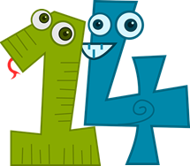

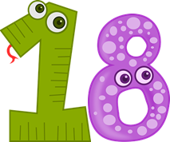



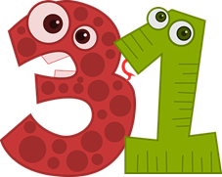
Leer y hablar
Lee los números en el orden correcto.
veintiuno
dieciocho
leer
hablar
catorce
nueve
diez
treinta
doce
60
segundos
treinta y uno
siete
once
dieciséis
veintitrés
cinco
- - - - - - - - - - - - - - - - - - - - - - - - - - - - - - -
INICIO
Notes:
Timing: 3 minutes
Aim: to practise written recognition and correct pronunciation of 13 numbers between 1-31.
Procedure:
Teacher reads the instruction in Spanish and ensures pupil understanding.
Pupils work in pairs to say the numbers in order (1-31). They have one minute.
Click to trigger the timer (60 seconds)
To bring up answers, each number / word disappears on click, and the correct answer appears.

Slide 6
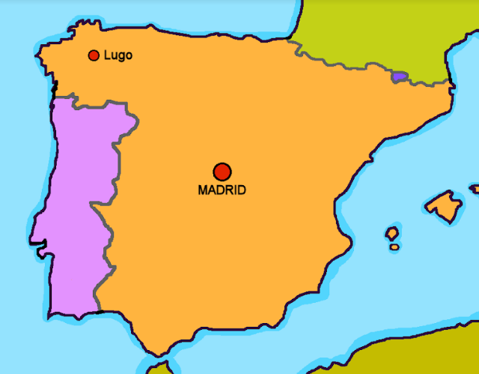
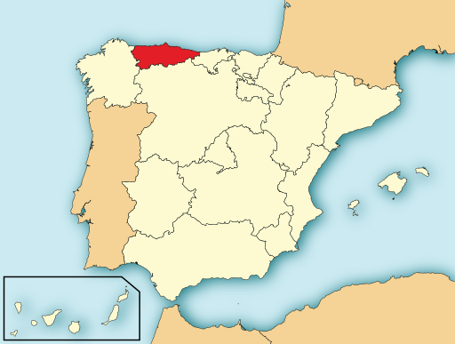
leer
Oviedo
Oviedo es una ciudad en el norte de España.
Es la capital de la región de Asturias.
Oviedo
el norte = north
Notes:
Timing: 1 minute
Aim: To locate Oviedo geographically on a map of Spain and provide an introduction into the context for this lesson.
Procedure:
1. Read the sentences aloud with pupils.
2. Ensure their understanding.
Picture attribution:
Mutxamel, subido por Rastrojo (D•ES), CC BY-SA 4.0 via Wikimedia Commons
Frequency of unknown words and cognates:
capital [581] región [545]
Source: Davies, M. & Davies, K. (2018). A frequency dictionary of Spanish: Core vocabulary for learners (2nd ed.). Routledge: London

Slide 7


Hay
⚠ Remember that un/una means a/an and one.
To say how many of something there are, use hay + number or + unos/unas (some):
Hay una ciudad en el norte.
Hay un parque allí.
There is a city in the north.
There is a park there.
Hay unas ciudades en el norte.
Hay unos parques allí.
There are some cities in the north.
There are some parks there.
⚠ Plurals: add –s to nouns ending in a vowel. Add –es to nouns ending in a consonant.
quinientos = 500
ochenta = 80
Hay dos ciudades grandes en Asturias.
Hay 586 parques en Oviedo.
There are two big cities in Asturias.
There are 586 parks in Oviedo.
Notes:
Timing: 2 minutes
Aim: to reintroduce negation with ‘no’ together with ‘hay’
Procedure:
1. Click to bring up each new part of the explanation.
2. Interactive elicitation: Try to elicit the English meaning in each of the example sentences.
Information source:
https://www.lavozdeasturias.es/noticia/oviedo/2019/08/21/parque-grande-oviedo/00031566388383218102608.htm

Slide 8

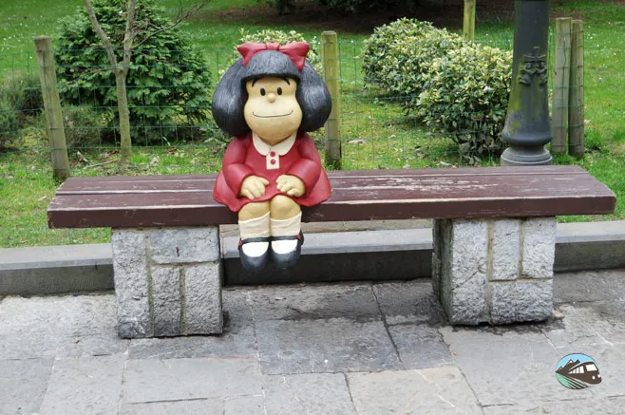
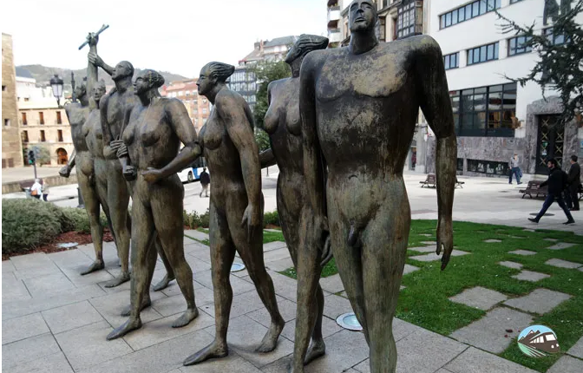
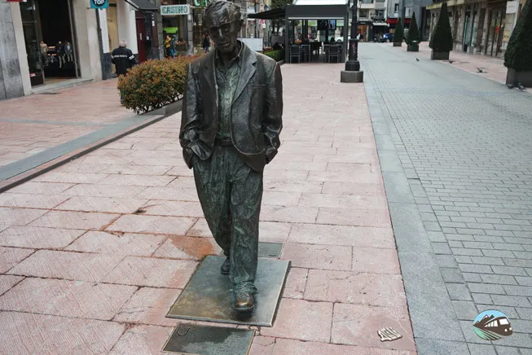
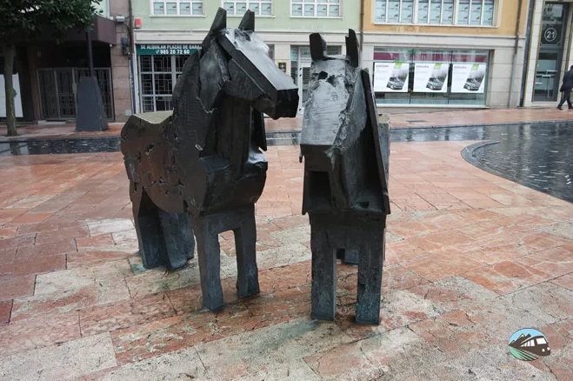
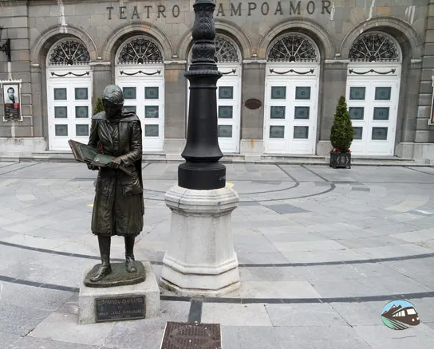
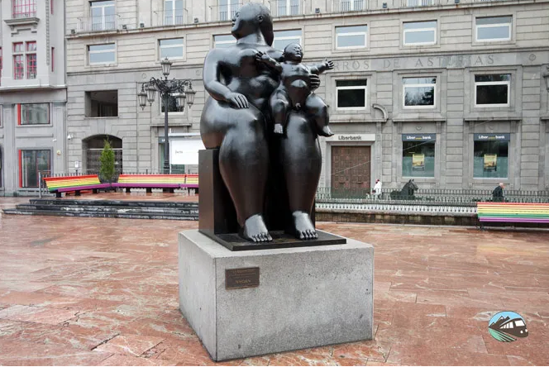
escuchar
Escucha y completa los espacios.
la estatua = statue
todo = all (of)
típico = typical
E
hay
En Oviedo, [E] ______ estatuas* por toda* la ciudad. En las fotos hay [1] _________ estatuas en total. En la imagen número uno hay [2] ________ personas. Las estatuas en la imagen número tres [3] _____ dos asturcones, [4] _________ típicos de Asturias. Los caballos en Asturias son [5] ___________. La chica en la imagen número cuatro [6] ____ un libro y la [6] _____ en la imagen número seis es Mafalda.
1
trece (13)
2
siete (7)
son
3
6
caballos
4
pequeños
5
lee
niña
6
Mafalda
1
2
3
4
5
La Concordia
Woody Allen
Los Asturcones
La Pensadora
La Maternidad
Notes:
Timing: 10 minutes (2 slides)
Aim: to practise transcription of previously taught vocabulary; to introduce pupils to a city in Spain.
Procedure:
1. Explain that pupils are going to learn a bit more about Oviedo.
2. They number E, 1-7 in their books.
3. Click to listen to the example. Allow pupils time to write the missing word.
4. Click to reveal and check the answer.
5. Continue with items 1-7, and check answers.
Transcript:
En Oviedo, hay estatuas* por toda* la ciudad.
En las fotos hay trece estatuas en total.
En la imagen número uno hay siete personas.
Las estatuas en la imagen número tres son dos asturcones,
caballos típicos de Asturias.
Los caballos en Asturias son pequeños.
La chica en la imagen número cuatro lee un libro
y la niña en la imagen número seis es Mafalda.
Photo from:
https://www.rutasporespana.es/blog/2019/07/ruta-por-las-esculturas-de-oviedo/#:~:text=Recorrer%20las%20m%C3%A1s%20de%20cien,la%20plaza%20de%20la%20Catedral.
Many thanks to José, Adrián and Alicia.
Frequency of unknown words and cognates:
estatua [3016] todo [472] total [840] típico [1934]
Source: Davies, M. & Davies, K. (2018). A frequency dictionary of Spanish: Core vocabulary for learners (2nd ed.). Routledge: London

Slide 9

leer
Identifica el vocabulario.
el personaje = character
small
city
people
they are (p)
she reads
pequeños
la ciudad
personas
son
lee
hay
En Oviedo, [E] ______ estatuas* por toda* la ciudad. En las fotos hay [1] _________ estatuas en total. En la imagen número uno hay [2] ________ personas. Las estatuas en la imagen número tres [3] _____ dos asturcones, [4] _________ típicos de Asturias. Los caballos en Asturias son [5] ___________. La chica en la imagen número cuatro [6] ____ un libro y la [6] _____ en la imagen número seis es Mafalda.
Mafalda es un personaje* en un cómic muy famoso en Argentina.
trece (13)
siete (7)
son
caballos
pequeños
lee
niña
there is/are
girl
typical
North
la niña
hay
típicos
el norte
Mafalda
Notes:
Aim: To practise written comprehension of previously taught vocabulary within a longer text.
Procedure:
Give pupils 2-3 minutes with a partner to find the Spanish meanings for the nine English words.
Elicit Spanish responses chorally, prompting with the English, e.g., ‘small?’ ‘pequeños’, muy bien. ☺
Note: click on each English word to reveal the Spanish translation.
Further questions can be asked to draw out linguistic and content knowledge of the text, as appropriate: for example, ‘¿por qué pequeños y no pequeño?,
‘¿qué animales son pequeños en el texto? etc.
Ask pupils to identify any plural nouns in the text (estatuas, fotos, personas, asturcones, caballos)
Pupils could be asked to read the text aloud in pairs, taking it in turns to read alternate sentences. There are a few unknown words in the text, and a variety of words that were taught some time ago.
Click the audio player to hear the full text, if desired.
Transcript:
En Oviedo, hay estatuas* por toda* la ciudad. En las fotos hay trece estatuas en total. En la imagen número uno hay siete personas. Las estatuas en la imagen número tres son dos asturcones, caballos típicos de Asturias. Los caballos en Asturias son pequeños. La chica en la imagen número cuatro lee un libro
y la niña en la imagen número seis es Mafalda.
Photo from:
https://www.rutasporespana.es/blog/2019/07/ruta-por-las-esculturas-de-oviedo/#:~:text=Recorrer%20las%20m%C3%A1s%20de%20cien,la%20plaza%20de%20la%20Catedral.
Many thanks to José, Adrián and Alicia.
Frequency of unknown words and cognates:
estatua [3016] todo [472] total [840] típico [1934]
Source: Davies, M. & Davies, K. (2018). A frequency dictionary of Spanish: Core vocabulary for learners (2nd ed.). Routledge: London

Slide 10

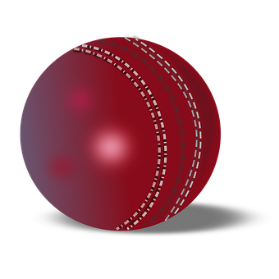

Adjectives following the noun
We know many adjectives follow the noun:
un sombrero rojo
una pelota roja
Remember that adjectives that end in ‘o’ change to an ‘a’ when the noun being described is feminine.
⚠ Remember: Adjectives that end in -e can describe a feminine or masculine noun.
a red hat
a red ball
When we describe more than one person or animal, we add an ‘s’ after‘o’, ‘a’ and ‘e’:
unos sombreros rojos
unas pelotas rojas
some red hats
some red balls
unos sombreros grandes
unas pelotas grandes
some big hats
some big balls
Notes:
Timing: 3 minutes
Aim: to revisit post-nominal adjective agreement.
Procedure:
Read the grammar explanation on post-nominal adjective agreement.
Elicit English translations for the Spanish examples provided.
Speech bubble 1 flags up the gender agreement.
Speech bubble 2 reminds students about gender agreement of adjectives ending in –e.

Slide 11
leer
Badajoz
⚠ Remember to use es (SER) to talk about permanent traits; Badajoz is a city.
Badajoz es una ciudad en el oeste de España.
En Badajoz hay un carnaval famoso.
El carnaval de Badajoz es en febrero.
Oviedo
When is means when an event ‘takes place’ we also use es (SER).
Badajoz
el oeste = west
Notes:
Timing: 1 minute
Aim: To locate Badajoz geographically on a map and introduce its carnival.
Procedure:
1. Click to present the new information.
2. Elicit English meanings from pupils, orally.
3. Click for callouts about uses of SER.
Frequency of unknown words and cognates:
oeste [2416] carnaval [4114] famoso [997]
Source: Davies, M. & Davies, K. (2018). A frequency dictionary of Spanish: Core vocabulary for learners (2nd ed.). Routledge: London

Slide 12
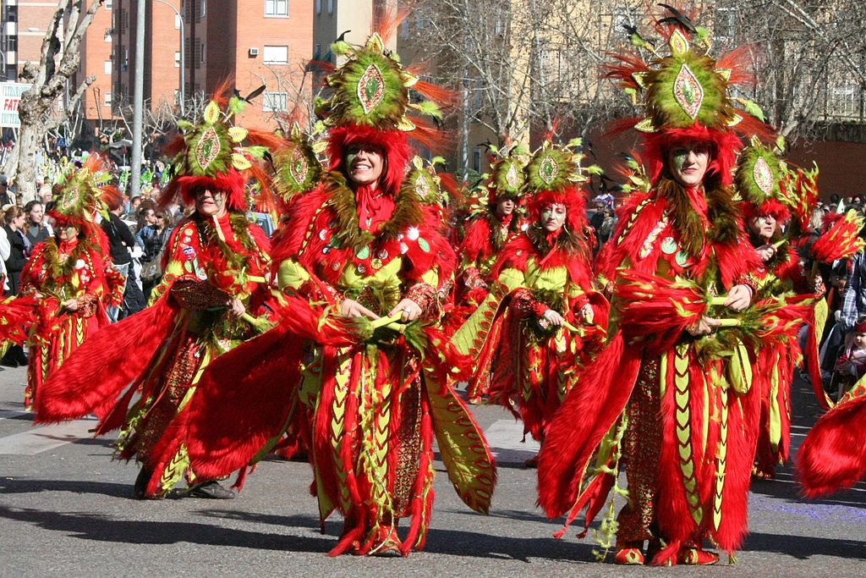
leer
¿Qué hay en la foto? [1/3]
diecisiete
hablar
En la foto hay ________ chicas.
siete
veintisiete
siete
blancos
rojos
Llevan vestidos ________ .
rojos
rojas
el vestido = dress
Notes:
Timing: 3 minutes [slide 1/3[
Aim: to practise written recognition of plural adjectival agreement and comprehension of revisited vocabulary in sentences; to find out more about the Badajoz festival.
Procedure:
Ask the question ‘¿Qué hay en la foto?’
2. Read the first sentence aloud with pupils with pupils and elicit the correct word for the gap, orally.
3. Click to confirm.
4. Continue with the remainder of the sentences, over three slides.
5. Elicit English meanings orally from pupils, too.
Frequency of unknown words and cognates:
vestido [1697]
Source: Davies, M. & Davies, K. (2018). A frequency dictionary of Spanish: Core vocabulary for learners (2nd ed.). Routledge: London
Image from https://www.flickr.com/photos/pacovila/ - https://www.flickr.com/photos/pacovila/3308276017, CC BY-SA 2.0, https://commons.wikimedia.org/w/index.php?curid=44283932

Slide 13
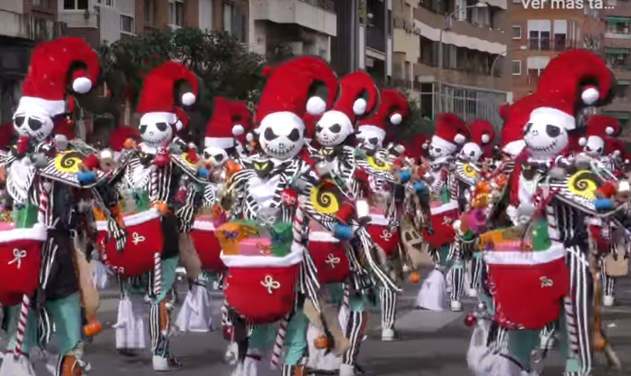
leer
¿Qué hay en la foto? [2/3]
hablar
once
rojas
negros
En la foto hay ________ sombreros ________ y ________.
once
diez
rojos
blancos
rosas
blancos
doce
rojos
blanco
Notes:
[2/4]

Slide 14
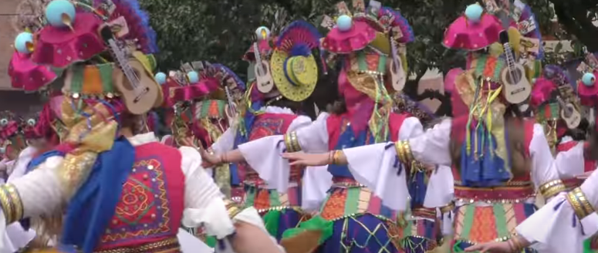
leer
¿Qué hay en la foto? [3/3]
hablar
cuatro
pequeñas
En la foto hay _______ guitarras _________.
pequeñas
cinco
grandes
cinco
catorce
pequeños

Slide 15
Using the negative ‘no’
In Spanish, to say there isn’t or there aren’t, put ‘no’ before the verb hay. This makes a negative.
⚠ It is also possible to omit the article: No hay playa en Oviedo.
No hay una playa en Oviedo.
There isn’t a beach in Oviedo.
No hay serpientes en Oviedo.
There aren’t any snakes in Oviedo.
⚠ There’s no Spanish word for ‘any’ in plural sentences.
Notes:
Timing: 2 minutes
Aim: to reintroduce negation with ‘no’ together with ‘hay’
Procedure:
1. Click to bring up each new part of the explanation.
2. Interactive elicitation of the English meaning in each of the example sentences.

Slide 16

leer
¿Es correcto o incorrecto? [1/4]
hablar
En la foto no hay caras blancas.
¡Es incorrecto!
Notes:
Timing: 3 minutes (four slides)
Aim: to practise written comprehension of hay and no hay in short sentences about the Badajoz festival.
Procedure:
1. Ask the question ¿Es correcto o incorrecto?
2. Elicit the response ‘es incorrecto’ and click to confirm.
3. Click to obscure the ‘no’ and elicit a repetition of the correct sentence from pupils.
4. Continue for slices 2-4.
Image attribution:
Image from https://www.flickr.com/photos/pacovila/ - https://www.flickr.com/photos/pacovila/3308276017, CC BY-SA 2.0, https://commons.wikimedia.org/w/index.php?curid=44283932

Slide 17
leer
¿Es correcto o incorrecto? [2/4]
hablar
En la foto hay veinte sombreros amarillos.
no
¡Es incorrecto.

Slide 18

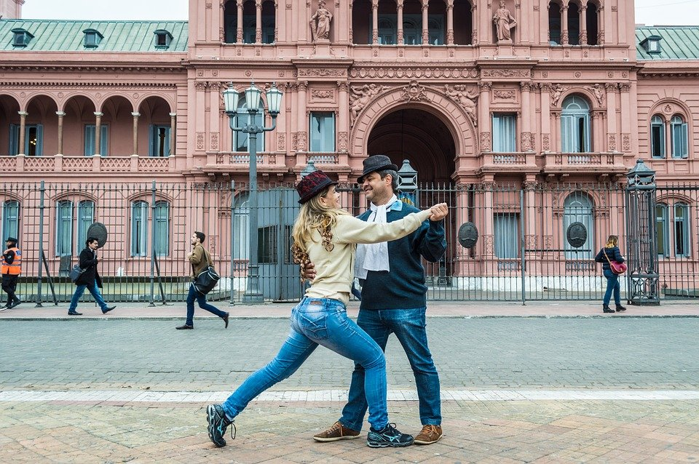
leer
¿Es correcto o incorrecto? [3/4]
hablar
En la foto no hay dieciséis personas.
¡Es correcto!
Bailan tango. El tango es un baile típico de Argentina.

Slide 19
leer
¿Es correcto o incorrecto? [4/4]
hablar
Hay cinco cocinas grandes.
no
¡Es incorrecto!

Slide 20
¡adiós!
azul

