Slide 1





Saying what me and others do
azul
Follow ups 1-5
Notes:
Artwork by Steve Clarke. All additional pictures selected are available under a Creative Commons license, no attribution required.
The frequency rankings for words that occur in this PowerPoint which have been previously introduced in NCELP resources are given in the NCELP SOW and in the resources that first introduced and formally re-visited those words.
Phonics: Revisit [n] and [ñ]
Vocabulary (new words in bold*): hay [13] dos [64] tres [134] cuatro [241] cinco [284] seis [438] siete [603] ocho [641] nueve [991] diez [449] once [1701] doce [1138] trece [2700] catorce [2411] quince [1215] dieciséis [3373] diecisiete [3400] dieciocho [2730] diecinueve [4232] veinte [819] veintiuno [819/425] veintidós, veintitrés, veinticuatro, veinticinco, veintiséis, veintisiete, veintiocho, veintinueve, treinta [830] treinta y uno [830/4/425]
Revisit 1: patio [1197] recreo [>5000]
revisit: aprender [428] beber [1085] comer [37] correr [343] hacer [26] leer [209] chocolate [3408] semana [301] a menudo [958] a veces [vez 59] siempre [96]
Revisit 2: tienen [8] tenemos [8] botella [1878] espacio [451] foto [882] gato [1728] goma [4437] lámpara [2978] lápiz [3740] mesa [187] oficina [1072] perro [888] regla [1380] ventana [725] excelente [1546] aquí [130] de12 [2] debajo [1366] detrás [2044] en2 [6]
*none of these is words is new in this lesson; bold text indicates the new words for Azul.
For any other words that occur incidentally in this PowerPoint, frequency rankings will be provided in the notes field wherever possible.
Source: Davies, M. and Davies, K. (2018). A frequency dictionary of Spanish: Core vocabulary for learners (2nd ed.). Routledge: London

Slide 2

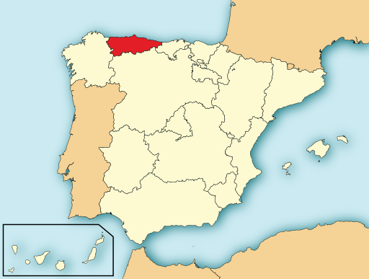
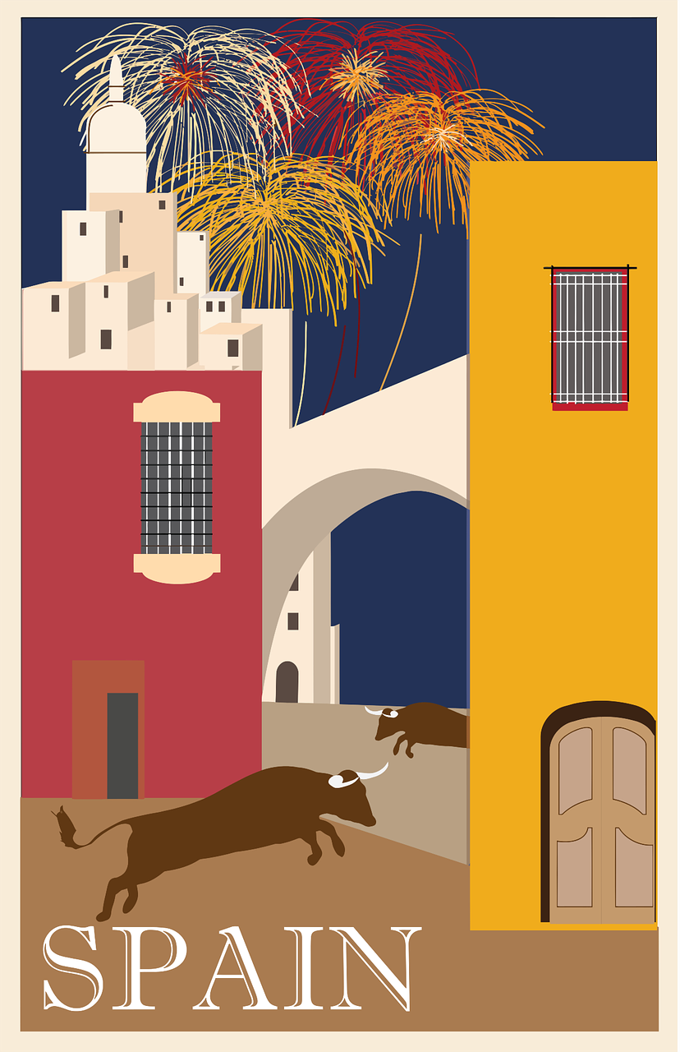

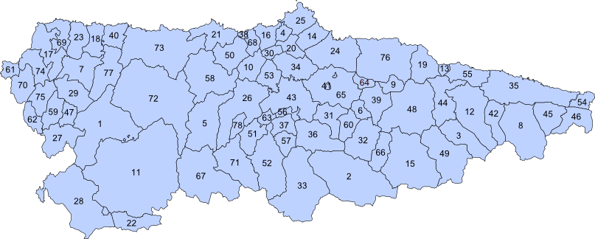
Follow up 1: el mapa de Asturias
Escucha y escribe. ¿Es [n] o [ñ]? ✍.
escuchar
C a r r e ñ o
5
_
C o a ñ a
4
_
6
C a b r a n e s
_
E
L l a n e s
_
18
14
9
35
6
32
1
B i m e n e s
22
_
D e g a ñ a
2
L a v i a n a
3
_
_
Notes:
Timing: 5 minutes
Aim: to practise transcription of [n] and [ñ] with towns and village names in Asturias.
Procedure:
Pupils listen to each word and write [n] or [ñ].
Click to reveal the letter and elicit pronunciation of the full place name from pupils.
Elicit also the number for each place name.
If desired, click on the number to hear the audio.
Click each audio button to listen.
Differentiation:
Pupils could turn away from the board and transcribe the whole place name. They have learnt all the SSC previously.
Transcript 1:
E. Llanes
1. Bimenes
2. Laviana
3. Degaña
4. Coaña
5. Carreño
6. Cabanes
Transcript 2:
treinta y cinco
seis
treinta y dos
veintidós
dieciocho
catorce
nueve
Picture attribution:
Eldelcarro, CC BY-SA 2.5 ES via Wikimedia Commons

Slide 3





Follow up 2: ¿Cuántos hay? ¿Cuántas hay? [1/6]
Escucha la frase y escribe el número correcto y el objeto en inglés. ✍.
escuchar
E
Notes:
Timing: 5 minutes
Aim: to practise aural comprehension of numbers and previously taught vocabulary that we are revisiting this week.
Procedure:
Click to listen to the sentence.
Pupils write the number (in digits) and the item in English. (e.g. 13 bottles)
Click to highlight the number answer and reveal the noun.
Repeat for the follow 5 sentences.
Differentiation:
For more challenge in terms of comprehension remove the number options (or in a mixed proficiency class, some pupils can turn away from the board).
For additional transcription practice, ask pupils to transcribe the sentence and then translate it.
Transcription:
Hay trece botellas.

Slide 4


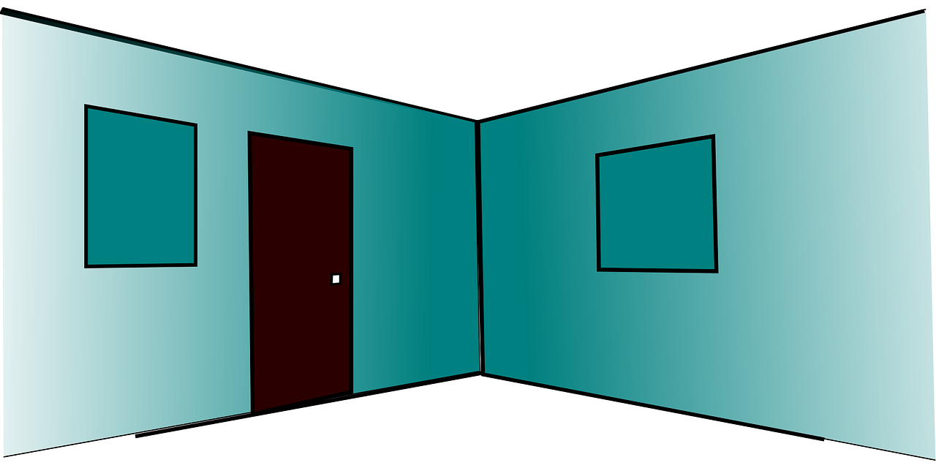


Follow up 2: ¿Cuántos hay? ¿Cuántas hay? [2/6]
Escucha la frase y escribe el número correcto y el objeto en inglés. ✍.
escuchar
1
Notes:
2/6
Transcription:
Hay unos espacios.

Slide 5





Follow up 2: ¿Cuántos hay? ¿Cuántas hay? [3/6]
Escucha la frase y escribe el número correcto y el objeto en inglés. ✍.
escuchar
2
Notes:
3/6
Transcription:
Hay diez lápices.

Slide 6





Follow up 2: ¿Cuántos hay? ¿Cuántas hay? [4/6]
Escucha la frase y escribe el número correcto y el objeto en inglés. ✍.
escuchar
3
Notes:
4/6
Transcription:
Hay quince ventanas.

Slide 7



Follow up 2: ¿Cuántos hay? ¿Cuántas hay? [5/6]
Escucha la frase y escribe el número correcto y el objeto en inglés. ✍.
escuchar
Veintiuno becomes becomes veintiuna before a feminine noun. E.g., Hay veintiuna gomas.
4
Notes:
5/6
Transcription:
Hay veintiuna gomas.

Slide 8



Follow up 2: ¿Cuántos hay? ¿Cuántas hay? [6/6]
Escucha la frase y escribe el número correcto y el objeto en inglés. ✍.
escuchar
5
Notes:
6/6
Transcription:
Hay cuatro lámparas.

Slide 9

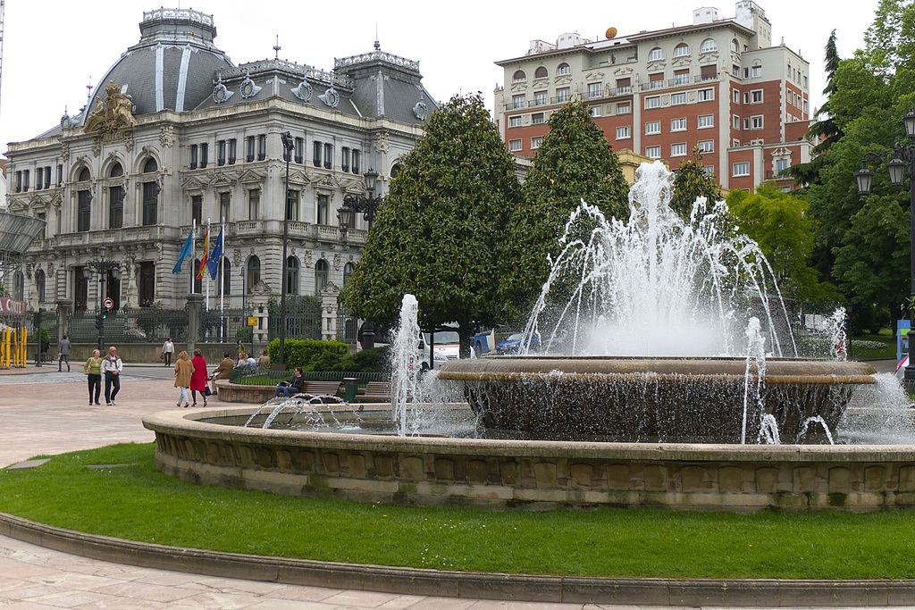

Follow up 3:
Hay y tiene
[there is, there are | s/he, it has
hay
Remember: to say ‘there is’ and ‘there are’, use ______.
Sentences with hay often start with en:
En Oviedo hay unas plazas bonitas.
In Oviedo there are some pretty squares.
tiene
Use _______ to mean ‘s/he, it has’:
Oviedo tiene unos museos importantes.
Oviedo has some important museums.
Sentences with tiene don’t usually start with en.
Notes:
Timing: 8 minutes (2 slides)
Aim: to revisit hay and tiene and remind them that en is often used to start sentences with hay.
Procedure:
Click to present the information.
Elicit English translations for the Spanish examples provided.
Picture attribution:
José Luis Filpo Cabana, CC BY 3.0 via Wikimedia Commons

Slide 10

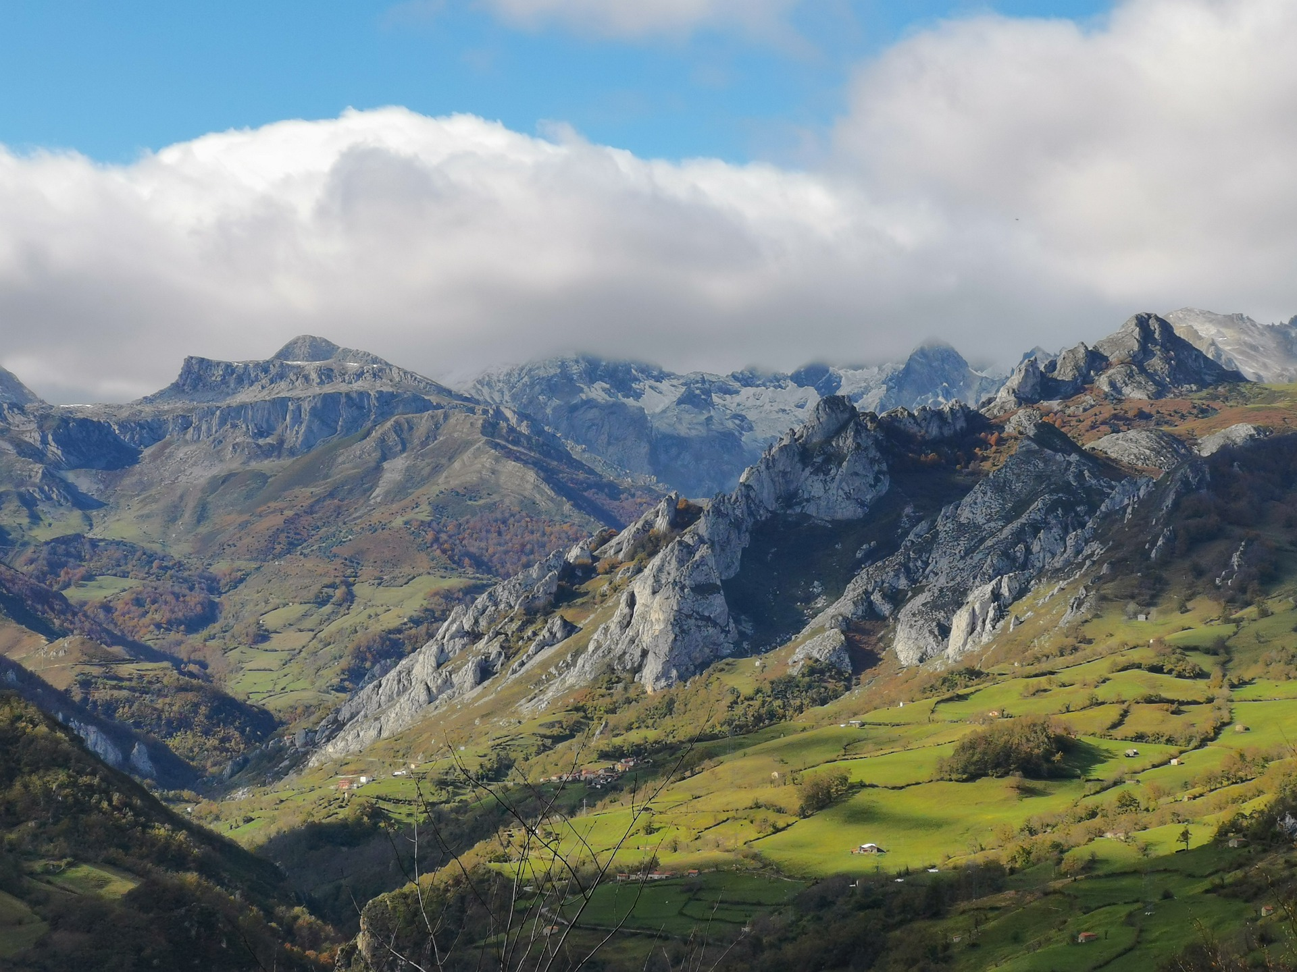

Follow up 3:
Oviedo
Lee las frases y marca el verbo correcto: ¿Es hay o tiene?.
Escribe la segunda parte de la frase en inglés.
leer
1. En Oviedo | tiene | hay | unos museos en el centro de la ciudad.
2. Oviedo | hay | tiene | unos espacios verdes y bonitos también.
3. En la ciudad no | hay | tiene | playas.
4. En la región | tiene | hay | unas montañas, los Picos de Europa.
5. Oviedo | tiene | hay | unas fiestas importantes el 21 de septiembre.
6. La zona no | hay | tiene | temperaturas muy bajas.
1
some museums in the centre of the city
2
some pretty green spaces, too.
3
Los Picos de Europa =
the Peaks of Europe
beaches.
4
some mountains, the Peaks of Europe
5
some important celebrations on the 21st September
6
very low temperatures
la zona = area
Notes:
Aim: to practise written comprehension of affirmative and negative sentences with hay and tiene and previously taught vocabulary; to learn more about Oviedo.
Procedure:
Ensure that pupils understand the task. Remind them to look out for the presence of ‘en’ at the start.
First pupils read the sentence and select the correct verb.
Then they translate the 2nd part of the sentence into English.
When feeding back, elicit the full Spanish sentence from pupils and the English translation, orally.
Note that sentences 3 and 6 are negative!
Click the audio buttons to hear the full sentences, if required.
Answers:
1. In Oviedo there are some museums in the centre of the city / city centre.
2. Oviedo has some pretty green spaces, too.
3. In the city there aren’t any beaches.
4. In the region there are some mountains, the Peaks of Europe.
5. Ovideo has some important celebrations on the 21st September.
6. The area doesn’t have very low temperatures.
Picture attribution:
José Luis Filpo Cabana, CC BY 3.0 via Wikimedia Commons

Slide 11

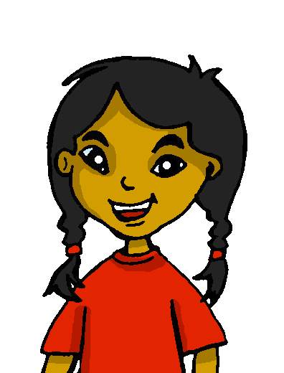
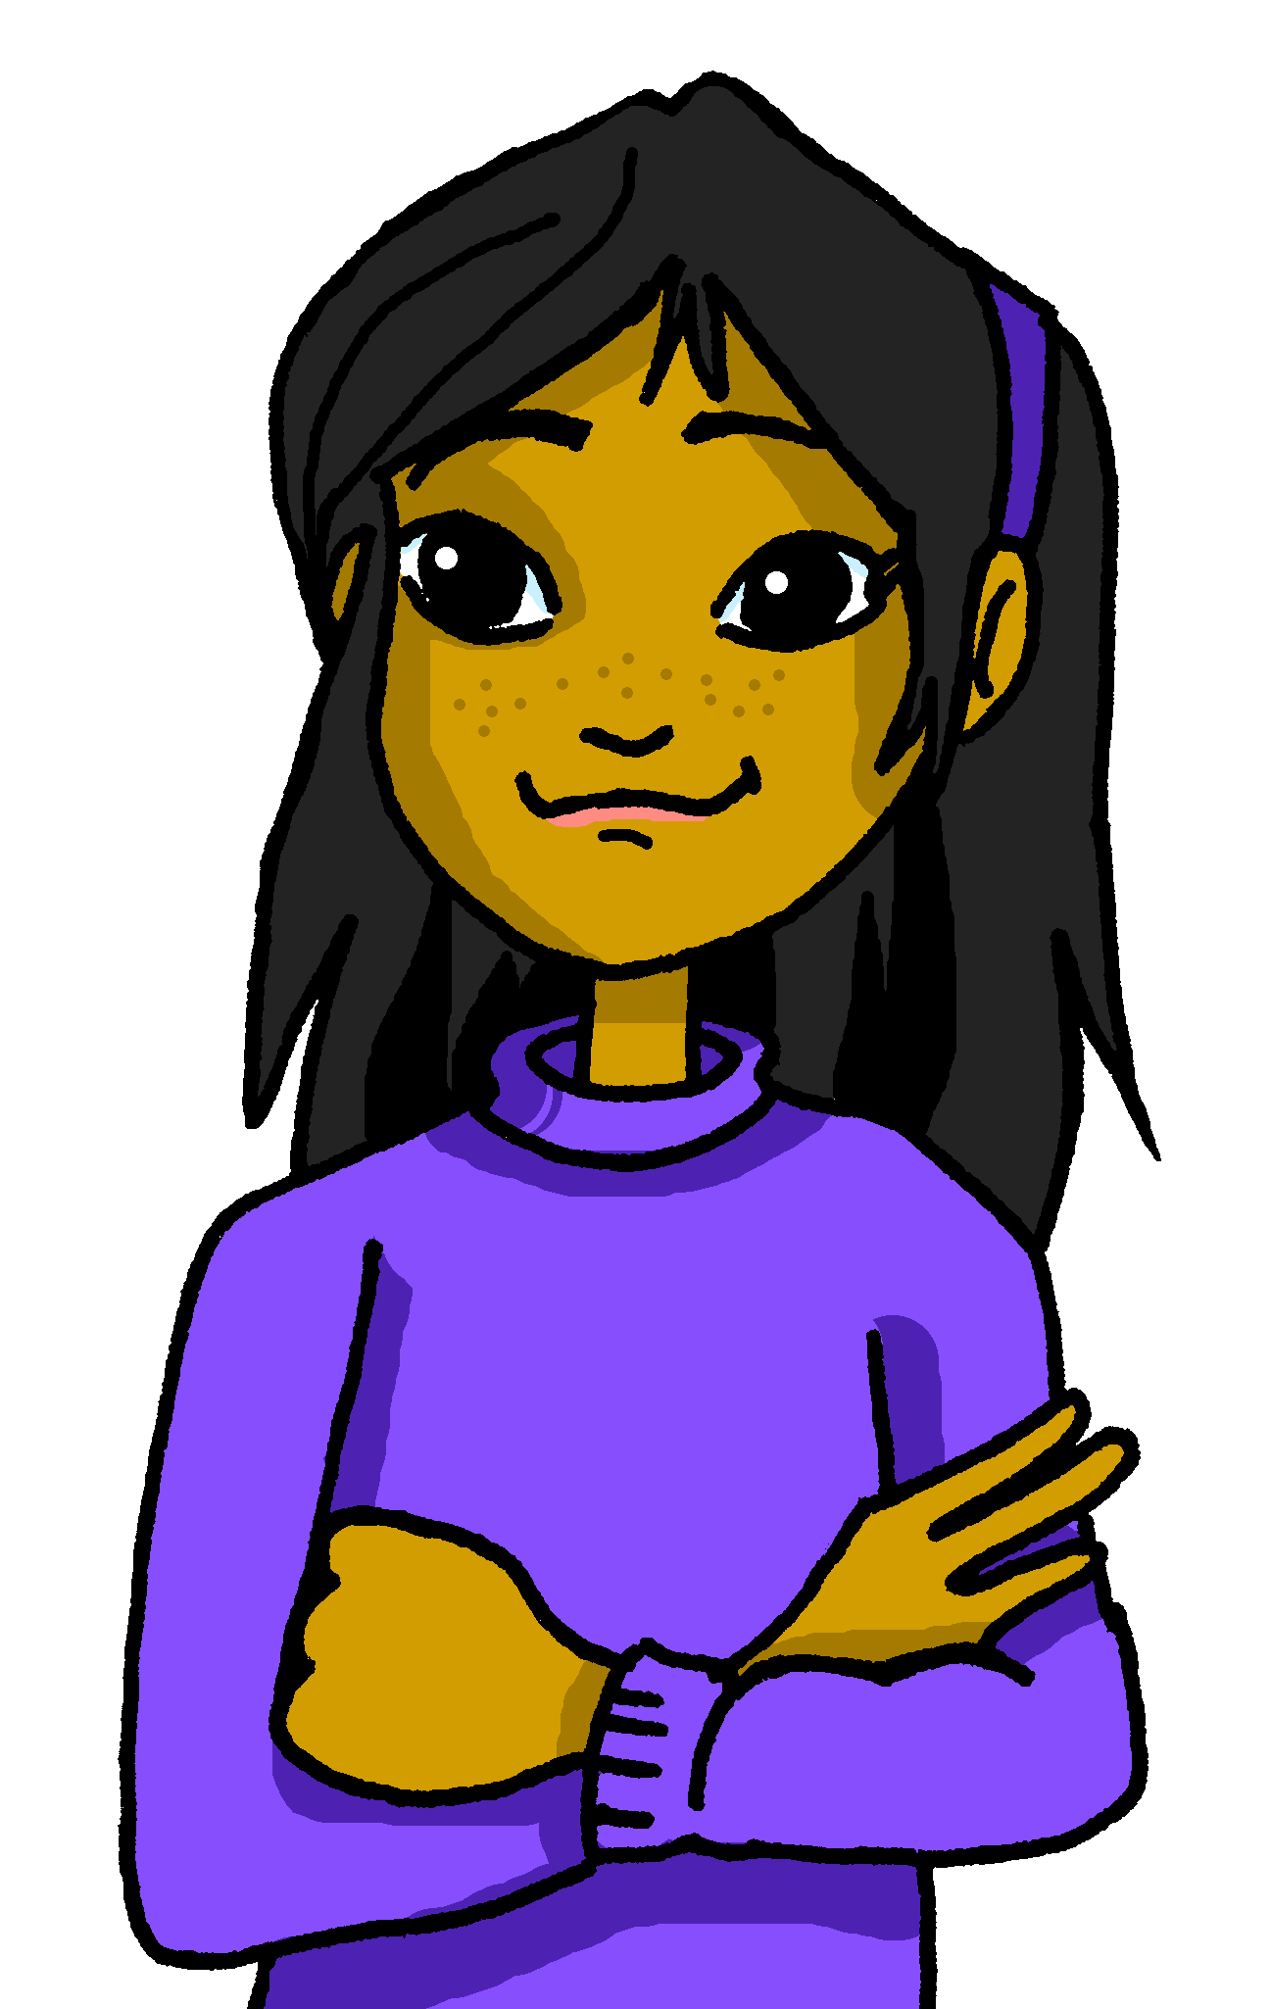


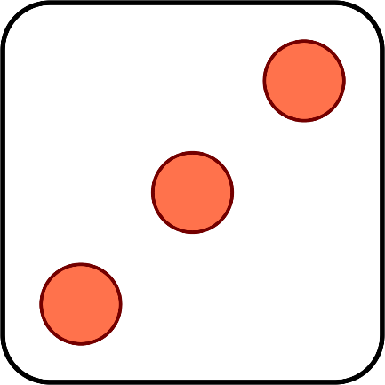
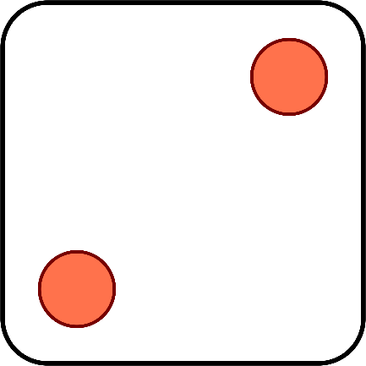


Follow up 4b:
Sofía y Ángela inventan un juego divertido.
¿Cuántos puntos* tienen en total? Habla en español.
hablar
catorce
trece
quince
dieciséis
diecisiete
dieciocho
veintitrés
veintiuno
el punto = point
Notes:
Timing: 2 minutes
Aim: to practise oral recall of numbers.
Procedure:
1. Click to ‘roll’ the dice Sofía and Elena.
2. Students say the total shown on the two dice in Spanish.
3. Click again to move on to the next number.
Word frequency of unknown words and cognates used (1 is the most frequent word in Spanish):
punto [189]
Source: Davies, M. and Davies, K. (2018). A frequency dictionary of Spanish: Core vocabulary for learners (2nd ed.). Routledge: London

Slide 12










Follow up 4b:
¿Qué número es?
Persona A: Lee el número.
Persona B: Lee el número.
escuchar
Persona B:
Persona A:
Escucha y escribe el número.
1
veinticinco
25
6
veintidós
22
pronunciar
2
treinta y uno
31
7
treinta
30
3
veintinueve
29
8
veinticuatro
24
4
veintiséis
26
9
veintisiete
27
5
veintiocho
28
10
veintitrés
23
Notes:
Time: 5 minutes
Aim: to practise reading aloud, understanding and transcribing cardinal numbers (22 -31).
Procedure:
1. Explain the task to pupils, using the Spanish instructions.
2. Pupil B turns away from the board with a pen and something to write on. They will just write the digits this time.
3. Click to bring up the first set of numbers. Pupil A reads the numbers slowly and carefully, one by one, repeating as necessary.
4. Pupil B writes down the 5 numbers, then turns back to face the board.
5. Teacher elicits numbers in Spanish from pupils chorally for additional read aloud practice, and click to reveal the number answers.
6. Pupils swap roles.
7. Repeat steps 2 – 5 with the 2nd set of numbers.
8. If required, teachers can click the number buttons to hear the numbers said by a native speaker.
Transcript:
veinticinco
treinta y uno
veintinueve
veintiséis
veintiocho
veintidós
treinta
veinticuatro
veintisiete
veintitrés

Slide 13




Follow up: 5

Escribe en inglés.
Can you get at least 15 points?
 | la oficina | debajo (de) | detrás (de)
 | el espacio | la goma | la lámpara
 | el recreo | tienen | tenemos
 | veintinueve | treinta | el patio
 | diecinueve | veinticuatro | veintiséis
 | siete | once | doce
(the) office
under
behind
vocabulario
x3
(the) space
(the) rubber
(the) lamp
(the) break
they have
we have
x2
(the) playground
twenty-nine
thirty
nineteen
twenty-five
twenty-six
x1
seven
eleven
twelve
Notes:
Timing: 5 minutes
Aim: to practise written production of vocabulary from this week and this week’s revisited sets.
Procedure:
1. Give pupils a blank grid. They fill in the English meanings of any of the words they know, trying to reach 15 points in total.
Note:
The most recently learnt and practised words are pink, words from the first revisit are green and those from the second revisit are blue, thus more points are awarded for them, to recognise that memories fade and more effort (heavy lifting!) is needed to retrieve them.

Slide 14
Follow up: 5

Escribe en español.
Can you get at least 15 points?
 | (the) office | under | behind
 | (the) space | (the) rubber | (the) lamp
 | (the) break | they have | we have
 | twenty-nine | thirty | (the) playground
 | nineteen | twenty-four | twenty-six
 | seven | eleven | twelve
la oficina
debajo (de)
detrás (de)
vocabulario
x3
el espacio
la goma
la lámpara
el recreo
tienen
tenemos
x2
veintinueve
treinta
el patio
diecinueve
veinticuatro
veintiséis
x1
siete
once
doce
Notes:
Timing: 5 minutes
Aim: to practise written production of vocabulary from this week and this week’s revisited sets.
Procedure:
1. Give pupils a blank grid. They fill in the Spanish meanings of any of the words they know, trying to reach 15 points in total.
Note:
The most recently learnt and practised words are pink, words from the first revisit are green and those from the second revisit are blue, thus more points are awarded for them, to recognise that memories fade and more effort (heavy lifting!) is needed to retrieve them.

Slide 15
Follow up: 5

Escribe en inglés.
Can you get at least 15 points?
 | la oficina | debajo (de) | detrás (de)
 | el espacio | la goma | la lámpara
 | el recreo | tienen | tenemos
 | veintinueve | treinta | el patio
 | diecinueve | veinticuatro | veintiséis
 | siete | once | doce
vocabulario
x3
x2
x1
Notes:
HANDOUT

Slide 16
Follow up: 5

Escribe en español.
Can you get at least 15 points?
 | (the) office | under | behind
 | (the) space | (the) rubber | (the) lamp
 | (the) break | they have | we have
 | twenty-nine | thirty | (the) playground
 | nineteen | twenty-four | twenty-six
 | seven | eleven | twelve
vocabulario
x3
x2
x1
Notes:
HANDOUT

