Slide 1

Saying what me and others do
azul
Follow ups 1-5
Notes:
Artwork by Steve Clarke. All additional pictures selected are available under a Creative Commons license, no attribution required.
The frequency rankings for words that occur in this PowerPoint which have been previously introduced in NCELP resources are given in the NCELP SOW and in the resources that first introduced and formally re-visited those words.
Phonics: revisit [que] [qui] paquete [2325] equipo [373]
Vocabulary (new words in bold): armario [5000] cosa [69] habitación [1069] piso [889] radio [933] televisión [825]
Revisit 1: aprender [428] beber [1085] comer [347] correr [343] hacer [26] leer [209] vender [528] ver [38] dinero [364] más [23]
Revisit 2: tienen [8] enorme [631] un poco [76] solo [181] bocadillo [>5000] clase [320] conejo [4728] cuaderno [3301] hermano [333] hermana [3409] lápiz [3740] libro [230] mochila [>5000] regla [1380] ventana [725] activo [1278] bonito [891] grande [66] nuevo [94] viejo [225] bastante [308] muy [43] de12 [2]
Glossed words: el ordenador [2624] mencionar [1102]
For any other words that occur incidentally in this PowerPoint, frequency rankings will be provided in the notes field wherever possible.
Source: Davies, M. and Davies, K. (2018). A frequency dictionary of Spanish: Core vocabulary for learners (2nd ed.). Routledge: London

Slide 2



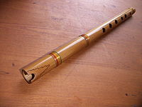
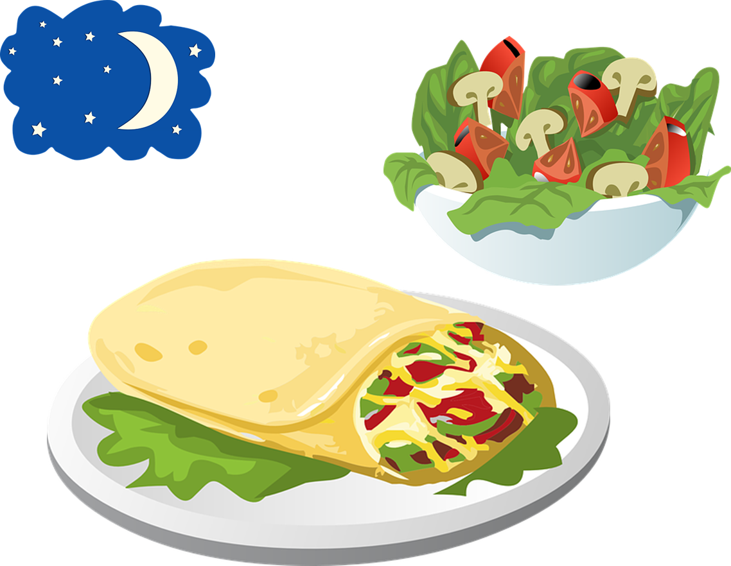
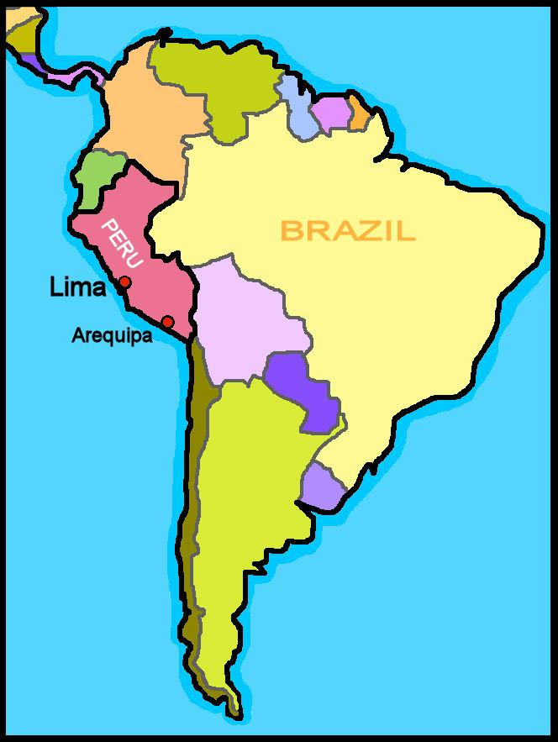
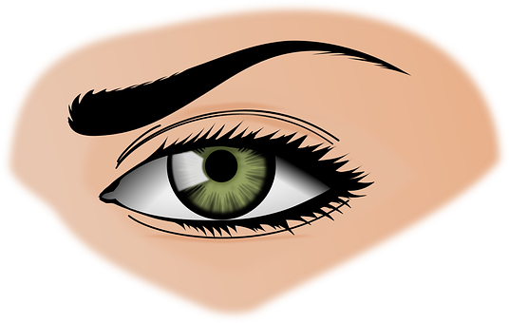



Follow up 1:
[A] Escucha y escribe el orden. ¿Es A B o B A? ✍.
escuchar
 | A|B B|A | A | B
cena
quena
1
A|B
quitar
citar
la quena
2
B|A
[I take off]
[to make a date]
quedo
cedo
3
B|A
[I keep]
[I cede]
ceja
queja
4
B|A
[complaint]
queso
ceso
5
A|B
[I stop]
cien
quién
6
B|A
Notes:
Timing: 5-6 minutes (two slides)
Aim: to practise que/qui in contrast with ci/ce
Procedure:
Pupils listen to each pair of words and decide which order they are spoken in A|B or B|A.
They write 1-6 and A|B or B|A.
Click each audio button to listen.
Click to reveal the correct order.
Frequency of unknown words:
ceder [1956] ceja [3700] cena [2542] cesar [2460] cien, ciento [440] citar [1440] quedar [100] quena [>5000] queja [1942] queso [3187] quitar [668]
Source: Davies, M. and Davies, K. (2018). A frequency dictionary of Spanish: Core vocabulary for learners (2nd ed.). Routledge: London

Slide 3
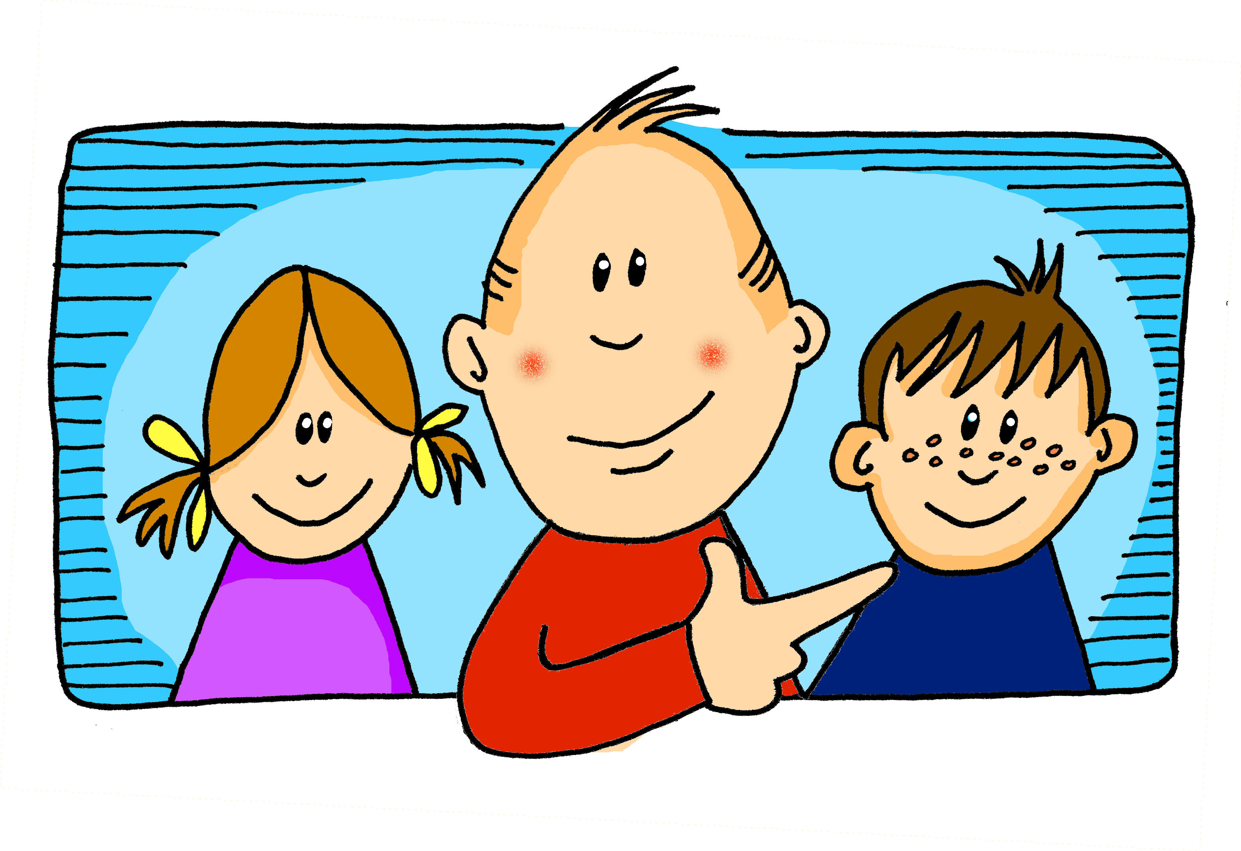
Follow up 1:
[A] Escucha a tu compañero/a y escribe ✍.
escuchar
quedo
cien
quién
quitar
ceso
la quena
cedo
dice
[says]
queja
queso
ceja
dique
citar
Notes:
Aim: to practise que/qui in contrast with ci/ce
Procedure:
Partner A sits with their back to the board whilst partner B reads aloud 3 words. Partner A writes the words.
Pupils check their spellings.
Partner then swap roles.
Teachers should circulate to listen to students’ pronunciation and praise/correct as necessary.

Slide 4




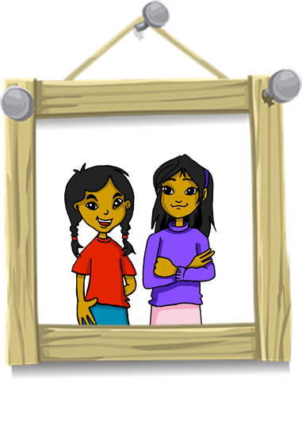
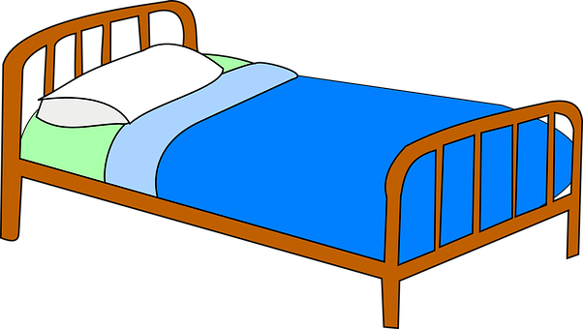
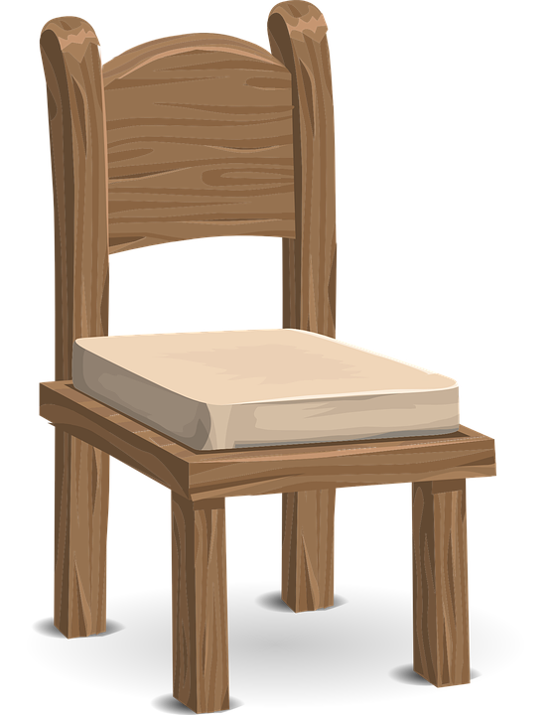
Follow up 2:
[A] Escribe “a/an” & “some”.
[B] Escribe el número.
Notice ‘televisión’ loses the accent in the plural form.
vocabulario
 | indefinite (a/an) | indefinite (some)
 | ____ cosa | ____ cosas
 | ____ televisión | ____ televisiones
 | ____ armario | ____ armarios
 | ____ cama | ____ camas
 | ____ ventana | ____ ventanas
 | ____ foto | ____ fotos
 | ____ silla | ____ sillas
E
una
unas
2
1
1
una
unas
4
E
E
E
2
un
unos
una
unas
[things]
E
3
Don’t forget ‘foto’is a feminine noun ☺
E
5
4
una
unas
E
5
una
unas
6
una
unas
3
E
E
6
Notes:
Timing: 5 minutes
Aim: to use the indefinite article (singular and plural) in written production, connecting words with meaning.
Procedure:
Part A
Pupils write down the correct form of the indefinite article (masculine / feminine, singular / plural).
Click to listen and check.
NB. Speech bubbles appear after #2 televisión to bring their attention to the spelling change (televisión → televisiones) and reminder of the gender of ‘foto’.
Teachers could draw pupils’ attention to the change of stress in televisión / televisiones. The former follows the stress 1 rule, whereas the latter follows stress 2 rule (Where there is no written accent, stress the penultimate syllable for any word ending in a vowel, ‘n’ or ‘s’).
Part 2 (connecting words with meaning)
Click to bring up instructions and pictures.
Teacher to elicit the Spanish word for the picture.

Slide 5

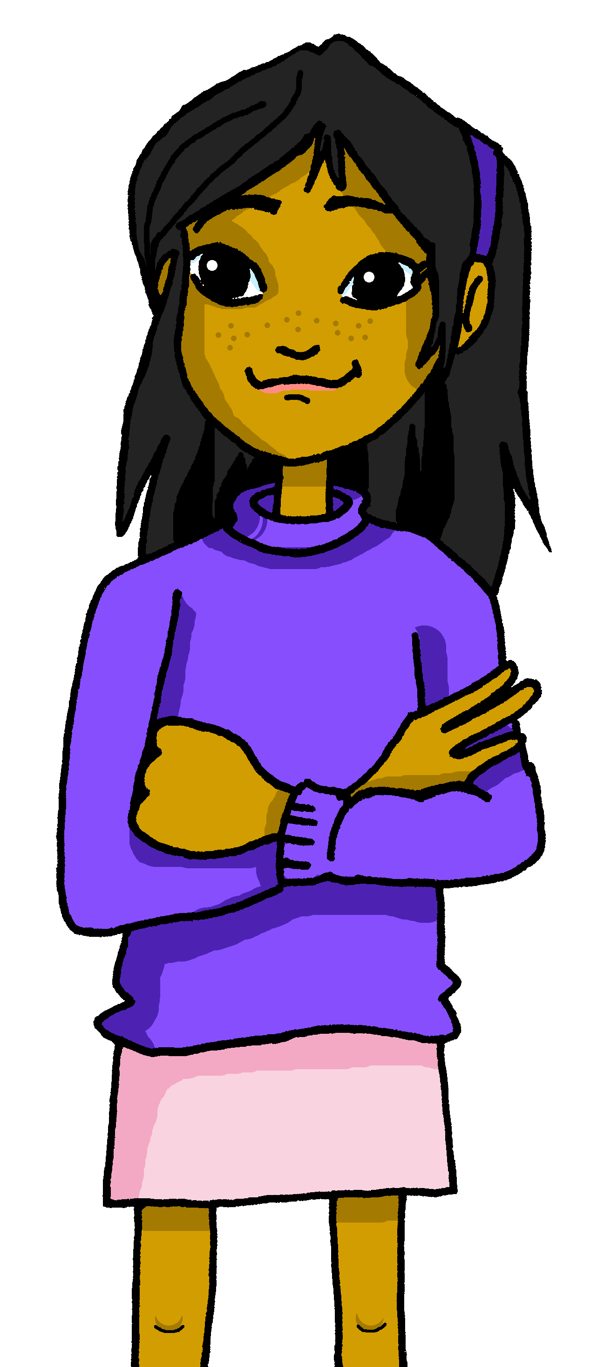


Follow up 3:
Asking about possession: tener
[I have; you have; do you have?; negative ‘no’]
We have already seen the verb tener means ‘to have’.
To say ‘I don’t’ have’, simply put ‘no’ before the verb. This makes a negative.
¿?
I
You (singular)
No tengo un gato.
¿Tienes un conejo, Elena?
I don’t have a cat.
Do you have a rabbit, Elena?
This works with any person of the verb
No, no tengo un conejo.
No, I don’t have a rabbit.
Notes:
Timing: 8 minutes (2 slides)
Aim: to revisit 1st and 2nd person singular of ‘tener’, including revisiting raised intonation for question formation and negation.
Procedure:
Read the grammar explanation on tener (to have).
Elicit English translation for the Spanish examples provided.

Slide 6


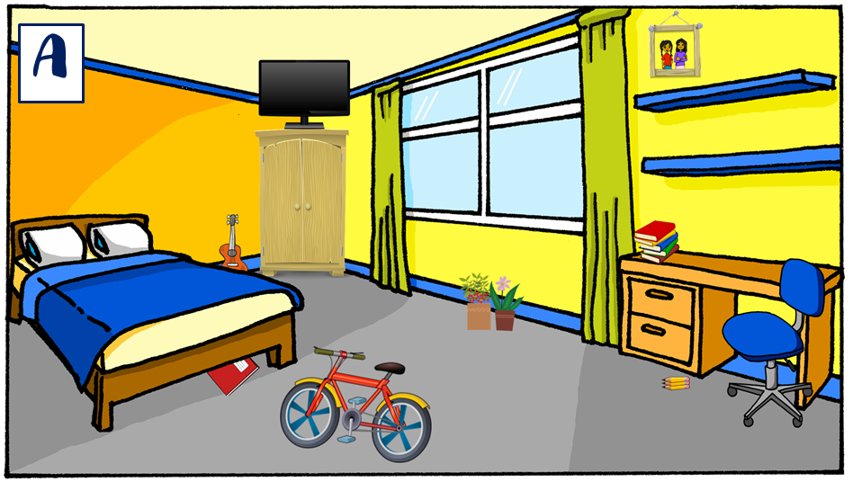
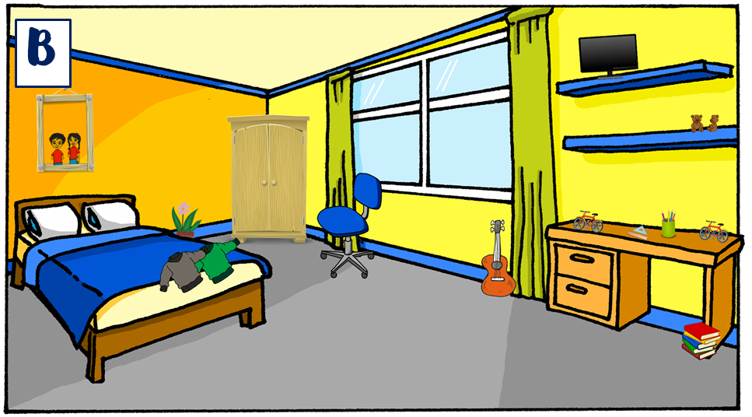
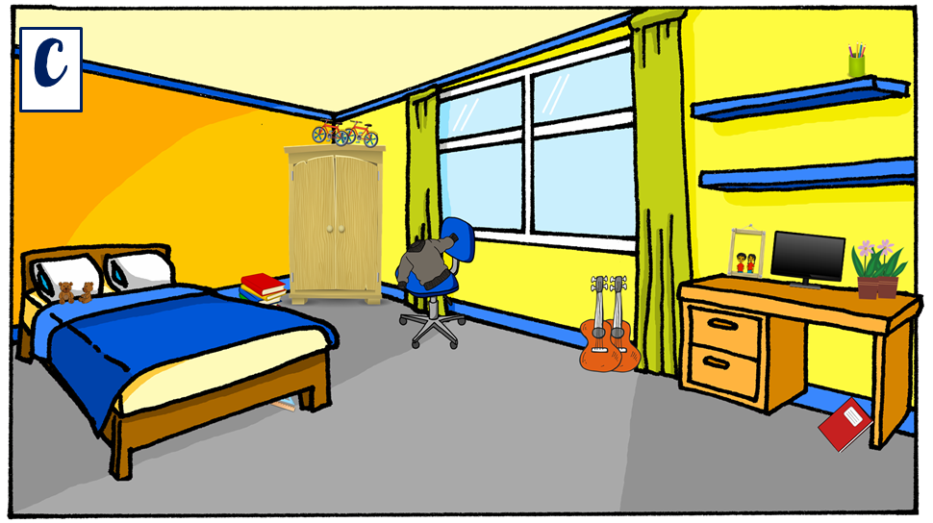
Follow up 3:
Pregunta y adivina la foto de tu compañero/a.
escuchar
hablar
Sí, tengo [some; a/an] [_____] en [my] habitación.
60
¿Tienes [some; a/an] [_____] en [your] habitación?
No, no tengo [some; a/an] [_____] en [my] habitación.
S
0
A
INICIO
Notes:
Timing: 8 minutes (Slide 1/2)
Aim: to use ‘tengo’ and ‘tienes’ in oral production, together with negation; indefinite articles.
Procedure:
Ask pupils to choose one picture (A, B or C), in secret.
Pupils take turns to find out their partner’s picture by asking ‘do you have ….?.
3. Click to bring up speech bubbles and model the dialogue. Insist on pupils answering in full sentences in order to practise negation with ‘tengo’.

Slide 7
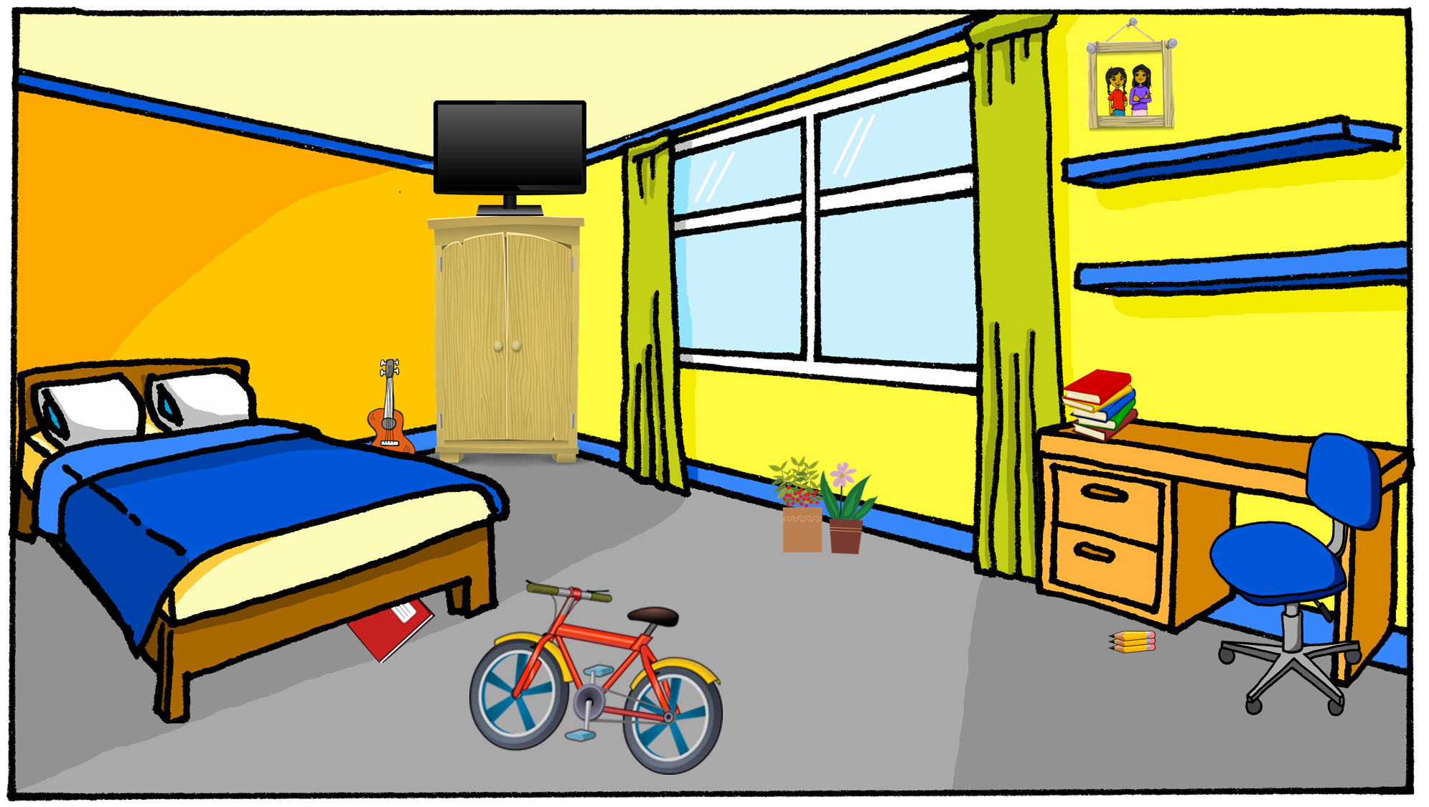
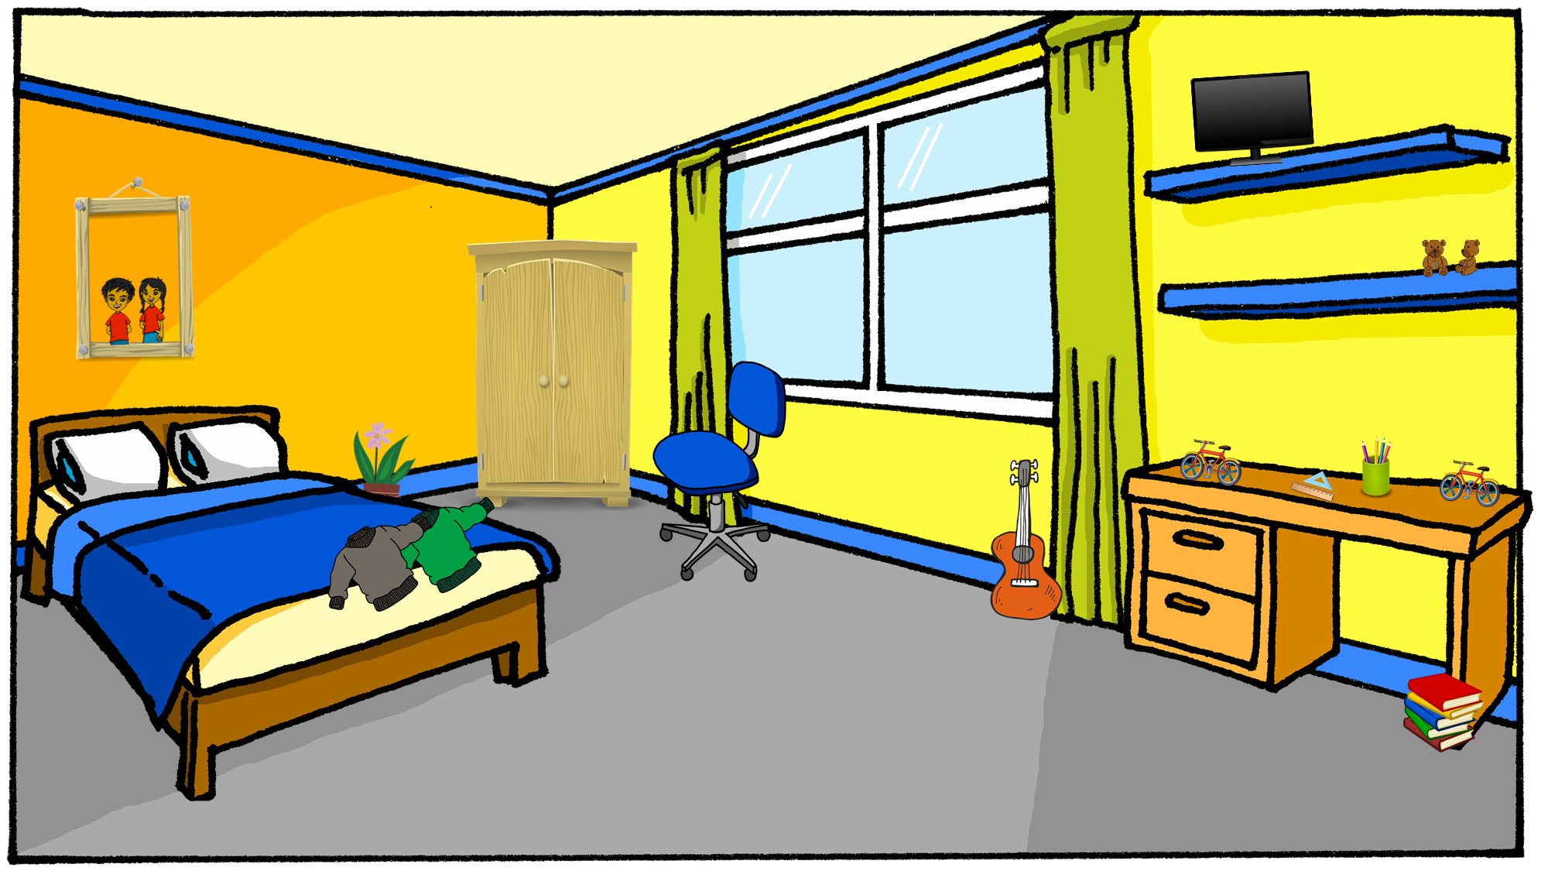
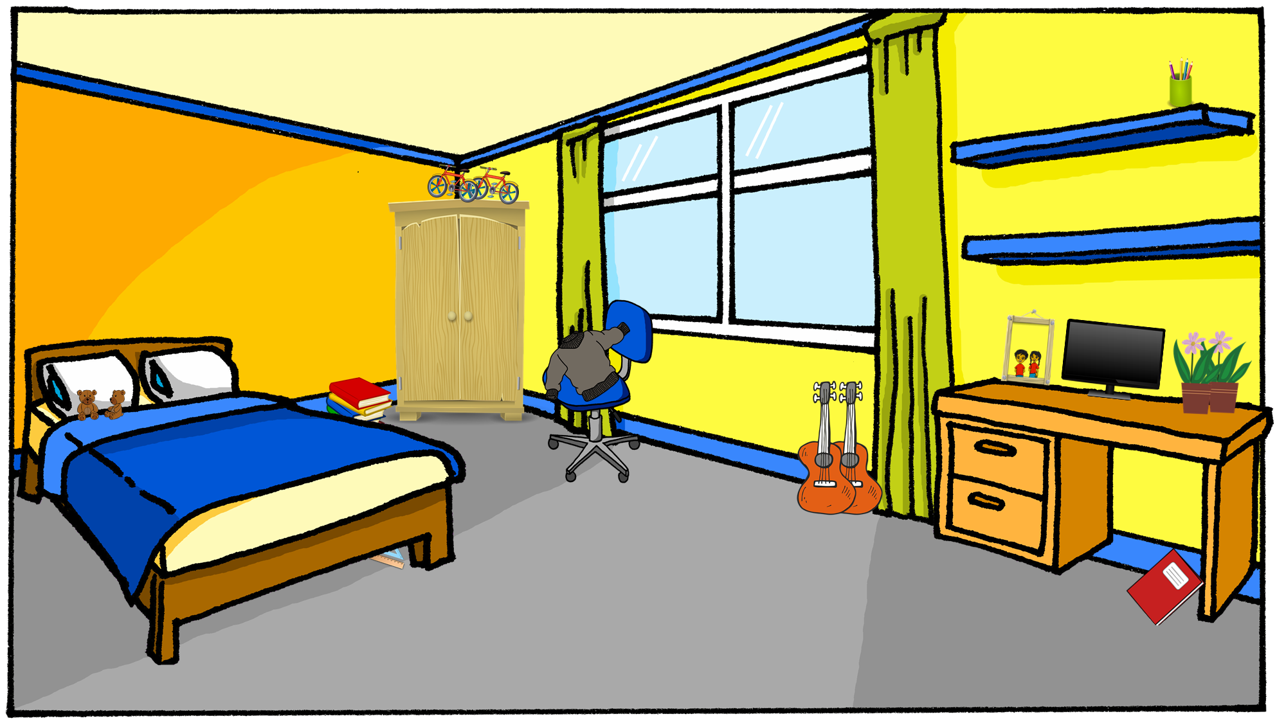
A
B
C

Slide 8


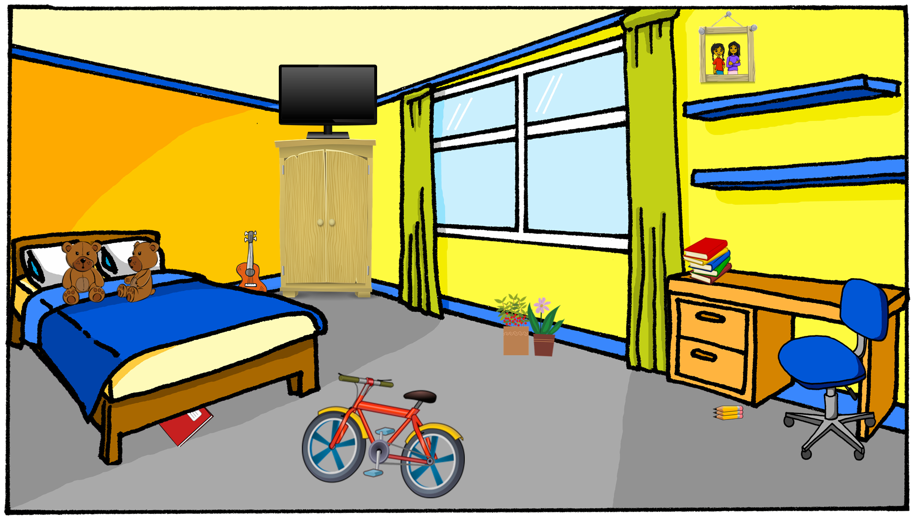
Follow up 4:
El ordenador* tiene un problema 😨.
Lee el mensaje con tu compañero/a.
Leer y hablar
¿Qué cosas menciona? ✍
Mi [h_b_t_c__n] es muy grande y
[it has] una [v_nt_n_]. En [my]
[room] [I have] [my] [c_m_] y [my] [_rm_r_ _]. También [I have] [my] [l_br_s] [and] [my] [pl_nt_s].
[Do you have] [your] [l_p_c_s] [there]?
habitación
tiene
ventana.
mi
habitación.
tengo
mi
cama
mi
armario
tengo
mis
libros
y
mis
plantas.
¿Tienes
tus
lápices
allí?
el ordenador = computer
mencionar = to mention, mentioning
Notes:
Timing: 6 minutes
Aim: oral practice of the key grammatical features of week 6 (tener, possessive adjectives).
Procedure:
Teacher to read the context and ensure this is clear.
Pupils to read the message aloud in pairs. Some words have gaps, some others are in English.
Elicit answers from pupils and click to bring up answers.
Click to listen to the full message, if desired.
Click to bring part 2 of the task to check understanding. Pupils can say the English words for the items mentioned in the e-mail aloud (animations appear on click from left to right, in the order they are mentioned in the text).
Frequency of unknown words:
ordenador [2624] mencionar [1102]
Source: Davies, M. and Davies, K. (2018). A frequency dictionary of Spanish: Core vocabulary for learners (2nd ed.). Routledge: London

Slide 9



Follow up: 5

Escribe en inglés.
Can you get at least 15 points?
 | un poco | solo | la clase
 | tener | tiene | enorme
 | vender | el dinero | más
 | beber | comer | correr
 | el piso | la radio | la televisión
 | el armario | la cosa | la habitación
a bit, a little
only
(the) class
vocabulario
x3
to have, having
s/he, it has
enormous
to sell, selling
(the) money
more
x2
to eat, eating
to run, running
to drink, drinking
(the) flat
(the) radio
(the) television
x1
(the) wardrobe
(the) thing
(the) room
Notes:
Timing: 5 minutes
Aim: to practise written production of vocabulary from this week and this week’s revisited sets.
Procedure:
1. Give pupils a blank grid. They fill in the English meanings of any of the words they know, trying to reach 15 points in total.
Note:
The most recently learnt and practised words are pink, words from the first revisit are green and those from the second revisit are blue, thus more points are awarded for them, to recognise that memories fade and more effort (heavy lifting!) is needed to retrieve them.

Slide 10
Follow up: 5

Escribe en español.
Can you get at least 15 points?
 | a bit | only | (the) class
 | to have, having | s/he, it has | enormous
 | to sell, selling | (the) money | more
 | to drink, drinking | to eat, eating | to run, running
 | (the) flat | (the) radio | (the) television
 | (the) wardrobe | (the) thing | (the) room
un poco
solo
la clase
vocabulario
x3
tener
tiene
enorme
vender
el dinero
más
x2
beber
comer
correr
el piso
la radio
la televisión
x1
el armario
la cosa
la habitación
Notes:
Timing: 5 minutes
Aim: to practise written production of vocabulary from this week and this week’s revisited sets.
Procedure:
1. Give pupils a blank grid. They fill in the Spanish meanings of any of the words they know, trying to reach 15 points in total.
Note:
The most recently learnt and practised words are pink, words from the first revisit are green and those from the second revisit are blue, thus more points are awarded for them, to recognise that memories fade and more effort (heavy lifting!) is needed to retrieve them.

Slide 11
Follow up: 5

Escribe en inglés.
Can you get at least 15 points?
 | un poco | solo | la clase
 | tener | tiene | enorme
 | vender | el dinero | más
 | beber | comer | correr
 | el piso | la radio | la televisión
 | el armario | la cosa | la habitación
vocabulario
x3
x2
x1
Notes:
HANDOUT

Slide 12
Follow up: 5

Escribe en español.
Can you get at least 15 points?
 | a bit | only | (the) class
 | to have, having | s/he, it has | enormous
 | to sell, selling | (the) money | more
 | to drink, drinking | to eat, eating | to run, running
 | (the) flat | (the) radio | (the) television
 | (the) wardrobe | (the) thing | (the) room
vocabulario
x3
x2
x1
Notes:
HANDOUT

