Slide 1


español, con Quique

Slide 2

Saying what I and others do
azul
-AR verbs: s/he, it & they
Stress patterns 2 and 3
Notes:
Artwork by Steve Clarke. All additional pictures selected are available under a Creative Commons license, no attribution required.
The frequency rankings for words that occur in this PowerPoint which have been previously introduced in the resources are given in the SOW (excel document) and in the resources that first introduced and formally re-visited those words.
Phonics: Stress 3 - amor [283] feroz [4988] profesional [682]
Vocabulary (new words in bold): ayudar [328] limpiar [1713] tocar [327] trabajar [174] cocina [1214] guitarra [2705] vaca [2775] de [2] dentro [548] fuera [299]
Revisit 1: aprender [428] comprender [434] hacer [26] leer [209] poner [91] responder [464] vencer [1426] actividad [344] cultura [469] juego [409] miedo [491] país [109] pregunta [507] prueba [651] revista [920] texto [753] vocabulario [>5000] con [14] sobre [62]
Revisit 2: tiene [tener 19] tienes [tener 19] bocadillo [>5000] botella [1878] casa [106] cuaderno [3301] gato [1728] libro [230] mentira [1673] mochila [>5000] pegamento [>5000] pelota [2270] pregunta [507] verdad [176] nuevo [94] viejo [225] pero [30] también [49] y [4] unos, unas [6]
Glossed: sueño [460] granja [>5000]
Source: Davies, M. & Davies, K. (2018). A frequency dictionary of Spanish: Core vocabulary for learners (2nd ed.). Routledge: London
For any other words that occur incidentally in this PowerPoint, frequency rankings will be provided in the notes field wherever possible.
Corregir [2351]

Slide 3





pronunciar
Stress 2
We have learned to stress the penultimate syllable (second to last) for any word ending in a vowel, ‘n’ or ‘s’, where there is no written accent.
pasado
[past]
nunca
[never]
orden
[order]
casas
[houses]
Stress 3
For all other words, stress the final syllable.
amor
profesional
feroz
verdad
[truth]
[love]
[ferocious]
Notes:
Timing: 2 minutes
Aim: to recap one rule of stress without written accents and introduce the other.
Procedure:
Read the explanation.
Introduce the example words to exemplify the rule.

Slide 4
pronunciar
Pronuncia en parejas.
unos
vencer
bocadillo
verdad
60
actividad
responder
pregunta
revista
aprender
tenemos
profesional
feroz
mentira
sobre
amor
tener
0
INICIO
Notes:
Timing: 3 minutes
Aim: to practise Stress 2 and Stress 3 pronunciation
Procedure:
Pupils work in pairs to pronounce as many Stress 2 words as they can in 60 seconds.
Click on ‘inicio’ to start the timer.
Pupils then practise pronunciation of stress 3 words in pairs.
Pupils could do this activity as a competitive game, in which the listening pupil checks the speaking pupils’ pronunciation, and if s/he selects and says a word from the wrong category, s/he is sent back to the beginning to start again.
Click to highlight 12 words from this week’s revisiting sets and elicit English meanings.
Alternatively, or additionally, prompt students to recall the Spanish by prompting with English meanings of these 12 words. E.g. ¿Cómo se dice ‘question’ en español?
NB. Most of these words have been previously taught and are being revisited this week.

Slide 5


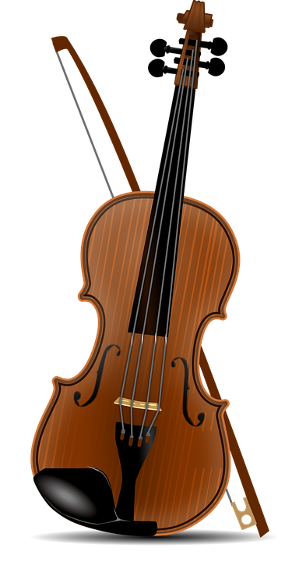
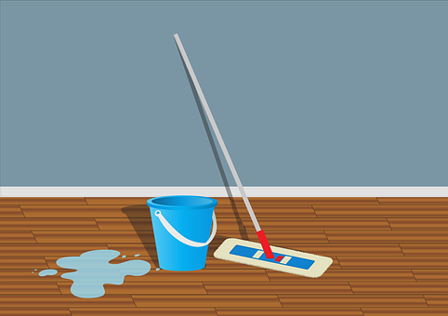
vocabulario
Escucha y repite. 🗣
limpiar
t_ _ _ r
_y_d_r
limpiar
ayudar
l_mp_ _r
tocar
ayudar
tocar
[to help, helping]
[to clean, cleaning]
[to touch, play (instrument)]
Notes:
Timing: 5 minutes (two slides)
Aim: to introduce key vocabulary for this week.
Procedure:
1.Teacher introduces items one by one (word, then picture and English) and pupils practise pronunciation aloud.
Alternatively, pupils work in pairs, reading the Spanish words out loud and looking at the English meanings (1 minute).
2. Then the teacher removes the English words and pictures (one by one) and pupils try to recall the English orally (chorally), looking at the Spanish (1 minute).
3. Teacher removes Spanish word and elicits Spanish from pupils. (The word is replaced with a gapped version).
NB. Further rounds of learning can be facilitated by one pupil turning away from the board, and his/her partner asking him/her the meanings (‘Cómo se dice X en español?’). This activity can work from L2 → L1 or L1 → L2.

Slide 6
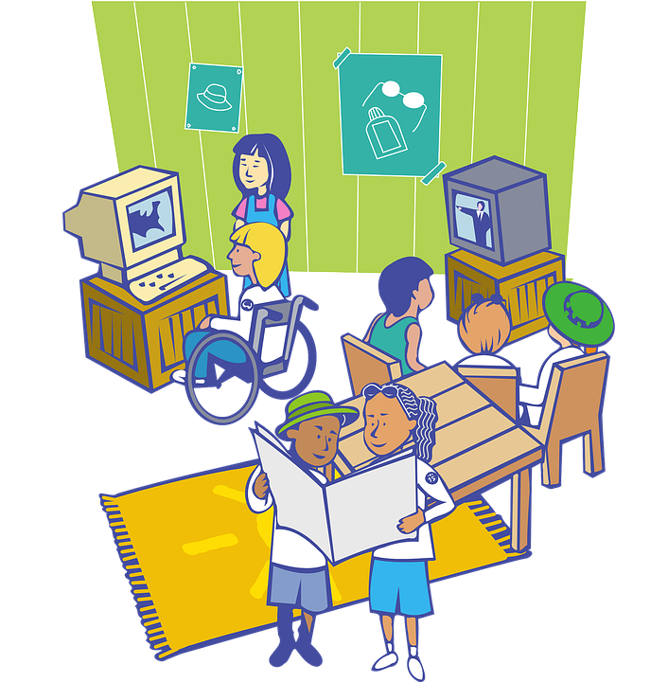


vocabulario
Escucha y repite. 🗣
f _ _ r_
d_ _ t_ _
fuera
la vaca
dentro
fuera
l_ v_ _ a
dentro
la vaca
[cow]
[inside, indoors]
[outside, outdoors]
Notes:
Timing: 5 minutes (two slides)
Aim: to introduce key vocabulary
Procedure:
1.Teacher introduces items one by one (word, picture, English) & pupils practise pronunciation aloud.
Alternatively, pupils work in pairs, reading the Spanish words out loud and looking at the English meanings (1 minute).
2. Then the teacher removes the English words or pictures (one by one) and pupils try to recall the English orally (chorally), looking at the Spanish (1 minute).
3. Teacher removes Spanish word + picture and elicits Spanish from pupils.
NB. Further rounds of learning can be facilitated by one pupil turning away from the board, and his/her partner asking him/her the meanings (‘Cómo se dice X en español?’). This activity can work from L2 → L1 or L1 → L2.

Slide 7

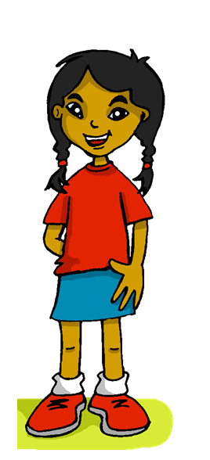



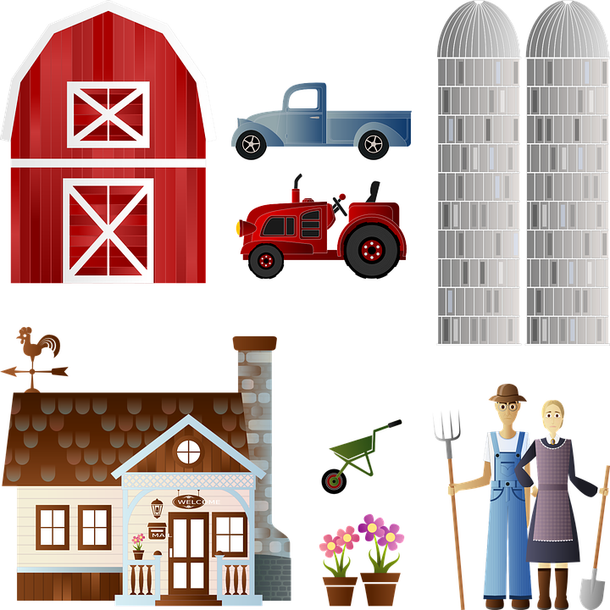
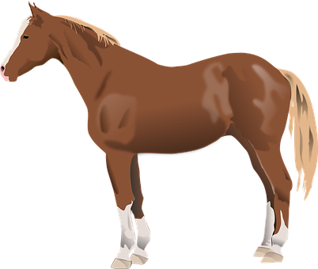
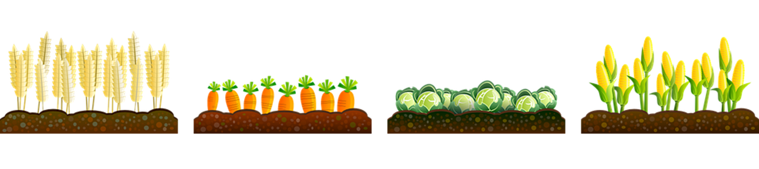
leer
Sofía está en la cama y tiene un sueño raro.
Está en una granja*.
el sueño = dream
la granja = farm
Notes:
Timing: 1 minute
Aim: to set the scene for this week’s lesson, Sofía’s dream; and to revisit the vocabulary caballo, casa and vaca (new this week).
Procedure:
1. Read the title and ensure understanding.
2. Click to bring up the horse and elicit the Spanish, prompting ‘¿Qué es? → un caballo, sí. ‘¿Qué es? → una vaca. ‘¿Qué es? → una casa.
Frequency of unknown words and cognates:
granja [>5000] sueño [460]
Source: Davies, M. & Davies, K. (2018). A frequency dictionary of Spanish: Core vocabulary for learners (2nd ed.). Routledge: London

Slide 8

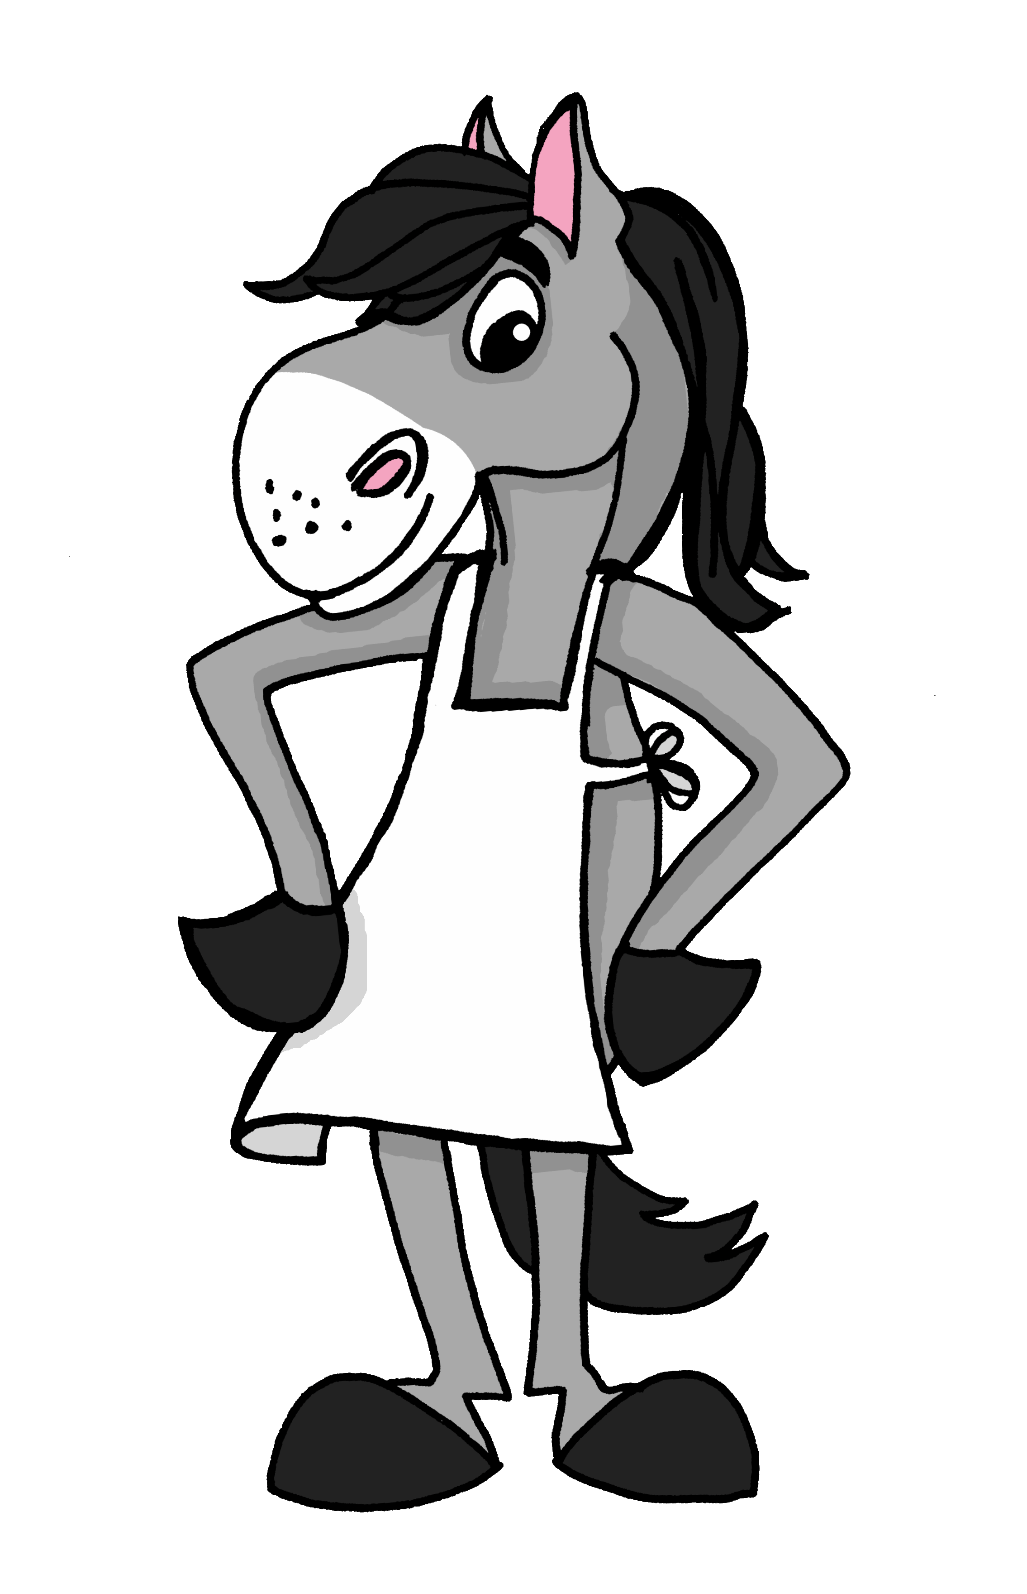
leer
Sofía tiene un sueño* 😴 muy raro.
el sueño = dream
guitar
cleans
things
horse
la guitarra
limpia
cosas
el caballo
En el sueño de Sofía hay cosas muy raras. Está en una granja con la abuela Valeria. En la granja hay animales: una vaca y un caballo. Sofía no comprende el sueño: ¿la vaca toca la guitarra? ¿El caballo limpia la cocina?
plays
grandma
kitchen
cow
toca
la abuela
la cocina
la vaca
Notes:
Timing: 5 minutes
Aim: to set the scene for this week’s lesson; to practise written comprehension of previously taught vocabulary and this week’s new words,
Procedure:
Pupils read the text aloud with teacher support, as needed.
Click on Sofía to hear an audio version of the text, if desired.
3. Pupils focus on the English words and identify the Spanish words from the bold words in the text. Pupils can volunteer answers in any click – teacher clicks on the English word and the Spanish translation appears.
4. Teachers elicit an oral translation of the text from the class to establish the context of this week’s lesson.

Slide 9


Knowing who does what
[–ar verbs: ‘S/he,it’ vs. ‘they’]
To mean ‘S/he, it’ with a verb, we remove –ar and add -a.
To mean ‘they’ with a verb, we remove –ar and add –an.
S/he, it
they
Ayuda en la cocina.
Ayudan en la cocina.
S/he helps in the kitchen.
They help in the kitchen.
Notes:
Timing: 3 minutes
Aim: to introduce 3rd person plural for–ar verbs and revisit 3rd person singular.
Procedure:
Click through the animations to present the new information.
Elicit English translations for the Spanish examples provided.

Slide 10

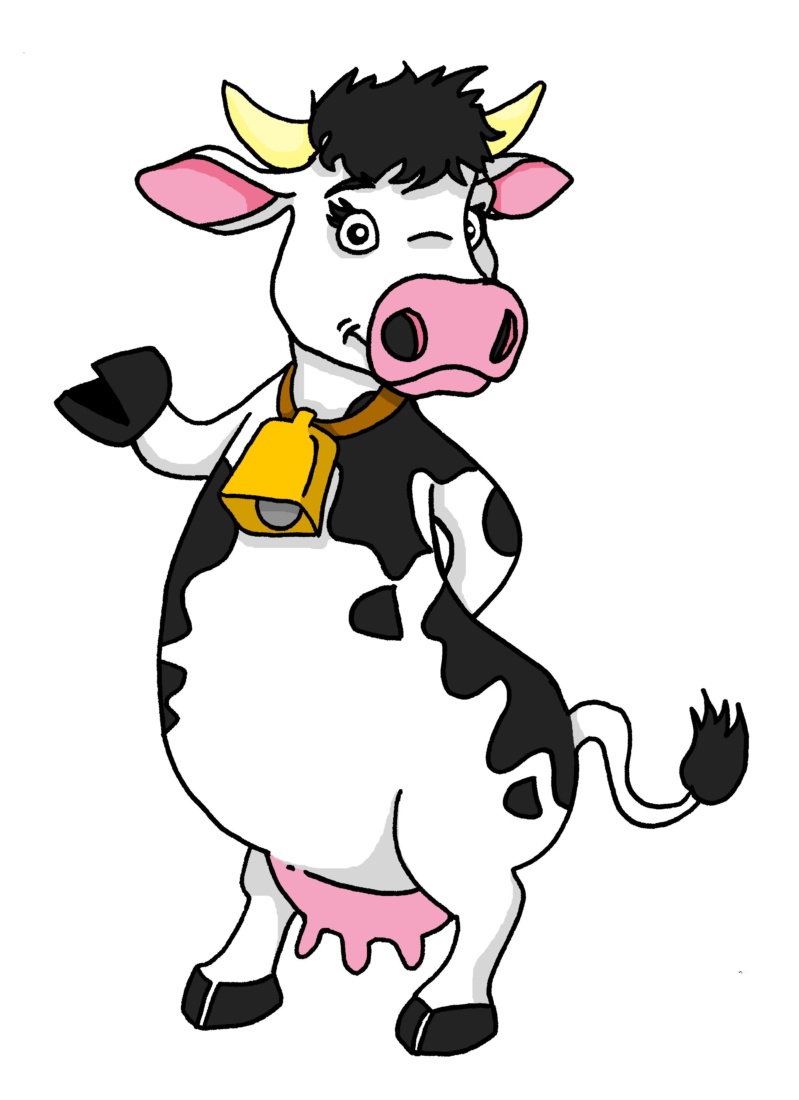
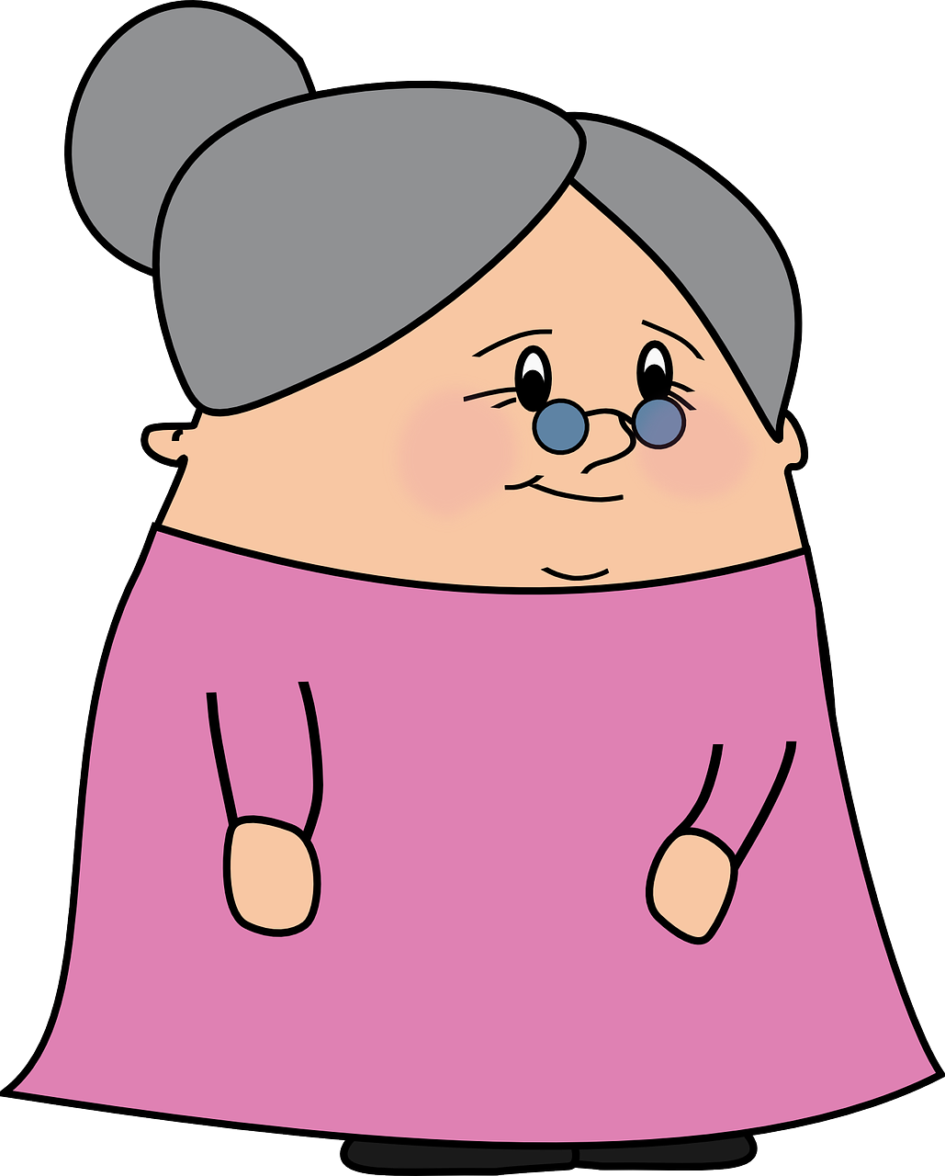
escuchar
En el sueño* 😴 de Sofía hay cosas raras.
¿Quién es? ¿Es Valeria (she) o la vaca y el caballo (they)?
Marca
 | Valeria | la vaca y el caballo
Información extra
E
con las flores
1
la cocina
2
pollo asado
3
el violín
4
fuera
5
dentro
el sueño = dream
Notes:
Timing: 5 minutes (2 slides)
Aim: to practise aural identification of 3rd person singular and plural based on the verb ending.
Part 1
Procedure:
1. Ensure pupils are clear about the task.
2. Click to play the example. Ask pupils to tick Valeria (she) or ‘la vaca y el caballo’ (they).
3. Click to reveal the answer.
4. Play 1-5 and pupils complete.
5. Click to reveal answers.
NB. Meaning will be checked in Part 2 of this task.
Transcript:
[E] Ayuda con las flores.
[1] Limpian la cocina.
[2] Cocina pollo asado.
[3] Tocan el violín.
[4] Bailan fuera.
[5] Limpia dentro.
Frequency of unknown words and cognates:
sueño [460] violín [>5000]
Source: Davies, M. & Davies, K. (2018). A frequency dictionary of Spanish: Core vocabulary for learners (2nd ed.). Routledge: London

Slide 11
leer
Lee y escribe las frases en inglés.
Sofía wants to tell Krina about her dream. Can you help her?
 | Ayuda con las flores.
 | Limpian la cocina.
 | Cocina pollo asado.
 | Tocan el violín.
 | Bailan fuera.
 | Limpia dentro.
____ _______ _____ ___ ________.
____ _______ _____ ________.
____ _______ _____ ________.
____ _______ ___ ________.
____ _______ ________.
____ _______ ________.
E
She helps with the flowers
1
They clean the kitchen
2
She cooks roast chicken
3
They play the violin
4
They dance outside
5
She cleans inside
Notes:
Timing: 5 minutes
Aim: to practise written comprehension of present tenses sentences in 3rd persons singular and plura.
Part 2
Procedure:
Click to bring up the two callout explanations.
Do the example together.
Pupils write translations for 1-5.
Click to play the full question audio and elicit question meanings in English from pupils.
Click to reveal answers.

Slide 12


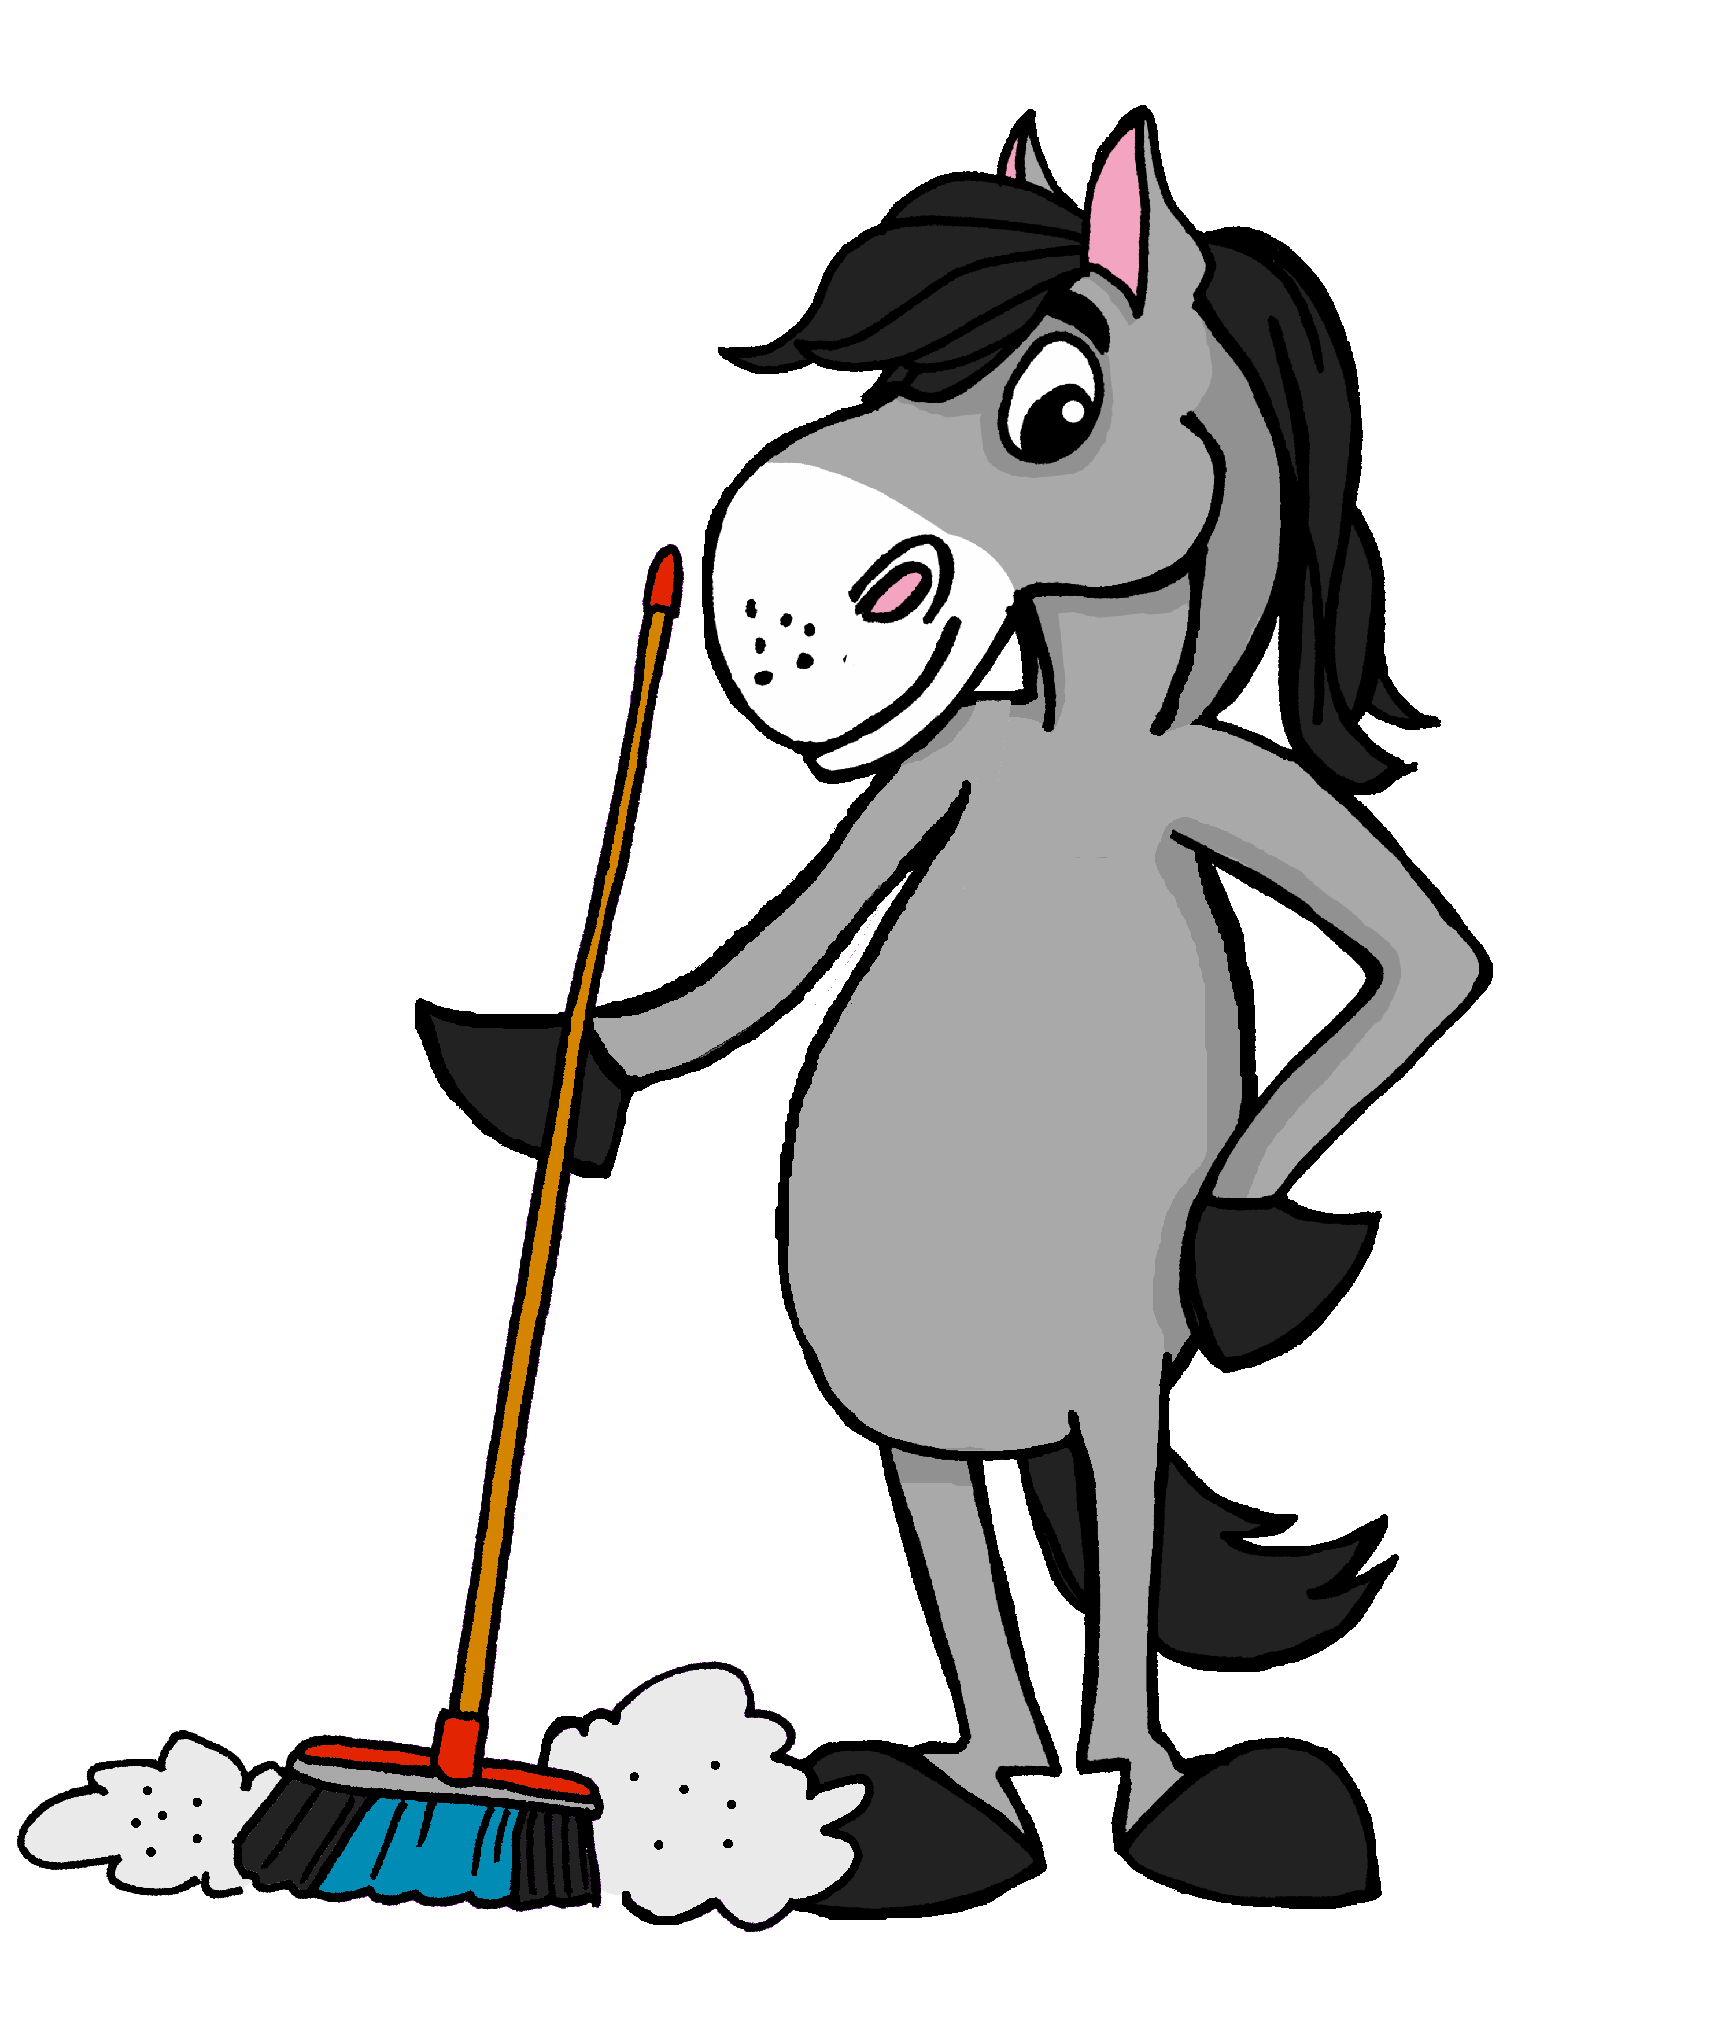
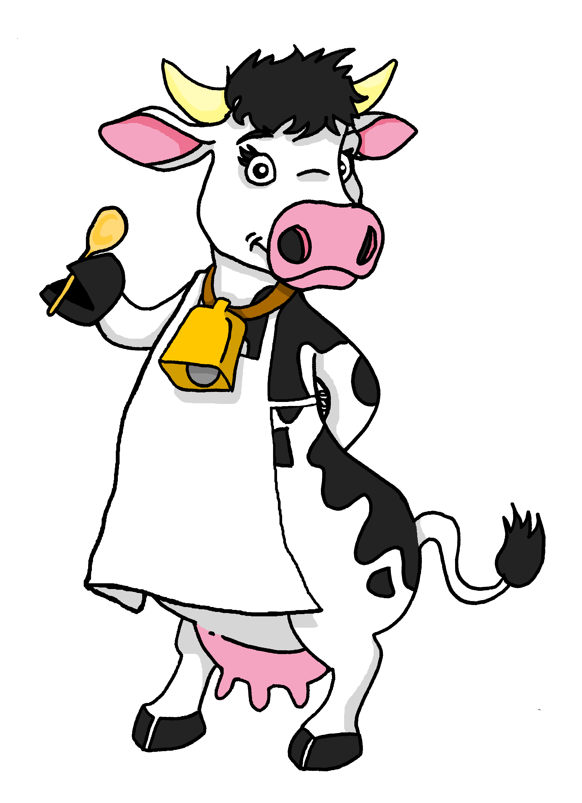
hablar
Lee las frases.
Con tu compañero/a, reacciona.
¡Es posible!
Ayuda con las flores.
Limpian la cocina.
Cocina pollo asado.
Tocan el violín.
Bailan fuera.
Limpia dentro.
60
¡Es imposible!
S
0
INICIO
Notes:
Timing: 3 minutes
Aim: to practise reading aloud of newly introduced and revisited vocabulary and processing the sentences for meaning.
Procedure:
Pupil take turns to read the sentences and react to them according to whether they are likely in real life.
Model the task using E.
Ensure that pupils understand the premise of the activity.
Given them 1 minute to say all 6 statements and react, working in pairs.
Time allowing, the teacher can elicit whole class choral responses to verify pupils’ reactions and judge their confidence in understanding.
Frequency of unknown words and cognates:
posible [427]
Source: Davies, M. & Davies, K. (2018). A frequency dictionary of Spanish: Core vocabulary for learners (2nd ed.). Routledge: London

Slide 13
¡adiós!
azul

