Slide 1
Saying what I and others do
azul
Follow ups 1-5
Notes:
Artwork by Steve Clarke. All additional pictures selected are available under a Creative Commons license, no attribution required.
The frequency rankings for words that occur in this PowerPoint which have been previously introduced in NCELP resources are given in the NCELP SOW and in the resources that first introduced and formally re-visited those words.
Phonics: Stress 3 - amor [283] feroz [4988] profesional [682]
Vocabulary (new words in bold): ayudar [328] limpiar [1713] tocar [327] trabajar [174] cocina [1214] guitarra [2705] vaca [2775] de [2] dentro [548] fuera [299]
Revisit 1: aprender [428] comprender [434] hacer [26] leer [209] poner [91] responder [464] vencer [1426] actividad [344] cultura [469] juego [409] miedo [491] país [109] pregunta [507] prueba [651] revista [920] texto [753] vocabulario [>5000] con [14] sobre [62]
Revisit 2: tiene [tener 19] tienes [tener 19] bocadillo [>5000] botella [1878] casa [106] cuaderno [3301] gato [1728] libro [230] mentira [1673] mochila [>5000] pegamento [>5000] pelota [2270] pregunta [507] verdad [176] nuevo [94] viejo [225] pero [30] también [49] y [4] unos, unas [6]
For any other words that occur incidentally in this PowerPoint, frequency rankings will be provided in the notes field wherever possible.
Source: Davies, M. and Davies, K. (2018). A frequency dictionary of Spanish: Core vocabulary for learners (2nd ed.). Routledge: London

Slide 2
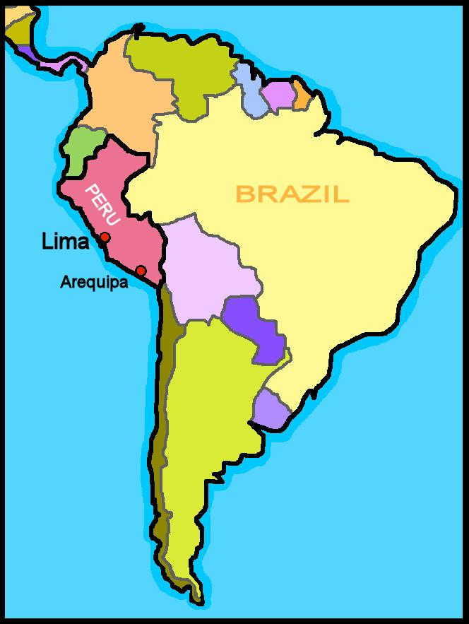
Follow up 1:
[Stress]
Escucha y ordena las sílabas.
escuchar
¿Dónde está el estrés?
Colorea la sílaba en rojo.
We capitalise countries in Spanish, but not languages.
Muchas personas hablan [1] por todo el mundo.
En [2] el español es el idioma [3] en España.
En América Latina [4] español en [5] , [6] ,[7] El y muchos países más.
En [8] no hablan español, hablan portugués.
es
pa
pa
es
ñol
ñol
Eu
ro
ro
eu
pa
pa
o
fi
fi
o
cial
cial
blan
ha
blan
ha
le
¡hola!
Chi
chi
le
Ar
gen
gen
ti
Ar
na
ti
na
va
dor
Sal
sal
va
dor
sil
bra
Bra
sil
Notes:
Timing: 6 minutes (2 slides)
Aim: to revisit stress patterns 2 and 3 in the context of Spanish speaking countries.
Procedure:
Clarify the task, pupils number 1-8 in their books.
Click to play the first sentence to do number 1 as an example.
Click to provide the answer (the individual words appear with audio).
Click to bring up the callout about capitalisation.
Click to play sentences 2,3,4 and pupils write their answers.
Teachers can elicit the answers orally from pupils chorally by number, to check their correct production of the stress pattern. Click to bring up the answer after each pupil elicitation.
Elicit an oral translation of the text to ensure understanding of the text information.
Note: for greater stretch and challenge, ask pupils to decide where the stress falls by applying rules 2 and 3 first, and then use the audio as a listen and check activity.

Slide 3
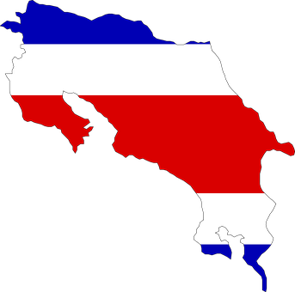
Follow up 1:
[Stress]
Pronuncia los países en parejas.
pronunciar
60
Colombia
Bolivia
Ecuador
Uruguay
Costa Rica
Paraguay
El Salvador
Honduras
0
INICIO
Notes:
Timing: 2-3 minutes
Aim: to practise oral production of and distinction between stress patterns 2 and 3, in the context of Latin American countries.
Procedure:
Click to highlight the syllabification of each country and elicit the pronunciation from pupils, chorally.
Bring up the instruction to work in pairs and click the timer.
Pupils should work together to try to pronounce each country accurately, paying attention to the two different stress patterns.
Click again to remove all the visual syllabification support and repeat the task.
Note: click on the country image to hear each country pronounced, as required.

Slide 4
Follow up 2:

Escribe en inglés. Can you get at least 15 points?
 | nueva | unos | unas
 | también | el pegamento | viejo
 | la mentira | el bocadillo | la verdad
 | el miedo | la prueba | sobre
 | poner | vencer | la cultura
 | la vaca | fuera | dentro
 | limpiar | tocar | ayudar
new (f)
some (mpl)
some (fpl)
vocabulario
x3
also, too
(the) glue (stick)
old (m)
(the) lie
(the) sandwich
(the) truth
x2
(the) fear
(the) test
on, on top of
to put, putting
to overcome
(the) culture
(the) cow
outside
inside
x1
to clean, cleaning
to touch, play (instrument)
to help, helping
Notes:
Timing: 5 minutes
Aim: to practise written comprehension (this slide) of vocabulary from this week and this week’s revisited sets.
Procedure: Give pupils a blank grid. They fill in the English meanings of any of the words they know, trying to reach 15 points in total.
Note: The most recently learnt and practised words are pink, words from the first revisit are green and those from the second revisit are blue, thus more points are awarded for them, to recognise that memories fade and more effort (heavy lifting!) is needed to retrieve them.

Slide 5
Follow up 3:
Knowing who does what
[–ar verbs: ‘I’,‘s/he’ & ‘they’]
Remember, to mean ‘I’, ‘s/he, it’ or ‘they’ with a verb, the verb ending changes.
I
S/he, it
they
Limpio la cocina.
Limpia la cocina.
Limpian la cocina.
I clean the kitchen.
S/he cleans the kitchen.
They clean the kitchen.
Notice that in English, the verb only changes when referring to s/he, it ☺.
Notes:
Timing: 10 minutes in total (2 slides) - grammar info (3 minutes) + reading task (7 minutes)
Aim: to revisit singular persons in the present tense for –ar verbs.
Procedure:
Click through the animations to present the information.
Elicit English translations for the Spanish examples provided.

Slide 6
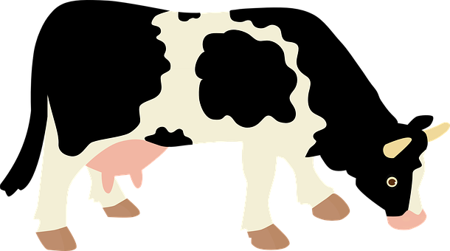
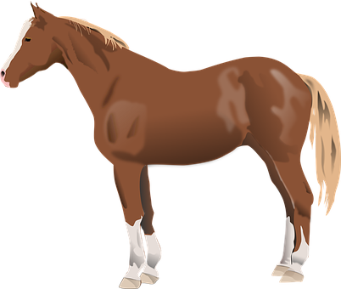
leer
Sofía tiene otro sueño raro.
el sueño = dream
la granja = farm
Está en la granja* otra vez…
Notes:
Timing: 5 minutes (6 slides) 1 intro and 6 reading items. Aim: to set the scene for the activity; Sofía is dreaming again, but who is doing each activity.
Procedure: 1. Read the title and ensure understanding.
2. Move to the next slide for the reading and speaking activity.
Frequency of unknown words and cognates:
granja [>5000] sueño [460]
Source: Davies, M. & Davies, K. (2018). A frequency dictionary of Spanish: Core vocabulary for learners (2nd ed.). Routledge: London

Slide 7
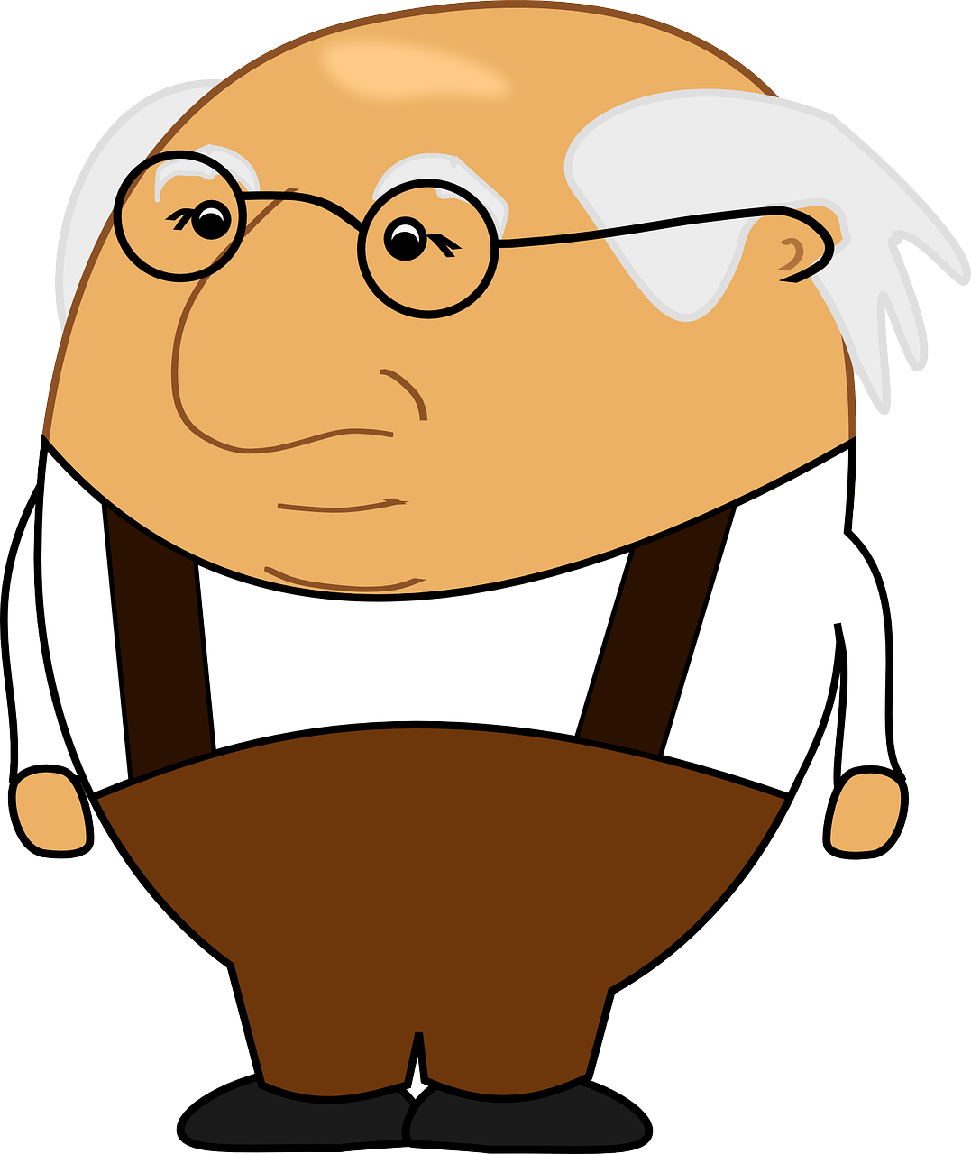
Follow up 3:
¿Quién es? ¿Cuál es la frase correcta? [1/5]
Con tu compañero/a, reacciona.
leer
hablar
Limpio el jardín.
Limpia el jardín.
Limpian el jardín.
15
¡Es posible!
S
¡Es imposible!
0
INICIO
Notes:
[1/6]
Aim: to practise written recognition of different persons of present tense –AR verbs; to consider sentence meaning and react orally. Procedure: 1. Pupils read the three phrases.
2. They decide which one describes the picture. It’s important that they know that this is Sofía’s dream so any activities that feature Sofía will be in the 1st person (I) form.
3. Teacher elicits the correct sentence, orally.
4. Click to reveal the answer.
5. Pupils turn to a partner to react to the ‘logicality’ of the sentence.
6. Teacher elicits the reaction chorally.
7. Repeat steps 1-6 with the following four slides. Frequency of unknown words and cognates:
posible [427] Source: Davies, M. & Davies, K. (2018). A frequency dictionary of Spanish: Core vocabulary for learners (2nd ed.). Routledge: London

Slide 8
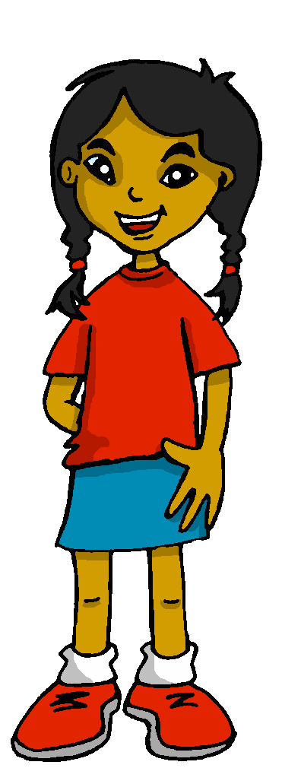
Follow up 3:
¿Quién es? ¿Cuál es la frase correcta? [2/6]
Con tu compañero/a, reacciona
leer
hablar
Cocina pollo asado.
Cocino pollo asado.
Cocinan pollo asado.
15
¡Es posible!
S
¡Es imposible!
0
INICIO
Notes:
[2/5]
Frequency of unknown words and cognates:
posible [427] Source: Davies, M. & Davies, K. (2018). A frequency dictionary of Spanish: Core vocabulary for learners (2nd ed.). Routledge: London

Slide 9
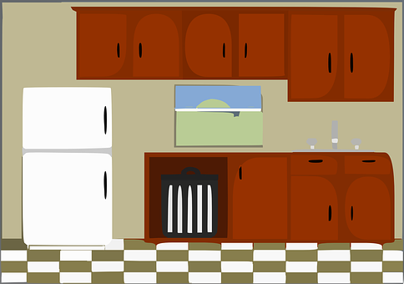
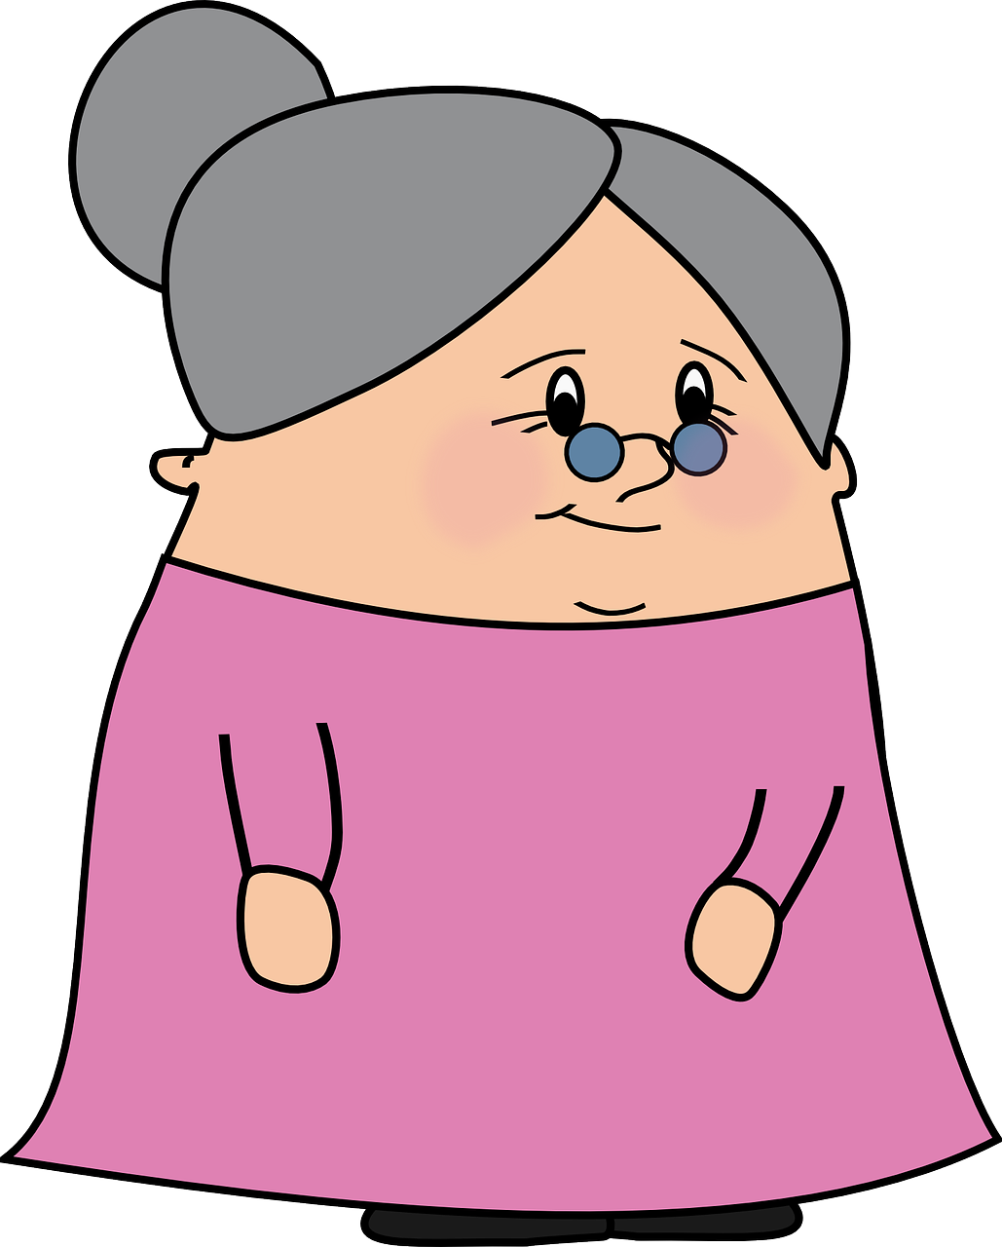
Follow up 3:
¿Quién es? ¿Cuál es la frase correcta? [3/6]
Con tu compañero/a, reacciona
leer
hablar
Bailan en la cocina.
Bailo en la cocina.
Baila en la cocina.
15
¡Es posible!
S
¡Es imposible!
0
INICIO
Notes:
[3/6]
Frequency of unknown words and cognates:
posible [427] Source: Davies, M. & Davies, K. (2018). A frequency dictionary of Spanish: Core vocabulary for learners (2nd ed.). Routledge: London

Slide 10
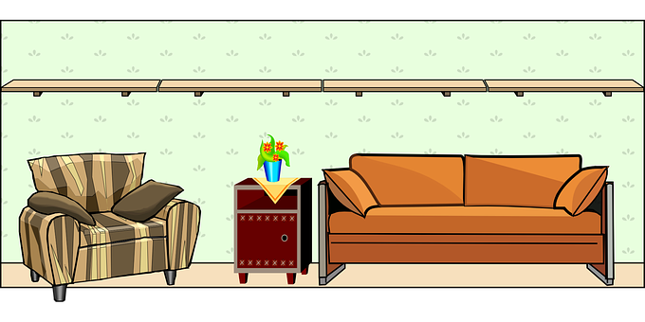
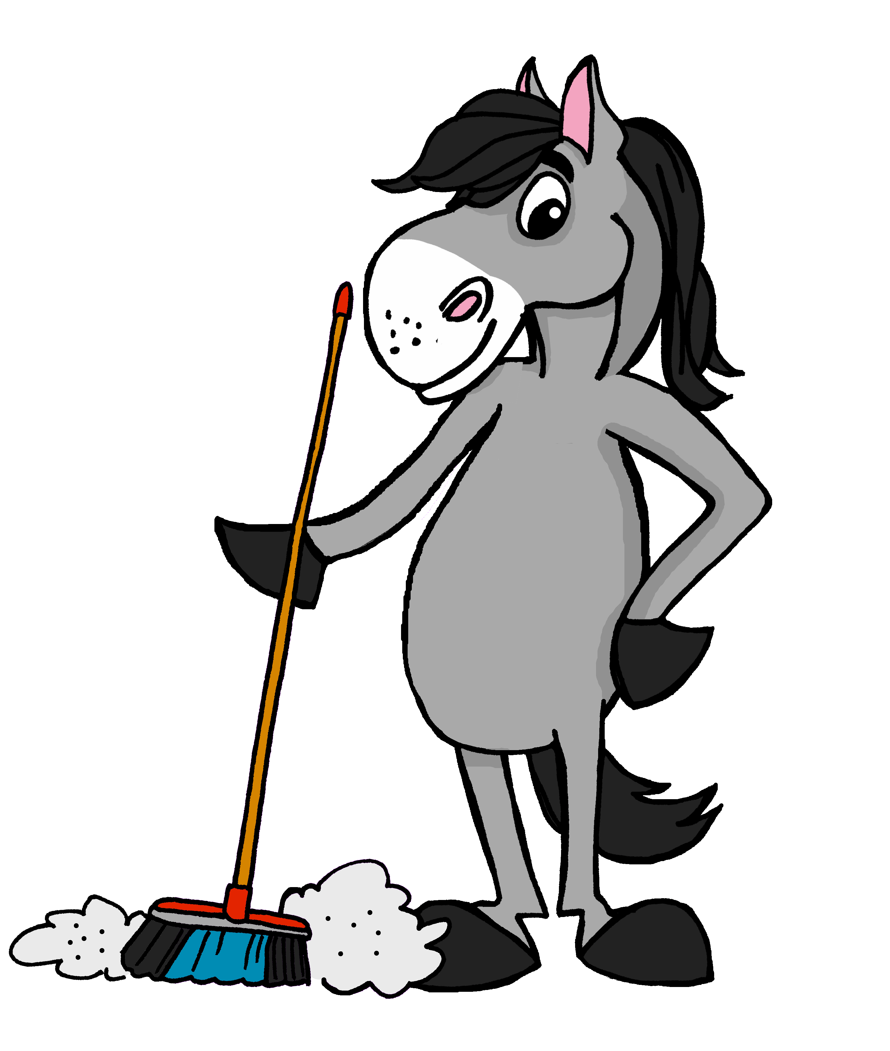
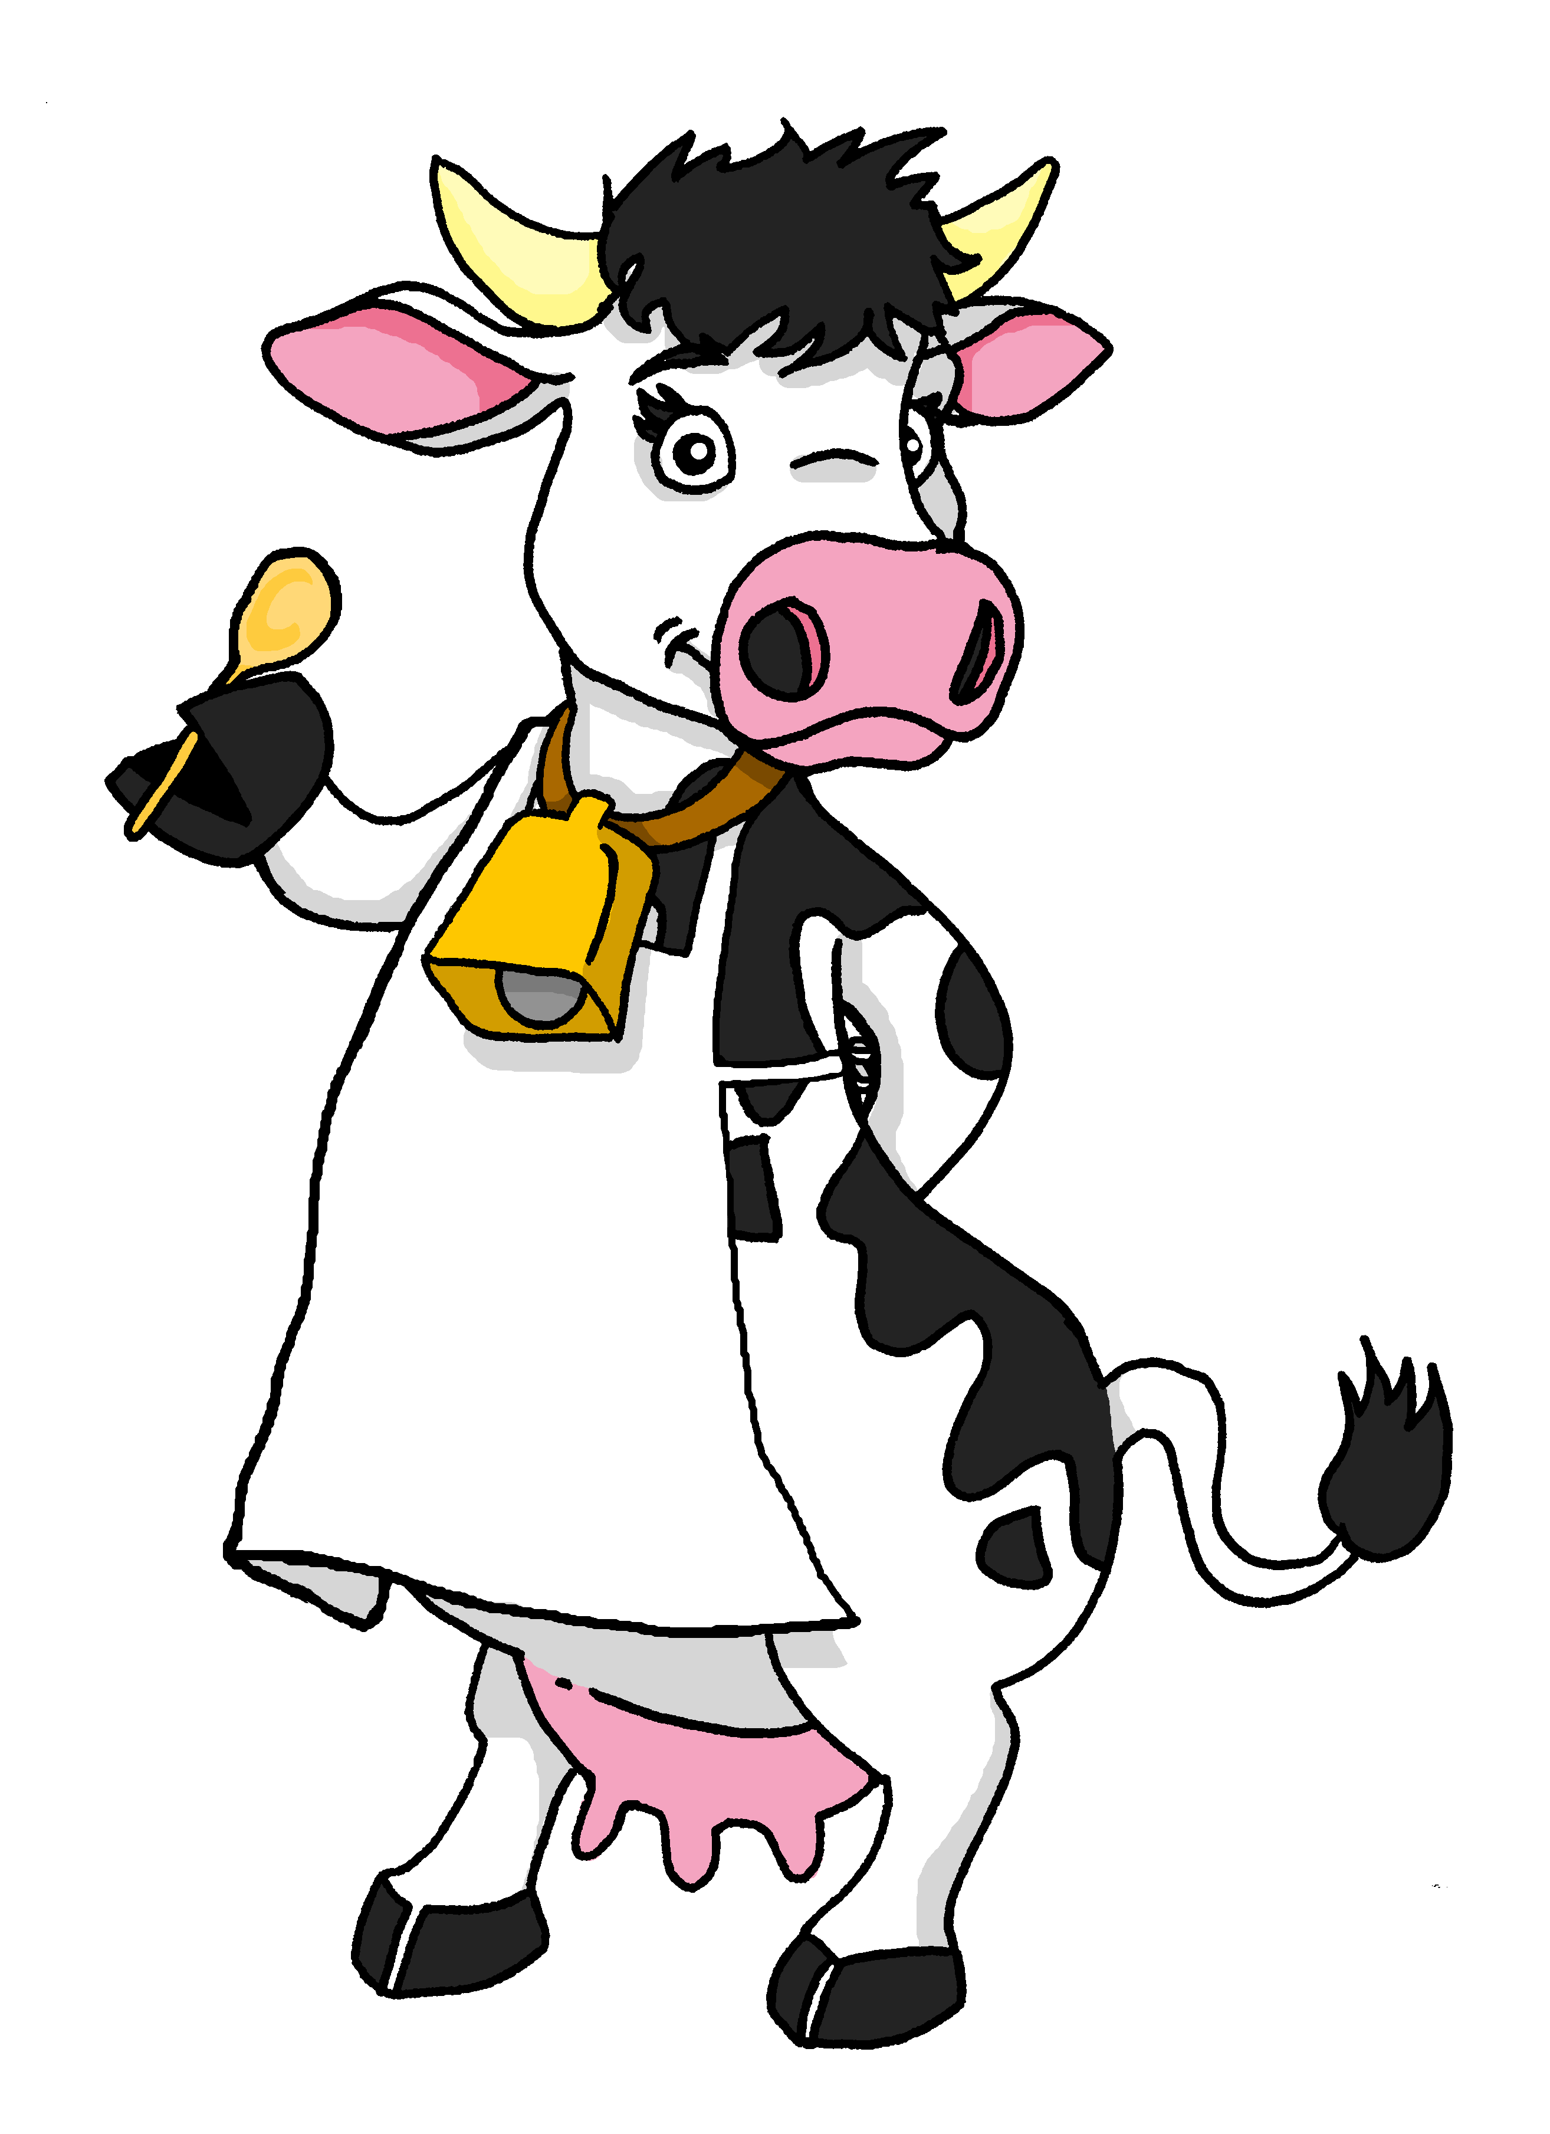
Follow up 3:
¿Quién es? ¿Cuál es la frase correcta? [4/6]
Con tu compañero/a, reacciona
leer
hablar
Limpio el jardín.
Limpia el jardín.
Limpian la casa.
15
¡Es posible!
S
¡Es imposible!
0
INICIO
Notes:
[4/6]
Frequency of unknown words and cognates:
posible [427] Source: Davies, M. & Davies, K. (2018). A frequency dictionary of Spanish: Core vocabulary for learners (2nd ed.). Routledge: London

Slide 11
Follow up 3:
¿Quién es? ¿Cuál es la frase correcta? [5/6]
Con tu compañero/a, reacciona
leer
hablar
Canto dentro.
Canta dentro.
Cantan dentro.
15
¡Es posible!
🎶
S
¡Es imposible!
0
INICIO
Notes:
[5/6]
Frequency of unknown words and cognates:
posible [427] Source: Davies, M. & Davies, K. (2018). A frequency dictionary of Spanish: Core vocabulary for learners (2nd ed.). Routledge: London

Slide 12
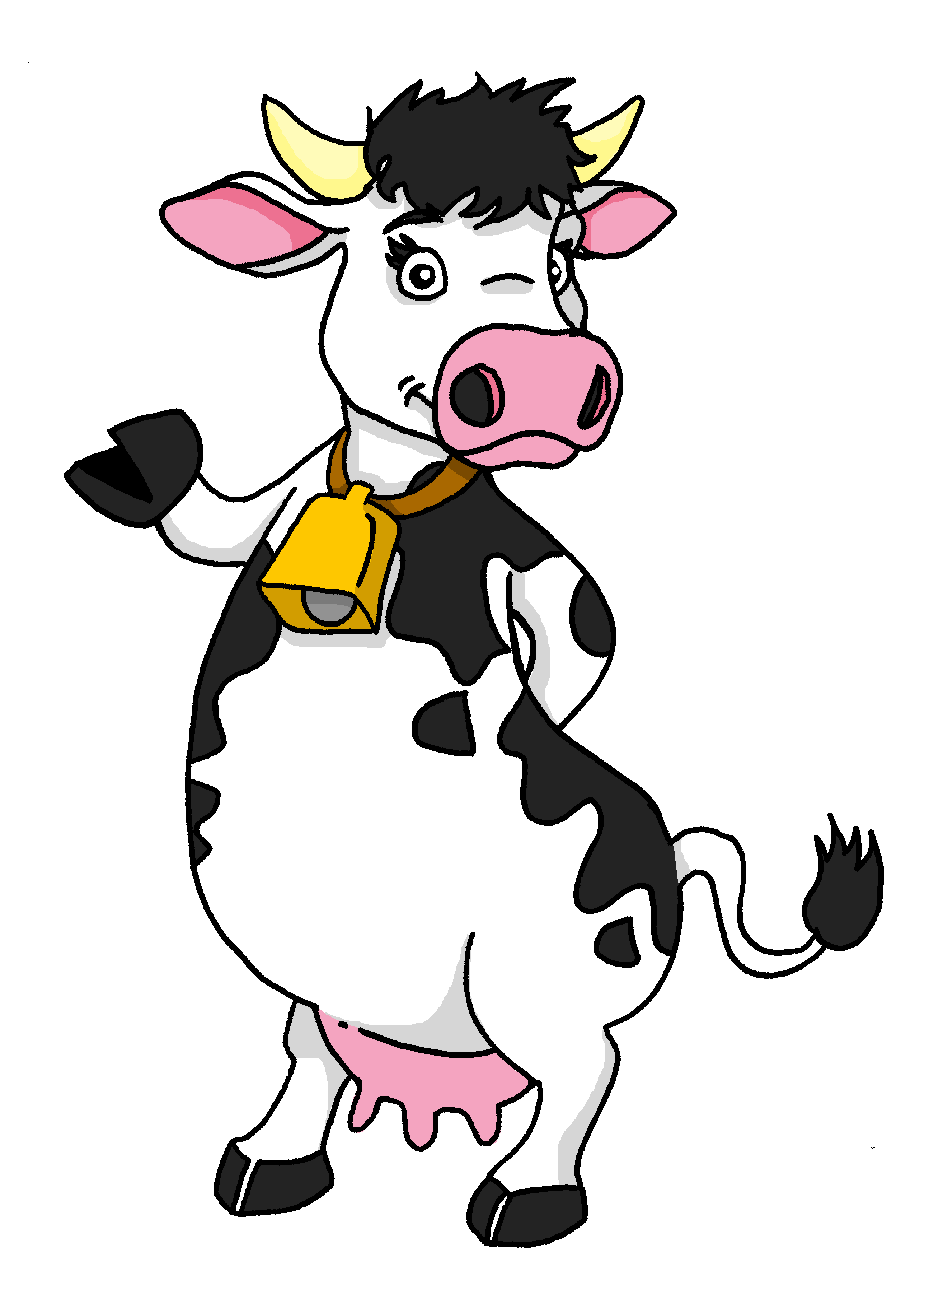
Follow up 3:
¿Quién es? ¿Cuál es la frase correcta? [2/5]
Con tu compañero/a, reacciona
leer
hablar
Tocan la guitarra.
Toca la guitarra.
Toco la guitarra
15
¡Es posible!
S
¡Es imposible!
0
INICIO
Notes:
[6/6]
Frequency of unknown words and cognates:
posible [427] Source: Davies, M. & Davies, K. (2018). A frequency dictionary of Spanish: Core vocabulary for learners (2nd ed.). Routledge: London

Slide 13
Follow up 4
B Escucha otra vez.
A Escucha. ¿Qué verbo es?
Use the correct words to
translate what you hear.
There are some extra ones!
escuchar
¿Es una frase positiva o negativa? Escribe P o N.
E
I work | s/he plays | I play
c | don’t| guitar | they| play | at home | I
 | on Sundays| don’t| they| you | clean | the house
 | but | I | dance | they | in the kitchen | help
 | learn | s/he | about | doesn’t | culture | learn
 | s/he | read | I | doesn’t | a text | in Spanish
 | they | outside | I | dance | in the garden | don’t
E
1
s/he cleans | they clean | I clean
I don’t play the guitar at home.
. . . . . . . . . . . . . . . . . . . . . . . . . . . . . . . . . . . . . .
2
they cook | they help | s/he helps
1
They clean the house on Sundays.
. . . . . . . . . . . . . . . . . . . . . . . . . . . . . . . . . . . . . .
3
I learn | s/he learns | they learn
2
They also help in the kitchen
. . . . . . . . . . . . . . . . . . . . . . . . . . . . . . . . . . . . . ...
4
s/he reads | I see | I read
3
S/he doesn’t learn about the culture of Ec...
. . . . . . . . . . . . . . . . . . . . . . . . . . . . . . . . . . . . . .
5
they dance | I dance | s/he dances
4
I read a text in Spanish.
E | 1 | 2 | 3 | 4 | 5
. . . . . . . . . . . . . . . . . . . . . . . . . . . . . . . . . . . . . .
N
P
P
N
P
N
5
They don’t dance outside in the garden.
. . . . . . . . . . . . . . . . . . . . . . . . . . . . . . . . . . . . . .
Notes:
Timing: 10 minutes
Aim: to practise aural comprehension of this week’s new vocabulary and revisiting adjectives from week 2-6. Connecting sound with meaning.
Procedure:
(Part A)
Read the instruction in Spanish & click to bring further instruction.
Do [E] with them. Click to listen. Pupils circle the correct words & write ? Or . According to whether it’s a statement or a question NB. Some puplis would benefit from working on a handout. Alternatively, they can use numbers 1,2,3.
Click for answers
(Part B)
1. Pupils listen to 1-5 and write the sentences, selecting from the options given (there are additional words that are not needed).
Click to reveal answers.
Transcript for parts A and B:
[E] No toco la guitarra en casa.
[1] Limpian la casa los domingos.
[2] También ayudan en la cocina.
[3] No aprende sobre la cultura de Ecuador.
[4] Leo un texto en español.
[5] No bailan fuera en el jardín.

Slide 14
Follow up 4:
B Traduce la postal.
¡[Hello] Krina!
Lee y escribir
[In] mi sueño [I am - location] en una granja
¡Hola Ángela!
[con] mi [grandad] y [grandma].
[It is - trait] muy raro porque* [there is]
[a horse] y [a cow] [and] hacen* [activities] humanas*.
Ángela Flores García
Por ejemplo*, [the horse] y [the cow] [cook] y [dance] en la cocina [too].
[I sing] a veces [and] [my] [grandad] [helps] en [the garden].
porque = because
hacen = they do
humanas = human
por ejemplo = for example
Hasta pronto 👋, Sofía
Notes:
Timing: 8 minutes (two slides)
Aim: to practise written production of key verbs and vocabulary from this and previous weeks.
Procedure:
Pupils write the Spanish for each English word and prepare to volunteer answers, orally.
Move to next slide. Teacher elicits answers chorally, and clicks to reveal the answers.
Frequency of unknown words and cognates: humano [243] ejemplo [187] porque [40]
Source: Davies, M. and Davies, K. (2018). A frequency dictionary of Spanish: Core vocabulary for learners (2nd ed.). Routledge: London

Slide 15
Follow up 4:
B Traduce la postal.
¡[Hello] Krina!
¡Hola Krina!
Lee y escribir
En mi sueño estoy en una granja
[In] mi sueño [I am - location] en una granja
¡Hola Ángela!
[con] mi [grandad] y [grandma].
con mi abuelo y abuela.
[It is - trait] muy raro porque* [there is]
Es muy raro porque* hay
un caballo y una vaca y hacen* actividades humanas*.
[a horse] y [a cow] [and] hacen* [activities] humanas*.
Ángela Flores García
Por ejemplo*, [the horse] y [the cow] [cook] y [dance] en la cocina [too].
Por ejemplo*, el caballo y la vaca cocinan y bailan en la cocina también.
[I sing] a veces [and] [my] [grandad] [helps] en [the garden].
Canto a veces y mi abuelo ayuda en el jardín.
porque = because
hacen = they do
humanas = human
por ejemplo = for example
Hasta pronto 👋, Sofía
Notes:
ANSWERS
Procedure:
Teacher elicits answers chorally, and clicks to reveal the answers.
Frequency of unknown words and cognates: humano [243] ejemplo [187] porque [40]
Source: Davies, M. and Davies, K. (2018). A frequency dictionary of Spanish: Core vocabulary for learners (2nd ed.). Routledge: London

Slide 16
Follow up: 5

Escribe en español. Can you get at least 15 points?
 | new (f) | some (mpl) | some (fpl)
 | also, too | (the) glue (stick) | old (m)
 | (the) lie | (the) sandwich | (the) truth
 | (the) fear | (the) test | on, on top of
 | to put, putting | to overcome | (the) culture
 | (the) cow | outside | inside
 | to clean cleaning | to touch, play (instrument) | to help, helping
nueva
unos
unas
vocabulario
x3
también
el pegamento
viejo
la mentira
el bocadillo
la verdad
x2
el miedo
la prueba
sobre
poner
vencer
la cultura
la vaca
fuera
dentro
x1
limpiar
tocar
ayudar
Notes:
Timing: 5 minutes
Aim: to practise written production of vocabulary from this week and this week’s revisited sets.
Procedure: 1. Give pupils a blank grid. They fill in the Spanish meanings of any of the words they know, trying to reach 15 points in total.
Note: The most recently learnt and practised words are pink, words from the first revisit are green and those from the second revisit are blue, thus more points are awarded for them, to recognise that memories fade and more effort (heavy lifting!) is needed to retrieve them.

Slide 17
Follow up 2:

Escribe en inglés. Can you get at least 15 points?
 | nueva | unos | unas
 | también | el pegamento | viejo
 | la mentira | el bocadillo | la verdad
 | el miedo | la prueba | sobre
 | poner | vencer | la cultura
 | la vaca | fuera | dentro
 | limpiar | tocar | ayudar
vocabulario
x3
x2
x1
Notes:
Follow up 2 HANDOUT

Slide 18
Follow up: 5

Escribe en español. Can you get at least 15 points?
 | new (f) | some (mpl) | some (fpl)
 | also, too | (the) glue (stick) | old (m)
 | (the) lie | (the) sandwich | (the) truth
 | (the) fear | (the) test | on, on top of
 | to put, putting | to overcome | (the) culture
 | (the) cow | outside | inside
 | to clean cleaning | to touch, play (instrument) | to help, helping
vocabulario
x3
x2
x1
Notes:
Follow up 5 HANDOUT

