Slide 1
Saying what I and others do
azul
Follow ups 1-5
Notes:
Artwork by Steve Clarke. All additional pictures selected are available under a Creative Commons license, no attribution required.
The frequency rankings for words that occur in this PowerPoint which have been previously introduced in NCELP resources are given in the NCELP SOW and in the resources that first introduced and formally re-visited those words.
Phonics: pasado [932] nunca [158] orden [421] sacapuntas [>5000]
Vocabulary (new words in bold): patio [1197] recreo [>5000] revisit: aprender [428] beber [1085] comer [37] correr [343] hacer [26] leer [209] chocolate [3408]semana [301] a menudo [958] a veces [vez 59] siempre [96]
Revisit 1: bailar [1323] cocinar [3074] mandar [588] mirar [125] luz [278] pollo [3577] suéter [>5000] tarjeta [1958] común [742]
Revisit 2: tener [19] tengo [tener 19] tiene [tener 19] casa [106] familia [233] habitación [1069] jardín [1195] libro [230] madre [226] padre [162] problema [145] profesor / profesora [501] silla [1271] estricto [3155] feo [2373] terrible [1246] muy [43] un [6] una [6]
Re-use adjectives: bonito [891]cómodo [2237] diferente [293] divertido [2465] feliz [908] elegante [2742] grande [66] importante [171] independiente [1177] negativo [1804] normal [1000] pequeño [202] tranquilo [1093]
Glossed words: él [9] su [12] otras [35]
For any other words that occur incidentally in this PowerPoint, frequency rankings will be provided in the notes field wherever possible.
Source: Davies, M. and Davies, K. (2018). A frequency dictionary of Spanish: Core vocabulary for learners (2nd ed.). Routledge: London

Slide 2
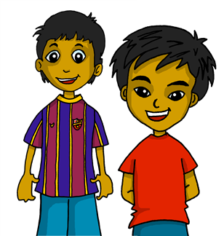
Follow up 1:
[Stress 2]
[A] Escucha y ordena las sílabas.
pronunciar
Where’s the stress?
Colorea la sílaba en rojo.
60
Where there is no written accent, stress the penultimate (second to last) syllable for any word ending in a vowel, ‘n’ or ‘s’.
pe
ces
E
ces
pe
fec
per
per
fec
ta
1
ta
co
ci
ci
co
nan
2
nan
ta
can
mos
3
can
ta
mos
di
ro
di
4
ne
ro
ne
0
5
pe
men
tos
pe
men
tos
ga
ga
[B] Practica con tu compañero/a.
INICIO
Notes:
Timing: 3 minutes
Aim: to practise stress rule 2.
Procedure:
Part A 1. Click to listen to each word. 2. Pupils write the words, putting the syllables in the correct order.
3. Pupils then colour (or underline/circle etc.) the syllable that is stressed. Note: they will have heard the stress, but might not have paid full attention as they were writing. However, they can apply the rule to the written forms and then listen again to check, if needed. Part B 1. Pupils practise the pronunciation of the words.
2. Click ‘inicio’ to start a 12-second timer.
Transcript: E. peces 1. perfecta 2. cocinan 3. cantamos 4. dinero 5. pegamentos

Slide 3
Follow up 2:

Escribe en inglés: Can you get at least 15 points?
 | el jardín | la habitación | muy
 | el texto | la prueba | el deporte
 | la luz | la información | el libro
 | la tarjeta | el suéter | la revista
 | hacer | correr | leer
 | aprender | beber | comer
 | el patio | el recreo | la semana
vocabulario
garden
room
very
x3
text
test
sport
light
information
book
x2
card
jumper
magazine
to do, doing
to run, running
to read, reading
to learn, learning
to drink, drinking
to eat, eating
x1
playground
break
week
Notes:
Timing: 10 minutes (two slides)
Aim: to practise written comprehension (this slide) and production (next slide) of vocabulary from this week and this week’s revisited sets.
Procedure: 1. Give pupils a blank grid. They fill in the English meanings of any of the words they know, trying to reach 15 points in total.
Note: The most recently learnt and practised words are pink, words from the first revisit are green and those from the second revisit are blue, thus more points are awarded for them, to recognise that memories fade and more effort (heavy lifting!) is needed to retrieve them.

Slide 4
Follow up 3:
Knowing who does what & negative ‘no’
[–er verbs: ‘I’,‘s/he,it’ & ‘we’| no ]
Remember, to mean ‘I’, ‘s/he,it’ or ‘we’ with a verb, the verb ending changes.
I
S/he, it
we
Como en el patio.
No come en el recreo.
No como en el patio.
Come en el recreo.
No comemos en clase.
Comemos en clase.
I eat in the playground.
S/he eats at break time.
We eat in class.
I don’t eat in the playground.
We don’t eat in the playground.
She doesn’t eat at break time
To say what you or others don’t do, put ‘no’ before the verb. This makes a negative.
Notes:
Timing: 3 minutes
Aim: to revisit the negative ‘no’, drawing on pupils’ knowledge of 1st and 3rd person singular and 1st person plural.
Procedure:
Click through the animations to present the new information.
Elicit English translations for the Spanish examples provided.

Slide 5
Follow up 3:
él = he su = his/her
Quique habla sobre él, Sofía y él* y Rubén.
escuchar
leer
Escucha y completa el texto.
En clase [1] __________ muchas cosas. Por ejemplo, [2] __________ libros sobre historia y cultura de Inglaterra. También [3] __________ mucho vocabulario de inglés. Es muy útil porque [4] _______ una amiga de Inglaterra. Su* nombre es Krina. En el recreo [5] ________ una fruta y Rubén [6] ____________ un bocadillo enorme y siempre [7] _________ agua.
hacemos
leemos
aprendo
tengo
como
come
bebe
Notes:
Timing: 10 minutes (two slides)
Aim: to practise transcription of key verbs in the 1st person plural and 3rd person singular.
Procedure: 1. Pupils write 1-7.
2. Click to listen to each sentence. Pupils write in the missing verb.
3. Click to correct answers.
4. Move to the next slide for a comprehension task.

Slide 6
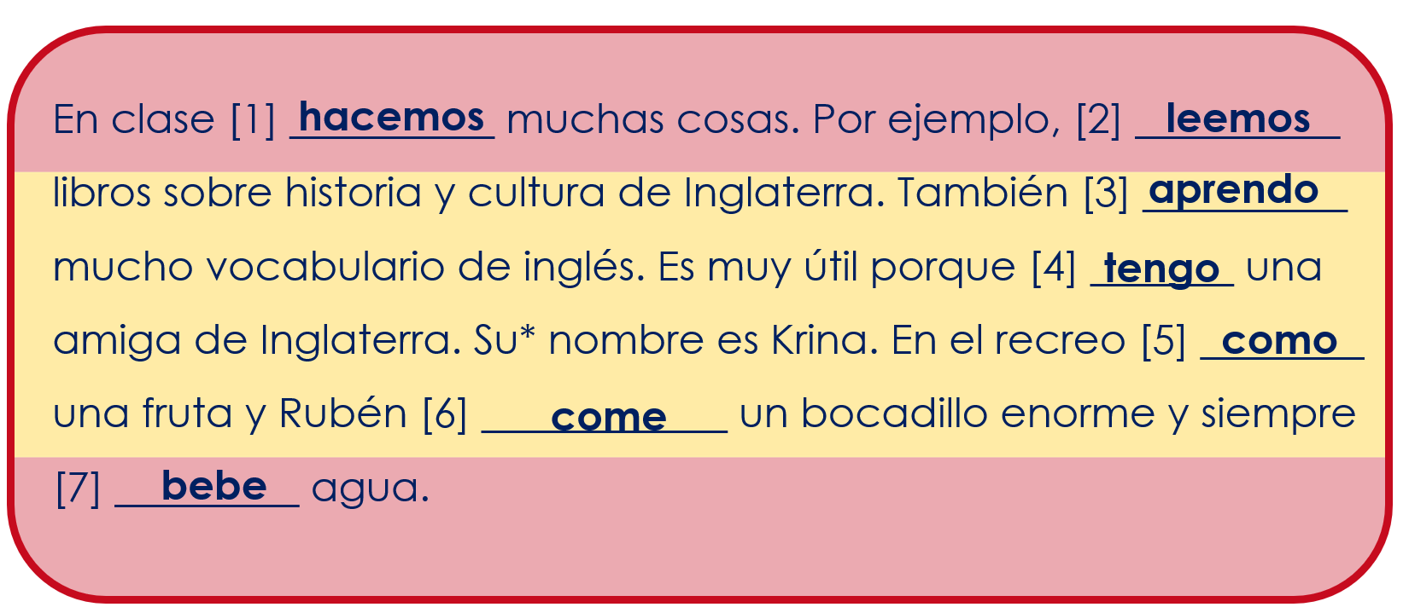
Follow up 3:
Lee otra vez.
¿Es Quique, Quique y Sofía o Rubén?
Escribe Q [I], Q&S [we] o R [he]. ✍
leer
él = he su = his/her
Who….
Q [I]
Q&S [we]
has a friend from England?
eats (a piece of fruit) at break time?
eats a huge sandwich at break time?
drinks water at break time?
does lots of things in class?
reads books about English history and culture?
learns lots of vocabulary in class?
Q [I]
Q&S [we]
R [he]
Q [I]
R [he]
Notes:
[2/2] Aim: to practise written comprehension of the text, understanding the difference between ‘I’, ‘s/he’ and ‘we’ verb forms.
Procedure: 1. Pupils read the text again.
2. They write 1-7 and the name or names that answer each question.
3. Click to correct.

Slide 7
Follow up 4:
Knowing who does what & negative ‘no’
[–er verbs: ‘I’ & ‘you’| no ]
I
you
No comprendo las instrucciones.
Comprendo las instrucciones.
No comprendes las instrucciones.
Comprendes las instrucciones.
I understand the instructions.
You understand the instructions.
I don’t understand the instructions.
You don’t understand the instructions.
We also put ‘no’ before the verb to make these sentences negative.
Notes:
Timing: 3 minutes
Aim: to revisit the negative ‘no’; to revisit 1st and 2nd persons singular
Procedure:
Click through the animations to present the new information.
Elicit English translations for the Spanish examples provided.

Slide 8
Follow up 4:
Con tu compañero/a, termina las frases.
hablar
Persona A comienza y persona B termina.
Persona A
1) I don’t learn…
……………………………….
……………………………….
Persona B

[ I ] | [you]
I don’t learn 5 words each day.
|
… 5 words each day
… 5 words each week.
No aprendo…
5 palabras cada día.
A
B
Notes:
Timing: 5 minutes
Aim: to practise oral production and aural recognition of ‘I’ and ‘you (singular)’ verbs & negation; to practise clear pronunciation when reading aloud.
Procedure: 1. Use this slide to model the task.
2. Pupil A produces the verb in Spanish.
3. Pupil B completes the sentence, based on the verb form heard.
4. Pupil A writes down the full sentence meaning in English.
5. Then they will swap roles and repeat the task. 6. See next slides for answers, and handouts at the end of the presentation.

Slide 9
parler
Round 1
Persona A
1) I don’t learn…
……………………………….
2) You understand…
……………………………….
3) You read…
……………………………….
4) I don’t run...
……………………………….
5) You don’t make…
………………………………..
6) You eat… ………………………………..
Persona B
[I] | [you]
parler
… 5 words each day
… 5 words each week.
I don’t learn 5 words per day.
… a text in English.
… a text in Spanish.
You understand a text in Spanish.
… a magazine in class.
… a magazine at home
You read a magazine at home.
… at break time.
… in the playground
I don’t run at break time.
… a jumper.
… a card.
You don’t make a card.
… in the playground.
… in class.
We eat in the playground.
Notes:
ANSWERS ROUND 1
1. No aprendo cinco palabras cada día.
2. Comprendes un texto en español.
3. Lees una revista en casa.
4. No corro en el recreo.
5. No haces una tarjeta.
6. Comemos en el patio.
9

Slide 10
parler
Round 1
Persona B
1) You don’t drink…
……………………………….
2) I read…
……………………………….
3) You run…
……………………………….
4) I understand...
……………………………….
5) You don’t do…
………………………………..
6) I don’t run… ………………………………..
Persona A
[I] | [you]
parler
You don’t drink in class.
… water in class
… in class.
… a book in Spanish.
… a book in English.
I read a book in Spanish.
… in the playground
… in class
You run in the playground.
… the information.
… a language
I understand the information.
… sport at break time.
… a test at break time.
You don’t do a test at break time.
I don’t run in my room.
… in my room
… at home
Notes:
ANSWERS ROUND 2
1. No bebes en clase. 2. Leo un libro en español. 3. Corres en el patio. 4. Comprendo la información. 5. No haces una prueba en el recreo. 6. No corro en mi habitación.
10

Slide 11
Follow up 2:

Escribe en español: Can you get at least 15 points?
 | (the) garden | (the) room | very
 | (the) text | (the) test | (the) sport
 | (the) light | (the) information | (the) book
 | (the) card | (the) jumper | (the) magazine
 | to do, doing | to run, running | to read, reading
 | to learn, learning | to drink, drinking | to eat, eating
 | (the) playground | (the) break | (the) week
el jardín
la habitación
muy
vocabulario
x3
el texto
la prueba
el deporte
la luz
la información
el libro
x2
la tarjeta
el suéter
la revista
hacer
correr
leer
aprender
beber
comer
x1
el patio
el recreo
la semana
Notes:
Timing: 10 minutes (two slides)
Aim: to practise written comprehension (this slide) and production (next slide) of vocabulary from this week and this week’s revisited sets.
Procedure: 1. Give pupils a blank grid. They fill in the Spanish meanings of any of the words they know, trying to reach 15 points in total.
Note: The most recently learnt and practised words are pink, words from the first revisit are green and those from the second revisit are blue, thus more points are awarded for them, to recognise that memories fade and more effort (heavy lifting!) is needed to retrieve them.

Slide 12
Follow up 2:

Escribe en inglés: Can you get at least 15 points?
 | el jardín | la habitación | muy
 | el texto | la prueba | el deporte
 | la luz | la información | el libro
 | la tarjeta | el suéter | la revista
 | hacer | correr | leer
 | aprender | beber | comer
 | el patio | el recreo | la semana
vocabulario
x3
x2
x1
Notes:
HANDOUT

Slide 13
Follow up 4: handout
Round 1
Round 2
Persona A
1) I don’t learn…
……………………………….
2) You understand…
……………………………….
3) You read…
……………………………….
4) I don’t run...
……………………………….
5) You don’t make…
………………………………..
6) You eat… ………………………………..
Persona A
[I] | [you]
… water in class
… in class.
… a book in Spanish.
… a book in English.
… in the playground
… in class
… the information.
… a language
… sport at break time.
… a test at break time.
… in my room
… at home
Notes:
HANDOUT Persona A
13

Slide 14
Follow up 4: handout
Round 1
Round 2
Persona B
1) You don’t drink…
……………………………….
2) I read…
……………………………….
3) You run…
……………………………….
4) I understand...
……………………………….
5) You don’t do…
………………………………..
6) I don’t run… ………………………………..
Persona B
[I] | [you]
… 5 words each day
… 5 words each week.
… a text in English.
… a text in Spanish.
… a magazine in class.
… a magazine at home
… at break time.
… in the playground
… a jumper.
… a card.
… in the playground.
… in class.
Notes:
HANDOUT Persona B
14

Slide 15
Follow up 2:

Escribe en español: Can you get at least 15 points?
 | (the) garden | (the) room | very
 | (the) text | (the) test | (the) sport
 | (the) light | (the) information | (the) book
 | (the) card | (the) jumper | (the) magazine
 | to do, doing | to run, running | to read, reading
 | to learn, learning | to drink, drinking | to eat, eating
 | (the) playground | (the) break | (the) week
vocabulario
x3
x2
x1
Notes:
HANDOUT

