Slide 1

Saying what I and others do
Actividades
azul
Follow ups 1-5
Notes:
Artwork by Steve Clarke. All additional pictures selected are available under a Creative Commons license, no attribution required.
The frequency rankings for words that occur in this PowerPoint which have been previously introduced in NCELP resources are given in the NCELP SOW and in the resources that first introduced and formally re-visited those words.
Phonics: ácido [2932] último [188] árbol [748] frágil [3922] corazón [475] interés [388]
Vocabulary (new words in bold): aprender [428] beber [1085] comer [347] correr [343] hacer [26] leer [209] vender [528] ver [38] dinero [364] más [23]
Revisit 1: tiene [8] cara [337] médico [692] nariz [1570] ojo [169] oreja [2095] pelo [873] profesor / profesora [501] azul [811] corto [1055] grande [66] gris [1751] largo [300] moreno [3304] negro [307] pequeño [202] redondo [2470] rubio [2861]verde [812] los / las [1]
Revisit 2: hay [13] cuántos/cuántas [580] diccionario [3844] flor [739] foto [882] regalo [1986] blanco [372] especial [436] feliz [908] grande [66] importante [171] normal [1000] pequeño [202] rojo [534] útil [3951]
For any other words that occur incidentally in this PowerPoint, frequency rankings will be provided in the notes field wherever possible.
Source: Davies, M. and Davies, K. (2018). A frequency dictionary of Spanish: Core vocabulary for learners (2nd ed.). Routledge: London

Slide 2




Follow up 1:
Stress 1
[A] Escucha: ¿Dónde está el estrés?
escuchar
Escribe el acento ✍.
 | ¿Quién?
 | Ramon Gonzalez Garcia
 | Jose Gomez Martin
 | Belen Alvarez Leon
 | Cesar Lopez Fernandez
 | Benjamin Vazquez Pallares
In Spain and Spanish American countries, each person has two surnames. Traditionally, the first surname comes from the father, while the second surname the mother.
hablar
E
´
´
´
1
´
´
´
2
´
´
´
3
´
´
´
[B] Practica en parejas.
4
´
´
´
Notes:
Timing: 5 minutes
Aim: to apply knowledge of the SSC [l] and [ll].
Procedure:
Teacher explains the scenario. A special day at school. People have some unusual things in school today.
Click to listen. First pupils need to identify whether the sentence refers to one or more people. They write the name or names.
They then write the corresponding form of ‘visita/’visitan’
Click to listen again and pupils transcribe the item.
Elicit answers orally from pupils.
Click to reveal written answers and pictures.
Pupil A practises pronouncing sentence 1. Partner B translates into English.
Transcript:
Ramón González García
José Gómez Martín
Belén Álvarez León
César López Fernández
Benjamín Vázquez Pallarés

Slide 3

Follow up 2:
B Escucha.
Escribe la pregunta en inglés.
A Escucha. ¿Qué palabra es?
escuchar
Does s/he do two activities every day?
E
face | nose | hair
E
¿Hace dos actividades cada día?
1
dark | red | blond
Do you read a book every week?
1
¿Lees un libro cada semana?
2
small | big | happy
Do you eat more fruit?
3
black | grey | green
2
¿Comes más fruta?
Does s/he sell cakes?
4
normal | useful | important
3
¿Vende tartas?
5
short | long | large
4
Do you drink a bottle of water every day?
6
eye | ear | blue
¿Bebes una botella de agua cada día?
5
Does s/he answer more questions in class?
¿Responde a más preguntas en clase?
Notes:
Timing: 5 minutes
Aim: to practise aural comprehension of this week’s new vocabulary and revisiting adjectives from week 2-6. Connecting sound with meaning.
Procedure:
(Part A) Click to listen. Students circle the correct word (if they have the sheet printed). If not, they can use numbers 1,2,34. Click for answers.
(Part B) Students listen to 1-5 and write the sentences, selecting from the options given (there are additional words that are not needed).
Click to reveal answers.
Transcript A:
Ejemplo: cara
rubio
pequeño
negro
útil
largo
oreja
Transcript B:
E. ¿Hace dos actividades cada día?
1. ¿Lees un libro cada semana?
2. ¿Comes más fruta?
3. ¿Vende tartas?
4. ¿Bebes una botella de agua cada día?
5. ¿Responde a más preguntas en clase?

Slide 4


Knowing who does what
Remember, I do and
I put are irregular verb forms in Spanish.
[–er verbs: ‘I’ vs. ‘you’]
To mean ‘I’ with a verb, we remove –er and add -o.
To mean ‘you’ with a verb, we remove –er and add –es.
you
I
Aprendo sobre España.
Aprendes sobre Inglaterra.
I learn about Spain.
You learn about England.
Hago una actividad.
Haces una actividad.
I do an activity.
You do an activity.
Pongo el regalo en la mesa.
Pones el regalo en la mesa.
I put the present on the table.
You put the present on the table.
Notes:
Timing: 3 minutes
Aim: to reintroduce 3rd person singular for–er verbs and introduce 1st plural.
Procedure:
Click through the animations to present the new information.
Elicit English translations for the Spanish examples provided.

Slide 5






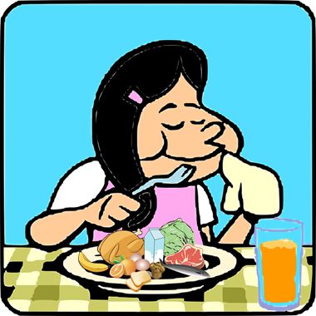

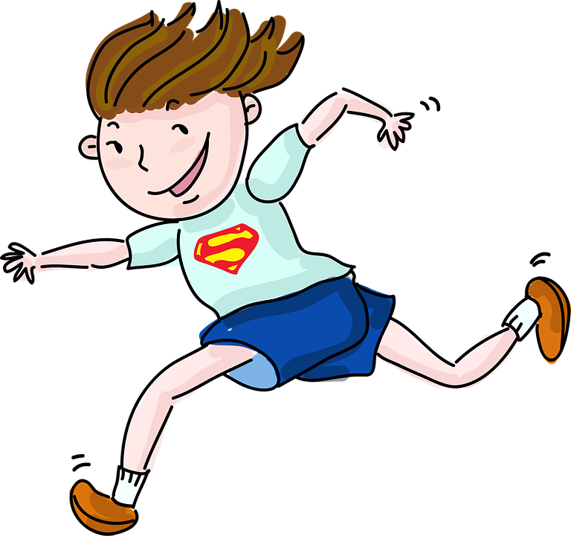

Follow up 3:
Sofía escribe a Krina.
She draws pictures for some of the words for Krina to practise her Spanish.
leer
you
¡Hola, Krina! ¿Cómo estás ?
Cada día Quique y yo hacemos actividades para ganar dinero.
Quique aprende 10 palabras de inglés cada semana.
Y tú, ¿cuántas palabras de español aprendes?
put
Yo hago un esfuerzo* especial en casa. Pongo la mesa cada día, como más fruta y bebo más agua.
make
This means ‘a hug’ and is a typical sign off to friends and family.
Y tú, ¿cuántos kilómetros corres o caminas cada semana?
Ángela, Quique y yo vendemos tartas en la escuela, también.
Krina, ¿haces actividades así en tu escuela?
Un abrazo, Sofía
Notes:
Timing: 5 minutes
Aim: to practise written comprehension of vocabulary and structures from this week and revisited weeks.
Procedure:
Pupils write five sentences using one element from each column. (They should use all the options but only once).
Click to check answers.

Slide 6


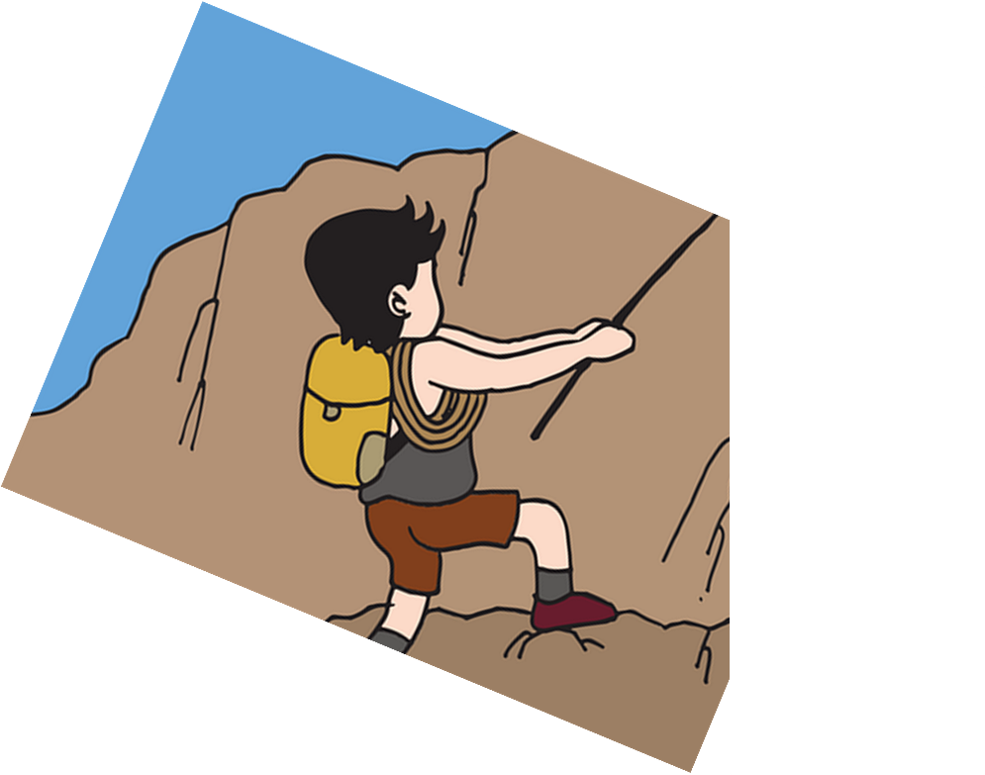
Follow up 4:
Habla en español [1/5]
Traduce 🗣
S/he reads some books at home.
leer
hablar
5
cada semana.
en clase.
en casa.
en la escuela.
4
preguntas
libros
revistas
textos
3
más
cinco
unas
unos
2
Lee
Leo
Lees
Leemos
1
Notes:
Timing: 5 minutes [10 slides, 5 items]
Aim: to use correct forms of –er verbs and other previously taught vocabulary in guided oral production.
Procedure:
Tell students they need to use the words, starting from the bottom, to climb up the mountain (so that they translate the sentence!).
Ask students to work in pairs to practise first.
Click to trigger the timer (15 seconds per sentence).
Ask a volunteer from a pair to say the Spanish sentence out loud – next slide reveals the answer.
Repeat with the next 4 sentences (there are 5 in total).

Slide 7
Follow up 4:
Respuesta [1/5]
S/he reads some books at home.
leer
hablar
cada semana
en clase
en casa
en la escuela
preguntas
libros
revistas
textos
más
cinco
unas
unos
lee
leo
lees
leemos
Notes:
Click the English prompt to hear the sentence in Spanish.

Slide 8
Follow up 4:
Habla en español [2/5]
Traduce 🗣
We make a cake every week.
leer
hablar
5
cada día.
en clase.
en casa.
cada semana.
4
tarta
nariz
actividad
regalo
3
un
una
la
el
2
Haces
Hace
Hacemos
Hago
1
Notes:
[2/5]

Slide 9
Follow up 4:
Respuesta [2/5]
We make a cake every week.
leer
hablar
cada día.
en clase.
en casa.
cada semana.
tarta
nariz
actividad
regalo
un
una
la
el
Haces
Hace
Hacemos
Hago
Notes:
[2/5]
Click the English prompt to hear the sentence in Spanish.

Slide 10
Follow up 4:
Habla en español [3/5]
Traduce 🗣
We drink more water in school.
leer
hablar
5
en la escuela.
en clase.
en casa.
en la cama.
4
coca cola
agua
café
té
3
muy
mucha
menos
más
2
Bebo
Bebemos
Bebes
Bebe
1
Notes:
[3/5]

Slide 11
Follow up 4:
Respuesta [3/5]
We drink more water in school.
leer
hablar
en la escuela.
en clase.
en casa.
en la cama.
coca cola
agua
café
té
muy
mucha
menos
más
Bebo
Bebemos
Bebes
Bebe
Notes:
[3/5]
Click the English prompt to hear the sentence in Spanish.

Slide 12
Follow up 4:
Habla en español [4/5]
Traduce 🗣
You learn some words in Spanish.
leer
hablar
5
en inglés.
en clase.
en casa.
en español.
4
palabras
frases
preguntas
respuestas
3
unos
más
menos
unas
2
Aprende
Aprendemos
Aprendes
Aprende
1
Notes:
[3/5]

Slide 13
Follow up 4:
Respuestas [4/5]
You learn some words in Spanish.
leer
hablar
en inglés.
en clase.
en casa.
en español.
palabras
frases
preguntas
respuestas
unos
más
menos
unas
Aprende
Aprendemos
Aprendes
Aprende
Notes:
[4/5]
Click the English prompt to hear the sentence in Spanish.

Slide 14
Follow up 4:
Habla en español [5/5]
Traduce 🗣
I sell some pencils every week.
leer
hablar
5
cada día.
en clase.
en casa.
cada semana.
4
reglas
lápices
cuadernos
gomas
3
unos
más
menos
unas
2
Vende
Vendemos
Vende
Vendes
1
Notes:
[5/5]

Slide 15
Follow up 4:
Respuesta [5/5]
I sell some pencils every week.
leer
hablar
cada día.
en clase.
en casa.
cada semana.
reglas
lápices
cuadernos
gomas
unos
más
menos
unas
Vende
Vendemos
Vendo
Vendes
Notes:
[5/5]
Click the English prompt to hear the sentence in Spanish.

Slide 16


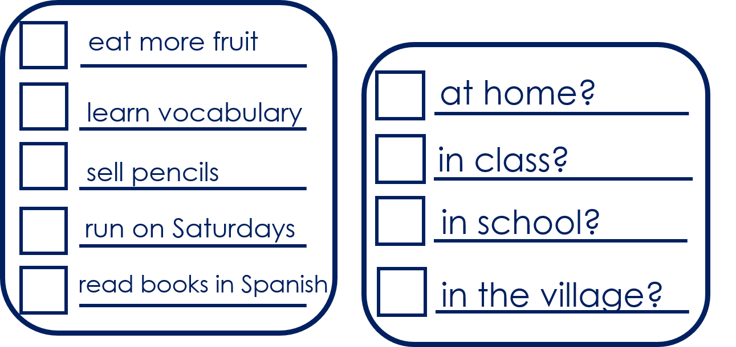


Follow up 5:
Pregunta y responde: What do you do?
Turno 1
Persona A
hablar
Pregunta (¿?) y marca
¿Comes más fruta …?
…en casa?
Persona B
¡No!
Escucha y responde.
Then swap roles.
Notes:
Timing: 5 minutes (four slides)
Aim: to develop fluency in using 2nd person singular of –ar verbs using intonation questions.
Procedure:
1. Divide the class into A and B. Pupils work in pairs or work chorally, in two class halves.
2. Pupil A asks questions to find out what B does, and where.
3. Pupil B answers “yes / no” according to their card. This is Pupil A’s task – Turno 1.
If needed, first practise further with the class. Elicit the question forms of the verbs and then of the locations from pupils, and then click the audio buttons to check.
Move briefly to the next slide to show “turno 2” and model further if necessary.

Slide 17
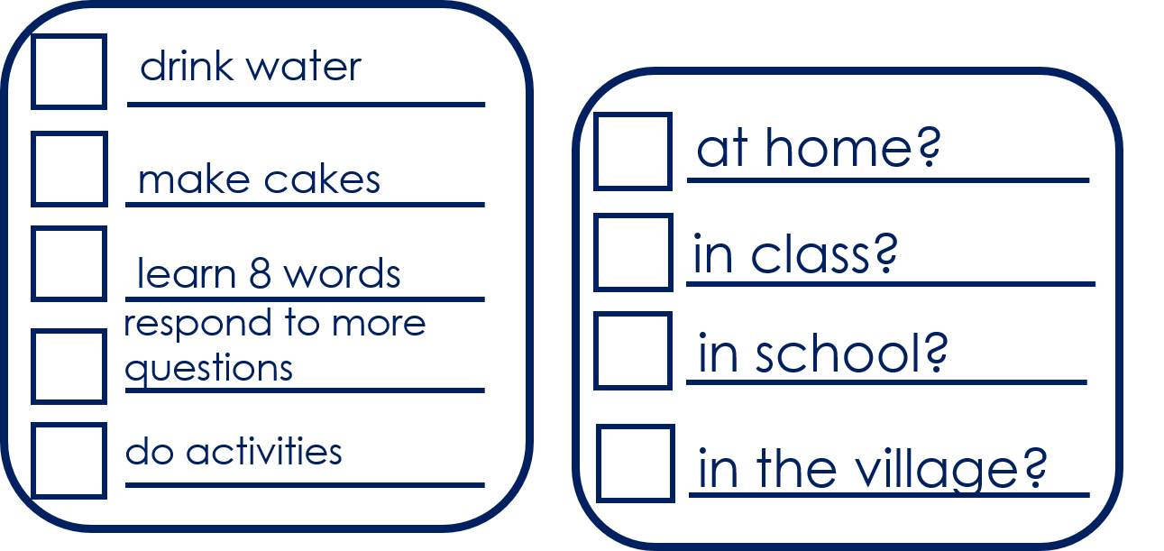
Follow up 5:
Pregunta y responde: What do you do?
Persona B
Turno 2
hablar
Pregunta (¿?) y marca
¿Bebes agua…?
…en clase?
Persona A
¡Sí!
Escucha y responde.
Notes:
Procedure:
1. Roles are swapped.
2. Model the change.
3. Pupil B asks questions to find out what Sofía does, and where.
2. Pupil A answers “yes / no” according to their card (a card describing what Sofía does)..
6. Answers for all are on the next slide.

Slide 18
Follow up 5
Respuestas
hablar
Persona A
Persona B
1
eat more fruit
1
drink water
2
learn vocabulary
2
make cakes
sell pencils
3
learn 8 words
3
respond to more questions
4
run on Saturdays
4
read books in Spanish
5
do activities
5
Notes:
ANSWER SLIDE
Pupils will have noted answers on their task sheets.
Procedure:
Click to reveal answers for pupils to check.
To hear the Spanish questions, click the audio buttons.

Slide 19
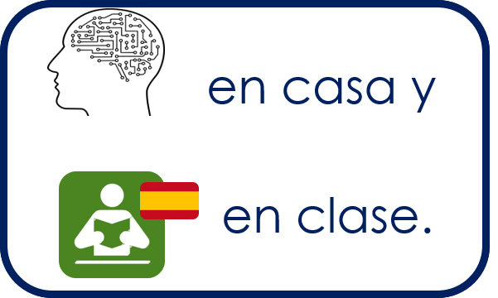

to print
Persona A
Persona B
1 Pregunta y marca
1 Escucha y responde.
|
|
|
|
|
|
|
|
|
|
|
|
|
|
2 Pregunta y marca
2 Escucha y responde.
Notes:
HANDOUT

Slide 20




Follow up [extra]:

Escribe en inglés: Can you get at least 15 points?
 | redondo | el diccionario | la foto
 | larga | moreno | negra
 | el pelo | la cara | corto
 | el médico | la médica | la oreja
 | vender | el dinero | más
 | beber | comer | correr
vocabulario
round (m)
(the) dictionary
(the) photo
x3
long (f)
dark (m)
black (f)
(the) hair
(the) face
short (m)
x2
doctor (f)
(the) ear
doctor (m)
to sell, selling
(the) money
more
x1
to drink, drinking
to eat, eating
to run, running
Notes:
Timing: 10 minutes (two slides)
Aim: to practise written comprehension (this slide) and production (next slide) of vocabulary from this week and this week’s revisited sets.
Procedure:
1. Give pupils a blank grid. They fill in the English meanings of any of the words they know, trying to reach 15 points in total.
Note:
The most recently learnt and practised words are pink, words from the first revisit are green and those from the second revisit are blue, thus more points are awarded for them, to recognise that memories fade and more effort (heavy lifting!) is needed to retrieve them.

Slide 21
Follow up [extra]:

Escribe en inglés: Can you get at least 15 points?
 | redondo | el diccionario | la foto
 | largo | moreno | negro
 | el pelo | la cara | corto
 | el médico | la médica | la oreja
 | vender | el dinero | más
 | beber | comer | correr
vocabulario
x3
x2
x1
Notes:
HANDOUT

Slide 22
Follow up [extra]:

Escribe en español: Can you get at least 15 points?
 | round (m) | (the) dictionary | (the) photo
 | long (m) | dark (m) | black (m)
 | (the) hair | (the) face | short (m)
 | (the) doctor (m) | (the) doctor (f) | (the) ear
 | to sell, selling | (the) money | more
 | to drink, drinking | to eat, eating | to run, running
vocabulario
redondo
el diccionario
la foto
x3
largo
moreno
negro
el pelo
la cara
corto
x2
el médico
la médica
la oreja
vender
el dinero
más
x1
beber
comer
correr
Notes:
Timing: 5 minutes
Aim: to practise written production of vocabulary from this week and this week’s revisited sets.
Procedure:
1. Give pupils a blank grid. They fill in the Spanish meanings of any of the words they know, trying to reach 15 points in total.
Note:
The most recently learnt and practised words are pink, words from the first revisit are green and those from the second revisit are blue, thus more points are awarded for them, to recognise that memories fade and more effort (heavy lifting!) is needed to retrieve them.

Slide 23
Follow up [extra]:

Escribe en español: Can you get at least 15 points?
 | round (m) | (the) dictionary | (the) photo
 | long (m) | dark (m) | black (m)
 | (the) hair | (the) face | short (m)
 | (the) doctor (m) | (the) doctor (f) | (the) ear
 | to sell, selling | (the) money | more
 | to drink, drinking | to eat, eating | to run, running
vocabulario
x3
x2
x1
Notes:
HANDOUT

