Slide 1


español, con Quique

Slide 2

Saying what I and others do
En la clase de inglés y español
azul
-ER verbs:
we & s/he, it
SSC: [ga] [go] [gu]
Notes:
Artwork by Steve Clarke. All additional pictures selected are available under a Creative Commons license, no attribution required.
The frequency rankings for words that occur in this PowerPoint which have been previously introduced in the resources are given in the SOW (excel document) and in the resources that first introduced and formally re-visited those words.
Phonics: revisit [ga] [go] [gu]
Vocabulary (new words in bold): aprender [428] comprender [434] hacer [26] leer [209] poner [91] responder [464] vencer [1426] actividad [344] cultura [469] juego [409] miedo [491] país [109] pregunta [507] prueba [651] revista [920] texto [753] vocabulario [>5000] con [14] sobre [62]
Revisit 1: tienen [8] tenemos [8] botella [1878] espacio [451] foto [882] gato [1728] goma [4437] lámpara [2978] lápiz [3740] mesa [187] oficina [1072] perro [888] regla [1380] ventana [725] excelente [1546] aquí [130] de12 [2] debajo [1366] detrás [2044] en1 [6]
Revisit 2: están [21] son [7] demasiado [494] hoy [167] normalmente [1696]
Source: Davies, M. & Davies, K. (2018). A frequency dictionary of Spanish: Core vocabulary for learners (2nd ed.). Routledge: London
For any other words that occur incidentally in this PowerPoint, frequency rankings will be provided in the notes field wherever possible.
Corregir [2351]

Slide 3




[ga]
ganar
pronunciar
[go]
lago
[gu]
gusano
Notes:
Timing: 1 minute
Aim: To revisit SSC [ga] [go] [gu]
Procedure:
To recap and elicit the pronunciation of the individual SSC [ga] [go] [gu]
Click to bring the picture & get students to repeat (with gesture, if using).
Gesture suggestion for ganar: lift your fist up in two goes.
Gesture suggestion for lago: rowing – two movements
Gesture suggestion for gusano: with index finger, lift up and down three times.

Slide 4

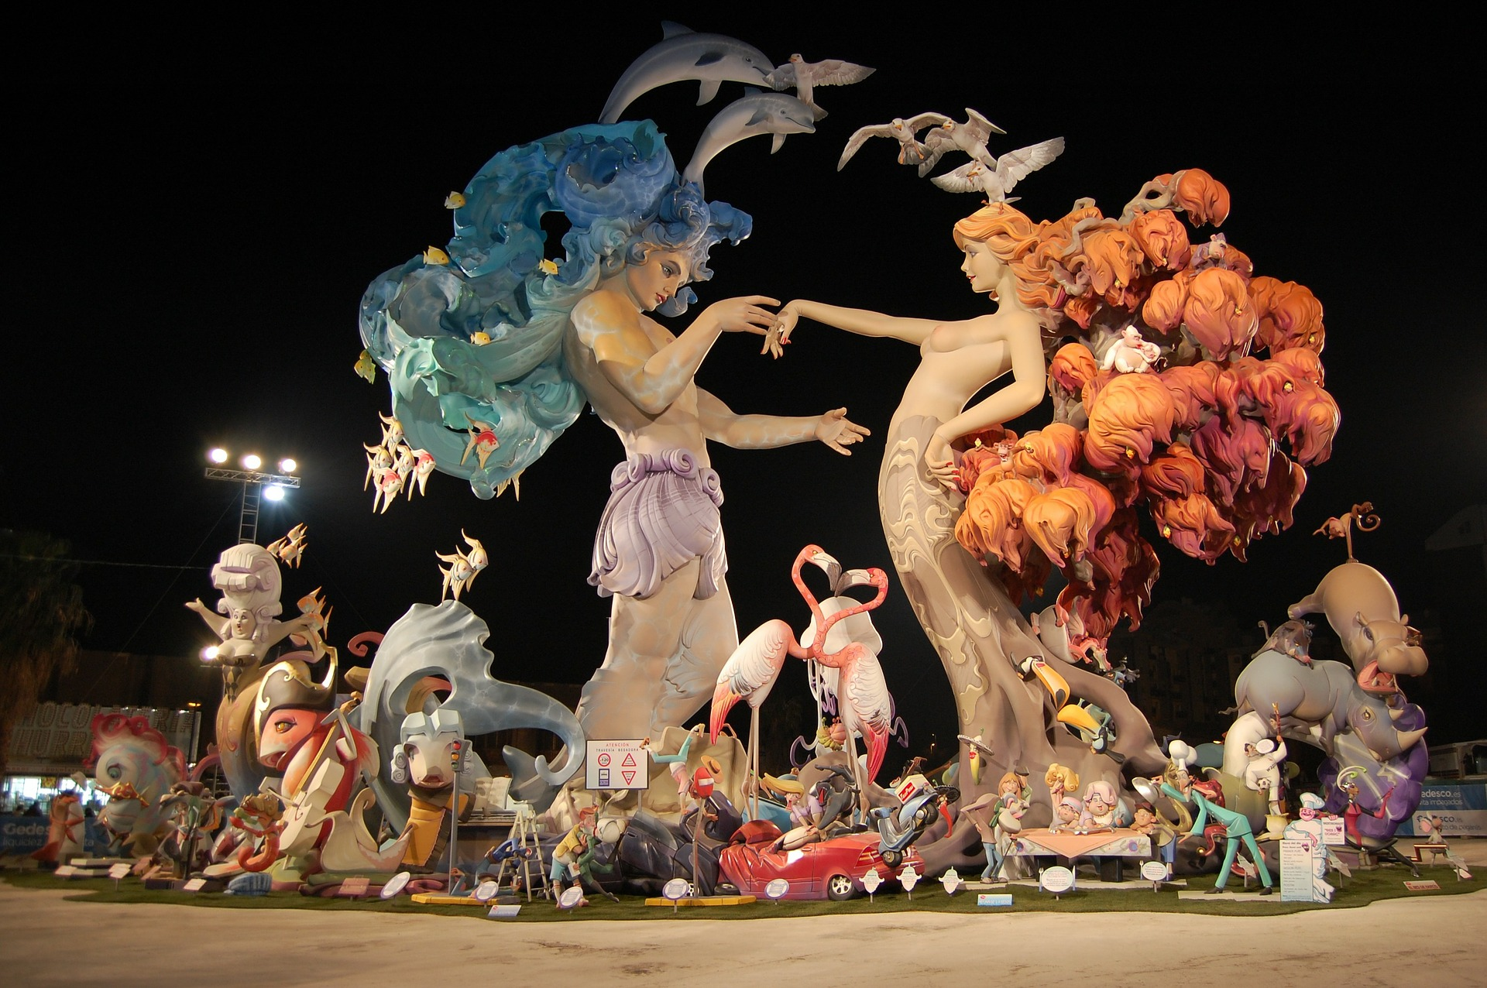
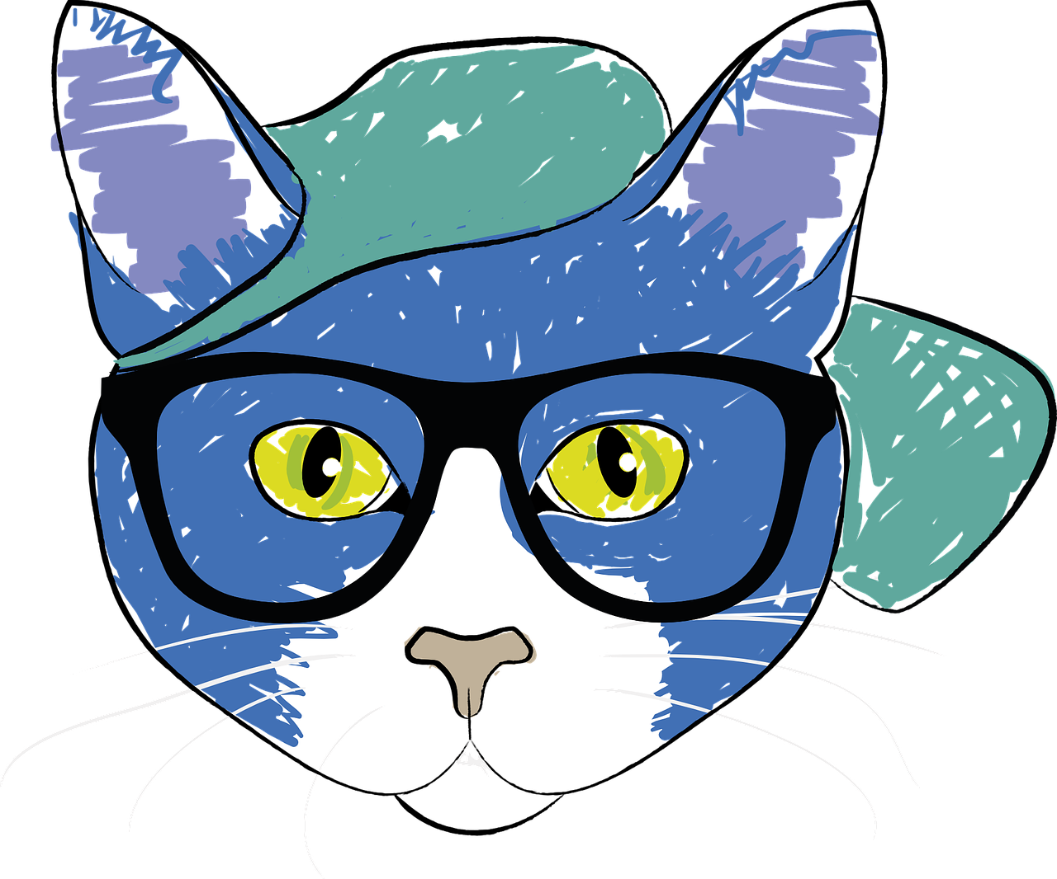


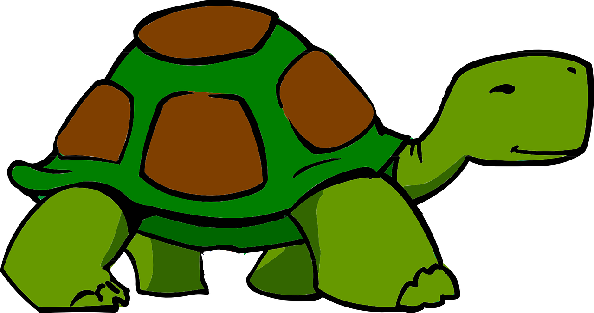



Un poema
pronunciar
[A] Practica. Luego, escucha y repite.
Un domingo largo de agosto
Galeno el gato lleva gafas,
Guzman el gusano busca figuras
y Gala la tortuga organiza regalos.
Las Fallas, Valencia
[B] Con tu compañero, practica
Notes:
Timing: 2 minutes
Aim: to develop phonological confidence with SSC [ga] [go] [gu]
Procedure:
Give pupils a minute or two in pairs to practise reading aloud each line.
Play the audio for each line separately, eliciting pupil repetition.
Give one more minute for paired practice, encouraging them to speed up, as they are able.
Finally, elicit English meanings for each phrase from pupils. All words have been previously taught, except ‘gafas’ and ‘figuras’ but the illustrations and the surrounding words should be sufficient for pupils to arrive at their meanings.

Slide 5


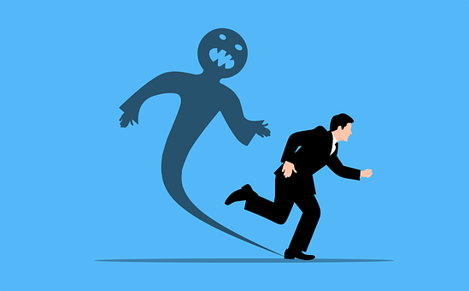
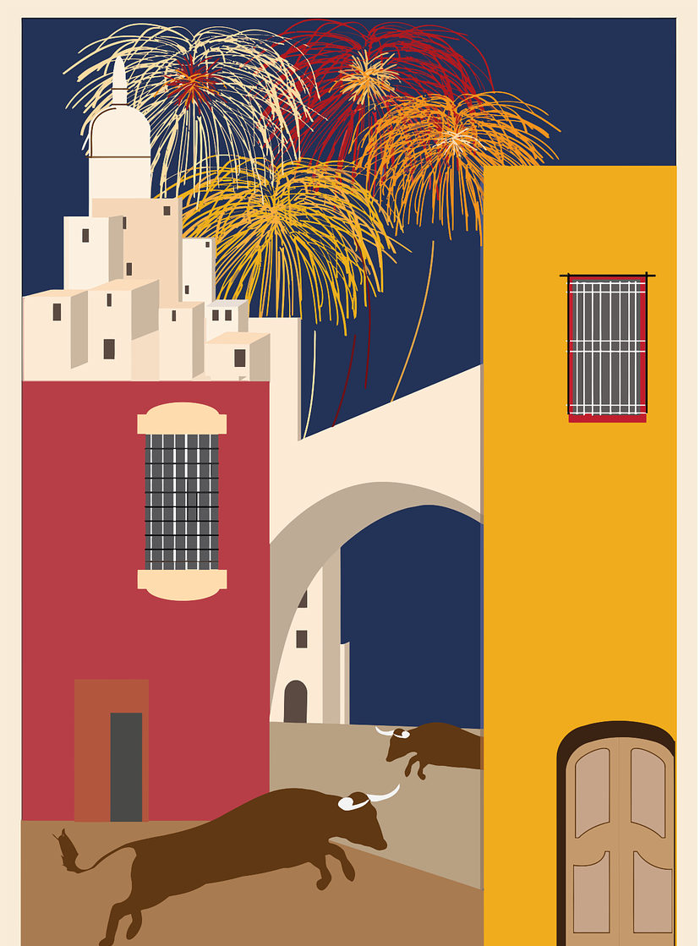

vocabulario
Vocabulario
hacer
vencer
aprender
poner
[to do, make; doing, making]
[to overcome, overcoming]
[to learn, learning]
[to put, putting]
la prueba
el miedo
la cultura
sobre
[test]
[fear]
[culture]
[about; on]
Notes:
Timing: 5 minutes (two slides)
Aim: to introduce new vocabulary for this week and recap two previously taught –ER verbs.
Procedure:
Round 1 [slide 1]
1.Teacher introduces items one by one (word, then picture & English) and pupils practise pronunciation aloud.
Alternatively, pupils work in pairs, reading the Spanish words out loud and looking at the English meanings (1 minute).
2. Then the teacher removes the English words or pictures (one by one) and pupils try to recall the English orally (chorally), looking at the Spanish (1 minute).
Round 2 [Next slide]
1. The Spanish meanings are removed (hints provided) and pupils try to recall them orally (again, chorally), looking at the English (1 minute).
4. Click on the pictures to remove the hints and reveal Spanish word.
NB. Further rounds of learning can be facilitated by one pupil turning away from the board, and his/her partner asking him/her the meanings (‘Cómo se dice X en español?’). This activity can work from L2 → L1 or L1 → L2.

Slide 6
vocabulario
Vocabulario
vocabulario
[to learn, learning]
[to put, putting]
l_ c_lt_ _a
la cultura
aprender
_pr_nd_r
_l m_ _ d _
p_n_r
el miedo
poner
[culture]
[fear]
[to do, make; doing, making]
[to overcome, overcoming]
[about; on]
la prueba
l_ pr_ _ b_
h_c_ _
hacer
v_ _ c_ _
vencer
s_b_ _
sobre
[test]
Notes:
Round 2
Procedure:
Round 2 [Next slide]
1. Parts of the Spanish words are missing and pupils try to recall them orally (again, chorally), looking at the English (1 minute).
2. Click on the pictures or English prompt to remove the hints and reveal each Spanish word.

Slide 7



Knowing who does what
[–er verbs: ‘S/he, it’ and ‘we’]
Remember that some Spanish infinitives end in –er.
To mean ‘S/he, it’ with a verb, we remove –er and add -e.
To mean ‘we’ with a verb, we remove –er and add –emos.
aprender
⚠ We don’t need pronouns because the verb ending tells us who is doing the action.
Compara.
Hello, Krina & Max!
S/he, it
Aprende español.
we
S/he learns Spanish.
Aprendemos inglés.
Krina aprende español.
We learn English.
Krina learns Spanish.
Notes:
Timing: 3 minutes
Aim: to reintroduce 3rd person singular for–er verbs and introduce 1st plural.
Procedure:
Click through the animations to present the new information.
Elicit English translations for the Spanish examples provided.

Slide 8


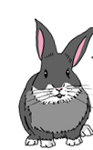



leer
Agua 💧 en los deberes de Quique.
¡Manchita!
¡Lo siento!
Manchita has spilled water all over Quique’s English homework.
Aprende sobre la cultura de España.
Lee las frases y marca.
E
Sheearns
She learns about the culture of Spain.
Q & S (we) | Krina (she)
1
Vencemos el miedo con el profesor.
We overcome fear with the teacher.
weovercome
[E]
2
Hacemos una prueba en la oficina.
We do a test in the office.
[1]
Wedo0
3
Pone la goma sobre la mesa.
[2]
She puts the rubber on the table.
shedoe0
4
Aprendemos el vocabulario en español.
[3]
We learn the vocabulary in Spanish.
shedoe0
[4]
Notes:
Timing: 7 minutes
Aim: to practise written comprehension of key –1st person plural and 3rd person singular of -er verbs.
Procedure:
Read the title & click to explain the context of the task.
Click to bring further instructions in Spanish. Is Quique talking about Sofía and himself, or about Krina? Clarify that Q & s refers to Quique and Sofía (they go to school together = we form of the verb).
Do [E] with them to model the task and draw their attention to the verb.
Pupils complete 1-4.
Click through the animations to bring up answers.
If desired, click on the green buttons to hear the sentences pronounced.

Slide 9

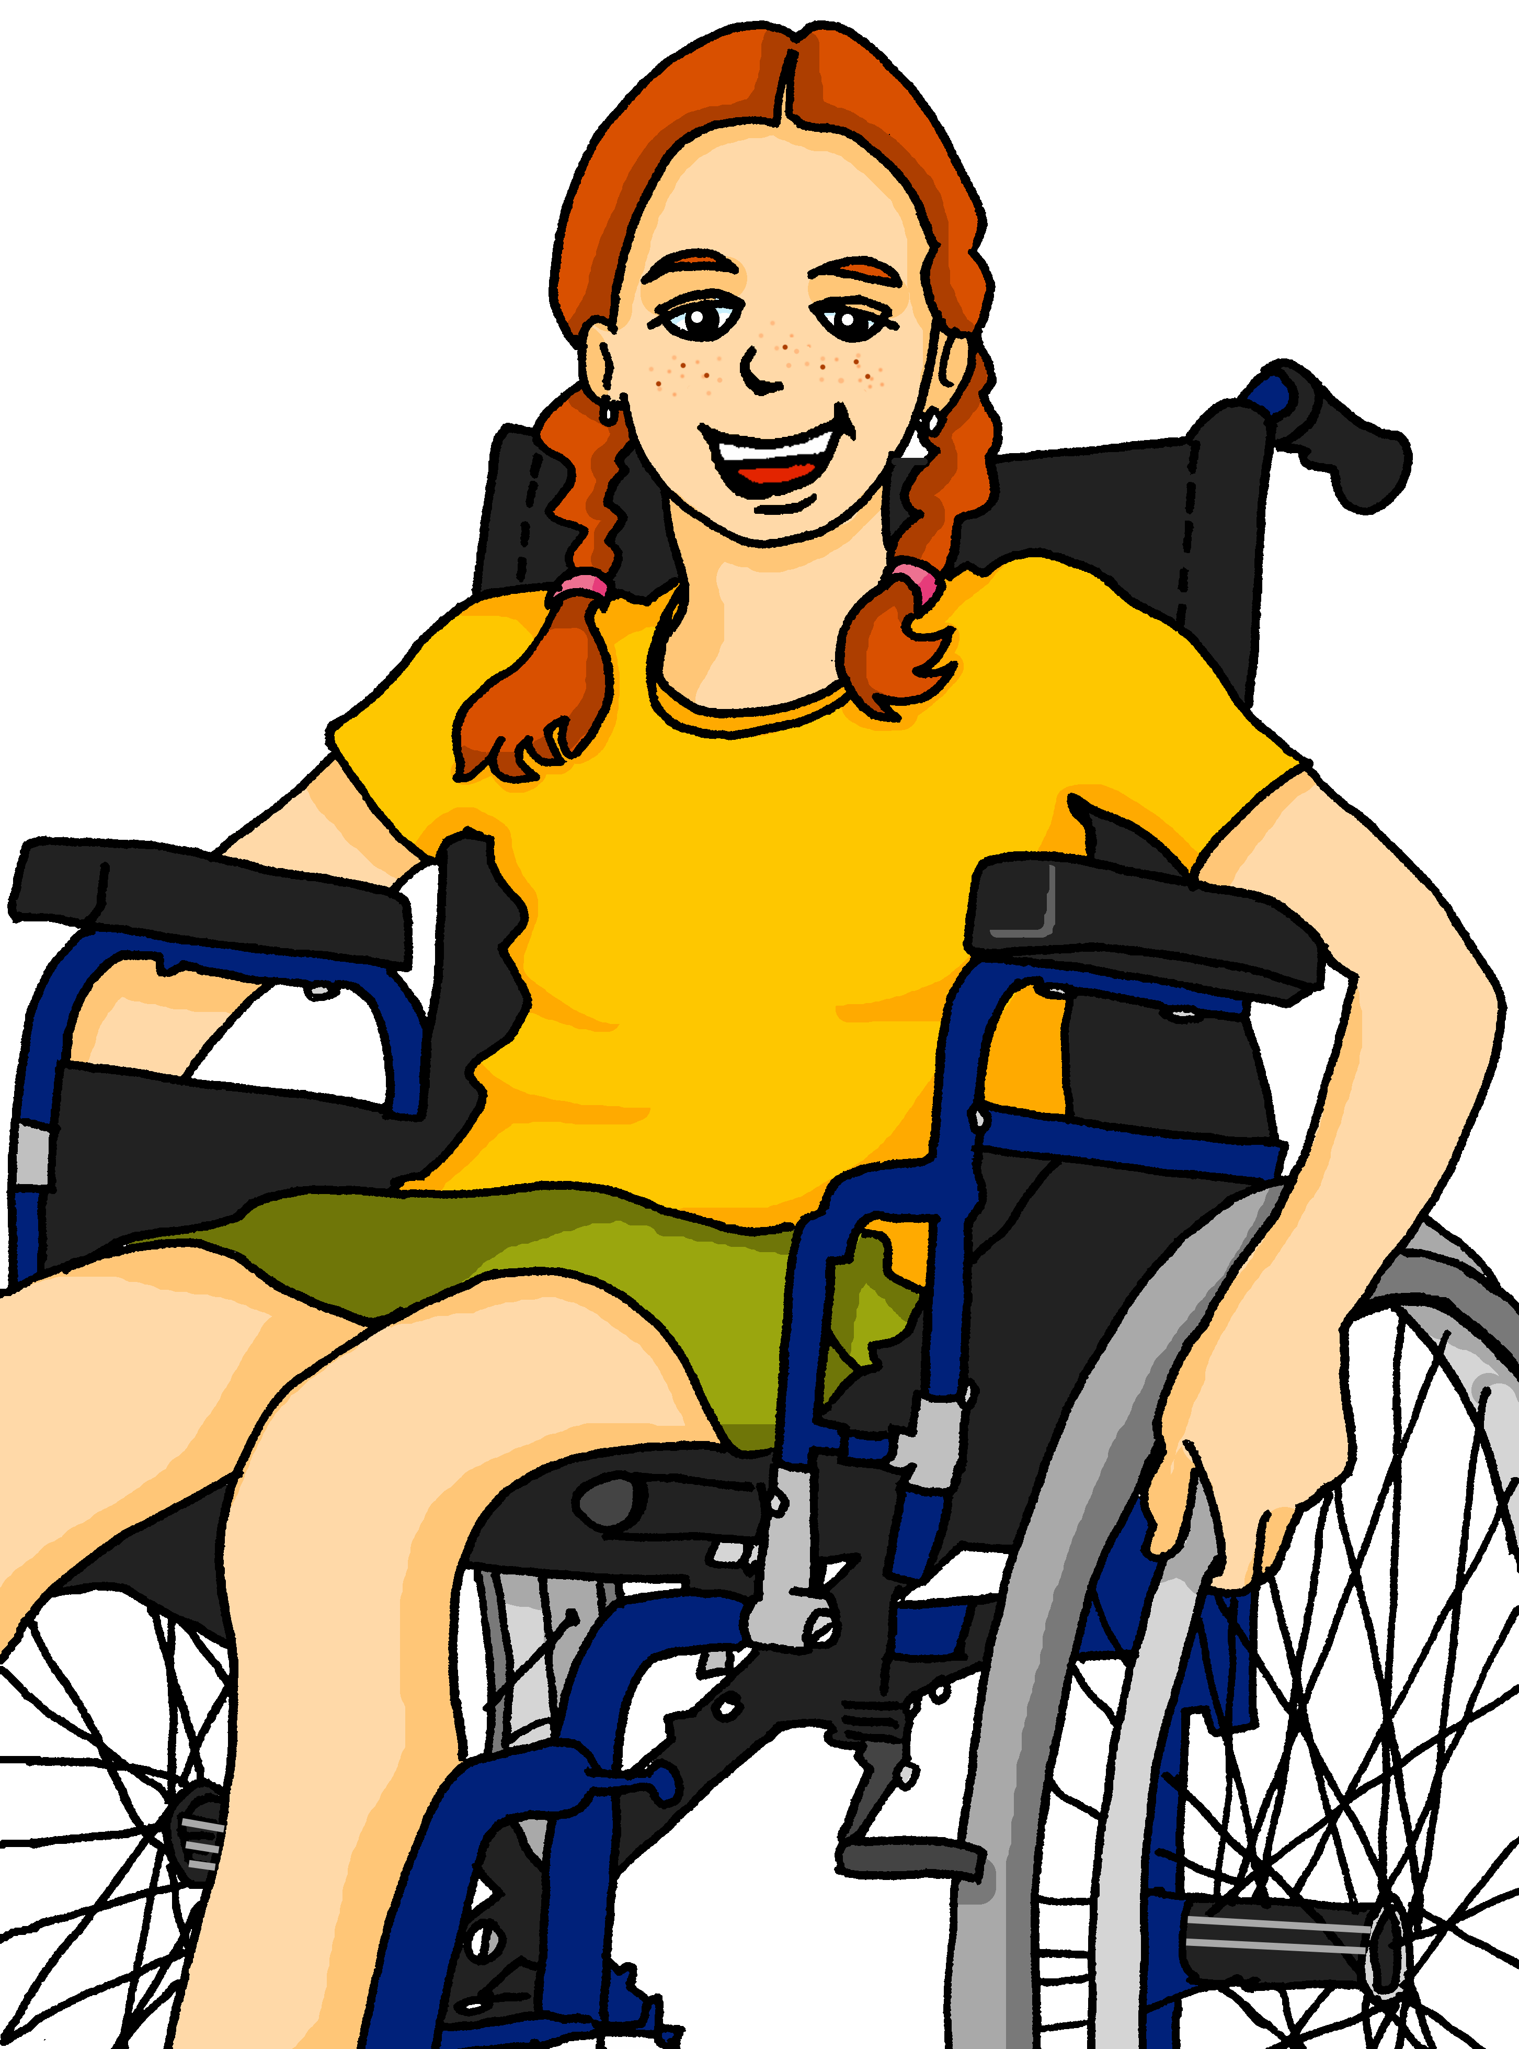
escuchar
¿Quique y Sofía (we) o Krina (she)?
Escucha a Quique.
Marca la opción correcta y escribe el verbo.
s/he ; we | verbo | completa la frase
s/he
we
s/he
we
s/he
we
s/he
we
s/he
we
E
lee
un libro
1
hacemos
una actividad
Aprendo español.
2
vence
el miedo
I learn English.
3
leemos
una revista
4
comprende
la frase
Notes:
Timing: 8 minutes
Aim: to practise distinguishing aurally between the meanings of the 1st person plural and 3rd person singular ‘-er’ verbs in the present.
Procedure:
Click the number button to play the recording.
Students first need to write or circle s/he or we, and then write the correct form of the verb they heard in Spanish. They then transcribe the rest of the sentence. They may want to listen twice to each item.
Click to show the answers one by one for each question in order.
Ask students to translate the sentences into English orally. Feedback can be given here on anything that is unclear.
Transcript
E. Lee un libro
Hacemos una actividad.
Vence el miedo.
Leemos una revista.
Comprende la frase.
Note: all words not taught this lesson were previously taught in Y3/4. However, if you are using this SOW for the first time, pupils may have vocabulary gaps. Reassure them to do their best as they transcribe and then clarify meanings with them during feedback.

Slide 10
¡adiós!
azul

