Slide 1

Saying what I and others do
En la clase de inglés y español
azul
Follow ups 1-5
Notes:
Artwork by Steve Clarke. All additional pictures selected are available under a Creative Commons license, no attribution required.
The frequency rankings for words that occur in this PowerPoint which have been previously introduced in NCELP resources are given in the NCELP SOW and in the resources that first introduced and formally re-visited those words.
Phonics: revisit [ga] [go] [gu]
Vocabulary (new words in bold): aprender [428] comprender [434] hacer [26] leer [209] poner [91] responder [464] vencer [1426] actividad [344] cultura [469] juego [409] miedo [491] país [109] pregunta [507] prueba [651] revista [920] texto [753] vocabulario [>5000] con [14] sobre [62]
Revisit 1: tienen [8] tenemos [8] botella [1878] espacio [451] foto [882] gato [1728] goma [4437] lámpara [2978] lápiz [3740] mesa [187] oficina [1072] perro [888] regla [1380] ventana [725] excelente [1546] aquí [130] de12 [2] debajo [1366] detrás [2044] en1 [6]
Revisit 2: están [21] son [7] demasiado [494] hoy [167] normalmente [1696]
For any other words that occur incidentally in this PowerPoint, frequency rankings will be provided in the notes field wherever possible.
Source: Davies, M. and Davies, K. (2018). A frequency dictionary of Spanish: Core vocabulary for learners (2nd ed.). Routledge: London

Slide 2


Follow up 1
[ga]
[go]
[gu]
Escucha. Marca [ga], [go] o [gu]. Luego, escribe la palabra.
escuchar
 | [ga] | [go] | [gu]
en español | en inglés
E
fuego
fire
1
pregunta
question
2
jugar
to play
3
regalar
to give (a gift)
4
figura
figure
5
enemigo
enemy
Notes:
Timing: 5 minutes
Aim: to apply knowledge of the SSC [ga], [go], [gu]
Procedure:
Click to listen. Pupils indicate which SSC they hear.
Listen to each word again. Pupils write the word in Spanish, and in English if they can.
Note: some words were previously taught, others are cognates. We begin with previously taught words.
Transcript:
Ej. fuego
1. pregunta
2. jugar
3. regalar
4. figura
5. enemigo
enemigo [1066] figura [632] regular [1420]
Source: Davies, M. and Davies, K. (2018). A frequency dictionary of Spanish: Core vocabulary for learners (2nd ed.). Routledge: London

Slide 3







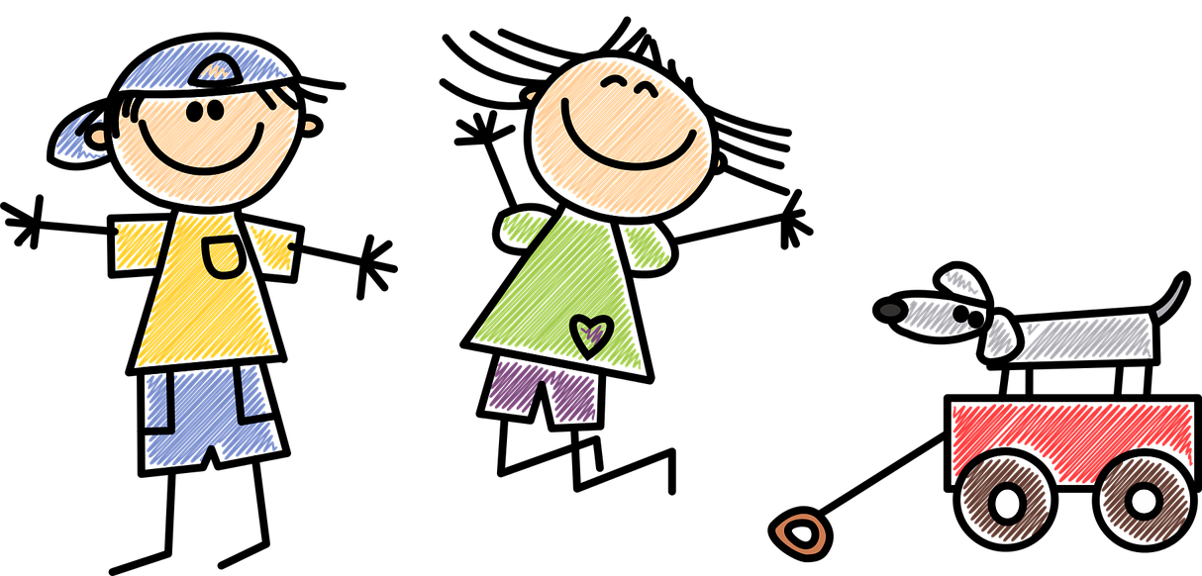


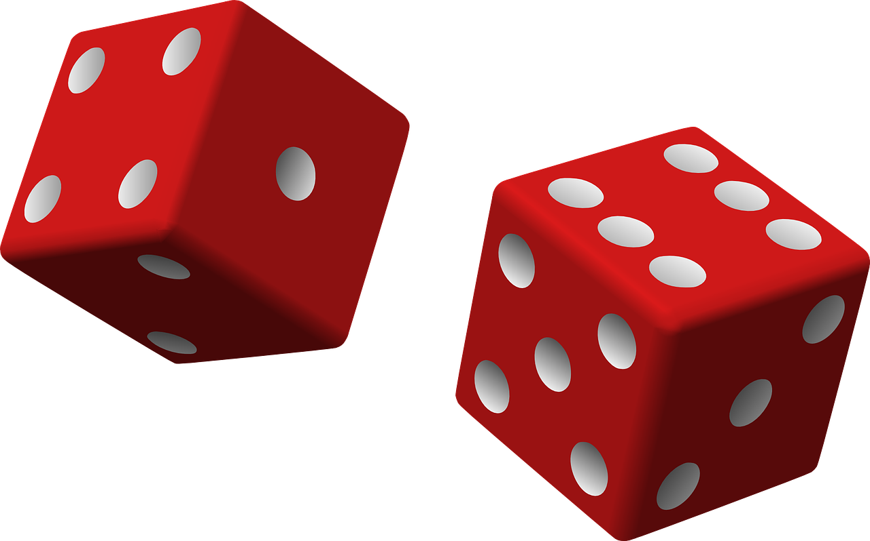
Follow up 2:
Vocabulario
leer
leer
tener
comprender
responder
hablar
un país
una actividad
una pregunta
un juego
to understand, understanding
to read, reading
to have, having
to respond, responding
a game
an activity
a country
a question
Notes:
Timing: 5 minutes
Aim: to revisit previously taught vocabulary that we will use again this week.
Procedure:
1. Click for an English prompt.
2. Elicit the Spanish word from pupils.
3. Continue until all 8 items have been seen and heard.

Slide 4
Follow up 3:
Combina las palabras y escribe frases.
 | A | B | C
1 | Respondemos | los lápices | las pruebas.
2 | Vence | la cultura de | pregunta en inglés.
3 | Aprende sobre | a la | sobre el país de Cuba.
4 | Ponemos | el miedo a | Inglaterra.
5 | Leemos | un texto | sobre la mesa.
leer
1.
2.
3.
4.
5.
Respondemos a la pregunta en inglés.
Vence el miedo a las pruebas.
Aprende sobre la cultura de Inglaterra.
Ponemos los lápices sobre la mesa.
Leemos un texto sobre el país de Cuba.
Notes:
Timing: 5 minutes
Aim: to practise written comprehension of vocabulary and structures from this week and revisited weeks.
Procedure:
Pupils write five sentences using one element from each column. (They should use all the options but only once).
Click to check answers.

Slide 5


Follow up 4: ¡Llueve!
Escribe en inglés.
comprende
hacemos
responder
leer
vencer
tenemos
comprender
5
aprendemos
lee
poner
4
vencemos
3
leer
responde
hace
2
aprende
ponemos
tener
1
Notes:
Timing: 5 minutes (two slides)
Aim: to practise written comprehension of verbs in infinitive, 1st person plural and 3rd person singular
Procedure:
Tell pupils to be ready to write the English meanings of verbs they have been learning and practising this week. There will be 16 altogether and they should prepare to work from the bottom of the slide, left to right.
Explain the scenario – it’s raining and the raindrops will splash down and cover the words. They need to write the meanings before the verbs get covered. Tell them they will have 5 seconds to get a headstart on the rain.
Click to start number animation.
Click once more to start raindrops. The timing has been carefully set! Don’t click again or all the raindrops will appear at once.
When finished move to the next slide to check answers.

Slide 6
Follow up 4: Respuestas
responder
comprende
hacemos
to respond,
responding
leer
s/he, it understands
we do, make
vencer
comprender
tenemos
to overcome, overcoming
to understand, understanding
we have
aprendemos
poner
lee
we learn
to put
s/he, it reads
vencemos
responde
we overcome
hace
leer
to read, reading
s/he, it responds
s/he, it does, makes
aprende
ponemos
tener
we put
s/he, it learns
to have, having
Notes:
Procedure:
Elicit responses from the bottom, left to right, from pupils.
Click to bring up a written version of the answer.

Slide 7

Follow up 5:
Ahora, habla con tu pareja.
Escribe la frase.
She | put(s) | fear | on the table
He | overcome(s) | the culture | with the teacher
We | do(es), make(s) | a test | in class
 | read(s) | a magazine | in English
 | learn(s) | the phrase | about Perú
 | understand(s) | an activity | about the cat
 | respond(s) | the book | every day
 | has, have | (to) a question | in Spanish
escribir
Vencemos el miedo con el profesor.
Hace una prueba en español.
Ponemos el libro en la mesa.
Respondemos a una pregunta sobre Perú.
Comprende una actividad en inglés.
Lee la frase en clase.
Notes:
Timing: 10 minutes
Aim: to create 6 sentences with –er verbs in 1st person plural and 3rd person plural based on the prompts.
Procedure:
Bring up each combination of sentence parts
Ask students to volunteer the answer orally. Alternatively they could just to write the Spanish on mini-whiteboards or in their books, then
Students then create a number of their own sentences, using new combinations of words in the grid.
After writing the six sentences, teachers could encourage an oral simultaneous translation task, where students say a sentence and their partner translates it. Some may find this challenging to do on the spot, so this oral component could be done by some students, while other students continue to practise writing.
Sentences:
1) Lee la frase en clase.
2) Hace una prueba en español.
3) Vencemos el miedo con el professor.
4) Respondemos a una pregunta sobre Perú.
5) Ponemos el libro en la mesa.
6) Comprende una actividad en inglés.

Slide 8




Follow up [extra]:

Escribe en inglés: Can you get at least 15 points?
 | están | son | demasiado
 | en | la oficina | normalmente
 | la mesa | debajo (de) | detrás (de)
 | tenemos | tienen | el espacio
 | el miedo | la prueba | sobre
 | poner | vencer | la cultura
vocabulario
they are [state]
they are [trait]
too much, too
x3
in, on
office
usually
table
under
behind
x2
we have
they have
space
fear
test
about, on
x1
to put, putting
to overcome
culture
Notes:
Timing: 10 minutes (two slides)
Aim: to practise written comprehension (this slide) and production (next slide) of vocabulary from this week and this week’s revisited sets.
Procedure:
1. Give pupils a blank grid. They fill in the English meanings of any of the words they know, trying to reach 15 points in total.
Note:
The most recently learnt and practised words are pink, words from the first revisit are green and those from the second revisit are blue, thus more points are awarded for them, to recognise that memories fade and more effort (heavy lifting!) is needed to retrieve them.

Slide 9
Follow up [extra]:

Escribe en español: Can you get at least 15 points?
 | they are [state] | they are [trait] | too much, too
 | in, on | office | usually
 | table | under | behind
 | we have | they have | space
 | fear | test | about, on
 | to put, putting | to overcome | culture
vocabulario
están
son
demasiado
x3
en
la oficina
normalmente
la mesa
debajo de
detrás de
x2
tenemos
tienen
el espacio
el miedo
la prueba
sobre
x1
poner
vencer
la cultura
Notes:
Timing: 5 minutes
Aim: to practise written production of vocabulary from this week and this week’s revisited sets.
Procedure:
1. Give pupils a blank grid. They fill in the Spanish meanings of any of the words they know, trying to reach 15 points in total.
Note:
The most recently learnt and practised words are pink, words from the first revisit are green and those from the second revisit are blue, thus more points are awarded for them, to recognise that memories fade and more effort (heavy lifting!) is needed to retrieve them.

Slide 10
Follow up [extra]:

Escribe en inglés: Can you get at least 15 points?
 | están | son | demasiado
 | en | la oficina | normalmente
 | la mesa | debajo | detrás
 | tenemos | tienen | el espacio
 | el miedo | la prueba | sobre
 | poner | vencer | la cultura
vocabulario
x3
x2
x1
Notes:
Handout 1

Slide 11
Follow up [extra]:

Escribe en español: Can you get at least 15 points?
 | they are [state] | they are [trait] | too much, too
 | in, on | office | usually
 | table | under | behind
 | we have | they have | space
 | fear | test | about, on
 | to put, putting | to overcome | culture
vocabulario
x2
x1
Notes:
Handout 2

