Slide 1


español, con Quique

Slide 2

Saying what I and others do
azul
-AR verbs: we & they
connecting sentences
SSC: [l] [ll]
Notes:
Artwork by Steve Clarke. All additional pictures selected are available under a Creative Commons license, no attribution required.
The frequency rankings for words that occur in this PowerPoint which have been previously introduced in the resources are given in the SOW (excel document) and in the resources that first introduced and formally re-visited those words.
Phonics: revisit [l] and [ll]
Vocabulary (new words in bold): bailar [1323] cocinar [3074] mandar [588] mirar [125] luz [278] pollo [3577] suéter [>5000] tarjeta [1958] común [742]
Revisit 1: tienen [8] enorme [631] un poco [76] solo [181] bocadillo [>5000] clase [320] conejo [4728] cuaderno [3301] hermano [333] hermana [3409] lápiz [3740] libro [230] mochila [>5000] regla [1380] ventana [725] activo [1278] bonito [891] grande [66] nuevo [94] viejo [225] bastante [308] muy [43] de12 [2]
Revisit 2: cuál [445] día [65] fecha [756] lunes [1370] martes [3101] miércoles [1816] jueves [1650] viernes [1259] sábado [1179] domingo [693] hoy [167]
Source: Davies, M. & Davies, K. (2018). A frequency dictionary of Spanish: Core vocabulary for learners (2nd ed.). Routledge: London
For any other words that occur incidentally in this PowerPoint, frequency rankings will be provided in the notes field wherever possible.
glossed: asado [>5000]

Slide 3


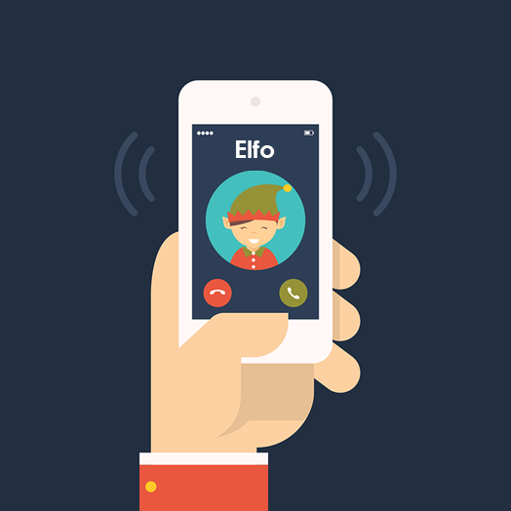
[l]
libro
pronunciar
[ll]
llamar
Notes:
Timing: 1 minute
Aim: to revisit SSC [l] and [ll].
Procedure:
To recap and elicit the pronunciation of the individual SSC [ll] [l]
Click to bring the picture and get students to repeat (with gesture, if using).
Gesture suggestions:
libro: use two hands to pretend to open a book
llamar: with your right hand, pretend to answer the phone, then repeat with the left hand. Two gestures = two syllables of the word.

Slide 4


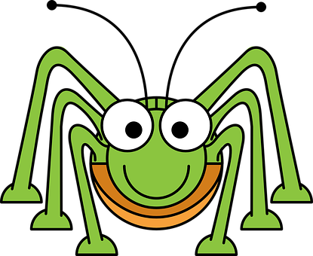
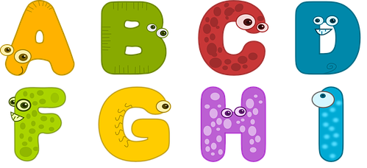

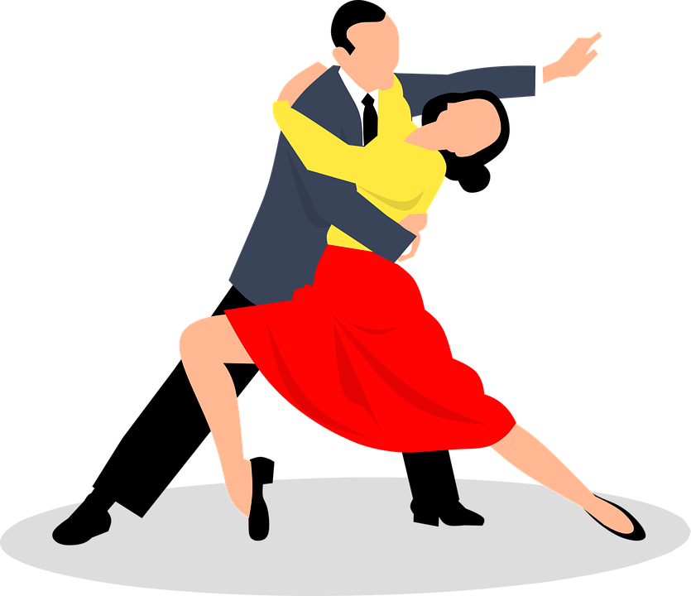
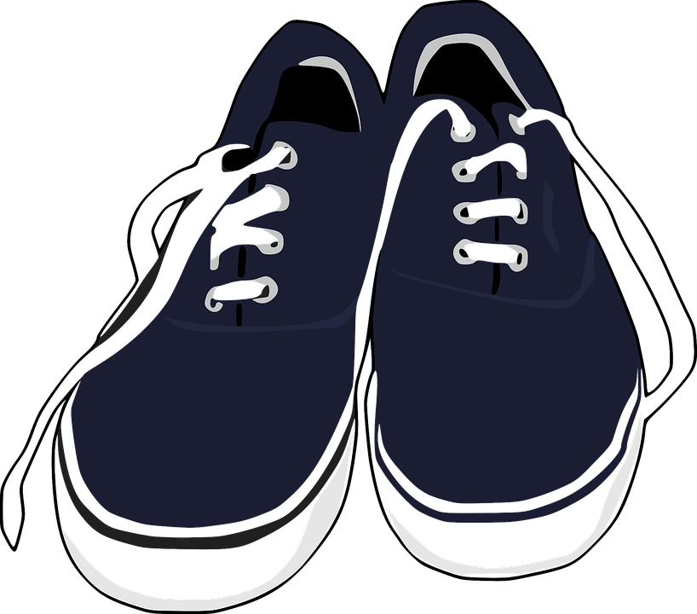
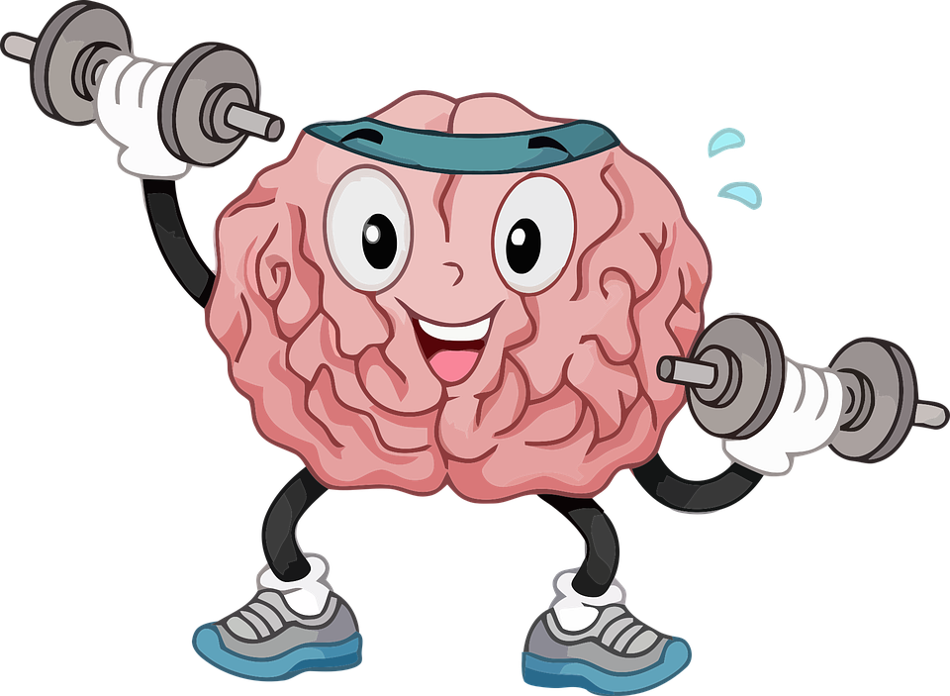
pronunciar
Escucha. ¿Se escribe con [l] o [ll]? Luego, pronuncia.
20
[to arrive, arriving]
luz
grillo
letras
llegar
ella
intel igente
bailar
zapatillas
0
INICIO
Notes:
Timing: 5 minutes
Aim: to develop phonological awareness of [l] and [ll].
Procedure:
Click to listen.
Pupils write 1-8 and either ‘l’ or ‘ll’.
Click again to reveal the pictures and the answers.
Click inicio for pupils to pronounce all of the words.
Click on each image to hear it, if desired.
Transcript:
1. luz
2. grillo
3. Letras
4. llegar
5. ella
6. inteligente
7. bailar
8. zapatillas
Frequency of unknown words and cognates:
luz [278] grillo [>5000] letras [977] llegar [75] ella [72] inteligente [2167] bailar [1323] zapatillas [4939]
Source: Davies, M. & Davies, K. (2018). A frequency dictionary of Spanish: Core vocabulary for learners (2nd ed.). Routledge: London

Slide 5


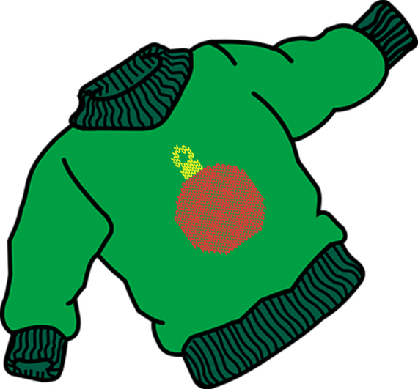

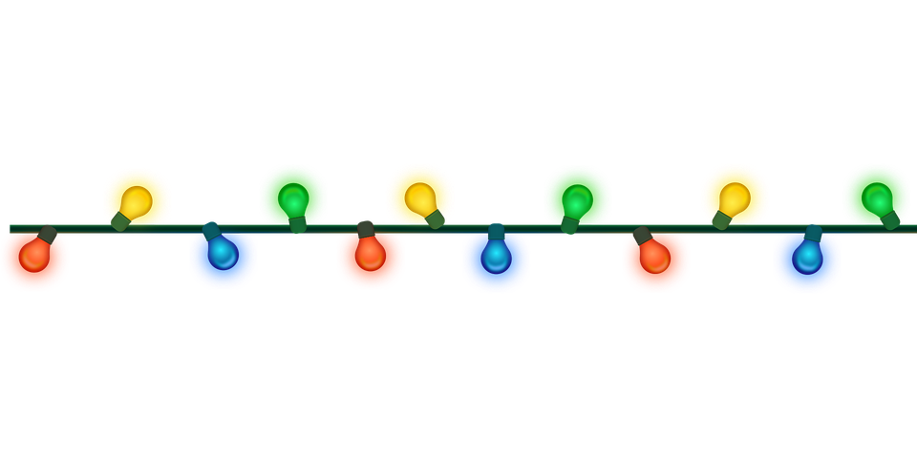
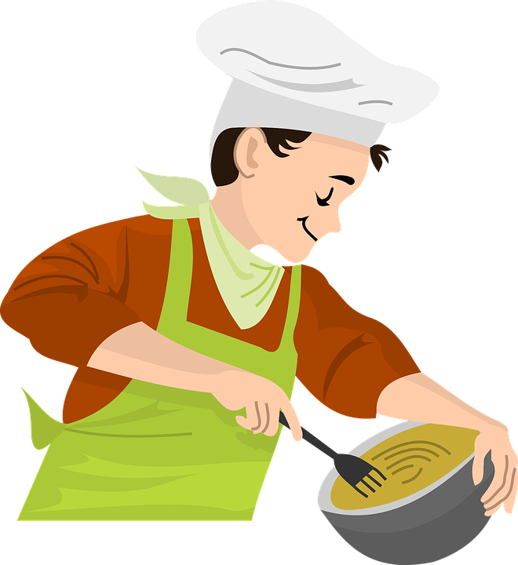


vocabulario
Vocabulario
el suéter
el pollo
la tarjeta
la luz
[jumper]
[chicken]
[card]
[light]
bailar
mirar
mandar
cocinar
[to dance, dancing]
[to look, looking]
[to send, sending]
[to cook, cooking]
Notes:
Timing: 3 minutes (one slide)
Aim: to introduce key vocabulary for the context of comparing countries and customs.
Procedure:
Teacher introduces items one by one (word, picture, English) and pupils practise pronunciation aloud.
2. Then the teacher removes the English words and/or pictures (one by one) and pupils try to recall the English orally (chorally), looking at the Spanish (1 minute).
3. Then the Spanish meanings are removed (one by one) and pupils try to recall them orally (again, chorally), looking at the English (1 minute)
4. Further rounds of learning can be facilitated by one pupil turning away from the board, and his/her partner asking him/her the meanings (‘Cómo se dice X en español?’). This activity can work from L2 → L1 or L1 → L2.

Slide 6


Knowing who does what
⚠ We don’t need pronouns because the verb ending tells us who is doing the action.
[–ar verbs: Singular forms vs. ‘we’]
In Spanish, the words for ‘I’ and ‘S/he, it’ (pronouns) are often unnecessary.
To mean ‘I’, ‘you’, ‘s/he,it’ with a verb, the verb ending changes.
Compara:
llevar
llevo
llevas
lleva
I wear
You wear
S/he, it wears
we
To mean ‘we’ with a verb, we remove –ar and add -amos.
Llevamos un suéter de Navidad.
We wear a Christmas jumper.
Notes:
Timing: 3 minutes
Aim: to introduce 1st person plural (we-form) for –ar verbs, building on the singular forms of –ar verbs.
Procedure:
Click through the animations to present the new information.
Elicit English translations for the Spanish examples provided.

Slide 7



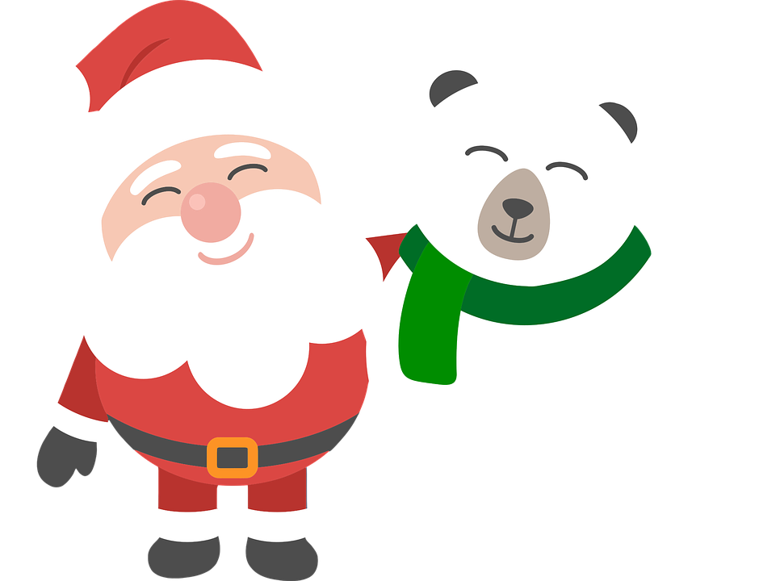

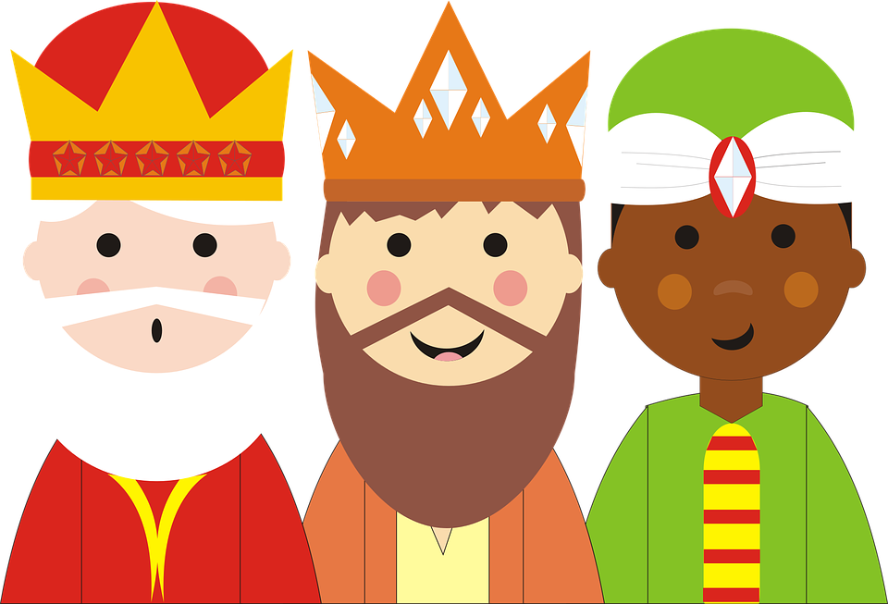
escuchar
Las Navidades de Quique y Krina.
asado – roast
Quique habla de Navidad con su familia y compara con la Navidad de Krina.
Marca
Escucha otra vez.
Quique y su familia | Krina
el verbo
información extra
E
escuchamos
music
1
paseamos
through the city
2
cocina
roast chicken
3
bailamos
with the family
4
lleva
a Christmas jumper
5
manda
cards
Notes:
Timing: 7 minutes
Aim: to practise aural comprehension of ‘3rd person singular ’ & ‘1st person plural’.
Procedure:
Pupils write 1-5 in their books Sofía & su familia and Krina.
Click to listen to the example. Pupils decide whether Sofía is talking about her and her family (we), or Krina (she).
Click to listen again. Pupils transcribe the verb in Spanish and any additional detail in English.
Complete the task with items 1-6, listening once for the verb forms.
Click to correct for number.
Listen again to allow time for pupils to transcribe the verbs and write any additional details in English.
Click to reveal answers.
Transcript:
E. Escuchamos música.
Paseamos por la ciudad.
Cocina pollo asado.
Bailamos con la familia.
Lleva un suéter de Navidad.
Manda tarjetas.

Slide 8
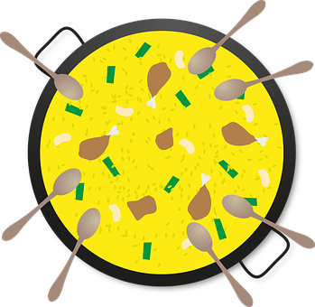
Knowing who does what
[–ar verbs: ‘we’ versus ‘they’]
To mean ‘we’ with a verb, we remove –ar and add -amos.
To mean ‘they’ with a verb, we remove –ar and add –an.
Ejemplo: cocinar
we
they
Cocinamos pollo asado.
Cocinan paella.
We cook roast chicken.
They cook paella.
asado – roast
Notes:
Timing: 3 minutes
Aim: to introduce 3rd person plural for –ar verbs and revisit 1st person plural.
Procedure:
Click through the animations to present the new information.
Elicit English translations for the Spanish examples provided.

Slide 9
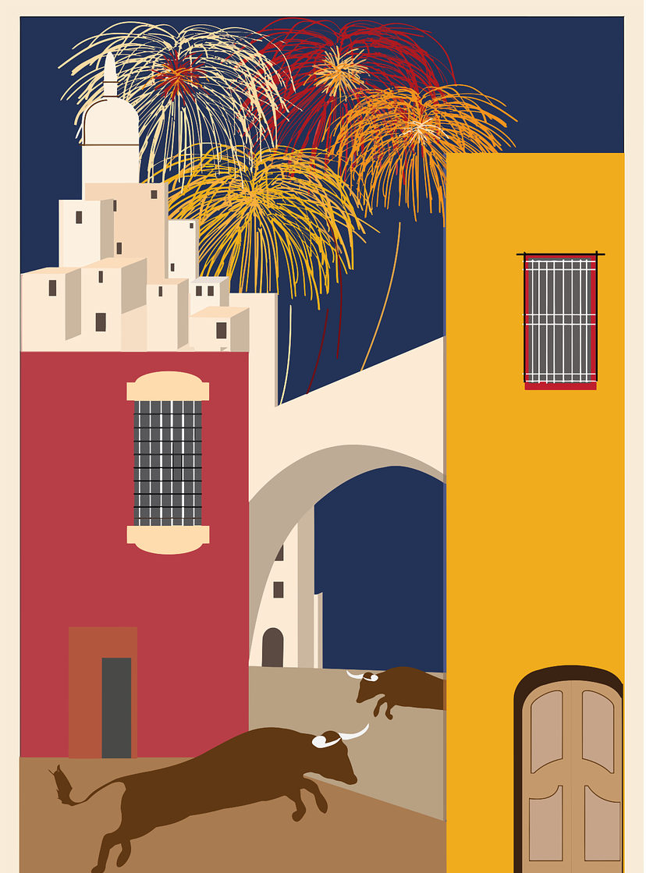

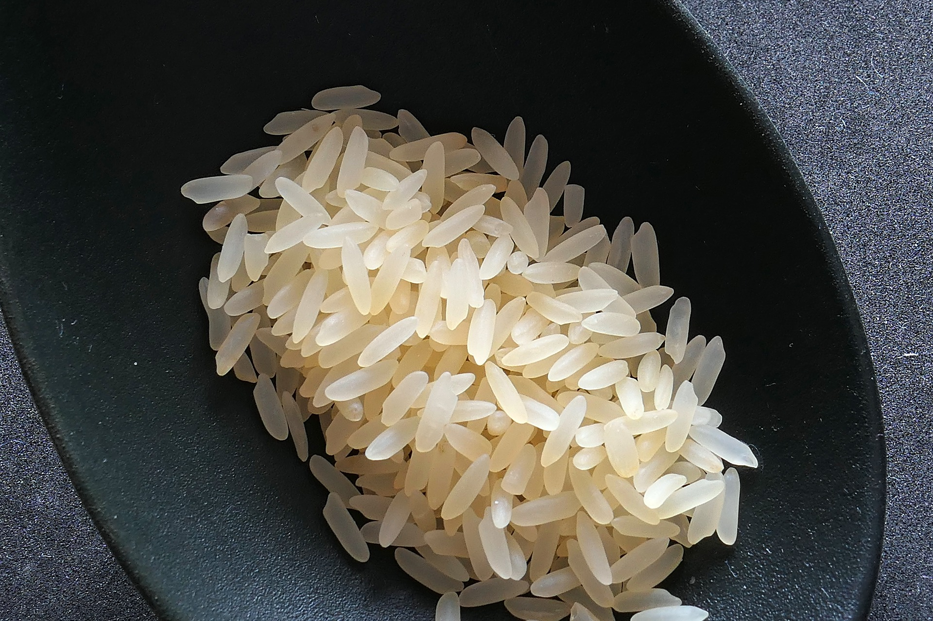
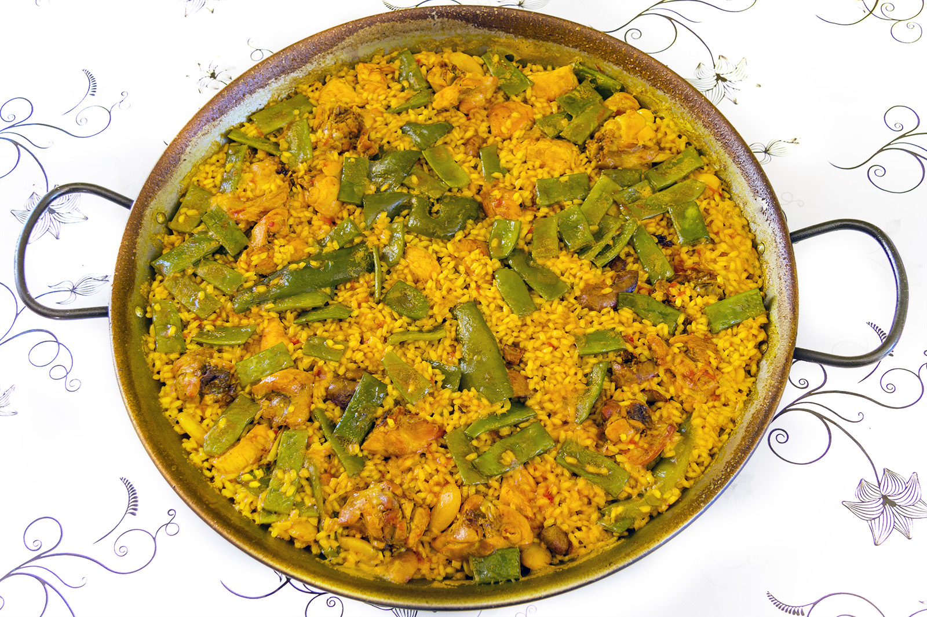
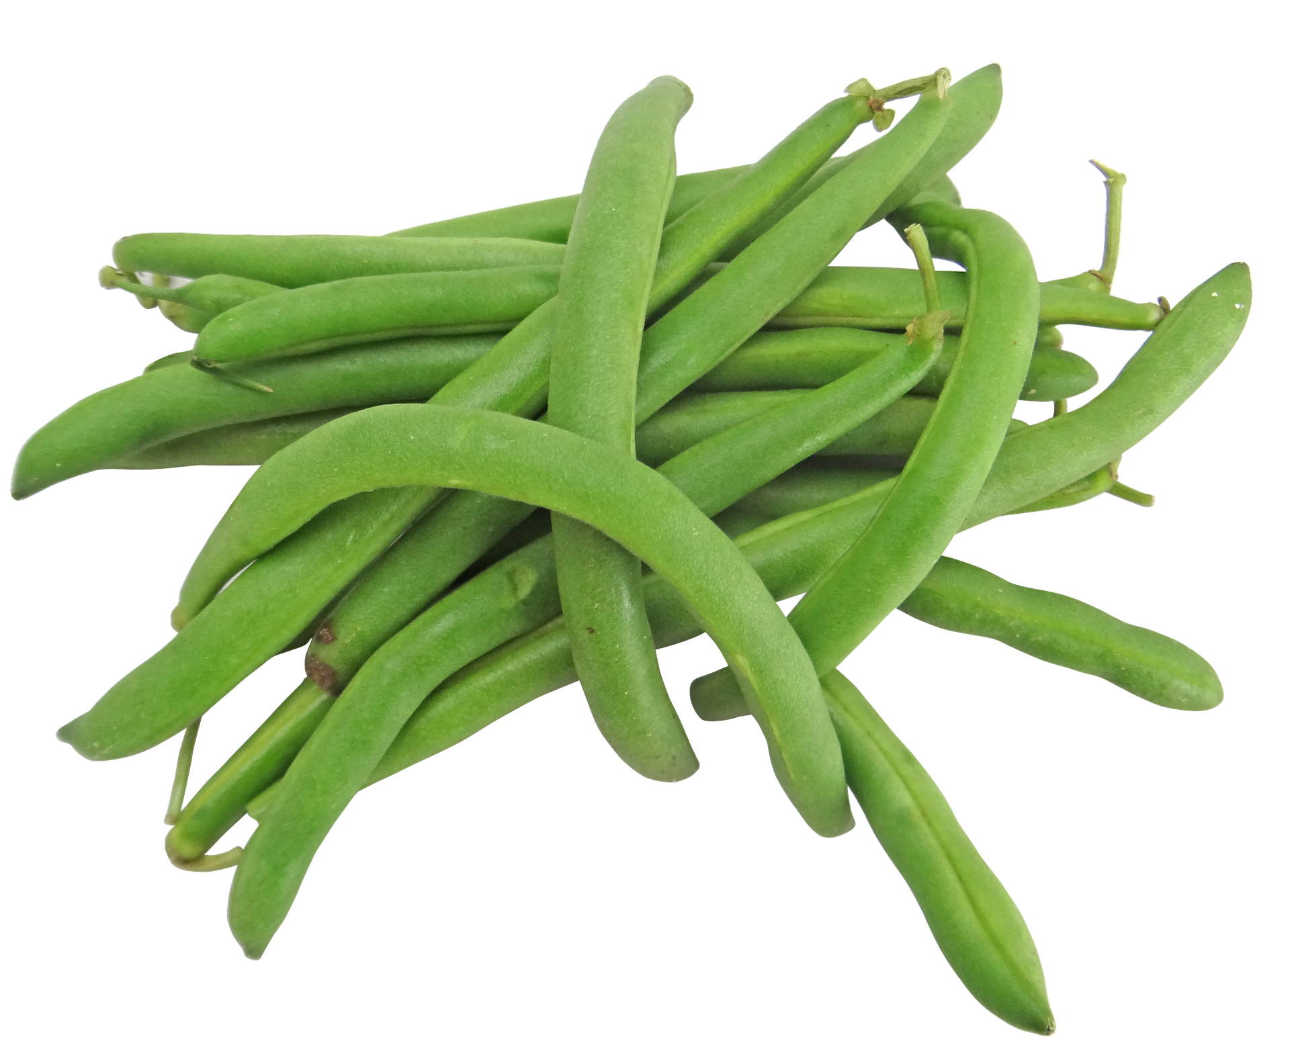
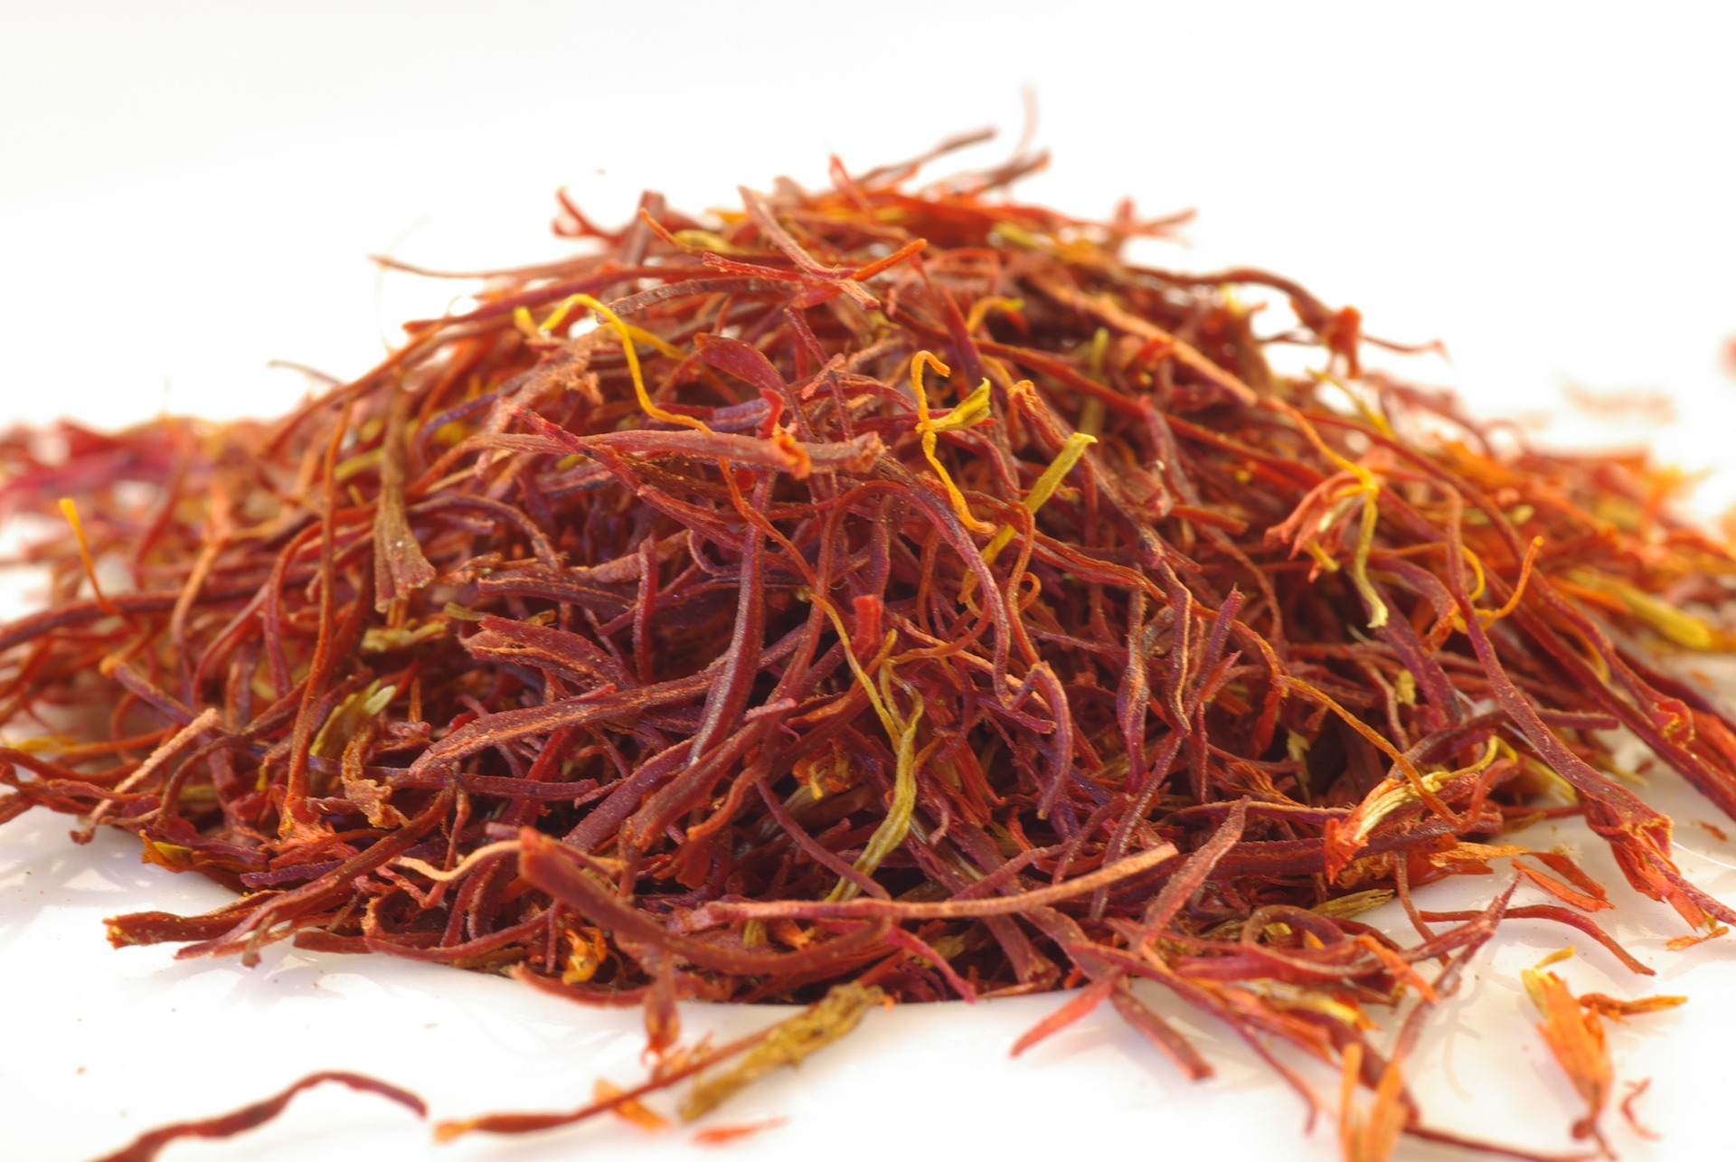
la paella
La paella es un plato típico de la región de Valencia.
Lleva arroz, pollo, conejo y
judías verdes.
El color amarillo es de azafrán.
el plato – dish
el azafrán - saffron
Notes:
Timing: 1 minute
Aim: to introduce some further information about Spain’s most famous dish, paella.
Procedure:
Click through the animations to present the new information.
Elicit English translations for the Spanish with prompting, as needed.
Ask if any pupils have tried paella.
Image attribution (paella):
Jan Harenburg, CC BY-SA 4.0, via Wikimedia Commons

Slide 10


leer
Sofía manda mensajes a Ángela.
¿Quién es?
She’s telling her about her conversation with Krina.
E
3
Lee las frases y marca.
Llevan un
suéter de Navidad.
Pasean por la ciudad.
Sofía y su familia (we) | Krina y su familia (they)
1
4
[E]
Cocinamos paella el domingo.
[1]
Miran las luces.
[2]
[3]
2
5
[4]
Mandamos
la carta a los tres Reyes Magos.
Visitamos a la familia.
[5]
Notes:
Timing: 7 minutes
Aim: to practise written comprehension of key –ar verbs in the 1st and 3rd persons plural.
Procedure:
Read the title & click to explain the context of the task.
Click to bring further instructions in Spanish.
Do [E] with them to model the task and draw their attention to the verb (llevan). Is it Sofía talking about Krina & her family (they) or is she talking about herself and her own family (we)?
Pupils complete 1-5.
Click through the animations to bring up answers. If desired, click on the numbered buttons to hear sentence audio.
Ask pupils to translate the verbs into English.

Slide 11
¡adiós!
azul

