Slide 1

Saying what I and others do
azul
Follow ups 1-5
Notes:
Artwork by Steve Clarke. All additional pictures selected are available under a Creative Commons license, no attribution required.
The frequency rankings for words that occur in this PowerPoint which have been previously introduced in NCELP resources are given in the NCELP SOW and in the resources that first introduced and formally re-visited those words.
Phonics: revisit [l] and [ll]
Vocabulary (new words in bold): bailar [1323] cocinar [3074] mandar [588] mirar [125] luz [278] pollo [3577] suéter [>5000] tarjeta [1958] común [742]
Revisit 1: tienen [8] enorme [631] un poco [76] solo [181] bocadillo [>5000] clase [320] conejo [4728] cuaderno [3301] hermano [333] hermana [3409] lápiz [3740] libro [230] mochila [>5000] regla [1380] ventana [725] activo [1278] bonito [891] grande [66] nuevo [94] viejo [225] bastante [308] muy [43] de12 [2]
Revisit 2: cuál [445] día [65] fecha [756] lunes [1370] martes [3101] miércoles [1816] jueves [1650] viernes [1259] sábado [1179] domingo [693] hoy [167]
For any other words that occur incidentally in this PowerPoint, frequency rankings will be provided in the notes field wherever possible.
Source: Davies, M. and Davies, K. (2018). A frequency dictionary of Spanish: Core vocabulary for learners (2nd ed.). Routledge: London
glossed: asado [>5000]

Slide 2



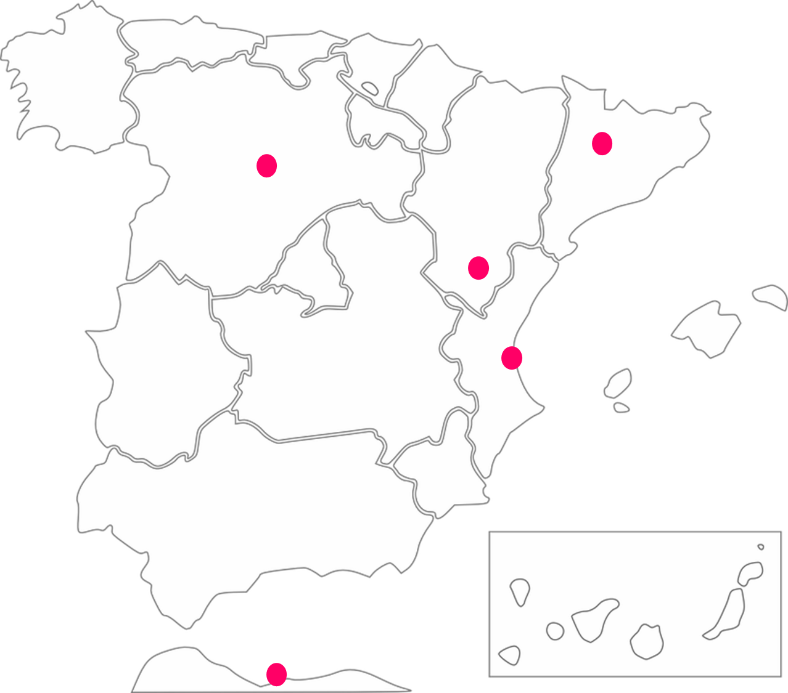
Follow up 1:
Una visita por España.
[l]
[ll]
Escucha: ¿Quién es?
¿Qué ciudad?
escuchar
 | ¿Quién? |  | visita visitan |  | ciudad
 | Lorena y Luna Llorente |  | visita |  | Va__ ado __ id
 | Lucas y Lorna Lluc |  | visitan |  | Va__ encia
 | Pilar y Mirella Millán |  | visitan |  | Me__i __a
 | Luis y Lluvia Luismi |  | visita |  | ___eida
 | Estrella y Lázaro Estela |  | visitan |  | Terue__
hablar
E
ll
l
……
1
……
l
[1]
[4]
[5]
2
……
l
ll
[2]
3
……
Ll
4
……
l
[3]
Notes:
Timing: 5 minutes
Aim: to apply knowledge of the SSC [l] and [ll].
Procedure:
Teacher explains the scenario. A special day at school. People have some unusual things in school today.
Click to listen. First pupils need to identify whether the sentence refers to one or more people. They write the name or names.
They then write the corresponding form of ‘visita/’visitan’
Click to listen again and pupils transcribe the item.
Elicit answers orally from pupils.
Click to reveal written answers and pictures.
Pupil A practises pronouncing sentence 1. Partner B translates into English.
Transcript:
E. Llorente visita Valladolid.
1. Lucas y Lorna visitan Valencia.
2. Pilar y Mirella visitan Melilla.
3. Luismi visita Lleida.
4. Estrella y Lázaro visitan Teruel.

Slide 3



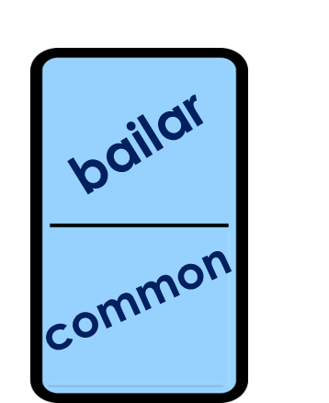
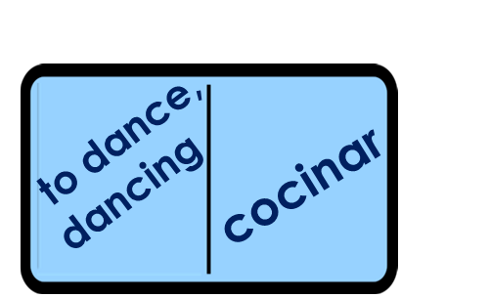
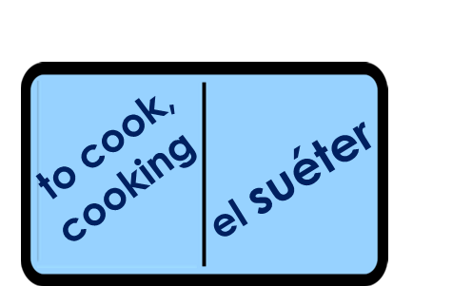
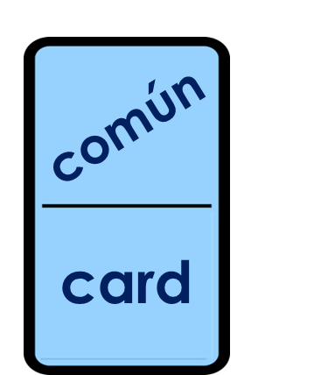
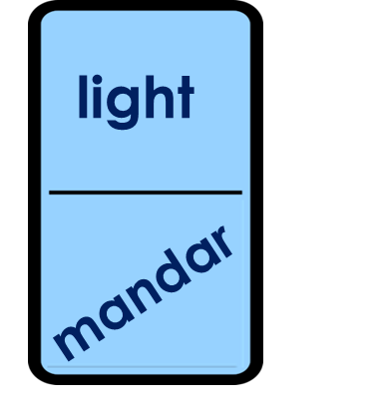


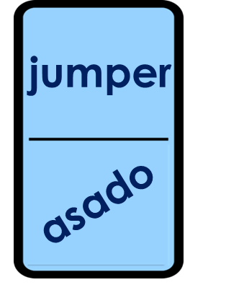


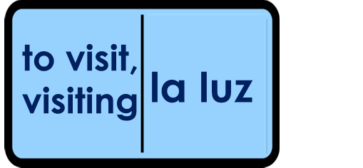


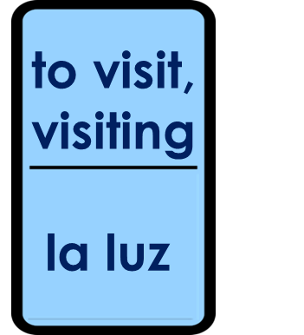
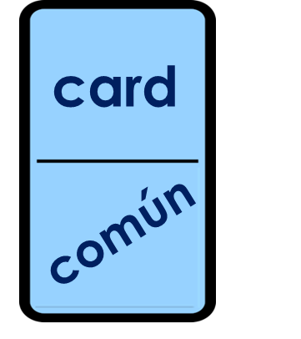
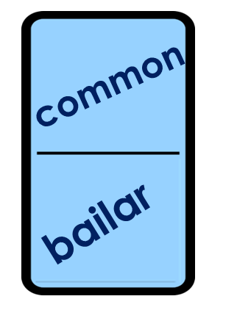
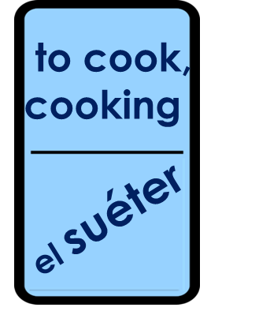

Follow up 2:
Completa el dominó. 🗣
vocabulario
Notes:
Timing: 5 minutes
Aim: to practise written comprehension and spoken pronunciation of vocabulary.
Procedure:
Starting from the play button, pupils work in pairs to complete the domino orally.
The audio for each domino is triggered when it appears.

Slide 4

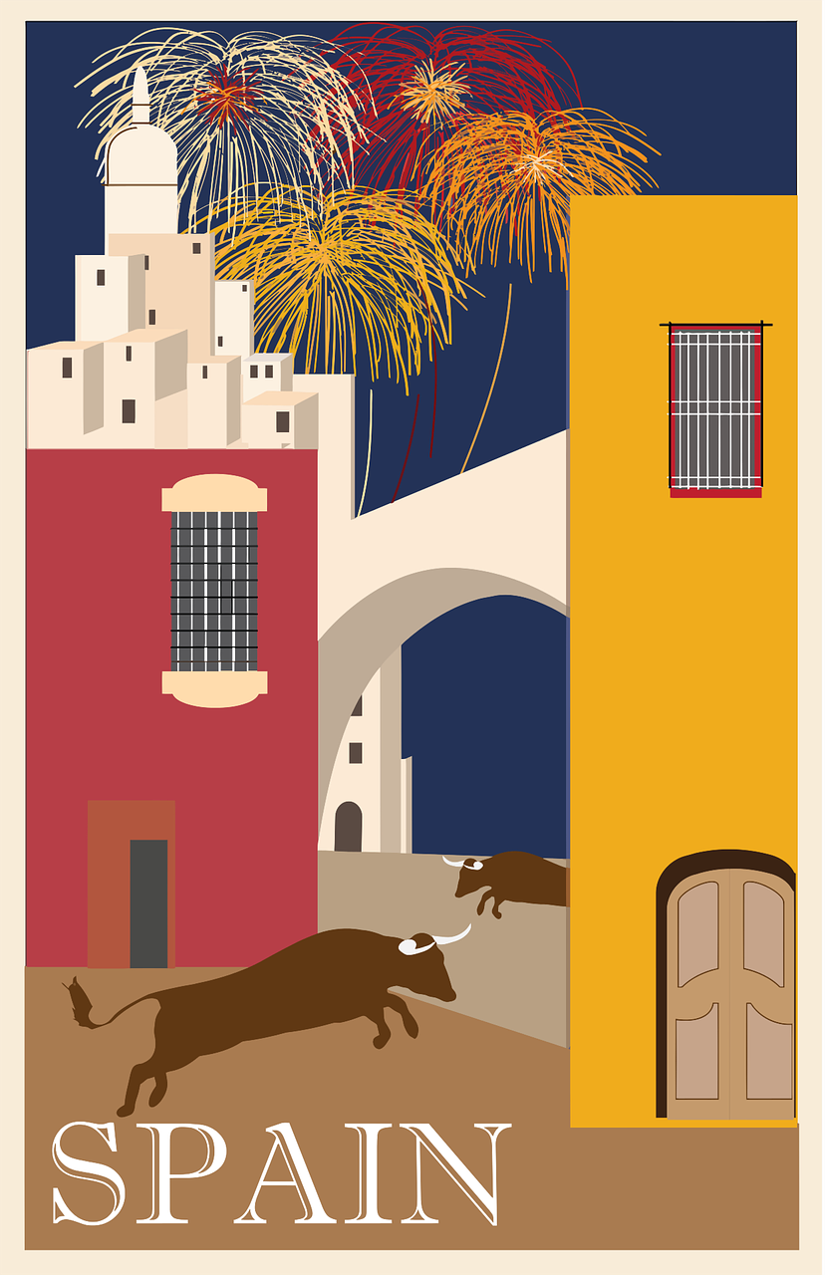

Follow up 3:
escuchar
En [1]_________, en Valencia, hay un festival famoso: ‘las Fallas’.
Las Fallas son figuras* de papel* y madera* con mucho [2]_________.
¡Son muy [3]__________!
También decoran las calles* con muchas [4]_________ y muchas personas [5]_________ vestidos tradicionales.
Cada [6]_________, hay fuegos artificiales por la noche.
El [7] _______ de marzo hay mucho [8] _________ : ¡Queman* las fallas!
marzo
color
grandes
luces
llevan
día
fuego
19
color
luces
llevan
marzo
(la) figura= figure (la) calle= street
(el) papel= paper
(la) madera = wood quemar= to burn
fuego
grandes
día
diecinueve (19)
Notes:
Timing: 5-8 minutes
Aim: to introduce key facts about one Spanish festival (las Fallas) and to practise written production of known vocabulary and structures from this and the revisited weeks.
Procedure
Pupils first write 1 – 8 rather than copy out the whole dialogue.
Then they spend 5 minutes trying to write any of the missing Spanish words that they know.
Note: reassure pupils that it is always important to try written recall from memory first, but that in stage 2 there will be some prompts.
After five* minutes, click to reveal the jumbled answers. Pupils spend another 3 minutes trying to complete the missing translations, using the prompts.
Click to reveal the answers. There is also an audio recording of the full dialogue to listen to.
Note: Click on the audio player to hear the full audio.
If time allows, elicit English meanings for each sentence from the whole class, orally.
*Teachers will judge for themselves when to bring up the reading prompts. It may be much sooner, depending on the vocabulary knowledge of the class.

Slide 5

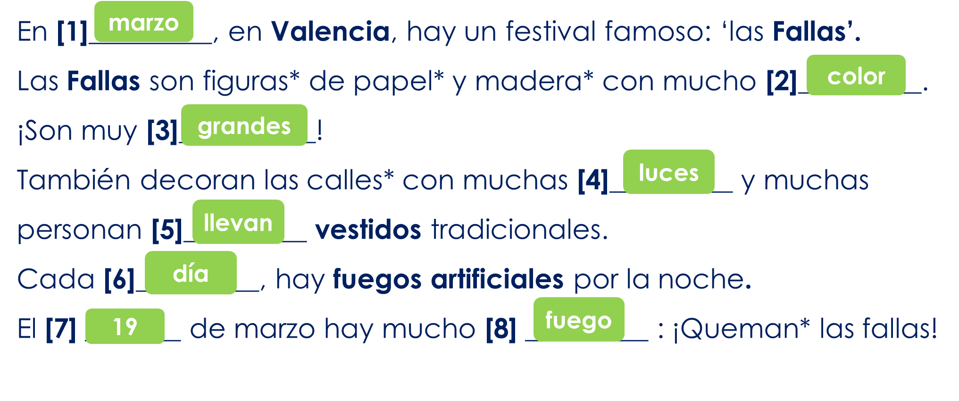
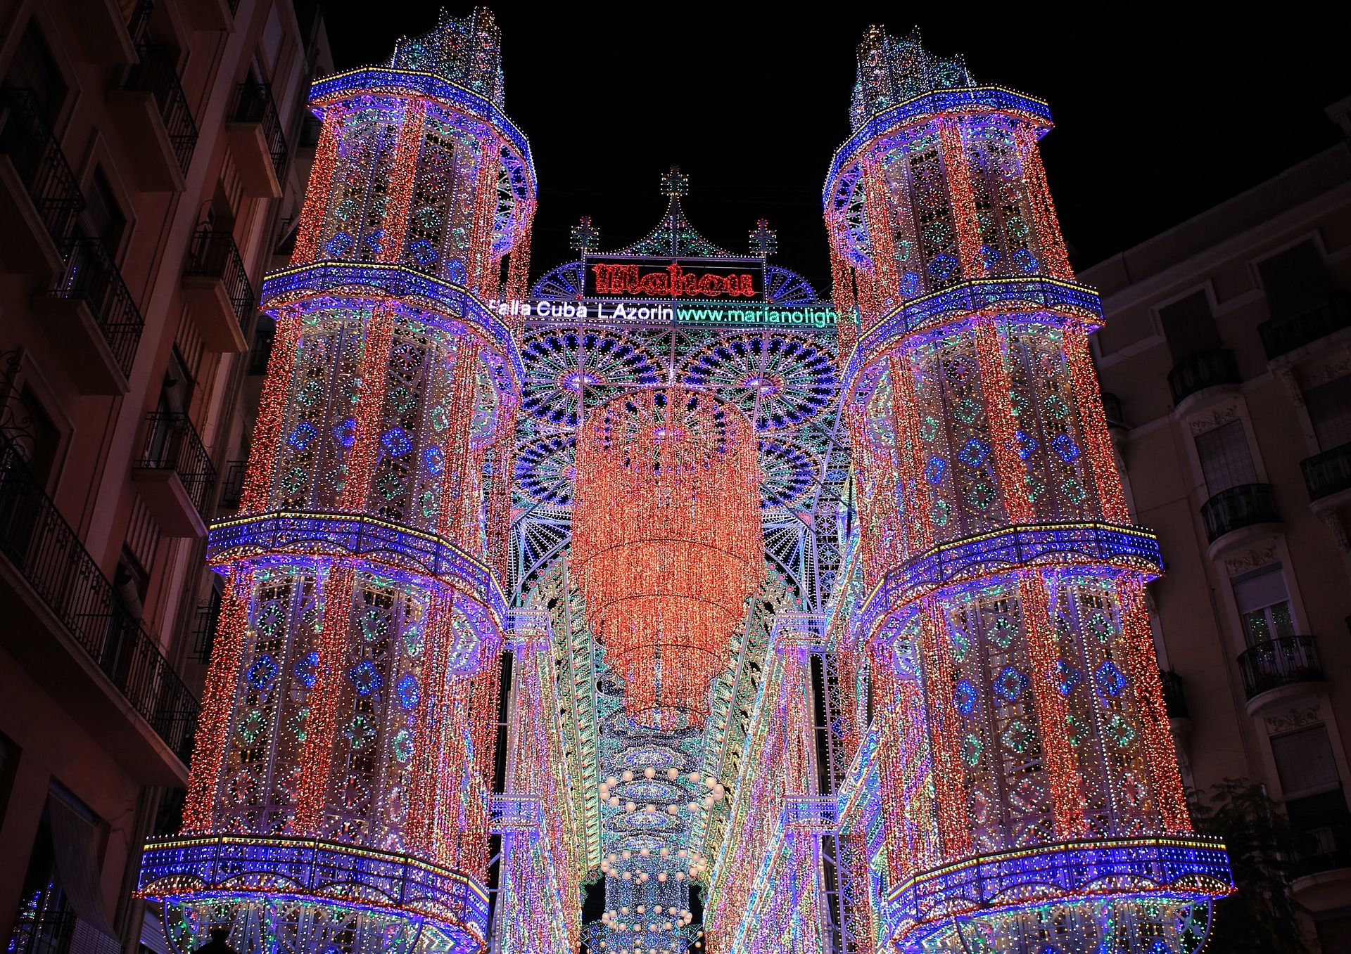
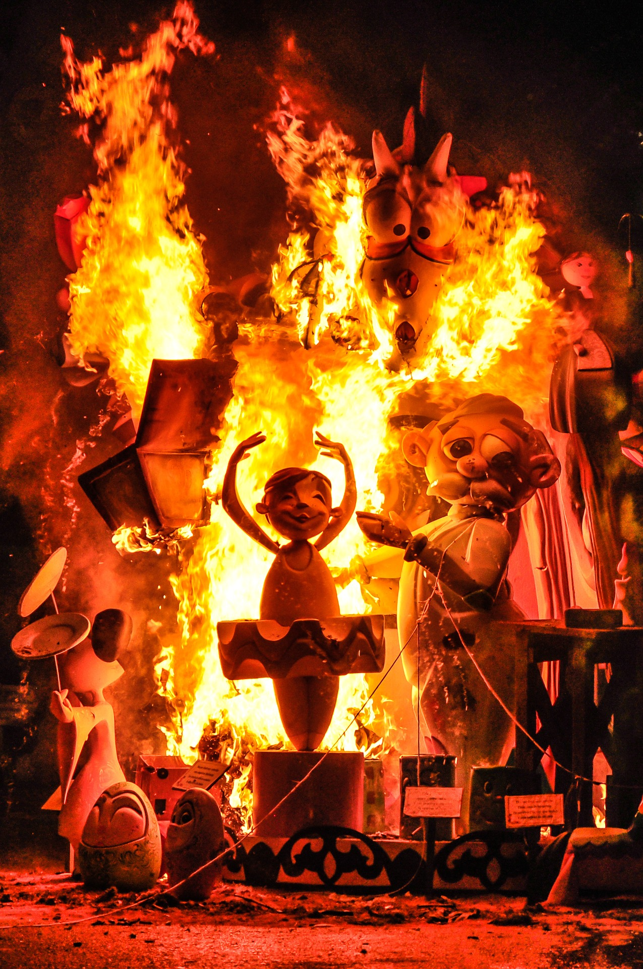
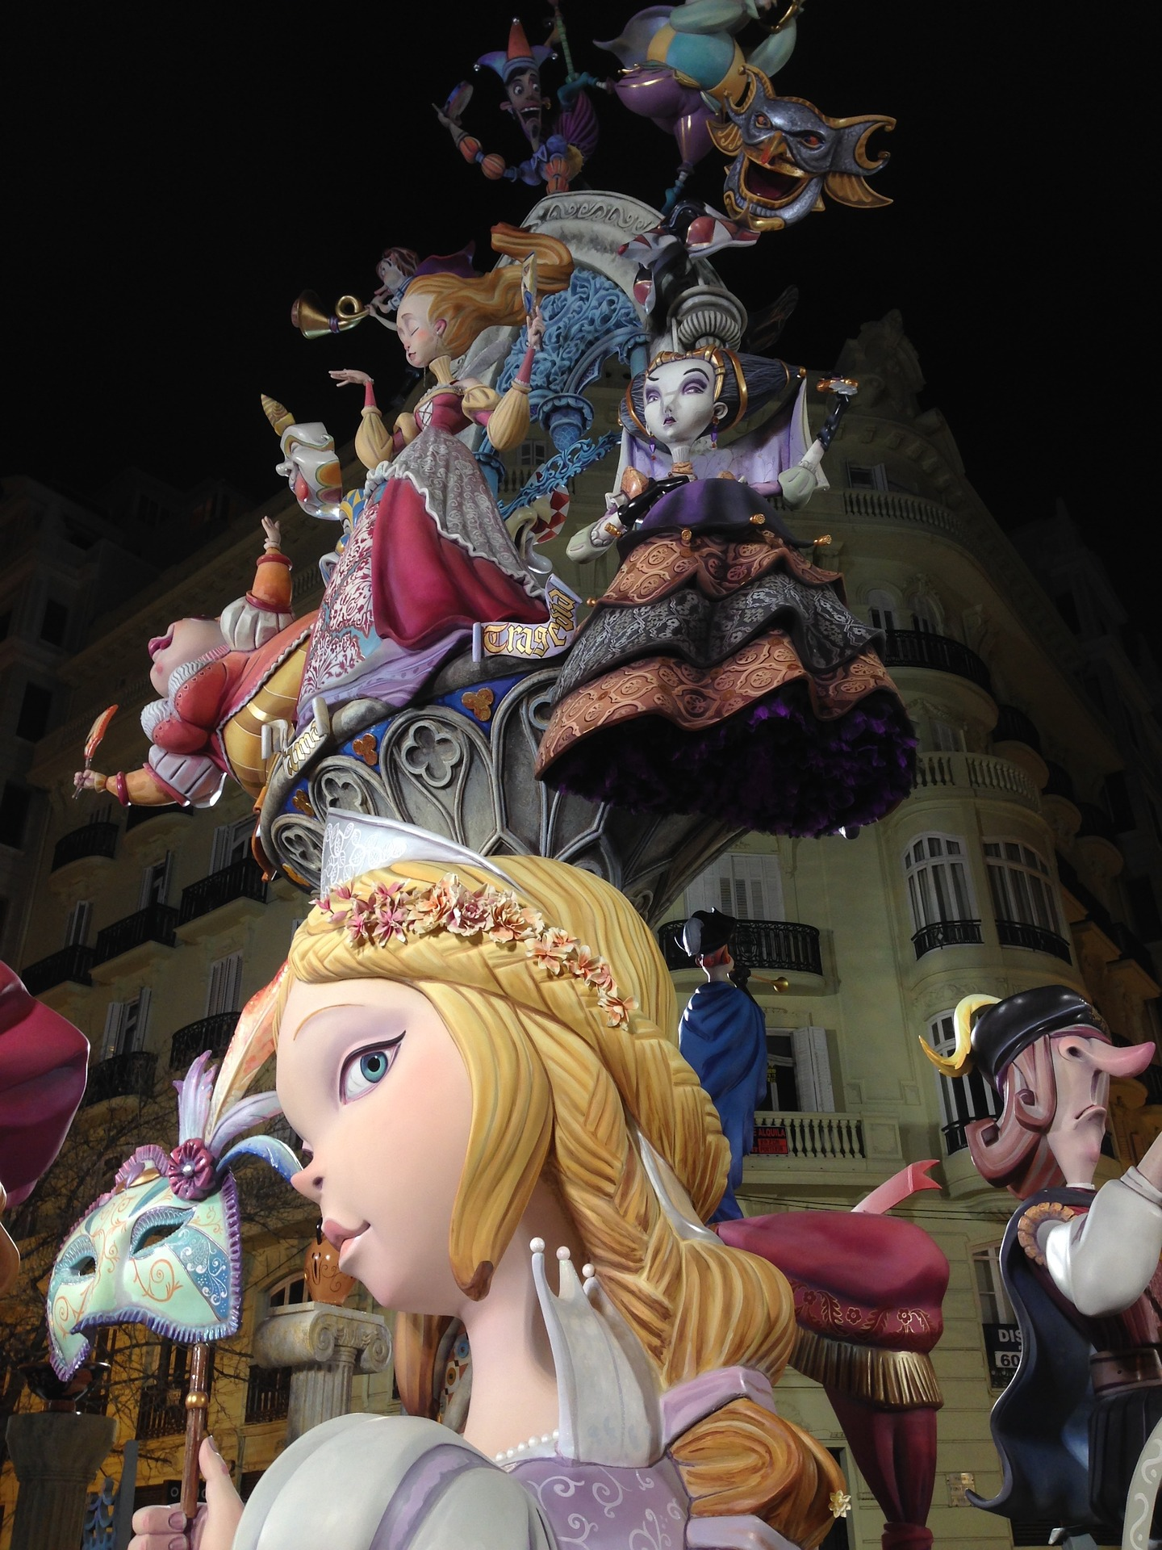
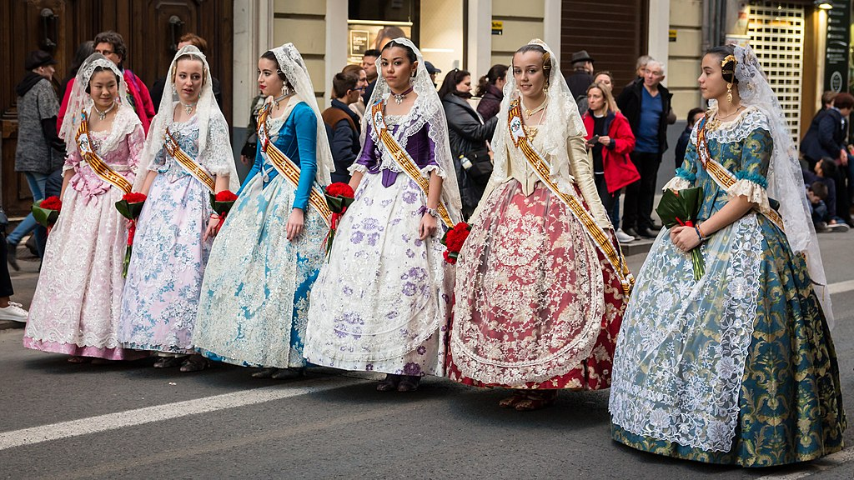

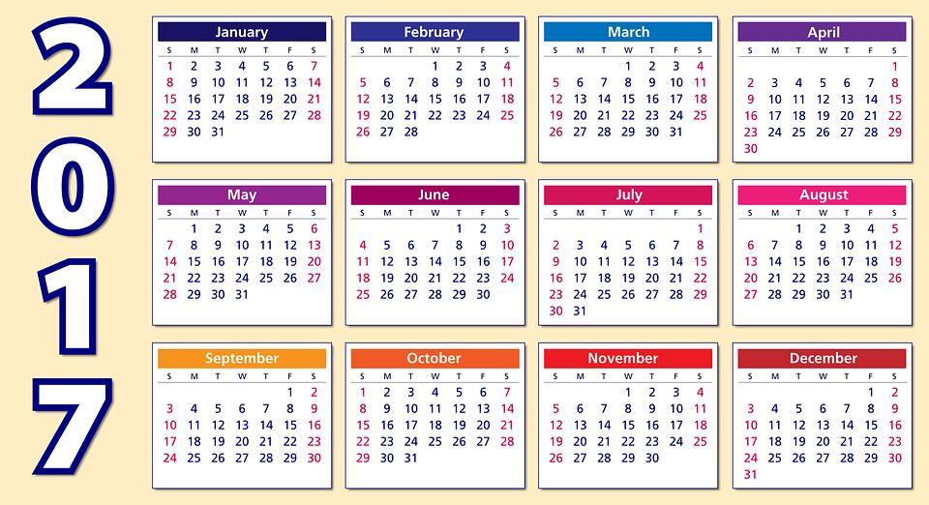
Follow up 3:
(la) figura= figure (la) calle= street
(el) papel= paper
(la) madera = wood quemar= to burn
B
leer
1
F
C
2
F
3
D
4
A
5
E
E
6
C
A
D
B
Notes:
Timing: 2 minutes
Aim: to practise reading comprehension of this and previous weeks’ vocabulary and structures.
Procedure:
1. Pupils write 1-6. They read each sentence and try to match it with the most appropriate picture A-F.
2. Click to reveal letter answers.
3. Clarify any word meanings. Encourage pupils to ask ‘¿Cómo se dice… en inglés?
De Rafa Esteve - Trabajo propio, CC BY-SA 4.0, https://commons.wikimedia.org/w/index.php?curid=67782028

Slide 6

Follow up 4:
Conjunctions: connecting sentences with ‘también’ and ‘pero’.
Note: to mean ‘we’ with a verb, we remove –ar and add -amos.
‘también’ means also and too.
Ejemplo:
En Fallas llevamos vestidos tradicionales y también cocinamos paella.
En Fallas llevamos vestidos tradicionales y cocinamos paella también.
también can follow y or go to the end of the sentence.
Remember: to mean ‘they’ with a verb, we remove –ar and add -an.
‘pero’ means but
Ejemplo:
En España cocinamos paella pero en Inglaterra cocinan pollo asado.
Notes:
Timing: 3 minutes
Aim: to revisit conjunctions ‘también’ and ‘pero’ in connecting sentences with 1st and 3rd person plural.
Procedure:
Click through the animations to present the new information.
Elicit English translations for the Spanish examples provided.

Slide 7




Follow up 5:
Habla en español [1/4]
investiga = s/he researches
sobre = about
e = and (when the next word start with ‘i’ or ‘hi’
Quique investiga* sobre* España e Inglaterra.
hablar
For his homework, he is recording what he’s found it, but his script is all mixed up! Can you help him?
 | We sing and we also dance.
1a
y
bailamos
también
bailan
cantamos
1b
Cantamos
y
también
bailamos.
bailan
La palabra extra es ______________
they dance
En inglés significa ______________
Notes:
Timing: 5 minutes [1/4]
Aim: to practise oral production of the 1st and 3rd person plural for –ar verbs and connecting setences with ‘pero’ and ‘también’.
Procedure:
1. Pupils use the words to translate the sentence into Spanish – there is one extra word per sentence.
2. Click to reveal the correct sentence.
3. Click to bring ‘la palabra extra es’ & elicit Spanish and English for the extra word.
4. Click the audio buttons to hear the correct sentence (Note: 1b has a version with también at the end – this is also possible in other sentences but we have only done both sentences with this first one, as an example).

Slide 8
Follow up 5:
Habla en español [2/4]
investiga = s/he researches
sobre = about
e = and (when the next word start with ‘i’ or ‘hi’
hablar
¡Ojo! ⚠ There are extra words.
 | We look at the Fallas and we visit the family too.
2
pero
las Fallas
visitamos a
y
la familia
miramos
también
Miramos
las Fallas
y
visitamos a
la familia
también.
pero
La palabra extra es ______________
but
En inglés significa ______________
Notes:
[2/4]

Slide 9
Follow up 5:
Habla en español [3/4]
investiga = s/he researches
sobre = about
e = and (when the next word start with ‘i’ or ‘hi’
hablar
¡Ojo! ⚠ There are extra words.
 | In England they wear Christmas jumpers, but here we wear elegant dresses.
pero
de Navidad
llevan
vestidos
suéteres
en
escuchamos
3
Inglaterra
llevamos
elegantes
aquí
En
Inglaterra
llevan
suéteres
de Navidad
pero
aquí
llevamos
vestidos
elegantes.
La palabra extra es ______________
escuchamos
En inglés significa ______________
we listen
Notes:
[3/4]

Slide 10
Follow up 5:
Habla en español [4/4]
investiga = s/he researches
sobre = about
e = and (when the next word start with ‘i’ or ‘hi’
hablar
¡Ojo!⚠ There are extra words.
 | In Fallas, they go for a walk in the streets and they also look at the lights.
las luces
en
y
las calles
por
los fuegos artificiales
Fallas
4
también
miran
pasean
En
Fallas
pasean
por
las calles
y
también
miran
las luces.
los fuegos artificiales
La palabra extra es ______________
En inglés significa ______________
fireworks
Notes:
[4/4]

Slide 11

Follow up 5:
Reescribe en español .
⚠ Don’t forget capital letters and full stops!
En España [we cook] Paella los [Sundays] [but] en Inglaterra
[they cook] [the chicken] asado. _______________________________________________________________.
_______________________________________________________________.
2. En Fallas [we look at] [the lights] y [also] [we listen to] música. _______________________________________________________________
3. [They send] [cards] de Navidad [but] [here] [we visit] a [the family]
_______________________________________________________________
4. In Valencia [we dance] la Jota [and] [we sing] traditional music too. __________________________________________________________________
escribir
En España cocinamos Paella los domingos pero en Inglaterra cocinan el pollo asado .
⚠ Remember: adjectives follow the noun in Spanish!
En Fallas miramos las luces y también escuchamos música .
Mandan tarjetas de Navidad pero aquí visitamos a la familia .
En Valencia bailamos la Jota y escuchamos música tradicional también.
tarjetas
aquí
tradicional
las luces
el pollo
domingos
Notes:
Timing: 6-8 minutes
Aim: to use the correct 1st and 3rd person plural as well as conjunctions ‘también’ and ‘pero’
Procedure:

Slide 12
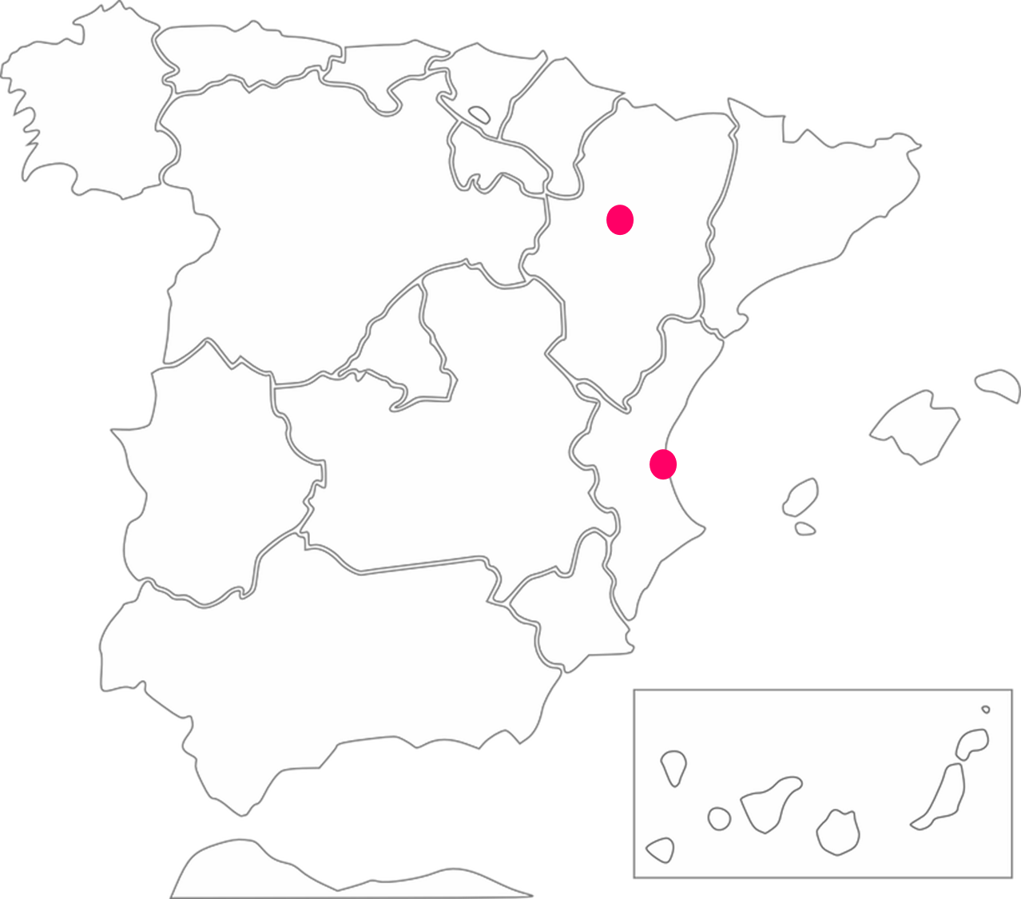
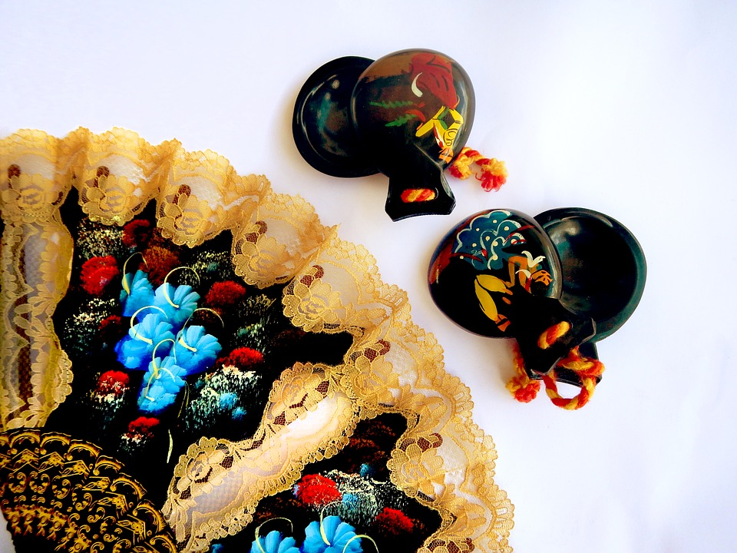
Follow up 5:
tocan = they play (instrument)
escribir
La Jota es tradicional en la Comunidad Valencia y Aragón.
Aragón
tocan* las castañuelas
Comunidad Valenciana

Slide 13



Follow up [extra]:

Escribe en inglés: Can you get at least 15 points?
 | jueves | martes | ¿cuál?
 | el día | hoy | la fecha
 | un poco | viejo | nueva
 | tienen | solo | enorme
 | el pollo | la luz | común
 | mandar | la tarjeta | el suéter
 | cocinar | mirar | bailar
vocabulario
Thursday
Tuesday
Which?
x3
day
today
date
a little (bit)
old (m)
new (f)
x2
they have
only
enormous
chicken
light
common
to send, sending
card
jumper
x1
to cook, cooking
to look, watch
to dance, dancing
Notes:
Timing: 10 minutes (two slides)
Aim: to practise written comprehension (this slide) and production (next slide) of vocabulary from this week and this week’s revisited sets.
Procedure:
1. Give pupils a blank grid. They fill in the English meanings of any of the words they know, trying to reach 15 points in total.
Note:
The most recently learnt and practised words are pink, words from the first revisit are green and those from the second revisit are blue, thus more points are awarded for them, to recognise that memories fade and more effort (heavy lifting!) is needed to retrieve them.

Slide 14
Follow up [extra]:

Escribe en español: Can you get at least 15 points?
 | today | Friday | Wednesday
 | which? | date | day
 | only | new (f) | old (m)
 | they have | enormous | a little (bit)
 | jumper | card | common
 | to look, watch | light | chicken
 | to dance, dancing | to cook, cooking | to send, sending
hoy
(el)viernes
(el) miércoles
vocabulario
x3
¿cuál?
la fecha
el día
solo
nueva
viejo
x2
tienen
enorme
un poco
el suéter
la tarjeta
común
mirar
la luz
el pollo
x1
cocinar
bailar
mandar
Notes:
Timing: 5 minutes
Aim: to practise written production of vocabulary from this week and this week’s revisited sets.
Procedure:
1. Give pupils a blank grid. They fill in the Spanish meanings of any of the words they know, trying to reach 15 points in total.
Note:
The most recently learnt and practised words are pink, words from the first revisit are green and those from the second revisit are blue, thus more points are awarded for them, to recognise that memories fade and more effort (heavy lifting!) is needed to retrieve them.

Slide 15
Follow up [extra]:

Escribe en inglés: Can you get at least 15 points?
 | jueves | martes | ¿cuál?
 | el día | hoy | a fecha
 | un poco | viejo | nueva
 | tienen | solo | enorme
 | el pollo | la luz | común
 | mandar | la tarjeta | el suéter
 | cocinar | mirar | bailar
vocabulario
x3
x2
x1
Notes:
Handout 1

Slide 16
Follow up [extra]:

Escribe en español: Can you get at least 15 points?
 | today | Friday | Wednesday
 | which? | date | day
 | only | new (f) | old (m)
 | they have | enormous (m/f) | a little (bit)
 | jumper | card | common
 | to look, watch | light | chicken
 | to dance, dancing | to cook, cooking | to send, sending
vocabulario
x3
x2
x1
Notes:
Handout 2

