Slide 1
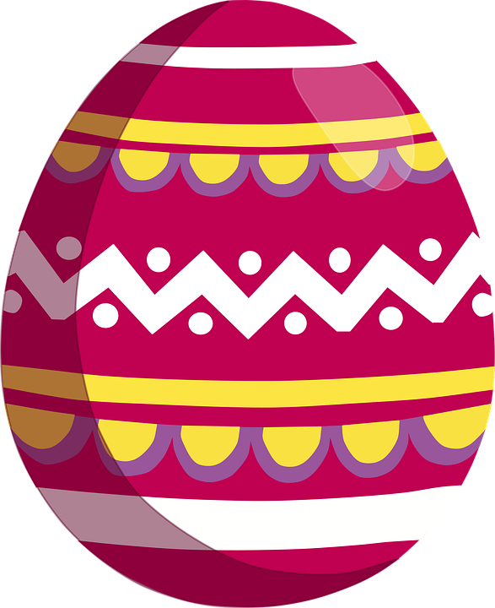
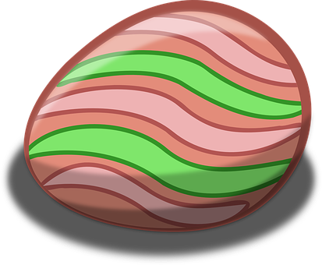
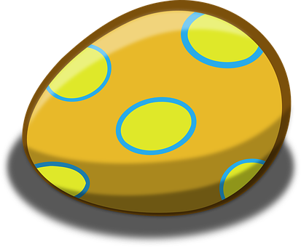
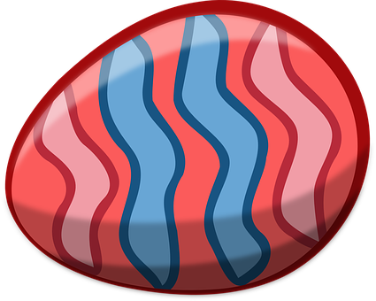
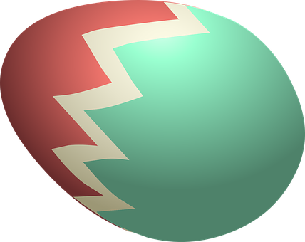
Saying where you are going and what there is there
azul
Phonics
Easter activities
Notes:
Artwork by Steve Clarke. All additional pictures selected are available under a Creative Commons license, no attribution required.
The frequency rankings for words that occur in this PowerPoint which have been previously introduced in the resources are given in the SOW (excel document) and in the resources that first introduced and formally re-visited those words.
Source: Davies, M. & Davies, K. (2018). A frequency dictionary of Spanish: Core vocabulary for learners (2nd ed.). Routledge: London
For any other words that occur incidentally in this PowerPoint, frequency rankings will be provided in the notes field wherever possible.

Slide 2
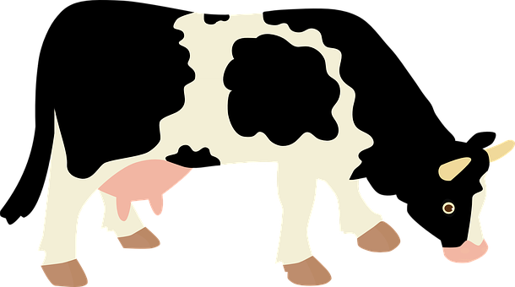
pronunciar
[v]
[b]
pronunciar
vaca
bolsa
Notes:
Phonics quiz
Timing: flexible during Week 11 Procedure:
Print out one set of these 14 phonics cards.
Working with one pupil at a time, elicit the pronunciation of each word.
Say: You have not learnt these words, but you have learnt how to read aloud these sounds, so just have a go at reading each word aloud.
Focus only on the accurate pronunciation of the target SSC and tolerate any other inaccuracies.
Use the pupil scoring sheet at the end of this presentation to assess SSC knowledge and give feedback.
Note: Whilst working with individual children, others can be doing the Easter activities at the end of this presentation.
2

Slide 3
pronunciar
[l]
[ll]
pronunciar
palo
llave
Notes:
3

Slide 4
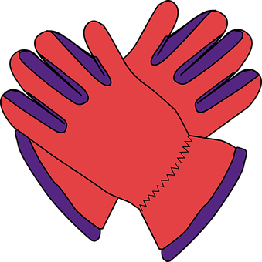
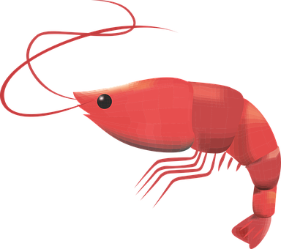
pronunciar
[gu]
[ga]
pronunciar
guantes
gamba
Notes:
4

Slide 5
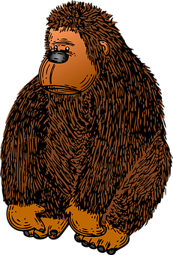
pronunciar
[go]
[Stress 1]
pronunciar
gorila
balón
Notes:
5

Slide 6
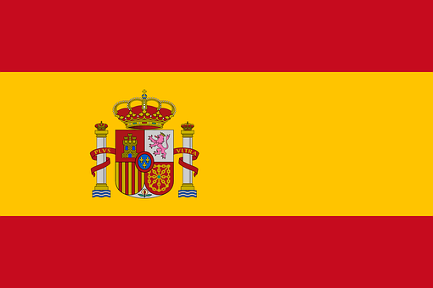
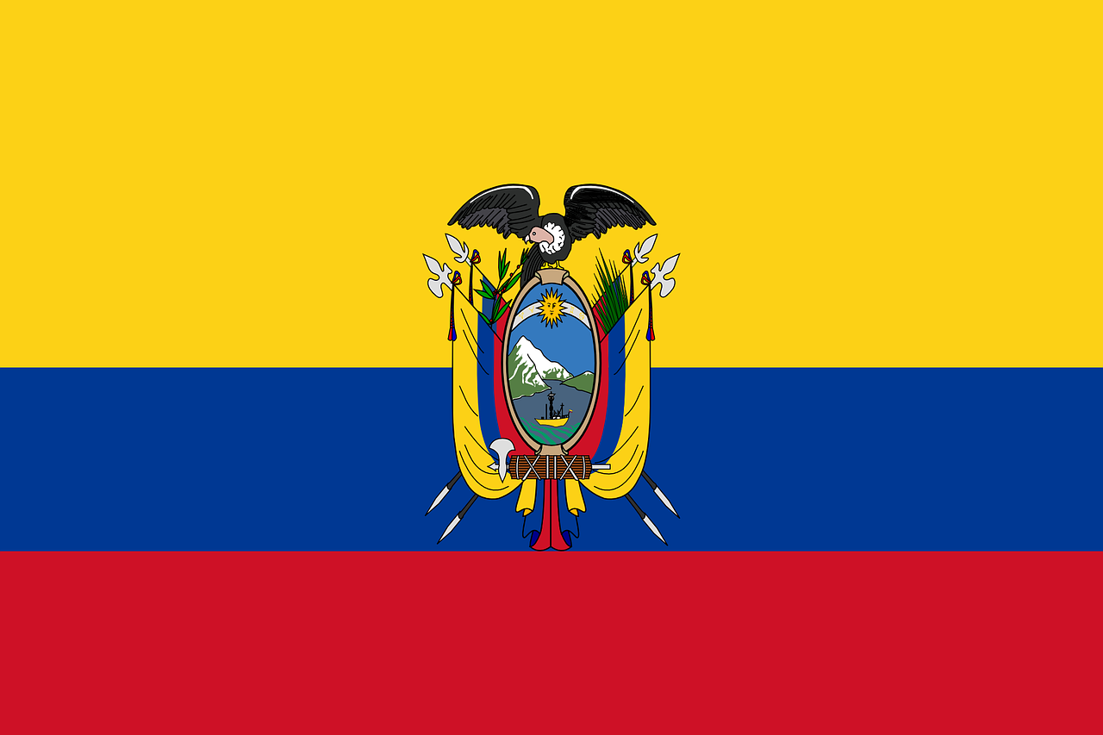
pronunciar
[Stress 2]
[Stress 3]
pronunciar
banderas
color
Notes:
6

Slide 7
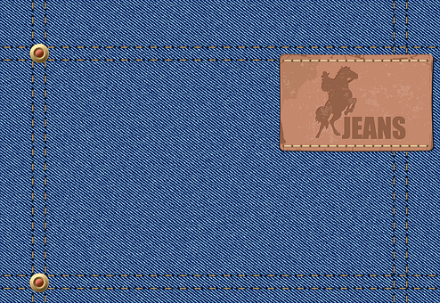
pronunciar
[que]
[qui]
pronunciar
vaqueros
equis
Notes:
7

Slide 8
pronunciar
[n]
[ñ]
pronunciar
cono
uña
Notes:
8

Slide 9
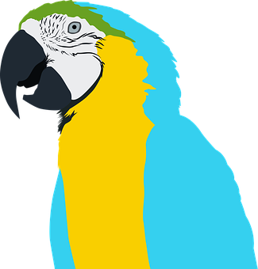
pronunciar
[r]
[rr]
pronunciar
loro
gorra
Notes:
9

Slide 10
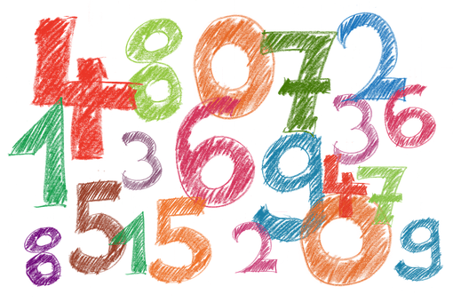
Actividades de Pascua
1. Crack the codes to find out the Spanish words. Write them out next to the English word.
🟦
en español | en inglés
 | hearts
 | flowers
 | circles
 | triangles
 | carpet
 | diamond
 | squares
 | crosses
c | u | a | d | r | a | d | o | s
1
2
3
4
5
6
7
8
9
r o o s
corazones
once (11)
 |  | m | b
5
8
10
11
c o r a o s
💗
flores
doce (12)
 |  |  |  | z |  | n | e
1
8
5
6
8
12
13
9
círculos
c r c u o s
🟢
nueve (9)
 | í |  |  |  | l
1
5
1
2
14
8
9
triángulos
dieciséis (16)
💐
f | l |  |  |  | s
o r e
15
14
8
5
13
9
alfombra
una (1)
t |  | i | á |  | g
🔺
r n u l o
5
12
2
14
8
rombo
seis (6)
c r u c e s
1
5
2
1
13
9
cuadrádos
veintiocho (28)
a l f o m b r a
cruces
dos (2)
3
14
15
8
10
11
4
6
Notes:
Timing: 10-15 mins (independent)
Aim: to provide written practice of Spanish numbers 1-29 and reading comprehension of plural verb endings and meanings.
This activity is designed as a worksheet for pupils to complete independently after completing assessments. Worksheet at end of this presentation. Answers on this slide.
Pupils crack the code to find the Easter words, then they write them out in the table next to the English translation.
Pupils read the information about Alfombras of Antigua, in Guatemala, and fill the gaps in the English translation with an appropriate word. This info sets the scene for #3.
Information and more photos about the festival here: about the festival: https://trans-americas.com/holy-street-art-alfombras-antigua/
3. Pupils write down the number of shapes in the picture of one alfombra in Guatemala (hearts, flowers, circles, etc.).
4. Pupils design their won design. Pupils can also play ‘I spy’ activity and write the number in Spanish.
5. Pupils colour the eggs to an appropriate basket by looking at and verb endings. They then write the English translation below each egg.
5.

Slide 11
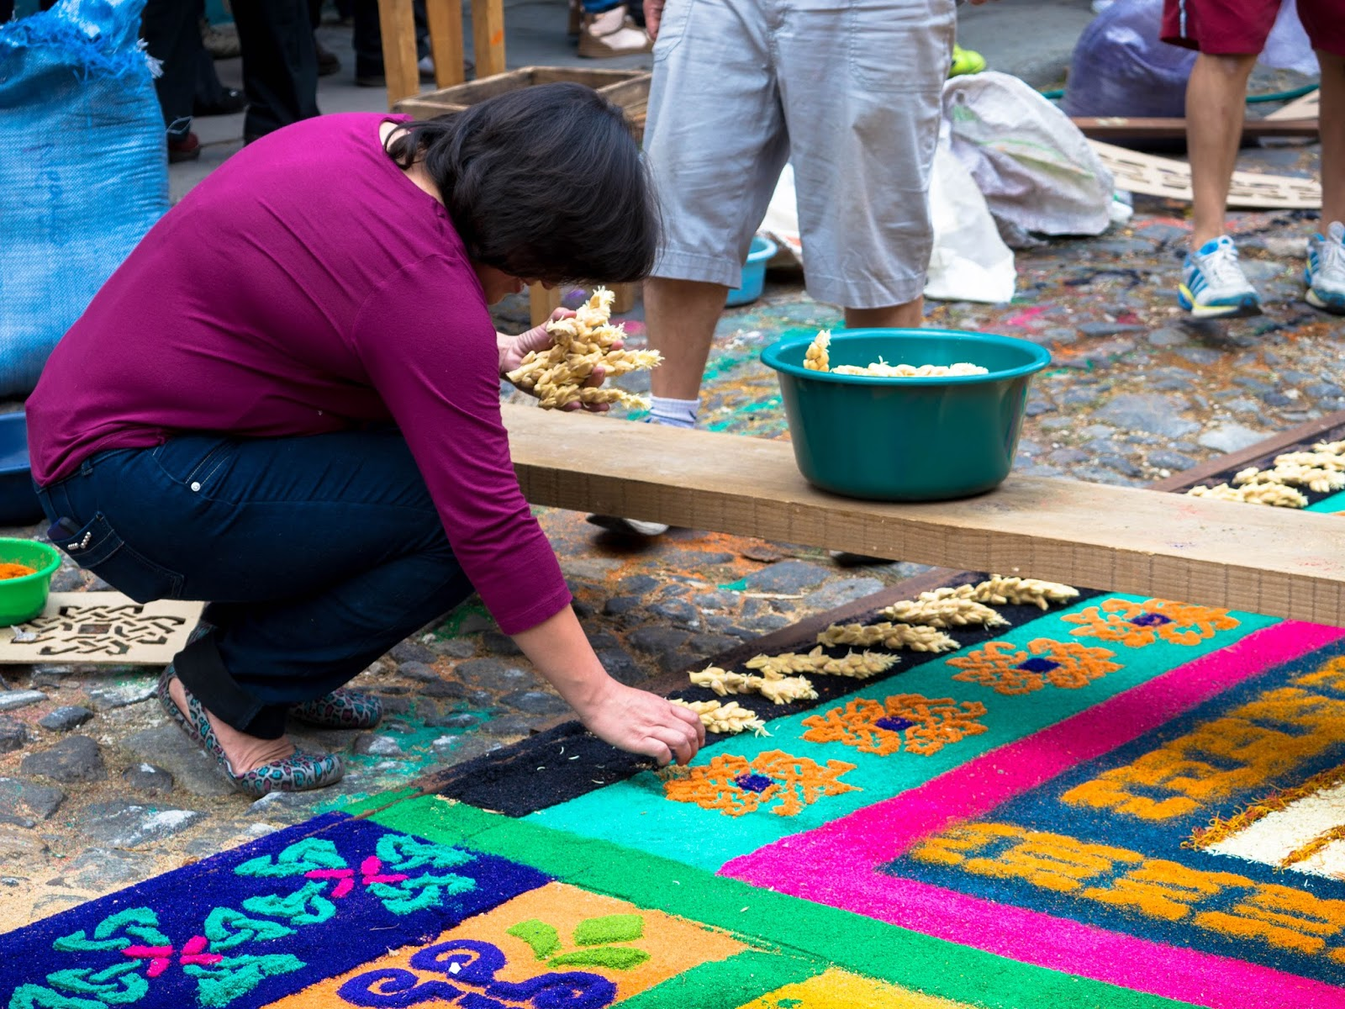
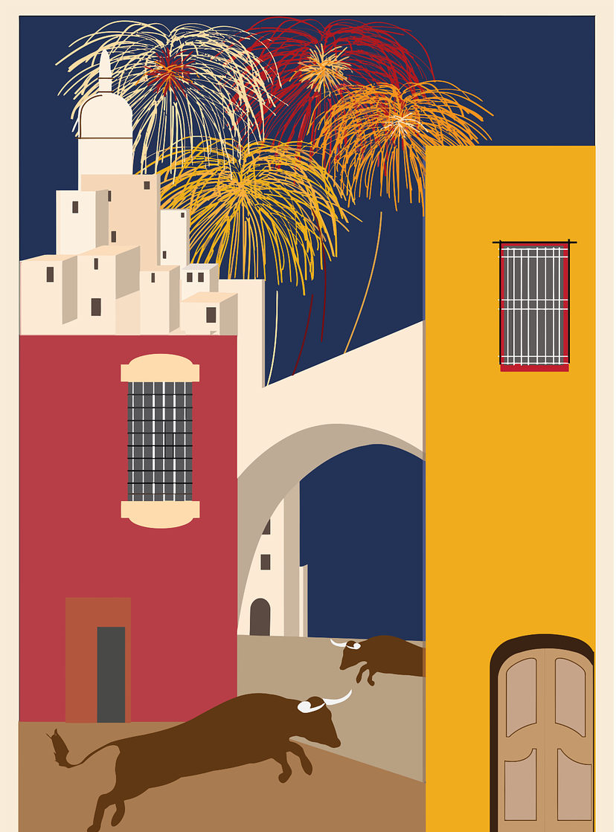
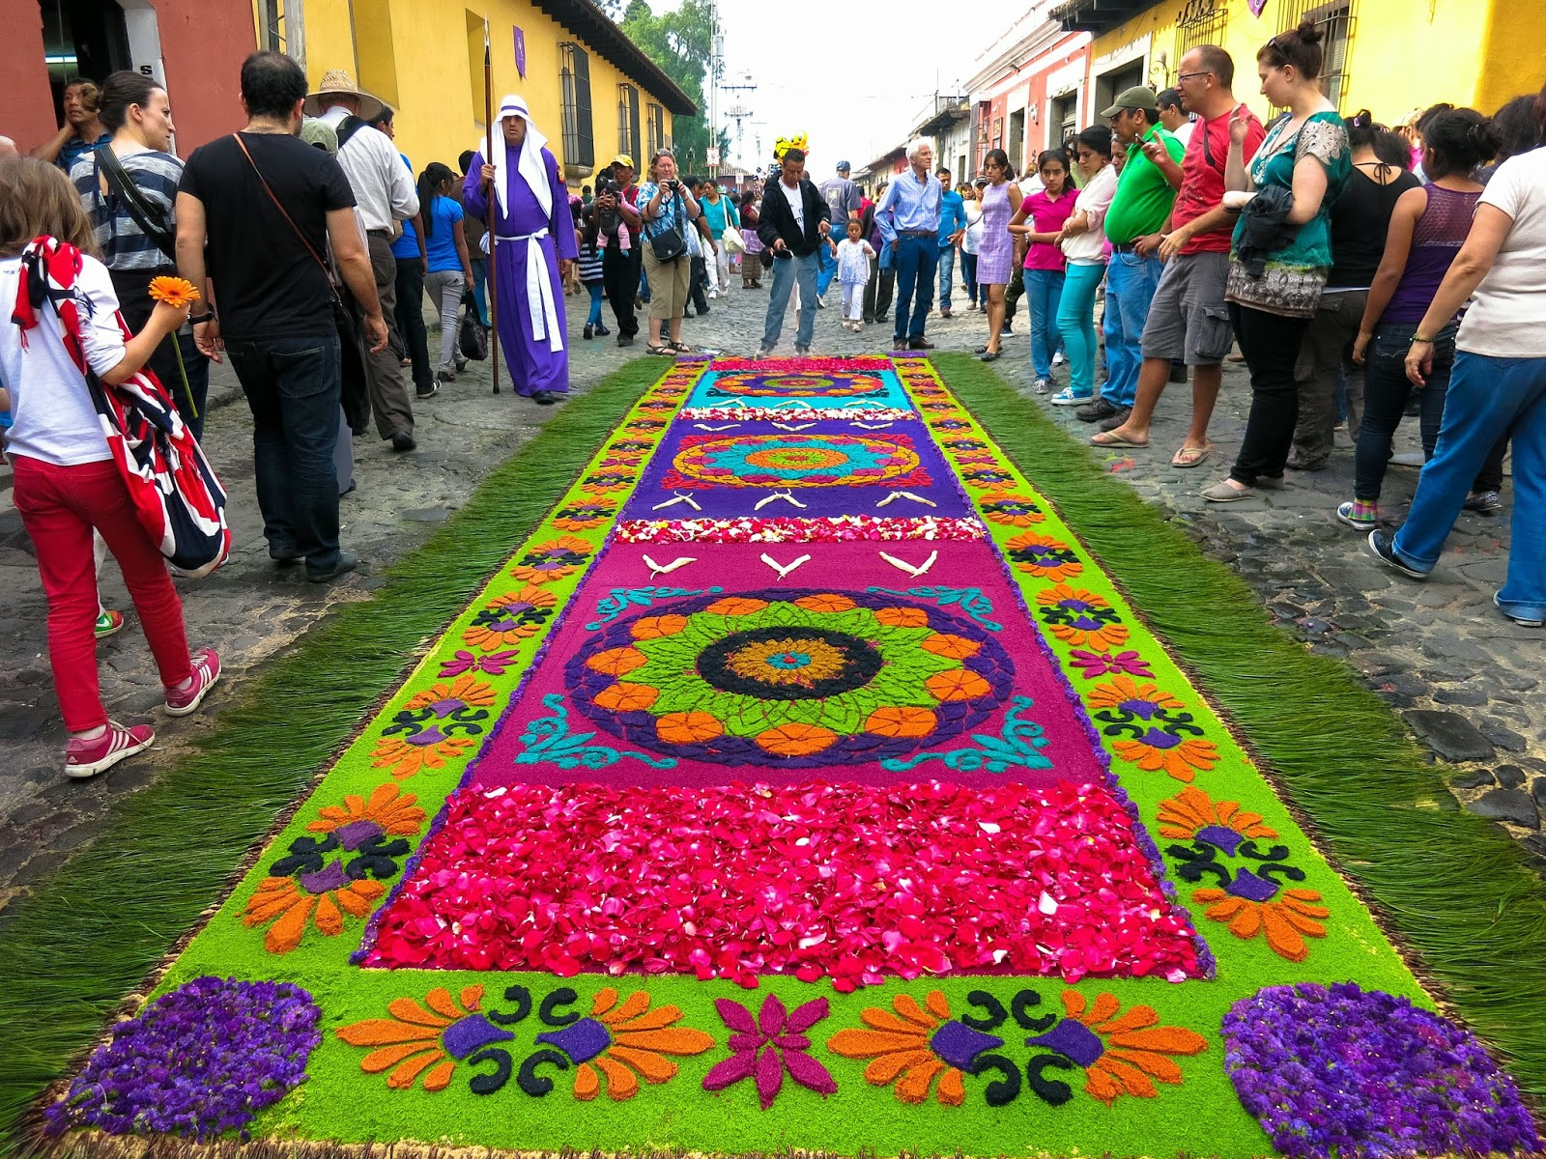
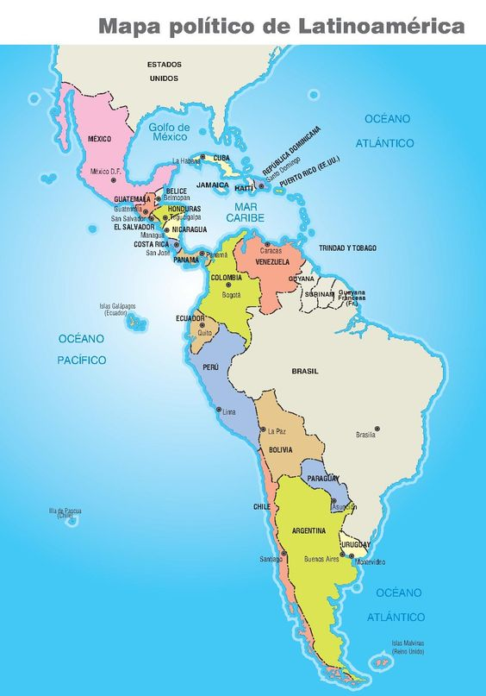
Alfombras of Antigua, Guatemala
2. Read the text in Spanish and write the missing words in the English translation.
Cada Semana Santa* las
personas en Antigua, Guatemala, hacen alfombras con serrín, arena de colores, flores, pétalos de flores , arroz, fruta, etc, creando formas y diseños diferentes.
______ Holy Week people in Antigua, Guatemala, _________ carpets with sawdust, colourful sand, flowers, flower petals, rice, ______, etc., creating ___________ designs and shapes.
Each
make
fruit
different
3. Count the shapes in the carpet write how many you see.

Slide 12
4. Create your own design of ‘alfombra’.

Slide 13
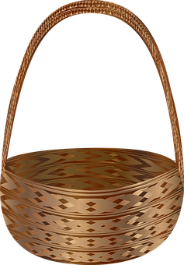
Actividades de Pascua
5. Colour each egg to match it to the correct basket. Write the English translations below.
vemos
miran
tocan
ayudamos
we see/watch
they look
they play
______________
______________
____________
we help
corren
they
__________
beben
hacen
bailan
they run
__________
they drink
ponemos
they do/make
they dance
______________
______________
_____________
bailamos
cocinamos
we put
ven
leemos
__________
they see/watch
we read
we dance
we cook
_______________
______________
______________
__________
we
leen
limpiamos
bebemos
they read
comen
__________
we clean
we drink
they eat
______________
______________
__________

Slide 14
pronunciar
Pupil name:
Pupil name:
SSC and word | px
vaca
bolsa
palo
llave
guante
gamba
gorilla
balón
banderas
color
vaqueros
equis
cono
uña
loro
gorra
SSC and word | px
vaca
bolsa
palo
llave
guante
gamba
gorilla
balón
banderas
color
vaqueros
equis
cono
uña
loro
gorra
Notes:
Pupil feedback and assessment sheet [16 points]
14

Slide 15
pronunciar
pronunciar
1. Estamos en Zaragoza en otoño. [2]
1. Estamos en Zaragoza en otoño. [2]
2. La oruga tiene hambre. [2]
2. La oruga tiene hambre. [2]
3. Llora a veces. [3]
3. Llora a veces. [3]
4. El gigante mide dos metros. [2]
4. El gigante mide dos metros. [2]
5. Mi goma borra los errores. [1]
5. Mi goma borra los errores. [1]
Notes:
Optional additional sentence read aloud [10 points]
15

