Slide 1
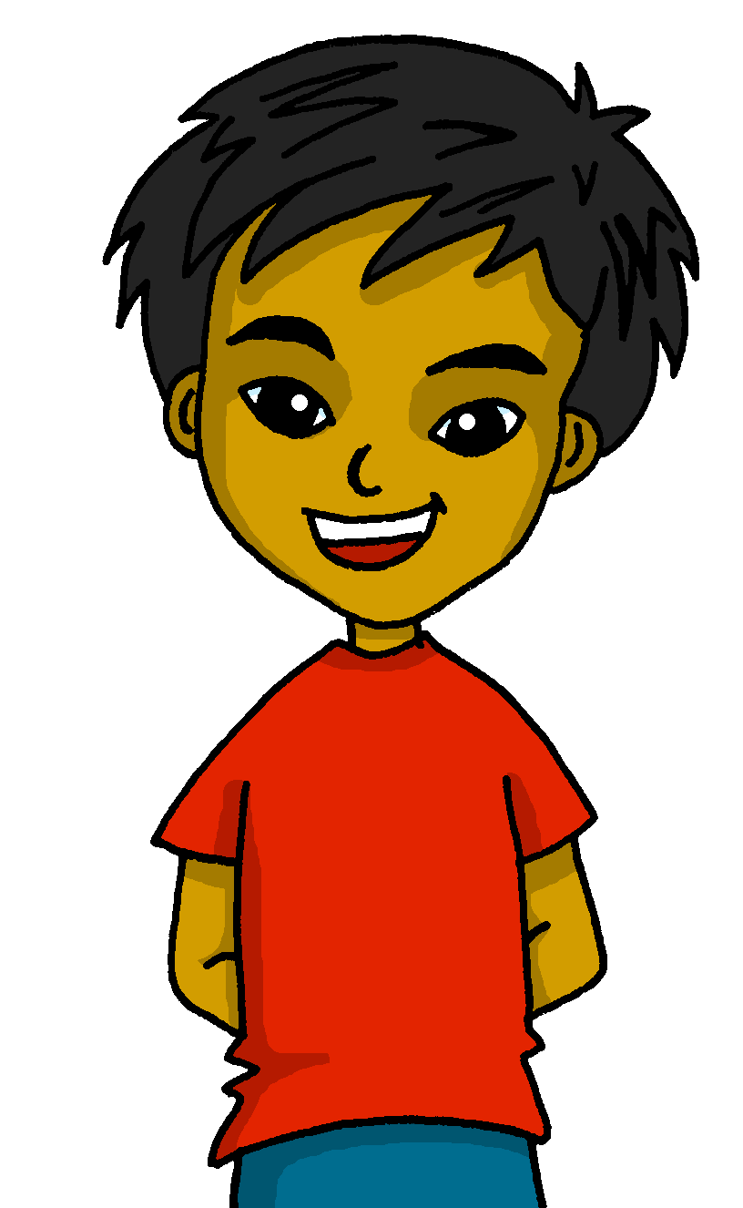
español, con Quique

Slide 2
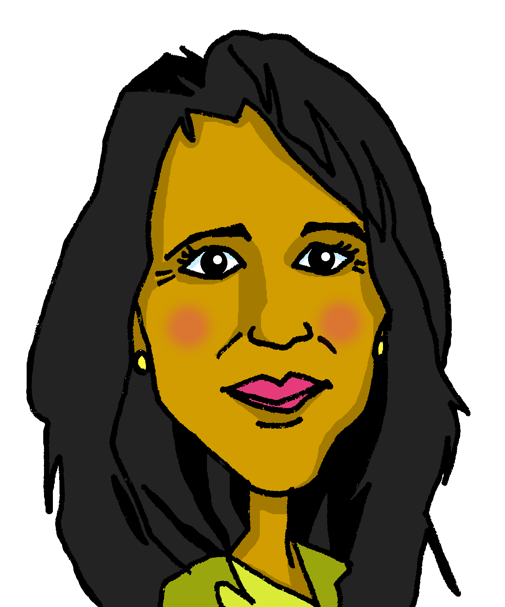
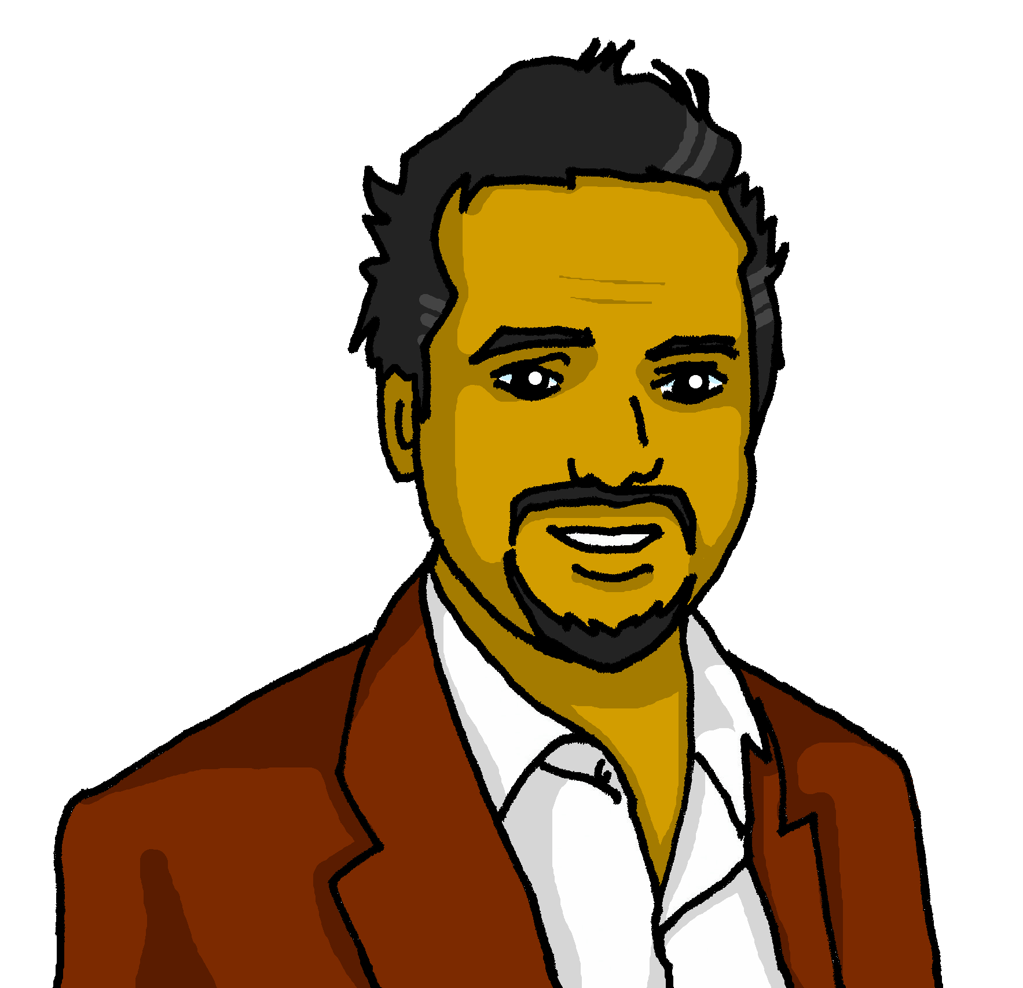
Saying what I and others have
Un día terrible
¿Qué tengo?
¿Qué tiene?
azul
tengo (I have), tiene (s/he, it has)
postnominal adjective agreement
vowels [revisited]
Notes:
Artwork by Steve Clarke. All additional pictures selected are available under a Creative Commons license, no attribution required.
The frequency rankings for words that occur in this PowerPoint which have been previously introduced in the resources are given in the SOW (excel document) and in the resources that first introduced and formally re-visited those words.
For any other words that occur incidentally in this PowerPoint, frequency rankings will be provided in the notes field wherever possible.
Phonics: All vowels revisited: casa [106] dos [64] universo [1603] elefante [5000] idea [247] cho-co-la-te [3408] in-te-re-san-te [616] oeste [2416] leer [209] feo [2373]cuándo [138] puente [1715] antiguo [446] autor [513] euro [2435] aceite 2101] aire [401] boina [>5000] ciencia [738] limpiar [1713] junio [1035]
Vocabulary (new words in bold): tener [19] tengo [tener 19] tiene [tener 19] casa [106] familia [233] habitación [1069] jardín [1195] libro [230] madre [226] padre [162] problema [145] profesor / profesora [501] silla [1271] estricto [3155] feo [2373] terrible [1246] muy [43] un [6] una [6] Re-use adjectives: bonito [891]cómodo [2237] diferente [293] divertido [2465] feliz [908] elegante [2742] grande [66] importante [171] independiente [1177] negativo [1804] normal [1000] pequeño [202] tranquilo [1093]
Revisit 1: cuál [445] día [65] fecha [756] lunes [1370] martes [3101] miércoles [1816] jueves [1650] viernes [1259] sábado [1179] domingo [693] hoy [167] Revisit 2: --
Frequency of unknown words:
orden [421]
Source: Davies, M. and Davies, K. (2018). A frequency dictionary of Spanish: Core vocabulary for learners (2nd ed.). Routledge: London

Slide 3
pronunciar
a
↓
z
Lee las palabras en orden alfabético.
elefante
feo
aceite
feo
1 minuto
cuándo
aire
idea
universo
a
↓
z
antiguo
interesante
casa
puente
boina
leer
chocolate
antiguo
casa
oeste
idea
chocolate
puente
dos
aire
universo
cuándo
interesante
boina
dos
0
oeste
elefante
INICIO
leer
orden = order
Notes:
Timing: 2 minutes
Aim: to practise spoken production of words containing all vowels and vowel combinations practised so far this term.
Procedure:
Read the instruction in Spanish.
Ensure meaning of ‘orden alfabético’ is clear and elicit first word from a volunteer.
3. Click on ‘inicio’ to start the timer. Pupils practise in pairs for one minute.
Start the timer again. This time, elicit responses chorally from pupils, as words appear on the right. Answers are animated (two clicks per word – one for disappearance effect, one for entrance).
Frequency of unknown words:
orden [421]
Source: Davies, M. and Davies, K. (2018). A frequency dictionary of Spanish: Core vocabulary for learners (2nd ed.). Routledge: London

Slide 4
hablar
💡 The noun ‘problema’ is masculine: el problema
Tabú inverso: ¿Qué palabra es?
familia
estrictochico
libros
importante
aprender
casa
flores
verde
terrible
grande
pequeño
casa
cama
independiente
padre
leer
jardín
problema
habitación
padre
leer
jardín
problema
habitación
¿Cuántos verbos hay en total?
¿Cuántos nombres hay en total?
¿Cuántos adjetivos hay en total?
Hay ____________ nombres en total.
once
Hay ____________ verbos en total.
siete
Hay ____________ adjetivos en total.
dos
to learn;
learning
books
green
casa tener jardín problema
madre padre habitación leer
bed
room
Notes:
Timing: 5 minutes
Aim: to recap previously introduced vocabulary as well as introduce context-specific words.
Procedure:
Part 1
Read the instruction in Spanish. Check understanding of ‘palabra’.
Tell pupils they need to figure out which word is being described. They have the possible options at the bottom. Por ejemplo, familia, estricto and chico. Is it ‘problema’, ‘madre’ or ‘padre’?
3. Mouse over and click the vocabulary box to make it disappear and reveal the right answer (padre).
4. Pupils work in pairs to read the words for each “card” (box) and work out the word being described.
5. Elicit answers from pupils and click on each box to reveal the answer.
Part 2:
Click to bring up all the ‘cards’ (boxes) back again.
Click to bring up the first English word (bed) and elicit the Spanish word from pupils (cama). Click to bring up the tick next to ‘cama’. Repeat x4.
Part 3
Click to bring up the first question about parts of speech. Ensure meaning of ‘nombres’ is clear.
Elicit answer from pupils.
Repeat x2 (adjectives and verbs).
Last click bring up the speech bubble with the gender of ‘problema’ (masculine noun despite ending in –a!).

Slide 5
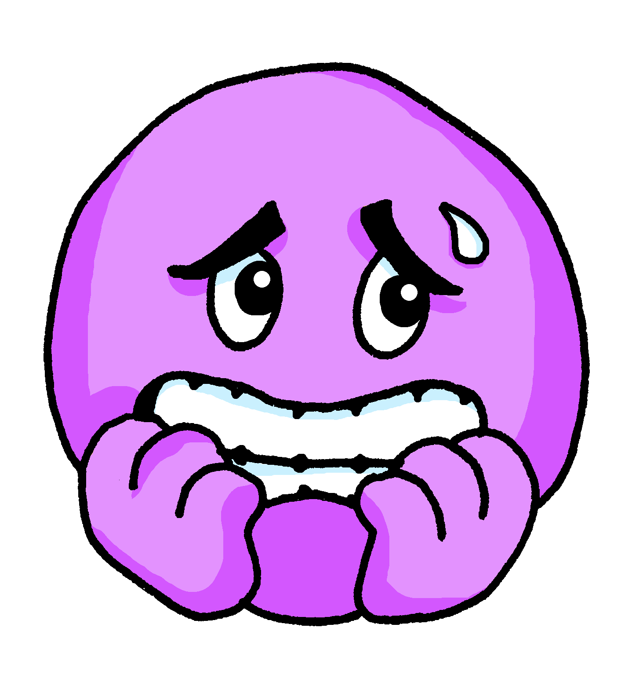
Tener: I have | s/he, it has
[to have, having]
to have
In Spanish the verb tener means ___________.
Remember that it is an irregular verb:
Tengo un problema.
Quique tiene un problema.
I have a problem.
Quique has a problem.
He has a problem.
Notes:
Timing: 2 minutes
Aim: to revisit 1st and 3rd person singular of ‘tener’.
Procedure:
Click to present the information.
Elicit English translations for the Spanish examples provided.

Slide 6
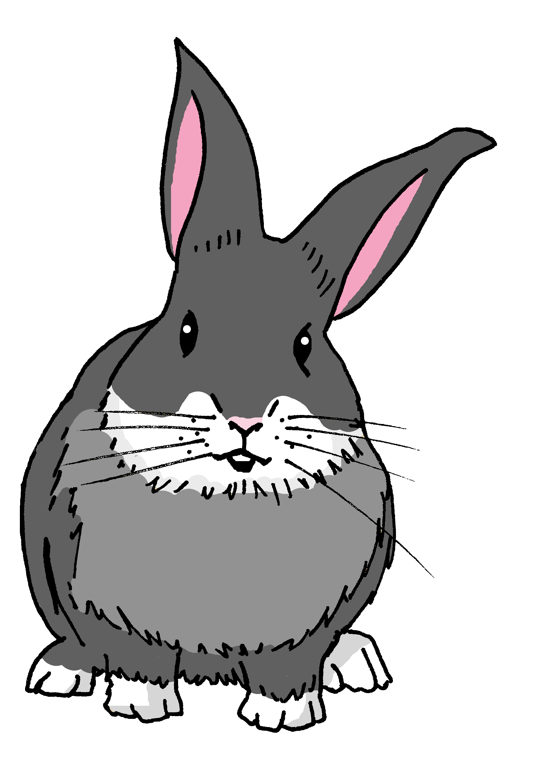
leer
Manchita come el diario de Quique.
¡ñam ñam!
¿Qué es ‘rabbit’?
¿Qué es ‘chair’?
¿Qué es ‘picture’?
¿Qué es ‘plant’?
Lee:¿Es Quique, Sofía o los dos?
Tengo una cama.
Tengo una planta.
Completa el diagrama en español.
Tiene un conejo.
Tengo una cuadro.
los dos
‘I have’ + ’she has’
Sofía ‘she has’
Tiene una silla.
Quique ‘I have’
conejo
Tiene una cama.
flor
cama
planta
silla
cuadro
Tengo una flor.
Tiene un cuadro.
Notes:
Timing: 5 minutes
Aim: to practise written understanding of ‘tengo’ and ‘tiene.
Procedure:
Read the task title in Spanish and click to bring up further instructions.
Click x1 to bring up Venn diagram and instruction, then draw pupils attention to the sentences. Was Quique writing about himself(I have) or Sofía (she has)? Are there any items they both have? (I have + she has)
3. Ask pupils to draw the diagram (or a table) and write down the Spanish words in the correct.
4. Go through answers together, answers are animated in groups (first Quique, then Sofía, lastly ‘los dos’).
Part 2
1. Click to bring up the question to check understanding on the vocabulary used in this activity (planta, cuadro, conejo, silla). Elicit Spanish from pupils.

Slide 7
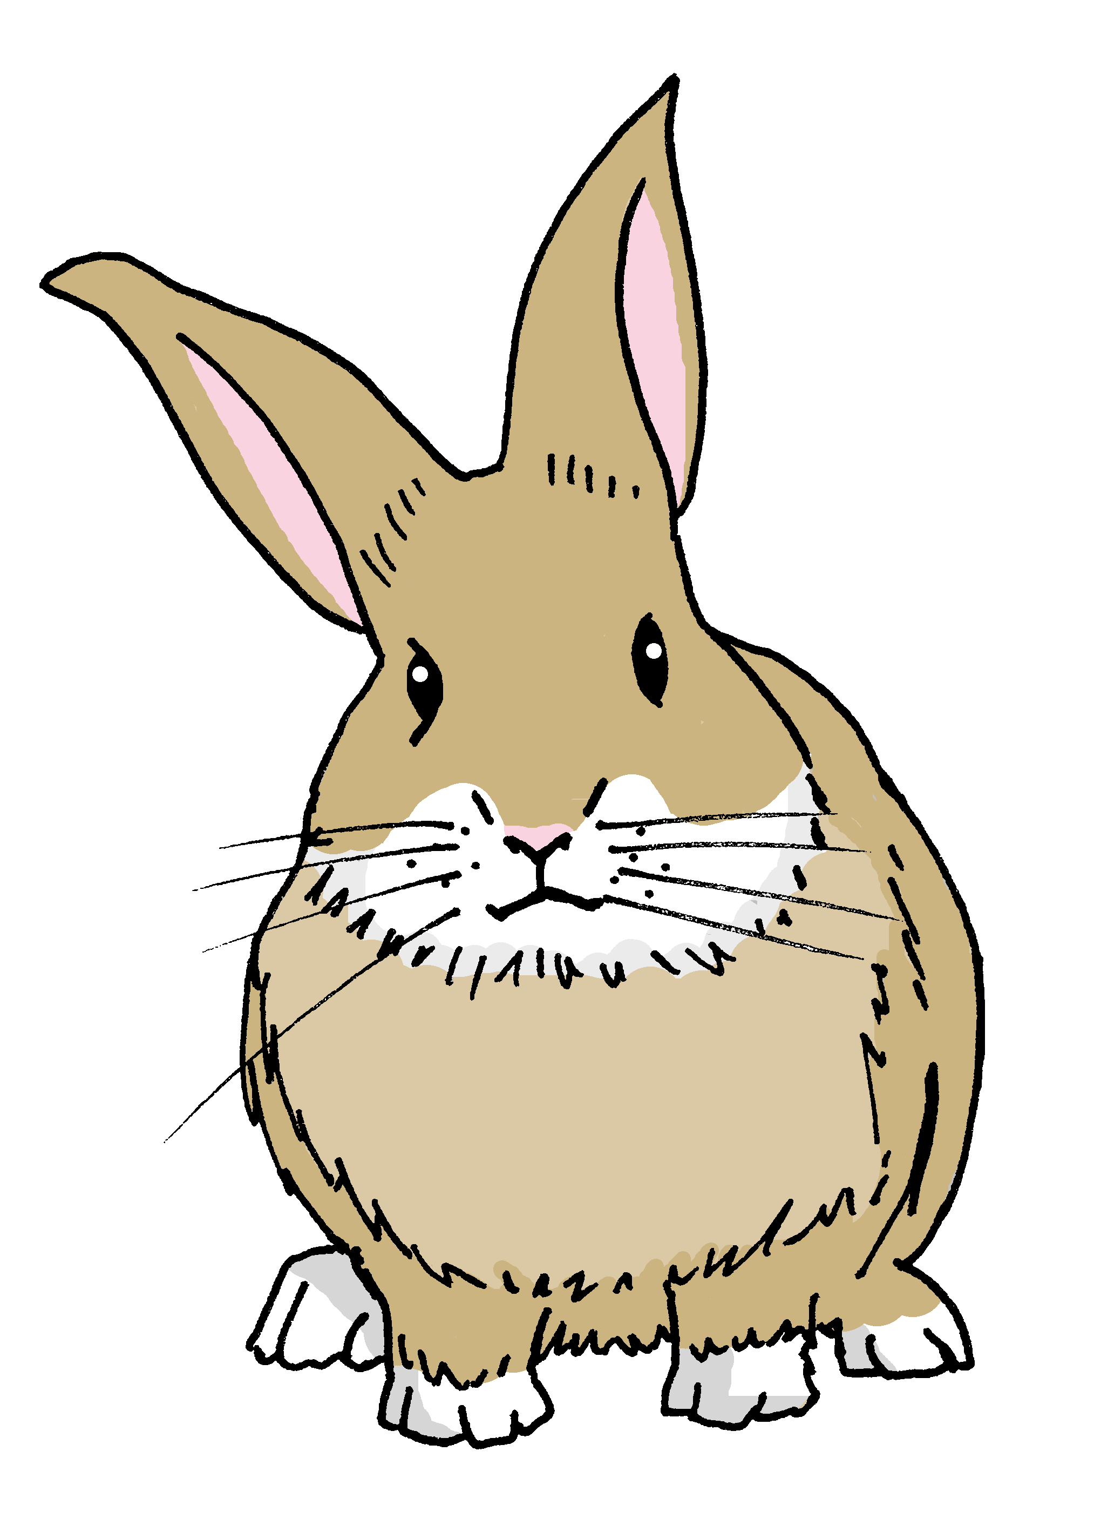
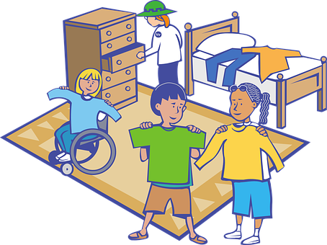
Adjectives following the noun.
In Spanish, many adjectives follow the noun:
un conejo simpático.
In English the adjective comes before the noun.
a nice rabbit
una cama cómoda
💡 Remember: Adjectives that end in -e describe stay the same to describe singular nouns.
a comfortable bed
una habitación grande
un jardín grande
a big room
a big garden
Notes:
Timing: 2 minutes
Aim: to introduce post-nominal adjective agreement.
Procedure:
Click through the animations to present the new information.
Elicit English translations for the Spanish examples provided.
Callout 1 highlights the difference between English and Spanish.
Callout 2 reminds pupils about gender agreement of adjectives ending in –e.

Slide 8
escuchar
¿De quién es el objeto?
Escucha y marca .
Escribe en inglés .
escuchar
Quique (I) | Sofía (she)
descripción
objeto
E
different
bed
1
terrible
chair
2
pretty
t-shirt
3
fun
game
ugly
bag
4
5
normal
room
small
rabbit
6
Notes:
Timing: 5 minutes
Aim: to practise aural recognition of ‘tengo’ and ‘tiene’ and their connection with meaning; to practise aural comprehension of postnominal adjectives and several nouns.
Procedure:
Read the instruction in Spanish.
Click to bring up further instruction (Marca).
Tell them that they will hear Quique talking about himself (I) or Sofía (she). Tell pupils they need to pay attention to whether they hear “tengo” or “tiene”. They can write the verb down for support or tick directly.
4. Do the example with them.
5. Ask pupils to write 1-6 in their books.
6. Click to listen to each item once. The first time they listen, pupils should identify whether the object belongs to Quique or Sofía and tick the correct box.
6. Go through answers 1-6 (use of tener).
7. Pupils listen again. The second time they listen, they need to write down the adjective in English. Many pupils will also be able to write the object.
8. Click to correct answers.
Transcript:
Ej. Tiene una cama diferente.
Tiene una silla terrible.
Tengo una camiseta bonita.
Tengo un juego divertido.
Tiene una mochila fea.
Tengo una habitación normal.
Tiene un conejo pequeño.

Slide 9
escribir
¡Un día terrible!
Quique escribe frases en el cuaderno.
¿Qué es incorrecto? Reescribe las frases.
una mochila
Tengo un bolírafo incómodo .
a
I have an uncomfortable bag.
Tiene
Tiene una silla pequeña.
una planta
I have a small plant.
The noun ‘problema’ is masculine: el problema
Tiene
Tengo un jardín pequeño.
bonito
She has a pretty garden.
Tengo una profesora estricta.
un padre
o
I have a strict dad.
feo
Rubén tiene un problema terrible.
Rubén has an ugly problem.
Notes:
Timing: 6-8 minutes
Aim: to use the correct postnominal adjective agreement in guided written production.
Procedure:
Read the title and the instruction in Spanish from the board.
Click to bring up further instruction.
Read the first sentence in Spanish, and the English sentence. Ask pupils to identify what’s incorrect in the Spanish sentence. Elicit the Spanish word for “bag/rucksack” and draw their attention to the gender and how that would affect the ending of the adjective “incómodo”.
Click to bring up speech bubble that reminds pupils about the gender of ‘problema’.
5. Pupils complete the remaining four sentences in their books.
6. Click to reveal written answers.

Slide 10
¡adiós!
azul

