Slide 1
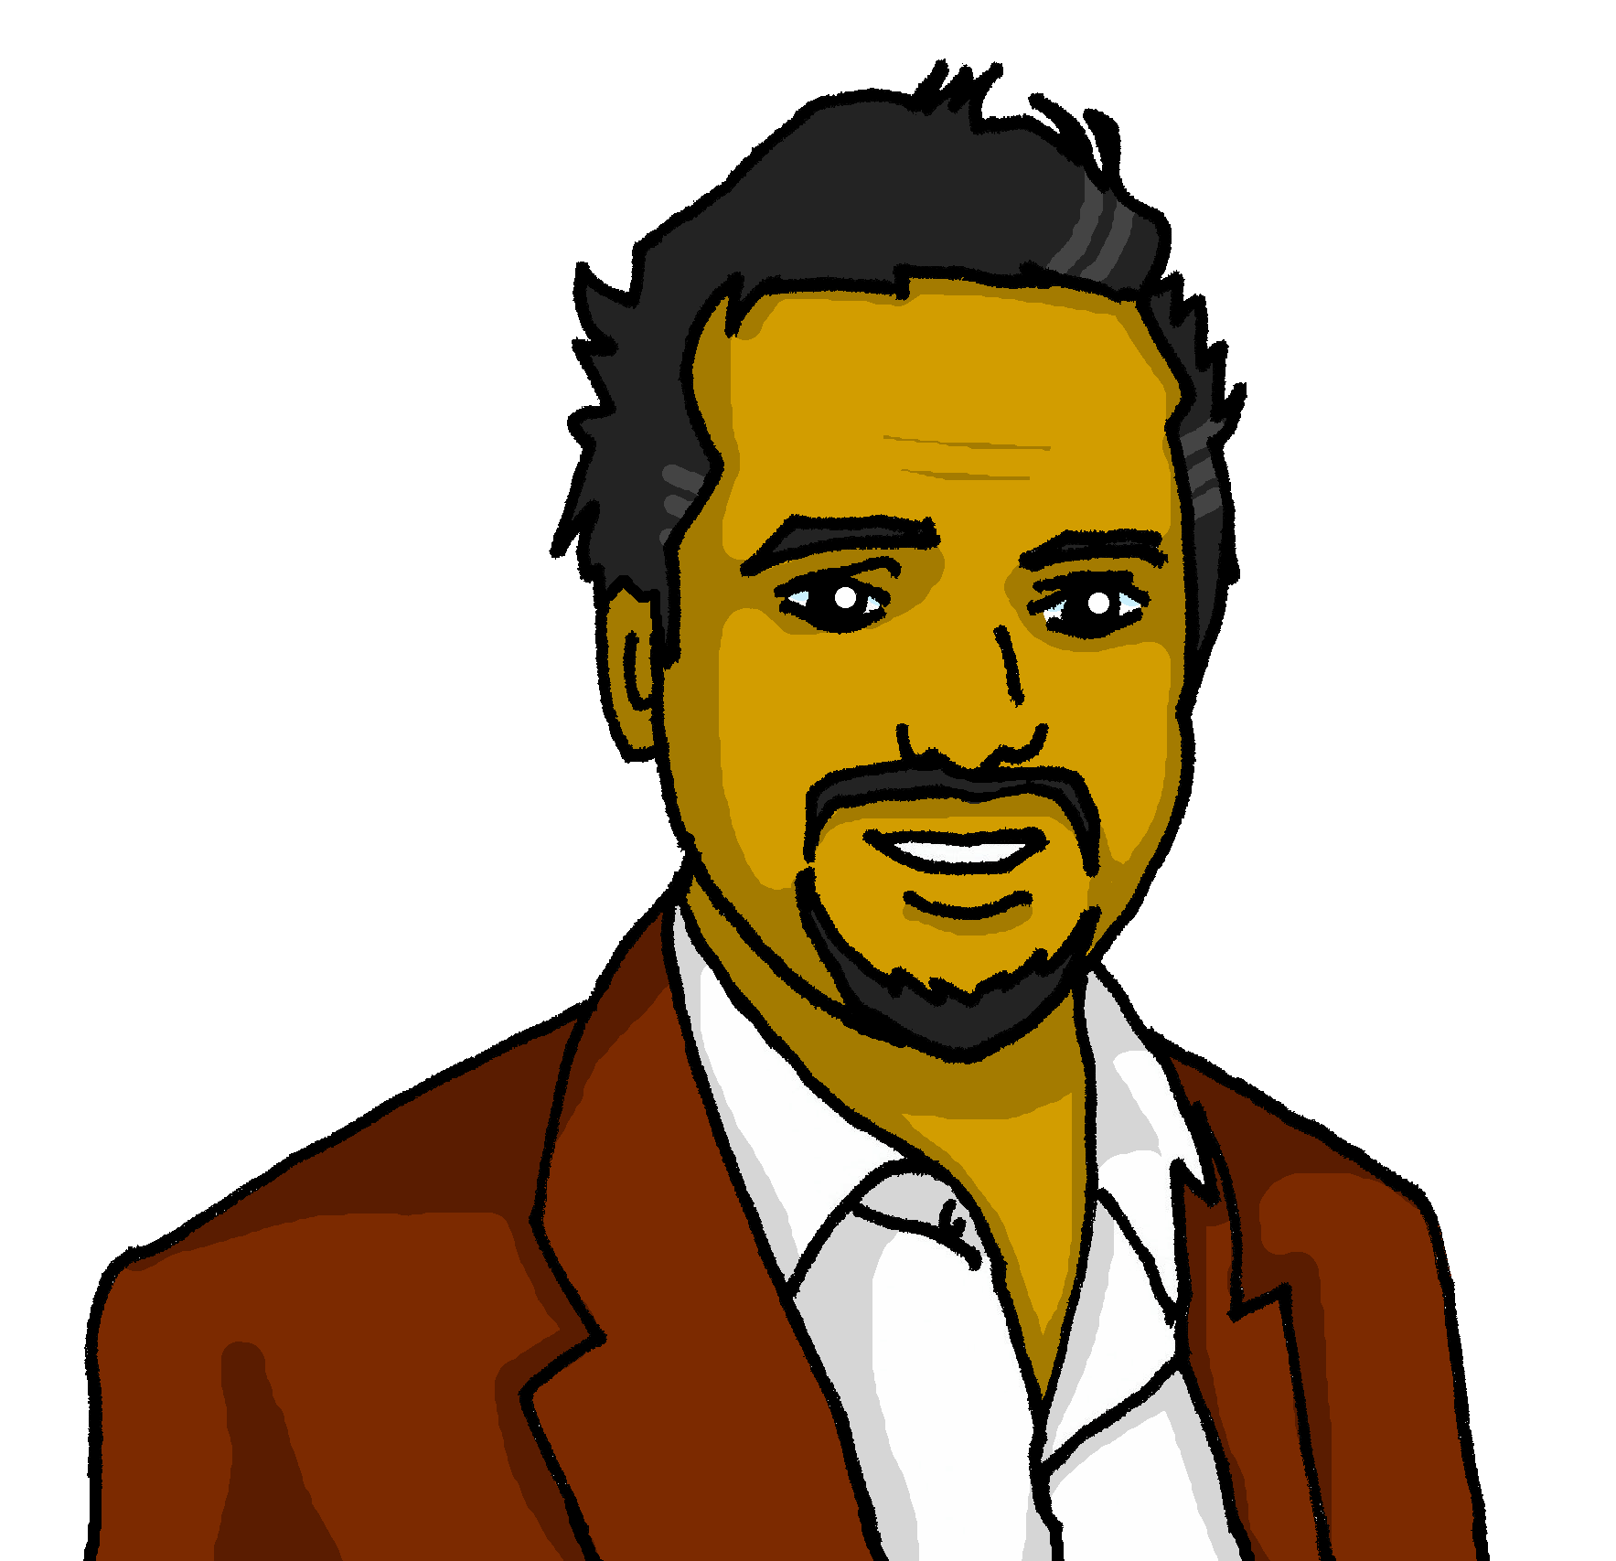
Describing me and others
Un día terrible
¿Qué tengo?
¿Qué tiene?
azul
Follow ups 1-5
Notes:
Artwork by Steve Clarke. All additional pictures selected are available under a Creative Commons license, no attribution required.
The frequency rankings for words that occur in this PowerPoint which have been previously introduced in the resources are given in the SOW (excel document) and in the resources that first introduced and formally re-visited those words.
For any other words that occur incidentally in this PowerPoint, frequency rankings will be provided in the notes field wherever possible.
Phonics: All vowels revisited: casa [106] dos [64] universo [1603] elefante [5000] idea [247] cho-co-la-te [3408] in-te-re-san-te [616] oeste [2416] leer [209] feo [2373]cuándo [138] puente [1715] antiguo [446] autor [513] euro [2435] aceite 2101] aire [401] boina [>5000] ciencia [738] limpiar [1713] junio [1035]
Vocabulary (new words in bold): tener [19] tengo [tener 19] tiene [tener 19] casa [106] familia [233] habitación [1069] jardín [1195] libro [230] madre [226] padre [162] problema [145] profesor / profesora [501] silla [1271] estricto [3155] feo [2373] terrible [1246] muy [43] un [6] una [6] Re-use adjectives: bonito [891]cómodo [2237] diferente [293] divertido [2465] feliz [908] elegante [2742] grande [66] importante [171] independiente [1177] negativo [1804] normal [1000] pequeño [202] tranquilo [1093]
Revisit 1: cuál [445] día [65] fecha [756] lunes [1370] martes [3101] miércoles [1816] jueves [1650] viernes [1259] sábado [1179] domingo [693] hoy [167] Revisit 2: --
Frequency of unknown words:
orden [421]
Source: Davies, M. and Davies, K. (2018). A frequency dictionary of Spanish: Core vocabulary for learners (2nd ed.). Routledge: London

Slide 2
Follow up 1:
[i] [o] [u]
[a]
[e]
Escucha y canta.
pronunciar
Tengo (ooo)
una abejita en la panchita (iii)
está mirando la tripita (aaa)
no me deja dormir
Con la i
Tingui (iii)
ini ibijiti in li pinchiti (iii)
istí mirindi li tripiti (iii)
ni mi diji dirmir
Con la a
Con la o
Tanga (aaa)
ana abajata an la panchata (aaa)
astá maranda la trapata (aaa)
na ma daja darmar
Tongo (ooo)
ono obojoto on lo ponchoto (ooo)
ostó morondo lo tropoto (ooo)
no mo dojo dormor
Con la e
Con la u
Tengue (eee)
ene ebejete en le penchete (eee)
esté merende le trepete (eee)
ne me deje dermer
Tungu (uuu)
unu ubujutu un lu punchutu (uuu)
ustú murundu lu truputu (uuu)
nu mu duju durmur
Notes:
Timing: 6 minutes
Aim: to practise pronouncing all the vowels in a series of unknown words (including nonsense words from this nursery rhyme)
Procedure:
With a partner, pronounce each set of four lines.
Then listen to the verse.
Then repeat in pairs again.
Repeat for all six verses.
Nursery rhyme to practise vowel sounds. Adapted from:
https://www.youtube.com/watch?v=nMB93puvMWo&ab_channel=Mar%C3%ADaPaulaAcevedoD%C3%ADaz

Slide 3
Follow up 2:
Escucha y rodea.
¿Qué describe? Escribe en inglés
Circle the words that are mentioned.
escuchar
E
I have | s/he has
elegant | special
a father
1
I have | s/he has
nervous | serious
a brother
a (male) rabbit
2
s/he has | I have
active | fun
s/he has | I have
big | small
room
3
4
I have | s/he has
terrible | ugly
garden
5
I have | s/h has
special | normal
family
Notes:
Timing: 5 minutes
Aim: to practise aural comprehension of ‘tengo’ & ‘tiene’, as well as nouns plus postnominal adjectives.
Procedure:
Explain instructions to pupils.
Ask pupils to write 1-5 in their books if working in books.
3. Do the example with them and click x2 to bring answers.
4. Click to bring further instruction (Challenge task).
Do 1-5. The first time they listen, they should identify whether they hear ‘I have’ or ‘s/he has.
Go through answers 1-5 (use of tener).
7. Play again. This time pupils listen out for the adjective and the noun (if they are able) and write them down in English. 8. Click for second set of answers.
Transcript:
E. Tengo un padre elegante
Tiene un hermano nervioso.
Tiene un conejo divertido.
Tengo una habitación pequeña.
Tiene un jardín feo.
Tengo una familia especial.

Slide 4
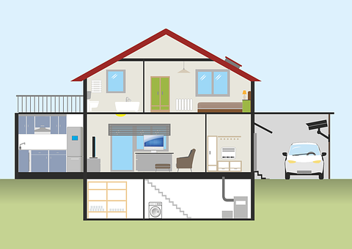
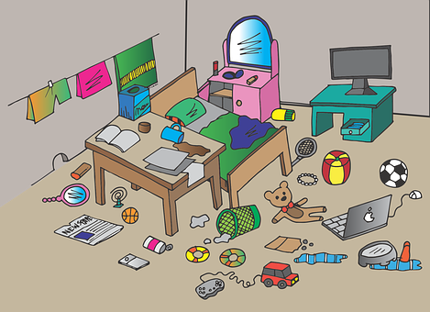
Follow up 3:
Describe en español.
Tengo …
leer
[father]
un p_ _ _ _
adre
asa
una c _ _ _
un j _ _ _ í _
ard
n
a
i
[mother]
un h _ _ _ t _ c _ ó _
abi
n
adre
una m_ _ _ _
[brother]
[teacher]
roblem
un h_ _ _ _ _ _ _
ro
esora
un p_ _ _ _ _ _a
ermano
una p _ _ f _ _ _ _ _
Notes:
Timing: 5 minutes (9 slides)
Aim: to practise written comprehension of adjectives and their forms (singular); to practise supported oral production of previously taught nouns.
Procedure:
Use this slide to elicit the Spanish nouns as a pre-task preparation task.
Move to the following slide to model the task.
Note: in the audio version the audio is on this slide but not on any of the rest of the Follow up 3 slides.

Slide 5
Follow up 3:
Ejemplo
feo
Tengo …
leer
feliz
¿Es correcta la gramática?
divertida
[father]
estricto
importante
un p_ _ _ _
adre
feo
grande
negativo
feliz
elegante
divertida
diferente
terrible
normal
tranquila
Notes:
Procedure: 1. Model example with “un padre”.
2. Elicit ‘padre’ from pupils.
3. Click for each adjective to appear and ask pupils if the combination is grammatically ok.
4. Ensure pupils understand that ‘divertida’ doesn’t work because of spelling (-a ending) not because of meaning.
NB. Teachers can draw their attention to the list of adjectives on the right-hand side. Teachers can ask for more possible combinations.

Slide 6
Follow up 3:
feo
Tengo …
leer
feliz
[father]
divertida
estricto
un p_ _ _ _
adre
importante
asa
una c _ _ _
grande
negativo
un j _ _ _ í _
ard
n
a
i
[mother]
un h _ _ _ t _ c _ ó _
abi
n
elegante
diferente
adre
una m_ _ _ _
terrible
[brother]
[teacher]
normal
roblem
un h_ _ _ _ _ _ _
ro
esora
un p_ _ _ _ _ _a
ermano
una p _ _ f _ _ _ _ _
tranquila
Notes:
Procedure:
Give pupils 3-4 minutes to write 2-3 adjective that would work with each noun.
Move to the following slide to elicit responses.

Slide 7
Follow up 3:
Tengo …
feo
leer
feliz
divertida
estricto
importante
feliz
importante
grande
una casa
grande
tranquila
estricto
negativo
elegante
diferente
¿Es correcta la gramática?
terrible
¿Es posible?
normal
tranquila
Notes:
Procedure:
Elicit noun.
For each adjective ask ‘¿es correcta la gramática?’ and ¿es posible?’ which refers to the meaning of the words – is it a sensible combination semantically?
Repeat the process for the remainder of the slides.
NB. Teachers can ask further questions using the adjectives on the right-hand side.

Slide 8
Follow up 3:
Tengo …
leer
[mother]
una madre
feo
feliz
estricto
negativo
¿Es correcta la gramática?
¿Es posible?
Notes:
Procedure:
Elicit noun.
For each adjective ask ‘¿es correcta la gramática?’ and ¿es posible?’ which refers to the meaning of the words – is it a sensible combination semantically?
Repeat the process for the remainder of the slides.

Slide 9
Follow up 3:
Tengo …
leer
feo
feliz
divertida
estricto
un jardín
importante
grande
¿Es correcta la gramática?
negativo
¿Es posible?
normal
tranquila

Slide 10
Follow up 3:
Tengo …
leer
feliz
divertida
grande
negativo
una habitación
elegante
diferente
terrible
¿Es correcta la gramática?
normal
¿Es posible?
tranquila

Slide 11
Follow up 3:
Tengo …
leer
feo
feliz
grande
negativo
[brother]
elegante
un hermano
diferente
terrible
¿Es correcta la gramática?
divertida
¿Es posible?
estricto

Slide 12
Follow up 3:
Tengo …
leer
feo
feliz
normal
[teacher]
negativo
una profesora
elegante
diferente
terrible
¿Es correcta la gramática?
divertida
¿Es posible?
estricto

Slide 13
Follow up 3:
Tengo …
💡 ’problema’ is a masculine noun!
leer
feo
feliz
negativo
un problema
elegante
diferente
terrible
¿Es correcta la gramática?
divertida
¿Es posible?
estricto
importante

Slide 14
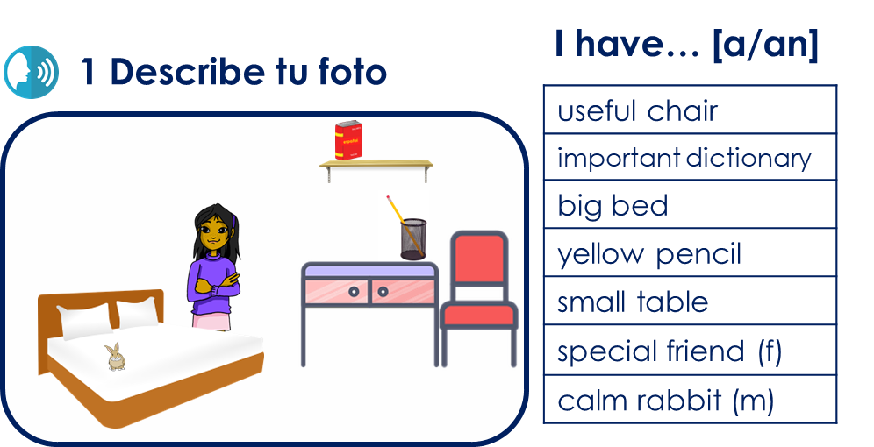
Follow up 4:
Habla y escribe con tu compañero/a.
escribir
hablar
Turno 1
Read your sentences top to bottom in this order.
Persona A Lee las frases a tu compañero y describe tu foto.
Persona B Escucha la descripción de tu compañero/a.
Tengo
una mochila
pequeña
💡 Remember: In Spanish, adjectives often follow the noun.
Notes:
Timing: 5-8 minutes
Aim: to practise oral production of ‘tengo’; correct position and form of adjectives, and recall of other vocabulary, as well as and aural comprehension of the vocabulary.
Give pupils a handout before modelling, and decide who will be A/B.
Use this slide to model first turn (Pupil A speaks, Pupil B writes).
Pupil A says his/her sentences in Spanish to Pupil B.
Pupil B listens and completes the table.
Swap roles (Use next slide to model if appropriate).

Slide 15
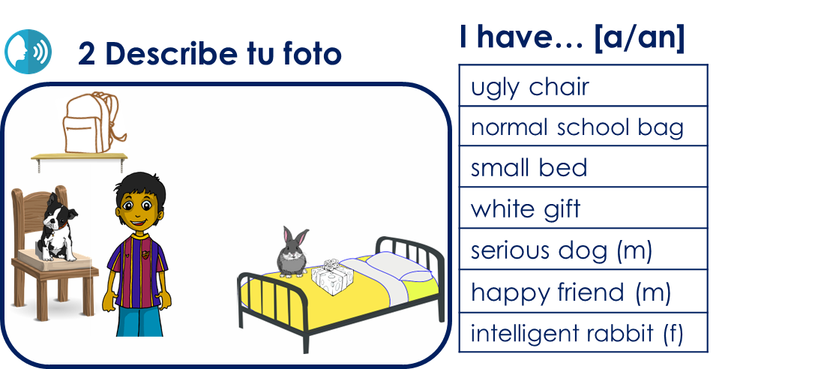
Follow up 4:
Habla y escribe con tu compañero/a.
escribir
hablar
Turno 2
Read your sentences top to bottom in this order.
Persona B Lee las frases a tu compañero y describe tu foto.
Persona A Escucha la descripción de tu compañero/a.
Tengo
una silla
fea
💡 Remember: In Spanish, adjectives often follow the noun.
Notes:
Timing: 5-8 minutes
Aim: to practise oral production of ‘tengo’; correct position and form of adjectives, and recall of other vocabulary, as well as and aural comprehension of the vocabulary.
Give pupils a handout before modelling, and decide who will be A/B.
Use this slide to model first turn (Pupil A speaks, Pupil B writes).
Pupil A says his/her sentences in Spanish to Pupil B.
Pupil B listens and completes the table.
Swap roles (Use next slide to model if appropriate).

Slide 16
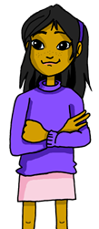
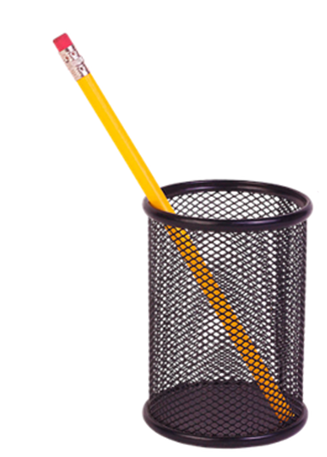
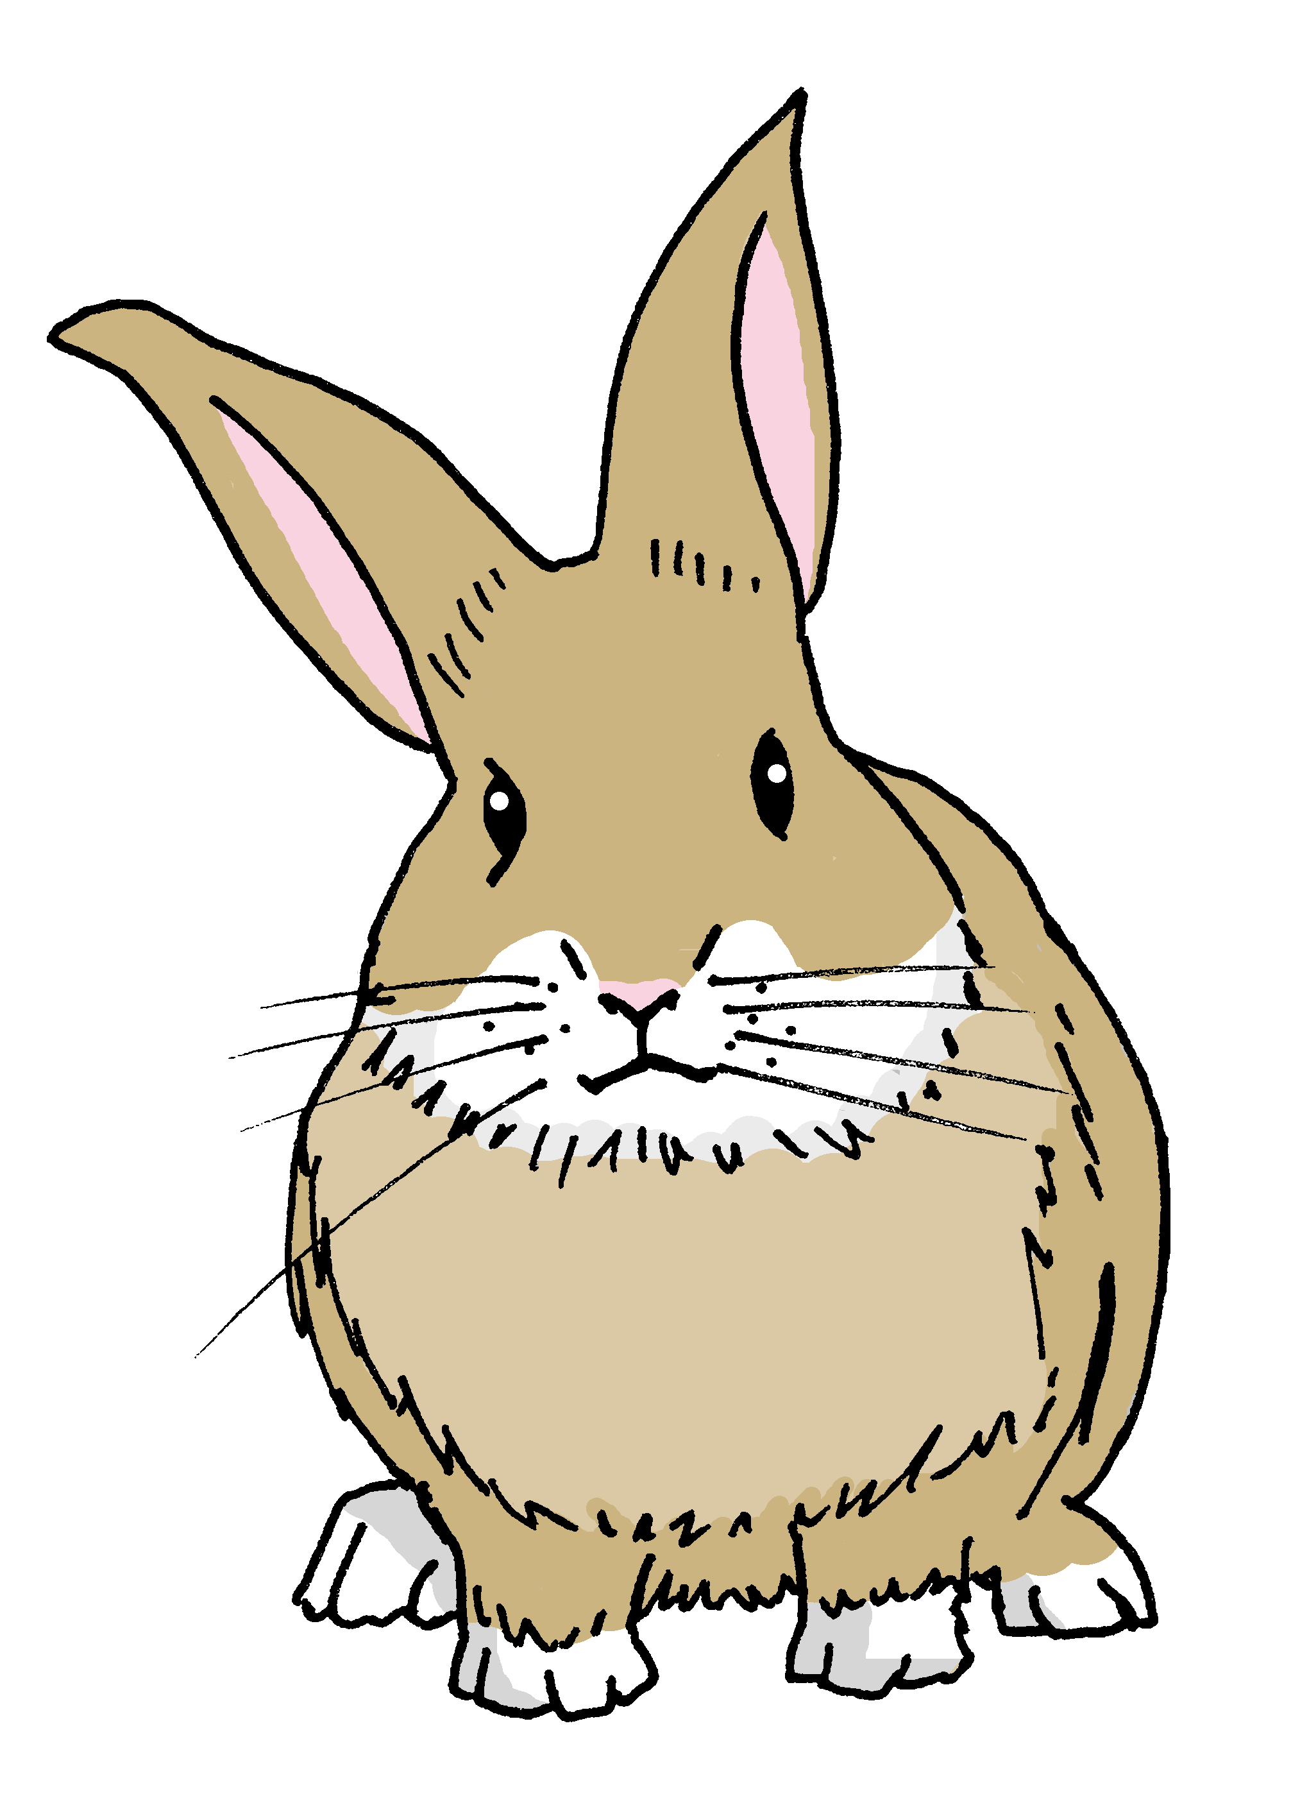
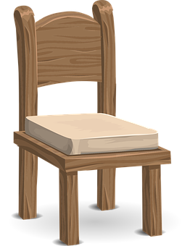
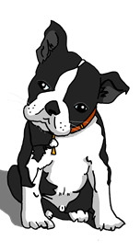
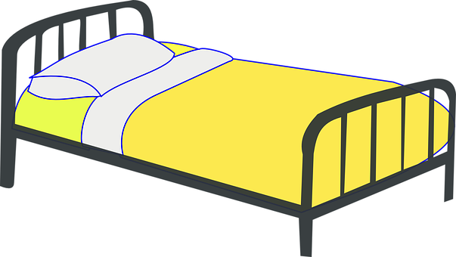
to print
Persona A
Persona B
I have… [a/an]
1 Describe tu foto
1 Escucha y elige la opción correcta:
|
|
|
|
|
|
|
|
|
|
|
|
|
|
useful chair
important dictionary
big bed
yellow pencil
small table
special friend (f)
calm rabbit (m)
1 | boat | garden | chair
2 | book | dictionary | pen
3 | door | bag | bed
4 | pencil | pen | bottle
5 | game | ball | table
6 | friend (f) | friend (m) | brother
7 | rabbit (m) | rabbit (f) | dog (m)
A | big
B | yellow
C | useful
D | important
E | small
F | quiet
G | special
2 Escucha y elige la opción correcta:
I have… [a/an]
2 Describe tu foto
1 | boat | garden | chair
2 | book | dictionary | bag
3 | door | t-shirt | bed
4 | gift | door | bottle
5 | rabbit (f) | dog (m) | dog (f)
6 | friend (f) | friend (m) | brother
7 | rabbit (m) | rabbit (f) | dog (m)
A | serious
B | white
C | small
D | happy
E | intelligent
F | ugly
G | normal
ugly chair
normal school bag
small bed
white gift
serious dog (m)
happy friend (m)
intelligent rabbit (f)
Notes:
HANDOUT

Slide 17
ANSWERS
Persona A
Persona B
1 Describe tu foto
1 Escucha y elige la opción correcta:
|
|
|
|
|
|
|
|
|
|
|
|
|
|
1 | boat | garden | chair
2 | book | dictionary | pen
3 | door | bag | bed
4 | pencil | pen | bottle
5 | game | ball | table
6 | friend (f) | friend (m) | brother
7 | rabbit (m) | rabbit (f) | dog (m)
A | big
B | yellow
C | useful
D | important
E | small
F | quiet
G | special
I have…
useful chair
important dictionary
big bed
yellow pencil
small table
special friend (f)
calm rabbit (m)
Notes:
ANSWERS Transcript: Tengo una silla útil. Tengo un diccionario importante.
Tengo una cama grande.
Tengo un lápiz amarillo.
Tengo una mesa pequeña. Tengo una amiga especial. Tengo un conejo tranquilo.

Slide 18
ANSWERS
Persona B
Persona A
2 Describe tu foto
2 Escucha y elige la opción correcta:
|
|
|
|
|
|
|
|
|
|
|
|
|
|
1 | boat | garden | chair
2 | book | dictionary | bag
3 | door | t-shirt | bed
4 | gift | door | bottle
5 | rabbit (f) | dog (m) | dog (f)
6 | friend (f) | friend (m) | brother
7 | rabbit (m) | rabbit (f) | dog (m)
A | serious
B | white
C | small
D | happy
E | intelligent
F | ugly
G | normal
I have…
ugly chair
normal school bag
small bed
white gift
serious dog (m)
happy friend (m)
intelligent rabbit (f)
Notes:
ANSWERS Transcript: Tengo una silla fea. Tengo una mochila normal.
Tengo una cama pequeña.
Tengo un regalo blanco.
Tengo un perro serio. Tengo un amigo feliz. Tengo un conejo inteligente.

Slide 19
Follow up 5:
¡Quique tiene un día terrible!
Escribe cinco frases en el diario.
escribir
Normalmente soy positivo pero hoy estoy bastante negativo.
Fecha :
Tengo una silla incómoda.
objeto | descripción
chair | uncomfortable
t-shirt | small
garden | ugly
teacher (f) | strict
my sister has a problem!
Tengo una camiseta pequeña.
Tengo un jardín feo.
Tengo una profesora estricta.
Mi hermana tiene un problema.
Notes:
Timing: 5-8 minutes
Aim: to practise written production of ‘tengo’ and ‘tiene’; correct position and form of adjectives, and other vocabulary.
Procedure:
Click to present the task.
Pupils write Quique’s diary entry in Spanish, using the prompts in the table.
Click to provide written versions of the answers.

Slide 20
Follow up [extra 1]:
Escribe en inglés 📝.
a b ñ
vocabulario
Can you get at least15 points?
 | pequeña | cómodo | bonita
 | el padre | la silla | muy
 | el día | ¿cuál? | hoy
 | el martes | el domingo | la fecha
 | el jardín | estricta | la familia
 | tengo | tiene | la habitación
 | feo | el problema | la casa
small (f)
comfortable (m)
pretty
x3
father
chair
very
day
which?
today
x2
Tuesday
Sunday
date
garden
strict (f)
family
I have
s/he, it has
room
x1
ugly (m)
problem
house
Notes:
Timing: 5 minutes
Aim: to practise written comprehension of vocabulary for this week and revisited weeks.
Procedure:
Pupils need to write the English for as many words as possible, aiming to get at least 15 points (but more if possible).
Remind pupils to pay attention to the forms of the words and be precise in their English meanings. Do the first one as an example.
2. Click for English answers.

Slide 21
Follow up extra 2:
Escribe en español 📝.
a b ñ
vocabulario
Can you get at least15 points?
 | (the) chair | (the) female teacher | (the) mother
 | calm, quiet | very | fun, funny
 | Monday | Thursday | day
 | Which? | Saturday | date
 | room | garden | ugly (f)
 | pretty (f） | problem | I have
 | family | strict （m) | s/he, it has
la silla
la profesora
la madre
x3
tranquila
muy
divertido
el lunes
el jueves
el día
x2
¿Cuál?
el sábado
la fecha
la habitación
el jardín
fea
bonita
el problema
tengo
x1
la familia
estricto
tiene
Notes:
Aim: to practise written production of vocabulary for this week and previous weeks.
Procedure:
Pupils need to write the Spanish for as many words as possible, aiming to get at least 15 points (but more if possible).
Tell pupils to write the correct word for ‘the’ with all the nouns.
3. Click for Spanish answers.

Slide 22
Follow up [extra]:
Escribe en inglés: Can you get at least 15 points?
 | pequeña | cómodo | bonita
 | el padre | la silla | muy
 | el día | ¿cuál? | hoy
 | el martes | el domingo | la fecha
 | el jardín | estricta | la familia
 | tengo | tiene | la habitación
 | feo | el problema | la casa
vocabulario
x3
x2
x1
Notes:
HANDOUT

Slide 23
Follow up [extra]:
Escribe en español: Can you get at least 15 points?
 | chair | teacher (f) | mother
 | calm (f) | very | funny (m)
 | Monday | Thursday | day
 | Which? | Saturday | date
 | room | garden | ugly (f)
 | pretty (f） | problem | I have
 | family | strict （m) | s/he, it has
vocabulario
x3
x2
x1
Notes:
HANDOUT

