Slide 1
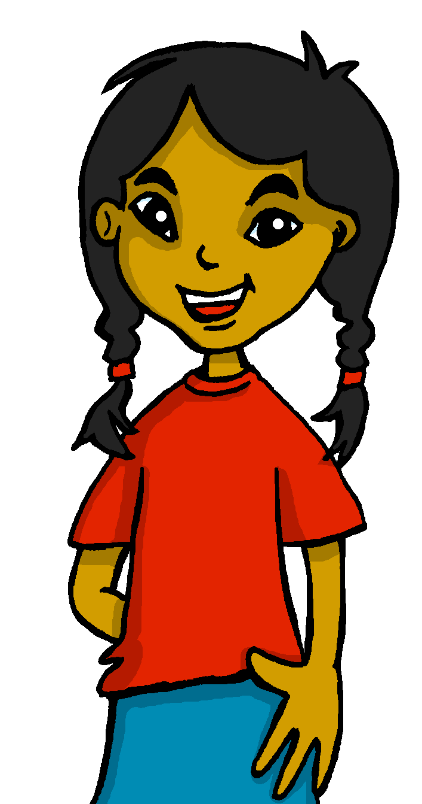
español, con Sofía

Slide 2
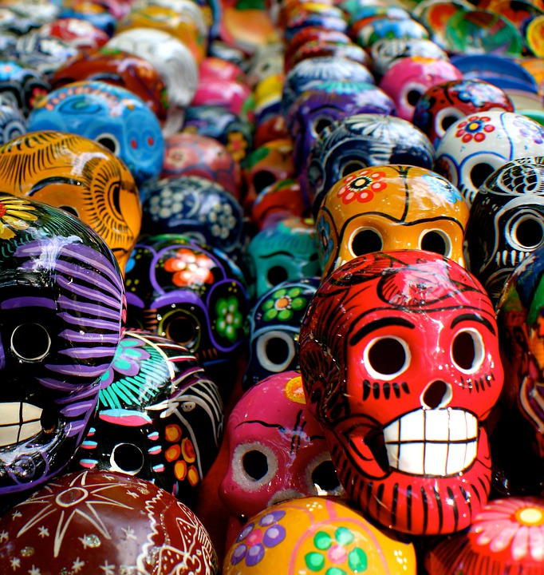
Describing me and others
El día de los muertos
azul
- Adjectives ending in -z and -l.
Strong and weak vowels [revisited]
Notes:
Artwork by Steve Clarke. All additional pictures selected are available under a Creative Commons license, no attribution required.
The frequency rankings for words that occur in this PowerPoint which have been previously introduced in the resources are given in the SOW (excel document) and in the resources that first introduced and formally re-visited those words. For any other words that occur incidentally in this PowerPoint, frequency rankings will be provided in the notes field wherever possible.
Phonics: Revisit strong and weak vowels: leer [209] aceite [2101] aire [401] boina [>5000] idea [247] oeste [2416] puente [1715] antiguo [446] feo [2373]
Vocabulary (new words in bold): hay [13] cuántos/cuántas [580] diccionario [3844] foto [882] regalo [1986] blanco [372] especial [436] feliz [908] grande [66] importante [171] normal [1000] pequeño [202] rojo [534] útil [3951]
Revisit 1: cumpleaños [3372] mes [288] enero [1173] febrero [1419] marzo [1231] abril [1064] mayo [909] junio [1035] julio [659] agosto [931] septiembre [1150] octubre [1242] noviembre [1434] diciembre [1165] cuándo [138] de [2] trece [2700] catorce [2411] quince [1215] dieciséis [3373] diecisiete [3400] dieciocho [2730] diecinueve [4232] veinte [819] veintiuno [819/425] veintidós | veintitrés | veinticuatro | veinticinco |veintiseis|veintisiete|veintiocho |veintinueve |treinta [830] treinta y uno [830/4/425]
Revisit 2: cuidar [751] enseñar [610] participar [593] practicar [1595] guitarra [2705] niño, niña [173] trabajo [152]
Frequency of unknown words and cognates:
altar [3272] vela [2247] calavera [>5000] Source: Davies, M. & Davies, K. (2018). A frequency dictionary of Spanish: Core vocabulary for learners (2nd ed.). Routledge: London

Slide 3
pronunciar
Strong & weak vowels revisited
We know that in Spanish strong vowels are pronounced separately when they appear next to each other.
[a]
[o]
[e]
The strong vowels are ____, ____ and _____.
E
O
A
In contrast, weak vowels merge with [a], [e] and [o] (or with each other – iu | iu) to make a single syllable.
U
I
[i]
[u]
The weak vowels are _____ and _____.
Notes:
Timing: 2 minutes
Aim: to recap strong and weak vowels.
Procedure:
Click to present and elicit information.

Slide 4
vocabulario
a b ñ
El día de los muertos
Clasifica el vocabulario.
vocabulario
números | adjetivos | verbos | nombres
= noun
cuatro
feliz
hay
la flor
cinco
especial
son
la cara
siete
importante
el festival
el ojo
cuatro
la flor
importante
siete
there is / are
eye
feliz
hay
la cara
el festival
flower
face
they are
happy
seven
especial
cinco
son
el ojo
Notes:
Timing: 5 minutes
Aim: to recap previously introduced vocabulary, classifying the words by parts of speech.
Procedure:
Teacher reads the title of the activity (also the context of this lesson – Day of the Dead) and elicits English translation from pupils.
Click to bring up Spanish instruction and read out loud. Draw pupils’ attention to the four categories (números, adjectivos, verbos and nombres). The first three are cognates. Elicit English translations and encourage pupils to anticipate the meaning of “nombres”. Click again and the translation appears (noun).
Pupils work in pairs to classify the nouns into the four categories.
Elicit answers from pupils (cuatro – número). Answers are animated in columns from left to right.
Click for English cues to prompt meaning recall and pronunciation of the words.

Slide 5
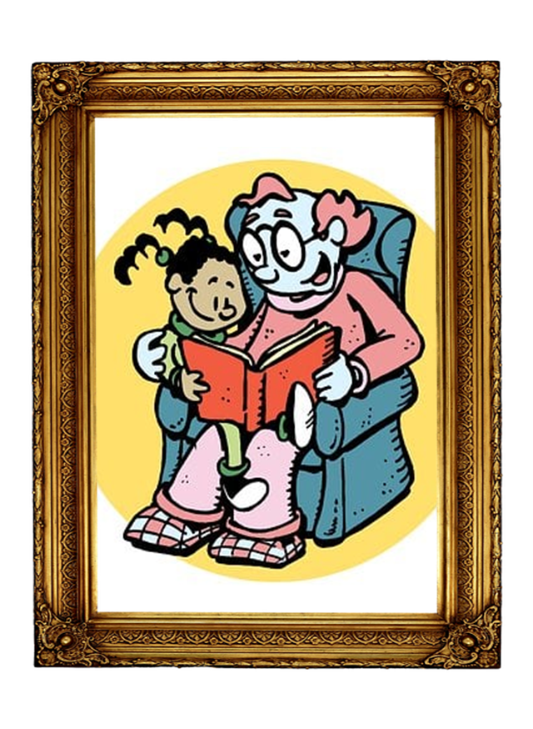
vocabulario
El altar del día de los muertos
a b ñ
el altar
vocabulario
la foto
la calavera – skull la vela - candle
la calavera
la vela
las flores
seis
En el altar hay _____ flores.
En el altar hay _____ calaveras.
dos
Notes:
Timing: 3 minutes
Aim: to introduce key vocabulary for the context of the lesson (Day of the Dead).
Notes: i) ‘foto’ is introduced for the first time. ii) ‘altar’, ‘vela’ and ‘calavera’ are unknown items and vela and calavera are glossed here. They are not part of the core vocabulary for the scheme of work but are included for enrichment in this lesson.
Procedure:
Teacher reads the title.
Click to bring up the Spanish words for the different items and elicit repetition from pupils.
Click to bring up full sentence ‘en el altar hay…’. Pupils complete the sentence with the correct number per item.
Frequency of unknown words and cognates:
altar [3272] vela [2247] calavera [>5000] Source: Davies, M. & Davies, K. (2018). A frequency dictionary of Spanish: Core vocabulary for learners (2nd ed.). Routledge: London

Slide 6
pronunciar
¿Cuántos?
💡The question word ‘¿cuánto?’ agrees with the gender and number of the noun it refers to.
How many?
¿Cuántos diccionarios hay?
[How many dictionaries are there?]
Rachel Hawkes / Emma Marsden
Notes:
Timing: 1 minute (two slides)
Aim: to introduce question words ¿cuántos? and ¿cuántas?
Procedure:
Pupils listen and repeat the key question word (include gesture if possible).
Display the word and get them to repeat one more time.
Elicit English meaning.
Reveal the sentence and elicit English translation from pupils.
Click to reveal speech bubble with reminder for agreement of this question word.
Repeat steps 1-5 with the following slide.
Gesture: mime the drawing of a five-bar tally with your index finger.

Slide 7
pronunciar
¿Cuántas?
💡 There are four forms: cuánto – how much (m) cuánta – how much (f) cuántos – how many (m, pl.) cuántas – how many (f, pl.)
How many?
¿Cuántas caras hay?
[How many faces are there?]
Rachel Hawkes / Emma Marsden

Slide 8
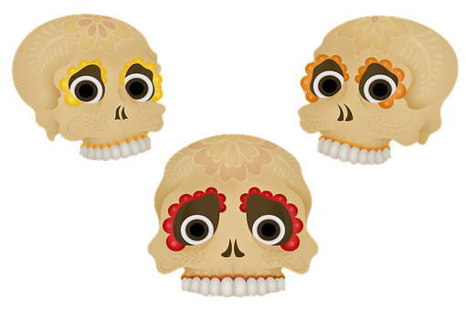
hablar
as
¿Cuánt____ calaveras hay?
Hay 3 calaveras.
Notes:
Timing: 3 minutes (6 slides)
Aim: to revisit agreement of the question words ‘cuántos’ and ‘cuántas’ and practise some numbers.
Procedure:
Read the question and model it with the two possible answers: cuántos or cuántas.
Elicit answer from pupils.
Click to bring up the correct ending ‘cuántos’
Click to bring up Sofía’s answers. Make sure pupils are familiar with ‘hay’ as this was introduced in Y3/4.
Repeat with the next 4 slides / examples.

Slide 9
hablar
os
¿Cuánt____ ojos hay?
Hay 6 ojos.
Notes:
[2/6]

Slide 10
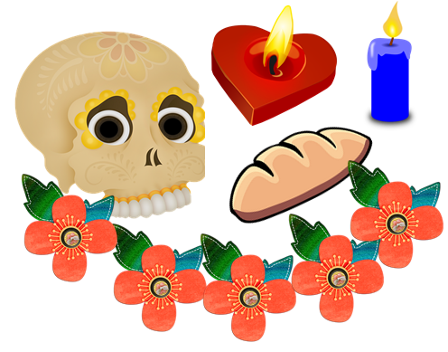
hablar
as
¿Cuánt____ flores hay?
Hay 5 flores.
Notes:
[3/6]

Slide 11
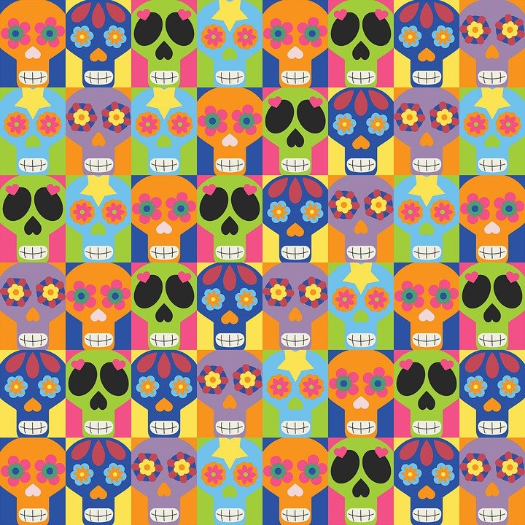
hablar
as
¿Cuánt____ calaveras hay?
Hay 24 calaveras.
Notes:
[4/6]

Slide 12
hablar
os
¿Cuánt____ regalos hay?
Hay catorce regalos
Notes:
[5/6]

Slide 13
hablar
as
¿Cuánt____ flores hay?
Hay 18 flores.
Notes:
[6/6]

Slide 14
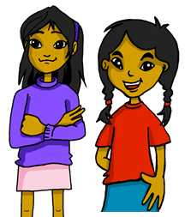
Number agreement on adjectives
Adjectives that end in -l, -s or -z describe singlular masculine and feminine nouns, e.g. feliz.
When we describe more than one noun, we add –s to adjectives ending in –o, –a or –e.
When we describe more than one noun with adjectives ending in -l,-s or –z, we add –es.
Note that nouns ending in -l, -s, -z also add -es for plural.
Los festivales son especiales.
The festivals are special.
ending in -z
When the adjective ends in –z, we change –z for –c and then add –es.
Ángela y Sofía son felices.
Ángela and Sofía are happy.
Notes:
Timing: 2 minutes
Aim: to explain the plural formation of adjectives ending in consonants (-l, -s), including the spelling changes that occur with adjectives ending in –z.
Procedure:
Click through the animations to present the new information.
Elicit English translation for the Spanish examples provided.

Slide 15
leer
Lee ¿Qué describe?
 |  | adjetivo
Las caras | Los regalos | azules
Los animales | Las profesoras | divertidos
Las lenguas | Los diccionarios | útiles
Las flores | Los regalos | antiguas
Los amigos | Las amigas | especiales
Sofía y Quique | Sofía y Ángela | normales
Los altares | Las fotos | pequeñas
E
1
2
3
4
5
6
el altar
Notes:
Timing: 3 minutes
Aim: to practise written comprehension of plural forms of adjectives that end in –o, –e and consonants.
Procedure:
Read the instructions in Spanish.
Read the adjective from the example (azules) and the two possible options “las caras” and “los regalos”. Does it describe “las caras”, “los regalos” or could it be both? How do we know? It can be both because it ends in –es.
3. Pupils do 1-6 in their books.
4. Go through answers together.

Slide 16
escuchar
Escucha y marca la opción correcta.
Escribe en español.
escuchar
add -s | adds -es
adjetivo (singular)
E
azul
1
divertido
2
útil
especial
3
importante
4
5
feliz
pequeño
6
Notes:
Timing: 5 minutes
Aim: to practise aural comprehension of plural adjectives and knowledge of different rules of formation.
Procedure:
Read the instructions in Spanish. Click to bring up instruction for the challenge (escribe).
Do the example with them.
Pupils write 1-6 in their books.
Click to play items 1-6 and pupils write –s or –es.
Click to listen again and pupils transcribe the singular form of the adjective. (Note – they could transcribe first what they hear and then remove the ending).
4. Click to bring up answers. Elicit English meaning of each adjective when going through answers.
NB: importante already ends in –e so just adds –s for plural.
Transcript:
Ej. Son azules.
Son muy divertidos.
Son útiles.
Son especiales.
Son importantes.
Son felices.
Son pequeñas.

Slide 17
hablar
Practica con tu compañero/a.
escribir
Persona B habla.
Lee las frases a tu compañero.
Persona A escucha.
¿Qué es diferente? Corrige las diferencias en tu texto.
Swap roles!
Notes:
Timing: 5 minutes
Aim:
ii) to develop fluency in decoding by reading aloud iii) to listen attentively, noting differences in the original text.
Procedure: 1. Pupil A reads his/her text. 2 to their partner 2. Pupil B follows along with the original and makes a note of any substituted words s/he hears (on his/her copy of the sheet – text 1)
3. Swap roles – instructions on next slide.
4. Pupils draw their altar based on the text 1.

Slide 18
hablar
Practica con tu compañero/a.
Persona A habla.
escribir
Lee las frases a tu compañero.
Persona B escucha.
¿Qué es diferente? Corrige las diferencias en tu texto.
A & B: dibuja el altar.
Notes:
Timing: 5 minutes
Aim:
ii) to develop fluency in decoding by reading aloud iii) to listen attentively, noting differences in the original text.
Procedure: 1. Pupil A reads his/her text. 2 to their partner 2. Pupil B follows along with the original and makes a note of any substituted words s/he hears (on his/her copy of the sheet – text 1)
3. Swap roles.
4. Pupils draw their altar based on the text 1.

Slide 19
to print
Persona A
Persona B
A Corrige las diferencias:
|
|
|
|
|
|
|
|
|
|
|
|
|
|
B Lee las frases a tu compañero/a.
En mi altar hay dos flores. Son pequeñas.
Hay cuatro regalos. Son especiales y con muchos colores. También hay dos velas. Son verdes. En mi altar hay dos niños. Son activos.
En mi altar hay tres flores. Son grandes. Hay cinco regalos. Son grandes y con muchas flores. También hay tres velas. Son azules. En mi altar hay dos niñas. Son felices.
B Lee las frases a tu compañero/a.
A Corrige las diferencias:
En mi altar hay dos fotos. Son rojas. Hay cuatro velas. Son grandes. También hay cinco niñas. Son felices. En mi altar hay dos calaveras. Son grandes y con muchos colores.
En mi altar hay dos diccionarios. Son amarilos. Hay tres velas. Son pequeñas. También hay dos niñas. Son amigas. En mi altar hay dos flores. Son grandes y con muchas flores.
Notes:
HANDOUT

Slide 20
¡adiós!
azul

