Slide 1


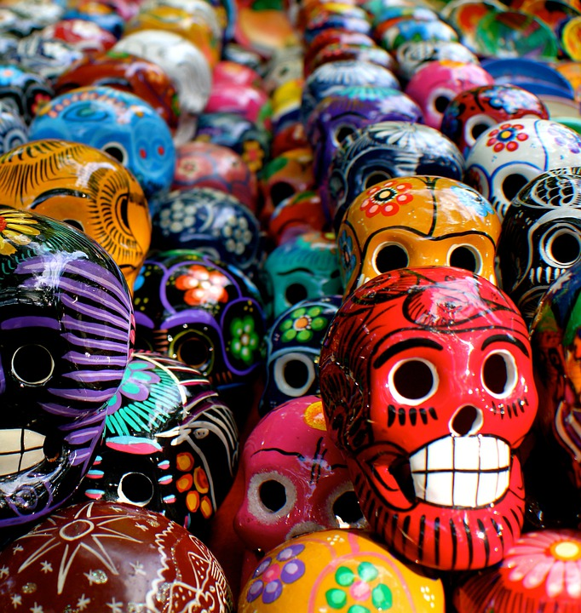
Describing me and others
El día de los muertos
azul
Follow ups 1-5
Notes:
Artwork by Steve Clarke. All additional pictures selected are available under a Creative Commons license, no attribution required.
The frequency rankings for words that occur in this PowerPoint which have been previously introduced in the resources are given in the SOW (excel document) and in the resources that first introduced and formally re-visited those words.
For any other words that occur incidentally in this PowerPoint, frequency rankings will be provided in the notes field wherever possible.
Phonics:
Revisit strong and weak vowels: leer [209] aceite [2101] aire [401] boina [>5000] idea [247] oeste [2416] puente [1715] antiguo [446] feo [2373]
Vocabulary (new words in bold): hay [13] cuántos/cuántas [580] diccionario [3844] foto [882] regalo [1986] blanco [372] especial [436] feliz [908] grande [66] importante [171] normal [1000] pequeño [202] rojo [534] útil [3951]
Revisit 1: cumpleaños [3372] mes [288] enero [1173] febrero [1419] marzo [1231] abril [1064] mayo [909] junio [1035] julio [659] agosto [931] septiembre [1150] octubre [1242] noviembre [1434] diciembre [1165] cuándo [138] de [2] trece [2700] catorce [2411] quince [1215] dieciséis [3373] diecisiete [3400] dieciocho [2730] diecinueve [4232] veinte [819] veintiuno [819/425] veintidós | veintitrés | veinticuatro | veinticinco |veintiseis|veintisiete|veintiocho |veintinueve |treinta [830] treinta y uno [830/4/425]
Revisit 2: cuidar [751] enseñar [610] participar [593] practicar [1595] guitarra [2705] niño, niña [173] trabajo [152]
Frequency of unknown words and cognates:
altar [3272] escuela [424] vela [2247] calavera [>5000]
Source: Davies, M. & Davies, K. (2018). A frequency dictionary of Spanish: Core vocabulary for learners (2nd ed.). Routledge: London

Slide 2



Follow up 1:
[e]
[o]
[a]
A
B
pronunciar
Escucha y completa.
¿Cuántas sílabas tiene?
Escribe las palabras.
[1]
Valenc _ _
_ _ _ _ _ _
i a
ca
[1]
H u e s
[2]
Bilb _ _
_ _ _ _ _ _ _ _
ao
l e n
c i a
[2]
V a
[3]
C_ _ dad R_ _ l
_ _ _ _ _ _
iu
ea
[3]
B i l
o
b a
[4]
H _ _ sca
_ _ _ _ _ _ _ _ _ _ _
ue
[4]
d a
j a
r a
G u a
l a
[5]
Ov _ _ do
_ _ _ _ _ _
ie
[5]
v i e
d o
O
[6]
G _ _ dalajara
_ _ _ _ _ _ | _ _ _ _
ua
[6]
d a d
R e
a l
C i u
Practica con tu compañero/a.
C
Notes:
Timing: 6 minutes
Aim: to practise listening out for pairs of strong and weak vowels in words and to successfully transcribe them.
Procedure:
Part A
pupils listen and write the strong + strong or strong + weak / weak + weak vowel combination.
Teacher reveals the answers for each word, one by one.
Part B
pupils count the syllables for each word of the six syllables in Part A, and write them down out to match the spaces in Part B.
The teacher shows the answers for each word, one by one.
Part C
pupils practise pronouncing the words, reading each one aloud. Click ‘Inicio’ to start timer.
Transcript:
Valencia
Bilbao
Ciudad Real
Huesca
Oviedo
Guadalajara

Slide 3


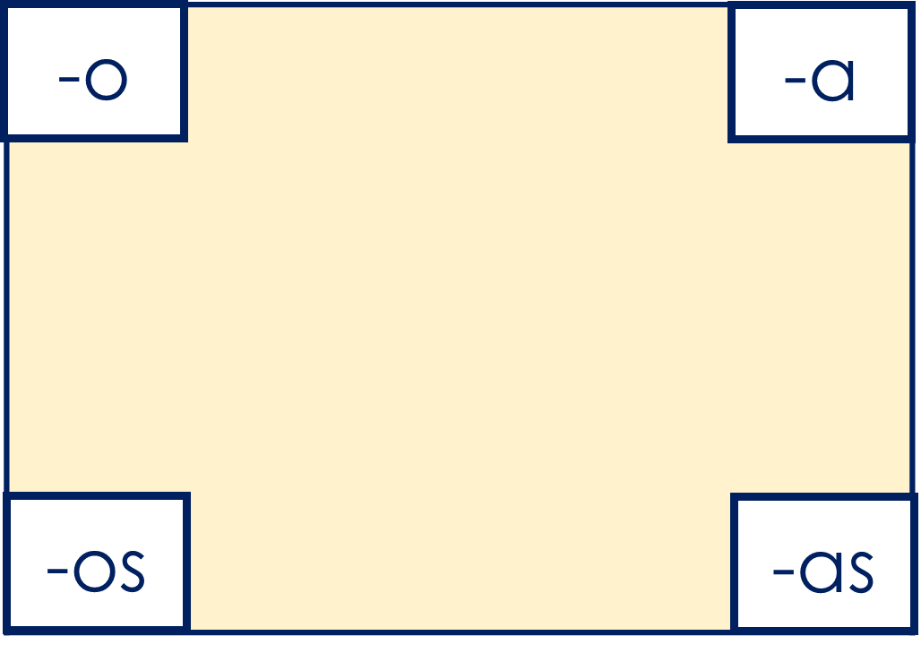



Follow up 2:
la escuela = school
they are
A
there is
‘son’ means ____________.
there are
‘hay’ means ________ or __________.
leer
‘hay’ is often used to identity or locate people or things.
C Clasifica los adjetivos.
‘son’ is often followed by an adjective to describe people or things..
activos
pequeñas
B Lee. ¿’son’ or ‘hay’?
1 | En la escuela hay niños. Son felices.
2 | En la foto hay animales. Son activos.
3 | Los cuadros son importantes. En el museo hay muchos.
4 | En el parque hay flores. Son muy pequeñas.
5 | Los diccionarios son útiles. En la clase hay solo uno. ☹
importantes
felices
útiles
What’s the singular form of ‘felices’?
feliz
Notes:
Timing: 5 minutes
Aim: to practise written comprehension of the verbs son and hay; to practise written recognition of familiar adjectives in plural form.
Procedure:
Click to present the recap of verbs son and hay (Part A) and elicit pupil responses.
Click to bring up Part B.
Pupils write 1-5 and the missing verbs.
Click to reveal answers.
Click to bring up Part C.
Pupils classify the adjectives.
Click to bring up answers. Check that pupils can produce the singular, base form of the adjectives orally and elicit English meanings.
Frequency of unknown words:
escuela [424]
Source: Davies, M. and Davies, K. (2018). A frequency dictionary of Spanish: Core vocabulary for learners (2nd ed.). Routledge: London

Slide 4


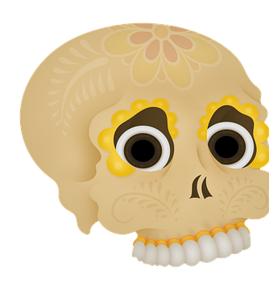


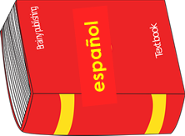



Follow up 3a:
Escucha ¿Qué altar es?
adjetivo en inglés
1
6 flowers
special
escuchar
2
2 dictionaries
useful
3
3 flowers
red
4
3 gifts
normal
2 skulls
blue
5
A
B
Hay seis flores. Son especiales.
Hay dos diccionarios. Son útiles.
Hay tres flores. Son rojas.
Hay tres regalos. Son normales.
Hay dos calaveras. Son azules.
C
D
Notes:
Timing: 10 minutes (2 slides). Alternatively, teachers can choose to complete just one of the two slides.
Aim: to practise aural comprehension of numbers, nouns and adjectives from this week in a longer context.
Procedure:
Read the instructions in Spanish.
Tell pupils they need to identify the photo that is going to be described by noting down each item and how many of each is mentioned. You might want to recap some of the key nouns introduced in the lesson (calavera, regalo, diccionario, flor) as well as “altar”.
Click on each number button to play each of the sentences, twice.
Pupils write 1-5 and note the item in English and the number (in digits.
Elicit from pupils the correct picture (B) and click to disappear ACD.
Elicit each item and its number from pupils.
Pupils listen again and note the adjective used for each item, in English.
Click to bring up the English adjective and the written version of each pairs of sentences, for further support.
Transcript:
Hay seis flores. Son especiales.
Hay dos diccionarios. Son útiles.
Hay tres flores. Son rojas.
Hay tres regalos. Son normales.
Hay dos calaveras. Son azules.

Slide 5
Follow up 3b:
Escucha ¿Qué altar es?
adjetivo en inglés
1
important
escuchar
6 flowers
2
2 skulls
green
3
6 flowers
pretty,
big
2 dictionaries
small
4
3 presents
yellow
B
A
5
Hay seis flores rojas. Son importantes.
Hay dos calaveras. Son verdes.
Hay seis flores. Son bonitas y grandes.
Hay dos diccionarios. Son pequeños.
C
Hay dos regalos. Son amarillos.
Notes:
Procedure:
Read the instructions in Spanish.
Tell pupils they need to identify the photo that is going to be described by noting down each item and how many of each is mentioned. You might want to recap some of the key nouns introduced in the lesson (calavera, regalo, diccionario, flor) as well as “altar”.
Click on each number button to play each of the sentences, twice.
Pupils write 1-5 and note the item in English and the number (in digits.
Elicit from pupils the correct picture (C) and click to disappear A and B.
Elicit each item and its number from pupils.
Pupils listen again and note the adjective used for each item, in English.
Click to bring up the English adjective and the written version of each pairs of sentences, for further support.
Transcript:
Hay seis flores rojas. Son importantes.
Hay dos calaveras. Son verdes.
Hay seis flores. Son bonitas y grandes.
Hay dos diccionarios. Son pequeños.
Hay dos regalos. Son amarillos.

Slide 6

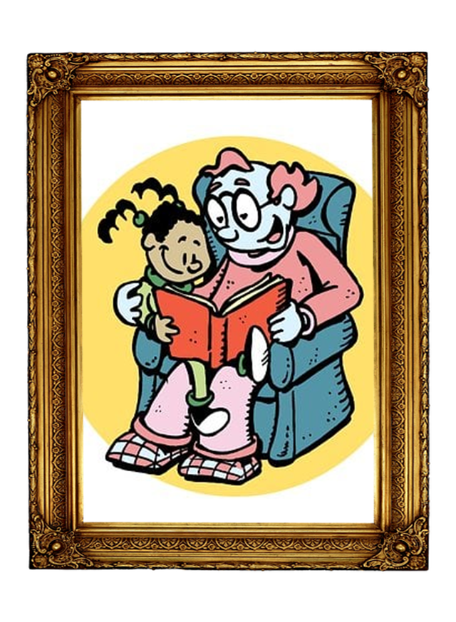


Follow up 4:
Escribe frases.
Use ‘hay’, ‘son’ and the correct ending for a suitable adjective.
Choose A or B.
escribir
A
happy, white, useful, small
B
important, white, special, red
Hay seis flores.
Son blancas.
Hay dos fotos.
Son especiales.
Hay seis calaveras.
Son felices.
Hay siete flores.
Son rojas.
Hay dos diccionarios.
Son útiles.
Hay cinco regalos.
Son importantes.
Hay cuatro flores rojas.
Son pequeñas.
Hay dos calaveras.
Son blancas.
Notes:
Timing: 5 minutes
Aim: written production ‘son’ and ‘hay and known adjectives, including the use of correct adjectival agreement.
Procedure:
Pupils select an altar picture (A or B) to describe.
They write two short sentences for each item, saying how many of it there are and what they are like, selecting one of the four adjectives each time.
Remind pupils to think about the form/spelling of the adjective and its connection to the noun.
Click to check answers.

Slide 7
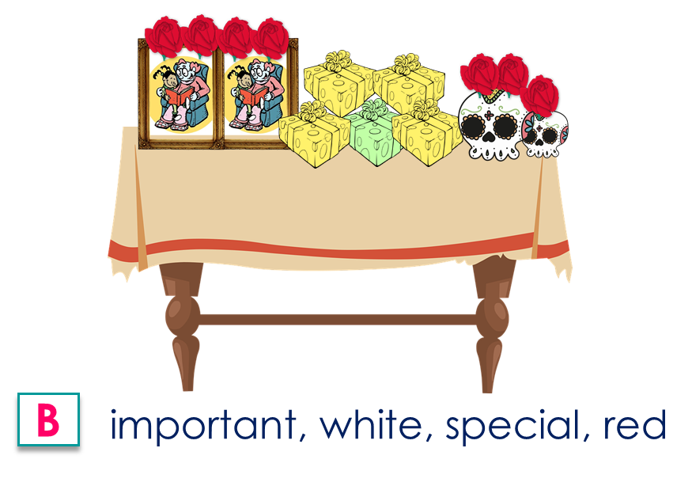
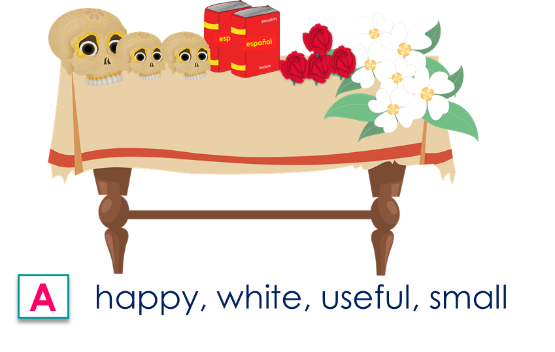

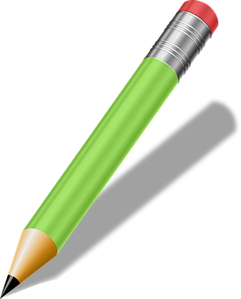
to print
1 Escribe frases. Use ‘hay’, ‘son’ and the correct ending for the adjectives.
1 Escribe frases. Use ‘hay’, ‘son’ and the correct ending for the adjectives.
|
|
|
|
|
|
|
|
|
|
|
|
|
|
1
2
3
4
1
2
3
4
2 Design and describe your own altar.
2 Design and describe your own altar.
Notes:
HANDOUT

Slide 8





Follow up 5a:
Escribe en inglés 📝.
a b ñ
vocabulario
Can you get at least15 points?
 | participar | (la) guitarra | (el) niño
 | cuidar | enseñar | (el) trabajo
 | el mes | ¿cuándo? | trece
 | veintiuno | treinta | enero
 | el diccionario | la foto | especial
 | la flor | felices | hay
 | ¿cuántos? | útil | pequeñas
to participate
guitar
child, kid (m)
x3
to look after
to teach, show
work
month
when?
thirteen
x2
twenty-one
thirty
January
dictionary
photo
special
flower
happy (m/f, pl.)
there is / are
x1
How many? (m, pl.)
useful
small (f, pl.)
Notes:
Timing: 5 minutes
Aim: to practise written comprehension of vocabulary for this week and revisited weeks.
Procedure:
Pupils need to write the English for as many words as possible, aiming to get at least 15 points (but more if possible).
Remind pupils to pay attention to the forms of the words and be precise in their English meanings. Do the first one as an example.
2. Click for English answers.

Slide 9
Follow up 5b:
Escribe en español 📝.
a b ñ
vocabulario
Can you get at least15 points?
 | guitar | participate | work, job
 | to look after | to teach, show | child, kid (f)
 | thirty-one | birthday | month
 | twenty-five | twenty-three | March
 | special | dictionary | how many? (f, pl)
 | useful (m/f, pl.) | there is / are | flower
 | small (m, pl.) | photo | happy (m/f, pl.)
la guitarra
participar
el trabajo
x3
cuidar
enseñar
la niña
treinta y uno
el cumpleaños
el mes
x2
veinticinco
veintitrés
marzo
especial
el diccionario
¿cuántas?
útiles
hay
la flor
x1
pequeños
la foto
felices
Notes:
Aim: to practise written production of vocabulary for this week and previous weeks.
Procedure:
Pupils need to write the Spanish for as many words as possible, aiming to get at least 15 points (but more if possible).
Tell pupils to write the correct word for ‘the’ with all the nouns.
3. Click for Spanish answers.

