Slide 1


español, con Sofía

Slide 2

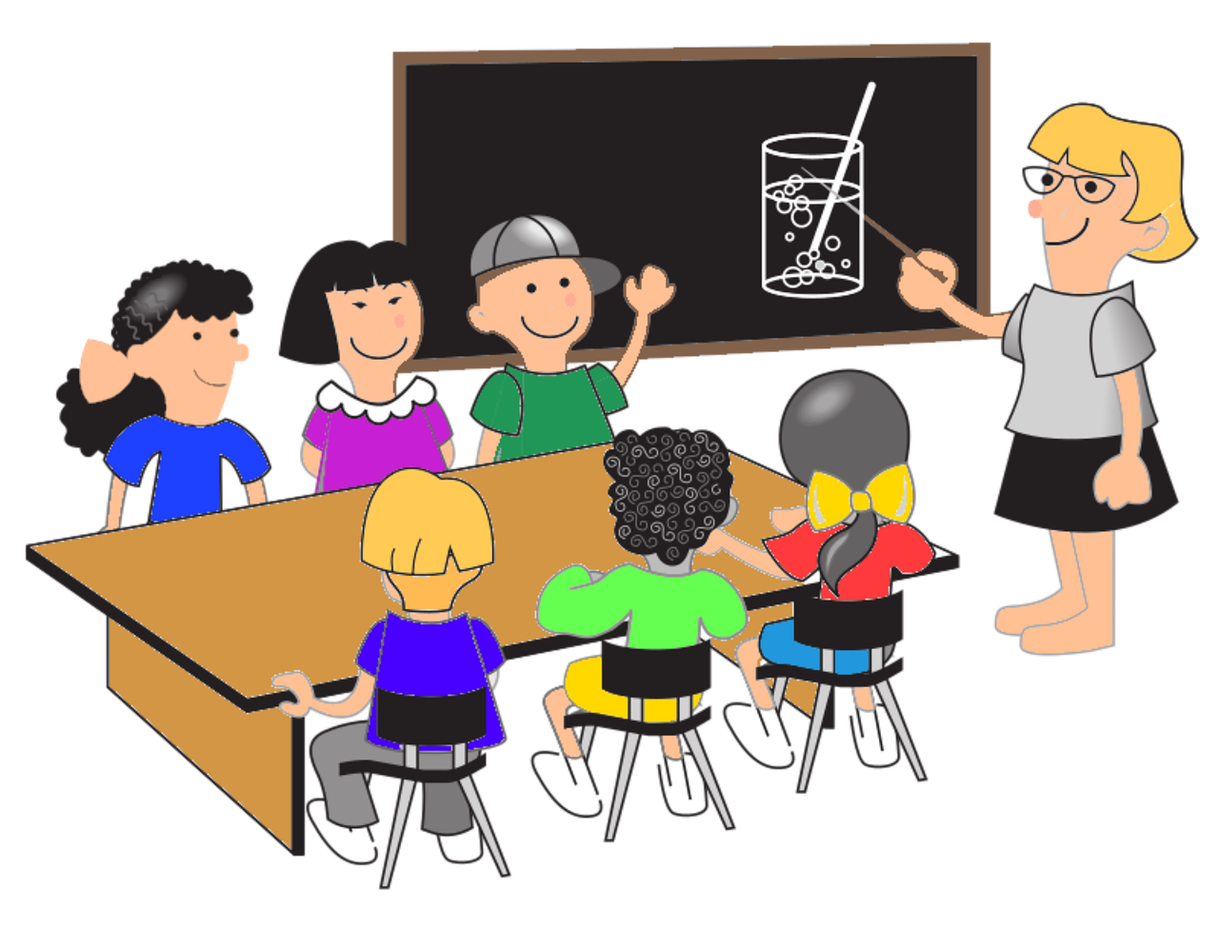

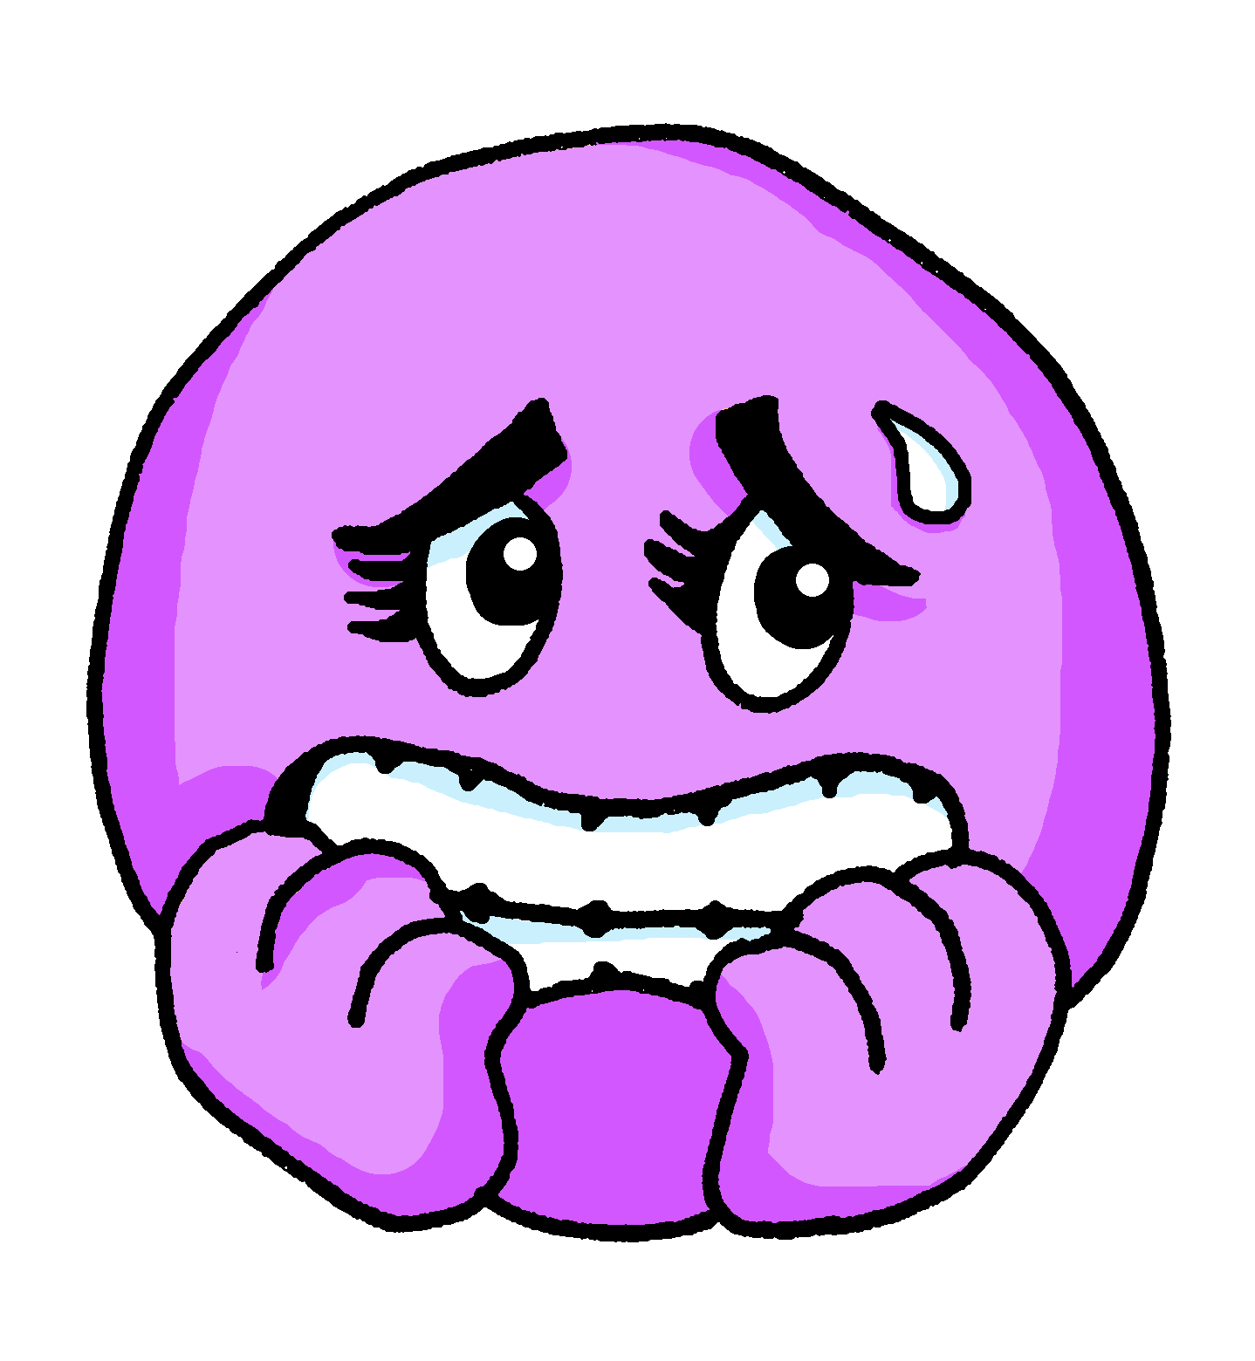


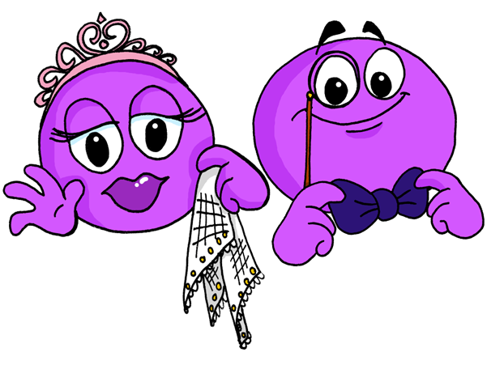
Describing me and others
ser
vs.
estar
azul
- To be [state and trait]: están | son
- SSC: weak vowel [i]
Notes:
Artwork by Steve Clarke. All additional pictures selected are available under a Creative Commons license, no attribution required.
The frequency rankings for words that occur in this PowerPoint which have been previously introduced in the resources are given in the SOW (excel document) and in the resources that first introduced and formally re-visited those words.
For any other words that occur incidentally in this PowerPoint, frequency rankings will be provided in the notes field wherever possible.
Phonics:
Introduce weak vowel [i]: aceite [2101] aire [401] boina [>5000] ciencia [738] junio [1035] limpiar [1713]
Vocabulary (new words in bold): están [21] son [7] demasiado [494] hoy [167] normalmente [1696]
Revisit 1: somos [ser, 7] estamos [estar, 21] activo [1278] cansado [1818] contento [1949] diferente [293] importante [171] independiente [1177] inteligente [2167] pero [30]
Revisit 2: comer [347] jugar [356] llevar² [101] preparar [570] canción [981] profesor, profesora [505] después [115]
Frequency of unknown words:
describir [1272] traducir [2037]
Source: Davies, M. and Davies, K. (2018). A frequency dictionary of Spanish: Core vocabulary for learners (2nd ed.). Routledge: London

Slide 3










pronunciar
Weak vowel [i]
[u]
We know that the vowel ____ merges with [a], [e] and [o] to make a single syllable. This makes it a ‘weak’ vowel.
[i]
The same happens with _____.
a, e, o
a, e, o = strong vowels
Escucha unos ejemplos:
A
E
O
aceite
ciencia
I
U
aire
limpiar
i, u = weak vowels
boina
junio
Notes:
Timing: 2 minutes
Aim: to recap the ‘weak’ vowel [u] and introduce the ‘weak’ vowel [i], which attaches to a strong vowel to create a diphthong, where one vowel ‘glides’ into another.
Procedure:
Click through the animations to present the new information.
Teacher models pronunciation and/or plays audio.
Pupils say the six words in chorus.
Teacher clarifies meanings of the six words, as necessary.

Slide 4

están | son
3rd person plural [they are]
As you know, in Spanish there are two verbs for ‘to be, being’:
ser
estar
We use ser to describe
____________________
We use estar to describe ______________________ and __________.
permanent traits.
temporary states / moods
location
To say ‘they are’ with a permanent trait, use ‘son’.
To say ‘they are’ with a location or for a temporary state, use ‘están’.
Notes:
Timing: 2 minutes
Aim: to present the 3rd person plural of to be for estar (for location / mood / temporary states) and ser (permanent traits) building on pupils’ understanding of the different uses of ser and estar.
Procedure:
Click to present the information. Elicit answers from pupils. This will give you an idea of how confident they are with this.
Click to bring up the definition for “ser” and elicit the answer from pupils.
Click to bring up the statement for “estar” and elicit the different uses from pupils.
Click to introduce “son”
Click to introduce “están”.

Slide 5


están | son
Compara:
Están en clase.
Son tranquilos.
They are in class.
They are calm.
location
permanent trait
💡 They are calm in general.
Están tranquilos hoy.
They are calm today.
temporary state / mood
💡 It’s not their natural state; they’re feeling calm today!
Notes:
Timing: 2 minutes
Read the examples out loud, eliciting English meaning (and correct use) from pupils.

Slide 6





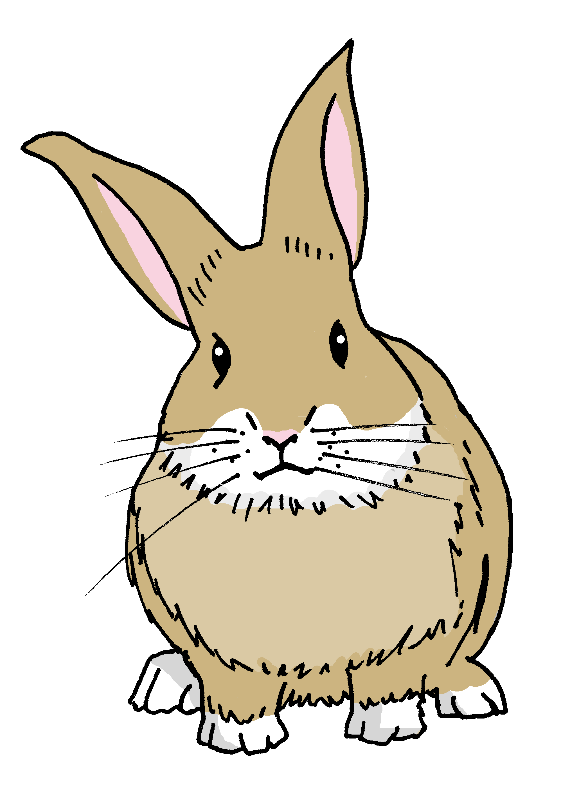
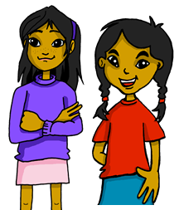
escuchar
Esucha a Sofía: ¿Cómo describe?
Marca .
escuchar
 | today / location | in general
EJ
1
2
3
4
5
extra info
important (for/to me)
E
active
1
positive,
too intelligent
2
3
different
4
independent
5
too slow
describe = she describes
Notes:
Timing: 8 minutes
Aim: to practise aural comprehension of the verbs ‘son’ and ‘están’ and revisit vocabulary from one of this week’s revisited sets.
Procedure:
1. Ask pupils to write 1-5 in their books.
2. Read the instruction in Spanish from the board.
3. Tell them that they will hear Sofía talking about her friends. They need to identify they correct use of ‘to be’. Is it today or all the time?
4. Do the example with them. Elicit extra info if possible.
5. Do 1-5. The first time they listen they identify the correct use of ‘to be’. The second time, encourage pupils to write down any extra information.
Transcript
E. Son importantes para mí.
1. Están activos.
2. Son positivos y demasiado inteligentes.
3. Están diferentes.
4. Están independientes.
5. Son demasiado lentos.
Note:
i) we omit temporal adverbs to avoid giving additional cues; pupils must focus on the verb form and connect it to its use/meaning.
ii) each adjective could be used with either verb ser or estar.
Frequency of unknown words:
describir [1272]
Source: Davies, M. and Davies, K. (2018). A frequency dictionary of Spanish: Core vocabulary for learners (2nd ed.). Routledge: London

Slide 7
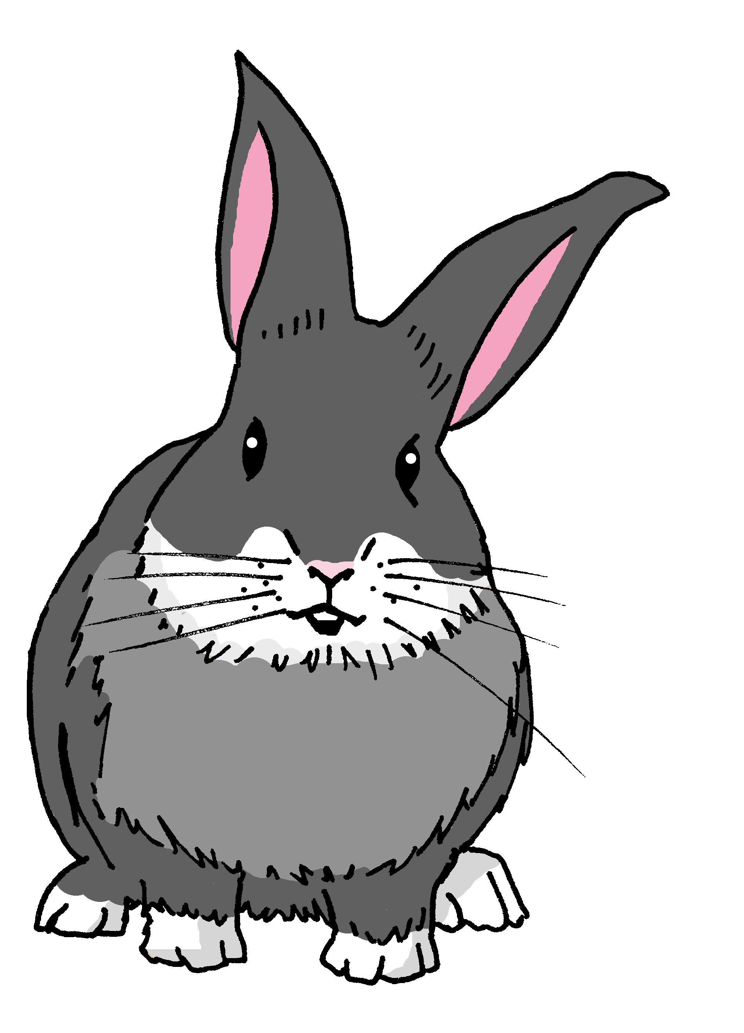
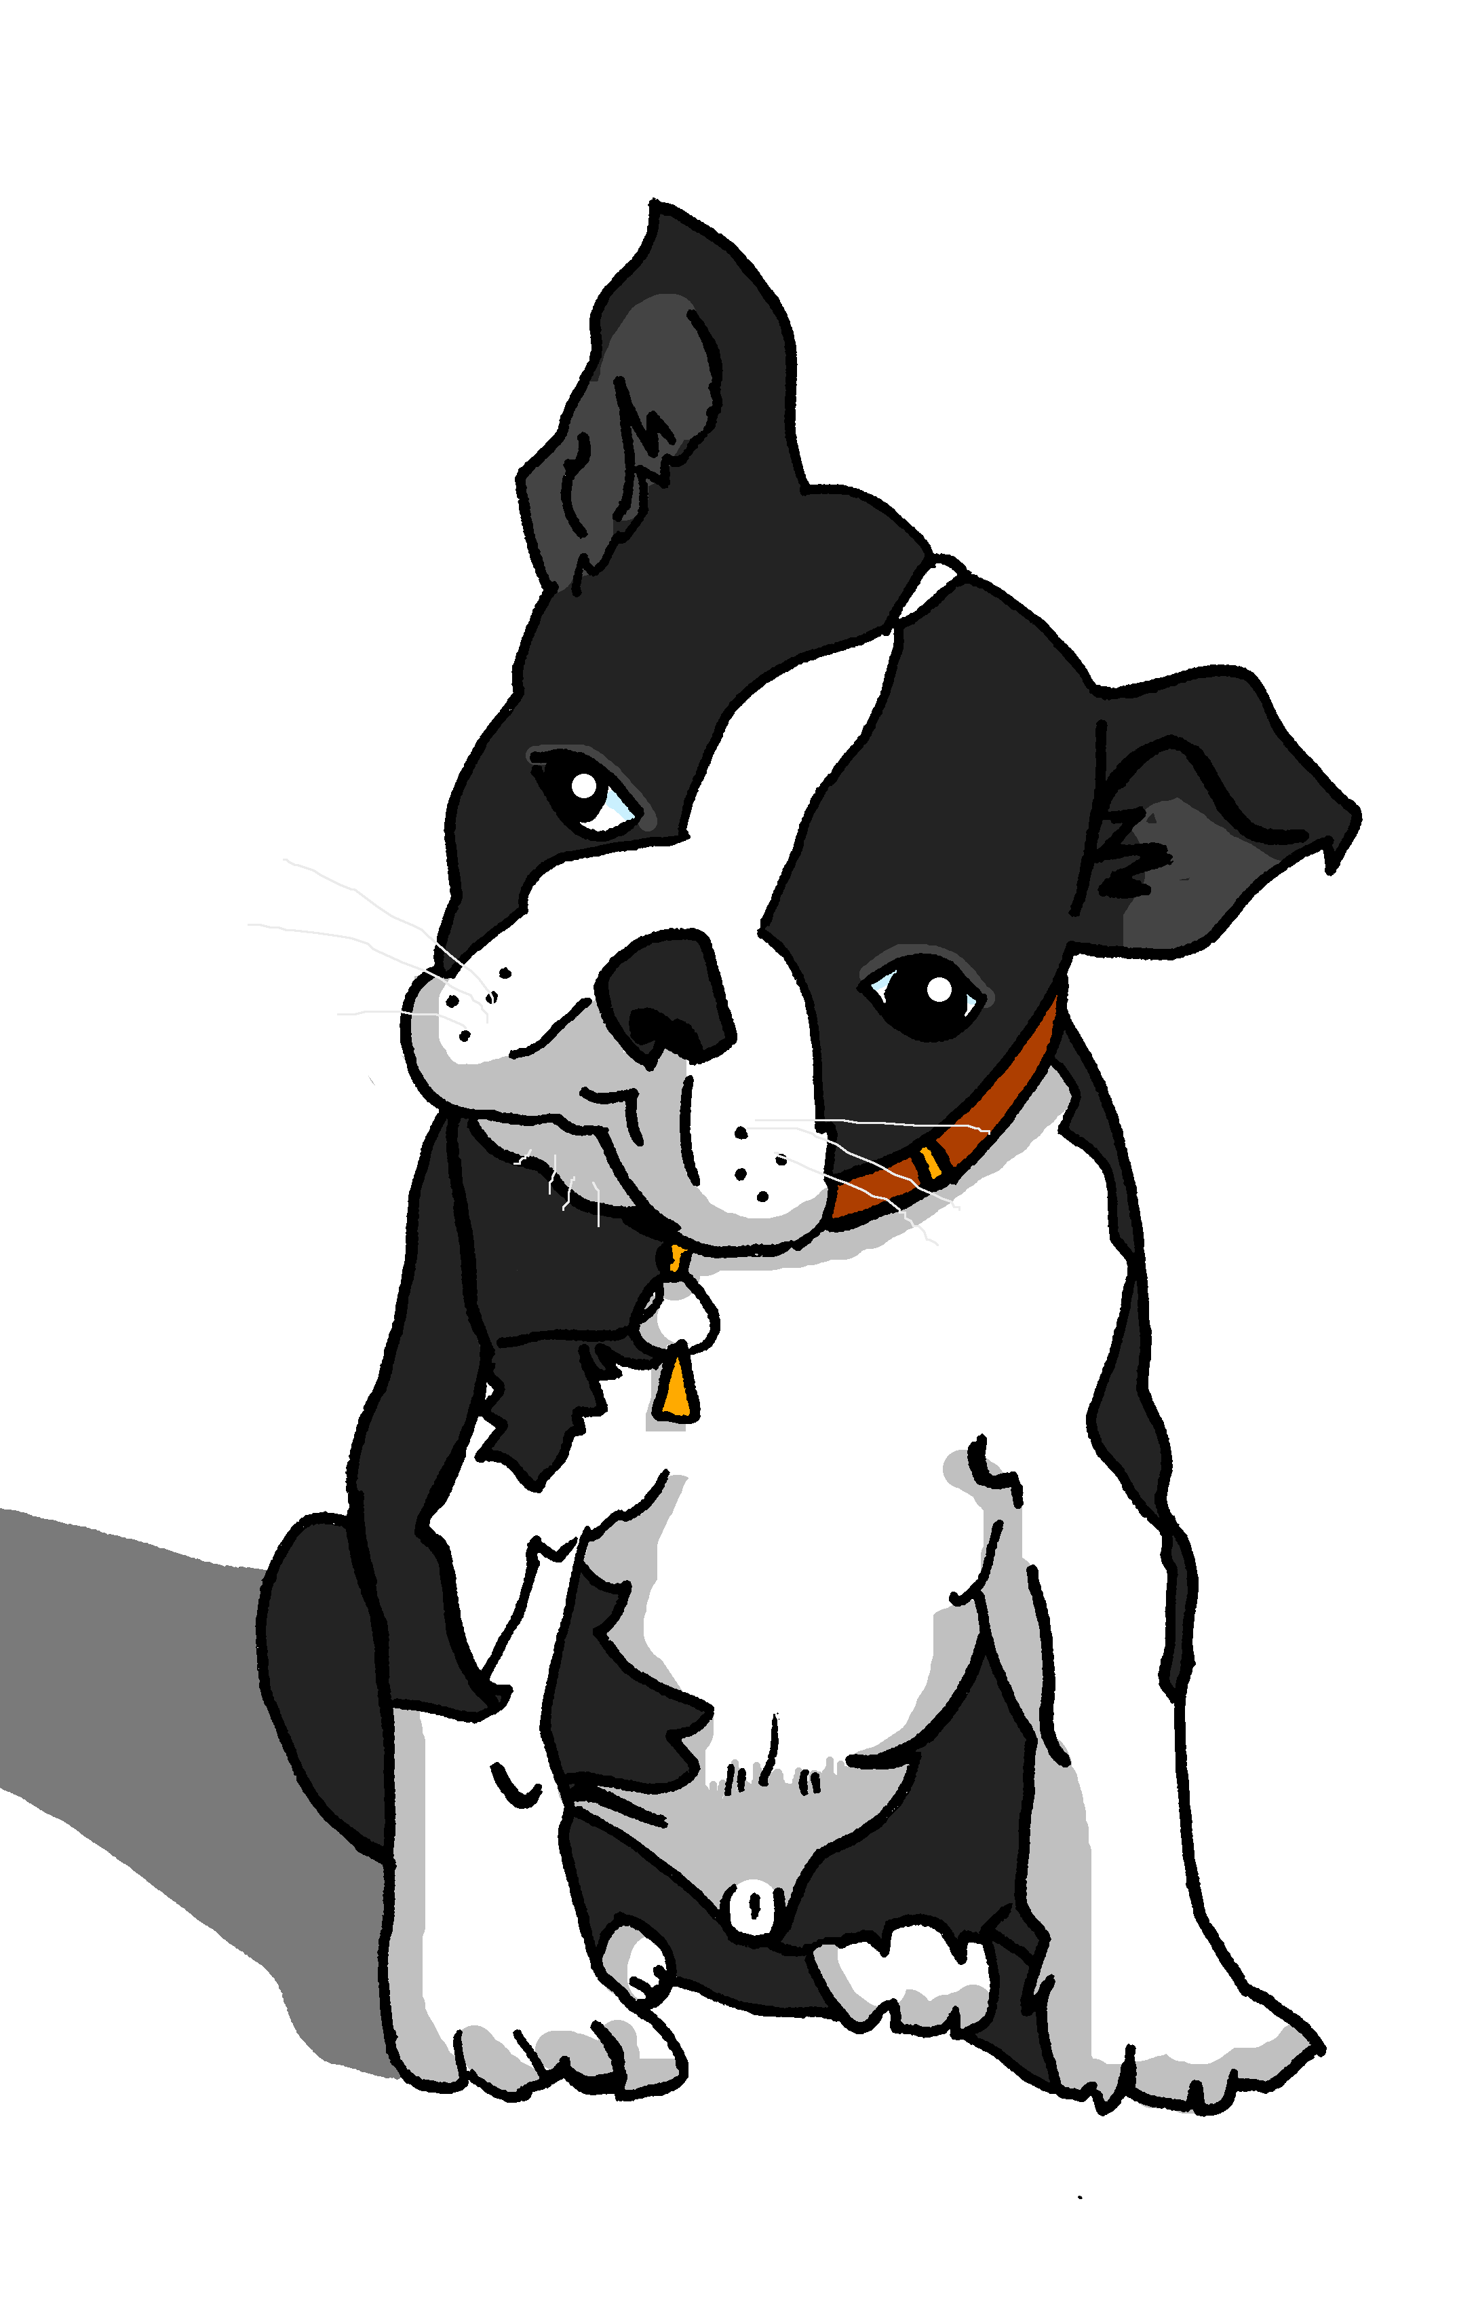
Gender and number agreement on adjectives
In Spanish, we already know that adjectives that end in ‘o’ change to an ‘___’ when the noun described is feminine.
a
Pancho está activo.
Manchita está activa.
When an adjective ends in –e, it can describe both masculine and feminine nouns.
Santi es inteligente.
Manchita es inteligente.
Santi is intelligent.
Manchita is intelligent.
–s
When we describe more than one noun we add an___ to these adjectives.
Notes:
Timing: 2 minutes
Aim: to recap the plural form of regular adjectives ending in –o, -a and -e when describing masculine and feminine nouns.
Procedure:
Click to present the grammar explanation of gender and number agreement of adjectives.
Elicit English translations for the Spanish examples provided.

Slide 8






leer
¿Quién? Sofía describe a sus amigos.
¡Ay ay ay! She’s spilled hot chocolate on her diary so we can’t see who she’s describing.
¿Ángela y Eva o Rubén y Santi? ¿O los dos?
Marca .
Marca .
¡extra!
Ángela y Eva | Rubén y Santi | los dos
in general | today
E
Rubén y Santi están activos.
inglés
1
Ángela y Eva son serias.
active
2
Rubén y Santi están diferentes.
serious
3
Ángela y Eva son tranquilas.
different
Rubén y Santi están pesados.
4
calm
Ángela y Eva son inteligentes.
annoying
6
intelligent
Notes:
Timing: 10 minutes
Part 1
Aim: to practise written comprehension of masculine and feminine plural forms of regular adjectives ending in –o, -a and –e.
Procedure:
Read the task title in Spanish and click to trigger the English and Spanish instructions.
2. Click to bring up the tables, Spanish instructions (marca) and challenge task (extra).
3. Ask pupils to tick the people each sentence refers to (Sofía and Eva, Rubén and Santi or ‘los dos’ = could be both because it ends in -es). Encourage them to write down the English meaning of the adjectives under ‘extra’.
5. Click to bring up the tick and to reveal the names in the diary. Click one more time for the English translation.
Part 2
Aim: to practise written comprehension of ‘están’ and ‘son’.
Procedure:
Click x3 to bring up the table and Spanish instructions (marca).
Draw pupils’ attention to the sentences one more time, this time they should focus on the use of ‘ser’ and ‘estar.
Ask pupils to write down if Sofía is describing how her friends are ‘in general’ (son – permanent attributes) or ‘today’ (están – temporary, location).
4. Click to reveal answers.

Slide 9
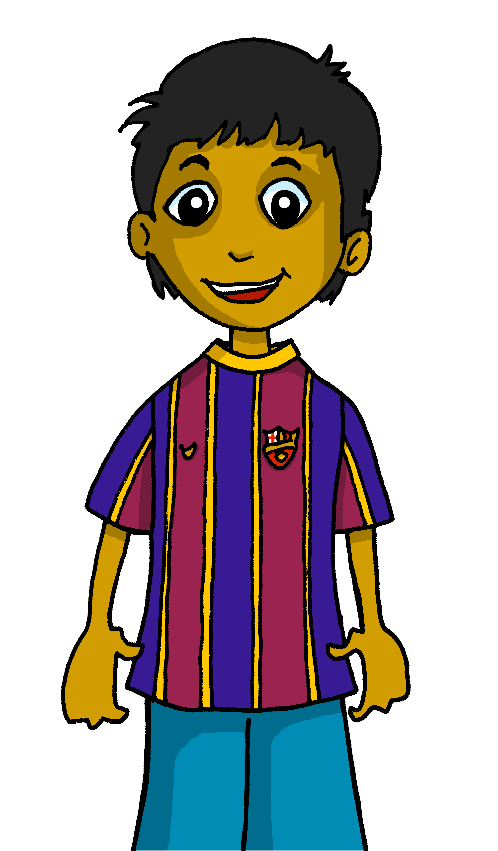
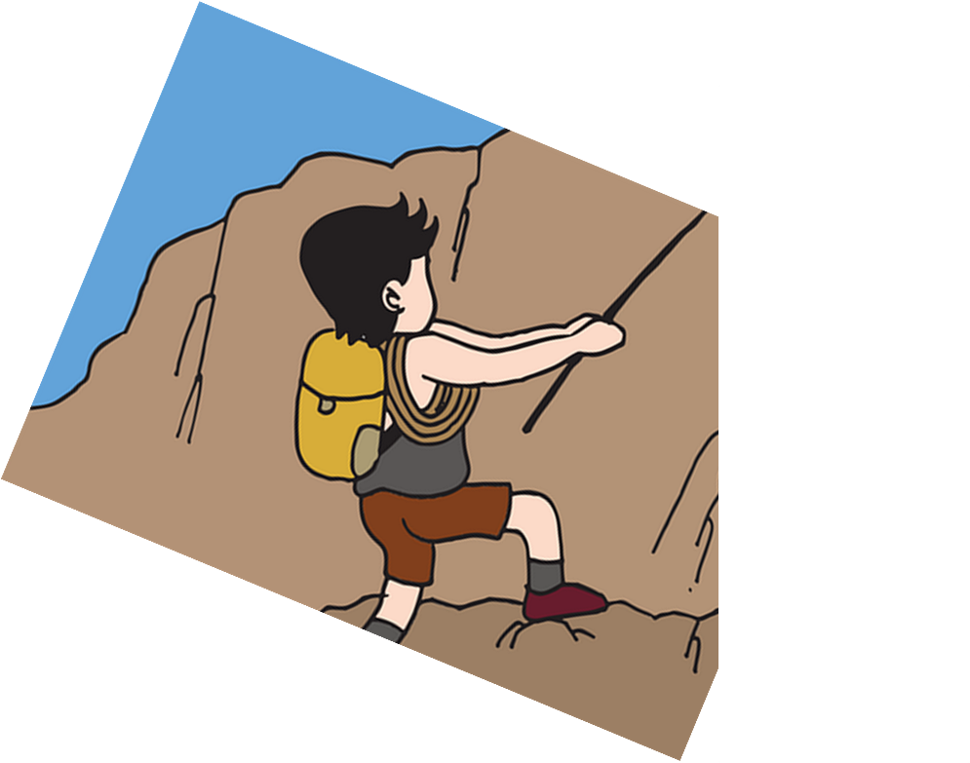
hablar
Traduce al español.
They are my friends and they are positive.
positivos
negativo
positivos
positivas
5
son
somos
están
son
4
y
y
pero
demasiado
también
3
mi familia
mis profesores
mi amigo
mis amigos
mis amigos
2
están
somos
son
son
1
traduce = translate
Notes:
Timing: 5 minutes
Aim: to use “son”, “están” and the correct masculine and feminine plural form of regular adjectives in guided oral production.
Procedure:
Tell pupils they need to use the words, starting from the bottom, to climb up the mountain (so that they translate the sentence!).
Ask pupils to work in pairs to practise first.
Click to trigger the timer (15 seconds per sentence).
Ask a volunteer from a pair to say the Spanish sentence out loud – next slide reveals the answer.
Repeat with the next 3 sentences (there are 4 in total).
Frequency of unknown words:
traducir [2037]
Source: Davies, M. and Davies, K. (2018). A frequency dictionary of Spanish: Core vocabulary for learners (2nd ed.). Routledge: London

Slide 10
hablar
Traduce al español.
They are always tired on Mondays.
jueves
martes
lunes
lunes
5
en
el
los
los
4
cansados
amables
cansada
cansadas
cansadas
3
están
están
estamos
son
2
siempre
a menudo
hoy
normalmente
siempre
1
Notes:
This sentence can be problematic for pupils if they interpret “siempre” as a clue for a “permanent trait”. Draw their attention to being tired as a temporary state. Remind them we use ‘estar’ with moods.

Slide 11
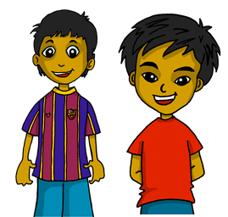
hablar
Traduce al español.
Normally they are very kind but today they are too negative.
tristes
serios
negativos
negativas
negativos
demasiado
demasiado
muy
un poco
somos
estamos
están
son
están
5
siempre
normalmente
hoy
hoy
4
pero
pero
y
también
amable
amables
amables
contentos
contentas
3
muy
muy
un poco
demasiado
2
son
somos
estamos
están
son
siempre
normalmente
1
normalmente
hoy

Slide 12
hablar
Traduce al español.
They are my friends and they are at home today.
siempre
hoy
hoy
lunes
septiembre
en casa
en casa
la casa
a casa
5
están
somos
estamos
son
están
4
y
y
pero
también
3
mis padres
mis profesores
mis amigas
mi amigo
mis amigas
2
somos
estamos
son
están
son
1

Slide 13
¡adiós!
azul

