Slide 1

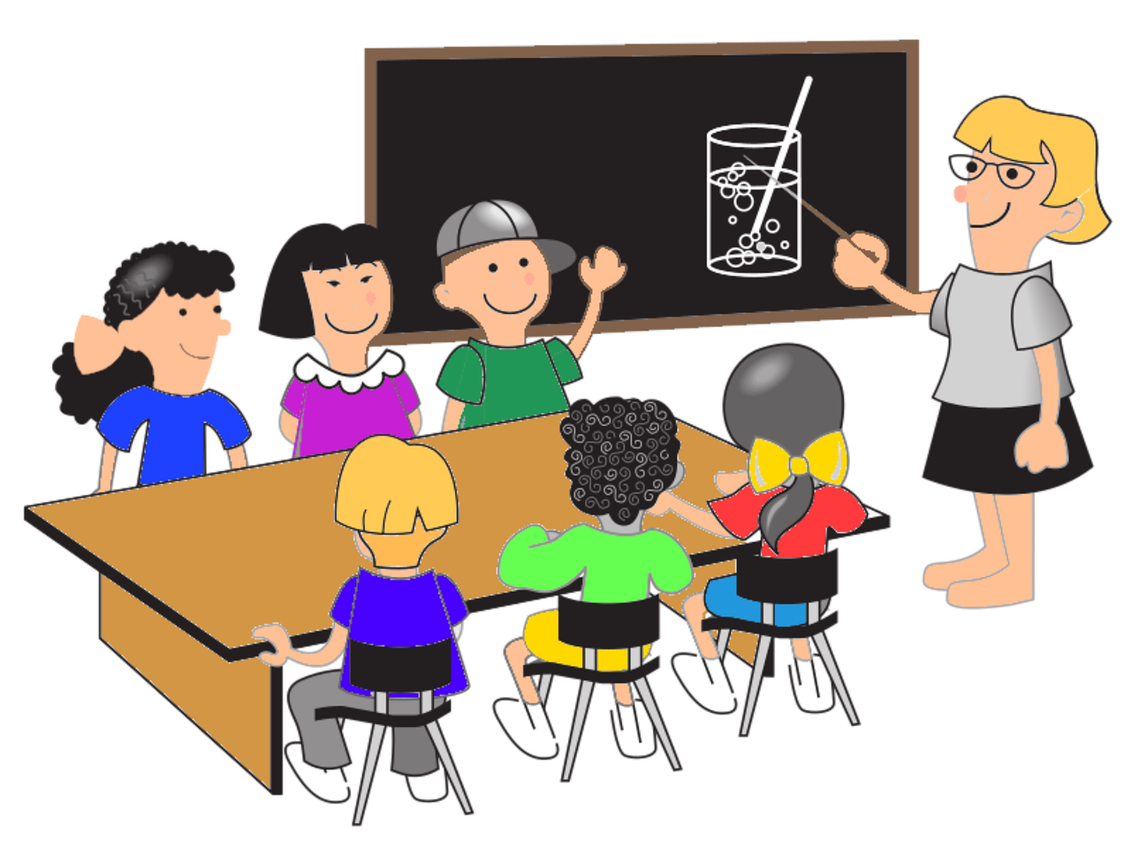

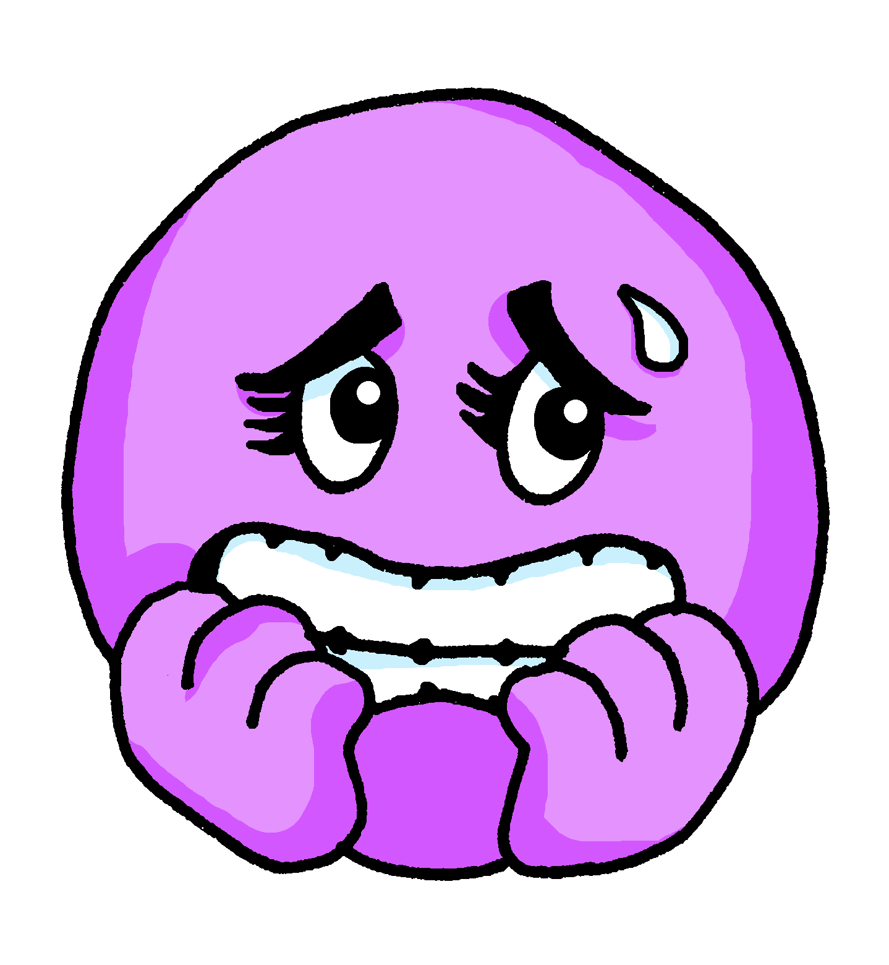
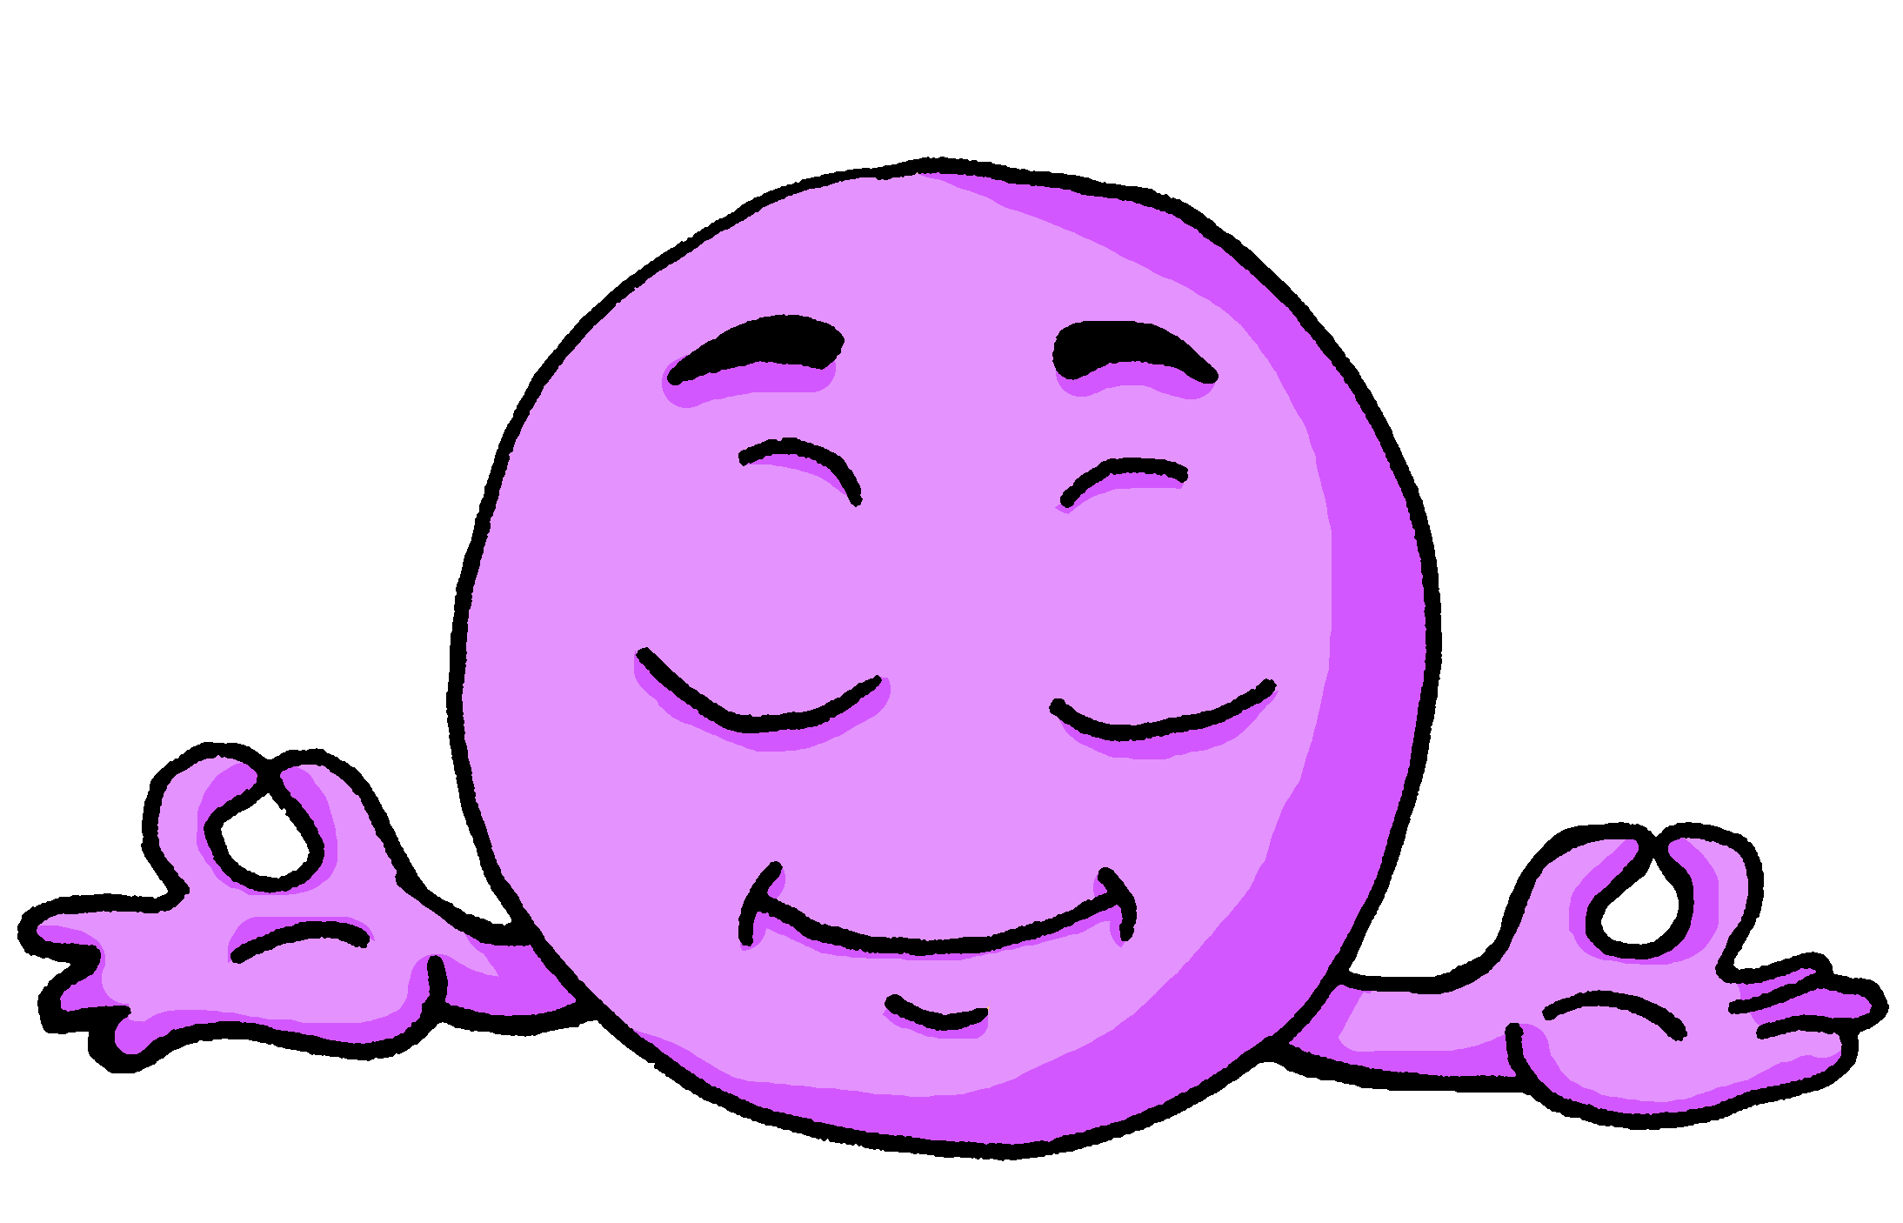

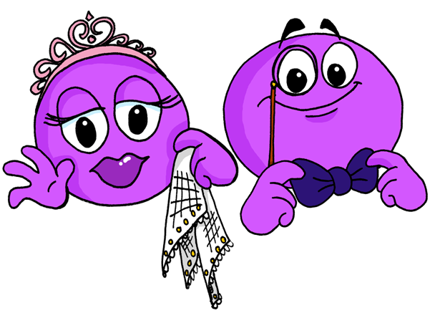
Describing me and others
ser
vs.
estar
azul
Follow ups 1-5
Notes:
Artwork by Steve Clarke. All additional pictures selected are available under a Creative Commons license, no attribution required.
The frequency rankings for words that occur in this PowerPoint which have been previously introduced in the resources are given in the SOW (excel document) and in the resources that first introduced and formally re-visited those words.
For any other words that occur incidentally in this PowerPoint, frequency rankings will be provided in the notes field wherever possible.
Phonics:
Introduce weak vowel [i]: aceite [2101] aire [401] boina [>5000] ciencia [738] junio [1035] limpiar [1713]
Vocabulary (new words in bold): están [21] son [7] demasiado [494] hoy [167] normalmente [1696]
Revisit 1: somos [ser, 7] estamos [estar, 21] activo [1278] cansado [1818] contento [1949] diferente [293] importante [171] independiente [1177] inteligente [2167] pero [30]
Revisit 2: comer [347] jugar [356] llevar² [101] preparar [570] canción [981] profesor, profesora [505] después [115]
Frequency of unknown words:
combinar [1964] poema [1430]
Source: Davies, M. and Davies, K. (2018). A frequency dictionary of Spanish: Core vocabulary for learners (2nd ed.). Routledge: London

Slide 2



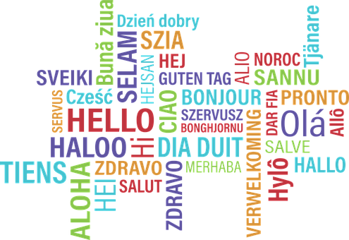




Follow up 1
Weak vowel [i]
Lee el poema.
pronunciar
1 La mona Jacinta
2 se peina, se peina
3 y quiere ser reina.
4 ¡No te rías de sus monerías!
5 La pobre mona
6 no tiene corona.
7 La mona Jacinta
8 entiende diez idiomas
9 y es muy nerviosa.
1
2
3
4
5
6
7
8
9
(el) poema = poem
Notes:
Timing: 5 mins
Aim: to practise week vowel [i]. Choral repetition exercise.
Procedure:
Teacher reads the instruction ‘recitamos un poema’.
Each line appears on one click, and the relevant picture appears on another click.
Pupils to read each line out loud after the teacher.
Pupils can work in pairs and recite the poem for further practice.
Click each number to hear the line spoken by a native speaker.
N.B Each verse can be accompanied by an action.
1 monkey action
2 combing hair
3 hands on the heart and putting a crown
4 ‘no’ action with finger + monkey action for ‘monerías’
5 ‘tears’ action
6 ‘no’ action with finger + putting a crown
7 monkey action
8 thumb + speaking action with hand
9 shaking both hands
Transcript:
1 La mona Jacinta
2 se peina, se peina
3 y quiere ser reina.
4 ¡No te rías de sus monerías!
5 La pobre mona
6 no tiene corona.
7 La mona Jacinta
8 entiende diez idiomas
y es muy nerviosa.
Frequency of unknown words:
poema [1430]
Source: Davies, M. and Davies, K. (2018). A frequency dictionary of Spanish: Core vocabulary for learners (2nd ed.). Routledge: London

Slide 3

ser | estar
ser
[to be, being]
Remember that in Spanish there are two verbs for ‘to be, being’:
ser
estar
We use ser to describe
____________________
We use estar to describe _________________________ and __________.
permanent traits.
temporary states / moods
location
To say ‘we are’ for permanent traits,
use __________.
To say ‘we are’ for location or state,
use ___________.
somos
estamos
To say ‘they are’ for permanent traits,
use _________.
To say ‘they are’ for location or state,
use ___________.
son
están
Notes:
COMPLETE THIS SLIDE BEFORE FOLLOW UP 2.
Timing: 1 minute
Aim: to recap the 1st and 3rd person plural forms of estar (for mood / temporary state) and ser (permanent traits).
Procedure:
Click to present the explanation.
Elicit English and Spanish from pupils.

Slide 4


Follow up 2:
Escucha.
Escribe el adjetivo en inglés.
escuchar
We or they? In general or today?
 | we | they | in general | today | description?
 |  |  |  |  | calm
 |  |  |  |  | tired
 |  |  |  |  | different
 |  |  |  |  | independent
 |  |  |  |  | serious
 |  |  |  |  | funny
 |  |  |  |  | active
E
1
2
3
4
5
6
Notes:
Timing: 5 minutes
Aim: to practise aural comprehension of 1st and 3rd person plural forms of ser and estar and revisited adjectives.
Procedure:
Complete the example with the class.
Pupils write 1-6 and the table headings.
Click to listen to each item.
Click to check answers.
Transcript:
EJ. Somos tranquilos.
1. Están cansadas.
2. Estamos diferentes.
3.Son independientes.
4. Están serias.
5. Somos divertidas.
6. Estamos activos.

Slide 5

Follow up 3:
Combina las palabras.
leer
1 | Los | en | hoy.
2 | Luis está | es | son amables.
3 | La cama | profesores siempre | importantes.
4 | Elvira y Sofía están | tranquilo | muy cómoda.
5 | Los amigos | son | clase.
1.
2.
3.
4.
5.
Los profesores siempre son amables.
Luis está tranquilo hoy.
La cama es muy cómoda.
Elvira y Sofía están en clase.
Los amigos son importantes.
combina = combine
Notes:
Timing: 5 minutes
Aim: to practise written comprehension of vocabulary and structures from this week and revisited weeks.
Procedure:
Pupils write five sentences using one element from each column. (They should use all the options but only once).
Click to check answers.
Frequency of unknown words:
combina [1964]
Source: Davies, M. and Davies, K. (2018). A frequency dictionary of Spanish: Core vocabulary for learners (2nd ed.). Routledge: London

Slide 6

Follow up 4
Completa las frases con las palabras correctas.
escribir
Normalmente los amigos [are] [kind] .
Los profesores [are] [calm] hoy.
Quique y Rubén [are] en clase y [they are] [pleased] .
Ángela y Sofía [are] amigas y [they are] muy [positive] pero hoy [are] demasiado [annoying] .
son
amables
están
tranquilos
están
están
contentos
son
son
positivas
están
pesadas
Notes:
Timing: 5 minutes
Aim: to practise written production of the two translations of ‘they are’ and adjectives and their correct agreement.
Procedure:
Pupils write the missing words (or full sentences, as instructed).
Click for written answers.

Slide 7





Follow up 5a:
Escribe en inglés 📝.
a b ñ
vocabulario
Can you get at least15 points?
 | comer | (la) canción | preparar
 | jugar | después | profesora
 | importantes | diferentes | independiente
 | estamos | somos | contentas
 | están | hoy | activos
 | pero | cansadas | son
 | normalmente | inteligentes | demasiado
vocabulario
vocabulario
vocabulario
vocabulario
to eat, eating
song
to prepare
x3
after
teacher (f)
to play, playing
important (m/f, pl.)
different (m/f, pl.)
independent (m/f)
x2
we are (state)
we are (trait)
pleased (f, pl.
they are (state)
today
active (m, pl.)
but
calm (f, pl.)
they are (trait)
x1
normally
intelligent (m/f, pl.)
too (much)
Notes:
Timing: 5 minutes
Aim: to practise written comprehension of vocabulary for this week and revisited weeks.
Procedure:
Pupils need to write the English for as many words as possible, aiming to get at least 15 points (but more if possible).
Remind pupils to pay attention to the forms of the words and be precise in their English meanings. Do the first one as an example.
2. Click for English answers.

Slide 8
Follow up 5b:
Escribe en español 📝.
a b ñ
vocabulario
Can you get at least15 points?
 | song | after | to play, playing
 | to take, wear | to prepare, preparing | to eat, eating
 | different (m/f) | independent (m/f, pl.) | we are (state)
 | pleased (m, pl.) | we are (trait) | important (m/f, pl.)
 | active (f, pl.) | tired (m, pl.) | but
 | they are (state) | intelligent (m/f, pl.) | they are (trait)
 | too (much) | normally | today
la canción
después
jugar
x3
llevar
preparar
comer
diferente
independientes
estamos
x2
contentos
somos
importantes
activas
cansados
pero
están
inteligentes
son
x1
demasiado
normalmente
hoy
Notes:
Aim: to practise written production of vocabulary for this week and previous weeks.
Procedure:
Pupils need to write the Spanish for as many words as possible, aiming to get at least 15 points (but more if possible).
Tell pupils to write the correct word for ‘the’ with all the nouns.
3. Click for Spanish answers.

