Slide 1
Describing me and others
¿Cuál es la fecha de hoy?
azul
Follow ups 1-5
Notes:
Artwork by Steve Clarke. All additional pictures selected are available under a Creative Commons license, no attribution required.
The frequency rankings for words that occur in this PowerPoint which have been previously introduced in the resources are given in the SOW (excel document) and in the resources that first introduced and formally re-visited those words.
For any other words that occur incidentally in this PowerPoint, frequency rankings will be provided in the notes field wherever possible.
Phonics:
Introduce weak vowel [u]: cuándo [138] puente [1715] antiguo [446]
Vocabulary (new words in bold): cuál [445] día [65] fecha [756] lunes [1370] martes [3101] miércoles [1816] jueves [1650] viernes [1259] sábado [1179] domingo [693] hoy [167]
Revisit 1: es [ser, 7] está [estar 21] amigo [210] profesor [510] divertido [2465] lento [1569] rápido [870] serio [856] tranquilo [1093] pesado [2166] también [49] hoy [167] siempre [96] y [4]
Revisit 2: amar [700] odiar [2211] abuela [783] abuelo [4796] comida [906] las [1] los [1]
Frequency of unknown words:
Orden [421]
Source: Davies, M. and Davies, K. (2018). A frequency dictionary of Spanish: Core vocabulary for learners (2nd ed.). Routledge: London

Slide 2
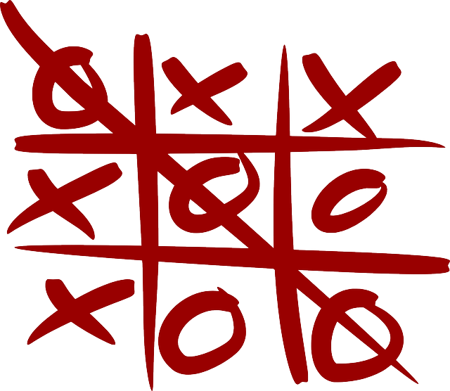
Follow up 1
Weak vowel [u]
pronunciar
escuchar
Connect the words where the weak vowel [u] merges with a strong vowel.
B
A
Escucha. ¿Qué sonido es?
Strong vowels
[a] [e] [o]
Weak vowel
[u]
 | ua | ue | uo
 |  |  |  | p _ _ r t a
 |  |  |  | j _ _ g o
 |  |  |  | m o n s t r _ _
 |  |  |  | c _ _ d r o
 |  |  |  | c _ _ t a
 |  |  |  | l e n g _ _
E
u e
A
E
O
1
u e
antiguo
oeste
aula
2
u o
Paula
idea
cuento
3
u a
pueblo
jaula
sueño
4
u o
C Practica las palabras con tu compañero/compañera.
5
u a
Notes:
Timing: 5 minutes
Aim: to develop phonological awareness of weak vowel [u] in combination with a strong vowel [a] [e] [o].
Procedure:
1. Click to bring up the instruction.
2. Click to bring up table and do example together (E).
3. Pupils tick and/or write the correct sound [ua] [ue] [uo]
4. Click to bring up Part B and read instructions.
5. Click to bring up reminder on strong vowels [a] [e] [o] and weak vowel [u]. The visual support reinforces the idea that strong vowels can be pronounced separately as seen in week 4, whereas weak vowels attach to the strong vowel.
6. Click to bring up words and ask pupils to start from ANTIGUO.
B. Click to bring up section C. Pupils to practise words in pairs.
Transcript [EJ] puerta
[1] juego
[2] monstruo [3] cuadro
[4] cuota
[5] lengua

Slide 3
Follow up 2:
Use the correct words to
rewrite the sentences.
There are some extra ones!
Escucha. ¿Qué palabra es?
escuchar
E
I am (state) | he is (state) | you are (state)
 | mi | sábado | día | es | hoy
 | Today is Saturday.
 | tu | cuándo | día | es | cumpleaños
 | When is your birthday?
 | día | hoy | cuál | qué | cada | es
 | What day is it today?
 | cada | hoy | un | día | día | feliz | es
 | Every day is a happy day.
 | qué | cuál | la | fecha | hoy | de | es
 | Which is the date today?
E
Hoy es sábado.
1
today | usually | always
annoying (f) | slow | annoying (m)
1
2
¿Cuándo es tu cumpleaños?
3
your friend (f) | your friend (m) | my friend (f)
2
¿Qué día es hoy?
4
Thursday | Tuesday | Monday
3
5
I play | you play | s/he plays
Cada día es un día feliz.
He is (trait) | She is (state) | She is (trait)
4
6
¿Cuál es la fecha de hoy?
Notes:
Timing: 5 minutes
Aim: to practise aural and written comprehension of this week’s new vocabulary and revisited vocabulary sets.
Procedure:
(Part A) Click to listen. Pupils circle the correct word (if they have the sheet printed). If not, they can use numbers 1-6 and A, B, C to identify the answers. Alternatively, they can transcribe the words.
Click for answers.
(Part B) Pupils write the sentences, translating the English prompts, selecting from the options given (there are additional words that are not needed).
Click to listen and check answers and see the written version.
Transcript Part A:
Ejemplo: El profesor está serio hoy. 1. Mi amigo es tranquilo siempre. 2. Cada día es pesada. 3. Tu amiga juega rápido. 4. ¿Qué día es? ¿martes o miércoles? 5. Hoy juego con mi amigo. 6. Siempre es divertida y también tranquila.
Transcript Part B:
Ej. Hoy es sábado. 1. ¿Cuándo es tu cumpleaños? 2. ¿Qué día es hoy? 3. Cada día es un día feliz. 4. ¿Cuál es la fecha de hoy?

Slide 4
Using ‘el’ with dates
[on]
Remember, we use the definite article ‘el’ to mean ‘on the’ with dates.
Por ejemplo:
Navidad es el 25 de diciembre.
Christmas day is on the 25th of December.
El día de los Muertos es el 2 de noviembre.
The day of the Dead is on the 2nd of November.
Notes:
Use this recap slide ahead of Follow up 3.
Time: 2 minutes Aim: to recap the use of “el” with the meaning of “on the”
Procedure: 1. Click to present the information. It is animated to allow for a paced, interactive delivery. 2. Elicit the English translation from the examples.

Slide 5
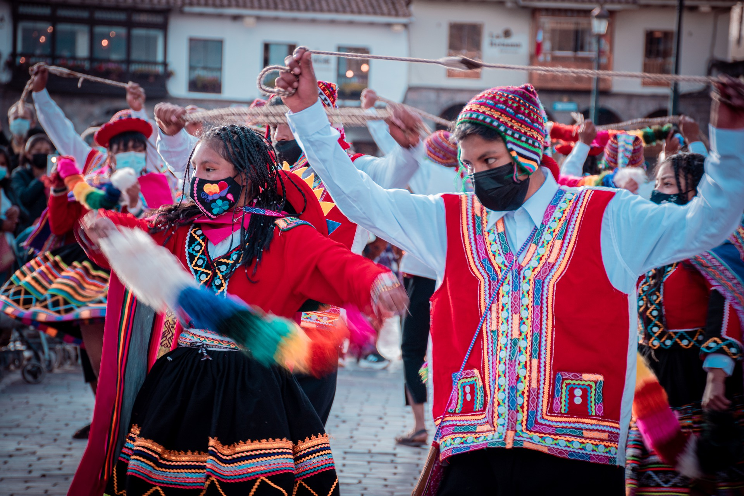
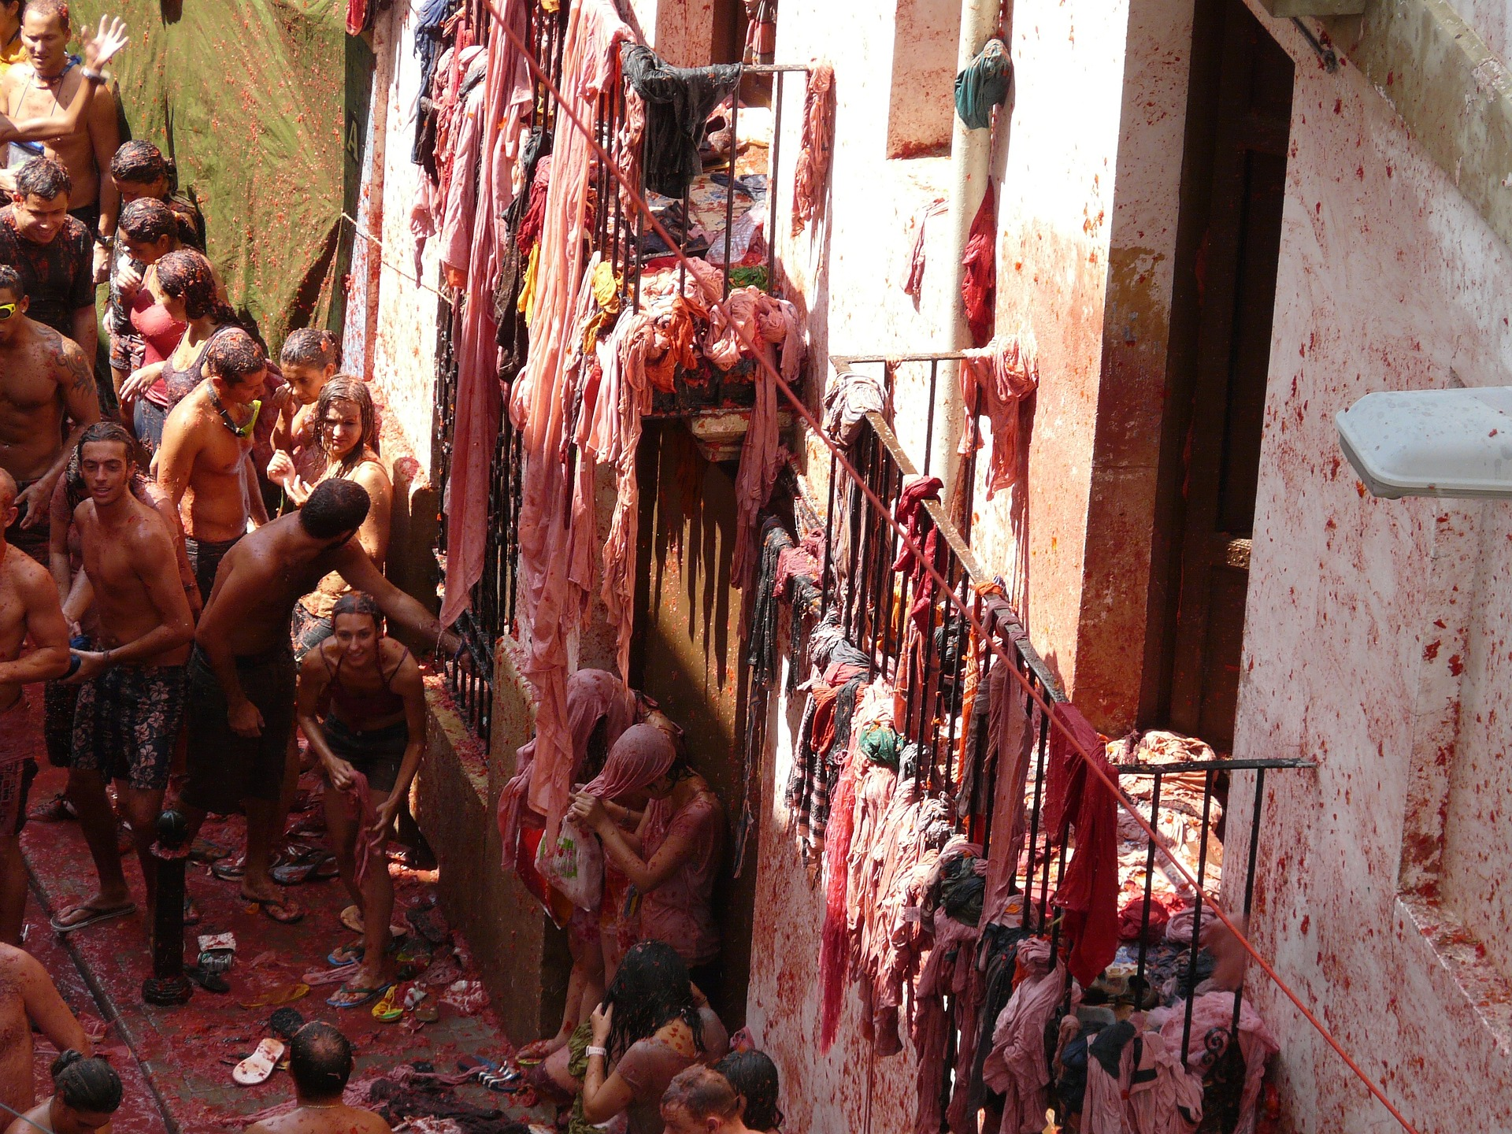
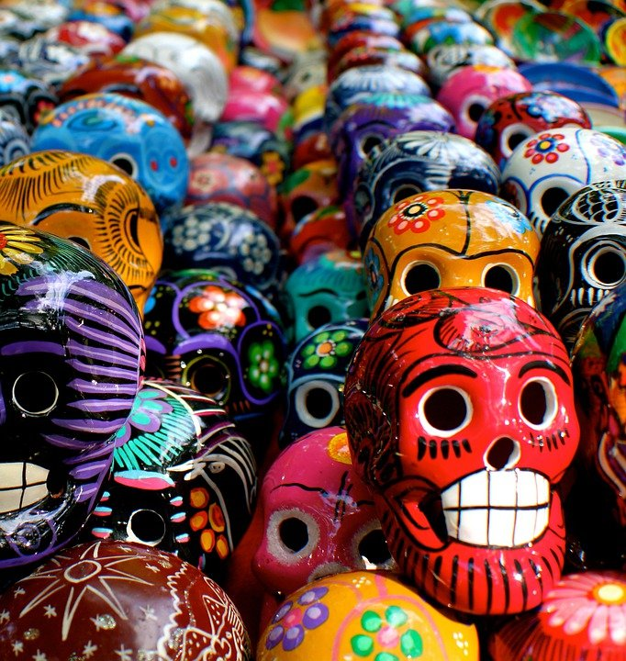
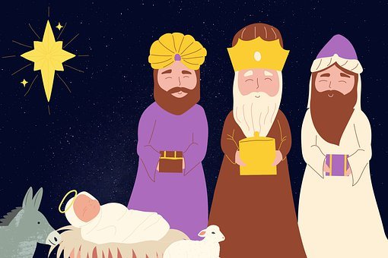
Follow up 3:
Escucha y lee los textos.
Luego completa la tabla en inglés.
escuchar
leer
[1] Inti Raymi es el veintidós de junio. Es un festival de Perú donde hay mucho color.
[2] El día de Reyes es el seis de enero. Es un día especial en España. Hay muchos regalos para los niños.
[3] La Tomatina es en agosto. Es una fiesta en Buñol, en España. Hay muchos tomates.
[4] El día de los Muertos es una fiesta familiar en México. Es el dos de noviembre. Hay muchas flores y muchos colores.
event | date | month | where | extra
Inti Raymi
La Tomatina
El día de Reyes
El día de los Muertos
Notes:
Time: 8 minutes (2 slides) Aim: to practise written comprehension of numbers, months and other vocabulary in longer sentence contexts; to learn key details about four festivals in the Spanish-speaking world.
Procedure: 1. Read instructions in Spanish. 2. Pupils to copy the table.
3. Click to listen and read each text.
4. Pupils fill in the details in English. 5. Move to next slide to check answers.
Transcript:
[1] Inti Raymi es el veintidós de junio. Es un festival de Perú donde hay mucho color.
[2] El día de Reyes es el seis de enero. Es un día especial en España. Hay muchos regalos para los niños.
[3] La tomatina es en agosto. Es una fiesta en Buñol, en España. Hay muchos tomates.
[4] El día de los Muertos es un fiesta familiar en México. Es el dos de noviembre. Hay muchas flores y colores.

Slide 6
Follow up 3:
4
leer
event | date | month | where | extra
[1] Inti Raymi
[2] El día de Reyes
[3] La Tomatina
[4] El día de los Muertos
lots of colour
22nd
June
Peru
January
Spain
special day / lots of presents
6th
(Buñol), Spain
lots of tomatoes
--
August
family festival /lots of flowers and colours
2nd
November
Mexico
Notes:
Procedure: Click to check pupil answers.

Slide 7
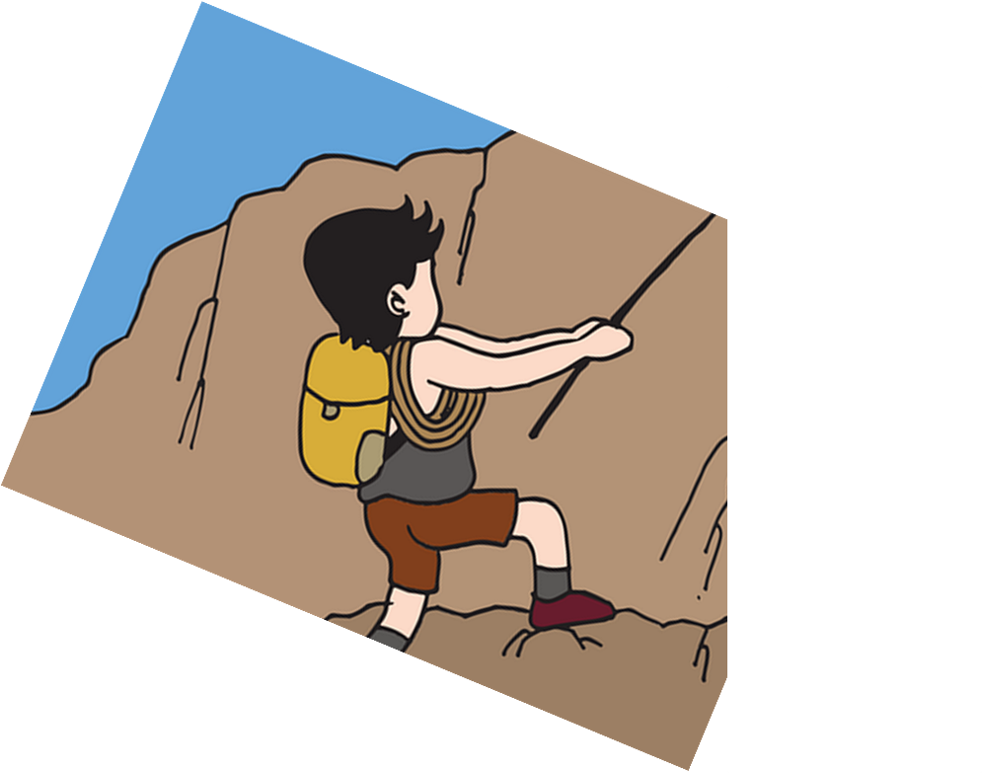
Follow up 4
Today is Sunday the 11th of January.
hablar
octubre
diciembre
enero
septiembre
enero
es
en
de
de
5
doce
treinta
once
veinte
once
4
lunes
domingo
domingo
jueves
sábado
3
cuál
somos
es
soy
es
2
hoy
hoy
ahora
siempre
1
Notes:
Timing: 5 minutes (8 slides)
Aim: to select and produce orally key vocabulary to ask about and give dates; to practise the scaffolded oral production of longer sentences.
Sentence 1/4
Procedure:
Tell pupils they need to use the words, starting from the bottom, to climb up the mountain (And translate the sentence!).
Ask pupils to work in pairs to practise first.
Click once to trigger the countdown (15 seconds per sentence). Note: the number 5 appears and the other numbers are timed to appear automatically. If you click more than once, it cancels the timing sequence.
Ask a volunteer from a pair to say the Spanish sentence out loud – next slide reveals the answer.
Repeat with the next 3 sentences (there are 4 in total). 6. Click on the English sentence to hear the Spanish answer on each answer slide, if desired.

Slide 8
Follow up 4
Which date is it today?
hablar
ahora
hoy?
hoy
enero
septiembre
5
es
en
de
de
4
el mes
la fiesta
la fecha
la fecha
la casa
sábado
3
es
de
es
enero
somos
es
2
¿Cuándo
¿Cuál
¿Cuál
¿Dónde
1
Notes:
Timing: 5 minutes
Aim: to use “es” and “el” when using dates in guided oral production.
Sentence 1/4
Procedure:
Tell pupils they need to use the words, starting from the bottom, to climb up the mountain (And translate the sentence!).
Ask pupils to work in pairs to practise first.
Click to trigger the countdown (15 seconds per sentence).
Ask a volunteer from a pair to say the Spanish sentence out loud – next slide reveals the answer.
Repeat with the next 3 sentences (there are 4 in total).

Slide 9
Follow up 4
Christmas is on the 25th of December.
hablar
octubre
diciembre
diciembre
enero
septiembre
es
en
de
de
5
quince
cinco
veinticinco
doce
veinticinco
4
es
el
sábado
el
de
3
es
somos
es
de
soy
es
2
La fiesta
El cumpleaños
Navidad
Navidad
1
Notes:
Timing: 5 minutes
Aim: to use “es” and “el” when using dates in guided oral production.
Sentence 1/4
Procedure:
Tell pupils they need to use the words, starting from the bottom, to climb up the mountain (And translate the sentence!).
Ask pupils to work in pairs to practise first.
Click to trigger the countdown (15 seconds per sentence).
Ask a volunteer from a pair to say the Spanish sentence out loud – next slide reveals the answer.
Repeat with the next 3 sentences (there are 4 in total).

Slide 10
Follow up 4
My birthday is on the 12th of May.
hablar
marzo
agosto
mayo
junio
mayo
de
de
el
es
5
doce
cinco
diecinueve
trece
doce
4
el
es
de
sábado
el
3
somos
es
es
soy
es
el
2
Hoy
Mi cumpleaños
Inti Raymi
Mi cumpleaños
1
Notes:
Timing: 5 minutes
Aim: to use “es” and “el” when using dates in guided oral production.
Sentence 1/4
Procedure:
Tell pupils they need to use the words, starting from the bottom, to climb up the mountain (And translate the sentence!).
Ask pupils to work in pairs to practise first.
Click to trigger the countdown (15 seconds per sentence).
Ask a volunteer from a pair to say the Spanish sentence out loud – next slide reveals the answer.
Repeat with the next 3 sentences (there are 4 in total).

Slide 11
hablar
Follow up 4
¿Cuál e.... l... f... d... h...?
¿Cuál es la fecha de hoy?
H.. e.… j…. 13… d… m…..
Hoy es …
jueves trece de mayo.
May
13
Notes:
Time: 2 minutes (3 slides)
Aim: to practise oral production of questions and answers about dates.
Procedure:
Ask the question “¿cuál es la fecha de hoy? and encourage pupils to answer in Spanish. The calendar can be adapted for the day / month the lesson is taught.
Click to cover the questions and bring up the hints for the question / answer.
Get pupils to practise asking and answering the question with only first letter prompts.
Repeat step 3 for the next two slides.
Click on the gapped version of the question and also the answer to hear them spoken by a native speaker, if desired.
Note: this task and the previous one can be shortened to fit the time available for Follow up 4.

Slide 12
hablar
Follow up 4
¿Cuál e.... l... f... d... h...?
H.. e.… l…. 23… d… n…..
noviembre
23

Slide 13
hablar
Follow up 4
¿Cuál e.... l... f... d... h...?
H.. e.… v…. 31… d… m…..
March
31

Slide 14
Follow up 5a:
Escribe en inglés 📝.
a b ñ
vocabulario
Can you get at least15 points?
 | amar | (la)abuela | odiar
 | las | (la) comida | los
 | seria | siempre | también
 | está | lento | hay
 | lunes | hoy | día
 | viernes | domingo | sábado
 | ¿cuál? | fecha | martes
vocabulario
vocabulario
vocabulario
vocabulario
to love, loving
friend (f)
to hate, hating
x3
the (m., sing.)
food
the (m., sing.)
serious (f)
always
also, too
x2
s/he, it is (state)
slow (m)
there is / there are
Monday
today
day
Friday
Sunday
Saturday
x1
Which?
date
Tuesday
Notes:
Timing: 5 minutes
Aim: to practise written comprehension of vocabulary for this week and revisited weeks.
Procedure:
Pupils need to write the English for as many words as possible, aiming to get at least 15 points (but more if possible).
Remind pupils to pay attention to the forms of the words and be precise in their English meanings. Do the first one as an example.
2. Click for English answers.

Slide 15
Follow up 5
Escribe en español 📝.
a b ñ
vocabulario
Can you get at least15 points?
 | the (m., pl.) | grandma | to love, loving
 | food | the (f., pl.) | to hate, hating
 | s/he, it is (trait) | fast (f) | calm,quiet (f)
 | s/he, it is (state) | annoying (m) | also, too
 | Tuesday | birthday | Which?
 | day | today | Wednesday
 | date | Thursday | Saturday
vocabulario
vocabulario
vocabulario
los
la abuela
amar
x3
la comida
las
odiar
es
rápida
tranquila
x2
está
pesado
también
(el) martes
el cumpleaños
¿Cuál?
el día
hoy
(el) miércoles
x1
la fecha
(el) jueves
(el) sábado
Notes:
Aim: to practise written production of vocabulary for this week and previous weeks.
Procedure:
Pupils need to write the Spanish for as many words as possible, aiming to get at least 15 points (but more if possible).
Tell pupils to write the correct word for ‘the’ with all the nouns.
3. Click for Spanish answers.

