Slide 1
español, con Sofía

Slide 2
Describing me and others
azul
‘It is’: es + dates
numbers 13-31
- SSC: strong vowels
Notes:
Artwork by Steve Clarke. All additional pictures selected are available under a Creative Commons license, no attribution required.
The frequency rankings for words that occur in this PowerPoint which have been previously introduced in the resources are given in the SOW (excel document) and in the resources that first introduced and formally re-visited those words.
For any other words that occur incidentally in this PowerPoint, frequency rankings will be provided in the notes field wherever possible.
Phonics:
Introduce strong vowels [a] [o] [e]: idea [247] oeste [2416] leer [209] feo [2373]
Vocabulary (new words in bold): cumpleaños [3372] mes [288] enero [1173] febrero [1419] marzo [1231] abril [1064] mayo [909] junio [1035] julio [659] septiembre [1150] octubre [1242] noviembre [1434] diciembre [1165] cuándo [138] de [2] trece [2700] catorce [2411] quince[1215] dieciséis [3373] diecisiete [3400] dieciocho [2730] diecinueve [4232] veinte [819] veintiuno [819/425] veintidós, veintitrés, veinticuatro, veinticinco, veintiséis, veintisiete, veintiocho, veintinueve, treinta [830] treinta y uno [830/4/425]
Revisit 1: estar [21] estoy [21] estás [21] ser [7] soy [7] eres [7] es [7] cómo [151] quién [289] señor [201] señora [509] activo [1279] cansado [1818] creativo [2945] negativo [1804] nervioso [1521] perdido [1899] positivo [1188] preparado [2092] raro [1005] serio [856] tonto [2379] tranquilo [1093] muy [43] ¡Buenos días! [103/65] ¡Buenas tardes! [103/392] hola [1245] Revisit 2: año [46] hambre [1262] razón [306] sed [2214]
Source: Davies, M. & Davies, K. (2018). A frequency dictionary of Spanish: Core vocabulary for learners (2nd ed.). Routledge: London

Slide 3
pronunciar
Strong vowels [a] [e] [o]
When they appear next to each other, the Spanish vowels [a], [e] and [o] are pronounced separately.
This is why we call them ‘strong’ vowels!
a, e, o
feo
Escucha unos ejemplos:
leer
💡 Spanish vowels are usually short and open!
oeste
idea
Notes:
Timing: 2 minutes
Aim: to introduce the idea of ‘strong’ vowels and their pronunciation. Generally, Spanish vowels are very much more ‘open-mouthed’ than English vowels. The word ‘i-de-a’ is a good example for this as you get a very physically obvious dropping down of the jaw as you pronounce through the word.
Procedure:
Teacher clicks through animations to present the new information.
Teacher models pronunciation and/or plays audio.
Pupils say the four words in chorus, opening their mouth fully and pronouncing the strong vowels separately.
Transcript: feo leer
oeste
idea

Slide 4
Los números 13-15
Spanish numbers 13 – 15 are as follows:
trece
thirteen
catorce
fourteen
quince
fifteen
Notes:
Time: 3 minutes (two slides) Aim: to present the key knowledge needed for the formation of numbers 13 - 19. Procedure: 1. Teachers present the new information. It is animated to allow for a paced, interactive delivery. 2. Elicit the Spanish for numbers 13 – 15 again. Audio has been added to these numbers (digits) to allow for listen and check.
Transcript:
trece catorce quince

Slide 5
Los números 16-19
Spanish numbers 16-19 follow a clear pattern.
Use the combination “dieci“ + the number (6, 7, 8, 9).
16 = dieci + seis (which contracts to one word as “dieciséis”).
17 →
dieci + siete
diecisiete
💡 Remember, if the final syllable is stressed and the word ends in a vowel or ‘n’ or ‘s’, there is an accent on the final vowel.
18 →
dieci + ocho
dieciocho
dieci + nueve
diecinueve
19 →
Notes:
Procedure: 1. Teachers present the new information. It is animated to allow for a paced, interactive delivery. 2. Elicit the Spanish for numbers 16 - 19. Audio has been added to these numbers to allow for listen and check. Note: Speech bubble reminds pupils about rules for accents (we add an accent on the last syllable when it is stressed and the word ends in –n, -s or vowel).
Transcript:
dieciséis diecisiete dieciocho diecinueve

Slide 6
escuchar
Escucha y escribe el número y la palabra.
escuchar
E
12
doce
5
16
dieciséis
1
18
dieciocho
6
14
catorce
2
13
trece
7
10
diez
3
17
diecisiete
8
15
quince
4
19
diecinueve
9
11
once
Notes:
Time: 5 minutes Aim: to practise understanding and transcribing cardinal numbers (10 -19)
Procedure: 1. Do the example with pupils. Click E to list. Pupils write the number in digits and letters. Click to check the answer.
2. Complete items 1-9, then click to check. 3. In feedback, teachers can ask for the number in Spanish. This has been included in the answers to provide pupils with support when giving the number.
Transcript: Ej. doce 1. dieciocho 2. trece 3. diecisiete 4. diecinueve 5. dieciséis 6. catorce 7. diez 8. quince 9. once

Slide 7
Los números 21- 31
The numbers from 21 to 29 use a combination of veinti- and a number from 1-9, all in one word.
veinticinco
veintitrés
25 →
veintiuno
23 →
21 →
veinticuatro
veintiséis
veintidós
24 →
22 →
26 →
💡 Remember, if the final syllable is stressed and the word ends in a vowel or ‘n’ or ‘s’, there is an accent on the final vowel.
For numbers from 31 to 39, use treinta + y + a number from 1-9, in three separate words.
32 →
treinta y dos
treinta y tres
treinta y uno
33 →
31 →
Notes:
Time: 3 minutes Aim: to present the key knowledge needed for the formation of numbers 20-31. Procedure: 1. Teachers present the new information. It is animated to allow for a paced, interactive delivery. 2. Elicit the Spanish for numbers 21- 26.
3. Explain the rule for 31 to 39 and how this differs from twenties.
Notes: i) the rule for 31 + is explained but pupils will only be expected to understand and produce 31. ii) Speech bubble reminds pupils about rules for accents (we add an accent on the last syllable when it is stressed and the word ends in –n, -s or vowel).

Slide 8
escuchar
¿Qué número es?
Persona A: Lee el número.
escuchar
Persona B:
Escucha y escribe el número.
1
veintidós
22
pronunciar
2
treinta
30
3
veinticuatro
24
4
veintisiete
27
5
veintitrés
23
Notes:
Time: 5 minutes Aim: to practise reading aloud, understanding and transcribing cardinal numbers (22 -31).
Procedure: 1. Explain the task to pupils, using the Spanish instructions.
2. Pupil B turns away from the board with a pen and something to write on. They will just write the digits this time.
3. Click to bring up the first set of numbers. Pupil A reads the numbers slowly and carefully, one by one, repeating as necessary. 4. Pupil B writes down the 5 numbers, then turns back to face the board.
5. Teacher elicits numbers in Spanish from pupils chorally for additional read aloud practice, and click to reveal the number answers.
6. Pupils swap roles – move to next slide. 7. Repeat steps 2 – 5 with the 2nd set of numbers. 8. If required, teachers can click the number buttons to hear the numbers said by a native speaker.
Transcript: 1. veintidós 2. treinta 3. veinticuatro 4. veintisiete 5. veintitrés 6. veinticinco 7. treinta y uno 8. veintinueve 9. veintiséis 10. veintiocho

Slide 9
escuchar
¿Qué número es?
Persona B: Lee el número.
escuchar
Persona A:
Escucha y escribe el número.
6
veinticinco
25
pronunciar
7
treinta y uno
31
8
veintinueve
29
9
veintiséis
26
10
veintiocho
28
Notes:
Time: 5 minutes Aim: to practise reading aloud, understanding and transcribing cardinal numbers (22 -31).
Procedure: 1. Explain the task to pupils, using the Spanish instructions.
2. Pupil A turns away from the board with a pen and something to write on. They will just write the digits this time.
3. Click to bring up the first set of numbers. Pupil B reads the numbers slowly and carefully, one by one, repeating as necessary. 4. Pupil a writes down the 5 numbers, then turns back to face the board.
5. Teacher elicits numbers in Spanish from pupils chorally for additional read aloud practice and click to reveal the number answers.
Transcript: 6. veinticinco 7. treinta y uno 8. veintinueve 9. veintiséis 10. veintiocho

Slide 10
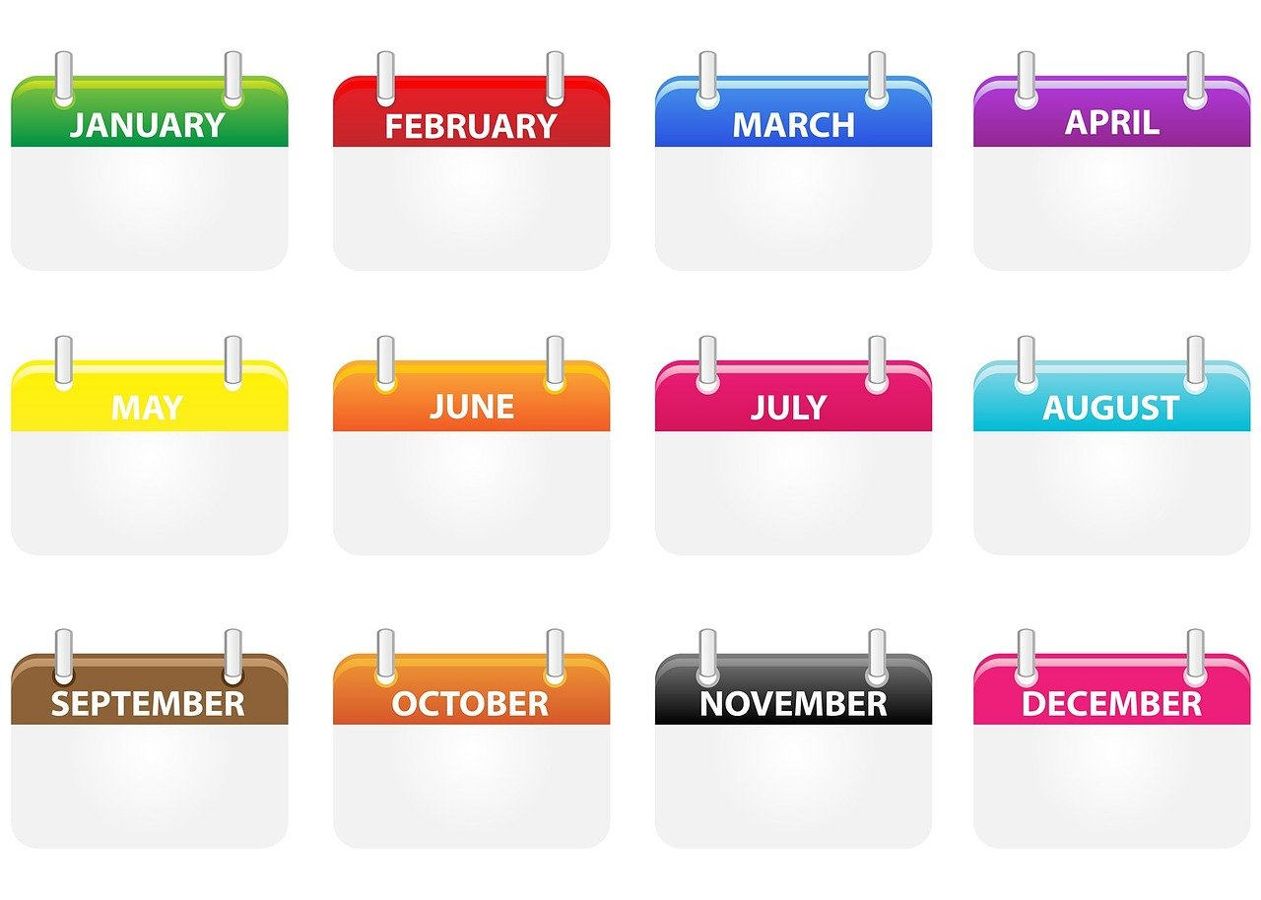
Los meses del año
Lee los meses del año.
hablar
12 segundos
enero
febrero
marzo
abril
mayo
junio
julio
agosto
septiembre
octubre
noviembre
diciembre
0
INICIO
Notes:
Time: 5 minutes (two slides) Aim: to revisit months of the year.
Procedure: 1. In pairs and alternating, pupils need to say the months in chronological order as quickly as possible and before the 12 seconds elapse.
2. They should have 2-3 attempts, to improve their spoken performance each time. 3. Pupil A then secretly selects 3 months (making a note that s/he can show his partner). Pupil B needs to try to say his/her partner’s 3 months correctly, within the 12 second time limit. S/he will need to say as many months as s/he can, but will naturally opt to say them out of order to try to match his/her partner’s choices.
4. Pupils then swap roles to play again.

Slide 11
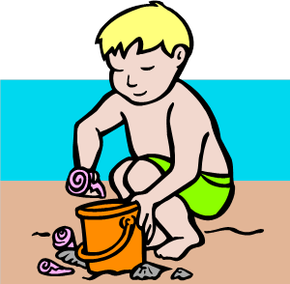
escribir
Lee los meses del año.
escribir
1 minuto
e _ _ r _
_ e _ r _ r o
m _ r _ o
_ _ r _ l
_ a _ o
e n e r o
f e b r e r o
m a r z o
a b r i l
m a y o
S
j u n i o
_ _ l _o
a _ _ s t _
_ _ n _ o
j u l i o
a g o s t o
_ _ p t _ e m b _ _
s e p t i e m b r e
0
o c t u b r e
n o v i e m b r e
d i c i e m b r e
o _ t _ b _ _
_ o _ _ e m b _ _
d _ c _ _ m b r e
INICIO
Notes:
Aim: to revisit months of the year.
Procedure: 1. Pupils need to write the months in order, filling in the missing letters, within the 60 second time limit.
2. Teacher starts the timer.
3. Click to show the full words for pupils to check their answers.

Slide 12
pronunciar
¿Cuándo?
when?
¿Cuándo es tu cumpleaños?
[When is your birthday?]
Rachel Hawkes / Emma Marsden
Notes:
Timing: 1 minute
Aim: to present the question word ¿cuándo?
Procedure:
Pupils listen and repeat the key question word (include gesture if possible)
Display the word and get pupils to repeat one more time.
Elicit English meaning.
Reveal the sentence and elicit English translation from pupils.
Gesture: turn to look at left wrist where a watch might be worn and tap it twice, in time with the two syllables of cuán-do.

Slide 13
escuchar
Quique pregunta: ¿Cuándo es tu cumpleaños?
Escucha y escribe.
escuchar
Rubén
El señor Valero
Elena
To talk about your birthday, use the cardinal number i.e 21 rather than 21st.
💡 Use el before the number to mean ‘on the’.
el 22 de octubre
el 31 de enero
el 25 de junio
____
____
____
Luis
Ángela
¡Mi cumpleaños es el 27 de noviembre también!
el 16 de mayo
¿Cuándo es tu cumpleaños?
el 25 de agosto
____
____
Leo
Sofía
el 12 de abril
el 27 de noviembre
____
____
Notes:
Time: 6 minutes Aim: to practise understanding cardinal numbers in birthday dates.
Procedure: 1. Pupils listen to the date given for each person’s birthday and write down the number. Click on the balloons to hear the audio. 2. In feedback, teachers can ask: ‘¿Quién dice “mi cumpleaños es el X de X?”’ to elicit the names from pupils, and allow them another opportunity to hear and understand the dates one more time. Note: these are all characters in Sofía and Quique’s story.
Transcript: [Rubén] Mi cumpleaños es el 22 de octubre [Señor Valero] Mi cumpleaños es el 31 de enero [Elena] Mi cumpleaños es el 25 de junio [Luis ]Mi cumpleaños es el 16 de mayo
[Ángela] Mi cumpleaños es el 25 de agosto [Leo] Mi cumpleaños es el 12 de abril
[Sofía] Mi cumpleaños es el 27 de noviembre

Slide 14
¡adiós!
azul

