Slide 1
















Describing me and others
azul
Follow ups 1-5
Notes:
Artwork by Steve Clarke. All additional pictures selected are available under a Creative Commons license, no attribution required.
The frequency rankings for words that occur in this PowerPoint which have been previously introduced in the resources are given in the SOW (excel document) and in the resources that first introduced and formally re-visited those words.
For any other words that occur incidentally in this PowerPoint, frequency rankings will be provided in the notes field wherever possible.
Phonics:
Introduce strong vowels [a] [o] [e]: idea [247] oeste [2416] leer [209] feo [2373]
Vocabulary (new words in bold): cumpleaños [3372] mes [288] enero [1173] febrero [1419] marzo [1231] abril [1064] mayo [909] junio [1035] julio [659] septiembre [1150] octubre [1242] noviembre [1434] diciembre [1165] cuándo [138] de [2] trece [2700] catorce [2411] quince[1215] dieciséis [3373] diecisiete [3400] dieciocho [2730] diecinueve [4232] veinte [819] veintiuno [819/425] veintidós, veintitrés, veinticuatro, veinticinco, veintiséis, veintisiete, veintiocho, veintinueve, treinta [830] treinta y uno [830/4/425]
Revisit 1: estar [21] estoy [21] estás [21] ser [7] soy [7] eres [7] es [7] cómo [151] quién [289] señor [201] señora [509] activo [1279] cansado [1818] creativo [2945] negativo [1804] nervioso [1521] perdido [1899] positivo [1188] preparado [2092] raro [1005] serio [856] tonto [2379] tranquilo [1093] muy [43] ¡Buenos días! [103/65] ¡Buenas tardes! [103/392] hola [1245]
Revisit 2: año [46] hambre [1262] razón [306] sed [2214]
Frequency of unknown words:
caos [3474] encuesta [2077] teatro [605] real [444] caer [251] Leona [>5000] recreo [>5000]
Source: Davies, M. and Davies, K. (2018). A frequency dictionary of Spanish: Core vocabulary for learners (2nd ed.). Routledge: London

Slide 2








Follow up 1:
[o]
[a]
B
[e]
A
pronunciar
Separa las sílabas.
Completa las palabras.
15 segundos
[E] Mateo
[1] creo
[2] poeta
[3] cumpleaños
[4] leer
[5] tarea
[EJ]
ao
c _ _ s
[1]
ea
t _ _ tro
[2]
r _ _ l
ea
[3]
ae
c _ _ r
[4]
eo
l _ _ na
C
[5]
eo
recr_ _
0
Practica con tu compañero/a.
INICIO
Notes:
Timing: 5-6 minutes
Aim: to practise listening out for pairs of strong vowels in words and to successfully transcribe them.
Procedure:
Part A
pupils listen and write the strong vowel combination
The teacher shows the answers for each word, one by one.
Part B
Pupils separate the words into syllables.
The teacher shows the answers for each word, one by one.
Part C
Pupils practise pronouncing the words, reading each one aloud. Click ‘Inicio’ to start timer.
Notes: Pupils have encountered ‘leer’ and ‘cumpleaños’ formally (Y3/4) and ‘caos’ incidentally (Y3/4). ‘tarea’ (995) and ‘teatro’ (605) will be introduced in the Spring and Summer term, respectively. ‘Real’ (444), ‘Leona’ (león 2107), ‘recreo’ (>5000), ‘creer’ (83) and ‘poeta’ (1054) are only used for the purpose of this activity.
Transcript Part A:
Ej. caos
teatro
real
caer
leona
recreo
Transcript Part B:
Ej. Mateo
1. creo
2. poeta
3. cumpleaños
4. leer
5. tarea
Frequency of unknown words:
caos [3474] teatro [605] real [444] caer [251] Leona [>5000] recreo [>5000]
Source: Davies, M. and Davies, K. (2018). A frequency dictionary of Spanish: Core vocabulary for learners (2nd ed.). Routledge: London
Source: Davies, M. & Davies, K. (2018). A frequency dictionary of Spanish: Core vocabulary for learners (2nd ed.). Routledge: London

Slide 3


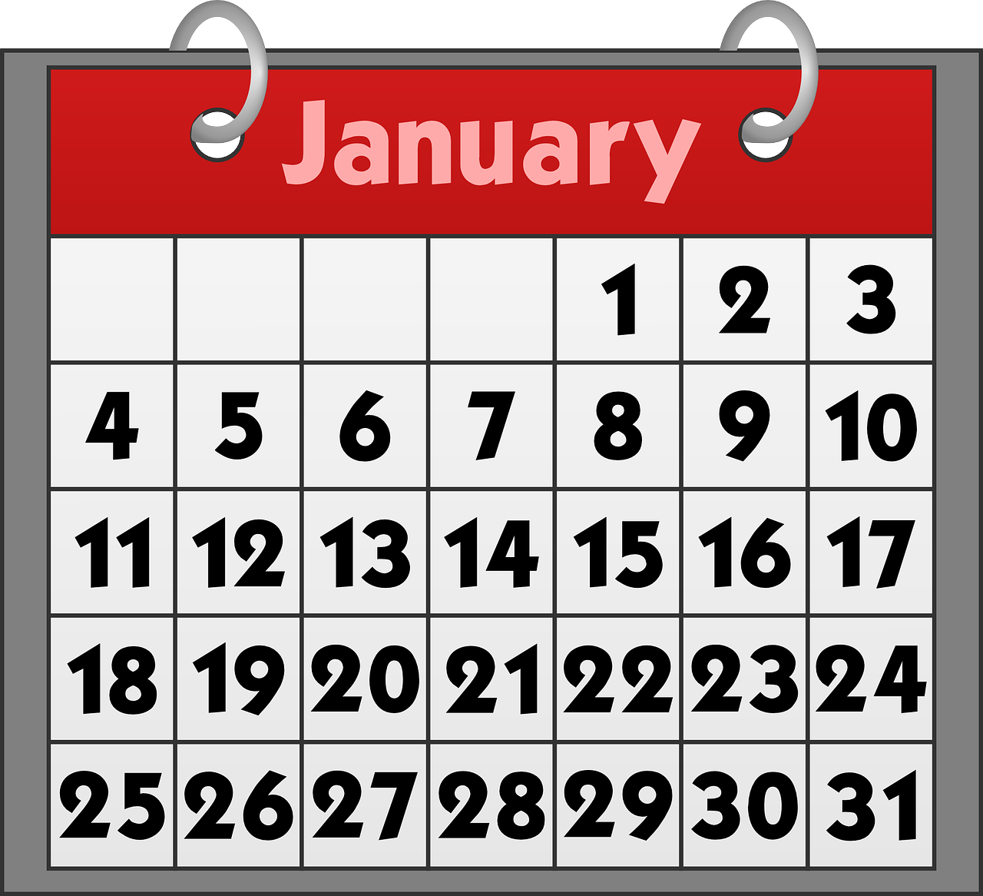
Follow up 2: Using ‘el’ with dates
[on the]
We use the definite article ‘el’ to mean ‘on the’ with specific dates.
Por ejemplo:
Mi cumpleaños es el 19 de agosto.
My birthday is on the 19th of August.
To say today’s date, don’t use ‘el’.
Hoy es 24 de enero.
Today is the 24th of January.
Notes:
Time: 6-8 minutes (two slides)
Aim: to learn the use of “el” with the meaning of “on the” with dates.
Procedure:
1. Teachers present the new information. It is animated to allow for a paced, interactive delivery.
2. Elicit the English translation from the examples.

Slide 4


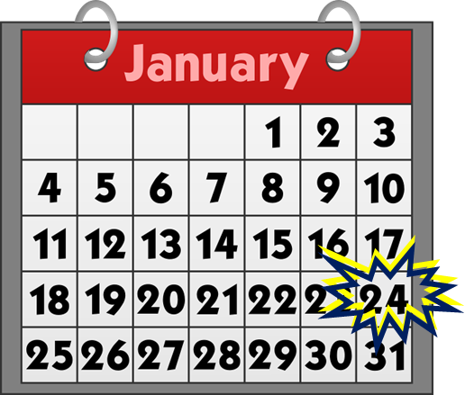

Follow up 2:
¿Qué día es?
Is it a birthday or today’s date?.
escuchar
Escucha y decide. Luego, escribe el día y el mes.
 | hoy | día | mes
mi
cumpleaños
E
E
18
September
1
1
27
June
2
2
11
October
3
3
16
April
4
4
12
August
5
5
28
December
6
6
15
May
Notes:
Aim: to practise aural distinction of birthday dates with ‘el’ and other dates.
Procedure:
1. Explain to pupils that they will not hear the start of the sentence (hoy or mi cumpleaños) but need to listen out for the article ‘el’ to know whether the date is a birthday or today’s date.
2. Click to listen to the example. Pupils note down either cumpleaños or hoy.
3. Pupils listen again and write the date in digits and the month in English.
4. Click to reveal the example answers.
5. Complete steps 2 – 4 with items 1-6.
Transcript:
EJ. [Hoy] es dieciocho de septiembre.
1. [Mi cumpleaños] es el veintisiete de junio.
2. [Hoy] es once de octubre.
3. [Hoy] es dieciséis de abril.
4. [Mi cumpleaños] es el doce de agosto.
5. [Hoy] es veintiocho de diciembre.
6. [Mi cumpleaños] es el quince de mayo.

Slide 5


Follow up 3:
¿Cuándo es tu cumpleaños?
hablar
1 minuto
Mi cumpleaños es el [_____] de [______]
0
INICIO
Notes:
Time: 10 minutes (three slides)
Aim: to ask and answer about birthdays in oral production.
Ask the question “¿cuándo es tu cumpleaños? and encourage pupils to answer in Spanish.
With the model answer on the board, tell pupils they have one minute to get as many pupils to ask and answer the question. Click on the timer to start the countdown. (One pupil asks another who answers the question and also asks another pupil).
If time allows, repeat for further practice (and encourage class to improve their results from round 1).
Round 2 (next slide). Click to remove support and display clues for each word in the question and answer. Repeat process from round 1, with less support.

Slide 6
Follow up 3:
¿Cuándo es tu cumpleaños?
¿C….. e.... t.... c……..?
hablar
M ….. C……… e.. e.. [_____] d.. [______]
1 minuto
0
INICIO
Notes:
Time: 10 minutes (three slides)
Aim: to ask and answer about birthdays in oral production.
Click to remove support and display clues for each word in the question and answer. Repeat process from round 1, with less support.

Slide 7
Follow up 3:
Pregunta y completa la encuesta.
¿C….. e.... t.... c……..?
M ….. C……… e.. e.. [_____] d.. [______]
hablar
Mi cumpleaños es el 5 de septiembre
January | February | March | April | May | June | July | August | September | October | November | December
5
encuesta = a survey
Notes:
Give the instruction in Spanish and clarify the meaning of ‘encuesta’.
Tell pupils they are going to conduct a survey in the class on birthdays.
Elicit the questions from pupils using the hints.
Then click to bring up a sample answer (‘Mi cumpleaños es el 5 de septiembre’). Click x1 to model how to use the survey sheet (a 5 will appear).
Tell pupils they have 5 minutes to ask as many pupils in the class about their birthdays. They should aim to ask and answer the questions, from memory, by the end of the survey.
! Encourage pupils to attempt to answer the question from memory
Frequency of unknown words:
encuesta [2077] (survey)
Source: Davies, M. and Davies, K. (2018). A frequency dictionary of Spanish: Core vocabulary for learners (2nd ed.). Routledge: London

Slide 8


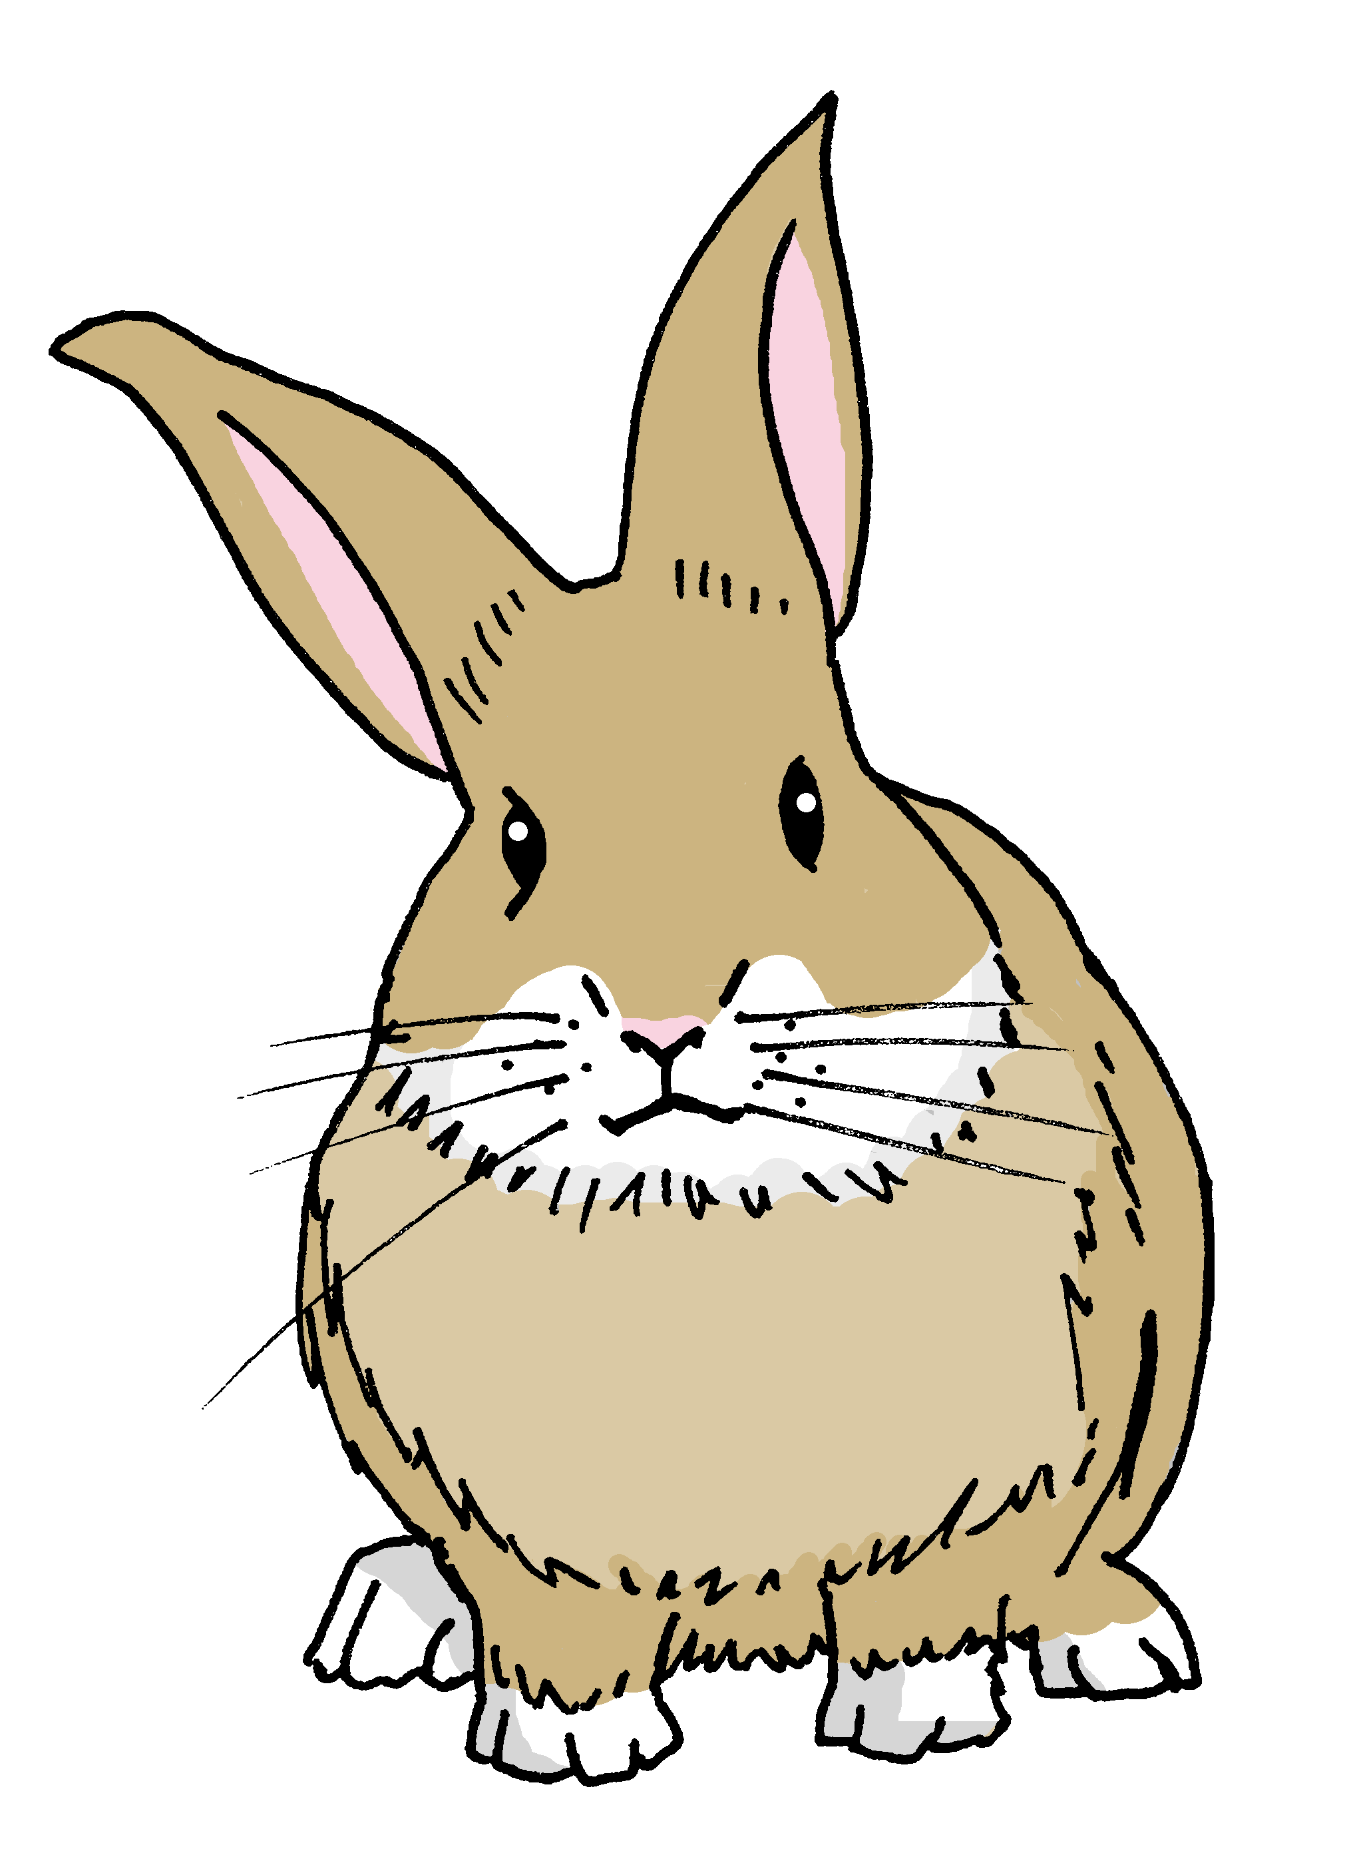
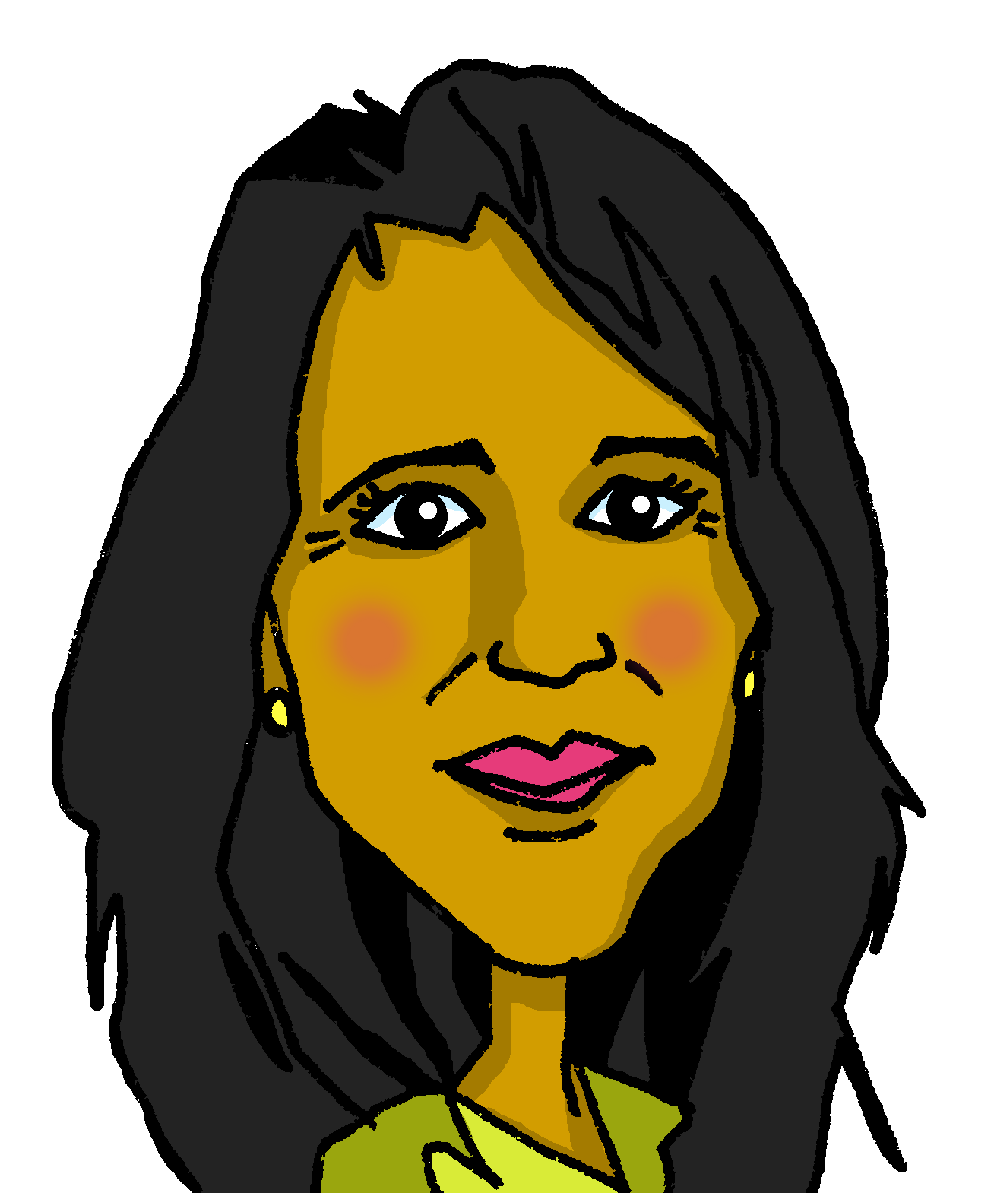
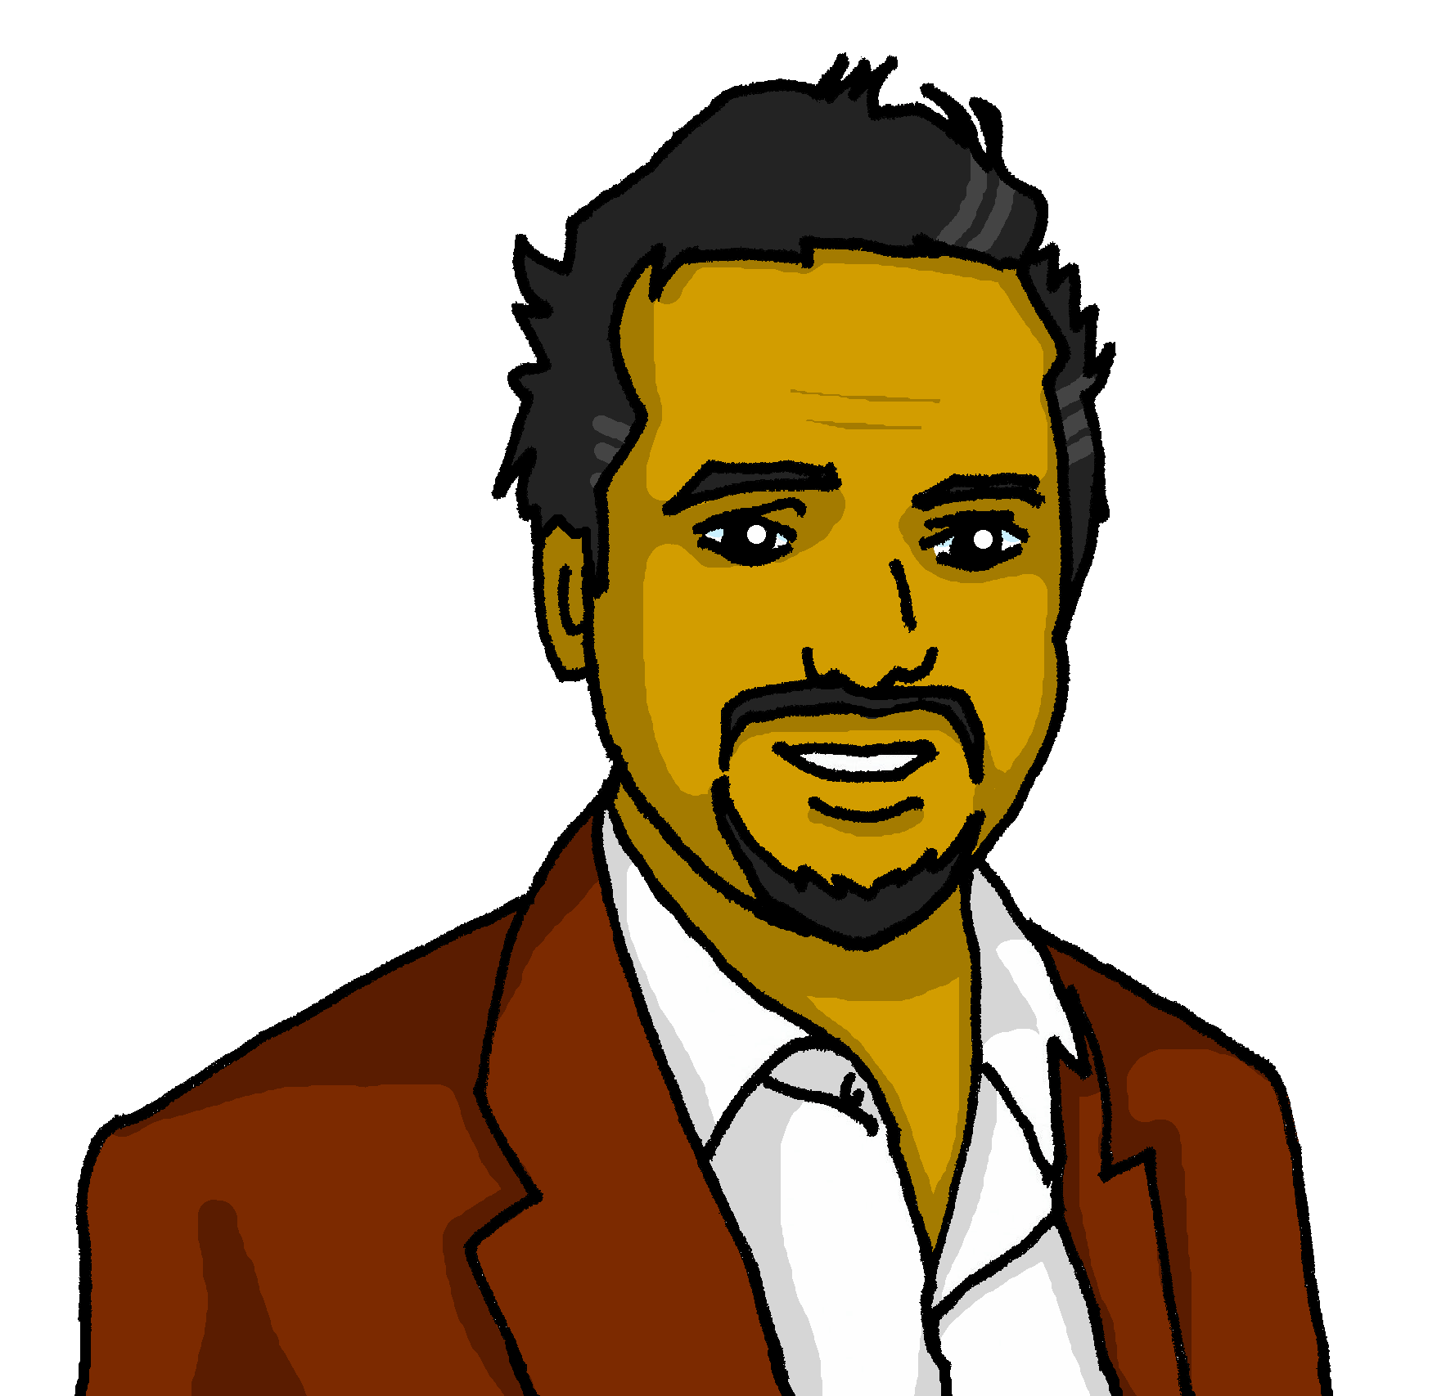
Follow up 4:
Escribe las frases en español.
escribir
My birthday is on the 27th of November.
Mi cumpleaños es el veintisiete de noviembre.
My birthday is on the 9th of September.
Mi cumpleaños es el nueve de septiembre.
💡 Remember that we don’t use capital letters with months in Spanish
My birthday is on the 25th of June.
Mi cumpleaños es el veinticinco de junio.
My birthday is on the 31st July.
Mi cumpleaños es el treinta y uno de julio.
Notes:
Timing: 6-8 minutes
Aim: to practise written production of dates (numbers and months) and use of ‘el’ with birthdays.
Procedure:
1. Pupils write the four sentences in Spanish.
2. Click to bring up written answers.
3. Pupils to check their sentences carefully.

Slide 9


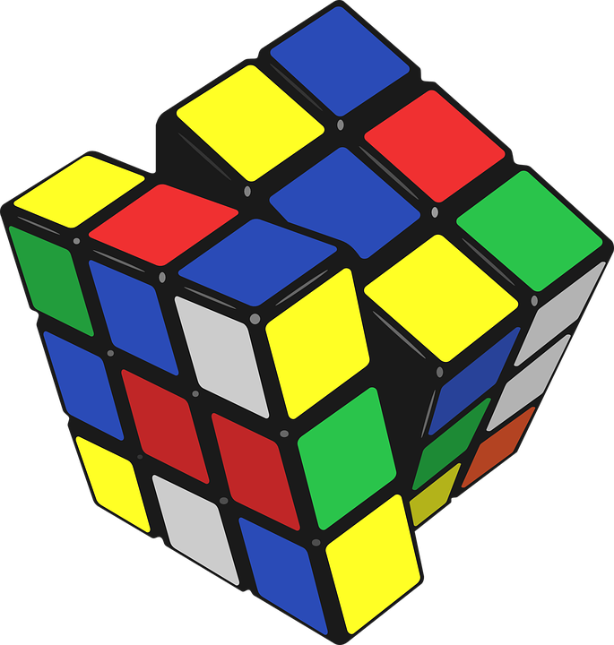
Follow up 5:
Reordena las sílabas y escribe en inglés.
a b ñ
a) ra se ño
señora
_________
calm
vocabulario
b) ti cre vo a
creativo
_________
fourteen
c) qui tran lo
tranquilo
_________
Mrs, Miss (teacher)
d) res e
eres
_________
active
e) tor ca ce
catorce
creative
_________
f) ga vo ti ne
_________
negativo
you are (trait)
g) vo ti ac
_________
activo
negative
Notes:
Timing: 12 minutes (three slides)
Aim: to practise written comprehension (slides 1 and 2) and production (slide 3) of this week’s new and revisited vocabulary.
Procedure:
Read the instruction in Spanish.
Click to trigger the answer for the first jumbled word– click one more time to trigger the arrow that links the word with the English meaning.
Elicit Spanish words from pupils (a-f), click one to trigger the Spanish word and one more time to link the Spanish word with the English translation.

Slide 10



Follow up 5a:
Escribe en inglés 📝.
a b ñ
vocabulario
Can you get at least15 points?
 | seria | (el) año | (la) razón
 | tranquilo | (el) hambre | (la) sed
 | quién | muy | cansado
 | perdido | rara | tonta
 | diceisiete | mayo | treinta y uno
 | veinte | cumpleaños | mes
 | ¿cuándo? | diecinueve | veinticinco
vocabulario
vocabulario
vocabulario
vocabulario
serious (f)
year
reason
x3
calm (m)
hunger
thirst
who?
very
tired (f)
x2
lost (m)
strange (f)
silly (f)
17
May
31
20
birthday
month
x1
When?
19
25
Notes:
Timing: 5 minutes
Aim: to practise written comprehension of vocabulary for this week and revisited weeks.
Procedure:
Pupils need to write the English for as many words as possible, aiming to get at least 15 points (but more if possible).
Remind pupils to pay attention to the forms of the words and be precise in their English meanings. Do the first one as an example.
2. Click for English answers.

Slide 11
Follow up 5
Escribe en español 📝.
a b ñ
vocabulario
Can you get at least15 points?
 | thirst | hunger | reason
 | quiet, calm (f) | Who? | year
 | Good afternoon | positive (f) | to be (trait)
 | to be (state) | serious (m) | tired (f)
 | 15 | birthday | month
 | 30 | 16 | 20
 | nervous (f) | When? | 21
vocabulario
vocabulario
vocabulario
la sed
el hambre
la razón
x3
tranquila
¿Quién?
el año
Buenas tardes
positiva
ser
x2
estar
serio
cansada
quince
el cumpleaños
el mes
treinta
dieciséis
veinte
x1
nerviosa
¿Cuándo?
veintiuno
Notes:
Aim: to practise written production of vocabulary for this week and previous weeks.
Procedure:
Pupils need to write the Spanish for as many words as possible, aiming to get at least 15 points (but more if possible).
Tell pupils to write the correct word for ‘the’ with all the nouns.
3. Click for Spanish answers.

